Slide 1
Update on Optical Fibre issues
Rainer Schwemmer

Slide 2
Key figures
Minimum required bandwidth: 32 Tbit/s
  # of 100 Gigabit/s links > 320, # of 40 Gigabit/s links > 800, # of 10 Gigabit/s links > 3200
  # of 5Gbit GBT links (3.2Gbit effective): > 10000
Option 1: BE downstairs
Option 2: BE upstairs

Slide 3

BE Downstairs
Detector
Short Distance links from Detector to Tell40
Long Distance commercial network links to upstairs
Pro:
  Detector → BE is within current versatile link specs
Cons:
  Currently no affordable commercial solution for BE to DAQ
  When it comes it will not be cheap
  All the little annoyances that come with having the electronics downstairs
  Limited space, limited power, limited cooling, access
Readout Units
~400 m cable equivalent length
100 m rock
DAQ network
Compute Units

Slide 4
Preferred Solution: GBT all the way
Detector
Long distance covered by low-speed links from detector to Readout Units.
Cheap and links required anyhow
100 m rock
~400 m cable equivalent length
Pros:
  DAQ Network + Readout Units in one place
  (Almost) no space constraints on BE installation
  All cots based interconnects are very short → cheap
Cons:
  See this presentation
Readout Units
DAQ network
Compute Units

Slide 5
Furukawa Fibre/Avago MiniPOD test
Versatile Link, like 10Gbit Ethernet is specified for 150m
Assumes rather high radiation levels which don’t really apply to us
VL only runs at 5Gbit/s signaling rate
Lower radiation levels
Commercial components are already capable of reaching much longer distances
➔ Test if we can find a fibre + receiver/transmitter which can reach the necessary 400m

Slide 6
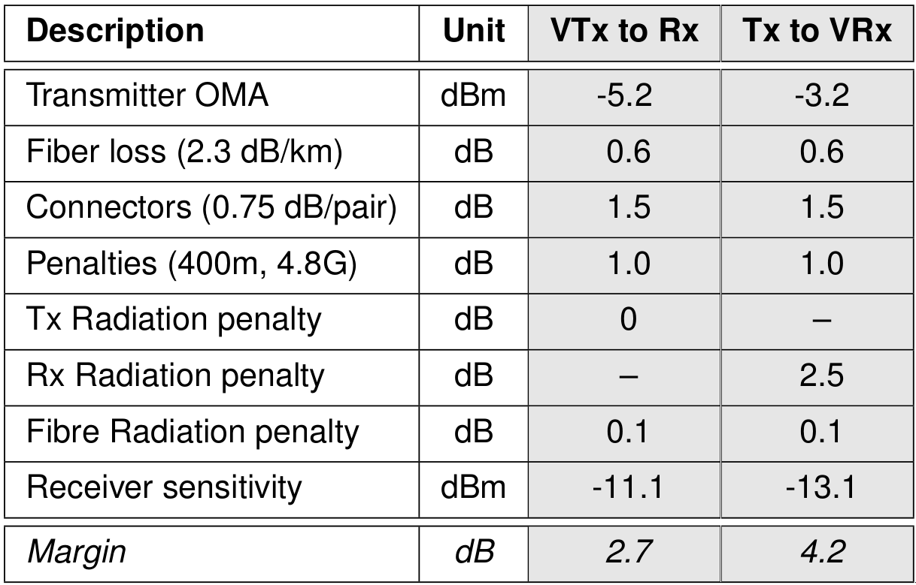
Early Optical Link Budget estimate
Measure these
values to see if we
can do better
First Estimate of available link quality in both directions, based on fibre estimates
and worst case receiver tests done by Avago in early 2011

Slide 7
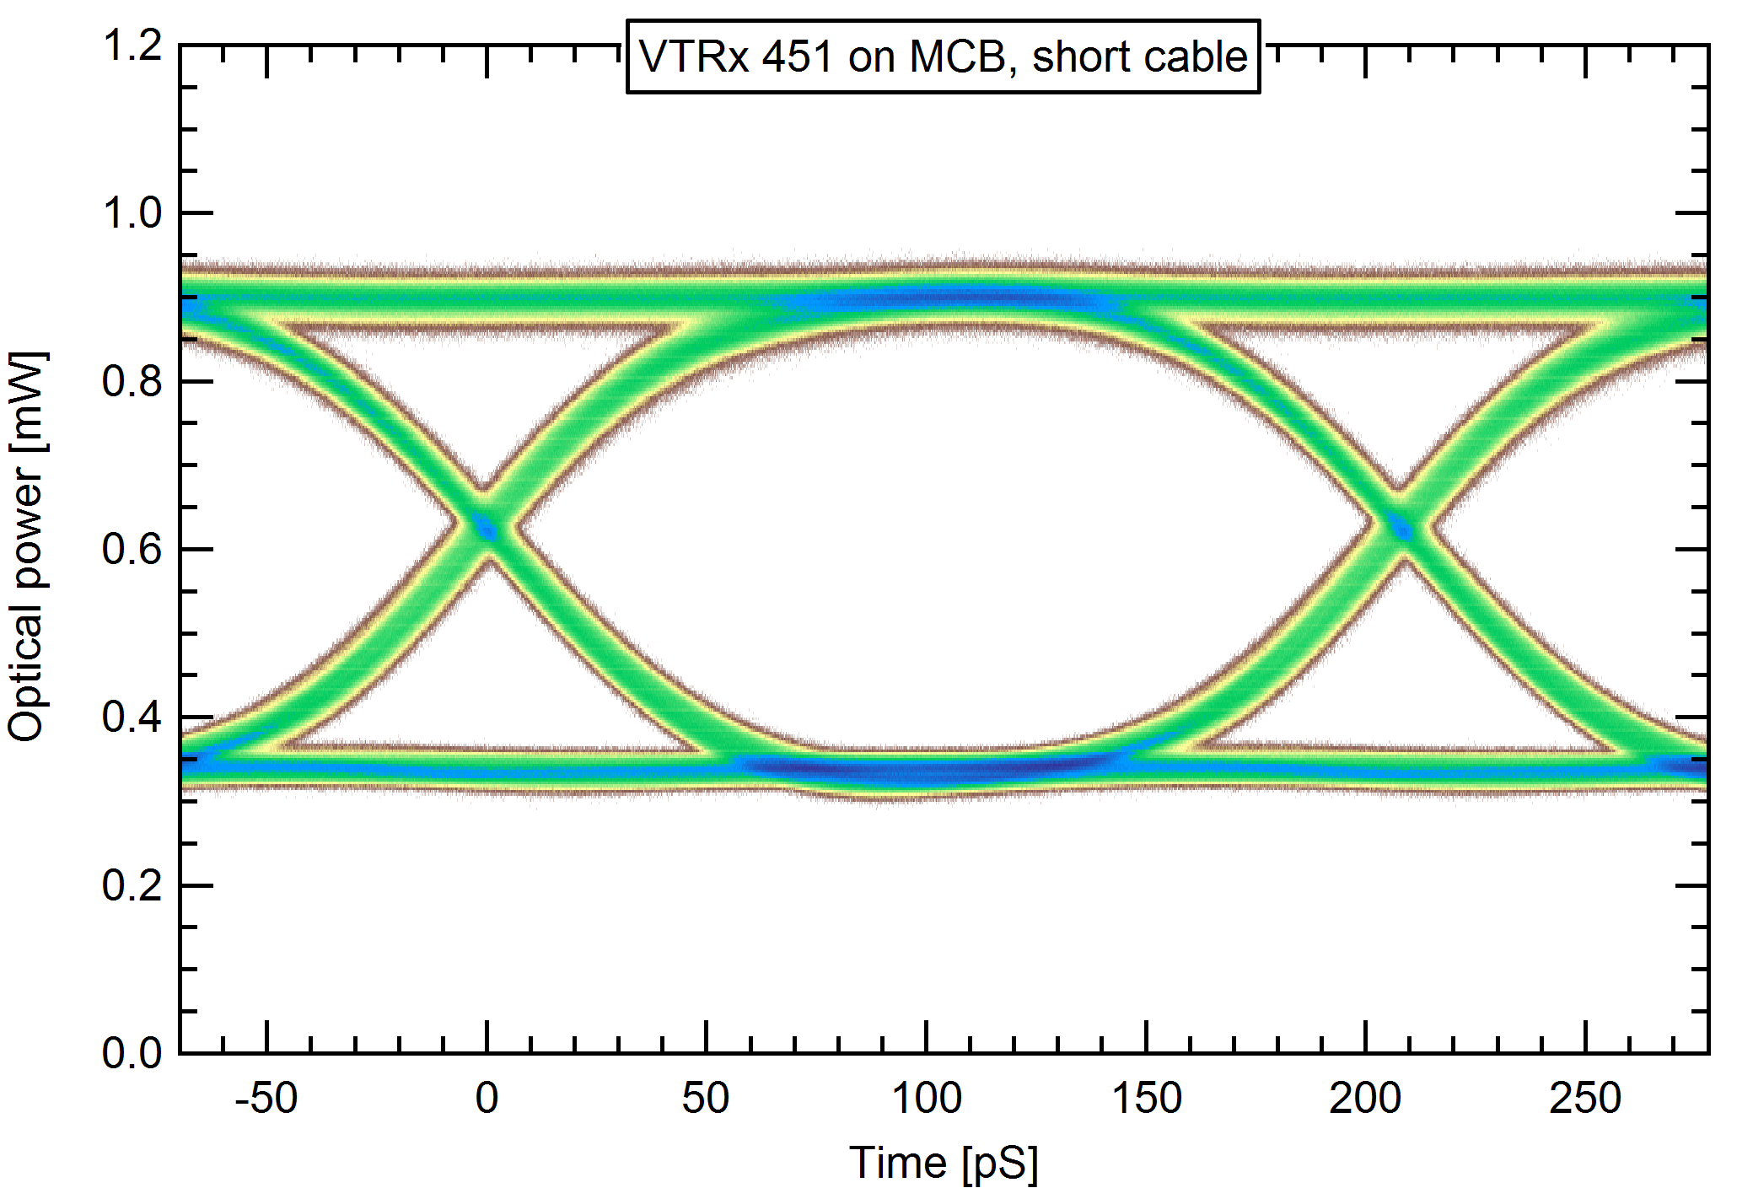
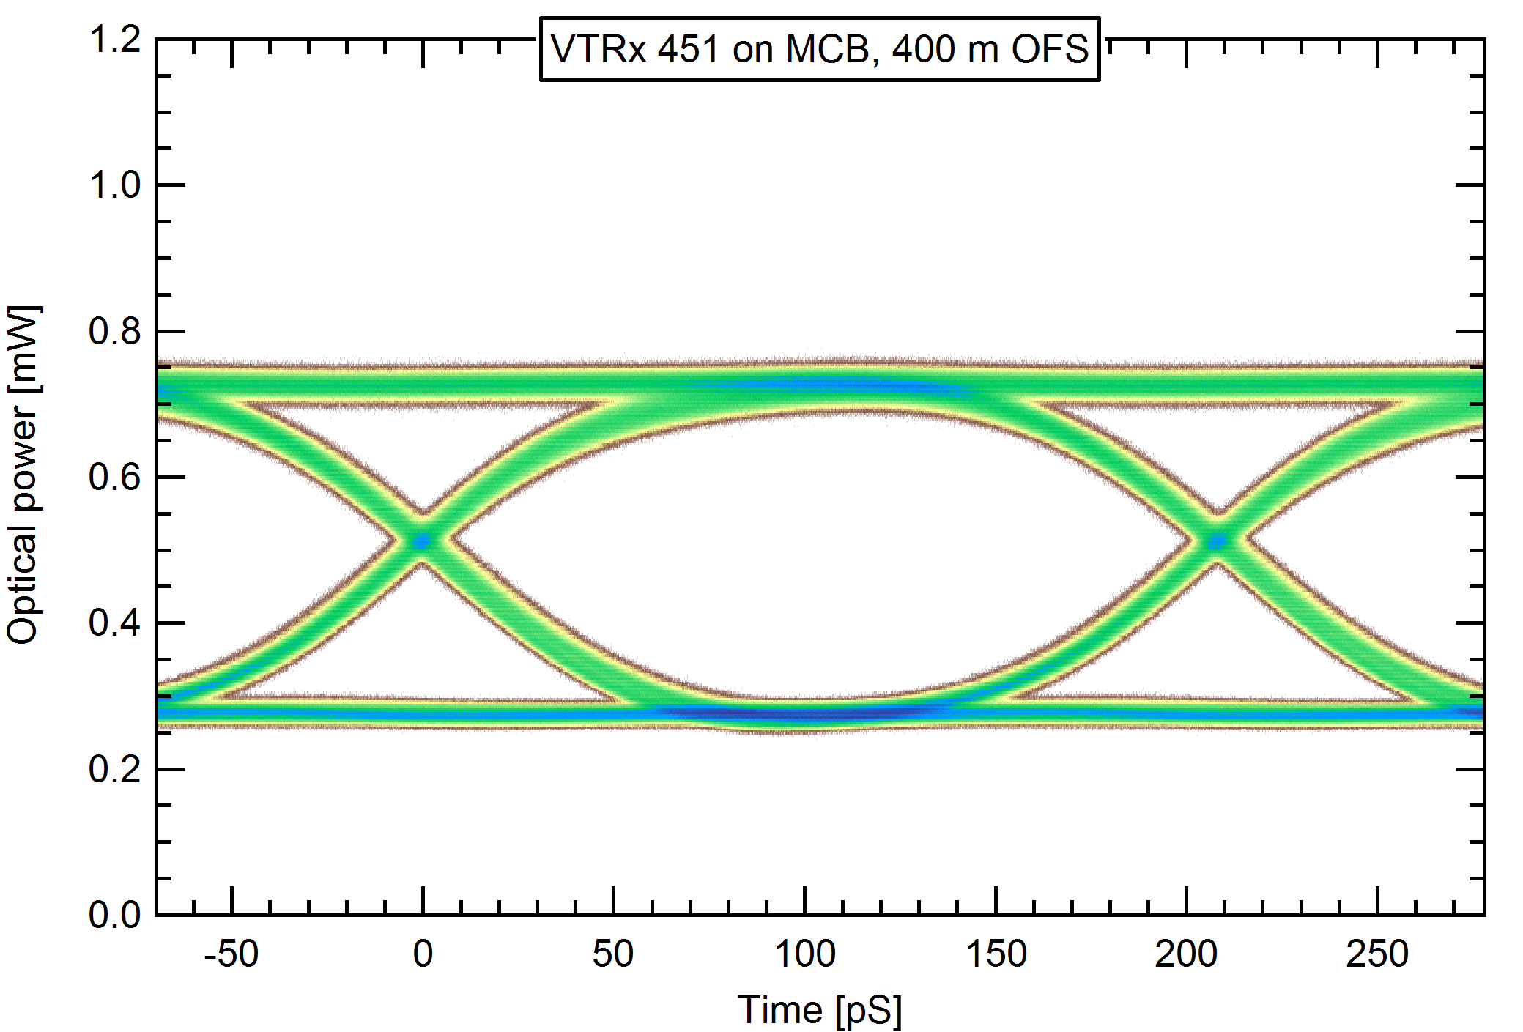
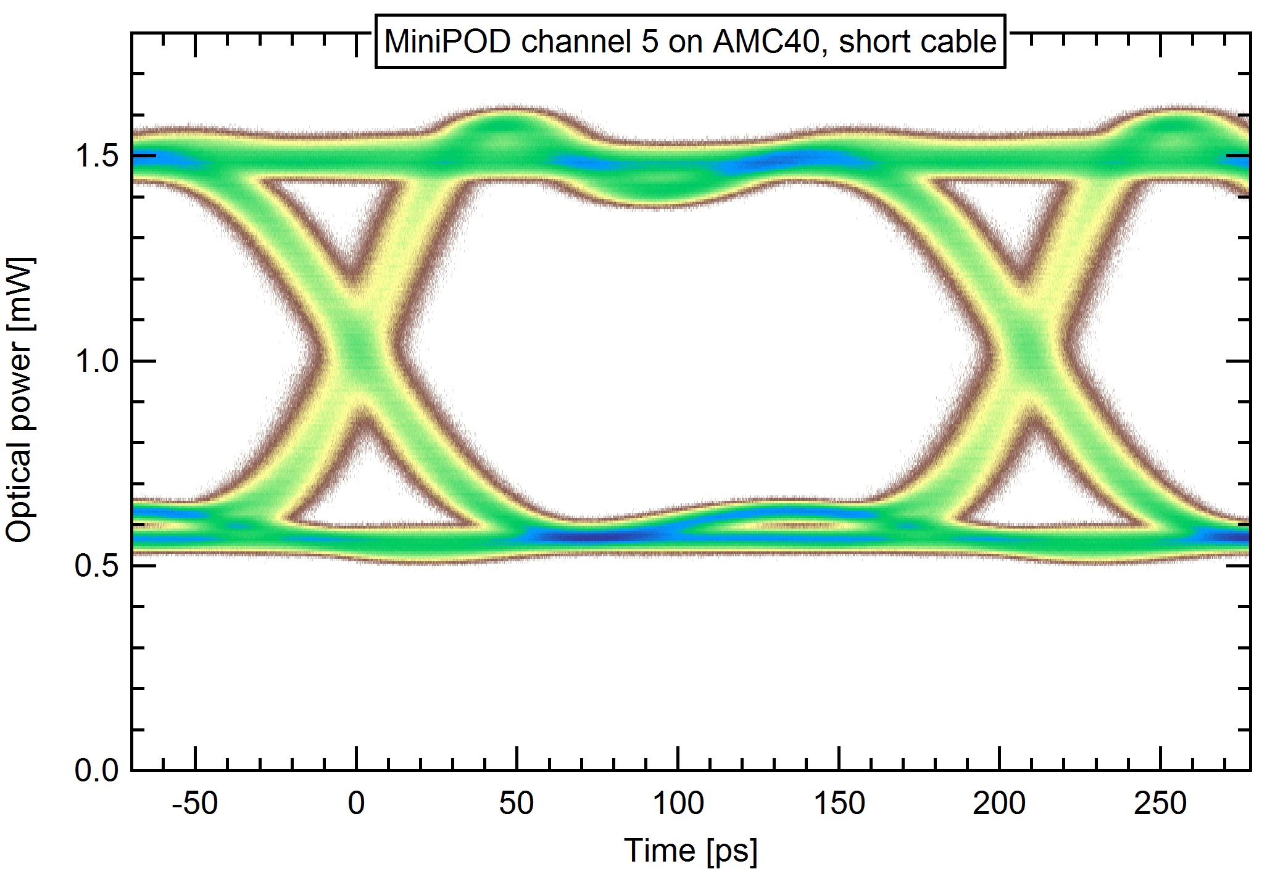
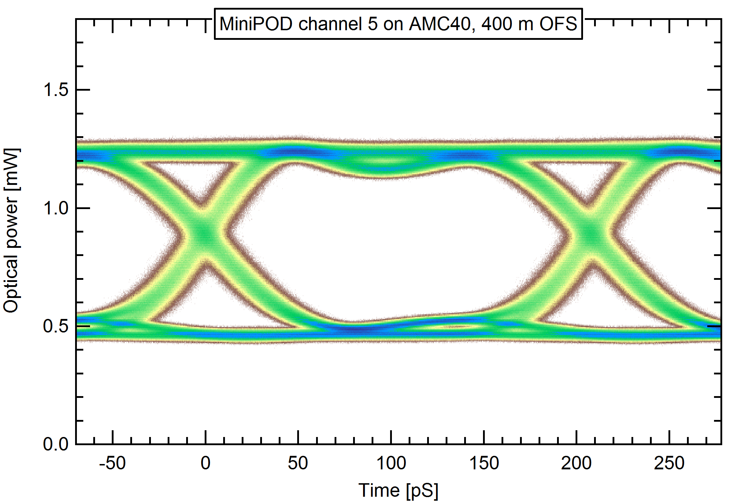
Eye Diagram Measurements
-1 dB
-1 dB
0 dBm
Attenuation is actually -1dB
Optical launch power of MiniPOD can be turned up to almost 0 dBm

Slide 8
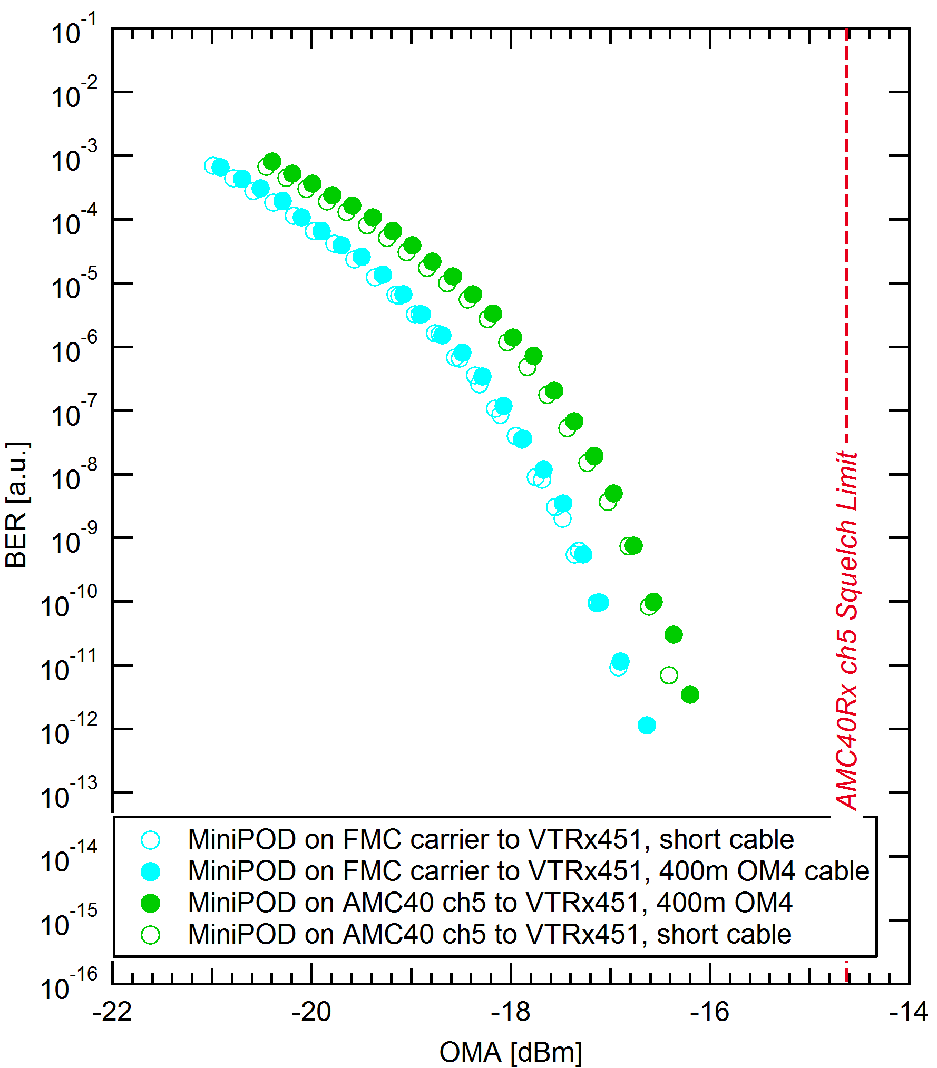
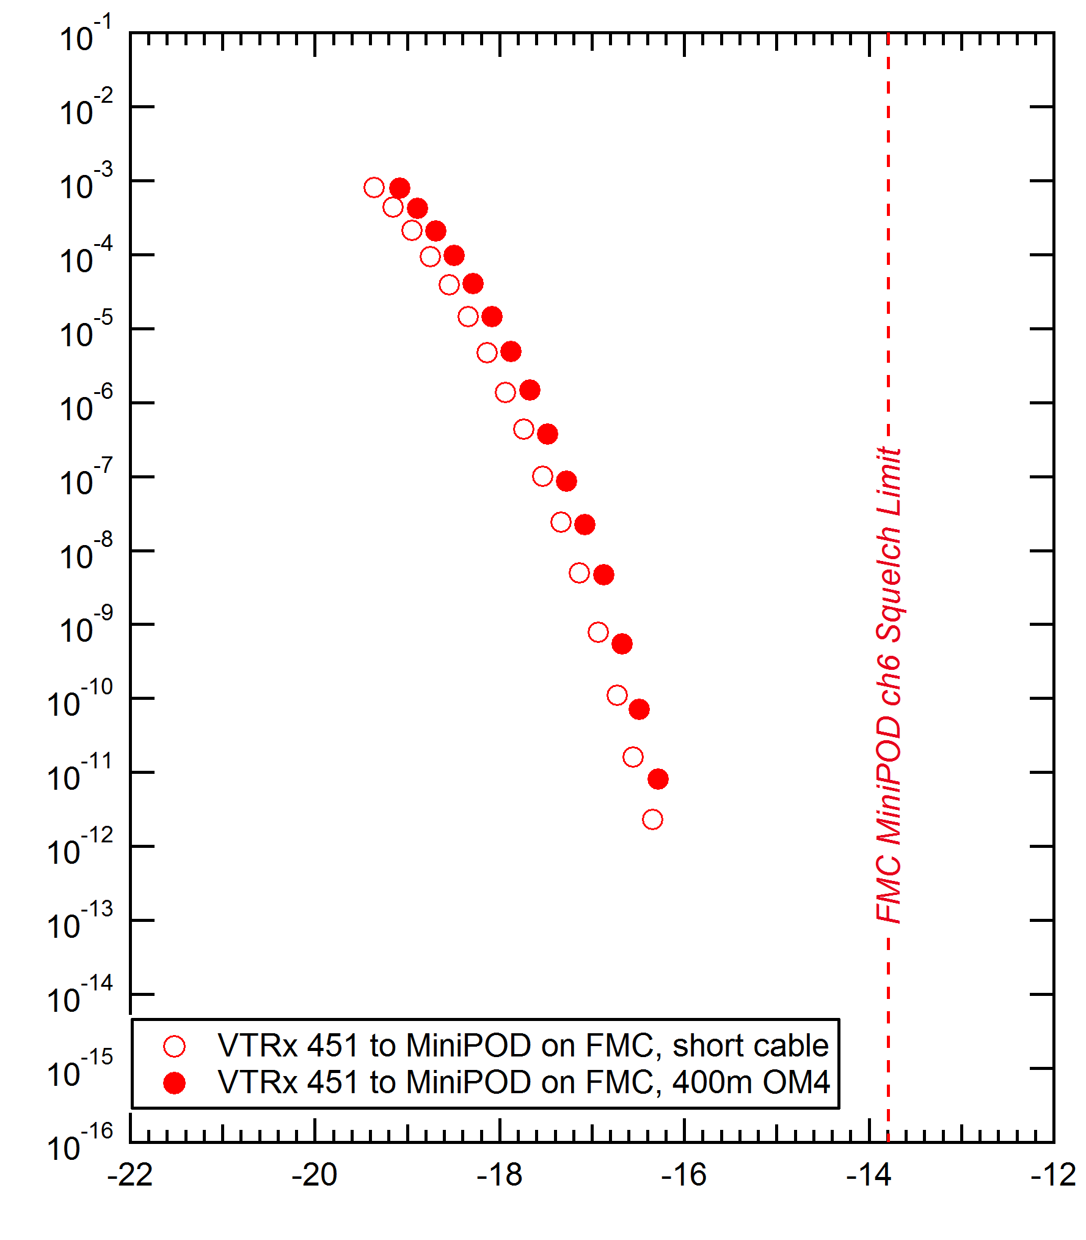
BERT for Mode Dispersion and Receiver sensitivity
Approx -0.3dB
Approx -0.3dB
Approx -16dBm @ 10⁻¹³
Penalty due to Mode Dispersion @ 5Gbit/s is much better than anticipated
  -0.3dB instead of -1dB
Receiver sensitivity also seems to have improved
  -16dBm @ BERT of 10⁻¹³
  -14dBm according to receiver noise detection threshold

Slide 9
New Optical Link Budget @ BERT 10⁻¹³
-0.4
1.0 (1.2)
1.0 (1.2)
0.5
0.5
0.5
-14.0
5.7(5.5)
7.1(6.9)
Current GBT FEC will add another 6-7dB to this Margin !
We have not used any equalizer cleanup yet

Slide 10
To do
Gather more statistics
  We are going to set up a more automated set-up to measure a larger amount of MiniPOD devices
If these values persist
Go for small scale installation at P8
  Install cable holding infrastructure
  Install small amount of long distance fibres
  Terminate with MPO connectors
  Install Tell40 and VTRx boards upstairs/downstairs
Do a long running system test

Slide 11
The network options
Two local area network technologies are investigated: Ethernet and InfiniBand
Speed-grades
  Ethernet 10 Gbit/s, 40 Gbit/s and 100 Gbit/s (only for up-links and interconnects)
  InfiniBand QDR 32 Gbit/s FDR 54 Gbit/s (in the future: EDR ~ 100 Gbit/s)
Both technologies will use the same physical link technology

Slide 12
The case for a long distance DAQ network
450m SR version of Ethernet and IB transceivers is going to be released within the next 2 years (at least by Avago)
They will of course be more expensive than the 100m versions
Similar measurements we did at 10Gbit/s show that it will work
Keep in mind though:
  Long distance GBT will also profit from 10Gbit improvements
  If we go for long distance network, we might have to buy twice the amount of optical equipment (can most likely get away with copper if BE upstairs)
  Increasing the amount of TELL40s upstairs is easy. Downstairs will be a nightmare

Slide 13
Summary
Fiber attenuation is more than expected, but mode dispersion is less strong
Performance of MiniPOD seems to be much better than advertised
  To be expected, since the manufacturer has an agenda of increasing range with these devices
Long distance GBT solution looks very feasible
Vendors will most likely not commit to this usage though
  They anyway don’t for 5 GBs
  We will have to qualify the components ourselves
Work on a test with more devices to gather more statistics
If this test checks out → Small system installation at P8 with and long time test to determine real BER

