Slide 1

The CMS Detector: Present and Future
Joel Butler
Fermilab
CMS Data Analysis School
Taipei
September 11, 2012

Slide 2
Lecture Objectives
Explain what kind of detector should one build to explore electroweak symmetry breaking and search for new physics beyond the Standard Model.
    The Answer: CMS!
      But we will discuss how it is designed and why it works
Present the basic information about the detector do you need to help you to understand how to analyze the data.
Explain why the CMS detector will need to be upgraded to keep it able to look for new physics as the luminosity of LHC is increased well beyond the original design
    Will just touch this topic, which is now very HOT
    It may well be in your future to work on the upgrade

Slide 3
A Detector to Study Electroweak Physics and Look Beyond the Standard Model at the Terascale
There are many models of how Electroweak symmetry breaking can be accomplished
  Even within the Standard Model, there are a variety of possible decay modes for the Higgs boson, depending on its mass
There are many candidates for new (unknown) physics
  Supersymmetry
  New interactions, e.g. Technicolor
  Extra dimensions
  Right-handed gauge bosons (broken left-right symmetric models)
  Many, many more ….
A “ discovery detector”, also called a “general purpose detector” at LHC must be able to study all these topics and separate the interesting events from a much larger background of uninteresting stuff that has the nasty habit of mimicking new physics and misleading us

Slide 4
How can we do this?
General Principles
Heavy objects decay into lighter objects
  The “lighter objects” are the particles of the Standard Model
    Photons, electrons, muons, τ leptons, jets (light quarks u,d, s and gluons)- especially “b-jets”, “charm jets”, “top”, Ws, and Zs
      Only a few particles are stable enough to be measured directly: e,μ,γ, plus some hadrons: pions, kaons, protons, neutrons
    Partons, the quarks and gluons, reveal themselves as collimated bursts of particles called “jets” so identifying jets and measuring their angles and energy becomes important
  It is a requirement for finding new physics to be able to measure all the known SM objects
Particles may leave the detector without interacting
  Neutrinos are known SM particles that do that all the time
  There may be NEW massive weakly interacting particles that behave similarly
  These can be “detected” by observing missing transverse energy , “MET”, so it is a requirement to be able to detect it

Slide 5
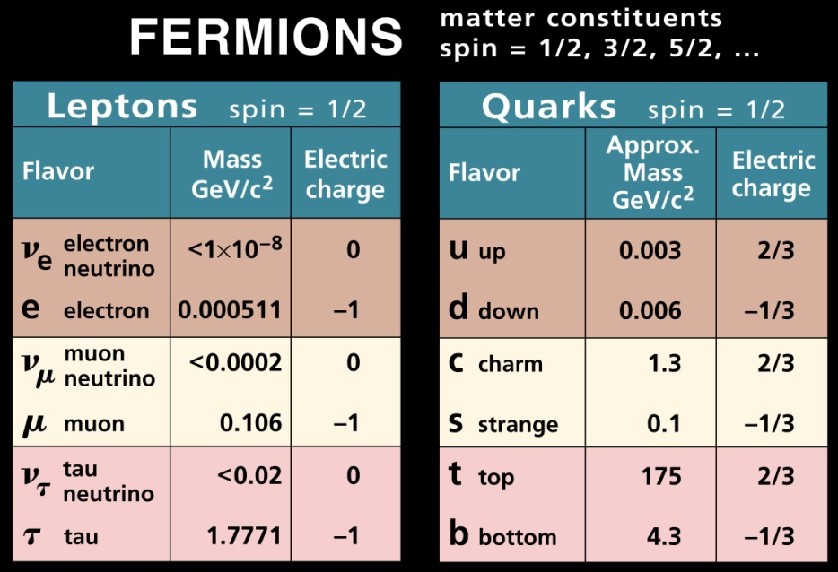
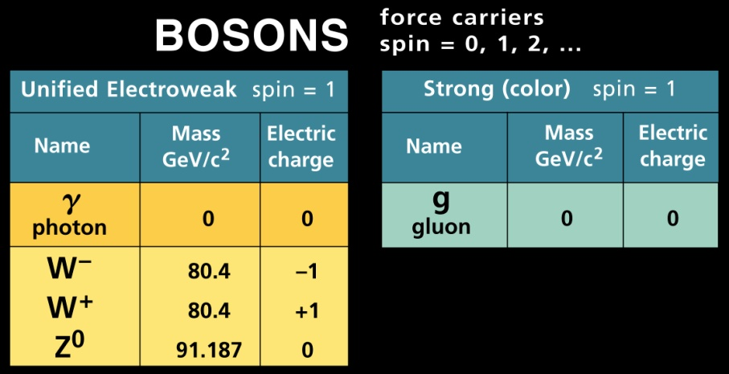

The Standard Model “Elementary Particles”
Our “periodic table”!!
The physics objects are
  Charged leptons: electrons (e), muons (μ), taus (τ)
  Neutral leptons: three flavors of neutrinos (ν) and their corresponding antineutrinos
  The quarks: u,d,s,c,b,t and the corresponding antiquarks
  The gauge bosons: photon (γ), the W, Z, and 8 gluons
The hadrons, here a proton, are composite particles of quarks and gluons

Slide 6
Simple to Detect vs Complex to Detect
“Elementary” Objects
Three objects are particles that are stable or long lived (survive traversal of the typical detector): e,μ, γ.
  Some hadrons, which are composites of quarks (antiquarks), are long lived and can be tracked -- charged pion and kaon, proton, and antiproton
The others are more complex and decay into the more stable objects
  The W and Z gauge bosons
  Quarks and Gluons
    Top and bottom quarks
  Tau leptons
  Neutrinos
Signals for new physics should emerge from
  Combinations of these objects (mass bump or “excess”)
  New objects that are different from the “normal” ones
Backgrounds come from similar combinations due to known physics, random combinations of objects, or either of the above with various misidentified objects due to detector limitations

Slide 7
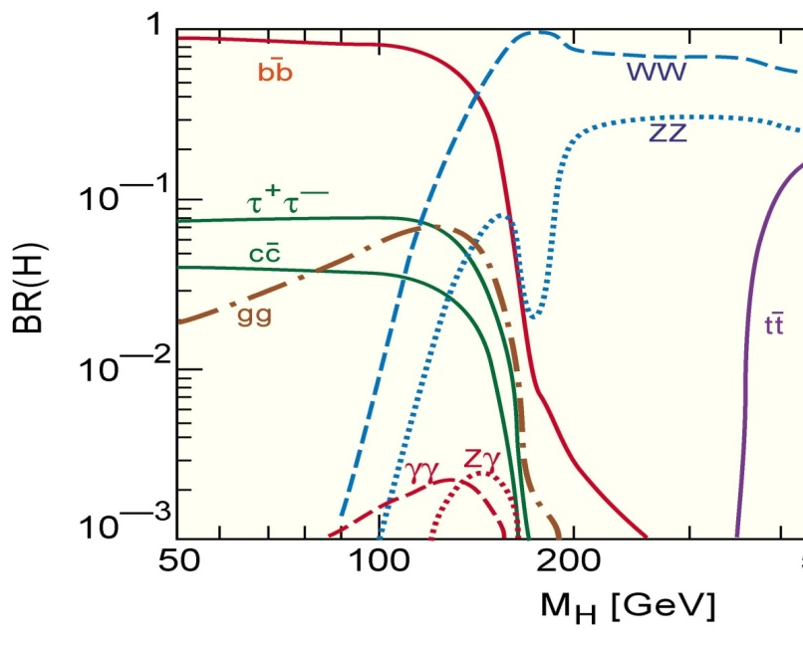
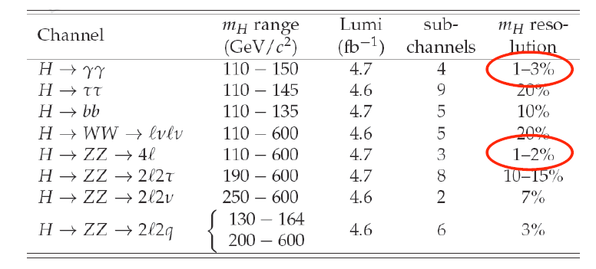
Physics from Objects, e.g. Higgs
All new signals are expected to decay into some combination of these SM physics objects
All “known” or “normal” processes will also have these objects in their final states, leading to backgrounds to physics searches,
Excluded by LEP

Slide 8
The New Boson
Came from a search for a “light Higgs”
  But is it really the SM Higgs?
The final states where the signal is seen are also expected decay modes of the “light Higgs”
  They were seen in the “high resolution” modes so far
But in order for it to be “the Standard Model Higgs” , all the branching fractions must agree with predictions so all the capabilities needed for the Higgs search will be needed also into the indefinite future (relevant to upgrades) to reach high precision in all modes
Decay Mode | SM Branching Fraction
H→ b b | 80%
H→ W*W | 10%
H→ τ⁺τ⁻ | 8%
H→ Z*Z | 1%
H→ γγ | 0.2%
bb difficult due to large QCD dijet background
WW and ττ have missing neutrinos→ poor mass resolution
ZZ* and γγ will have best mass measurements

Slide 9
Physics from Objects, e.g. SUSY
Search for Supersymmetry at the LHC in Events with Jets and Missing Transverse Energy
Search for supersymmetry in pp collisions at s√=7 TeV in events with a single lepton, jets, and missing transverse momentum
Inclusive search for squarks and gluinos in pp collisions at s√ = 7 TeV
Search for Supersymmetry in Events with b Jets and Missing Transverse Momentum at the LHC
Search for Physics Beyond the Standard Model Using Multilepton Signatures in pp Collisions at s√ =7 TeV
  at least 3 leptons and any number of jets
Search for supersymmetry in events with a lepton, a photon, and large missing transverse energy in pp collisions at s√ = 7 TeV
Search for Neutral Minimal Supersymmetric Standard Model Higgs Bosons Decaying to Tau Pairs in pp Collisions at s√=7 TeV
Search for Physics Beyond the Standard Model in Opposite-sign Dilepton Events in pp Collisions at s√ = 7 TeV

Slide 10
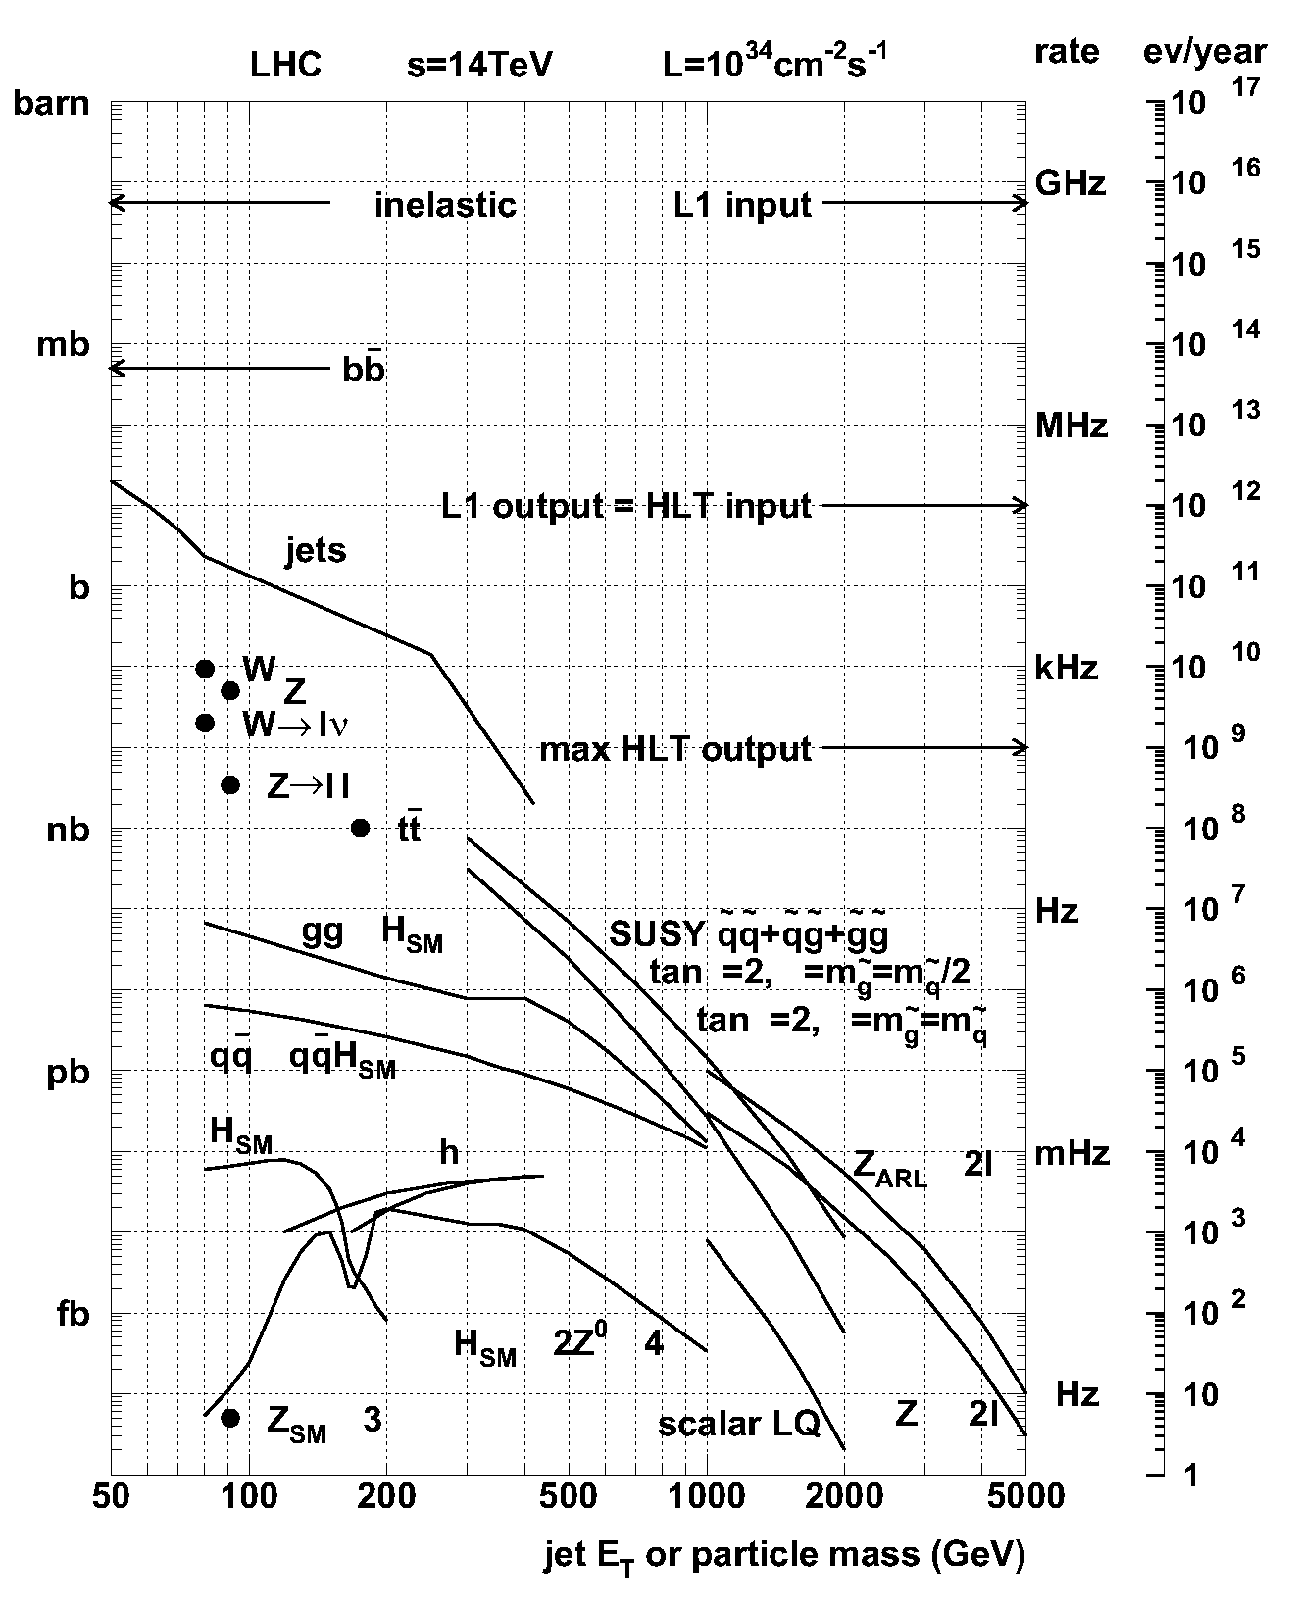
Production Cross Sections at the LHC
Cross sections and background estimates (measured, calculated) tell us what minimum energy and luminosity we need from the colliding beams and therefore what the detector must be able to handle
Production dynamics determine the range of energies and angles we need to measure
Inelastic background events produced at a rate of 1 GHz.
JETS
Supersymmetry ~ 1Hz
Detectable Higgs
production ~ 1 milliHz.
“CMS” values of cross sections
http://cmsdoc.cern.ch/cms/PRS/
gentools/www/xsec/cmsxsec.html
For Higgs: https://cms.web.cern.ch/org/higgs

Slide 11
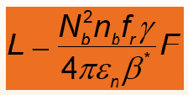
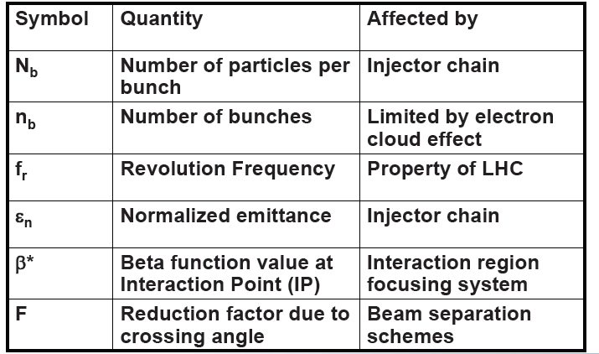
Luminosity
Each beam consists ~1350 (2808) bunches
a few cm long, 50 (25)ns apart
To maximize the interaction rate
  Maximize the number of particles per bunch
  Minimize spatial extent of each bunch
  Don’t hit at angle – hit them square on
But at a given luminosity, fewer bunches
→more interactions /bunch
  Several interactions/bunch is a challenge as they are all superimposed
    This is called “pileup” [exps (accel) like low (high) pileup]
The quantity “Luminosity” captures these ideas in one number. It has units of cm⁻²s⁻¹. The number of interactions = Luminosity x cross section (cm²) x run time(s)
One fb⁻¹ ~ 10¹⁴ (100 trillion) inelastic collisions
LHC design L=10³⁴ cm⁻² s⁻¹, ~40 (20) interactions/crossing, 50 (25) ns
After CM energy, luminosity is the most important parameter that defines the physics reach of a machine
Luminosity calculator: http://lpc.web.cern.ch/lpc/lumi.html

Slide 12
Typical Events and Hard Scatters
The typical inelastic event is mostly π⁺, π⁻, and π⁰s (which decay immediately to 2 photons) in ~ equal amounts. These are distributed with a relatively flat rapidity distribution, with about 6 tracks/unit of rapidity and reasonably small average P_{T}~0.150 GeV/c
    So ~30 tracks in the η = ±2.5 of CMS
    Less than 100 GeV of energy is deposited in the central region
    About 500 GeV is deposited in the interval η = 3 to 5
    These constitute the “pileup” events, many of which are superimposed on the occasional “hard scatter” we want to study
      Pileup of 20 → 600 tracks and 600 photons
    They also contribute to the “radiation damage” of the detector
    All the rest of the energy, ~> 6 TeV, goes forward or backward near or in the beam pipe
These events, often called “minimum bias”, are not interesting for addressing Electroweak physics or Beyond the Standard Model Physics
  Ideally, “minimum bias” includes the whole inelastic cross section. In reality, it is affected by the trigger hardware that produces it.

Slide 13
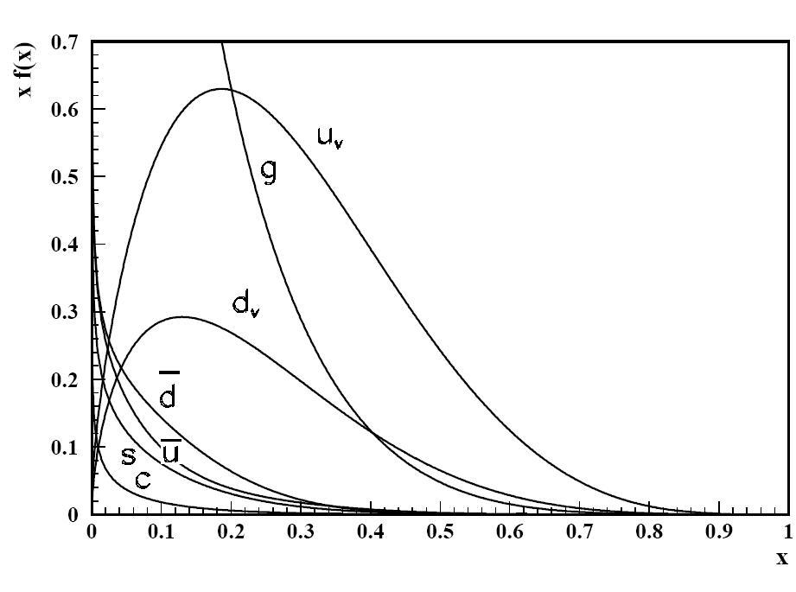
The Nature of Hard Collisions
A proton is a “bag” containing partons: 3 “valence” quarks (u, u, d) and a whole spectrum of gluons, and virtual quark-antiquark pairs, called the “sea”.
The partons are described by Parton Distribution Functions (PDF)s:
f_{j}(x)= probability density for having a parton of type j with fraction x of the proton’s momentum
“Hard” collisions between a parton “a” in one proton and a parton “b” in the other proton occur with probabilities given by the cross sections and PDFs:
At large x, u dominates over d. At x<0.2, the gluon is dominant
Higher total energy allows the collisions of lower “x” partons, that are more abundant, to have enough energy in the parton- parton CM to make heavy objects.
Cross sections are higher than at lower energy machines
The proton having M~1GeV, there is little intrinsic
transverse momentum in the initial state
http://hepdata.cedar.ac.uk/pdf/pdf3.html

Slide 14
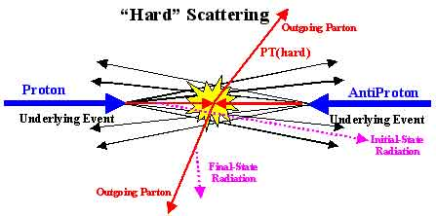
A Hard Scattering
Outgoing Parton, c
,c
Fragmented beam
Fragmented beam
Outgoing Parton, d
,d
Incoming parton, a
Incoming parton,b
Since parton a and parton b will rarely have the same energy, the center of mass of the parton-parton collision is moving in the proton-proton center of mass (corresponding to the collider lab frame)
The final state topology has four partons (jets), the two from the hard scatter and the two “beam fragments”

Slide 15
Production Kinematics - 1
Since P_{T} is limited but P_{L} varies greatly, we need special variables that transform well under a Lorentz boost to handle a center of mass with very different energies. E and p don’t work well, but (E+P_{L}) and (E-P_{L}) do (light cone variables)
A boost of a system by β is given by
This suggests using as a variable, the “rapidity”
A boost of β simply adds Y_{β} to the rapidity of every particle and any rapidity interval is unchanged by a boost

Slide 16
Production Kinematics - 2
Since y’= y + Y_{B}, the “span” of a object Δ y = y₁-y₂ is independent of CM motion of the 2 colliding partons →central to definition of a “jet”
For relativistic particles, β~1, the momentum drops out, only depends on angle. This new variable is called the “pseudorapidity”, η.
Relation to parton
momentum fractions:
A spectrometer that covers
2π in azimuthal angle and
down to 10⁰ on each end in
polar angle, covers 98% of
the full solid angle. It will accept the light decay products of heavy objects
2.5
10º

Slide 17
Production Kinematics - 3
What angular coverage is necessary?
  Heavy objects are produced more “centrally” e.g. y(or η)~ 0 so will not be moving too fast in the lab.
  Light decay products are emitted over a large range of lab angles and momenta
  A good P_{t} measurement at large polar angles requires a B field parallel to the beam axis. For forward particles requires a B field perpendicular to the beam axis
    In practice must choose!!!
  You do not gain much solid angle coverage for light decay products by going to small polar angles (d Ω = sin θ dθ dφ)
  The small angles, being closest to the beams and the forward burst of energy, are least likely to be useful.
The total rapidity interval is limited and depends on the mass of the object produced
√s | M(GeV/c²⁾
 | 0.140 | 100 | 350 | 1000
1.96 | 9.5 | 3.0 | 1.7 | 0.7
7.0 | 10.8 | 4.2 | 3.0 | 1.9
14.0 | 11.5 | 4.9 | 3.7 | 2.6
Y=0 corresponds to head on collisions at
Heavy objects are produced more centrally, so the detector should do the best job of instrumenting the central region!!!

Slide 18
Transverse Momentum
There is little transverse momentum in the initial state
Transverse momentum in the final state comes from
  The hard scattering process or
  The decay of some heavy object made by the collision
Transverse momentum is also invariant to a longitudinal boost
Detector should measure well P_{t} , η (polar angle), φ (azimuthal angle)
How well do we have to measure it? Suppose an extreme case- a 2 TeV object decaying into two particles (Z’→ μ⁺μ⁻), then, P_{T}~1TeV/c x sin θ
Suppose we want P_{T} to ~10% in this extreme case
(For a solenoid)
(B in Tesla, L and σ_{rφ} in m, P_{T} in GeV/c, N = number of tracking Layers)
If σ_{rφ}~ 50-100 μm,BL² must be around 3-4 T-m²

Slide 19
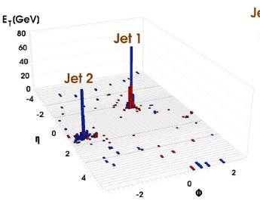
Complex Objects: Jets and Missing E_{t}
Jets are large deposits of energy in ~small regions of Δy (Δη) and Δφ:
To include a track or calorimeter energy deposit in a jet:
Total area of plot shown is ~62.8, so Δη~0.1, Δφ~0.1 for calorimeter segmentation should be adequate even to resolve several jets in event
MET is the negative the vector sum of all the transverse components of observed energy including any muons. It Indicates the presence of weakly interacting particles, usually neutrinos, but possibly new exotic objects that interact only weakly.
The focus is on the transverse energy because an unknown amount of longitudinal energy may be lost down the beam. If the angular coverage is sufficient, missing components will not contribute much to the missing transverse energy

Slide 20
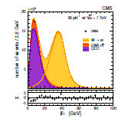
Complex Objects: Z’s and W’s
Z has a mass of (91.2 GeV/c²)
  It decays into
    the easily reconstructible states e⁺e⁻, μ+μ⁻
    τ+τ ⁻ (harder due to missing neutrinos)
    Two jets
    Two neutrinos – signified by large missing E_{T}
The W has a mass of (80.4 GeV/c²)
  It decays into
    e, μ, or τ plus the corresponding flavor of neutrino
      The neutrino results in MET and because of the 2-body decay the lepton has a characteristic P_{T} distribution (Jacobian peak at ½ x M_{W}.
    Two quark jets
  In addition to be a possible daughter particle of the decay of a heavy object, Z’s and W’s are very useful as a standard candle for calibrating many systems. The Z→ e⁺e⁻, μ+μ⁻ are especially useful since the whole momentum can be reconstructed.
M_{w}/2

Slide 21
b-quark jets
Discriminants of b jets from light quark or gluon jets based on
Long lifetime of b-hadrons in them
  τ= 1.512 x 10⁻¹² s, cτ = 455.4 μm
High masses
High fraction of semi-leptonic decays
  ~10% e, μ (and from charm)
Hard fragmentation
Methods for discrimination
  Impact parameter based
    Track counting high efficiency
    Track counting high purity
    Jet probability
    Jet B probability
  Secondary vertices
    Simple secondary vertex
    Combined secondary vertex
  Lepton based algorithms
    Soft muon by PTrel
    Soft muon by IP signficance
    Soft electron
  Combined algorithm
    Combined MVA
θ~1/γ
σ_{L}∼1/θ∼γ
L=<γcτ>
Impact
parameter
L/σ_{L} ~ independent of p of B
Impact parameter ~1/2πcτ independent of p

Slide 22
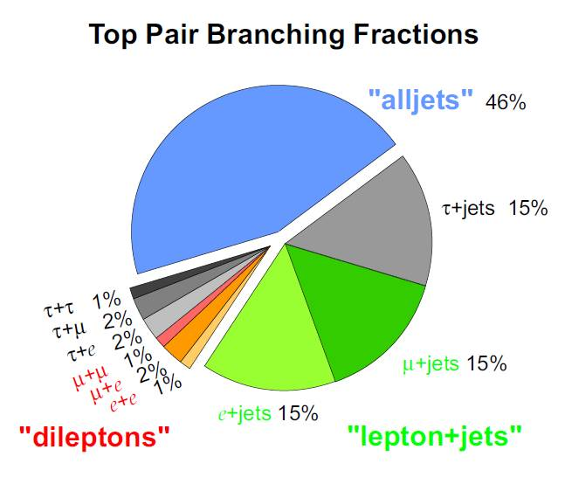
Top
Top has a mass of ~175GeV/c².
Top decays before it has time to hadronize (due to high mass) into W+ a “b-quark” because V_{tb} ~ 1 – A²λ⁴ ~ 1
    If the W decays leptonically,
      t→ lepton(e, μ, τ) + neutrino + b-jet
        Experimental signature includes MET
    If the W decays hadronically
        t→ two light quark jets + b-jet
          No MET
    W mass constraint helps constrain the neutrino momentum and thus the top kinematics
Tops are produced in pairs by strong interaction or singly in EW
Top may be “daughter particles” in the decays of new states
Top provides a good source of b-jets for calibrations
  “Estimation of the b-tagging efficiency …. on Top di-lepton events with 2011 data”

Slide 23
Tau leptons
Tau leptons either decay into
  a charged lepton (μ or e) and its corresponding antineutrino; or
  A tau neutrino and a hadronic state, which then typically decays into charged and neutral pions and kaons of relatively low multiplicity, sometimes with observable resonance behavior in the invariant mass of the hadrons
  Isolated small clusters of hadrons at large Pt are tau letpon candidates and can be distinguished from gluon or quark jets which typically have much higher multiplicity
  If the taus are produced in the signal in pairs the topology (e or μ) + hadrons is a powerful signature of the pair
  The event topology also features
    missing E_{T} from the neutrinos and
    charged tracks which might have an observable impact parameter (useful?)

Slide 24
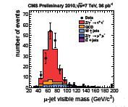
Tau leptons (continued)
Tau lepton decay modes with hadrons in CMS. “h” can be either a pion or kaon. The collection of modes is called τ_{h}. A tau pair consists of
  one leptonic decay into either electron or muon and neutrinos and one hadronic decay is called e τ_{h} or μ τ_{h} , respectively.
  two leptonic decays resulting in the eμ final state
Decay mode | Reson- ance | Mass (MeV/c²) | Branching Fraction (%)
τ⁻ → h⁻ ν _{τ} |  |  | 11.6
τ⁻ → h⁻ π⁰ ν _{τ} | ρ⁻ | 770 | 26.0
τ⁻ → h⁻ π⁰π⁰ν _{τ} | a₁⁻ | 1200 | 9.5
τ⁻ → h⁻ h⁺h⁻ν _{τ} | a₁⁻ | 1200 | 9.8
τ⁻ → h⁻ h⁺h⁻ π⁰ν _{τ} |  |  | 4.8
Tau leptons are being used successfully as objects in the search for the SM model Higgs and for MSSM Higgs where their production would be enhanced

Slide 25
Isolation
Since hard processes produce large angles between the final state partons and the beam remnant jets stay close to the beam line, the objects we are interested in for our studies are usually well separated or “isolated” from other objects in the event
Isolation is applied by drawing a cone around the object of interest in η−φ space; adding up the extra E_{T} in the cone (exclusive of the E_{T} of the candidate); and rejecting the object if the “extra E_{T}” is more than a certain fraction of the E_{T} of the candidate
Example of isolation: discriminating an isolated muon from a W from a muon coming from the semileptonic decay inside a b-jet
Isolated
Muon
Non-Isolated muon from semi-leptonic decay inside a b-jet

Slide 26
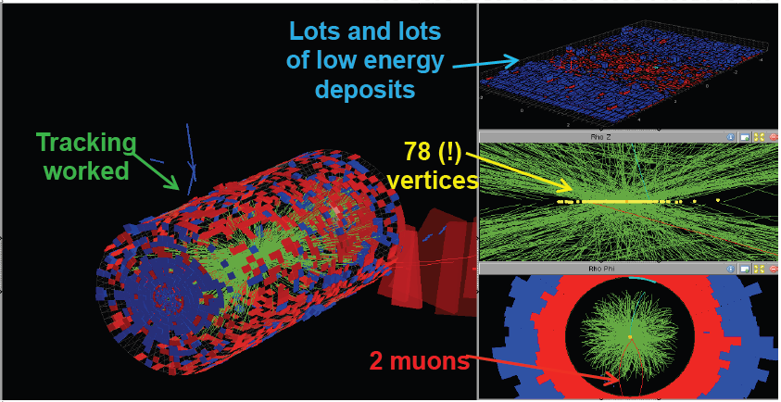
The Challenge Ahead - Pileup

Slide 27
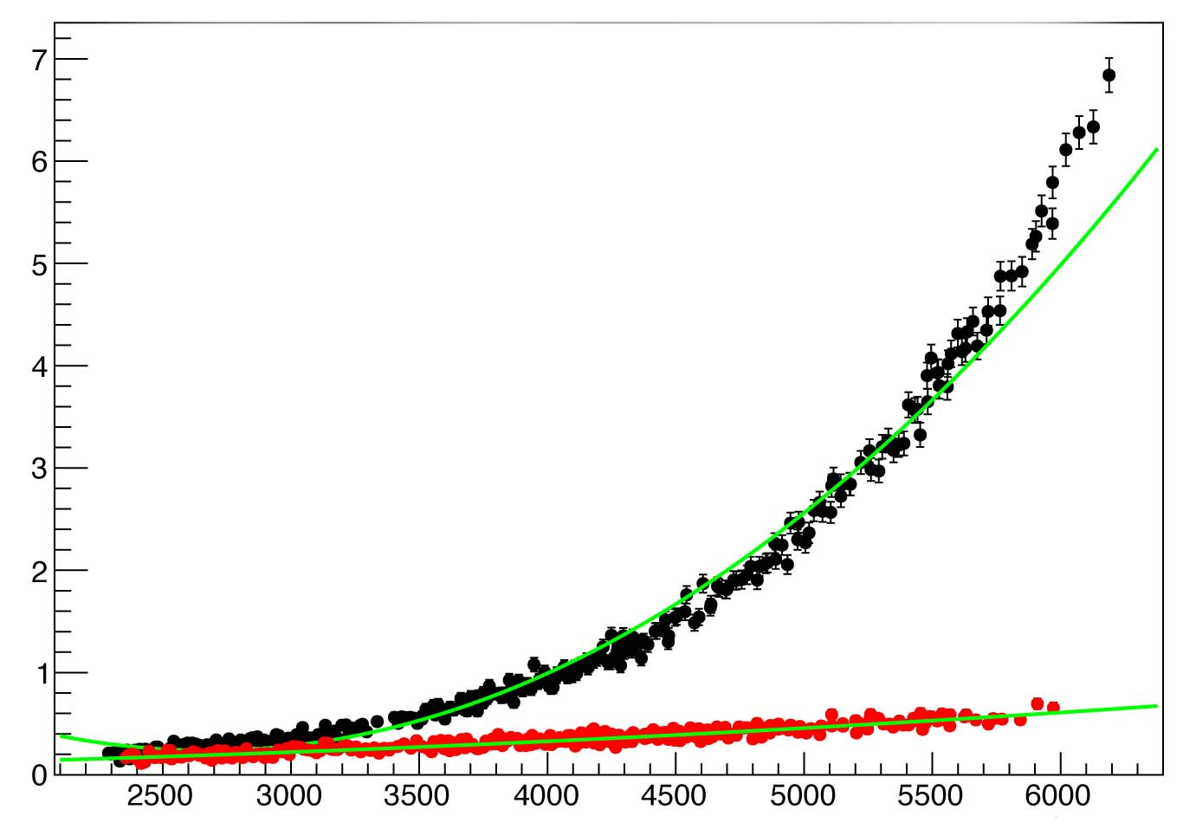
Pileup
The LHC has excellent performance, but with 50 ns rather than 25 ns bunch spacing, instantaneous luminosity ~7.5×10³³cm⁻²s⁻¹
  Average pileup has now increased to above 30
The pileup affects physics performance of isolation, Jet energy, Missing ET, confuses the trigger and causes execution times in the trigger and analysis to grow
Physics performance was maintained by:
  Changing triggers
  Improving reconstruction algorithm to distinguish vertices with ΔZ>1mm
  Correcting jet energies by subtracting the average expected pile up energy
  Developing pile-up safe variables for lepton isolation and identification
  Careful evaluation of the MET
IsoMu24_<PF<jet30_PFJet25_Deta3_CentralPFJET25
v3
v4

Slide 28
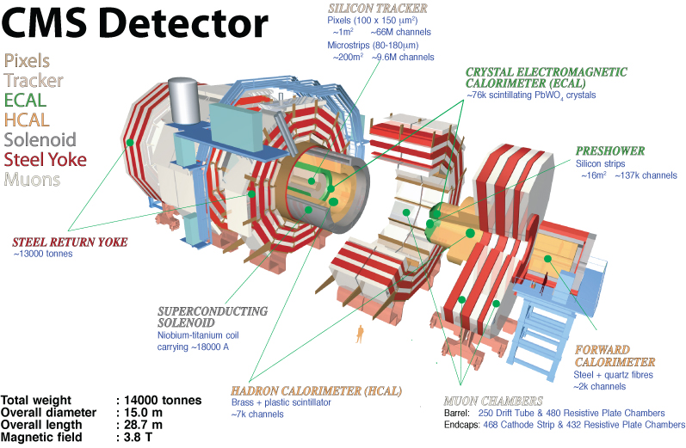
CMS - The Compact Muon Solenoid
Electromagnetic and hadronic calorimeters.
Muon Chambers
Tracker
4T Solenoid Magnet

Slide 29
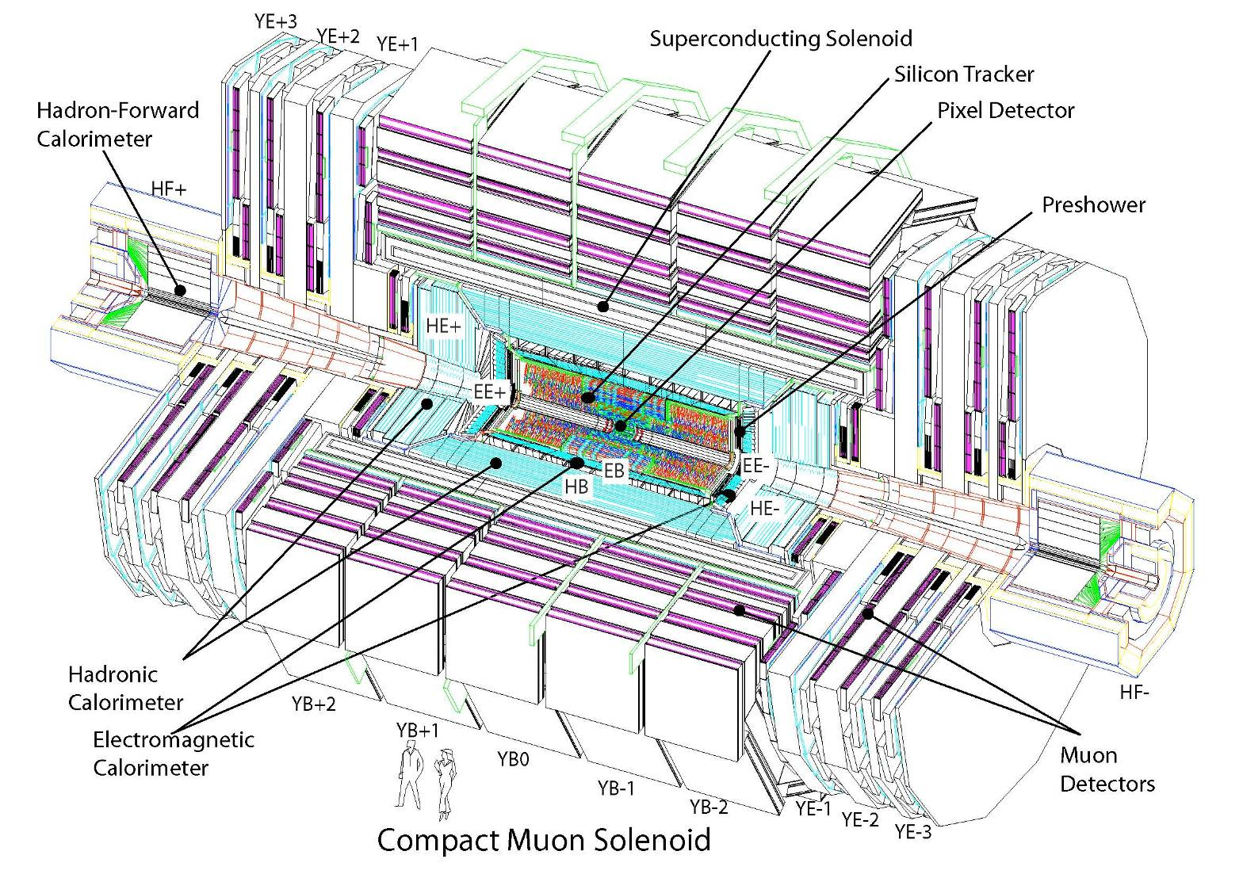
CMS - The Compact Muon Solenoid
(4T)
210 m² of silicon sensors: 9.6M (Str) & 66M (Pix) channels
2 planes of silicon modules for ECAL
Iron / Quartz fiber fwd calorimeter, 3<|η|<5;
+ Castor,
5<|η|<6.55
+ Zero Degree Calorimeter
Scintillator/brass
Cathode Strip Chambers,
Drift Tubes, Resistive Plates
PbWO₄ crystals (76K)
Notes:
Most crystals of any expt. Most silicon coverage

Slide 30
CMS Design Features
Very large solenoid – 6m diameter x 13 m long
Tracking and calorimetry fits inside the solenoid
  particles measured before they pass through the solenoid coil and cryostat, which would degrade their resolution
Very strong field – 3.8 T
  Excellent momentum resolution
  Coils up soft charged particles
Tracking chambers in the return iron track and identify muons
  This makes the system very compact
  Weight of CMS is dominated by all the steel and is 14,000 Tonnes
A lead tungstate crystal calorimeter (~76K crystals) for photon and electron reconstruction
Hadron calorimeters for jet and missing E_{t} reconstruction (provides coverage to η~5)
Charged Particle Tracking is based on all-silicon components
  A silicon pixel detector out to radius ~ 20 cm
  A silicon microstrip detector from there out to 1.1 m
  Small pitch gives CMS excellent charged particle tracking and primary and secondary reconstruction
  High segmentation results in very low occupancy
  Silicon detectors are very radiation hard
  Muon momentum is measured in the muon system but the best resolution comes from associating a silicon track, which has excellent momentum resolution ,with the muon track and doing a full fit. Challenge is to do this with high pileup → fine pitch→ low occupancy, MAJOR DIFFERENCE BETWEEN ATLAS AND CMS. It is why CMS is “compact”

Slide 31
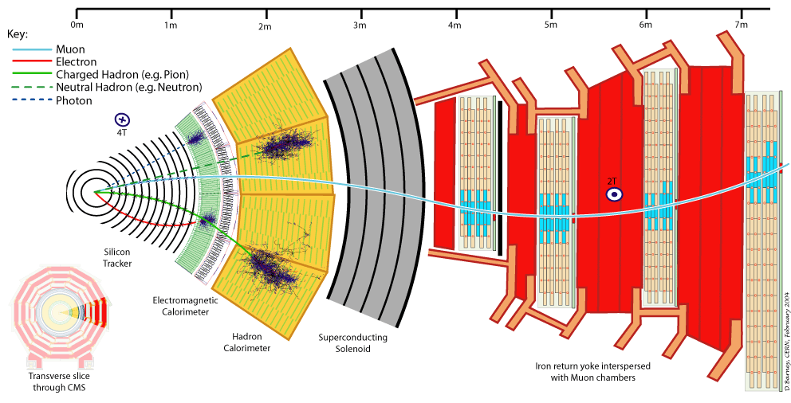
CMS Slice

Slide 32
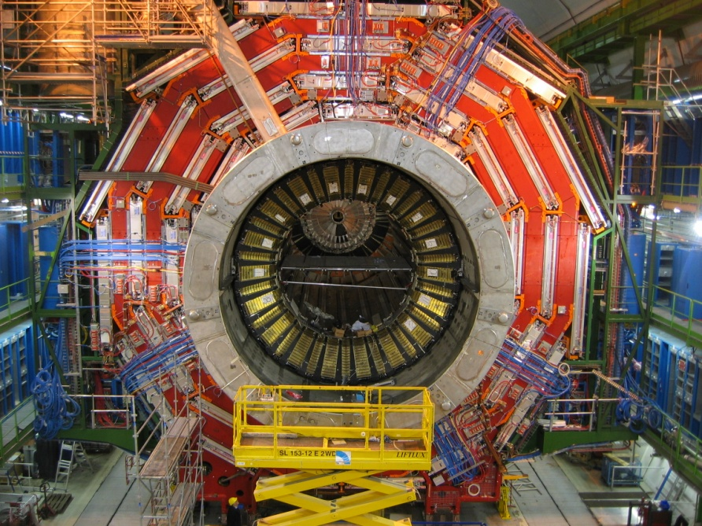
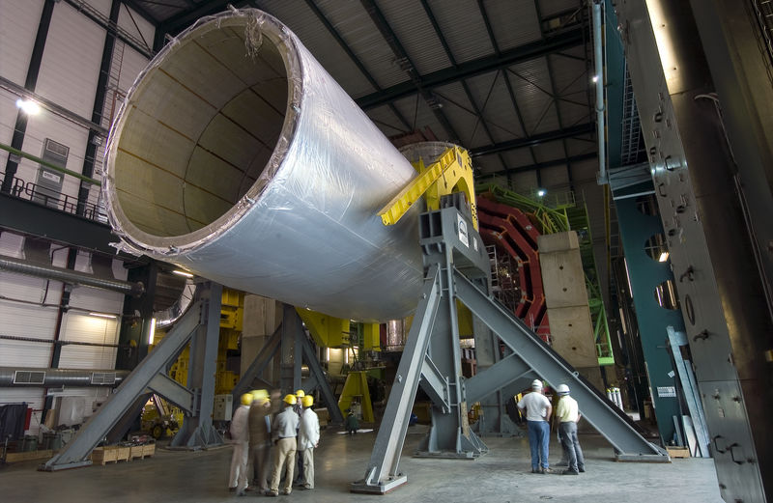
CMS Solenoid
Solenoid has the features described above
  Large acceptance in the most promising region
  Bends charged particles, allowing tracker to measure the transverse momentum. Optimal for measuring P_{t} in central region
3.8 T magnet at 4º K
6 m diameter and 12.5 m long (largest ever built)
220 t (including 6 t of NbTi)
Stores 2.7 GJ — equivalent to 1300 lbs of TNT

Slide 33
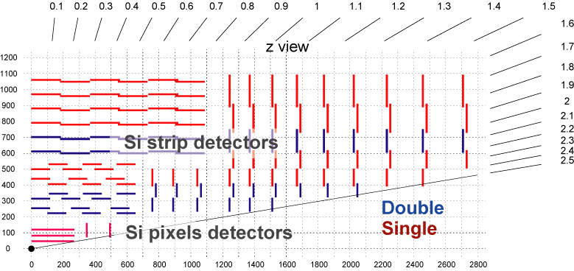
CMS Tracker
All silicon tracker
  3 layers of 100x150 μm² pixels: radii = 4.4cm, 7.3 cm, 10.3 cm
    Precision vertex – primary and secondary – reconstruction
    “seeds” the pattern recognition
  10 layers of silicon strips with ~100 μm pitch, from r =25 cm to 110 cm
    Measures the momentum
    Precision matching of charged tracks to calorimeters and muon detectors
    Four layers are “double sided” – two back to back ladders with an azimuthal and small angle stereo view
Entire system at -10ºC which improves radiation tolerance by a factor of 100 compared to 25ºC
68M pixels and 10M strips
produces low occupancy.
Detector can function well in
high pileup environment

Slide 34
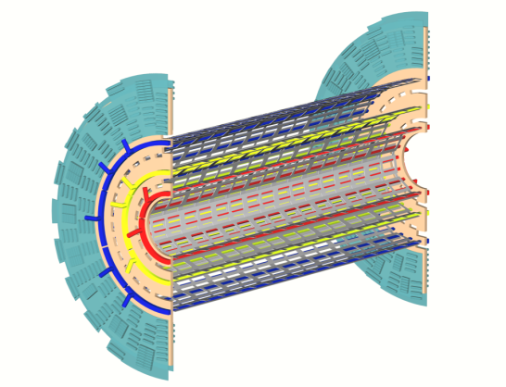
The CMS Pixel System
~60 cm

Slide 35
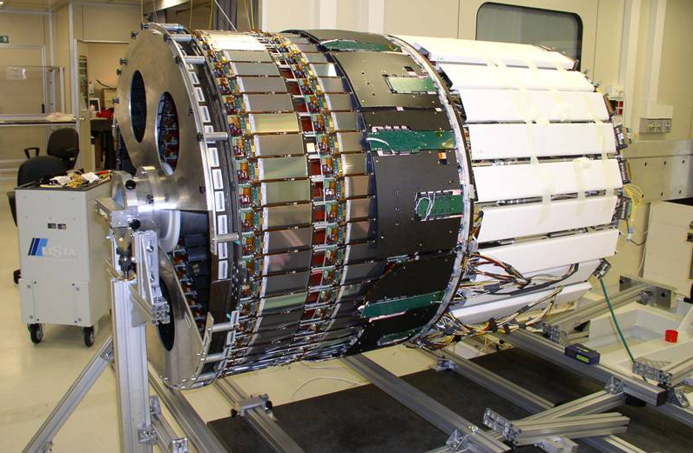
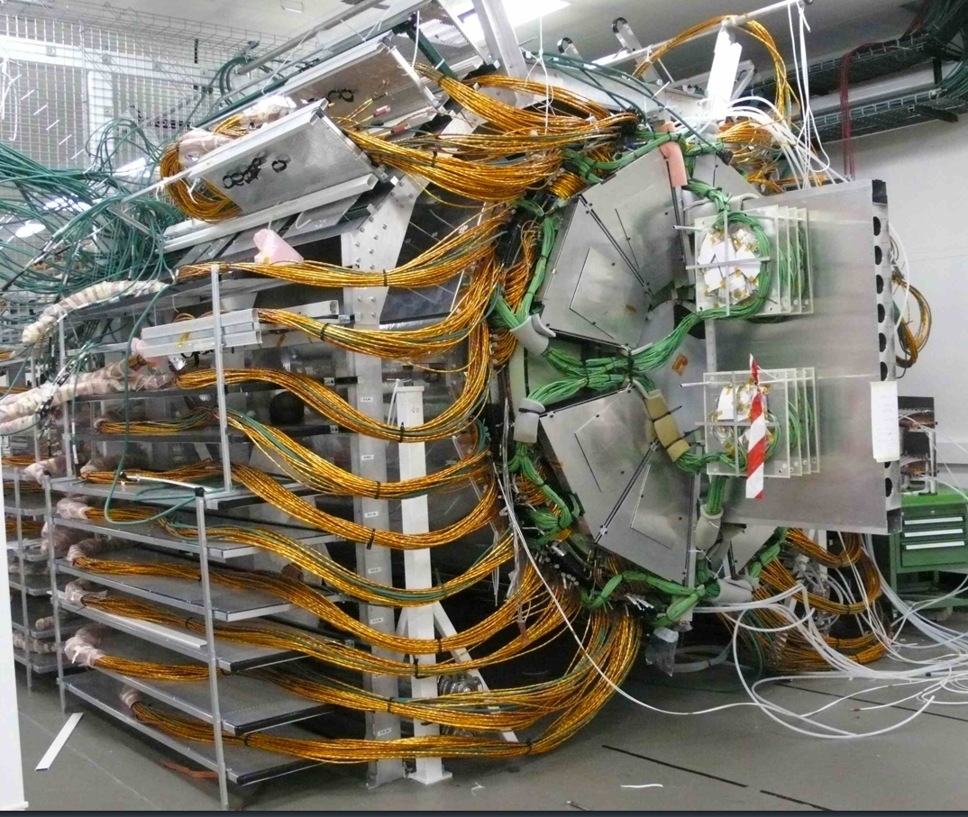
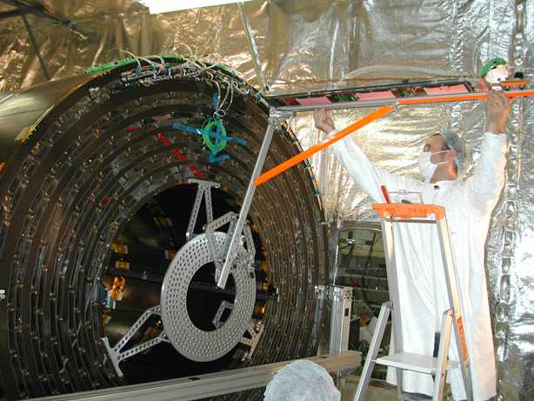
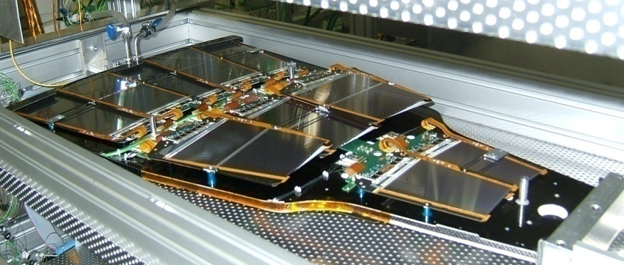
Completed Tracker
TIB
4 layers
TOB
6 layers
TEC “petal”
2300 square feet of silicon!!!!! detectors, 11 million strips

Slide 36
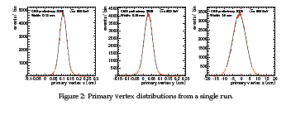
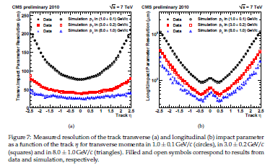
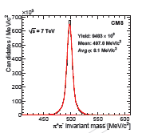
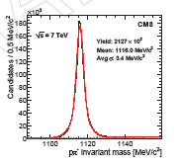
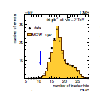
Tracking System Performance
<impact parameter> > resolution (50-100 μm)

Slide 37
Calorimetry
Particles shower in calorimeter creating other particles which shower and so on until no more energy is left
The created charged particles produce light via scintillation or Cherenkov mechanisms which can be collected and is proportional to the original particle energy
Passive heavy material
Sampling or Homogenous
Calorimeters
Resolution:
Scintillator
Active material (scintillator)
Constant term: calibration, temperature dependence, …
Sampling + Stochastic term (shower fluctuation + statistics
Noise term

Slide 38
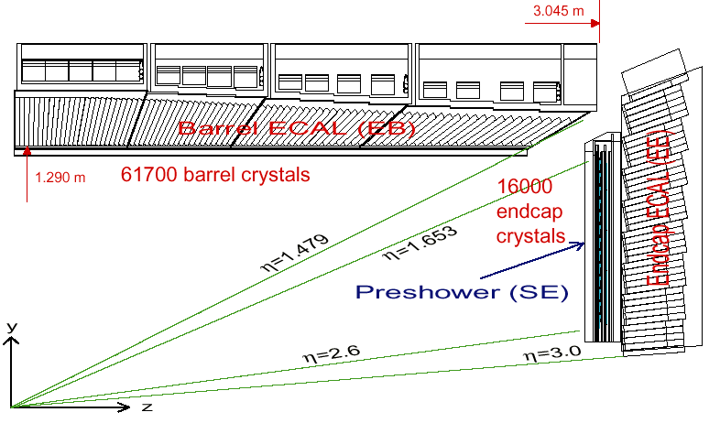
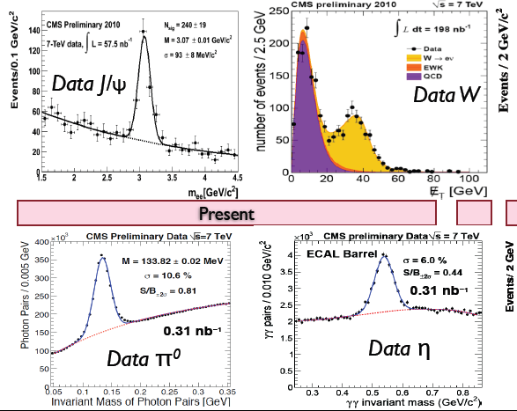
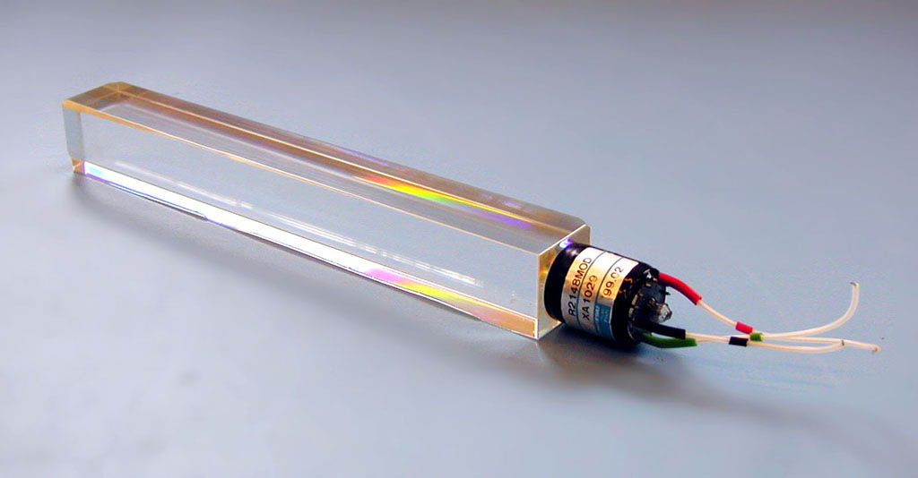
CMS ECAL
Photons and electrons shower in high Z material
Homogenous calorimeter
Lead tungstate (PbWO₄) crystals: 2.3 x 2.3 x 23 cm³
  ~76,000 crystals
Radiation hard, dense, and fast
Magnetic field and radiation require novel electronics APD and VPT
Δη x Δφ = 0.0174 x 0.0174

Slide 39
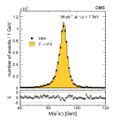
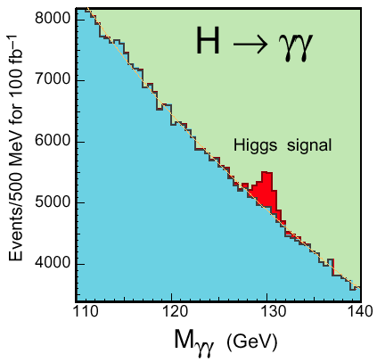
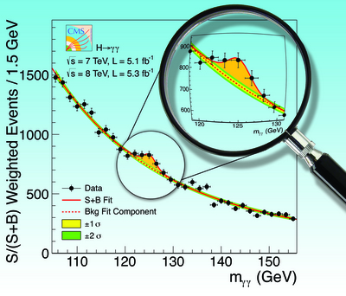
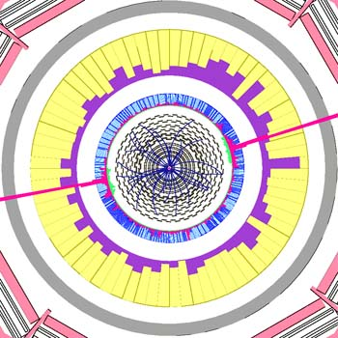
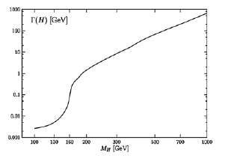
Higgs to 2 photons (H → γγ)
Excellent calorimeter provides ~1 GeV mass resolution which allows a peak to be seen
Γ_{H}<<1 GeV so resolution COUNTS
Ζ◊e⁺e⁻ very similar to H→γγ.
Simulated H→γγ with M_{H}=120 GeV as observed in the CMS detector

Slide 40
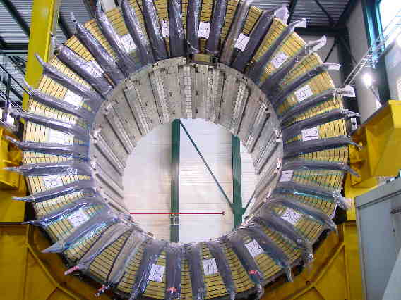
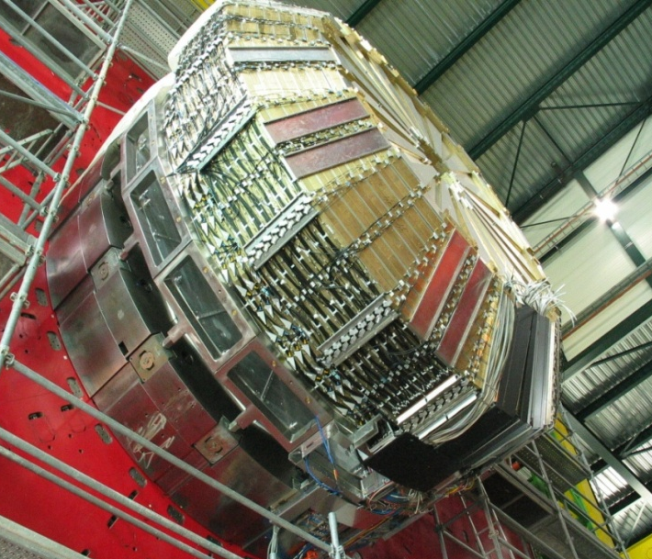
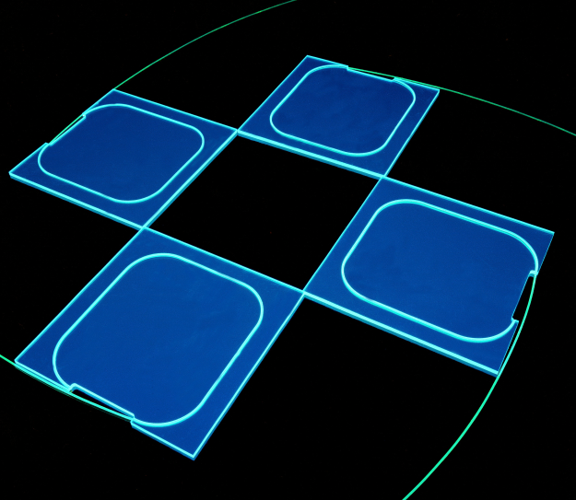
CMS HCAL
Sampling calorimeter
Brass absorber from Russian artillery shells (non-magnetic)
Scintillating tiles with wavelength shifting (WLS) fiber
WLS fiber is fed into a hybrid photo-diode (HPD) for light yield measurement
Tower size is ΔηΔφ=0.087x0.087

Slide 41
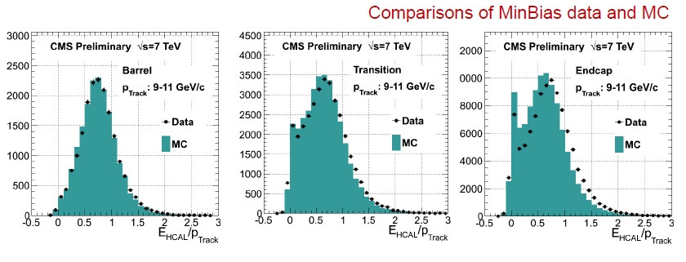
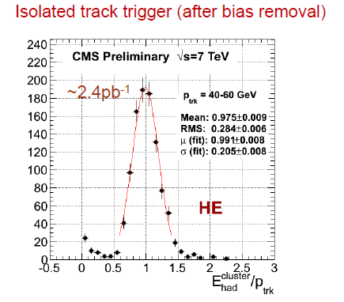
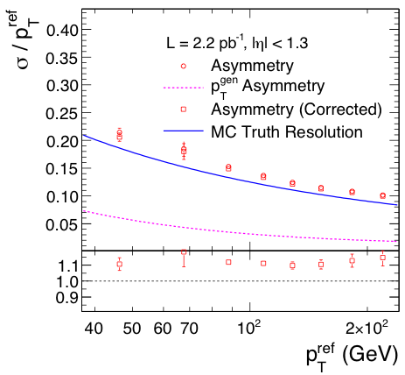
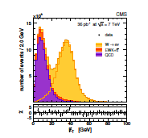
Hadron Calorimeter Performance
Data

Slide 42
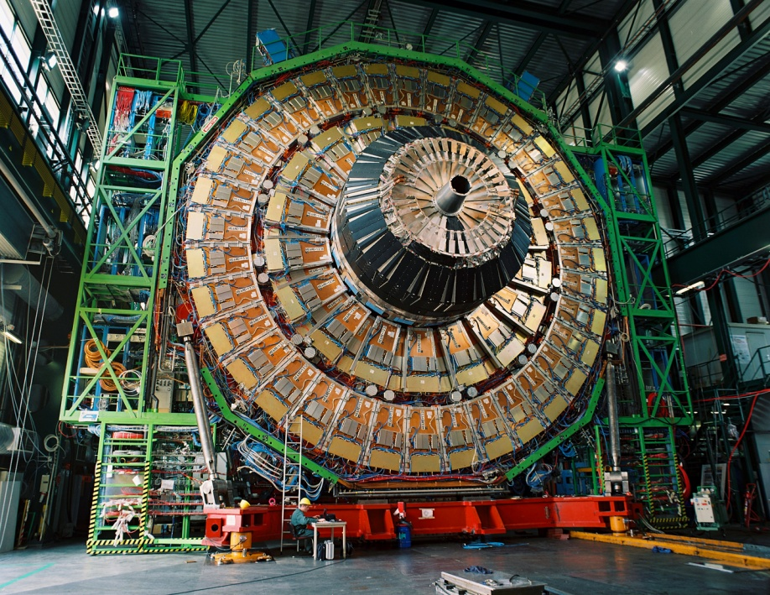
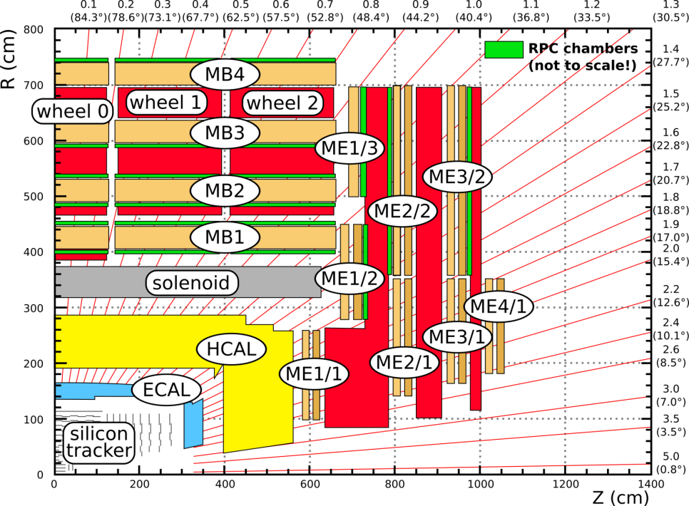
Muon systems
Muons interact less than other charged particles
  Place detectors after material and what comes through is a muon candidate
Add B field in steel and tracking to find momentum at trigger level and link with main tracker
14000 tonnes of iron absorber and solenoid flux return
Three tracking technologies: Drift Tube (Barrel), Resistive Plate Chamber (Barrel, Endcap), and Cathode Strip Chamber (Endcap)
  Each pseudorapidity interval is covered by two of these subsystems

Slide 43
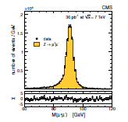
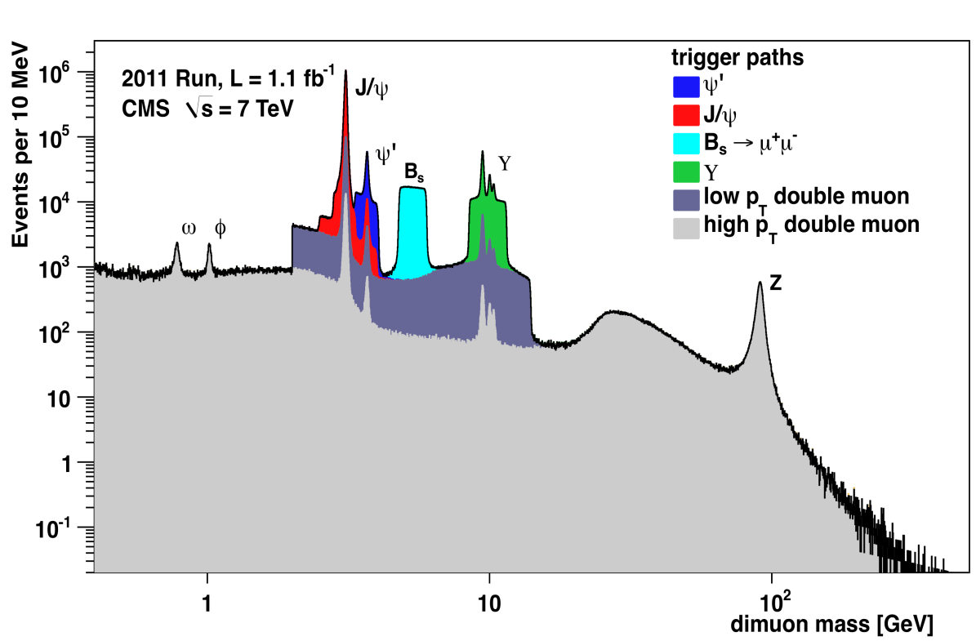
Muon System Performance
Tracker Muon (TM): silicon track with at least one matched muon segment
Standalone muon (STA): fits to hits and segments in muon system alone
Global Muon (GLB): combined fit to tracker and muon hits
Tight muons: global plus tracker plus additional requirements
Sculpting of
background
due to trigger

Slide 44
Triggering and data acquisition
The problem
40 MHz of beam crossings, with a average of ~20 interactions/crossing means that there are nearly 1 billion events/ second
Beam crossings generate ~1 MB of data or 40 Terabytes/s
Restricted to ~200 Hz of events = 200 MB/s = 20 TB/day = 2 Petabyte per year
Need to reject 99.9998% of events in quasi real time
The solution
Hardware trigger finds jets, electrons, muons, and missing E_{T} and rejects 99.8% of events in 3.2 μs
Surviving 100 KCrossings/s of events fed into ~1000 CPU farm where events are reconstructed and 0.3-0.5% kept

Slide 45

CMS Trigger and DAQ

Slide 46
Goal of the CMS Upgrade
The fundamental goal of the upgrade is to preserve the ability to reconstruct all the Standard Model objects and Missing E_{t} at higher luminosity than the original design, but which it now seems the LHC will reach
The long shutdowns of which three are planned are the best time to make major changes to CMS
  CMS can, however, do certain activities in so-called “technical stops” of a few months that typically occur each winter (or slightly extended versions of them)
The goal is to return from each long shutdown with the upgrades needed to cope with the most challenging running conditions foreseen for the next long operating period (and hopefully subsequent ones)

Slide 47

The Future: Luminosity Predictions
Conditions
~ 2E34 by LS2, higher after LS2
~ 200fb⁻¹ by LS2, ~ 500fb⁻¹ by LS3
25ns is the plan, but … easier and more reliable at 50ns?
Integrated luminosity is the goal
For the Upgrades
“Baseline” PU~50, study ~100
Lumi-leveling will come into play at some point

Slide 48

Luminosity Scenarios for LHC

Slide 49
CMS Improvements and Upgrades Timeline
Shutdown | System | Action | Result | Physics
LS 1 | Muon (ME42,ME11) uTCA trigger | CSC (Complex YB4 installation) New electronics | Improved μ trigger and reconstruction (1.1<|η|<1.8, 2.1<|η|<2.4) | W acceptance WH, H± →τν
LS 1 | Hadron Outer | Replace HPDs with SiPMs to reduce noise | Single μ trigger Tails of very high p_{T} jets | Muons from τ Z/H→ττ→μX
LS 1 | Hadron Forward | Install new PMT to reduce window hits | Forward jet tagging Improves MET | Vector-boson fusion H
LS 1 | Muon YB4 | New RP CSC (not funded) | Improved trigger at lower thresholds | Increase W acceptance
LS 1 | PLT | New diamond lumi- monitor | Improved lumi meas. | All
LS 1 | Beam Pipe | Install new beam pipe | Easier pixel installation | b-tagging
LS 2 | New Pixel system | Low mass 4 Layers, 3 Disks with new ROC | Reduces dead time Improves b-tag. | SUSY decay chains
LS 2 | HCAL Barrel and Endcap uTCA trigger | Replace HPDs with SiPMs for longitudinal segmentation New electronics | Reduces pileup effects Improves MET Improves τ, e, γ clustering and isolation | SUSY H→ττ H→ZZ→llττ
LS 3 | TRACKER New Trigger Endcap Calo. | Replace tracker Replace trigger ? | Maintain performance at high SLHC Lumi | Highest masses

Slide 50
Detector Issues for Phase 1
Maintain the CMS detector physics performance expected for L=10³⁴ cm⁻² s⁻¹ at higher luminosity and pileup
  By the end of Phase 1 already 40 (80) interactions/crossing at L=2×10³⁴ cm⁻² s⁻¹ and 25 (50) ns bunch crossing
In Phase 1 the main concern is the increase in L_{Instantaneous}
  Trigger performance degradation
    Upgrades to the muon system and the hadron calorimeters aim to preserve the Level 1 trigger capability by providing it with more and higher quality inputs.
  Decreases capability to discriminate electrons from jets
    Implement longitudinal segmentation in hadronic calorimeter
  Dead time
    Severe data losses in the inner pixel layer
    Radiation damage will lead to efficiency and poor position resolution in the inner pixel layer
.

Slide 51

Phase 2
In phase 2 radiation damage and increase in L_{instantaneous} lead to serious issues

Slide 52



Pixel and HCAL Upgrades
Pixels Features of the New Design
Robust design: 4 barrel layers and 3 endcap disks at each end
Smaller inner radius (new beampipe), large outer
New readout chip with expanded buffers,
embedded digitization and high speed data link
Reduced mass with 2-phase CO₂ cooling, electronics moved to high eta, DC-DC converters
Ready to install by end of 2016
New tracking, vertexing
HF
2-channel readout per PMT, and TDC –identify spurious signals and recover hits
Install end of 2015
HB/HE
SiPMs: Improved S/N and depth segmentation –
calibration, bkg & PU suppression, EM isolation (anal and trigger)

Slide 53
Significance of the Upgrades
Without upgrades CMS would suffer performance problems
  The pixel detector would become inefficient at tracking, track seeding, primary vertex reconstruction, secondary vertex reconstruction and b-tagging!!!!
    The pixel detector’s key role in track seeding for the High Level Trigger would be seriously compromised
  The calorimeter would suffer from radiation damage and isolation would be compromised. The lack of timing would result in poor ability to assign energy contributions to the correct beam crossing. Lack of timing would also make it difficult to veto accidental coincidences between beam background or cosmics and collision data that can mimic rare physics events
  The trigger would lack the ability to use isolation, which would especially affect the τ triggers, and would need to have thresholds so high that physics would be irretrievably lost. The efficiency of the muon trigger would be low and the P_{T} threshold will be so high that physics will be lost.

Slide 54
Summary
LHC is the first machine capable of exploring the whole range of phenomena up to ~1-3 TeV
CMS is superbly designed to find how nature behaves at the Terascale
  what is responsible for electroweak symmetry breaking (Higgs or other?) which is the final piece of the Standard Model
  find something (SUSY, other?) around 1 TeV to take care of some of the problems with the SM (and which might also be the elusive dark matter)
  Opening a new energy frontier can also bring lots of surprises,
    Maybe we can even learn something about gravity
In the next two years we might see some of the answers in the current data
After we return from LS1, we will have a much higher energy, ~14 TeV, and another “discovery run”
To continue to study what we have found and to go to higher mass reach by accumulating more data, we need to upgrade CMS
These tasks are left to you as an exercise !!

Slide 55
I wish you a wonderful experience at CMSDASia!
Thank you for your attention

Slide 56
Backups

Slide 57


LHC at CERN
A machine that collides two beams of 7 TeV protons,
producing1 billion interactions per second
Geneva
Airport

Slide 58

Alps
Jura Mountains
Pays de GEX
Swiss-French Border
Experiments: CMS, ALICE, LHCb in France; ATLAS in Switzerland

Slide 59

Collisions at Four Points for Experiments

Slide 60
LHC Facts – I
Tunnel (originally built for “Large Electron-Positron” Collider –LEP)
  Circumference: 26.659km
  Tilt: 1.4º (122m)
Number of magnets
  Main dipoles: 1232
    Magnetic field: 8.33 Tesla (@7 TeV)
    Two beam tubes and coils with opposite fields to guide two counter-circulating proton the beams
  Main quadrupoles: 858
  Correction magnets: 6208
  Total magnets: ~9300
Operating temperature: 1.9ºK
  Helium is superfluid
RF cavities: 8/beam at 5.5MV/m @ 400..8 MHz
Revolution frequency: 11.2455 KHz
Power consumption: ~120MW

Slide 61
LHC Facts – I I
Injection
  From SPS (Super Proton Synchrotron)
  450 GeV/c
Energy in each proton beam (peak) 7 TeV
  Stored energy in each beam is 350 MJ (Tevatron ~2MJ)
  Current in each beam: 0.5 A
Expected luminosity
  10³⁴/cm²-s (achieved after a few years of running)
Beams are bunched; bunch spacing is 25 ns
  Protons/bunch at peak luminosity: 1x10¹¹.
  Spot size: ~10-30 μm
  β*= ~30cm
At design luminosity 20 minimum bias events per beam crossing
  One billion collisions/second
  Thousands of particles produced per beam crossing – a major detector challenge to sort out 20 interactions

Slide 62
Energy frontier colliders
SUSY
High enough energy to produce the particles of interest

Slide 63
How Do SUSY Particles Decay?
Production: Gluons collide to make Gluinos
Decay: Cascade to quarks, leptons, LSP
Production: q anti-q collide to make Gaugino pair
Decay: Cascade to leptons plus neutrino plus LSP
Many more examples! In fact, so many that if SUSY is discovered, sorting it all out will be quite difficult.

Slide 64

Speculated SUSY Mass Spectrum
Why SUSY? Indications:
GUT Mass scale, unification
Improved Weak mixing angle prediction
p decay rate
Neutrino mass (seesaw)
Mass hierarchy – Planck/EW
Dark matter candidate
String connections
Mass [GeV]
A whole new spectrum waiting at a few hundred GeV?
Lightest Supersymmetric Particle (LSP), if stable, is a galactic Dark Matter candidate.

Slide 65

How are Higgs Bosons produced at LHC?
If the coupling to the Higgs field is what gives particles mass, then heavier particles have stronger couplings to the Higgs.
The heaviest particle we know, the top quark, then provides a virtual path to making the Higgs:
Two gluons collide, make a virtual top-antitop pair, which then annihilates into a Higgs.
Top
Loop
H

Slide 66


CMS Installation
The enclosure was finished very late - only became available in Oct 2007
Large pieces, weighing as much as 2000 Tons, were assembled above ground and lowered down a shaft to the hall 100m below ground using a massive crane
End Cap Muon, Plus side
Upstream wheel-Jan 9, 2007

Slide 67

A Half-cylinder of the Forward Pixels

Slide 68


CMS Silicon Strip Detectors
2300 square feet of silicon detectors, 11 million strips
TEC
TIB
TOB
TID

Slide 69

Tight Muon Requirement

Slide 70


Slide 71
Production Kinematics - 2
The Y_{B} that we effectively use is the one that takes the particle from the frame where P_{L}=0 to the lab
“Transverse Mass”
Since y’= y + Y_{B}, span of a object Δ y = y₁-y₂ is independent of CM motion of the 2 colliding partons →central to definition of a “jet”
For relativistic particles, β~1, the momentum drops out, only depends on angle. Called pseudorapidity, η.
5º
Relation to parton momentum fractions:
Detector should focus on measuring P_{t} , η (polar angle), azimuthal angle, φ

Slide 72
Physics Issues
CMS was designed to reconstruct all the “elementary particles”, also known as “physics objects”, of the SM
  All of these were needed and are used for the SM Higgs search
    If there is a light Higgs they will be used to learn as much as possible about decay modes and branching fractions
  Since new heavy objects decay into lighter objects, these will be needed to look for Physics Beyond the SM (BSM)
    We “need” BSM physics whether there is a light Higgs or not
The CMS trigger is designed to accept the best few hundred events/second without raising the thresholds on objects (PT, jet energy, MET) so high that discovery physics and new phenomena studies are compromised.
The goal of the CMS Phase 1 Upgrade is to preserve
Our physics reach at >2times design luminosity and
Possibly 4x the pileup for which CMS was designed

Slide 73

SM Higgs Decay Modes
Decay modes depend on(unknown) Higgs mass
M_{H} range (GeV)
Decay mode
M_{H}< 130 | bb, γγ, τ ⁺τ⁻, cc
130<M_{H}<150 | H→ZZ*
150<M_{H}<180 | H→WW
180<M_{H}<600 | H→ZZ
Excluded by LEP
The Higgs search all by itself guides us to excel at measuring all SM objects and shaped the original design of CMS

Slide 74

The challenge of 2011 data taking

Slide 75

Triggering on di-muons at 10³²-10³³ with CMS
Dimuon mass distribution obtained from overlapping several trigger paths.

Slide 76

EWK bosons and di-bosons

Slide 77
Pileup Correction to Jet Properties
Try to figure out the average energy density ρ in
  η x φ for an event (event-by-event) and subtract that
  amount from the area of the jet
  refine by excluding energy associated with the hard scatter
Try to use the fact that you know the P_{T} of all the charged tracks NOT associated with the vertex that has the hard scatter and can see if they point toward the jet

Slide 78


