Slide 1
Storage Federations - ATLAS
Doug Benjamin
Duke University

Slide 2
Cast of Characters
This work is based on the efforts of many folks across ATLAS, Xrootd Collaboration and even a few CMS colleagues.
  Hiro Ito, Ofer Rind (BNL); Gerry Ganis (CERN);
  Rob Gardner, Ilja Vukotic, Nate Yehle, Charles Waldman (Chicago)
  Dave Lesny (Illinois); Sarah Williams (Indiana)
  Tom Rockwell (Mich. State) ; Shawn McKee (Mich)
  Andy Hanushevsky, Wei Yang (SLAC)
  Patrick McGuigan (UTA); Saul Youssef (BU)
  Matevz Tadel (UCSD/CMS); Brian Bockelman (Neb/CMS)
  Doug Benjamin (Duke)

Slide 3
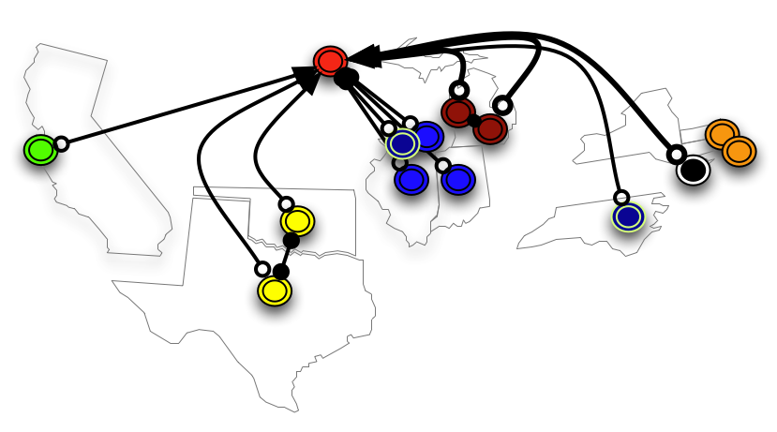
Xrootd Federation R&D project
As part of the ADC R&D projects, ATLAS has been using Xrootd to test federated storage.
Current Federation –
BNL Tier 1
AGLT2 (Tier 2)
MWT2 (Tier 2)
SWT2 (Tier 2)
SLAC (Tier 2)
ANL (Tier 3)
BNL (Tier 3)
Chicago (Tier 3)
Duke(Tier 3)
OU (Tier 3)
SLAC (Tier 3)
UTA (Tier 3)
soon:
NET (Tier 2)
Recent workshop at Univ of Chicago (April 10-11)

Slide 4
Use Case # 1 (missing files)
Retrieve missing file after the Job starts
  PD2P used to move files around
  PANDA sends jobs to sites w/ data
  Occasional glitches result in missing files
  Avoids rebrokerage
  LSM trigger error and notification of missing file
  Panda Pilot would give the job the file from federated storage
  Consistent behavior between “copy to scratch sites” and direct read sites

Slide 5
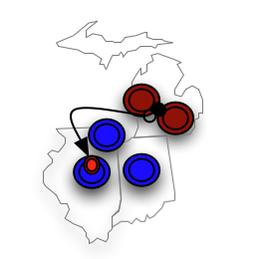
Use Case #2 Sharing storage amongst nearby Tier 2 sites
In US - The 5 sites in ANALY_AGLT2 & ANALY_MWT2 are all within 7 ms RTT
Midwest Tier 2 (MWT2) internal federation amongst 3 sub sites
AGLT2 has storage federated between two sites
~ 4.4 PetaBytes of storage amongst sites
Direct Read mode
Most efficient for jobs that read part of data file (like Analysis jobs)

Slide 6
Use Case #3 – sharing amongst sites (T1/T2/T3) close in network time
In US implies 4 locations
  Northeastern US ( BNL (Tier 1) , Boston U and Harvard U (NET 2), Tier 3 sites: SUNY Albany, SUNY Stoney Brook, NYU, Yale, Penn(?), Tufts, Brandies, Columbia)
  Midwest US ( Chicago, Univ. Illinois, Indiana (MWT2), Michigan, Michigan State (AGLT2), Tier 3 sites: ANL, Indiana, Pitt (?), Iowa and Iowa State)
  Southwest US ( UTA, OU (SWT2), Tier 3 sites: Langsten, UTD, SMU, U New Mexico )
  Western US ( SLAC (Tier 2), Tier 3 sites: UC Irvine, UC Berkely, UC Santa Cruz, CU Fresno, U Oregon, U Washington )
Cloud version – sharing storage with Public or Private Clouds
  Use clouds for data processing/analysis but not storage
  Amazon currently does not charge for inbound traffic only outbound

Slide 7
Use Case #4 File Caching at local Analysis Cluster
In this case a Tier 3 (or similar site) would fetch the files that they needed at the time of use
Files would come from the federated storage
Storage at site could become more cache like, less need for storage management
Frees up scientists to worry about the analysis and not the data handling tools

Slide 8
Speculative Use Cases
Series of redirectors for physics groups:
  Analyzers federate the storage (or part of it) from their local analysis cluster with others working on the same analysis
  Transparent to share ntuples and other data files
  Aids in the collaboration during the analysis and paper writing phases
  Once paper is published the local storage can be detached and no longer federated.
Poor person’s Drop Box. -
  Write Panda output to Panda site within Federation and fetch the data from even CERN!!!

Slide 9
Why Xrootd for storage federation?
It works now. There is little needed for code development
  Excellent access to Xrootd team if development is needed (many ATLAS members are part of Xrootd collaboration)
Mature product used for many years
Common technology with other LHC experiments (CMS and Alice)
Very efficient at file discovery
Works seeamlessly with the root data formats that we use
ROOT team collaborating with Xroot collaboration on efficient wide area data access

Slide 10
Xrootd federation status
In US cloud, Tier 1 site and 80% (4 out of 5) Tier 2 sites part of Federation, Soon all Tier 2 sites will be part
Using X509 authentication for reading
  Plugin code looks for ATLAS VOMS extension to allow access
  Deployed at MWT2, AGLT2,SWT2 and SLAC T2 currently – the rest (BNL, and NET2) shortly (less than 2 weeks)
Prototype Midwest region redirector setup at Chicago
  What is a regional redirector (next slide)
  Prun jobs used to test regional redirector

Slide 11
Configured Regional Redirectors
all.role meta manager
all.manager meta xyzzy:1234
all.role manager
all.manager leftregion:1234
all.manager meta xyzzy:1234
xrootd.redirect xyzzy:1234 ? /
Global Redirector
all.role manager
all.manager rightregion:1234
all.manager meta xyzzy:1234
xrootd.redirect xyzzy:1234 ? /
Regional Redirector
Regional Redirector
Local Redirector
Proxy Server
Proxy Manager
Local Redirector
Site A
Site B
Site C
Site D
Server
Proxy Server
Server
all.role manager
all.manager lefthand:1234
all.manager meta leftregion:1234
xrootd.redirect leftregion:1234 ? /
all.role server
all.manager leftregion:1234
ofs.osslib psslib.so
pss.origin mycluster:1094
all.role proxy manager
all.manager meta leftregion:1234
xrootd.redirect xyzzy:1234 ? /
all.role manager
all.manager righthand:1234
all.manager meta rightregion:1234
xrootd.redirect rightregion:1234 ? /
Andrew Hanushevsky (SLAC)

Slide 12
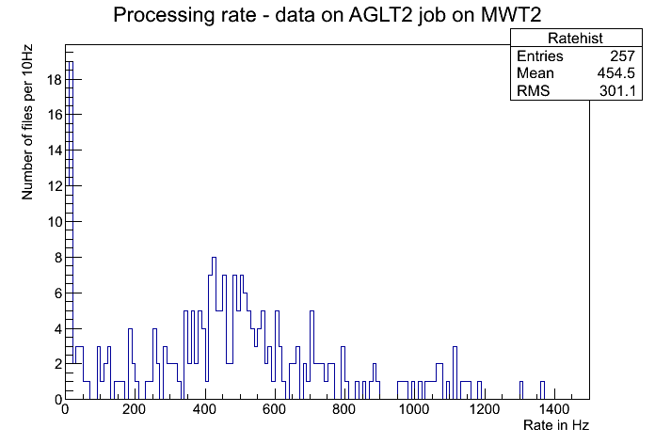
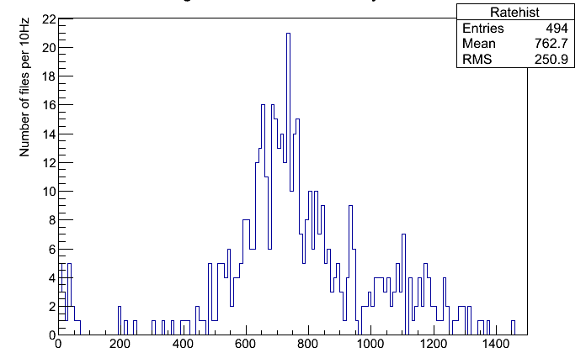
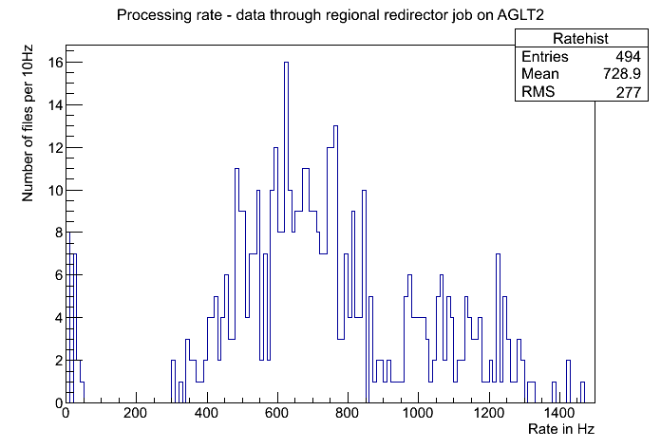
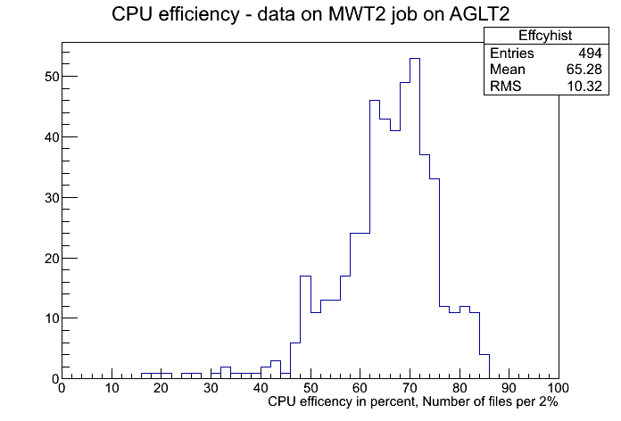
Recent results from Prun jobs
Data on MWT2 job AGLT2

Slide 13
Monitoring status
Simple RSV probe to check basic functionality
  http://uct3-xrdp.uchicago.edu:8080/rsv/
Site level summary ganglia monitoring
  Developed at Dubna
  https://svnweb.cern.ch/trac/t3mon/wiki/xRootdAndGanglia
Summary monitoring
  Developed in collaboration with CMS (Matevz Tadel)
  http://atl-prod05.slac.stanford.edu:4242/
  Aggregated monitoring
  http://atl-prod07.slac.stanford.edu:8080/display
Testing/Monitoring framework
  Ilija Vukotic (based on work from Wahid Bhimji and Ilija Vukotic) (see later slides)

Slide 14
Changes required from Panda
Need to integrate federated storage with job management system to combine the power of both
Panda changes should be incremental and part of a staged deployment
must augment existing functionality
Change to Pilot to handle missing files at run time
Evolve Panda to understand federated storage and federated site queues
  Panda understands things globally (ALL of ATLAS), at the Cloud (Ca, Fr , De, etc), at the site level (ANALY_BNL)
  Needs to understand a level between Cloud and site; The grouping of sites would have to be done outside of Panda but presented to Panda
Prun – create Federated storage file lists from dataset

Slide 15
WAN Data access
monitoring and improving

Slide 16
System to monitor status and performance of federated access to data
HC based
  HC submits jobs to the US ANALY queues
  Each job runs the same set of tests directed at all the “server” sites (redirectors)
  Each test can contain
    Ping
    Copy file using xrdcp
    Root reading scripts
      Different access patterns (10%, 100% of events, TTC ON/OFF, part of branches)
    Realistic analysis
Continuous
  Each ANALY queue does hundreds of jobs per day
  All the collected info stored in the DB
Stress tests
  Default behavior: one job always in the queue at each ANALY queue
  Arbitrary number of jobs at each queue
  Can choose between single file tests and random file test (to avoid caching effects)
Web based frontend

Slide 17
Results shown
Same dataset, same file. 750MB SMWZ ntuple.
Each site runs 5 simultaneous tasks.
Reading 100% of events with default 30MB TTreeCache

Slide 18
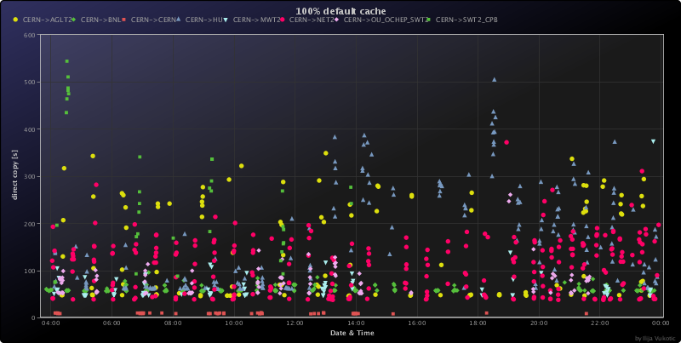
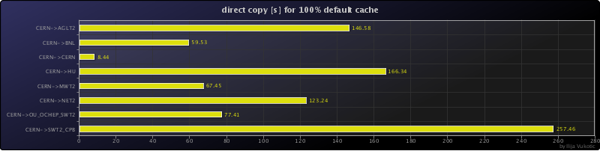
XRDCP from CERN

Slide 19
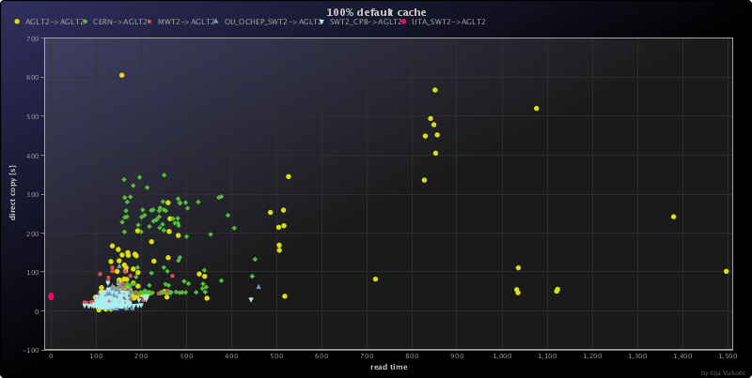
AGLT2 xrdcp vs read times
Site | Xrdcp [s] | Read[s]
AGLT2 | 119 | 318
CERN | 146 | 245
MWT2 | 34 | 134
OU_OCHEP_SWT2 | 37 | 140
SWT2_CPB | 20 | 130
UTA_SWT2 | 35 | -

Slide 20
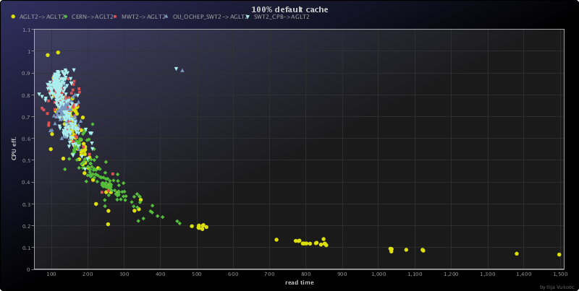
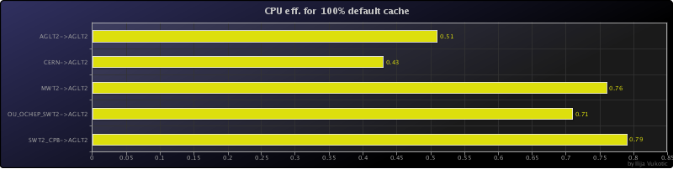
Efficiency – not bad at all – when it works ☺

Slide 21
message
Visit http://ivukotic.web.cern.ch/ivukotic/WAN/index.asp
Site admins
  If you want your site included in tests on either serving or client side, let me know
  Try to understand the plots related to your site.
  Is your site serving to all the ANALY_ queues?
  Are xrdcp throughputs the ones you expected?
  Are direct access times significantly different from xrdcp times?
  What kind of CPU efficiency it gives to requesting sites?
  Dependences on link free bandwidth, site load, WN load, …
Physicists
  Soon we will produce “frun”, a simple prun wrapper that uses the federation as a primary way to access data.
  It will be completely transparent to user and hopefully faster.
  We’ll want you to try it out and give a feedback.

Slide 22
Outstanding Issues
Additional work on the Caching use case
  Determine when a site can provide its files to the federation (quality of service issue)
  Further testing of xrdcp in extreme copy mode
  Testing at scale (cache 10K files with out problems)
Further testing with Real users, running their code

Slide 23
Conclusions
Xrootd federation R&D Phase coming to an end
Poised to bring it to production
Small bit of additional Panda development needed
When coupled with Panda, poised to be transformative for analysis jobs.
Caching could really simplify data management at the smaller sites.

Slide 24
Talking points for discusion
Changes to Panda
  Useful changes? Time Scale?
Enhanced pairing between available CPU cycles and required data
Increased collaboration through ad-hoc federated storage clusters

Slide 25
Backup Slides

Slide 26
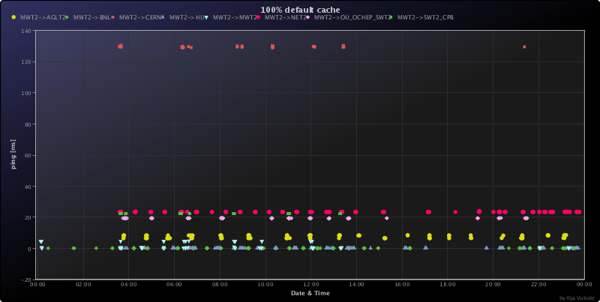
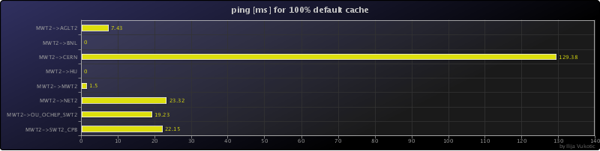
Ping

Slide 27
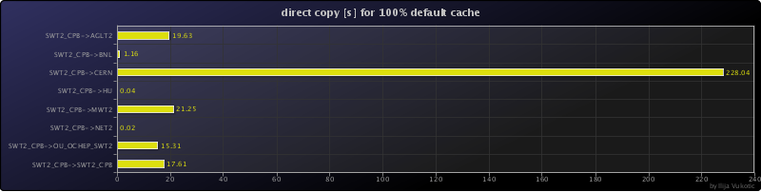
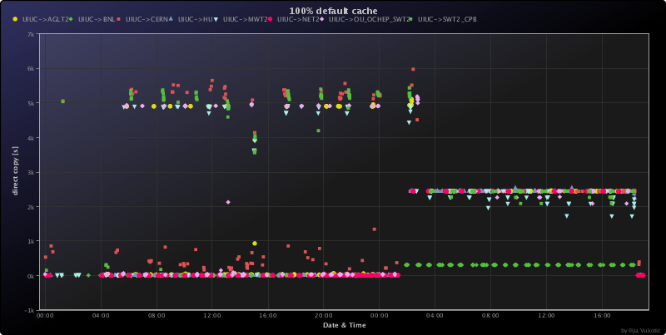
XRDCP – not everything is perfect
from SWT2_CPB
from UIUC

Slide 28
SMALL Issues
All the federation is quite young and a lot of things will have to be ironed out. I assume it can be done in a few weeks.
UIUC not serving at all
MWT2, AGLT2 serving only to itself and to each other. These two have workaround applied “on site”
NET2 no direct access from any site

