Slide 1

LHC Open Network Environment an update
Artur Barczyk
California Institute of Technology
Atlas TIM, Annecy, April 20th, 2012

Slide 2
LHCONE in a Nutshell
In a nutshell, LHCONE was born (out the 2010 transatlantic workshop at CERN) to address two main issues:
  To ensure that the services to the science community maintain their quality and reliability
  To protect existing R&E infrastructures against the potential “threats” of very large data flows that look like ‘denial of service’ attacks
LHCONE is expected to
  Provide some guarantees of performance
    Large data flows across managed bandwidth that would provide better determinism than shared IP networks
    Segregation from competing traffic flows
    Manage capacity as # sites x Max flow/site x # Flows increases
  Provide ways for better utilisation of resources
    Use all available resources, especially transatlantic
    Provide Traffic Engineering and flow management capability
  Leverage investments being made in advanced networking

Slide 3
Some Background
So far, T1-T2, T2-T2, and T3 data movements have been using General Purpose R&E Network infrastructure
  Shared resources (with other science fields)
  Mostly best effort service
Increased reliance on network performance → need more than best effort
    Separate large LHC data flows from routed R&E GPN
Collaboration on global scale, diverse environment, many parties
  Solution has to be Open, Neutral and Diverse
  Agility and Expandability
    Scalable in bandwidth, extent and scope
Organic activity, growing over time according to needs
LHCONE Services being constructed:
  Multipoint, virtual network (logical traffic separation and TE possibility)
  Static/dynamic point-to-point Layer 2 circuits (guaranteed bandwidth, high-throughput data movement)
  Monitoring/diagnostic
http://lhcone.net

Slide 4
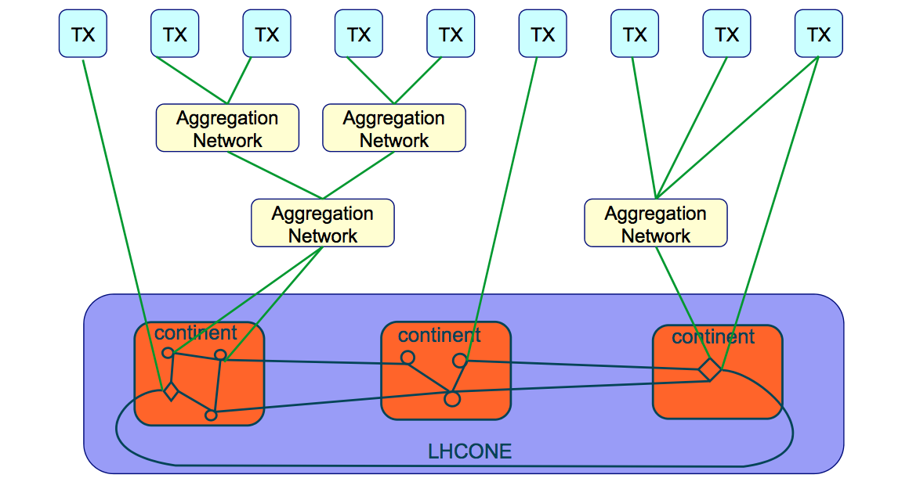
LHCONE Initial Architecture, The 30’000 ft view
LHCOPN Meeting, Lyon, February 2011

Slide 5
2011 Activity
During 2011, LHCONE consisted of two implementations, each successful in its own scope:
  Transatlantic Layer 2 domain
    Aka vlan 3000, implemented by USLHCNet, SURFnet, Netherlight, Starlight; CERN, Caltech, UMICH, MIT, PIC, UNAM
  European VPLS domain
    Mostly vlan 2000, implemented in RENATER, DFN, GARR, interconnected through GEANT backbone (DANTE)
In addition, Internet2 deployed a VPLS based pilot in the US
Problem: Connecting the VPLS domains at Layer 2 with other components of the LHCONE
The new multipoint architecture therefore foresees inter-domain connections at Layer 3

Slide 6
New Timescales
In the meantime, pressure lowered by increase in backbone capacities and increased GPN transatlantic capacity
  True in particular in US and Europe, but this should not lead us to forget that LHCONE is a global framework
The WLCG has encouraged us to look a at longer-term perspective rather than rush in implementation
The large experiment data flows will continue and alternatives to managing such flows are needed
LHC (short-term) time scale:
  2012: LHC run will continue until November
  2013-2014: LHC shutdown, restart late 2014
  2015: LHC data taking at full nominal energy (14 TeV)

Slide 7
LHCONE activities
With all the above in mind, the Amsterdam Architecture workshop (Dec. 2011) has defined 5 activities:
  VRF-based multipoint service: a “quick-fix” to provide the multipoint LHCONE connectivity as needed in places
  Layer 2 multipath: evaluate use of emerging standards like TRILL (IETF) or Shortest Path Bridging (SPB, IEEE 802.1aq) in WAN environment
  Openflow: There was wide agreement at the workshop that Software Defined Networking is the probable candidate technology for the LHCONE in the long-term, however needs more investigations
  Point-to-point dynamic circuits pilot: build on capabilities present or demonstrated in several R&E networks to create a service pilot in LHCONE
  Diagnostic Infrastructure: each site to have the ability to perform
  end-to-end performance tests with all other LHCONE sites

Slide 8
Multipoint service
The VRF Implementation

Slide 9
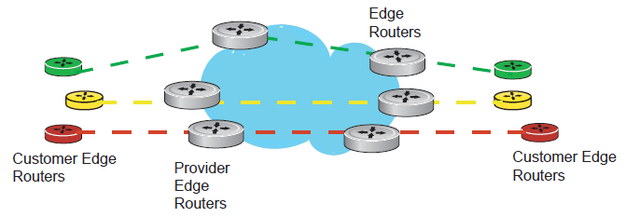
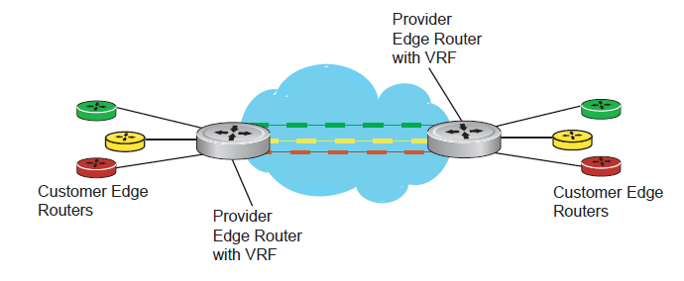
VRF: Virtual Routing and Forwarding
VRF: in basic form, implementation of multiple logical router instances inside a physical device
Logical separation of network control plane between multiple clients
VRF approach in LHCONE: regional networks implement VRF domains to logically separate LHCONE from other flows
BGP peerings used inter-domain and to the end-sites
Some potential for Traffic Engineering
  although scalability is a concern
BGP communities defined allowing sites to define path preferences

Slide 10
Multipoint Service:
VRF Implementation
WIX
MANLAN
NETHERLIGHT
CERNLIGHT
STARLIGHT

Slide 11
Multipoint, with regionals

Slide 12
Exchange Point Example: MANLAN

Slide 13
Connecting Sites to the VRF

Slide 14















LHCONE: A global infrastructure for the LHC Tier1 data center – Tier 2 analysis center connectivity
SimFraU
NDGF-T1a
DRAFT
UVic
UAlb
NDGF-T1a
NDGF-T1c
UTor
NIKHEF-T1
NORDUnet
Nordic
TRIUMF-T1
CANARIE
Canada
McGilU
SARA
Netherlands
Korea
CERN-T1
KISTI
Korea
Bill Johnston ESNet
CERN
Geneva
Amsterdam
TIFR
India
Geneva
Chicago
DESY
GSI
DFN
Germany
DE-KIT-T1
KNU
SLAC
ESnet
USA
KERONET2
Korea
FNAL-T1
BNL-T1
New York
India
Seattle
GÉANT
Europe
ASGC-T1
UCSD
Caltech
NE
Washington
ASGC
Taiwan
UWisc
UFlorida
SoW
CC-IN2P3-T1
PurU
UNeb
MidW
Sub-IN2P3
MIT
GLakes
GRIF-IN2P3
RENATER
France
CEA
Internet2
USA
Harvard
NCU
NTU
TWAREN
Taiwan
INFN-Nap
CNAF-T1
PIC-T1
RedIRIS
Spain
GARR
Italy
UNAM
LHCONE VPN domain
End sites – LHC Tier 2 or Tier 3 unless indicated as Tier 1
Regional R&E communication nexus
Data communication links, 10, 20, and 30 Gb/s
See http://lhcone.net for details.
CUDI
Mexico
NTU
Chicago

Slide 15
Software Defined Networking

Slide 16
Software Defined Networking
SDN Paradigm - Network control by applications; provide an API to externally define network functionality
. . .
App
App
App
App
API
“Network Operating System”
SNMP, CLI, …
OpenFlow
Packet Forwarding
Hardware
Packet Forwarding
Hardware
Packet Forwarding
Hardware
Packet Forwarding
Hardware

Slide 17
OpenFlow
Standardized SDN protocol
  Open Networking Foundation
  (https://www.opennetworking.org/)
Let external controller access/modify flow tables
Allows separation of control plane and data forwarding
Simple protocol, large application space
  Forwarding, access control, filtering,
  topology segmentation, load balancing, …
Distributed or centralized
Reactive or pro-active
App
App
Controller (PC)
OpenFlow
Protocol
OpenFlow Switch
Flow Tables
MAC
src
MAC
dst
…
ACTION
Controller (PC)
Controller (PC)
Controller (PC)
Controller (PC)
OpenFlow
Switch
OpenFlow
Switch
OpenFlow
Switch
OpenFlow
Switch
OpenFlow
Switch
OpenFlow
Switch

Slide 18
Dynamic Point-to-point service pilot

Slide 19
Dynamic Bandwidth Allocation
Will be one of the services to be provided in LHCONE
Allows to allocate network capacity on as-needed basis
  Instantaneous (“Bandwidth on Demand”), or
  Scheduled allocation
Significant effort in R&E Networking community
  Standardisation through OGF (OGF-NSI, OGF-NML)
Dynamic Circuit Service is present in several advanced R&E networks
  SURFnet (DRAC)
  ESnet (OSCARS)
  Internet2 (ION)
  US LHCNet (OSCARS)
Planned (or in experimental deployment)
  E.g. JGN (Japan), GEANT (AutoBahn), RNP (OSCARS/DCN), …
DYNES: NSF funded project to extend hybrid & dynamic network capabilities to campus & regional networks
  In deployment phase; fully operational in 2012

Slide 20
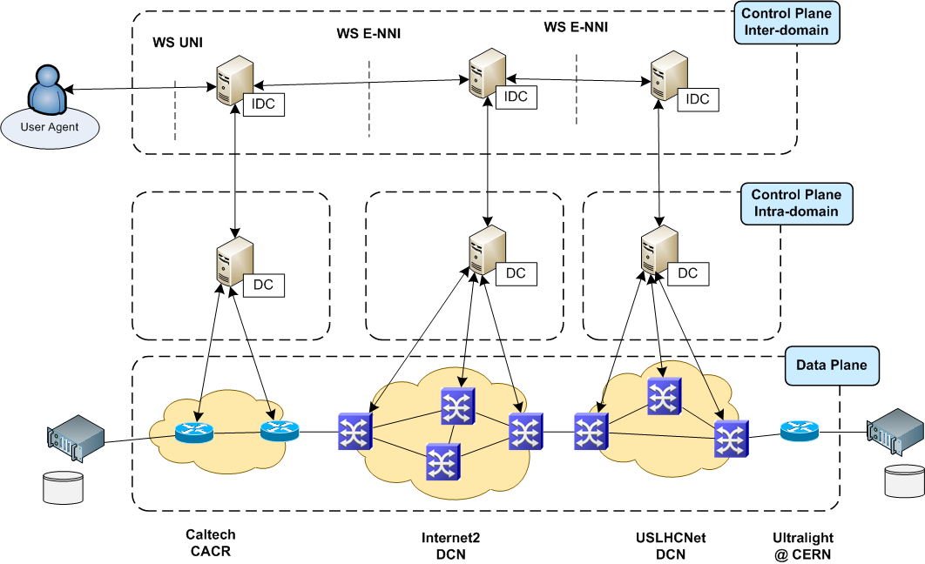
Dynamic Circuits: On-demand Point-to-Point Layer-2 Paths
Bandwidth requested by “User” Agent (application or GUI):
Scheduled
On-demand
2009 Example: CERN-Caltech using the OSCARS reservation system developed by ESNet

Slide 21
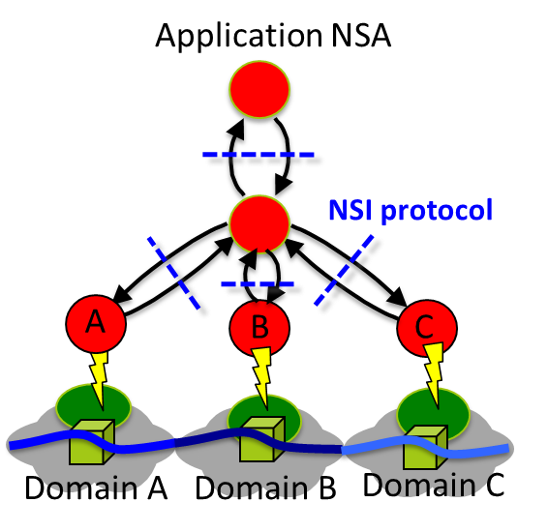
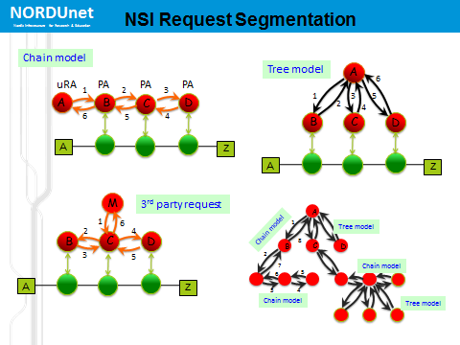
OGF NSI Framework
Aiming at definition of a Connection Service in a technology agnostic way
Network Service Agent (NSA)
High-level protocol
Jerry Sobieski, NORDUnet

Slide 22
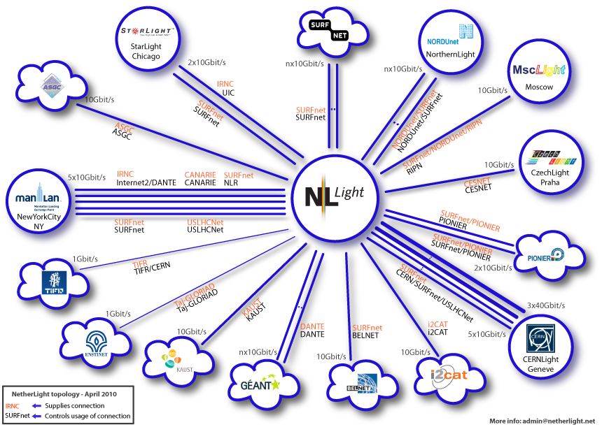
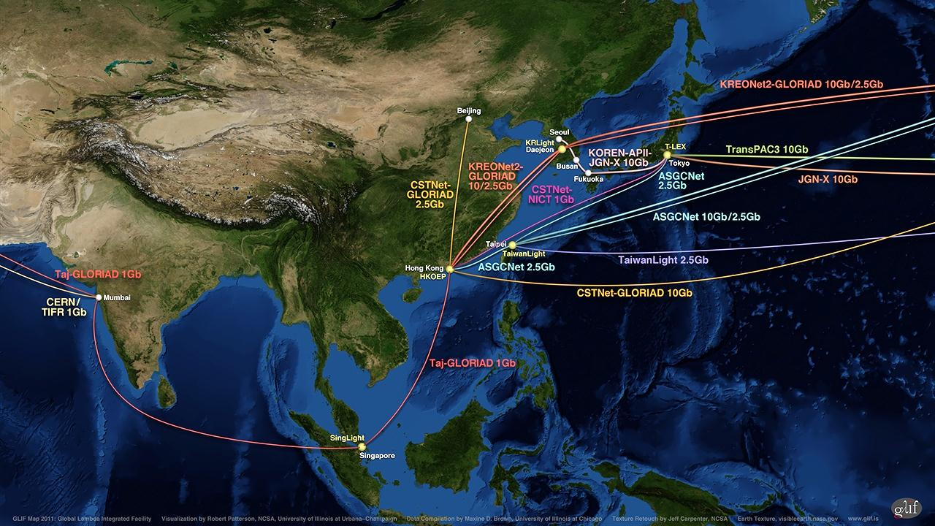
GLIF Open Lightpath Exchanges
GOLE Example: Netherlight in Amsterdam
Exchange Points operated by the Research and Education Network community
http://glif.is
Automated GOLE project: fabric of GOLEs for development, testing and demonstration of dynamic network services.
http://glif.is

Slide 23
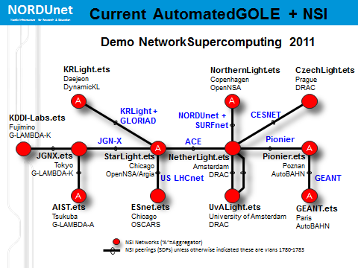
NSI + AutoGOLE demonstration
Software Implementations
OpenNSA – NORDUnet (DK/SE/)
OpenDRAC – SURFnet (NL)
G-LAMBDA-A - AIST (JP)
G-LAMBDA-K – KDDI Labs (JP)
AutoBAHN – GEANT (EU)
DynamicKL – KISTI (KR)
OSCARS* – ESnet (US)
Jerry Sobieski, NORDUnet

Slide 24
The Case for Dynamic Provisioning in LHC Data Processing
Data models do not require full-mesh @ full-rate connectivity @ all times
On-demand data movement will augment and partially replace static pre-placement → Network utilisation will be more dynamic and less predictable
Performance expectations will not decrease
  More dependence on the network, for the whole data processing system to work well!
Need to move large data sets fast between computing sites
  On-demand: caching
  Scheduled: pre-placement
  Transfer latency important for workflow efficiency
As data volumes grow, and experiments rely increasingly on the network performance - what will be needed in the future is
  More efficient use of network resources
  Systems approach including end-site resources and software stacks
Note: Solutions for the LHC community need global reach

Slide 25
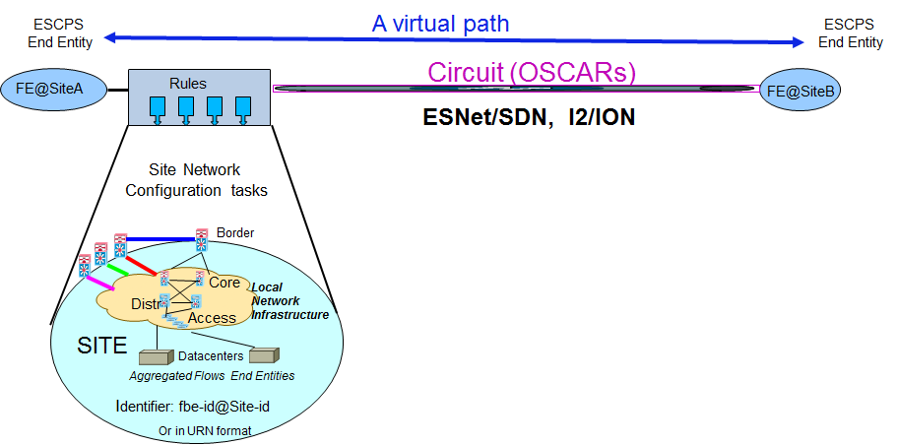
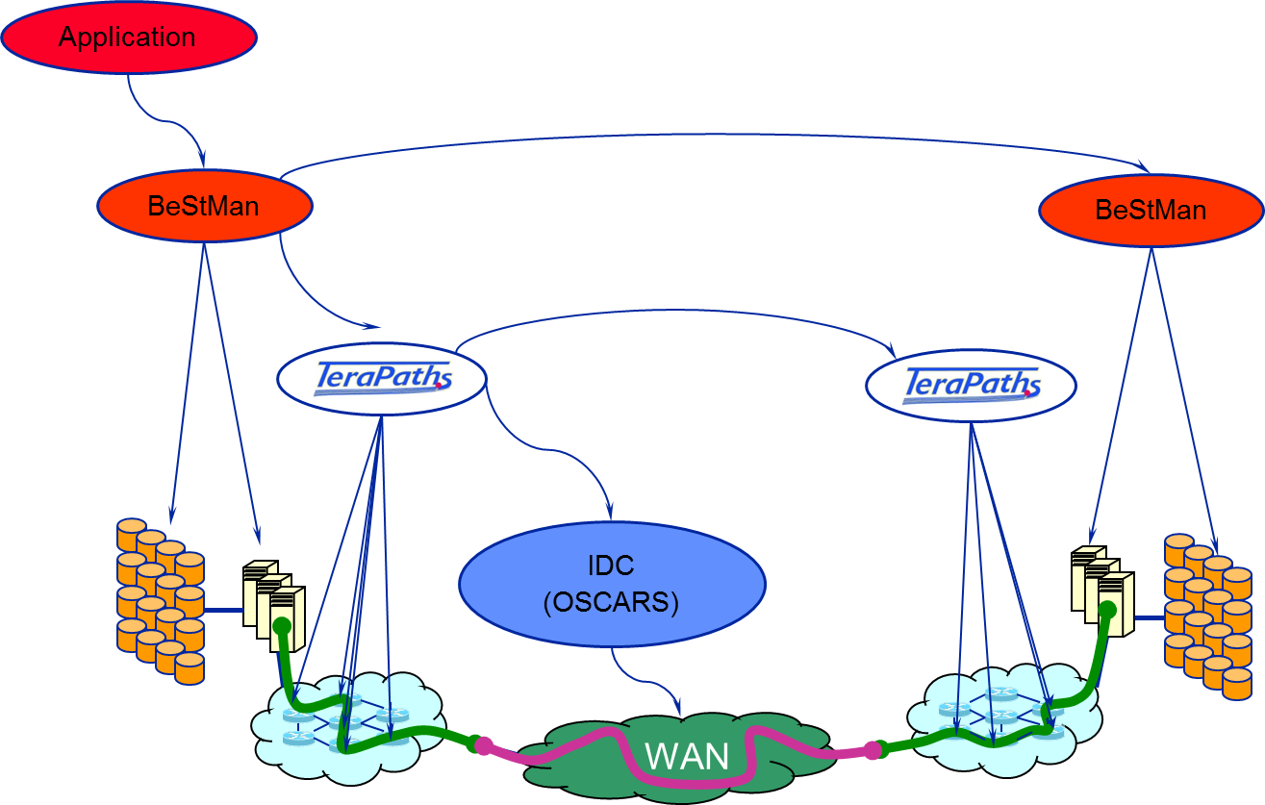
Dynamic Circuits Related R&D Projects in HEP: StorNet, ESCPS
Building on previous developments in and experience from the TeraPaths and LambdaStation projects
StorNet: Integration of TeraPaths and BeStMan
StorNet – BNL, LBNL, UMICH
  Integrated Dynamic Storage and
  Network Resource Provisioning
  and Management for Automated
  Data Transfers
ESCPS – FNAL, BNL, Delaware
  End Site Control Plane System

Slide 26
MULTIPATH
The Layer 2 challenge

Slide 27
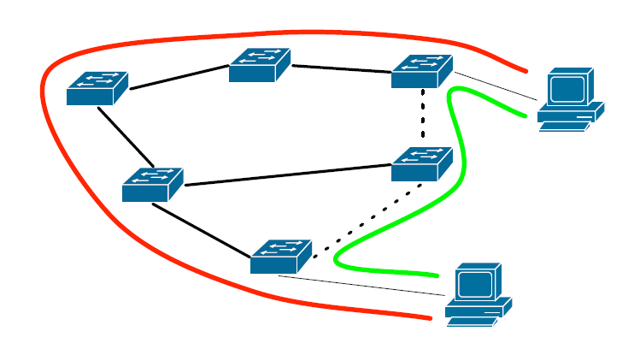
The Multipath Challenge
High throughput favours operation at lower network layers
We can do multipath at Layer 3 (ECMP, MEDs, …)
We can do multipath at Layer 1 (SONET/VCAT)
  But only point-to-point!
We cannot (currently) do multipath at Layer 2
  Loop prevention mandates tree topology – inefficient and inflexible

Slide 28
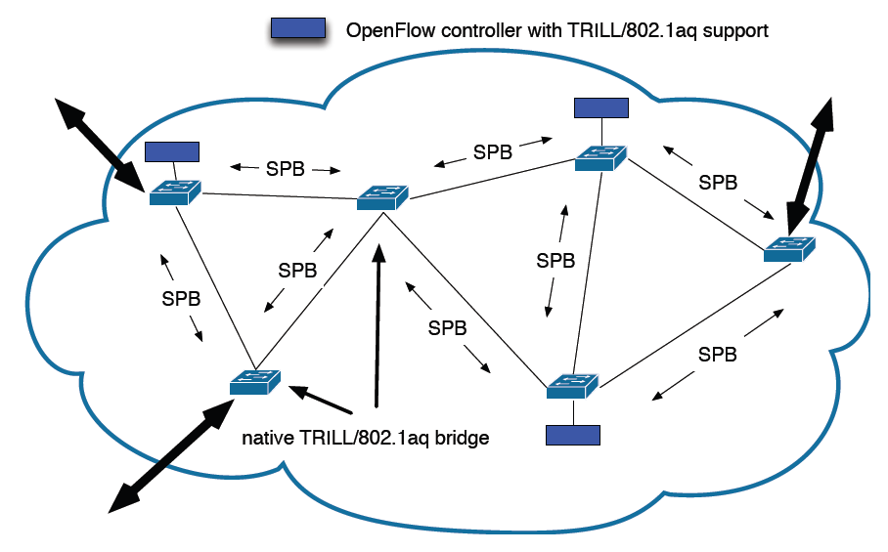
Multipath in LHCONE
For LHCONE, in practical terms:
  How to use the many transatlantic paths at Layer 2?
  USLHCNet, ACE, GEANT, SURFnet, NORDUnet, …
Some approaches to Layer 2 multipath:
  IETF: TRILL (TRansparent Interconnect of Lots of Links)
  IEEE: 802.1aq (Shortest Path Bridging)
None of those designed for WAN!
  Some R&D needed – e.g. potential use case for OpenFlow?

Slide 29
Monitoring and diagnostics
Briefly…

Slide 30
Monitoring
Monitoring and diagnostic services will be crucial for distributed global operation of the LHCONE data services
  For the network operators
  For the experiments and their operations teams
  For the end-site administrators
Two threads:
  Monitoring of LHCONE “onset”: verify and compare before and after
  Provide infrastructure for performance monitoring and troubleshooting in LHCONE operation
Both will be based on PerfSONAR-PS
  US Atlas playing an important front-role
See e.g. Shawn’s presentation at the recent WLCG GDB meeting:
  http://indico.cern.ch/getFile.py/access?contribId=6&resId=0&materialId=slides&confId=155067

Slide 31
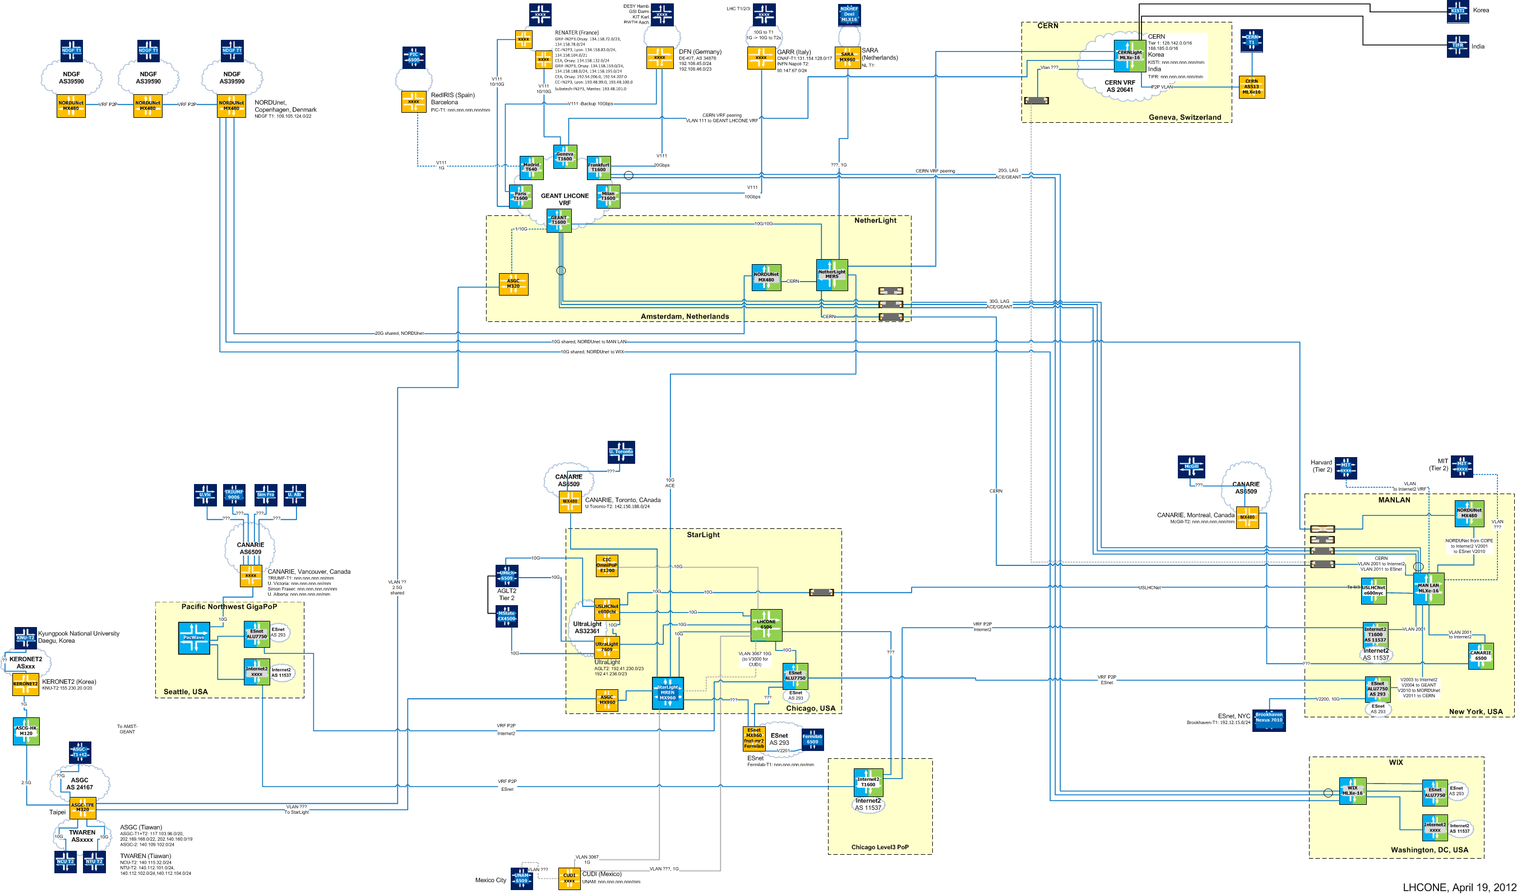
LHCONE Layer 1 connectivity
(Bill Johnston, April 2012)

Slide 32
Summary
LHCONE is currently putting in place the Multipoint and the Monitoring services
  Some sites are already using LHCONE data paths
  Be aware of the pre-production nature of the current infrastructure
  Coordination from the Experiments’ side is welcome/necessary
Point-to-point pilot is in preparation
  Building on a solid foundation, leveraging R&D investment in major networks and collaborations
  Future OGF NSI, NMC standards; current DICE IDCP de-facto standard
  Participation of sites interested in advanced network services is crucial
R&D activities defined and under way:
  Multipath (TRILL/SPB)
  OpenFlow
Converge on 2 year time scale (by end of LS1)
Next face-to-face meeting: Stockholm, May 3&4, 2012
  https://indico.cern.ch/conferenceDisplay.py?confId=179710

Slide 33
Thank You!
http://lhcone.net
Artur.Barczyk@cern.ch

