Slide 1
Wrap up and Future plans
Doug Benjamin
(Duke University)

Slide 2
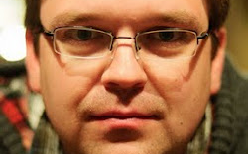
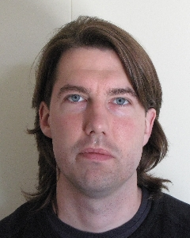


Outgoing Coordinators
Thanks and good Luck!!!
Dan van der Ster
Johannes Elmsheuser

Slide 3

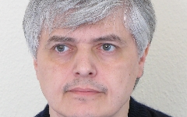
Incoming Coordinators
Andreu Pacheco Pages
Doug Benjamin
Dan and Johannes are a tough act to follow – we will do our best

Slide 4
Things to look forward to:
Repeat the excellent survey perform last year
  Can’t help our colleagues unless we listen to them
Work to reduces the problems user have fetching back their data
  In my view – Distributed Analysis spans from the grid to the local cluster it must all work
Continue to enhance the Hammer Cloud system through additional analysis jobs
  Hammer Cloud excellent tool – improves quality of sites
Establish Efficient use of D3PD’s

Slide 5
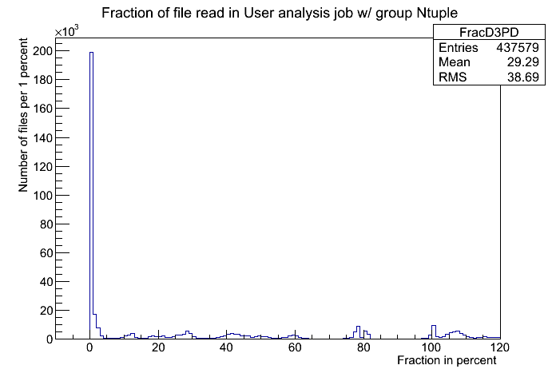
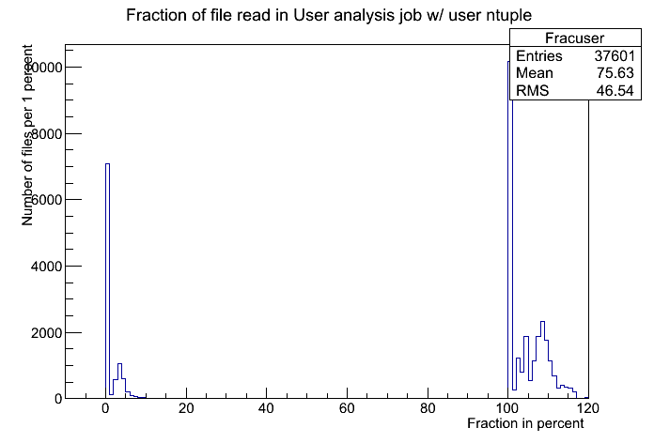
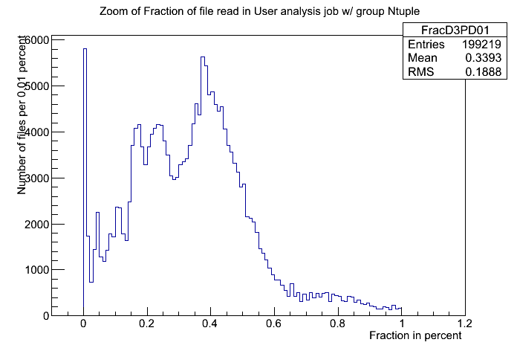
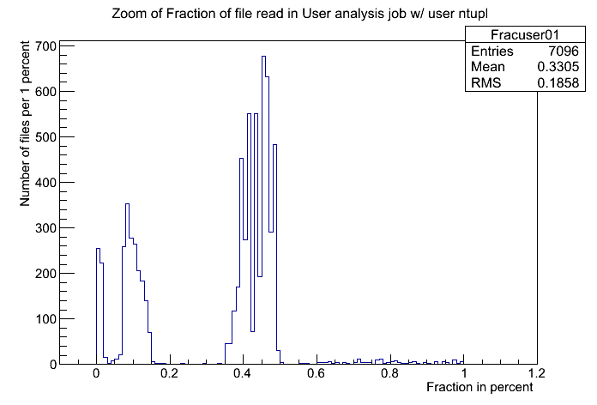
Simple analysis of 6 days of Analysis jobs at MWT2
Look at dCache billing DB, direct read Tier 2 site

Slide 6
Conclusions
Distributed analysis leadership is transitioning
You all have heard interesting talks on the status of activities within Distributed analysis
Will continue these activities
Will also work with others within ATLAS to improve D3PD analysis efficiency

