Slide 1
Common Analysis Framework for ATLAS and CMS
Feasibility study
Fernando H. Barreiro Megino
Mattia Cinquilli
Daniele Spiga
Daniel C. van der Ster
CERN IT-ES-VOS

Slide 2
What is it?
Initiative from CERN IT-ES, ATLAS and CMS for a common analysis framework started March 13 2012
Assess the potential for using common components for distributed analysis, based on elements from PanDA and glideInWMS
Initial plan
  Feasibility study - Mandate: http://cern.ch/go/9mNC
    Analyze architectures of both experiment's analysis frameworks
    Identify interfaces to external systems
    Identify what can be reused
    How much effort is it?
    Identify show-stoppers
  Functionality study
    What do ATLAS and CMS gain and loose in terms of functionality by adopting a common framework
  Operations study
    What is the impact on the cost of operating various proposals
A common analysis framework could lead the way to further commonalities and collaboration between the experiments in the future

Slide 3
Strategy for the Feasibility Study
Carried out by small working group from CERN IT-ES
Organize meetings with experts to discuss subcomponents
  Track discussions in http://cern.ch/go/8Z8Q
    Possibility for everybody to contribute and raise questions asynchronously
Report on a ~weekly basis for open discussion
Final delivery date: Document expected before CHEP 2012

Slide 4
What have we done so far?
Compare ATLAS & CMS analysis workﬂows and identify main components
Further studies with experts
  Server side
  Pilot factories
  Pilots
  GlideInWMS
Wrote summaries and had follow-up meetings

Slide 5
Overview of the the ATLAS and CMS analysis frameworks

Slide 6
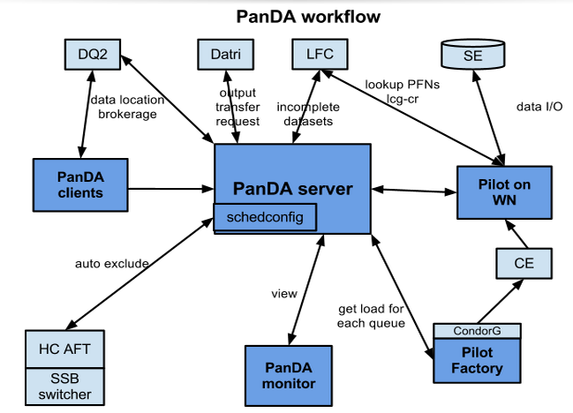
PanDA architecture

Slide 7
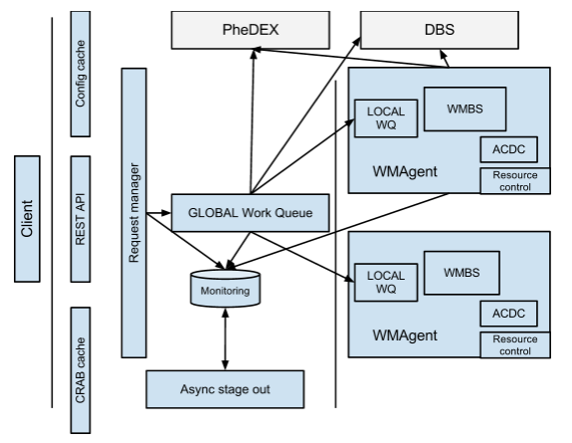
CMS analysis framework
CENTRAL
DISTRIBUTED

Slide 8
Resource management and brokerage
 | ATLAS | CMS
Site occupancy | PanDA job table (global view) | Tracked by WMAgent (local view)
Brokerage | Client discovers data locations Followed by load based site brokering based on weight function Site capacity measured dynamically PanDA picks best site at submit time PanDA tries to process whole dataset at one site | GlobalWQ asks PheDEX/DBS data locations Either WMAgent assigns based on static, local pledges Delegate to WMSes to decide the final site CMS sends a list of sites to WMS CMS will spread across sites

Slide 9
PD2P and rebrokerage
 | ATLAS | CMS
Dynamic Data Placement | ATLAS has a data distribution/pre-placement model which relies on dynamic data placement PD2P: When a jobset is submitted, PanDA can decide to trigger a replica request | -
Rebrokerage | Jobs waiting longer than x hours can be reassigned to another site | Locations for jobsets in GlobalWQ are continuously refreshed Once the job is in the LocalWQ locations are fixed

Slide 10
Priorities and fairshares
 | ATLAS | CMS
Priorities and fairshares | Users get x CPU hours per 24h Additional jobs are de-prioritized Priority boosts/beyond pledge for users and groups at particular resources @ submission: Jobs in a jobset get decreasing priorities (so that a few run right away to check for errors) Waiting jobs: Job priority increases while jobs wait to prevent starvation Retried jobs get lower priority to delay slightly Prod/analy balance set at site level | Priority is set by operators RequestManager processes requests in order of priority GlobalWQ fetches in order of priority Global and Local WQs are FIFO Prod/analy balance set at site level

Slide 11
Data handling in the server
 | ATLAS | CMS
Input | Pilot queries LFC to get PFNs Flexible input data handling configured in schedconfig Copy2scratch vs streaming I/O | Input handling completely delegated to CMSSW CMSSW uses Trivial File Catalogue
Output | DQ2 for detector, simulated and user data Copied to local SE by Pilot Registered by the client Optional additional copies via DaTRI | DBS/PheDEX primarily for detector data CRAB handles asynchronous stage out and optional DBS publication

Slide 12
Bookkeeping and redundancy
 | ATLAS | CMS
Bookkeeping | CLI for job/task bookkeeping and WWW PanDA monitor/Dashboard historical jobs CLI to kill and retry jobsets Jobset progress tracked in PandaDB (i.e. which files have been read) | Client to kill and retry request WMAgent handles retrial of jobs based on ACDC (i.e. which files are left to process)
Redundancy | PanDA@CERN is single point of failure CERN Outage: No new jobs Running jobs ~OK Completing jobs may fail | Distributed with n independent queues with enough work for one day CERN Outage: No new jobs

Slide 13
PanDA pilot, AutoPyFactory and GlideInWMS

Slide 14
PanDA Pilot and AutoPyFactory
PanDA Pilot
  Rather ATLAS specific
  A next generation pilot could put VO specifics into modules
    Environment Setup Module
    Data movers (mainly for outputs)
  glExec user switching: implemented but not used
    Not known if MyProxy can handle queries from all WNs
    US sites currently require pilot credential to write outputs
    PoC could run the CRAB wrapper in the pilot (prun job)
  AutoPyFactory (v2)
  Multi-threaded (one thread per queue)
  Modular and ATLAS agnostic. Plugin approach:
    WMSStatus Plugin: e.g. what is the state of the WMS (Panda)
    Sched Plugin: calculate how many pilots to submit
    BatchStatus and Submit plugins: submit and monitor pilots (Condor-G, Condor local…)
  Flexible proxy management (per-queue proxies)
  The interesting part will be combining APF with GlideInWMS…

Slide 15
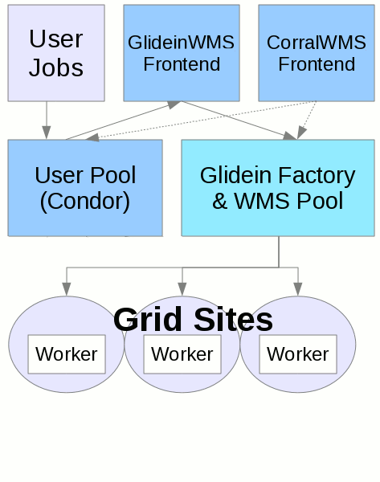
GlideInWMS Overview
Build a distributed Condor pool which looks like a local batch system
GlideInWMS automates submission of Condor GlideIns according to user jobs
Users (VOs) submit to a local Condor schedd; a frontend polls the user schedd and tells a GlideIn Factory to send GlideIns via CondorG to the grid.
  GlideIns run a condor startd on the WN which connects back to the user pool
Features:
  Credential management handled by Condor
  glExec id switching
  Condor scheduling and fairshare between users and groups
  Whole node scheduling
  SSH-to-job
  Preemption
Animation taken from
http://www.uscms.org/SoftwareComputing/Grid/WMS/glideinWMS/doc.prd/index.html

Slide 16
GlideInWMS and CMS
CMS is using GlideInWMS with CRAB 2 and testing with v3
  Each CRAB 2 server / WMAgent has a local schedd
CRAB server / WMAgent injects jobs (with full payload) to the schedd
Using simple condor matchmaking: jobs run in FIFO order
Condor itself has some scaling limits (provided by Igor, not definitive)
CMS architecture allows to replicate the CRAB server / WM agent to scale up:
  Currently ~7 agents, limit of ~20k per schedd
Component | Limiting factor | Observed limit
Schedd | Memory | 60k jobs on 64GB node
Collector | Memory | 90k jobs on 24GB node
Negotiator | CPU | 40k jobs, depending on complication of matchmaking expressions

Slide 17
GlideInWMS and PanDA
ATLAS is testing the integration of PanDA and GlideInWMS (see Rod’s presentation)
Schedd is ran on the current pilot factory machines
Submit pilots per site-user pair
  Check activated jobs in the panda queues
  Retrieve user proxy from MyProxy (+ cache it)
  The job submitted to Condor will run only one user’s jobs
    Panda server will give it the user’s job with the highest priority
VO-frontend watches the pilot factory schedd’s
  UCSD submit glideins to run the queued jobs

Slide 18
Integrating with GlideInWMS
Different Scenarios
GlideInWMS/
Condor
VO WMS
A)
Only PanDA
WMSystem or PanDA
B)
Possible PanDA approach
C)
Scale shows which service is scheduling the jobs

Slide 19
Scenario A: Rod’s approach
GlideInWMS/
Condor
PanDA
A)
AutoPyFactory (one thread per site/user) submitting to a VO Condor schedd (with user’s credential).
GlideIn factory submits appropriate glideins to the grid
Implications: Two knobs to control the job schedule
  Condor handles inter-user priority: fair share between users/groups
  PanDA handles intra-user priority: which of a user’s jobs to run next (based on priority)
  Current Panda share logic/functionality would need to be converted to Condor
  APF needs development to watch site/user queues

Slide 20
Scenario B: CMS Approach
GlideInWMS/
Condor
VO WMS
B)
This is a natural usage of GlideInWMS
Thin layer between WMS and GlideInWMS: a “job factory” submits jobs with the payload attached (e.g. crab wrapper.sh) , or alternatively with generic payload but specific job ID attached (e.g. panda pilot_wrapper.sh –pandaid 1234)
Result:
  Almost all of the job scheduling is handled by Condor (but jobs could still be submitted with priorities)
  If applied to ATLAS, job rebrokerage would become more complicated: Need “job-killer” that knows mapping between PanDA and Condor job ids

Slide 21
Scenario C
GlideInWMS/
Condor
PanDA
C)
ATLAS is still investigating AutoPyFactory as it is today with pilot+glExec to solve the security issue.
  MyProxy scalability is being investigated
    Local client/server limit ~10 Hz (~1M/day)
    Multiple clients separated from server easily >25Hz (John Hover)
AutoPyFactory and GlideInFactory have significant conceptual overlaps
Would lose out on Condor features
Not a common approach

Slide 22
Torre’s proposal:
Pool of credentials
GlideInWMS/
Condor
PanDA
Use a pool of credentials
  As large as number of users could run on a site simultaneously
  Assign a particular role to these credentials
  Implement framework to assign credentials to users
  Site never sees the real user, but there is increased traceability
  Removes dependency on MyProxy
All benefits of glideInWMS are preserved excepting prioritization/fairshare
Would enable PanDA to explore Condor fairshare mechanisms progressively
Recent proposal, not completely thought through by us
A certificate is bound to a user temporarily. Ideally you would like all pilots to accept all users’ jobs

Slide 23
Conclusions

Slide 24
Conclusions: PanDA server
Main differences between PanDA server and CMS analysis framework
  Complexity of the systems and levels of queuing
  Resource allocation
    Dynamic brokerage in PanDA, more fixed in CMS WMSystem given distributed character
PanDA server is modular
  Classes for externals (e.g. DM) can be implemented easily
Coupling between WM and DM is not extremely tight
  CMS I/O data handling could be handled
 | Architecture | Upside | Downside
PanDA | Simple central architecture | Global view and control | Potential single point of failure
CMS WMS | Distributed 2-level queuing | Higher scalability & reliability | No global view

Slide 25
Conclusions: Pilots
PanDA Pilot:
  Rather ATLAS specific, but modularization is being planned
  Proof-of-concept for CMS would be possible today
AutoPyFactory:
  Modular architecture where almost everything is pluggable
GlideInWMS:
  Attractive service where we can find common ground
  Various scenarios for plugging GlideInWMS to the VO job management systems
    Scenario A is a pragmatic approach to start working
    However we need to think more about the different possibilities

Slide 26
Future work
Next step in the Feasibility Study:
  User workflows, error troubleshooting and monitoring
If we convince ourselves about the feasibility:
  Deﬁne a detailed proposal for a proof-of-concept
  We would like to try a “Hello World” as a further check

Slide 27
Acknowledgements
We are very thankful to the experts for their time and ideas
Jose Caballero
Simone Campana
Burt Holzman
John Hover
Steve Foulkes
Claudio Grandi
Tadashi Maeno
Paul Nilsson
Maxim Potekhin
Igor Sfiligoi
Eric Vaandering
Rodney Walker
Torre Wenaus

Slide 28
Backup

Slide 29
Panda Pilot Overview
Pilots are sent to the batch systems and WNs using pilot factories
Collect local info
Signal handler
Abort and clean up
Job recovery
Additional cleanup
Collect local info
Multi-job loop could support parallel jobs for whole node scheduling
Check proxy
Check local space
Get job
Pilot
Fork sub process
Setup job
Multi-job loop
Transfer input
Check log size
Monitoring loop
(Check workDir)
runJob
Execute payload
Check local space
glExec
Looping check
Credits: Paul Nilsson
Transfer output
Clean up

