Slide 1

Analysis I/O Tuning
Wahid Bhimji
University of Edinburgh
as well as Ilija, Doug, Jack, Dan ,Johannes, Paul
and others
ADC TIM - Annecy

Slide 2
Background
All Atlas analysis uses ROOT I/O
Since 17.0.X we use ROOT 5.28 (or higher)
  When files are written we use ROOT feature to “autoflush” (AF) or ``optimize baskets'' so baskets (buffers) are resized to share out (configurable) 30MB and have approximately the same number of entries.
  When reading files user can switch on a memory buffer TTreeCache (TTC) which learns what branches are used and adds them to a cache.

Slide 3
Background
Ilija’s talk at last TIM:
Highlighted cases where AutoFlush and TTC don’t reduce HDD reads/time sufficiently
  Need for regular automatic tests on all storage systems we use to avoid “traps”.
Called for regular ROOT/experiments meetings.
  We now have a ROOT IO group well attended by ROOT developers as well as CMS and LHCb
Also called for rewritten basket optimization
  Asked ROOT IO Group to come up with one
  They are still working on it – but for our part we wanted to test any developments rapidly

Slide 4
Built Testing Framework
Hammercloud
Using hammercloud:
Takes our tests from SVN
Runs on all T2Ds
Highly instrumented
info from
root (e.g. reads; bytes);
WN (traffic; load);
panda (storage type etc.)
New dataset
SVN
Test code script
Set release
Datasets,…
Regularly
submitting
single tests
ROOT source (via curl)
Sites
Oracle Db
Uploads stats
Data mining tools
Command line, Web interface, Root scripts
Extremely fast feedback:
New feature to test in a.m.
Answers for all
storage systems p.m.
http://ivukotic.web.cern.ch/ivukotic/HC/index.asp

Slide 5
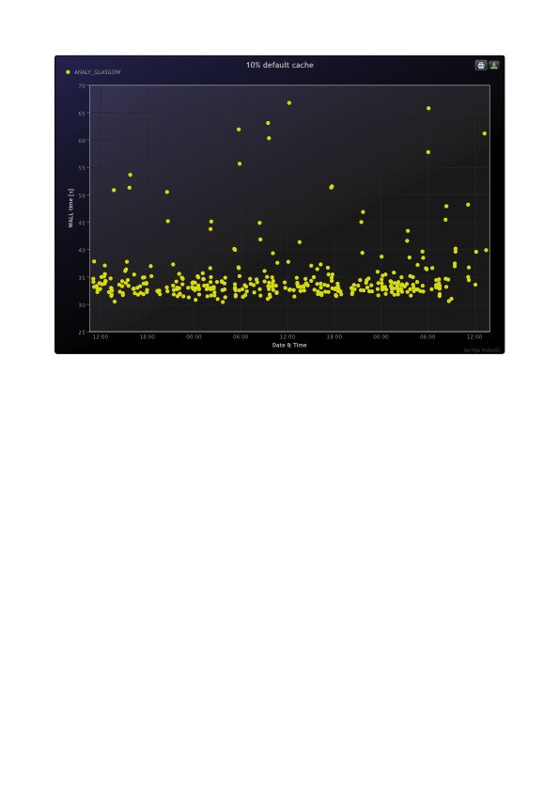
Some Results – CPU Efficiency
At S&C week – Ilija showed these average results over all sites using 17.0.4 (ROOT 5.28)
  77% Event loop CPU efficiency
Since updated to 17.1.4 then 17.2.0 (ROOT 5.30)
Since S&C week also testing ROOT 5.32
ROOT 5.28
(Athena 17.0.4)
ROOT 5.30
(Athena 17.1.4)
comparable
Realistic analysis

Slide 6
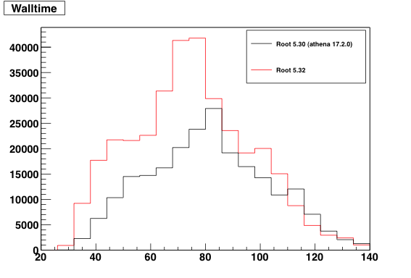
Looking forward: Root 5.32
100% read, TTC on (30MB)
Possibly some advantage
D3PD users needn’t be tied to athena releases

Slide 7
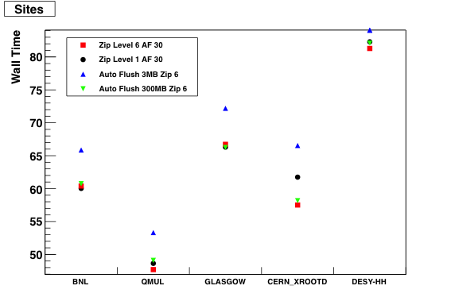
Tuning D3PDs
Write (in 17.1.4 (ROOT 5.30)) with different zip levels/ autoflush buffer size (thanks Attila for adding flags)
100% read, TTC on (30 MB)
Small benefits at some sites from zip 6 instead of current default 1.
Also stage-in time not included here for copy to WN sites (BNL; Glasgow) – zip 6 files are ~5% smaller
Also gain disk space
Should change zip
3 MB auto flush definitely
not good!

Slide 8
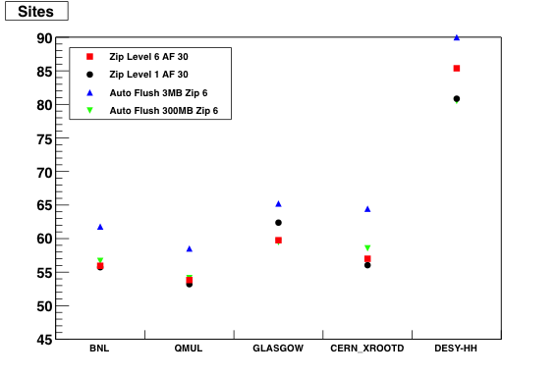
Using larger 300 MB TTreeCache
In Root 5.32: improvement even if AutoFlush size 30M
100% read, TTC on
Some winners
– seemingly those reading from local disk
At some point
would use too much memory

Slide 9
Doug asked for
Would a pROOT wrapper where panda owns the event loop be good?
Tests Ilija's been doing on federated xrootd storage.
New information on direct read performance vs copy to scratch?
Do we know how much of a file is being read.

Slide 10
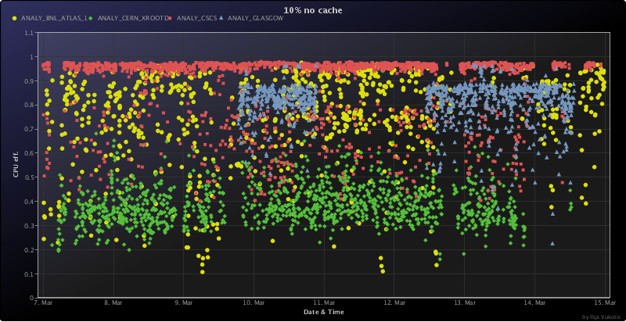
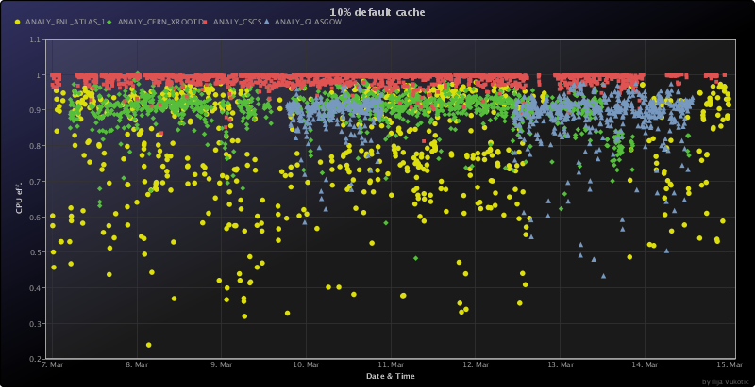
pROOT: a reason why:
TTreeCache essential (but set by user)
pROOT could also set cache size per site
No Cache
Default Cache
100%
100%
CPU Eff.
BNL: (Local): 75%-> 82% ; CERN: (xrootd/EOS): 39% ->90%
CSCS: (GPFS): 88% -> 99%

Slide 11
pROOT: a reason not
ROOT IO Group progressing towards:
  enabling TTC on by default
  Idea for Tree->GetEntry to essentially do branch->GetEntry()
This has been helped by Atlas (Peter vG) involvement.
I’m not sure users would use a proot
So maybe us putting more effort into ROOT defaults would be better.

Slide 12
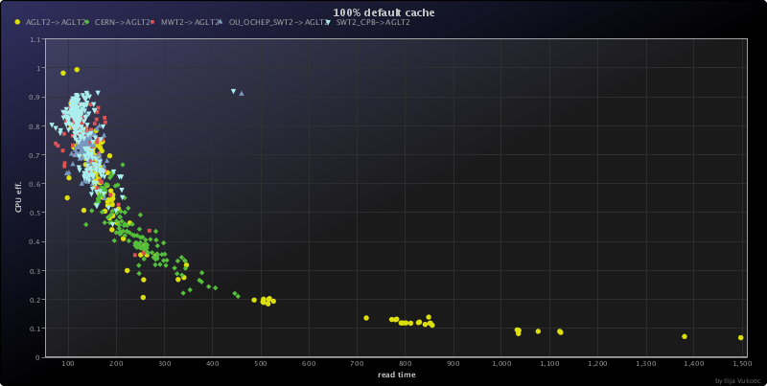
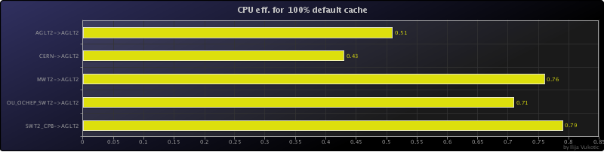
ROOT tuning for WAN
See Doug’s talk
Running same tests as described here
CPU eff ~50% for reading from CERN to US
Or ~80% from one US site to another

Slide 13
WAN tuning - asynch prefetching
Uses threads and two TTreeCache buffers to separate IO requests from CPU
Independent of access protocol (xrootd, httpd, etc)
Implemented in v5.30
Could be switched on in rootrc (and therefore by pilot)
ROOT developers see improvement in LAN or WAN; CMS see improvement in WAN not LAN
We activated in (LAN) tests not seeing any affect yet. Need to understand a bit more.

Slide 14
How much of a file is being read.
I doubt users on D3PD skip events
  But they do use limited branches
Added a test to read a limited set of branches
  Based on those read in for our H->bb analysis
  SMWZ
  D3PD
We should and can (for some clients) check the amount really read remotely - can also compare to server records.
Could also instrument all ROOT jobs to collect bytes read / reads etc. (for real jobs)
  Suggestion made to ROOT IO group.
ROOT BYTES READ* | 100% | 138 branches | FRACTION
c6-AF300-Root530 | 499.6M | 9.19M | 1.8%
c1-Root530 | 533.5M | 10.60M | 2.0%
c6-Root530 | 508.3M | 9.89M | 1.9%
c6-AF3-Root530 | 602.1M | 15.84M | 2.6%
17.0.x file | 795.2M | 16.95M | 2.1%
5860
branches
6066
branches

Slide 15
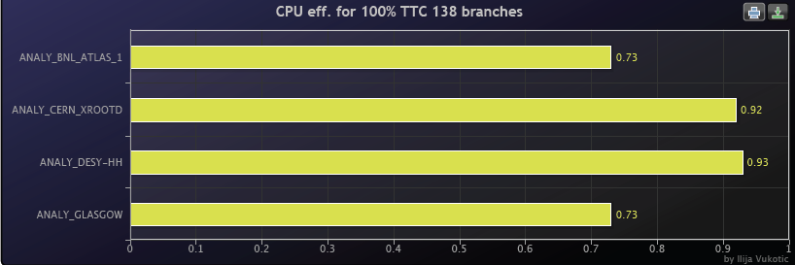
Direct read: a reason why
For reading limited branches
TTC seems more effective on sites with good vector read (dCap++; xrootd) than when reading from local disk;
And this doesn’t include stage-in times

Slide 16
Direct reads: a reason why
100%
138 branches
Root reads
Root reads
There are many other reasons for/against
Storage TEG suggested “for”
DPM http; nfs4.1; improved xroot clients– need testing
Why do some dCache sites cp and not use dCap++ (Reco?)
Will test direct Vs copy for all sites that offer both (should / can stress test too)

Slide 17
Conclusions
We now have a framework for tuning analysis IO for ATLAS storage systems
Some suggested tuning for D3PDs (zip size)
Need to analyze the data a lot more
Need to push optimize baskets changes or do it ourselves.
Possible benefits from:
  controlling user analysis (proot or ROOT defaults)
  direct read – should test clients on other sites

Slide 18
Backup

Slide 19
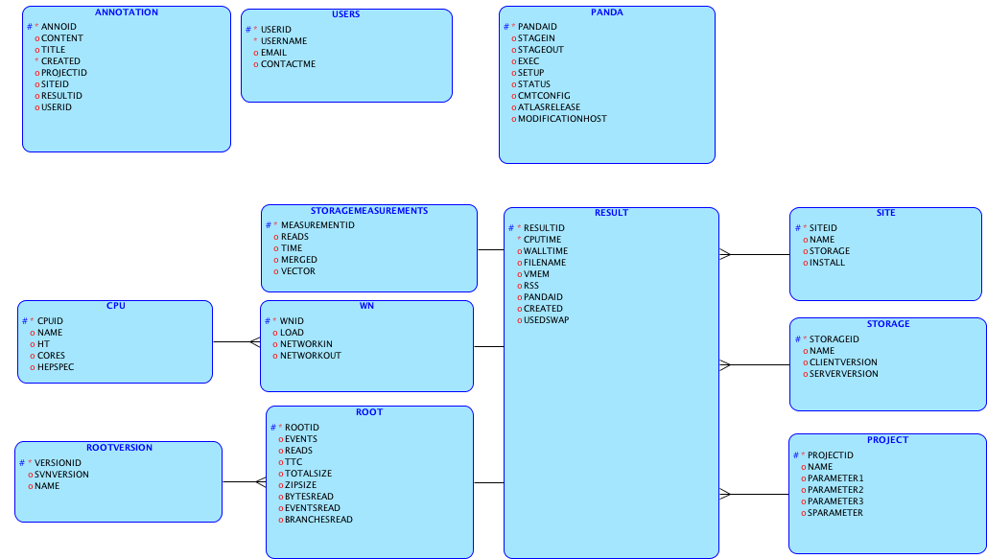
The stuff we’re storing
Pilot numbers obtained from panda db

Slide 20
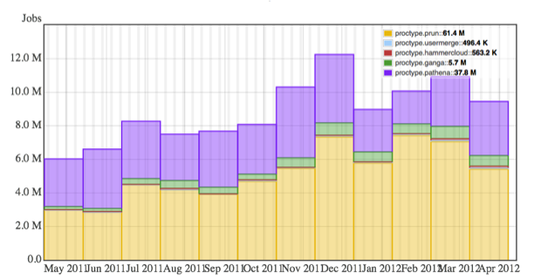
Background: prun / D3PD use

Slide 21
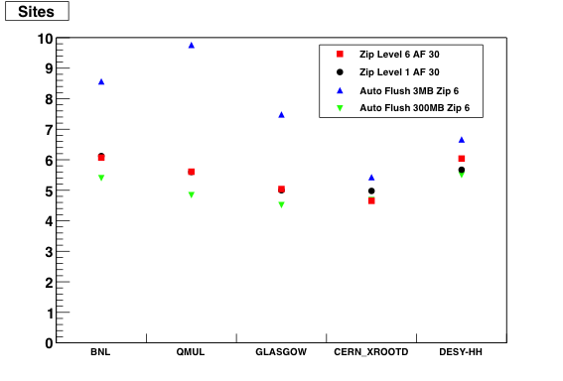
Test reading limited branches
PS data rate: ~7MB/s for 100% ~ 2MB/s for 138 branches
Event rate
100%
113Hz
138 branhes
1.6kHz

