Slide 1
Data & Storage Management TEGs
Summary of recommendations
Wahid Bhimji, Brian Bockelman, Daniele Bonacorsi, Dirk Duellmann
GDB, CERN
18th April 2012

Slide 2
WLCG Technical Evolution Groups
(see also John’s talk)
“Reassess the implementation of the grid infrastructures that we use in the light of the experience with LHC data, and technology evolution….”
Achieving commonalities between experiments where possible, etc. etc.
Several groups – most relevant here are
  Data Management (chairs: Brian Bockelman, Dirk Duellmann)
  Storage Management (chairs Wahid, Daniele Bonacorsi)

Slide 3
Process
Initial questionnaire
Defined topics [TopicsDataStorageTEG]
Soon Data / Storage TEG merged really..
Questions to experiments:
  Experiment Presentations and Twikis
[ALICE; ATLAS;CMS;LHCb]
Storage Middleware presentations: 165687
Face-to-face session for each topic
plus broader discussions.
Developed :
Layer Diagram: Overarching picture
Recommendations under each topic
See:
Final and draft report
Information
Gathering
Nov 2011
Synthesis /
Exploration/ Orientation
Jan 2012: Face-to-face
Feb 2012: GDB
“Emerging” recommendations
Refinement
Apr 2011
Recommendations

Slide 4
Layer Diagram
Data <-> Storage = Experiment <-> Site ??
Certainly not the case now:….
Layer diagram to map out architecture and responsibilities

Slide 5
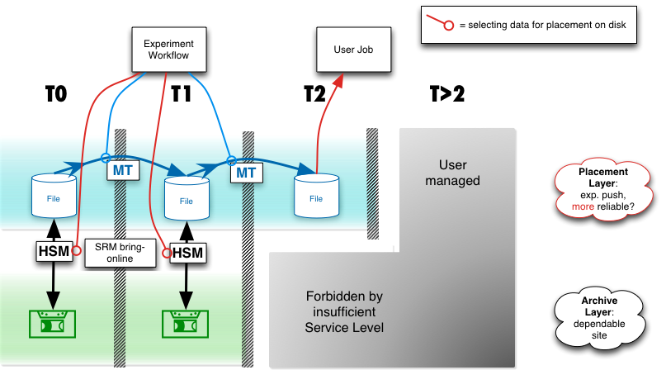
Data Placement

Slide 6
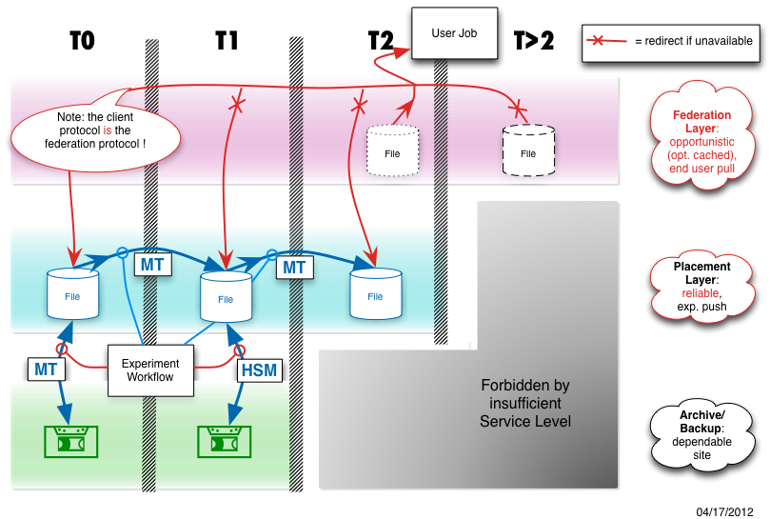
Placement with Federation

Slide 7
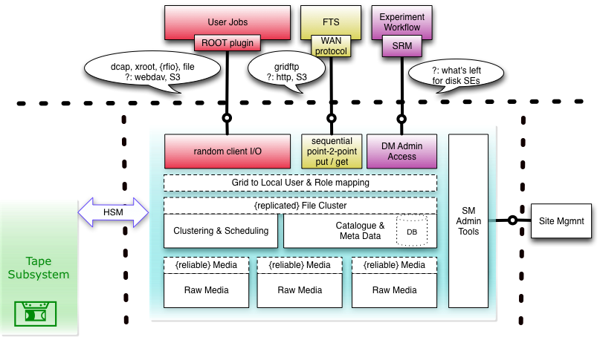
Storage Element Components

Slide 8
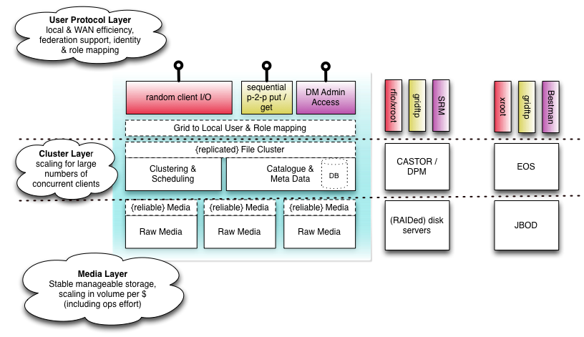
Examples of current SE’s

Slide 9
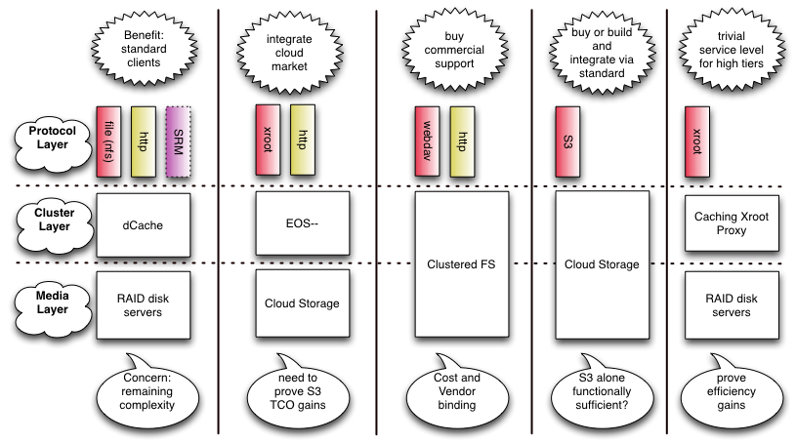
Examples of (possible) future SE’s

Slide 10
Recommendations and Observations

Slide 11
Placement & Federations
Current option is only xrootd
  Activity in http that should be supported (e.g. DPM)
  (NFS 4.1 possible but not near happening for this)
  R1: HTTP plugin to xrootd
Activity in ALICE ; CMS; ATLAS
All anticipate < 10 % of traffic this way
  R2: Monitoring of federation network bandwidth
Breakdown of what features experiments expect.
  R3: Topical working groups on open questions

Slide 12
Topical Working Groups
Launch working groups to follow up a list of technical topics in the context of the GDB:
  Detailing the process of publishing new data into the read-only placement layer
  Investigating a more strict separation of read-only and read-write data for increased scaling, stricter consistency guarantees and possibly definition of pure read-only cache implementations with reduced service levels (i.e. relevance for higher Tier sites).
  Feasibility of moving a significant fraction of the current (read-only) data to world readable access avoiding the protocol overhead of fully authenticated protocols (assuming auditing to protect against denial of service attacks).
  Investigating federation as repair mechanism of placed data; questions to answers would be:
    Who initiates repair? Which inter-site trust relationship needs to be in place? How proactive is this repair? (e.g. regular site checksum scans or repair & redirect after checksum mismatch) How is the space accounting done? How do we address the repair of missing metadata?

Slide 13
Point-to-point Protocols
GridFTP is ubiquitous and must be supported in medium term
  R4: gridFTP: use recent versions; exploit session reuse.
Xrootd is currently used alternative:
  R5: Ensure xrootd well supported on all systems
HTTP again a serious option (DPM<->dCache tests)
  R6: HTTP: continue tests; explore at scale

Slide 14
Managed Transfer (FTS)
FTS is the only tool and used for more than transfer
  Though experiments will go their own way if need be
  R7: Update FTS3 workplan to include use of replicas; http transfers; staging from archive
  R8: Cross-experiment test of FTS3 features
Management of Catalogues and Namespaces
  R9: LFC not needed (by LHC) in med-term:
      Could be repurposed and useful tools (e.g. for consistency checking) should work with other catalogues
  Also : Storage system quotas not needed (handled by experiment)

Slide 15
Separation of archives and disk pools/caches
All experiments will split archive (tape) and cache (disk pools):
  Atlas; LHCb; Alice already: CMS plan for this year
  R10: “HSM” still to be supported to manage disk buffer.
A large separate disk pool managed through transfer offers advantages:
  Performance: Lots of spindles.
  Practicality: Need not be at same site.
  R11: FTS should support staging (see R7); Experiment workflows should support this transfer model

Slide 16
Storage Interfaces:
SRM and Clouds
SRM:
Ubiquitous;
Needed in short-term buried in exp. frameworks;
Practical advantages from common layer
BUT:
Not all functions needed/implemented;
Performance concerns;
Industry not using (and developing alternatives);
Experiment frameworks adapting for alternatives.

Slide 17
SRM: Looked at each functional component:
Which used: (see big table in report for details)
Functional Group | Usage Observation
Storage Capacity Management | For Space Management: Only space querying used (LHCb; ATLAS) (not dynamic reservation, moving between spaces etc.)
File Locality Management | For Service Classes: on medium term, spacetokens could be replaced by namespace endpoints (no orthogonality required)
 | For Archives: bringOnline (and pinning) needed – no replacement.
Transfer protocol negotiation | Data access interface (get tURL from SURL): needed by LHCb: Alternatives exist: e.g algorithms or rule-based lookup
 | Load balancing and backpressure: Needed but alternatives exist (and backpressure not imp. in SRM)
Transfer and Namespace | FTS and lcg-utils at least should support alternatives
Looked at alternatives:
Some used by WLCG currently (GridFTP ; xrootd)
Some in industry (S3; WebDav; CDMI)
Mapped to functions: (see big table in report for details)

Slide 18
Storage Interfaces: Recommendations
R12: Archive sites: maintain SRM as there’s no replacement
Non-archive no alternative yet for everything:
  But experiments already looking at integrating
  R13: Working group should evaluate suitability targeting subset of used functions identified in report
    Ensuring alternatives are scalable and supportable
    must be supported by FTS and lcg_utils for interoperability
  R14: Working group should monitor and evaluate emerging developments in storage interfaces (e.g. Clouds) so experiments work together on long term solutions.

Slide 19
Storage Performance:
(Experiment I/O usage, LAN protocols, evolution of storage)
R15: Benchmarking and I/O requirement gathering
Develop benchmarks; Experiments forecast bandwidth IOPS and bandwidth needs; storage supports measurement of these.
R16: Protocol support and evolution
Experiments can use anything ROOT supports
But move towards fewer protocols and direct access supported.
ROOT; http direct access; and NFS4.1 should be developed
R17: I/O error management and resilience
Explicitly determine storage error types and ensure application handling
R18: Storage technology review
Incorporating vendors; spreading information between sites.
R19: High-throughput computing research
Not restricted to current data formats (ROOT);
Hadoop style processing or NextBigThingTM

Slide 20
Storage Operations:
Site-run services: monitoring; accounting etc
R20: Site involvement in protocol and requirement evolution:
ie. site representatives on storage interface working group to ensure proposals are manageable by them
R21: Expectations on data availability. Handling of data losses
Experiments should state data loss expectations (in MoU) and reduce dependence on “cache” data.
Common site policies for data handling (examples in report)
R22: Improved activity monitoring:
  Both popularity and access patterns
R23: Storage accounting
Support StAR accounting record

Slide 21
POOL Persistency
Recently LHCb moved, so now ATLAS specific sw.
Atlas also plan a move so:
  R24: POOL development not required in medium term
Security
Separate document with Security TEG.
Areas that need attention in the near term:
R25: Removal of “backdoors” from CASTOR
R26: Checks of the actual permissions implemented by Storage Elements.
R27: Tackling the issues with data ownership listed in document (e.g. ex. VO members; files owned by VO rather than individual)

