Slide 1
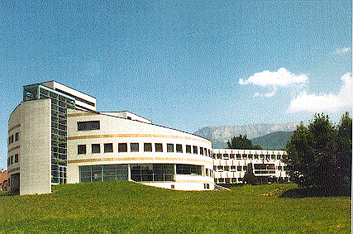

Welcome at LAPP
Nadine Neyroud (Technical director and IT manager)
April 18, 2012
ATLAS Computing meeting

Slide 2
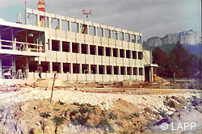
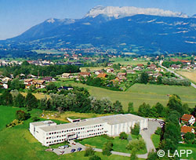
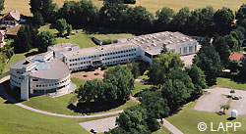
LAPP history
1976
1984
1976: Lapp was founded by physicists from Paris and Orsay wishing to live closer to CERN.
Most experiments at CERN (one at the Bugey Nuclear power)
2012:
Still many experiments at CERN (LHC)
New field of astroparticles: gravitational waves, high energy cosmic rays, search for anti-matter
1992
Many experiments or R&D in far away places: Italy (OPERA, VIRGO), Namibia (HESS), Japan (ATF2), international space station (AMS).

Slide 3
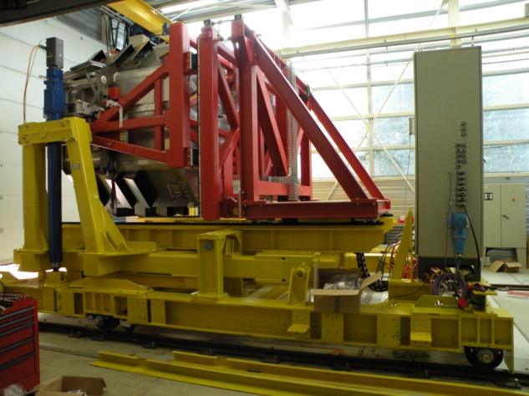
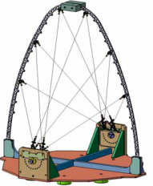
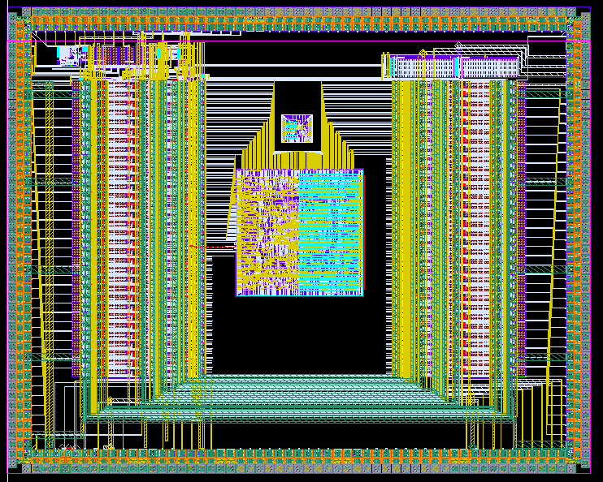
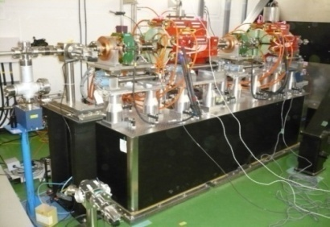
LAPP in a nutshell
63 physicists (including 10 PHD students and 9 post-docs)
In several large international collaborations working on accelerators (ATLAS and LHCb on the LHC at CERN, OPERA in Gran Sasso), astroparticle experiments (Virgo, AMS, HESS, CTA) and R&D: LC detectors (Micromegas chambers), magnet stabilization for future accelerators, (LAVISTA/ATF2), instrumentation for accelerators (CLIC), …
78 engineers, technicians and administrative staff
  In three technical services: mechanics, electronics and computing
  Specific skills in automatics, microelectronics, slow control, data acquisition and Grid computing.
  T2/T3 LCG node and computing platform for Université de Savoie research labs (MUST)
Notes:
Avant de terminer je vous presente quelques chiffres cles qui traduisent l activite de notre laboratoire

Slide 4


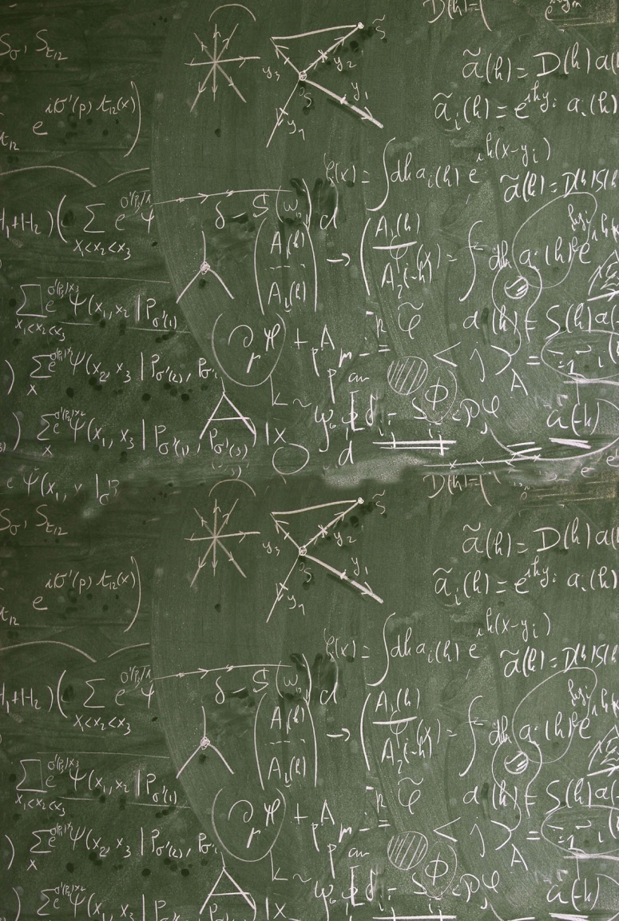
Theoretical physics
  LAPP also hosts a large [~33 researchers] theoretical physics group, LAPTH
  Together, the two labs have created CIPHEA, which invites every year foreign experimentalists and theorists working in the field of LHC physics, dark matter, etc.. (~10 visitors / Yr)

Slide 5

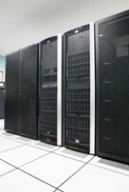



MUST : local and grid computing facility
Grid VO supported
  WLCG (90% of activity)
    ATLAS
    LHCb
  EGI
    GEANT4
    CTA
    ILC
    EARTH SCIENCES
    Regional VO
    …..
Local users activities
  Theoretical
  Mathematics
  Polymer research
  High frequency research
  ….
Today
816 cores
110 TB/GPFS
420 TB/DPM (ATLAS grid only)
1Gb/s sharing connection to French NREN

Slide 6
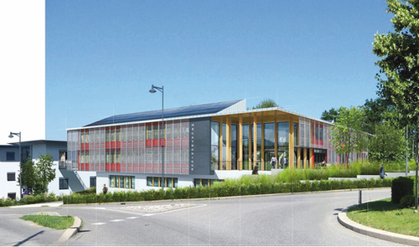
MUST : Evolution short term
2012 summer
New green building with a computing room of 200 m2 (Heat recuperation, free cooling ready)
Before end of 2012
New dedicated connection (10 Gb/s) to French NREN
Integration on LHCONE

Slide 7
Have a Nice Meeting!

