Slide 1
2012 ATLAS Technical Interchange Meeting
Annecy, France
Stephen Gray
Dell Global CERN/LHC Technologist
+1.512.574.5032 | Stephen_Gray@dell.com

Slide 2
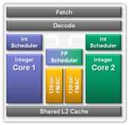



Building a “Bulldozer” Processor
Each processor die is composed of 4 “Bulldozer” modules
Module divisions are transparent to shared hardware, operating system or application
The modular architecture speeds chip development and increases product flexibility
  Server:
  “Interlagos” –16 cores (2 dies)
  “Valencia” –8 cores (1 die)
  Client:
  “Zambezi” –8 cores (1 die)
Shared L3 Cache
Memory Controller
NB/HT Links
8MB Shared L3 Cache per die
DELL/AMD CONFIDENTIAL
Notes:
Original legal approval – Hot Chips Press Presentation, August 2010

Slide 3



Romley EP Platform
Memory
DDR3 & DDR3L
RDIMMs & UDIMMs, LR DIMMs
4 channels per socket, up to 3 DPC; speeds up to DDR3 1600
Sandy Bridge CPUs
Up to 8 cores / socket
with up to 20M of cache
QPI
2 QPI links with bandwidth up to 8 GT/s
DDR3
Sandy Bridge CPU
Sandy Bridge CPU
DDR3
QPI
DDR3
DDR3
DDR3
QPI
DDR3
DDR3
DDR3
PCIe3 x8
PCIe3 x8
PCIe3 x8
PCIe3 x8
PCIe3 x8
PCIe3 x8
PCIe3 x8
PCIe3 x8
PCIe3 x8
DMI2
PCIe2 x4
PCIe3 x8
Patsburg
Patsburg
Optimized Server & WS PCH
Integrated Storage:
Up to 8 ports 6Gb/s SAS
RAID 5 optional
PCI Express* 3.0
40 lanes per socket
Extra Gen 2 x4 on 2nd CPU
DELL/Intel CONFIDENTIAL

Slide 4
All HS 06 Test Before 12/2011

Slide 5
Core Control

Slide 6
Very Cool Scalability

Slide 7
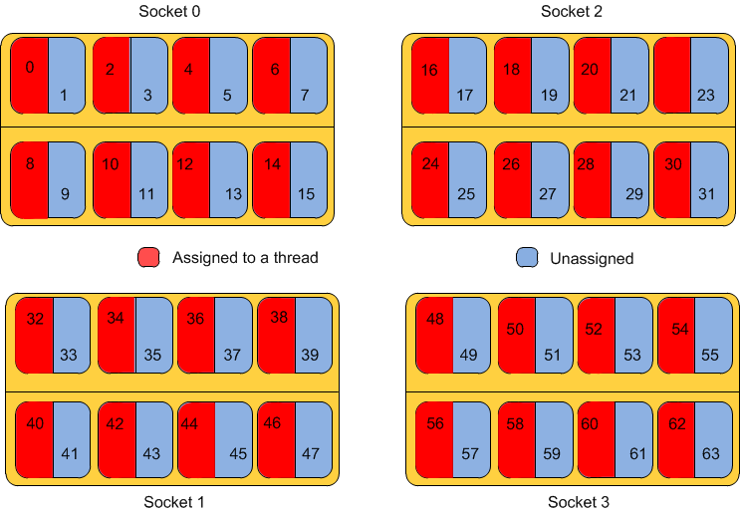
AMD C6145 Interlagos Map

Slide 8
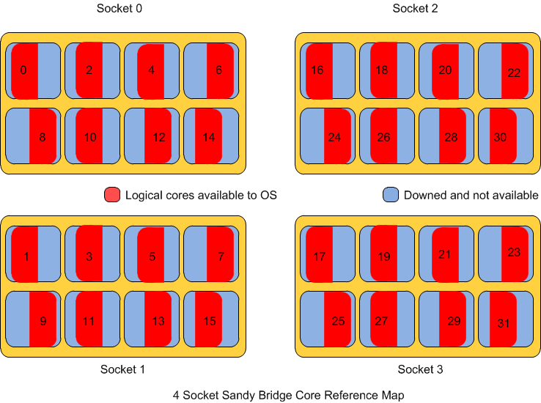
Intel Sandy Bridge
Get the Map Right

Slide 9
The Problem is an Old One
New x86 systems think they are SMP
As many CPUs in 2u as an HP SuperDome in a 42u rack (eta 2004)
One must relearn process/thread binding

Slide 10
OS Effect On HS06

Slide 11
Newer OSes Vs SL 5.5/5.7

Slide 13
Walk A Way
Intel Sandy Bridge is Fast (Porsche GT3)
  Must learn to use Numactl to bind thread
  Expensive -
Interlagos (Volkswagen GTI)
  Must learn to use Numactl to bind threads
  For some applications you must turn half the cores
  Cheaper -
New Operating Systems and Gcc are your friend

