Slide 1
Observations from the OP side
Bernard Vandorpe (Measurement)
Oliver Hans (Presentation)
Many thanks to Bernard for the effort and explanations.

Slide 2
Please interrupt for questions!
?

Slide 3
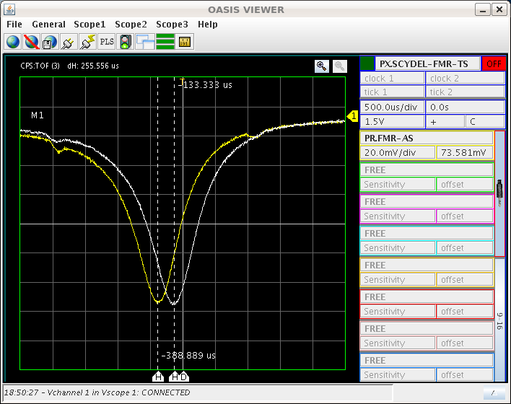
B-train calibration
During the 2011 run, OP observed with the installed FMR, a field fluctuation.
The measurement shows a field fluctuation of 2 Gauss.
Sampler BfC has only 0.4Gauss
fluctuation.
OASIS FMR signal
After some investigation the issue could be traced back to a calibration process taking place during the peaking strip signal.
The calibration window was shifted and OP sees this issue as solved.

Slide 4
First observation
Tune stability on flat top
7000 Gauss flat top for 500ms
(14 GeV - 6666 Gauss)
12566 Gauss flat top for 500ms
(26 GeV)

Slide 5
First observation
Tune stability on flat top
Bernard performed measurements
on 14 different flat tops
(Qh and Qv)
B-field (Gauss) | Qh start |  | dQh (10⁻³) | Qv start | dQv (10⁻³)
5000 | 0.226 | 0.31 |  | 0.303 | -0.01
6000 | 0.223 | 0.88 |  | 0.306 | 0.20
7000 | 0.222 | 0.84 |  | 0.307 | 0.72
7500 | 0.220 | 1.6 |  | 0.312 | 0.15
8000 | 0.216 | 1.98 |  | 0.312 | 0.1
8500 | 0.215 | 2.44 |  | 0.313 | -0.19
9000 | 0.216 | 2.39 |  | 0.313 | -0.11
10000 | 0.218 | 2.35 |  | 0.312 | 0.40
11000 | 0.224 | 2.33 |  | 0.312 | 0.90
11500 | 0.225 | 2.43 |  | 0.327 | 2.61
12000 | 0.229 | 4.66 |  | 0.315 | 3.28
12300 | 0.234 | 7.01 |  | 0.291 | 2.20
12566 | 0.232 | 8.40 |  | 0.277 | 1.41
12650 | 0.224 | 8.46 |  | 0.267 | 0.00
Observation:
Tune shift on flat top
Higher flat top field -> higher dQh+v

Slide 6
Machine stability seen by Samplers
PFW measured on 26 GeV flat top over 300ms, 5 cycles
Deviation
GFA setting
0.29%
0.24%
0.14%
0.71%
0.59%
0.71%
0.28%
MPS on 24 GeV flat top for 700ms
Very stable in current regulation!
No resistance change of the coil -> No thermo effect.
Field regulated
Current regulated

Slide 7
Machine stability seen by Samplers
Matrix (B=12566 Gauss) | dI (A) | dQh | dQv
WFN | 0.6 | 0.0009 | -0.0004
WFW | 0.3 | 0.0008 | 0.0005
WDN | 0.6 | -0.001 | -0.0015
WDW | 0.6 | -0.0009 | -0.0024
W8L | 4 | -0.0025 | -0.0024
Observed (B=12566 Gauss) | dQh | dQv
 | 0.0084 | 0.0014
Tune shift observed
To be noted:
The PFW current has ripples, whereas the tune shift has clear 1st order function
Tune shift calculated

Slide 8
Second observation
Tune stability vs MRP
Measurenents on
26 GeV flat top with
a length of 300ms

Slide 9
Second observation
Tune stability vs MRP
Measurenents on
26 GeV flat top with
a length of 300ms
1050
Time (ms)
1350
No orbit deformation observed
(orbit H and V measured at Rpos -20, 0, 30mm)
Example: Hor. Orbit for Rpos 0mm

Slide 10
Third observation
Tune vs PFW dI/dt
Measurements with a 24 GeV ION beam
PFW setting | WFNI; WFNP; WFW | WDNI; WDNP; WDW | W8L
Basic
Fast
(Vandorpe
setting)
di/dt (A/ms) | WFW | WDW | W8L
Basic | 0.61 | 0.53 | 3.50
Fast | 1.32 | 0.11 | 10.34
(Lachaize
setting)
/5
x3
With fast ramp PFW and B-field have important
over shoot. Stabilized at C1000.
Measurement done between
1000 – 1700 ms

Slide 11
Third observation
Tune vs PFW dI/dt
Measurements with a 24 GeV ION beam
 | MRP -20 mm | MRP 0 mm | MRP +20 mm
Qh
Qv

Slide 12
Third observation
Tune vs PFW dI/dt
Measurements with a 24 GeV ION beam
 | Oh = f(MRP) | Qv= f(MRP) | Xih= f(MRP) | Xiv= f(MRP)
Basic
Fast
C1000
C1050
C1100
C1200
C1300
C1400
C1500
C1600
C1700

Slide 13

Analysis
Example:
Vertical tune
Basic PWF setting
MRP-10 mm

Slide 14
Analysis
 | A Asymptote | B coefficient | τ
Qh
Qv

Slide 15
Summary
Machine settings are stable (what OP can see via Sampler)
Tune is not stable
Time
Field
dI/dt (PFW)
MRP
dQ = f
Tune changes with a first order function of time.
With a coefficient depending on B-field, MRP and dI/dt (PFW).

Slide 16
Outlook
Measurement campaign
1st Find a setting to measure the influence of one single PFW (WFW, WDW …..)
2nd More measurements with current regulation.

Slide 17
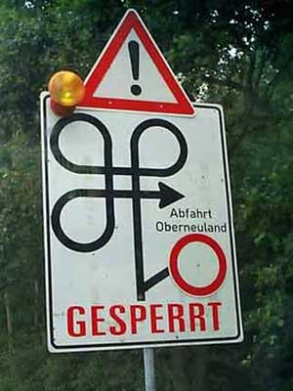
Discussion
All data shown in this presentation, and many more, could be found at:
\\Cs-ccr-samba1\pcshare\user\vandorpe\public\QhOnFlatTop
The measurement campaign was not always straight forward.
But Bernard did a great job.

