Slide 1
PS main Magnetic field issues
Workshop
MPS and PFW regulation
Fulvio Boattini
MiniWorkshop, 23rd February 2012

Slide 2
SUMMARY
POPS
Bfield and Imag starting of a cycle (non zero)
Bfield control loop with rst algorithm
Imag control loop with rst algorithm and saturation compensation
Vout control loop with rst algorithm
PFW and B8
Circuit connection and converter types
General control strategy and means to reduce coupling effects with dipolar magnets

Slide 3
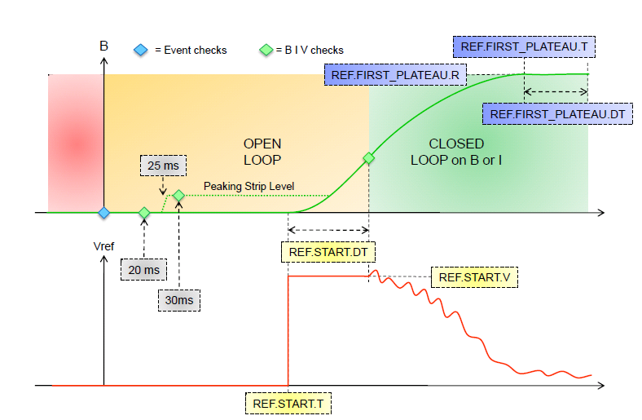
POPS: B or I non zero Cycle Starting
49.8G
23ms
8kV
53ms

Slide 4
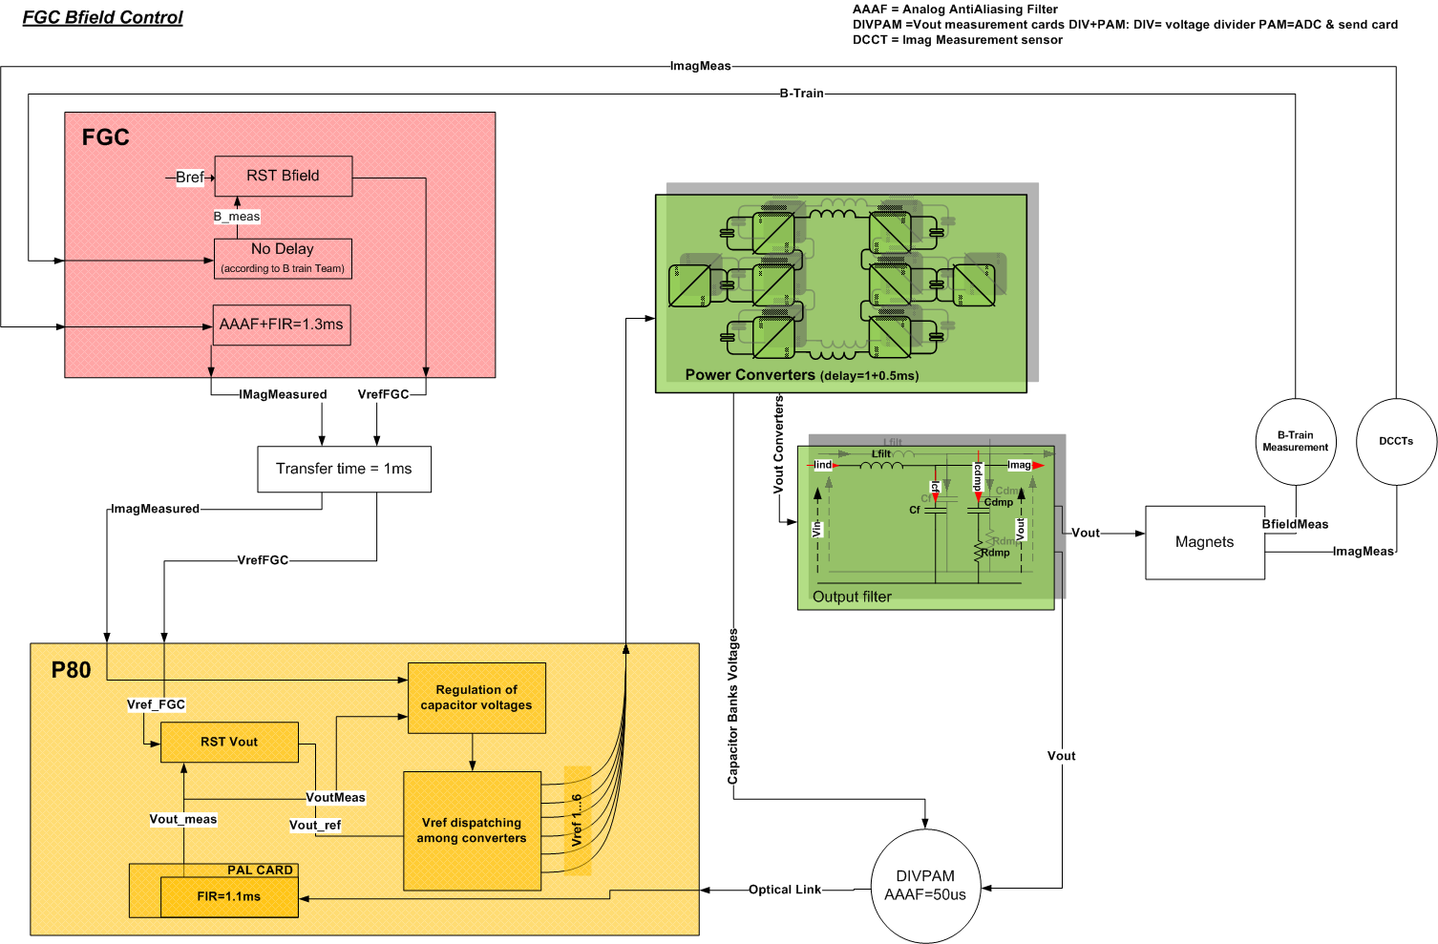
POPS B field regulation: General Schematics

Slide 5
POPS B field regulation

Slide 6
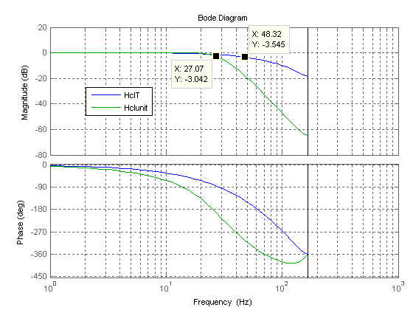
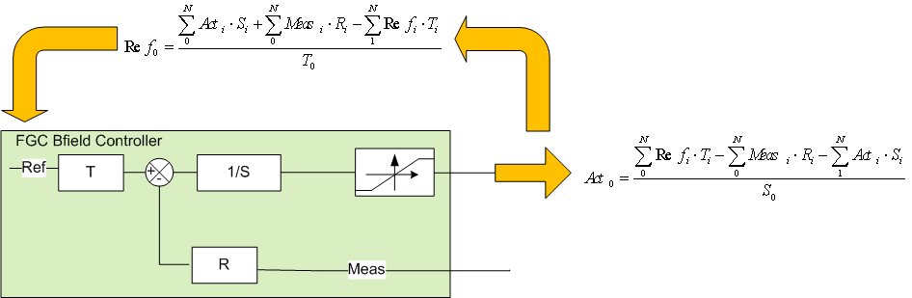
Bfield loop
RST regulator executed in FGC controller. Tsampl=3ms.
Each polynomial has a maximum of 10 coeffs for a total of 30.
Performance to date (based on theoretical calculations):
Ref following: 48Hz
Disturbance rejection: 27Hz

Slide 7
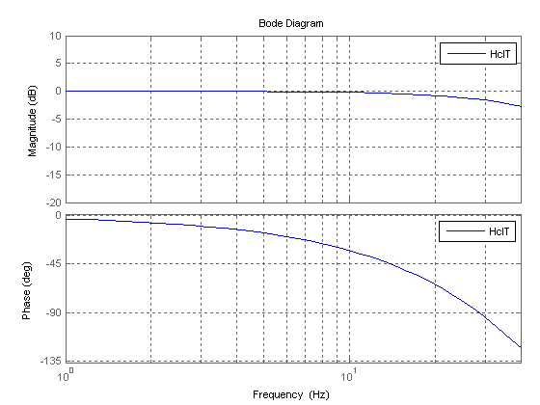
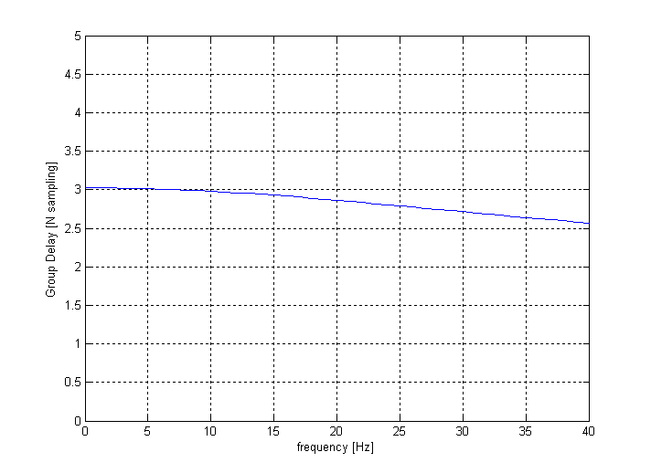
Bfield loop: Tracking delay
Complete transfer function (from reference to measure):
Given that group delay and amplitude response of filter are (almost) constant then group delay may be taken as a pure delay from input to output signal.
This is called Tracking delay in FGC and used to correctly advance the Bref
Track delay = 9ms

Slide 8
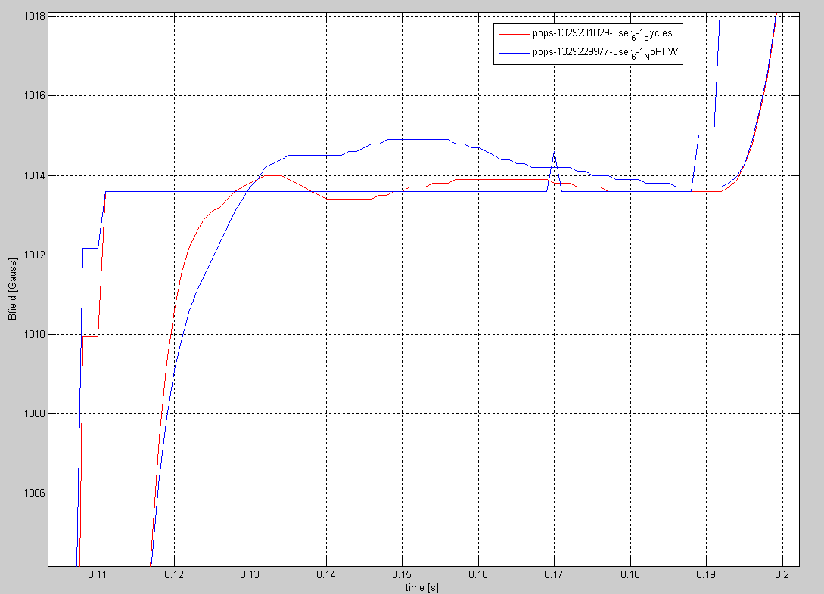
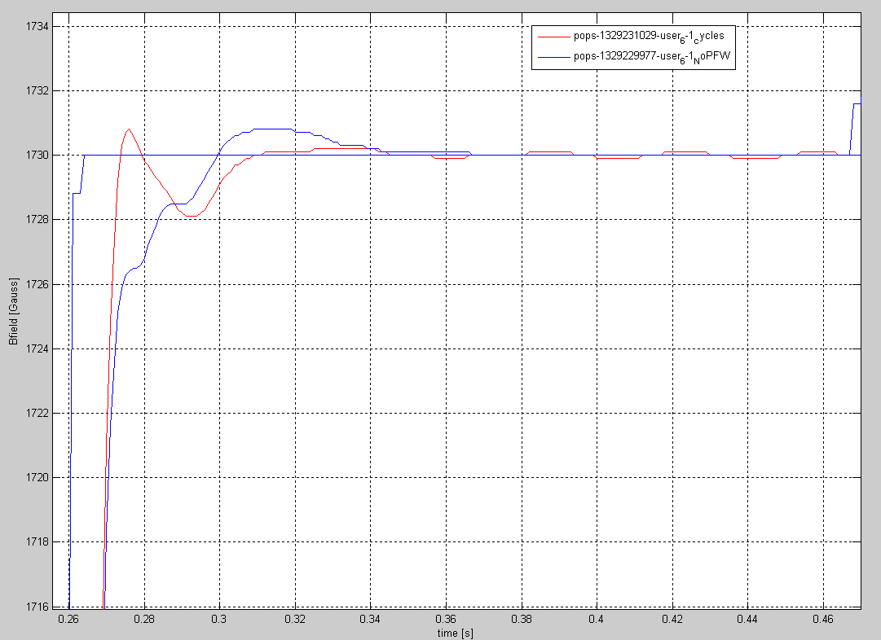

PFW effects on main B regulation (SFTPRO)
PFW off
PFW on
PFW off
PFW on
Injection
First plateau
PFW off
The RST algorithm is tuned with PFW. No active compensation is introduced in the control.
If PFW are switched off the behavior is worst because the internal dynamic of the Bfield regulator is not high enough
PFW on
Flat Top

Slide 9
POPS Imag regulation

Slide 10
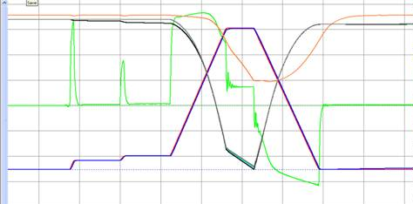
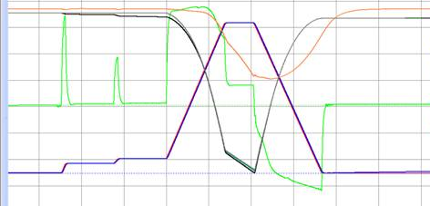
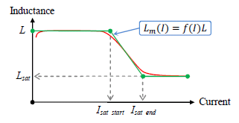
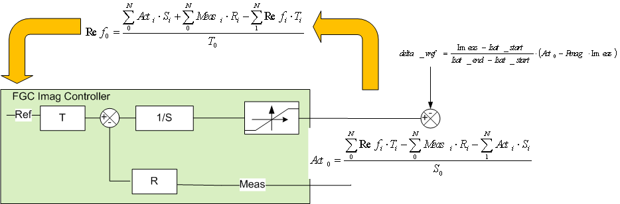
Imag loop: rst with saturation compensation
26Gev without Sat compensation
26Gev with Sat compensation
RST regulator with FFW to compensate saturation voltage drops. Executed in FGC (for testing in P80) Tsampl=3ms.
Each polynomial has a maximum of 10 coeffs for a total of 30.

Slide 11
POPS Vout regulation

Slide 12
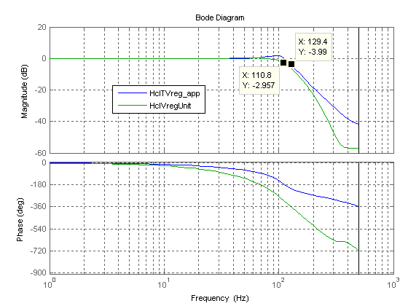
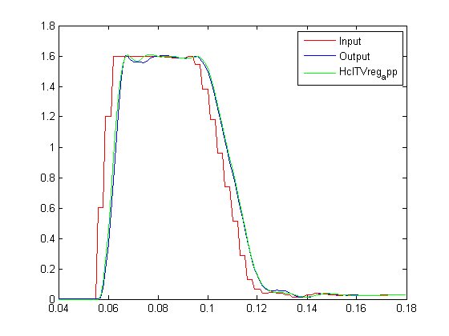
Vout loop
RST regulator with FFW to compensate for converters voltage drops. Executed in P80. Tsampl=1ms.
Each polynomial has a maximum of 10 coeffs for a total of 30.
Performance to date (identified with initial step response):
Ref following: 130Hz
Disturbance rejection: 110Hz
Ref following ------
Dist rejection ------
Step identification
This identified TF has been used for Bfield RST calculation
Transfer function:
0.02718 z^2 + 0.08804 z + 0.01852
----------------------------------------------
z^3 - 1.989 z^2 + 1.587 z - 0.4638

Slide 13
PFW and B8

Slide 14
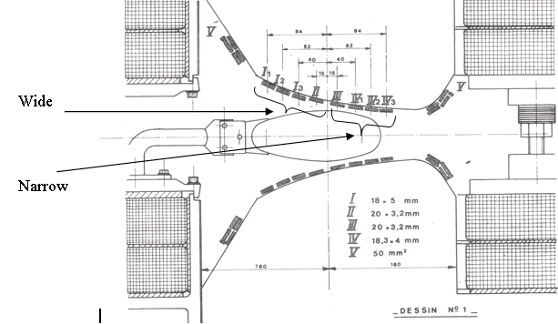
PFW and B8: circuits connection
The aux circuits are now connected in the 5 currents mode.
This mode allows more DOF for physics control but no compensation of the induced voltages is realised via the connection.
The emf induced by main dipolar field is a disturbance in the current regulation loop
‘I’ and ‘p’ mean even and uneven.
It refers to the numbering of the main magnet along the circuit

Slide 15
PFW : power supply
2 IGBT bridges connecte in series for PFW circuits
PFW | DNI | DNP | DW série | FNI | FNP | FW série
Résistance, Rmg | 3.74 Ω | 3.74 Ω | 3.32 Ω | 3.74 Ω | 3.74 Ω | 3.32 Ω
Inductance, Lmg | 0.034 H | 0.034 H | 0.008 H | 0.034 H | 0.034 H | 0.008 H
Constante de temps du circuit | 0.009 s | 0.009 s | 0.002 s | 0.009 s | 0.009 s | 0.002 s
Imax | 250 A | 250 A | 250 A | 250 A | 250 A | 250 A
Irms | 80 A | 80A | 80 A | 80 A | 80 A | 80 A
Vmax | 1200 V | 1200 V | 1200 V | 1200 V | 1200 V | 1200 V
Calcul de la tension
Rmg * Imax_op | 374 V | 374 V | 332 V | 841.5 V | 841.5 V | 747 V
Lmg * di/dt_max | 170 V | 170 V | 40 V | 170 V | 170 V | 40 V
Tension maximale | 544 V | 544 V | 372 V | 1011.5 V | 1011.5 V | 787 V

Slide 16
B8 : power supply
PFW | B8
Résistance, Rmg | 0.24
Inductance, Lmg | 0.012
Constante de temps du circuit | 0.050
Imax | 1600 A
Irms | 600 A
Vmax | 600 V
Calcul de la tension
Rmg * Imax_op | 384
Lmg * di/dt_max | 180
Tension maximale | 564 V
2 IGBT bridges connecte in parallel for the B8

Slide 17
The emf induced by dipolar field
The main dipole current rises from 0 to 5kA with 6500 A/s dynamic
The voltage induced on PFW windings is of the order of 100V (over the complete series connection).
These emf decreases as the saturation of the magnets begins

Slide 18
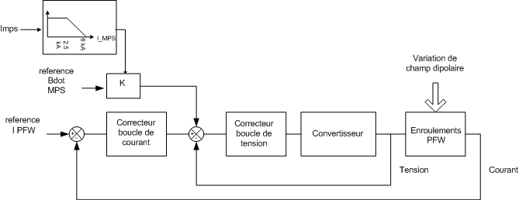
The control
Digital control Ts=100us.
PID for current regulation
PID for voltage regulation
50 A
25 A
Sans compensation
The reference Bdot from MPS and the measure Imps are used to correct the reference of the voltage loop using a linear correlation between Imps and saturation of the magnets.
Simple compensation
0
1
501
1001
1501
2001
Compensation avec
saturation intégrée
-25 A
-50 A

Slide 19
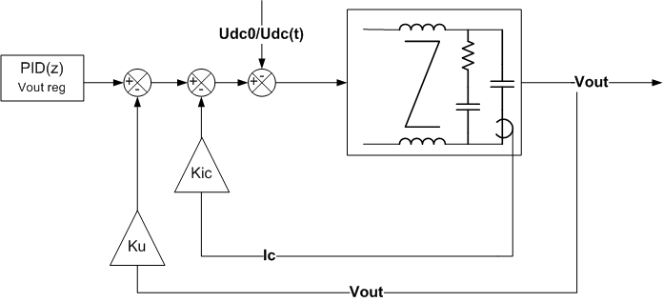
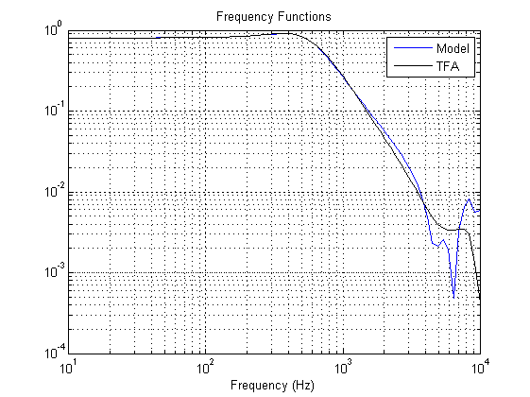
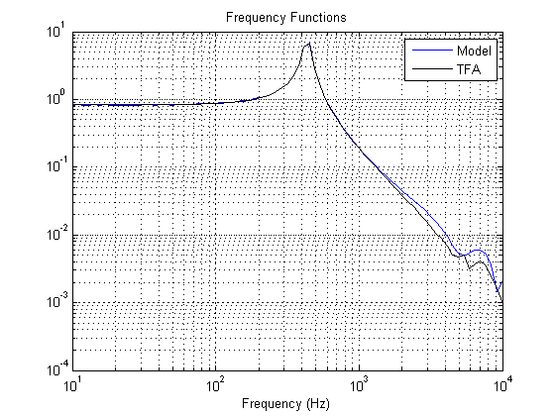
The state reaction
Compensate the (slow) variations of Udc
Improve the dumping of the filter
Improve the dynamic of the filter

Slide 20
Thanks for the attention.
Questions?

