Slide 1
Magnetic Measurements with the PS B-train Recent results and planned developments
M Buzio, D Giloteaux, D Oberson, L Walckiers
Contents
1 – Introduction
History and current status of the PS B-train system
2 – Magnetic measurements of reference U101
Summary of main results 2010-2011
First results of 2012 campaign on field harmonics and eddy currents
3 – The new B-train system
Concept and functional specifications
Hardware and software components
4 – Summary

Slide 2
Acknowledgment
Thanks to A. Beaumont, F. Caspers, G. Golluccio, O. Dunkel, L. Gaborit, P. Galbraith, R. Beltron Mercadillo for their technical and scientific contribution
Thanks to F. Boattini, S. Gilardoni, O. Michels, X. Genillon and the PS operation team for the organization and execution of recent tests
Thanks to H. Damerau, J. L. Gomez Costa, Q. King, P, Odier, J. Serrano, L. Soby for their collaboration towards the definition of the new serial distribution link

Slide 3
Introduction

Slide 4



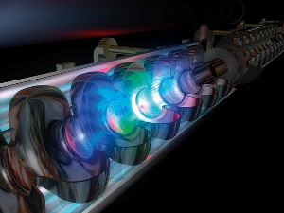
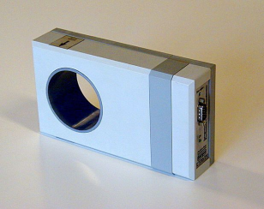
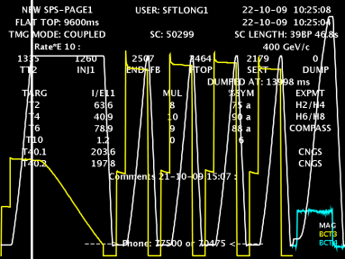
What is a B-train ?
real-time dipole field measurement for accelerator operation
sometimes B(t) ≠ f(I,dI/dt,I(τ≤t))
Hysteresis (“Pulse to Pulse Modulation”)
Temperature
Eddy currents
Ageing of iron yoke
I(t) measurement accuracy
Timing jitter
reference dipole
(in the ring or external + series excitation)
local measurement ⇒
I(t)
B(t)
power supply control (B or dB/dt)
RF control (mandatory)
beam diagnostics
(beam current DCCT)
qualitative feedback to operation

Slide 5
B-train working principle – dynamic marker
B(t)
B_{flat top}
coil measurement
Ḃ=-V_{coil}/A_{coil}
preset
marker trigger pulse
strategy currently implemented at CERN
in five machines: PSB, PS, SPS, LEIR, AD
marker 1
B_{flat bottom}
t₁
time
preset B(t₁)
UP-train
“PS pulses”
(24 V, 1 μs)
0.02, 0.1, 1 or 10 G/pulse
digital tech from the ‘60s !
DOWN-train

Slide 6
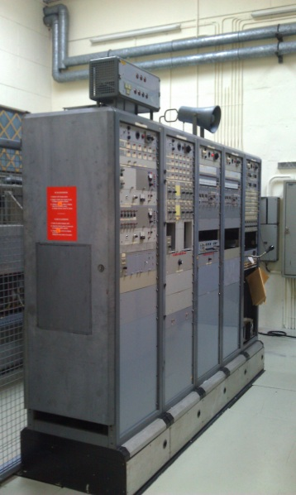
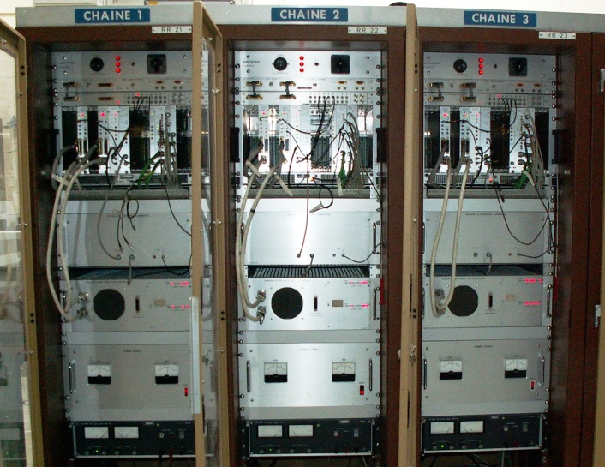
Timeline of PS B-train systems
3 systems in the lifetime of PS:
Mark I (1960-1980)
- included in the original magnet design
- only one side of U101 (block 4) equipped with
peaking strips @ 50 G + flux coils
- 3 channels @ 0.1, 1 and 10 G;
Mark II (1980-2000)
- motivation: adapt to multi-batch filling + new F8L
- different F/D fields → sensors in both halves
- new peaking strips designed for up to 400 G + new flux coils
- extra logic to interpolate B(t) between triggers
Mark III (2000 ‒ )
- motivation: improved precision and reliability
- peaking strips @ 50 G (D only) + flux coils (D + F)
- peaking strip F removed from B-train, after a few tests, in order to be compatible with the newly installed PSB/AD systems
Mark I
Mark II & III
R. Gouiran, 1979

Slide 7
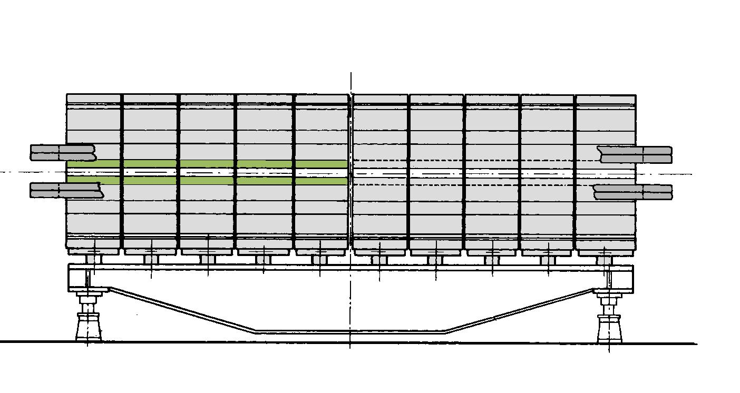
CERN PS B-train: current configuration
B-train = weighted average of the local field in F/D halves
In-built assumptions: B_{D}(t₀)=B_{F}(t₀)=4.98 mT, k=0.091†
Only one field marker in use (the second one is foreseen only for diagnostics)
When these assumptions are not satisfied → B-train error → beam may become unstable
Integrator is reset at the end of every magnet cycle (synch to control system timing)
Integrator internal auto-calibration every 15 cycles (not synch to timing ….)
A₀(1-k)
A₀(1+k)
V_{D}
V_{F}
peaking strip (in use)
flux coils
peaking strip (spare)
5D
4D
3D
2D
1D
1F
2F
3F
4F
5F
reference magnet U101, bldg. 355
† k takes into account an oscillating dipole component generated by the PFW in 3-current mode. See: R. Gouiran, Enroulements polaires de l'aimant du CPS, Note Interne PS/SM 76-1

Slide 8
Reference magnet U101
Source: A. Asklöv, Magnetic measurement on the CERN proton synchrotron, Master’s thesis, EDMS 609417, 2005
Longitudinal field distribution varies with I_{F8L}, I_{PFW}, saturation
Calibration vs. beam depends on sensor position
Sensors may not work properly in end blocks (inhomogeneous/3D field)

Slide 9
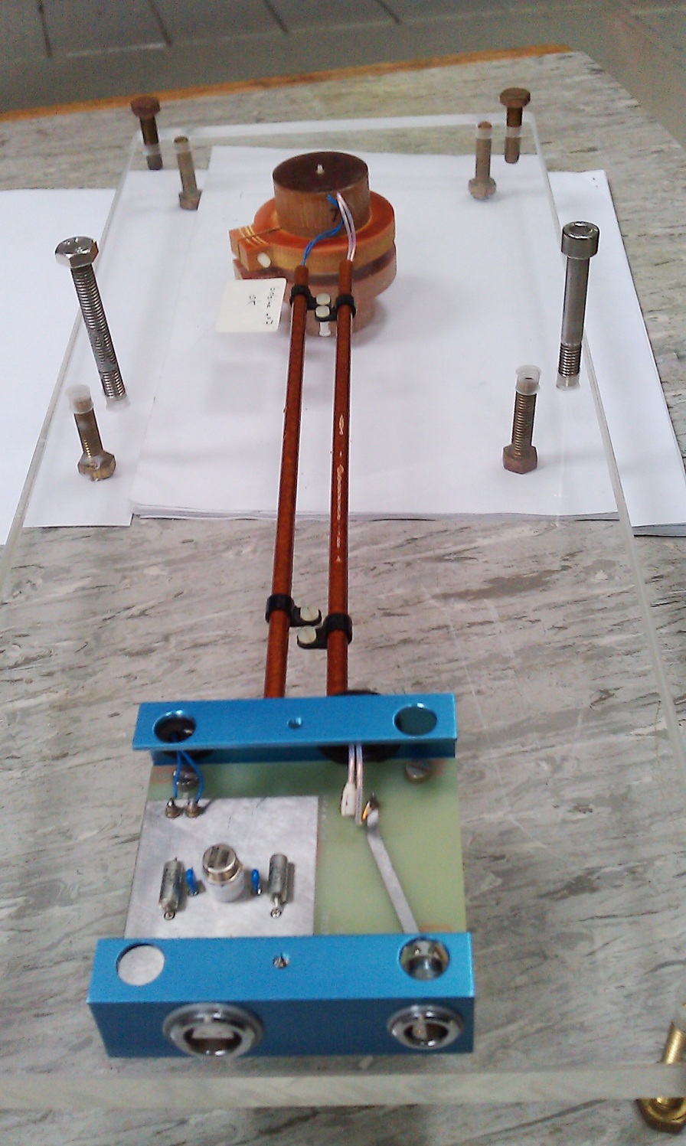
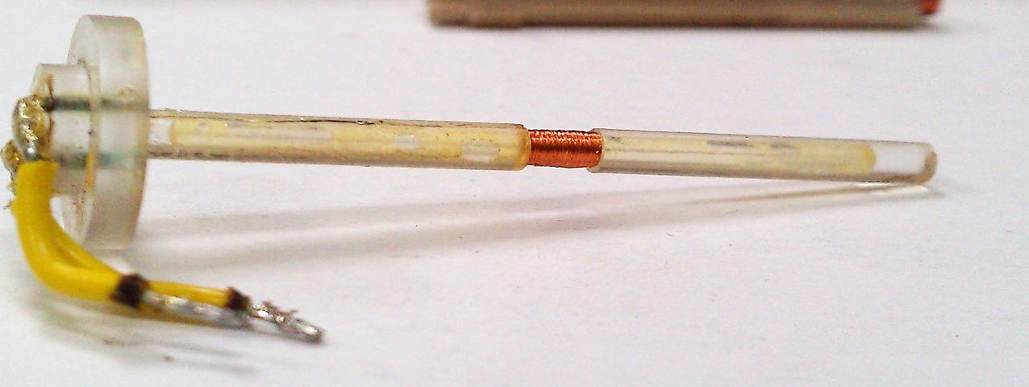
Existing field marker: peaking strips
Developed at CERN in 1956 specifically for combined-function PS magnets.
Based on a pre-stressed bi-stable magnetic needle: magnetization flips over at a preset level and generates a pulse detected by a pick-up coil
Two coils powered in series for bias and screening field, pulsed to avoid overheating
Main constraints: bias coil heating at high field (> 5 mT); does not work at too high or too low dB/dt
Experience shows that this sensor is very stable (drift <50 μT in 20 years),
Very few spares available, all different from each other (making new ones is difficult)
needle
bias and
screening coils
power
pick-up
voltage
pick-up coil
permalloy needle

Slide 10
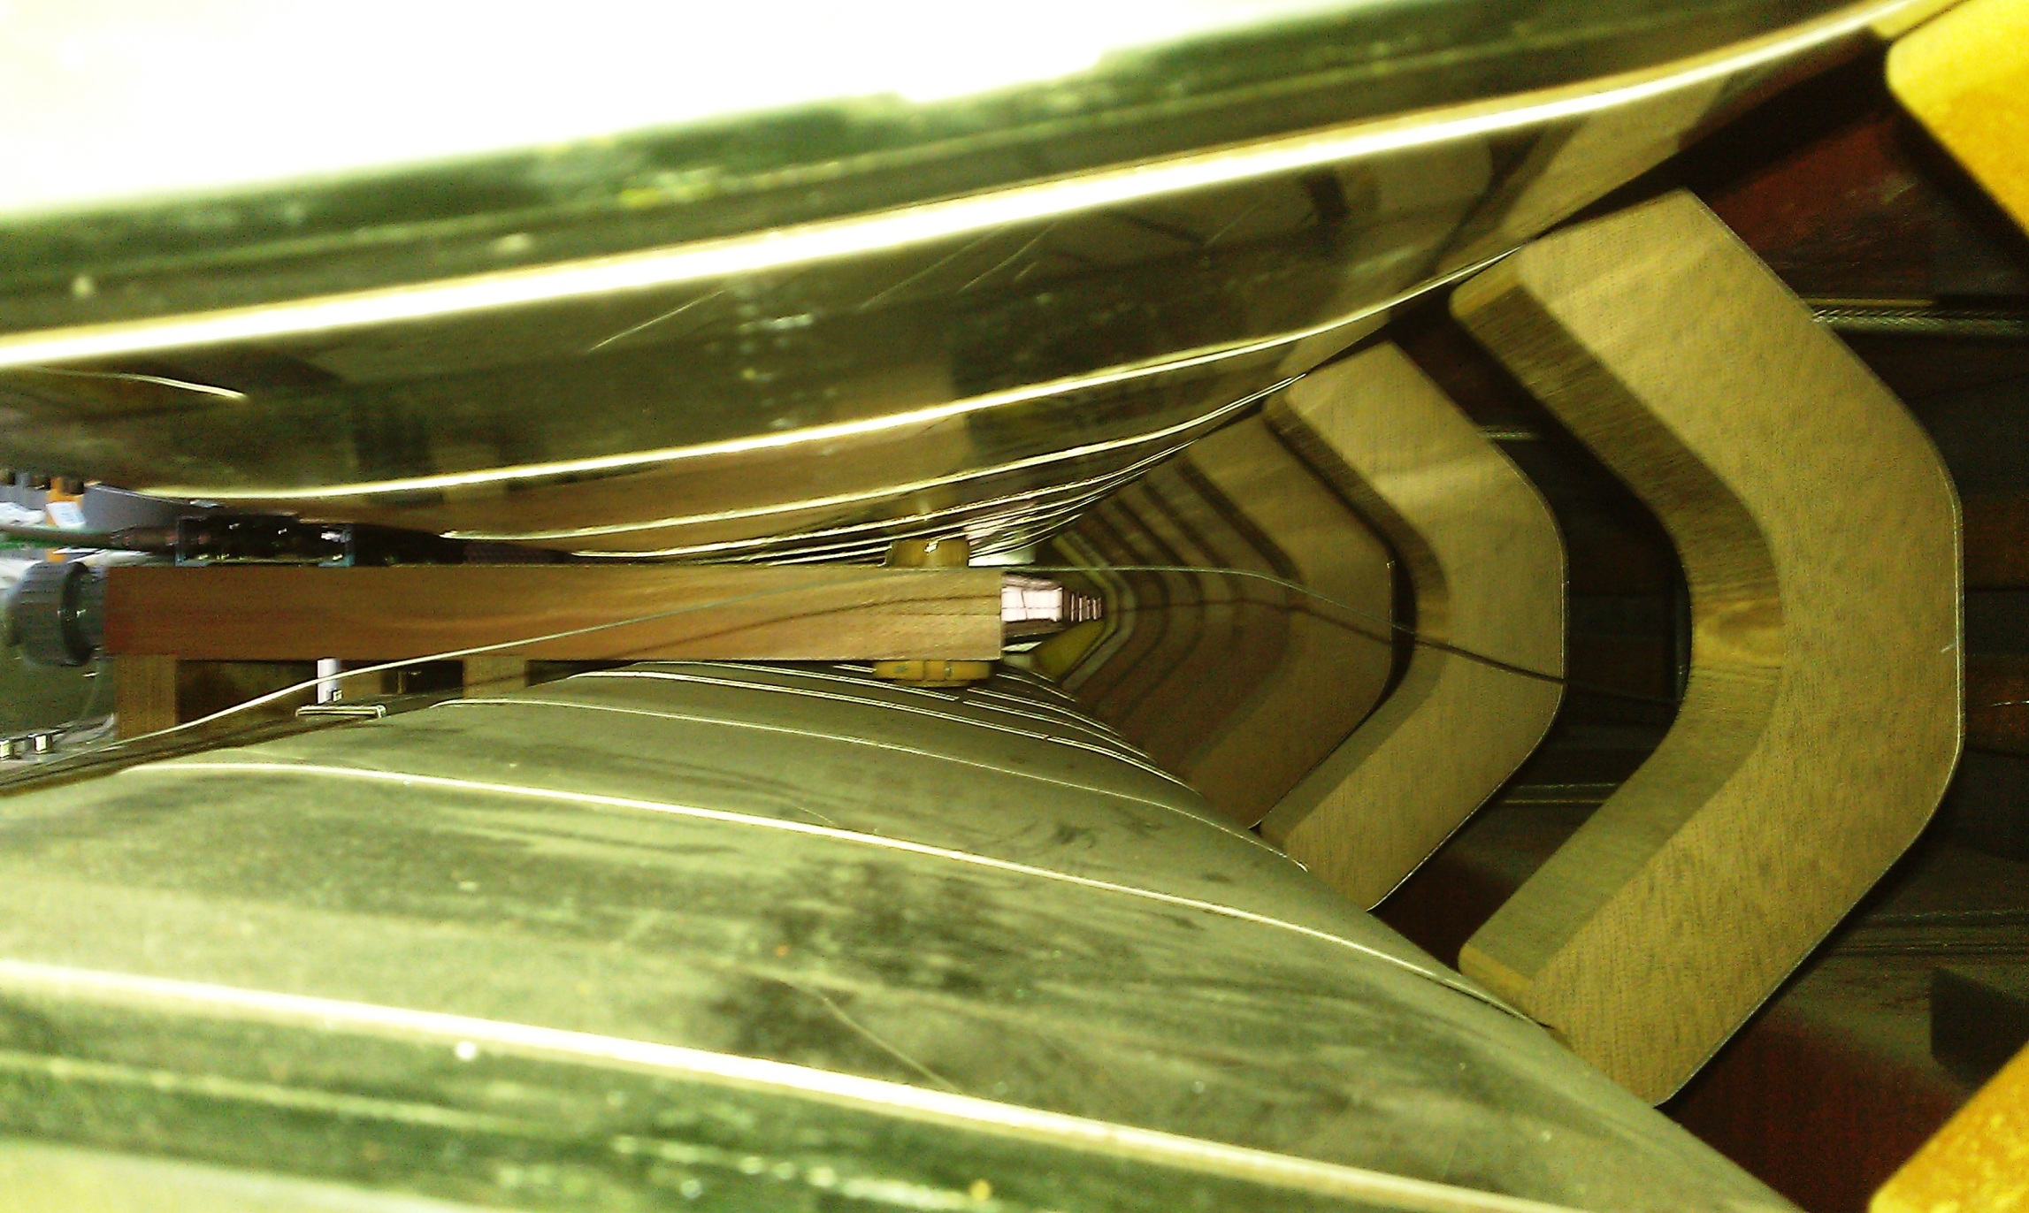
Peaking strips in side U101

Slide 11
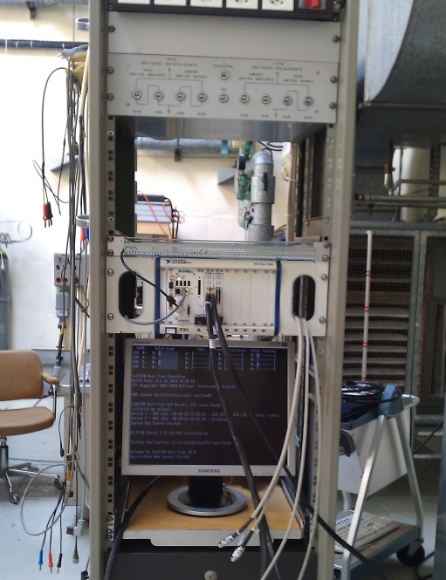
Diagnostic off-line “spy” system (2010)
Based on National Instruments hardware:
PXIe chassis, RT controller, 2× 6366 DAQ cards (8×2 MHz parallel 16-bit channels + 32×10MHz digital I/O channels)
Acquisition of all sensors and B-train signals
Introduced in 2010 to track the magnetic state in F/D halves
Used to check the consistency of sensor and B-train signals, timing and currents
Testbed for the design of new sensors and acquisition algorithms
NB: high sample rate in the 200 kHz range is necessary for:
accurate integration of flux coil output
correlation of current/field to few 0.01 G

Slide 12
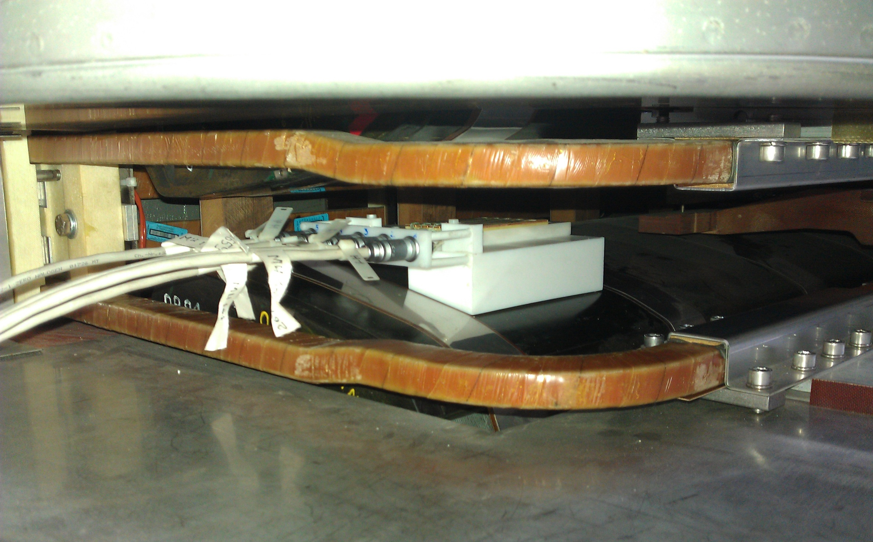
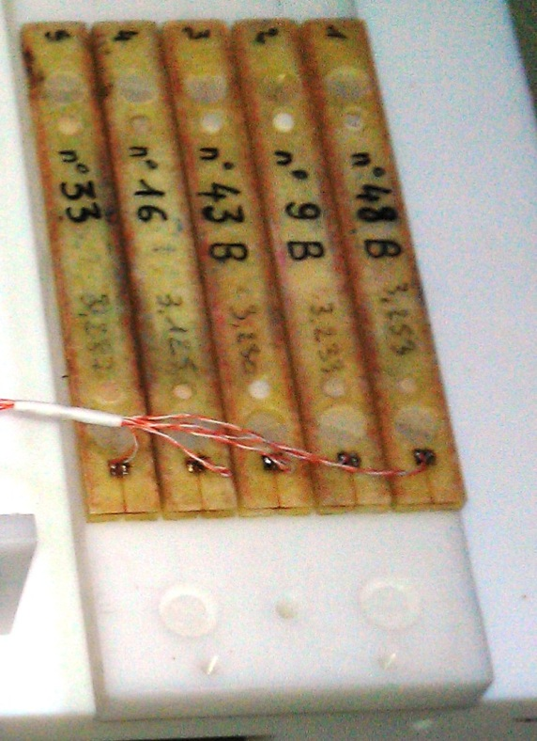
Harmonic coil array (2012)
New 5-coil, 102 mm fluxmeter for the dynamic measurement of normal harmonics B₁ → B₅
First test carried out 16/17 feb
Support can be quickly repositioned in all free F or D blocks (optimal position to be defined)
Second symmetrically placed unit foreseen
Notes:
(Re)establish clear responsibility boundaries with BE/CO:
- local control racks
- synthetic B-trains
- closed-loop field control regulation (e.g. ISOLDE)
“piquet” service: so far a best-effort approach with three people on-call has been sufficient, what about the long-term ?
standardization of synthetic trains with FIDEL-like algorithms: magnetic measurements+ beam measurements + numerical simulations → mathematical model of magnet behaviour

Slide 13

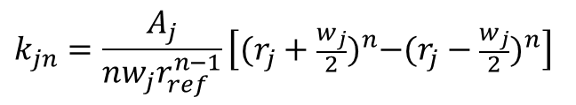
Dynamic measurement of harmonics
5× measured integrated fluxes
wanted harmonics
(normal only)
$$\left\{Φ_{j}(t)\right\}=\left[k_{jn}\right]\left\{B_{n}(t)\right\}$$
$$k_{jn}=\frac{A_{j}}{nw_{j}r_{ref}^{n−1}}\left[{(r_{j}+\frac{w_{j}}{2})}^{n}−{(r_{j}−\frac{w_{j}}{2})}^{n}\right]$$
weight matrix
(NB: problem intrinsically ill-conditioned
due to its polynomial-fitting nature)
Open issues:
integrator drift is very sensitive to calibration errors → only B1 and B2 OK for the moment
(more accurate calibration in preparation)
truncation error due to neglected n≥6 harmonics to be evaluated
major improvements planned:
- analog bucking of main components
- circular array of tangential coils (well conditioned calibration + skew harmonics + possibility of rotation to measure accurately remanent harmonic components )
Notes:
(Re)establish clear responsibility boundaries with BE/CO:
- local control racks
- synthetic B-trains
- closed-loop field control regulation (e.g. ISOLDE)
“piquet” service: so far a best-effort approach with three people on-call has been sufficient, what about the long-term ?
standardization of synthetic trains with FIDEL-like algorithms: magnetic measurements+ beam measurements + numerical simulations → mathematical model of magnet behaviour

Slide 14
Test results
highlights

Slide 15
Dipole transfer function
large fluctuations due to history-dependent residual field
240 A ≈ 60 mT
20 A ≈ 4.98 mT
going into saturation erases the previous magnetic history
Pre-cycling at high field + higher minimum current → better field stability

Slide 16
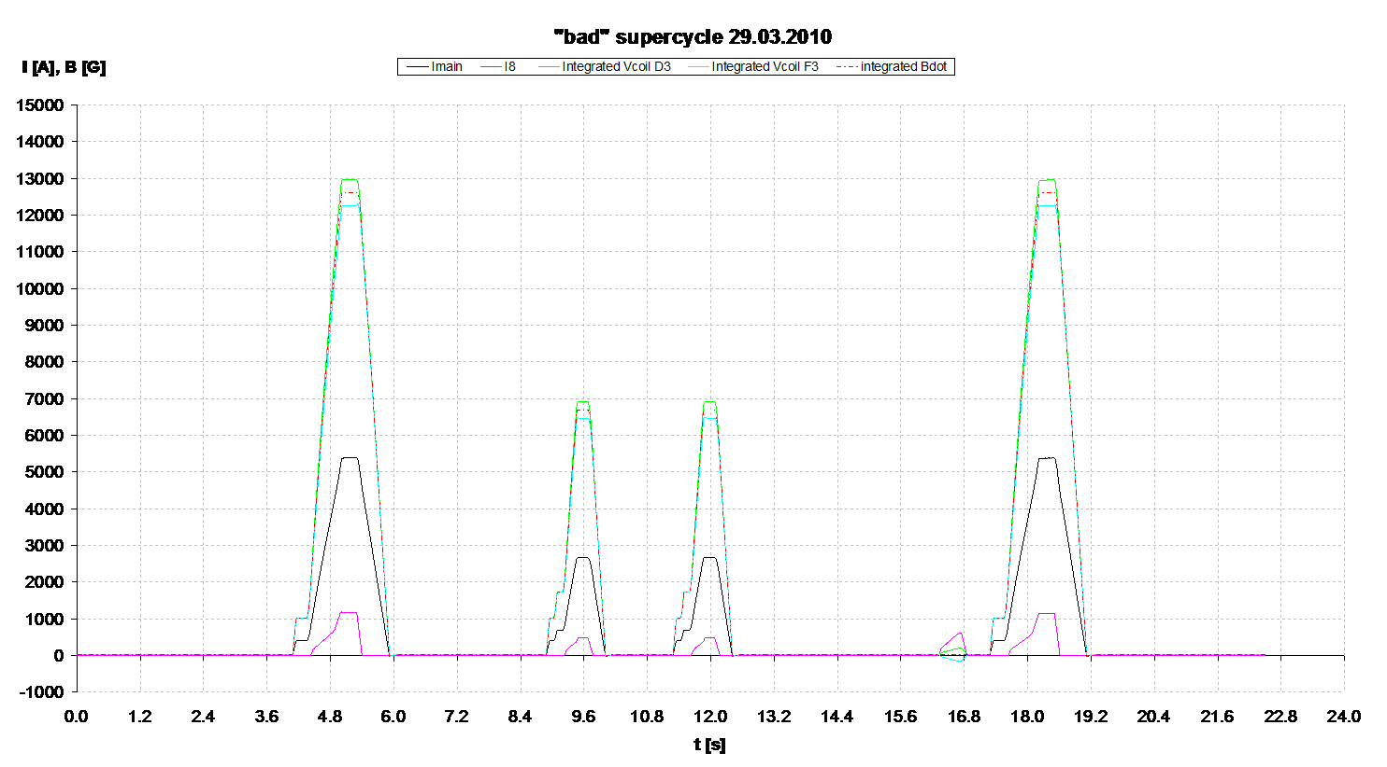
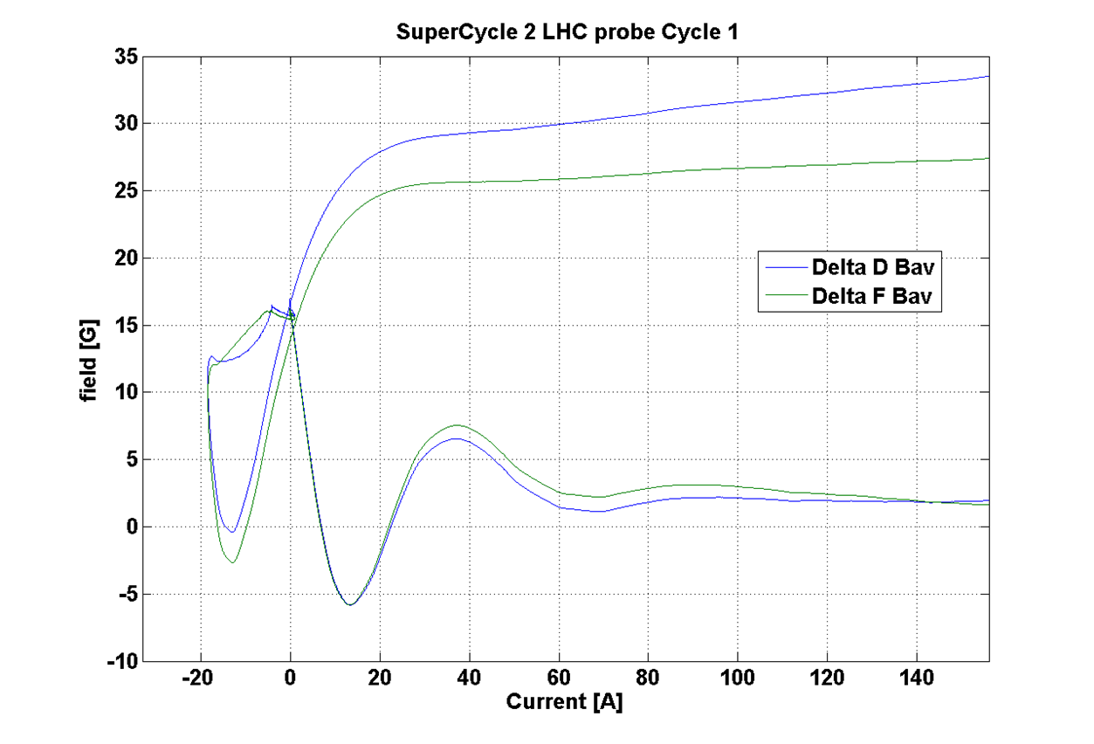
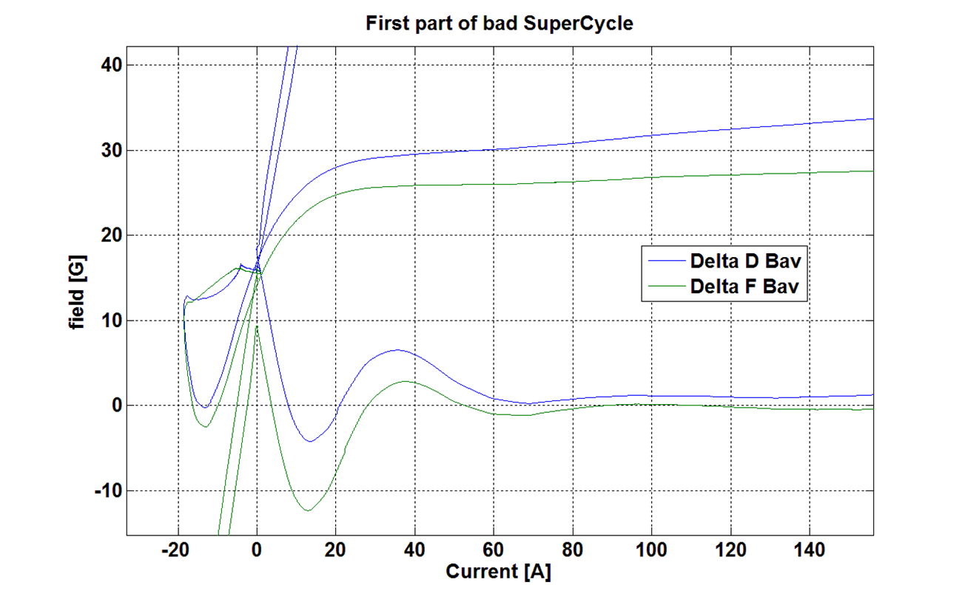
PS beam stability test – April 2010
MRP ∼4 mm
I_{F8L} pre-cycle
MRP ∼14 mm
“good” cycle
“bad” cycle
grossly asymmetric powering imbalances B_{F} and B_{D}
current B train system is blind to initial B_{F}
B_{avg} measurement error → beam MRP error
B_{F} remanent shift ∼ -10 G
Hysteresis curves B_{F}(I) and B_{F}(I) – Difference w.r.t. straight line fit

Slide 17
Field imbalance
negative quadrupole increment in the defocusing half
the field changes along the downwards limit cycle
positive quadrupole increment in the focusing half
the field changes towards the upwards limit cycle
dipole and quadrupole component are always proportional → tune trim circuit operation (I_{F8L}) at low field causes field imbalance in the two magnet halves
Independent field marking in the two halves is necessary for correct B(t) integration

Slide 18
PS beam stability test @ injection – June 2011
I_{main}
I_{F8L}
systematic correlation between initial field imbalance (→B-train error) and large RP error

Slide 19
PS beam stability test @ injection – June 2011
  CNGS
  CNGS
  CNGS
  2nd CNGS cycle unstable
  2nd CNGS cycle unstable
  2nd CNGS cycle OK
specific powering cycle sequences lead to reproducible MRP errors
now we can observe correlation with reproducible magnetic errors

Slide 20
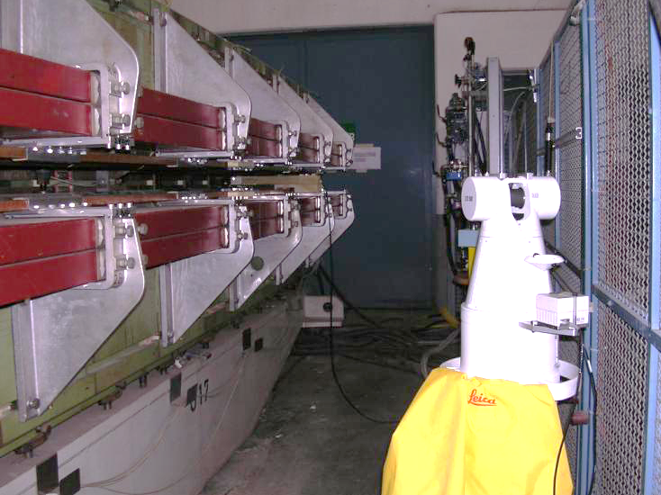
Possible mechanical side-effects
Courtesy A. Beaumont
Laser tracker measurements done on U17 to test stability
of NMR marker support in 2008
Notes:
(Re)establish clear responsibility boundaries with BE/CO:
- local control racks
- synthetic B-trains
- closed-loop field control regulation (e.g. ISOLDE)
“piquet” service: so far a best-effort approach with three people on-call has been sufficient, what about the long-term ?
standardization of synthetic trains with FIDEL-like algorithms: magnetic measurements+ beam measurements + numerical simulations → mathematical model of magnet behaviour

Slide 21
Possible mechanical side-effects
A₁
Δz
Vertical displacement of bottom pole = 0.16 mm @ 5400 A (gap closes due due magnetic forces)
All B-train sensors fixed to bottom pole
Top/bottom asymmetry → possible vertical displacement of sensors w.r.t. to ideal axis
Feed-down → skew spurious harmonics e.g. 0.1 mm → 5G
(systematic effect as a function of main current)
Notes:
(Re)establish clear responsibility boundaries with BE/CO:
- local control racks
- synthetic B-trains
- closed-loop field control regulation (e.g. ISOLDE)
“piquet” service: so far a best-effort approach with three people on-call has been sufficient, what about the long-term ?
standardization of synthetic trains with FIDEL-like algorithms: magnetic measurements+ beam measurements + numerical simulations → mathematical model of magnet behaviour

Slide 22
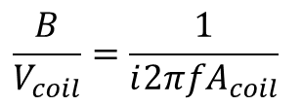
Bdot signal noise issues (2011)
Abnormally high noise on Bdot reported by Ops in Feb 2011 (concern for RF).
B(t) noise at f > 1 kHz found to be up to 40 dB higher in 2011 than 2010
Observations consistent with actual (small) B fluctuations (see EDMS 1168725)
Noise levels dropped back well below 2010 levels in 2012
Spectrum of magnetic field oscillations
Generatrice 2010
Field spectrum inferred
from flux coil measurements in U101:
(spurious resonances > 10⁴ Hz possible)
POPS 2011
$$\frac{B}{V_{coil}}=\frac{1}{ⅈ2πfA_{coil}}$$
POPS with filters 2012
Notes:
(Re)establish clear responsibility boundaries with BE/CO:
- local control racks
- synthetic B-trains
- closed-loop field control regulation (e.g. ISOLDE)
“piquet” service: so far a best-effort approach with three people on-call has been sufficient, what about the long-term ?
standardization of synthetic trains with FIDEL-like algorithms: magnetic measurements+ beam measurements + numerical simulations → mathematical model of magnet behaviour

Slide 23
Dynamic effects
(eddy currents)

Slide 24

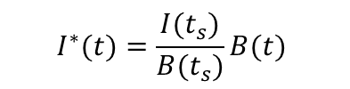
Eddy current measurement method
Scale so that the curves coincide at the end of the flat-top
B (obtained from flux coil integration)
I
without saturation (ideal)
with saturation
t_{s}
t
t_{s}
t
equivalent current:
No eddy currents → I*≡ I
$$I^{∗}(t)=\frac{I(t_{s})}{B(t_{s})}B(t)$$
I
A
Eddy currents show up as a transient
with exponential decay at end of ramp-up
(NB: direction depends on current overshoot!)
τ
relative field error
ε$\left(t\right)=\frac{I^{∗}\left(t\right)}{I\left(t\right)}−1$
Ideal model:
Transient amplitude A ∝ dB/dt
Decay time τ = constant
apparent field advance
due to the scaling procedure
t

Slide 25
Current-controlled plateau @ 3000 A, 9000 A/s
relative field error
I (A)
I(t)
3.5⋅10⁻³ (quadrupole)
1.0⋅10⁻³ (dipole)
τ ≈ 50 ms (quadrupole)
τ ≈ 25 ms (dipole)
I*₂(t) (quadrupole)
I*₁(t) (dipole)
I(t) (zoom-in)
At low field (linear range) eddy current effects are relatively small and fast
Quadrupole effects significatively larger than on dipole
t (s)
Notes:
(Re)establish clear responsibility boundaries with BE/CO:
- local control racks
- synthetic B-trains
- closed-loop field control regulation (e.g. ISOLDE)
“piquet” service: so far a best-effort approach with three people on-call has been sufficient, what about the long-term ?
standardization of synthetic trains with FIDEL-like algorithms: magnetic measurements+ beam measurements + numerical simulations → mathematical model of magnet behaviour

Slide 26
Current-controlled plateau @ 5380 A, 8150 A/s
B₁(t)
I*₂(t) (quadrupole)
quadrupole relative field error ≈ 5⋅10⁻³
τ ≈ 100 ms
B₂(t)
I(t) (zoom-in)
I*₁(t) (dipole)
Respect to intermediate field, the time constant and effect amplitude on the quadrupole are ~2 x
No appreciable change on the dipole
Dimensional considerations based on magnetic field diffusion equations → time constant at high field expected to drop by 20% due to saturation (low μ) only → dominant effect appears to be increase of magnetic circuit length due to flux leakage
Notes:
(Re)establish clear responsibility boundaries with BE/CO:
- local control racks
- synthetic B-trains
- closed-loop field control regulation (e.g. ISOLDE)
“piquet” service: so far a best-effort approach with three people on-call has been sufficient, what about the long-term ?
standardization of synthetic trains with FIDEL-like algorithms: magnetic measurements+ beam measurements + numerical simulations → mathematical model of magnet behaviour

Slide 27
Current-controlled plateau @ 5380 A, 3300 A/s
B₁(t)
quadrupole relative field error ≈ 2⋅10⁻³
τ ≈ 100 ms
B₂(t)
I(t) (zoom-in)
I*₂(t) (quadrupole)
Results at high field with reduced ramp rate show smaller relative field error → behaviour consistent with eddy currents
Equivalent current plot indicates much higher saturation effects on quadrupole than on dipole
I*₁(t) (dipole)
Notes:
(Re)establish clear responsibility boundaries with BE/CO:
- local control racks
- synthetic B-trains
- closed-loop field control regulation (e.g. ISOLDE)
“piquet” service: so far a best-effort approach with three people on-call has been sufficient, what about the long-term ?
standardization of synthetic trains with FIDEL-like algorithms: magnetic measurements+ beam measurements + numerical simulations → mathematical model of magnet behaviour

Slide 28
Mitigation of eddy current effects
Compensation of eddy currents by controlled current overshoot:
I(t)
I*(t)-I(t)
τ = L_{e}/R_{e}=time constant of the eddy currents
2τ
Ideally, a linear overshoot of length 2τ can cancel out completely eddy currents on the flat-top
Can this be done with I_{main} or I_{F8L} ?
Notes:
(Re)establish clear responsibility boundaries with BE/CO:
- local control racks
- synthetic B-trains
- closed-loop field control regulation (e.g. ISOLDE)
“piquet” service: so far a best-effort approach with three people on-call has been sufficient, what about the long-term ?
standardization of synthetic trains with FIDEL-like algorithms: magnetic measurements+ beam measurements + numerical simulations → mathematical model of magnet behaviour

Slide 29
The new B-train system
functional specifications

Slide 30
Why a new B-train
Idea conceived in 2007 and green-lighted by IEFC in 2011.
Main goals evolved over time:
Ensure long-term reliability
concerns about spares: peaking strips (PS), old electronics (SPS)
Improve performance and flexibility as requested by users
higher resolution 0.05 G, higher dB/dt for future machines
remove operation constraints and downtime: <50 G flat-bottom due to peaking strips, constraints on cycle sequencing, recurrent timing and synch errors …
Correct/extend measurements to counter beam instability
(e.g. instrument fully F half to cure injection instabilities observed in since 2010)
Applies to PS in priority; progressively to be extended to SPS, AD and ELENA, PSB (upgraded) and LEIR
Notes:
(Re)establish clear responsibility boundaries with BE/CO:
- local control racks
- synthetic B-trains
- closed-loop field control regulation (e.g. ISOLDE)
“piquet” service: so far a best-effort approach with three people on-call has been sufficient, what about the long-term ?
standardization of synthetic trains with FIDEL-like algorithms: magnetic measurements+ beam measurements + numerical simulations → mathematical model of magnet behaviour

Slide 31
B-train upgrade project: aim
All technical solutions discussed in detail with users:
operation/power converters/RF/beam diagnostics + control
Progressive upgrade in parallel with existing system
(for cross-check and as a fallback solution )
Phase | Objectives | Time frame
I – Component test | Test flux integration and correction algorithms Test individual electronic cards and components Compute offline B(t) and validate vs. beam behaviour | 2012
II – System test | Minimal viability test: broadcast simplified B(t) to POPS and/or RF with beam | Nov-Dec 2012
Deployment | Replace current system | LS1

Slide 32
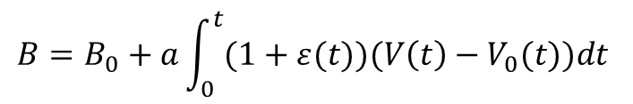
Functional specifications – B(t) integration
New concept: continuous digital distribution of B(t) on a fast serial line to replace old pulse train
Output stream continuously updated with current B(t) values
→ no need for complex triggering and reset logic; no B₀ initialization burst
Adaptive auto-calibration of gain and offset using field markers on flat-top and flat-bottom
→ fully transparent correction of measurement error
fast and robust transmission, no more timing conflicts
but: drift correction must be applied continuously on-the-fly
ADC offset (→ integrator drift)
updated every time the same marker level is reached
$$B=B_{0}+a\int_{0}^{t}{(1+ε(t))(V\left(t\right)−V_{0}(t)})dt$$
Integrator gain
updated every time a different marked level is reached
N different marker levels → up to 4 N corrections per cycle
Corrections smeared over a certain Δt to avoid sudden jumps

Slide 33
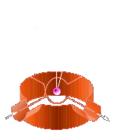
Functional specifications: integration F and D halves
Independent high-field markers and field integration in F/D halves
No complicated marker interpolation required: B_{avg} is constantly updated as t→∞
marker triggers transparent internal correction in F/D haves independently
Higher ~600 G flat-bottom level to improve magnetic reproducibility and allow the utilization
of new FMR markers (NB: a stopgap solution using existing peaking strips was discussed and found to be technically as complex as switching over to FMR, minus all the advantages)
A₀(1-k)
A₀(1+k)
V_{D}
V_{F}
FMR
flux coils
FMR
5D
4D
3D
2D
1D
1F
2F
3F
4F
5F
reference magnet U101, bldg. 355

Slide 34


test statistically real-world reproducibility of the FMR vs. peaking strips and beam
test NMR as a high field marker (the effectiveness of different combinations of FMR/NMR probes for offset and gain correction has to be proven)
measure time evolution of field harmonics
Component tests (2012)
Prototype harmonic coil array (in operation)
B_{n}(I_{k}) relationships
dynamic effects on multipoles
provide multipoles to operation
Second harmonic coil array
(symmetric)
Final FMR (single or poly-crystal)
symmetric placement
generate full integral
Prototype single-crystal FMR (due in March)
stability vs. peaking strips/beam
precision of trigger generation
test 600 G flat-bottom mode
High field marker for
on-the-fly gain correction
flux loops
NMR / high field FMR
flux loops
harmonic
array
FMR
peaking
strips
peaking
strips
FMR
harmonic
array
current B-train sensors
(stay in place)

Slide 35
Magnetic stability test: 500 G flat-bottom cycling mode
descent below 50 G no longer needed when FMR replaces peaking strip
10× flat bottom=500 G → better magnetic stability (should be tested shortly !)
injection level
p 1013 G (404 A)
ions 687 G (275 A)
zero cycle flat-top
200 A
low field marker
600 G (240 A)
flat bottom
500 G (200 A)

Slide 36
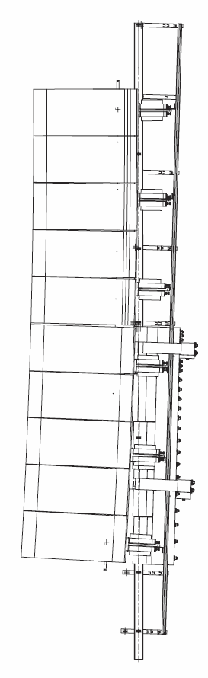

Integral fluxmeter
near-ideal sensor: integral coil array for ∫B_{n}d
removes one major uncertainty source i.e. extrapolation from local to integral measurement
→ future-proof against more surprises
no design available to date, but unlikely to be mechanically compatible with existing sensors
can we dare to give it a try with beam before LS1 ?
candidate technology:
MedAustron-style multi-PCB
Single-layer coils with <10 turns
sufficient for good signal levels
central coil is larger
to accommodate FMR markers

Slide 37
The new B-train system
hardware & software

Slide 38
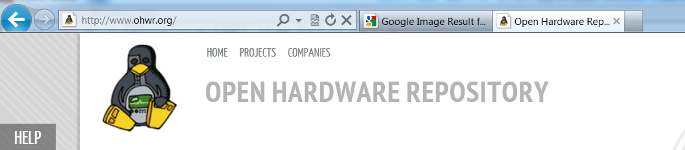
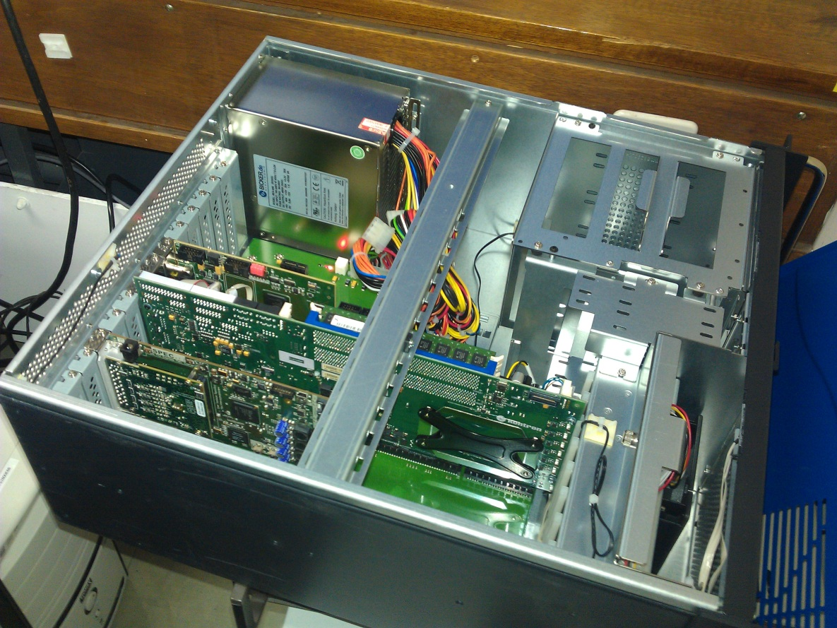

Hardware platform
Standard CERN HW/SW platform, mostly based on the Open Hardware concept strongly endorsed and fully supported by BE-CO in view of integration in the control infrastructure:
PICMG1.3 – (Open Modular Computing Specification) bus standard (industrial PC)
SPEC (Simple PCIe FMC carrier) +
FMC (FPGA mezzanine cards) for modular custom electronics, easily portable to other bus standards e.g. VME64x
Wishbone serializer bridge FPGA core
(used e.g. for DMA access)
White Rabbit serial link
Scientific Linux with C/C++, optional
real-time kernel

Slide 39

White Rabbit B(t) distribution
New CERN fieldbus standard = Ethernet + ns-accurate timing
inexpensive, robust, extremely fast (Gbit/s) and accurate optical link
Ethernet standard guarantees maintainability and interoperability with future control systems
64 byte standard data frames allow to pack in extra data for free (e.g. dB/dt)
New electronic cards needed for compatibility with POPS (with support from BE/CO)
The impact of switches on latency and jitter needs to be assessed
Proposed data format:
32-bit B(t) stream → ppb-level resolution (e.g. 50 nT over a range of 20 T)
PS only needs 4 ppm (0.05 G), however the extra range is useful for:
- upcoming applications e.g. ELENA (very low field) will use same electronics and software
- reducing quantization noise in the computed derivative
1 MHz frame rate → max. 0.02 G differences between updates
(even if the spectral content of the field is practically negligible above 10 kHz, high update rate comes at no cost and guarantees consistency for all users, which might be otherwise forced to use different interpolation methods)
No UTC referencing (1 μs latency target, to be tested)
System based on industry standard BUT largely overspecified respect to actual needs
leaves headroom to scale down in case 1 MHz frame rate cannot be met in practical tests
NB: users wishing to maintain old system (i.e. Beam Current DCCT) will retrofit their HW with our help but under their responsibility

Slide 40
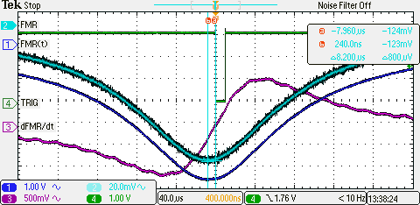
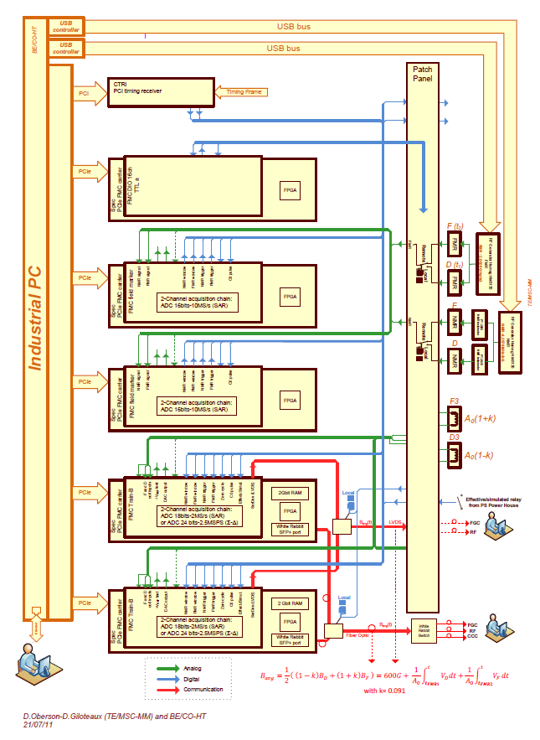
New hardware: PCIe FCM cards
Two cards designed and prototyped by MSC-MM
(no commercial equivalent exists):
FMR peak detection card: based on 16-bit, 10 MHz ADC
Function: produce a trigger corresponding to the FMR resonance peak via differentiation/threshold comparison.
Compatible with NMR demodulated signal.
Trigger validation (today done via error-prone synchronization with the timing system) could be accomplished downstream in software (e.g. by comparison with expected values B(I))
Dual integrator card: based on a 18-bit, 2 MHz ADC carries out the integration according to the model (page 3). Fully floating input for better CM rejection. Calibration coefficients are expected to be computed in software by the host controller (much less stringent timing needed, more flexibility to adapt software algorithms). General purpose ADC functions, card to be made available CERN-wide and beyond (OHCR community).
Overall system block diagram

Slide 41
FMR field marker

Slide 42
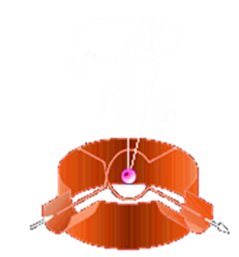
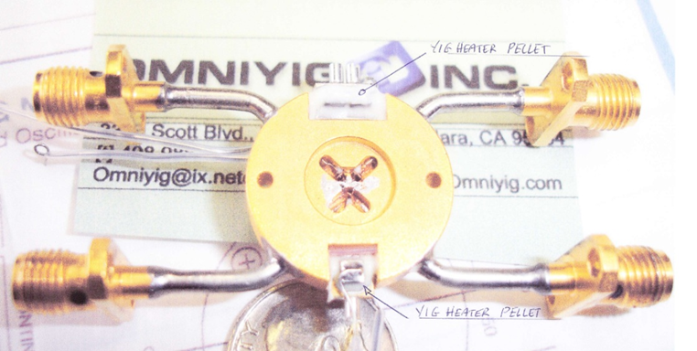
FMR resonator
∅0.3 mm
YIG sphere
RF in
semi-circular
RF loops
RF out
Yittrium Iron Garnet (YIG) sphere coupling two orthogonal semi-circular RF loops
Widespread commercial component used as bandpass RF filter
Insensitive to field gradient due to small diameter
Units tested at CERN:
  old poly-crystalline YIG, installed in the PS since the ‘90s as a manually operated diagnostic tool
  low filter Q, but insensitive to temperature
  new single-crystal YIG units. Higher Q ≈500-1000, critical alignment and T dependence
  tested in 2010/2011: one standard commercial + one customized unit
  new poly-crystalline unit: awaited May

Slide 43
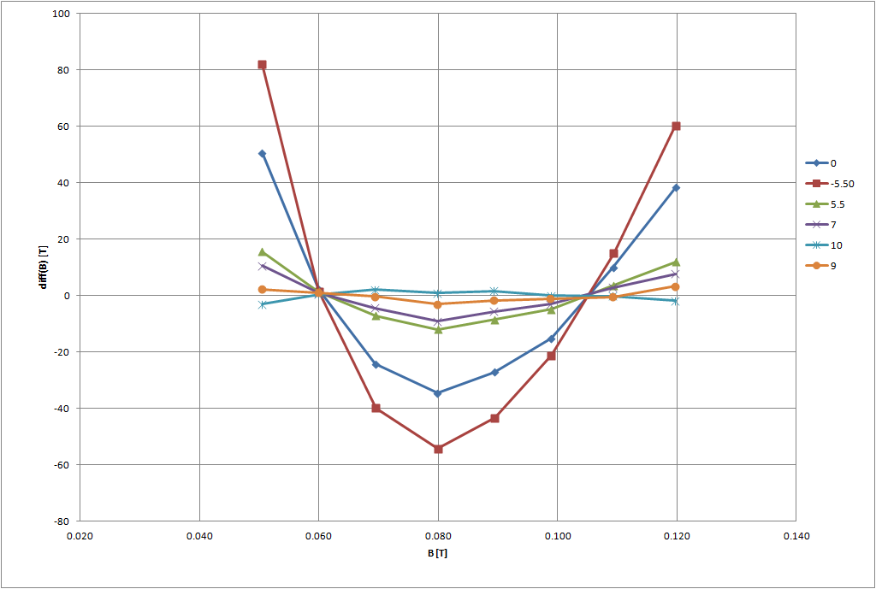
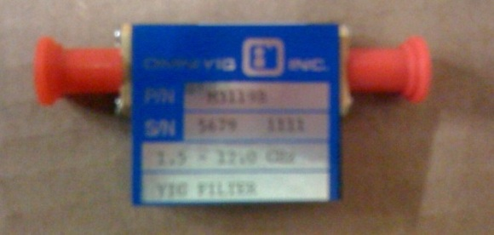
Metrological characterization of FMR field marker
Calibration of a factory-optimized Noryl-case resonator in a reference dipole vs. NMR:
DC reproducibility: 0.04 G over the range 550 to 1200 G
Ramp reproducibility: ∼0.1 G @ 600 G, 2.4 T/s
Temperature dependence: 0.04 G/°C (±2°C in U101 → close to tolerance !)
Roll angle dependence: 0.04 G/mrad @ 600 G; non-linearity vs. B disappears at certain angles
→ very difficult to use in teslameter mode; strict mechanical tolerance in marker mode
Resonance spread due to ∇B: still very good Q≈1000 at ∇B/B=4.6 m⁻¹ (as in U101)
nominal horizontal mounting
ramp-rate dependence ≤ reproducibility
non. linearity error vs. B, roll angle

Slide 44
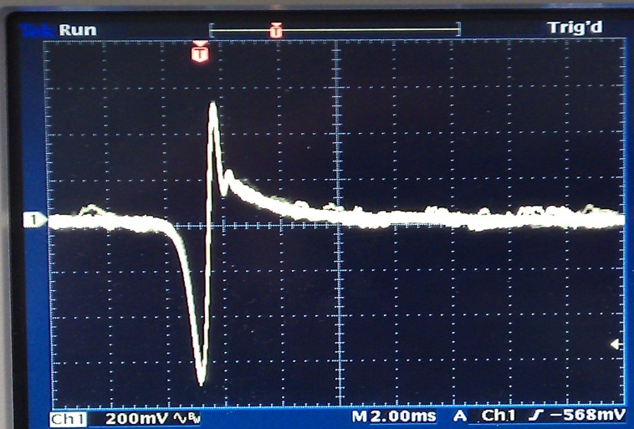
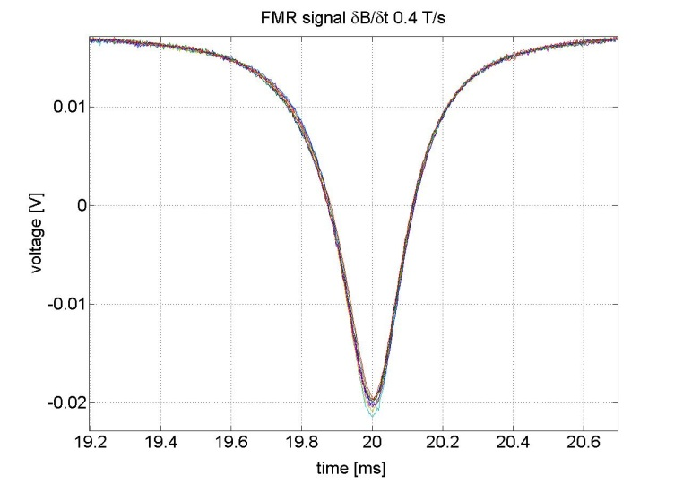
NMR vs FMR
Sensor output during a field ramp in “marker mode” (fixed frequency excitation)
∼ 10 μT
∼100 μT
FMR
NMR
Marker | ☺ | ☹
NMR | absolute reference (metrological standard) commercially available instrument | Requires ∇B compensation limited ramp rate: 20 to 50 mT/s B≥43 mT
FMR single-crystal | works up to several T/s simple direct acquisition of the resonance commercially available sensor larger dynamic range for a given sensor (current unit: 60-300 mT) | B≥60 mT broader resonance peak needs complex calibration temperature-dependent (must be optimized for a target field)

Slide 45
Conclusions & outlook

Slide 46
Summary
Diagnostic Spy System:
The system can be used to explain beam observations in terms of the magnetic response of U101.
Indication obtained: the tune drift on the flat top can be mitigated by controlling current overshoot
Systematic correlations will continue to be investigated at the demand of Operation and Beam Physics teams. Other tests will proceed in parallel when possible (e.g. impact of eddy currents in the vacuum chambers).
Upgraded B-train:
Prototypes of sensors and electronic components and are being built and shall be tested in the next months. When the existing B-train appears to be inconsistent with the beam, we shall provide a simulation of the upgraded B(t) to validate the measurement.
Detailed schedule of tests and requests of MD for 2012 is in preparation. Online tests involving generation and distribution of B(t) with both proton and ion beams should be carried out to validate the design before the 2013 shutdown. An extended period in which the old and new B-train work in parallel is foreseen in 2014.
Notes:
(Re)establish clear responsibility boundaries with BE/CO:
- local control racks
- synthetic B-trains
- closed-loop field control regulation (e.g. ISOLDE)
“piquet” service: so far a best-effort approach with three people on-call has been sufficient, what about the long-term ?
standardization of synthetic trains with FIDEL-like algorithms: magnetic measurements+ beam measurements + numerical simulations → mathematical model of magnet behaviour

