Slide 1
GridPix studies at Saclay
RD51
GridPix workshop, Feb. 22, 2012
Avalanche fluctuations
D. Attié, A. Chaus, P. Colas, M. Titov

Slide 2
On-going work at Saclay
Until now in LCTPC (EUDET, AIDA)
  Concept of digital TPC: single-electron sensitivity yields ultimate resolution and cluster counting dE/dx
If a light higgs is discovered, the emphasis might turn to a standard pad TPC
In this case, CAST with X-ray focus or directional dark matter search might become the driving application

Slide 3
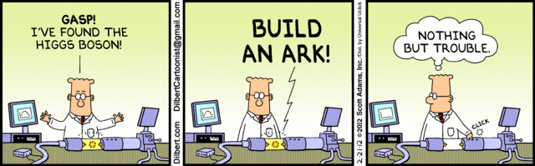
On-going work at Saclay
Until now in LCTPC (EUDET, AIDA)
  Concept of digital TPC: single-electron sensitivity yields ultimate resolution and cluster counting dE/dx
If a light higgs is discovered, the emphasis might turn to a standard pad TPC
In this case, CAST with X-ray focus or directional dark matter search might become the driving application

Slide 4
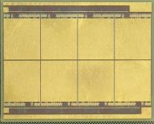
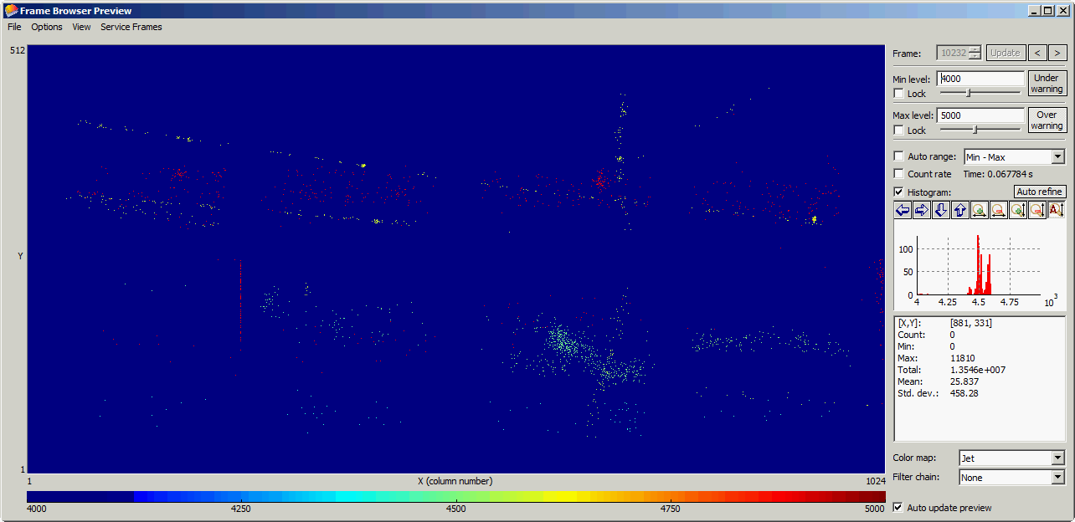
Send to a Friend or Friends
Tool for fundamental studies of gases
  Ionization
  Counting of X-ray induced electrons, Fano factor measurements
  Avalanche fluctuations
Octopuce: 8-chip

Slide 5
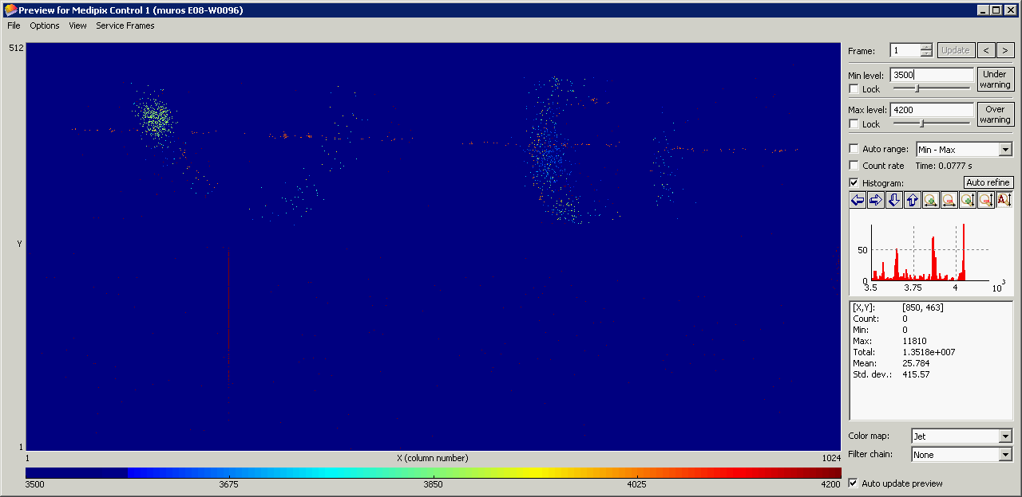
TPC at 1T
He/Iso 80/20
Vmesh = 400V
Time mode

Slide 6
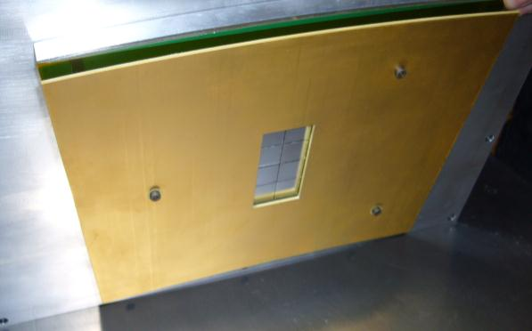
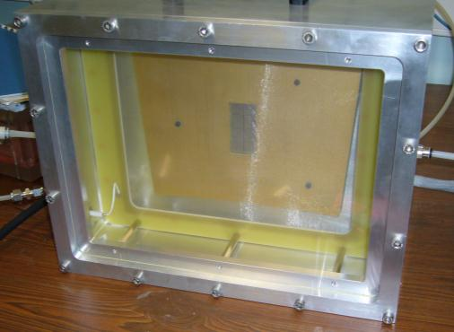
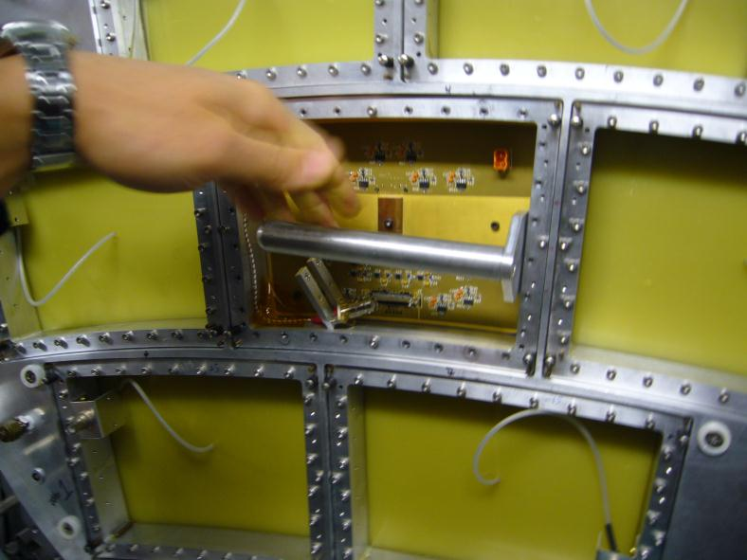
The Octopuce module at DESY
(Nikhef-Saclay)

Slide 7
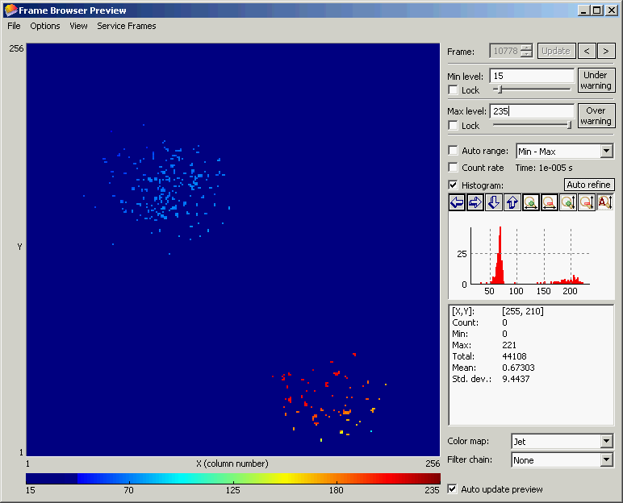
Electron counting and avalanche statistics
M. Lupberger’s Diploma thesis (2009-2010, Saclay and Freiburg)
Now being continued by Andrii Chaus (PhD student supervised by M. Titov)

Slide 8
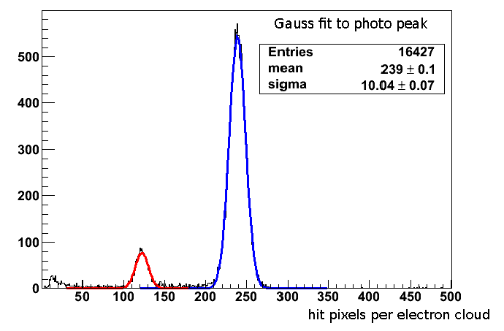
Electron counting
Direct access to Fano fluctuations

Slide 9
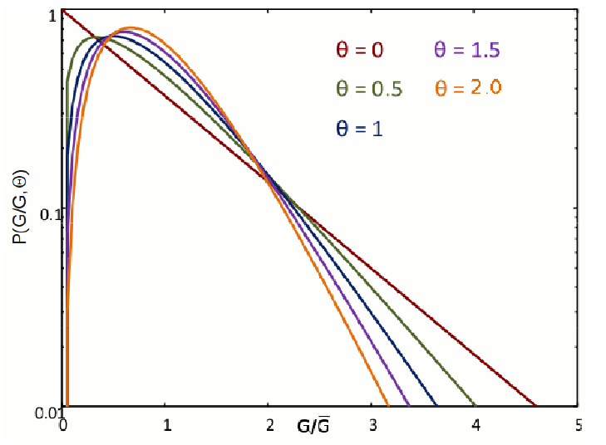

Avalanche fluctuations
Avalanche size fluctuates according to a distribution. The rms of this distribution is an important ingredient to single electron efficiency and resolution of a position-sensitive detector.
Common parametrization: polya

Slide 10
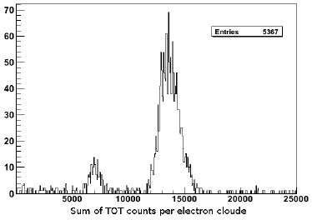
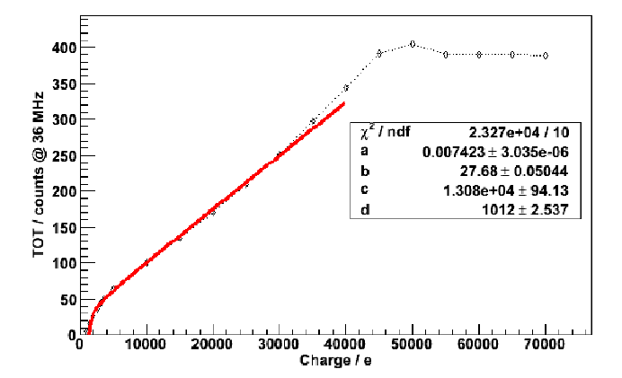
Avalanche fluctuations
Time over threshold calibration

Slide 11
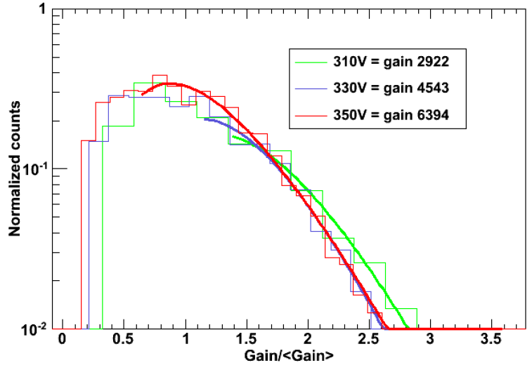
Direct measurement of avalanche size distribution using TOT

Slide 12
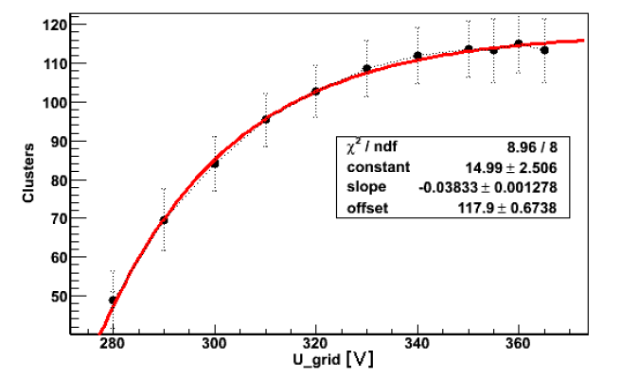
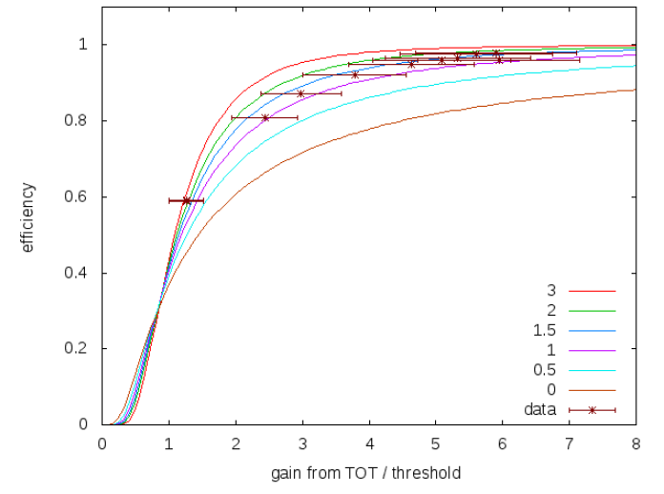
Efficiency for single electron detection

Slide 13
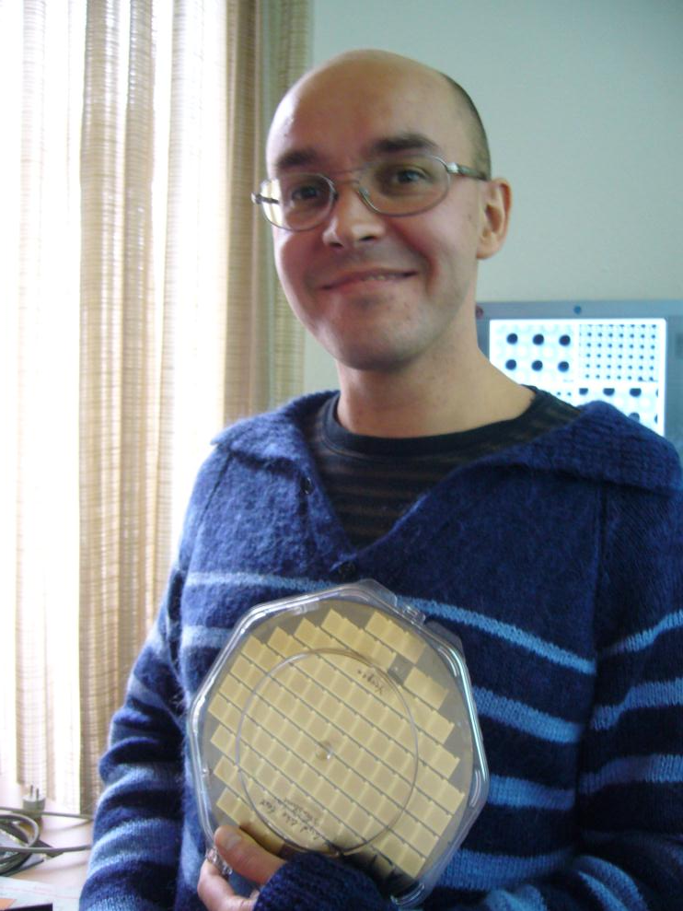
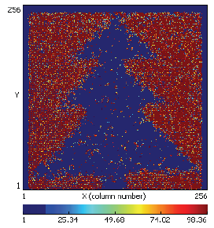
December 15, 2011 : good news, Yevgen Bilevytch came with 3 boxes of 16 good InGrids on TimePix chips, done by wafer-scale post-processing at IZM Berlin. Boxes shared between Bonn, Nikhef and Saclay
Tested by Harry van der Graaf et al. before Christmas.

Slide 14
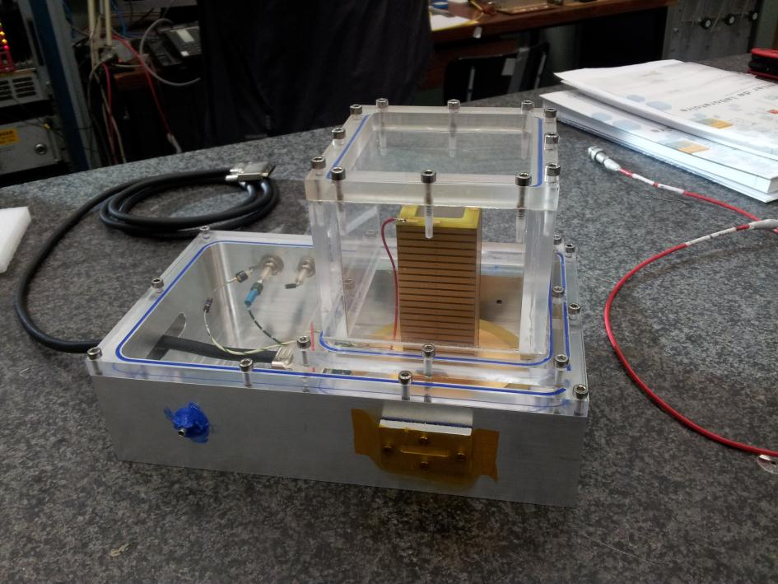
At Saclay we bonded 5 chips on boards.
At first they had a wrong connection to HV
After correcting this, a 1st chip worked for 1-2 days, and suddenly died at the highest voltage in Ar Isobutane 5%
A second chip looked unstable and was discarded
A 3rd chip is now taking good data in our new, optimized gas box (Heinrich Schindler, Rob Veenhof). Calibration, electron counting, efficiency vs threshold, avalanche fluctuations, are ongoing

Slide 15
Threshold calibration using 10 -> 50 mV on a capacitor
Threshold can be set as low as 500 electrons (used to be 700)
WORK RE-STARTED AND IN PROGRESS !

