Slide 1
The ALICE TPC upgrade
C. Garabatos, GSI
for the TPC group

Slide 2
The largest TPC ever
5 m x 5 m
High mechanical precision: 200 μm
100 kV in central electrode
Cooling everywhere
Wire chambers with pad readout
Ne-CO₂(-N₂)
Designed for dN/dy = 8000 (now 1600) and 200 Hz readout rate Pb-Pb

Slide 3
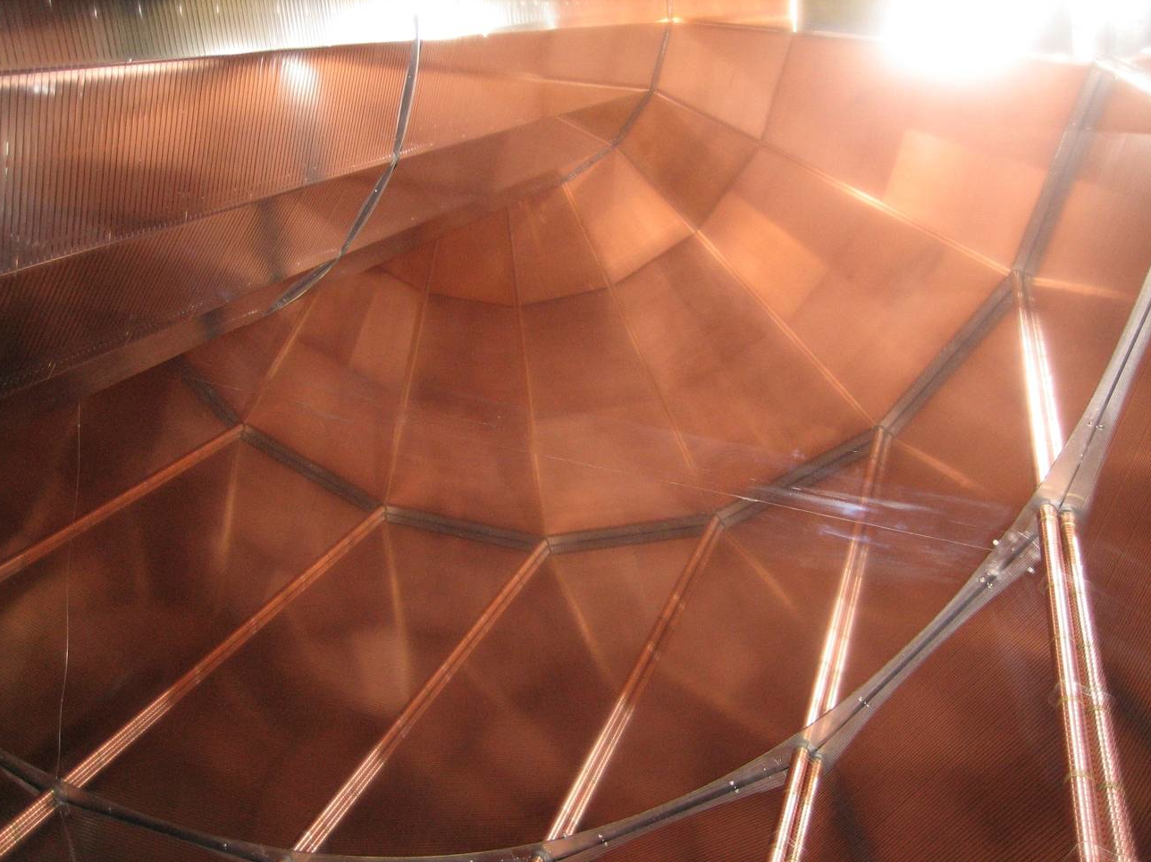

Slide 4
Challenging requirements for the gas
High
Multiplicities
High Rate
(200 Hz)
Momentum
Resolution
dE/dx
Resolution
Occupancy
2 track res.
Field
Distortions
Drift speed
(max. HV)
Multiple
Scattering
Signal/
Noise
Argon
CO₂
Hydrocarbons
Neon
CF₄
Small pads:
4 × 7.5 mm²
Neutrons
Ageing
?
???
?
Flammability
Gain:
2 × 10⁴
Concentration:
90-10

Slide 5
Gas dependencies: calibration challenge
Drift velocity | 90-10 | 90-10-5
Temperature | +0.37 % / K | +0.34 % / K
Pressure | -0.15 % / mbar | -0.15 % / mbar
CO₂ concentration | -7.6 % / %CO₂ | -6.4 % / %CO₂
N₂ contamination | -1 % / %N₂ | -1 % / %N₂
Gain | 90-10 | 90-10-5
Temperature | +0.9 % / K | ? % / K
Pressure | -0.34 % / mbar | ? % / mbar
CO₂ concentration | +67, -20 % / %CO₂ | +17, -14 % / %CO₂
N₂ contamination | +34 % / %N₂ | +6.3 % / %N₂

Slide 6
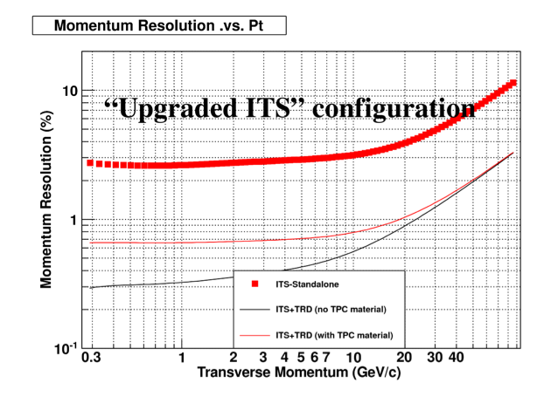
Baseline scenario: benefit from the excellent rate capability of GEMs
Continuous –untriggered- readout of Pb-Pb collisions at 50 kHz ➔ replace wires by triple GEMs
  to limit space-charge in drift volume
  cope with rate
Spatial resolution somewhat limited by space-charge, but ITS+TRD provide enough momentum resolution (3% at 80 GeV/c)
Maintain excellent PID
Perhaps a fast gas
New FE electronics
  x2 channles
Existing FC at ≤ 100 kV

Slide 7
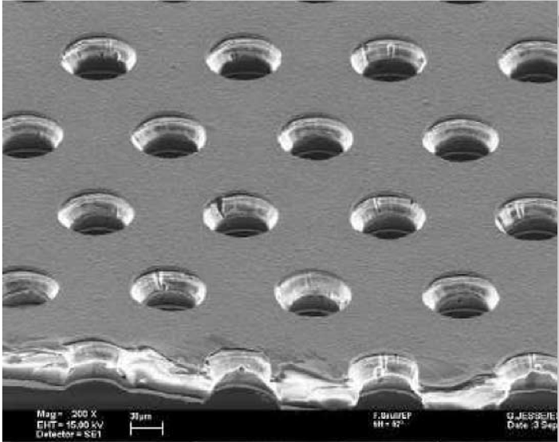
About GEMs
50 μm metalized polyimide foils with tiny holes at 150 μm spacing where amplification takes place
Signal entirely produced by electrons
Ions absorbed at the electrodes, some 0.1 % leak back into drift
Rate >10⁶ counts/mm²
Triple assembly
Segmentation to avoid
damaging discharges
Produced at CERN and others
Widely used now

Slide 8
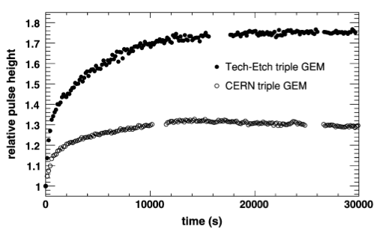
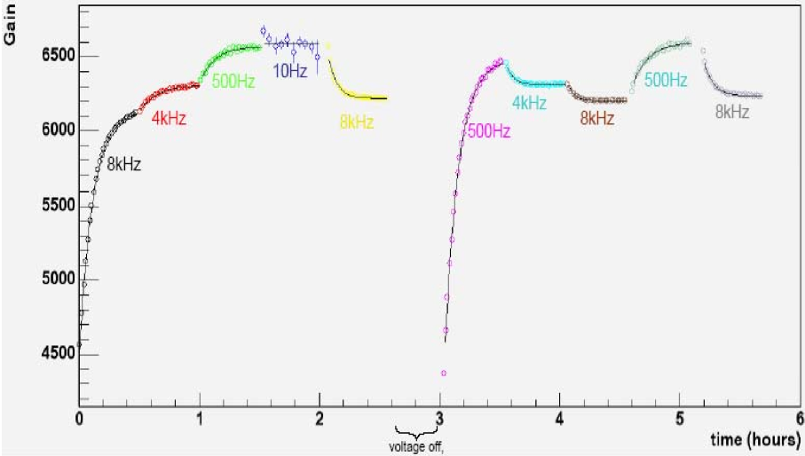
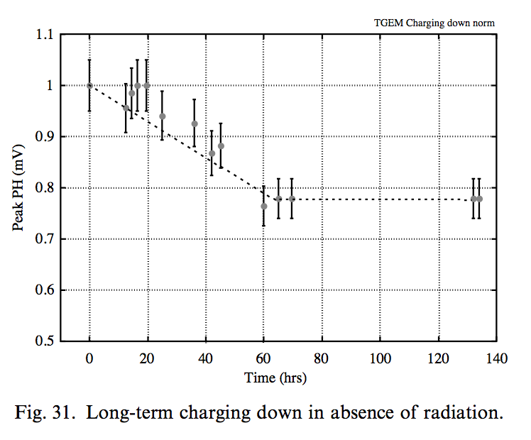
Gain dependence of GEMs
Gain increases at switch-on (30%)
Effect depends on foil properties and rate (mins-hour)
Slow decrease with time (hours/days)
Slow decrease at switch-off (days)
F. Simon et al,
IEEE TNS 54-6 (2007)
Gain depends on rate
F. Sauli et al, NIM A409 (2002)
B. Azmoun et al,
2006 IEEE NSS
Calibration issue

Slide 9
Gain dependence issue
Charge-up times at Stable Beams in ALICE probably or order of many minutes
Careful monitoring and calibration (offline, in baseline scenario) is needed
R&D on minimization of polyimide charge-up and polarization/charge migration effects is needed
  field configuration
  water? (Brrr…, not good with CF₄)

Slide 10
Fast gas: Ne-CF₄?
Up to factor 3 faster than CO₂ at 400 V/cm
Provides flexibility to choose drift field
Unfortunately, the transverse diffusion is smaller, and the longitudinal is larger, than in CO₂ (220 μm/√cm) ➔ wrong direction

Slide 11
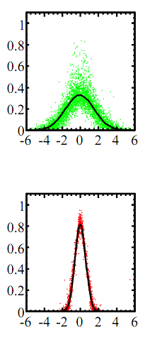
Fast gas: Ne-CF₄?
Ar-CF₄-iC₄H₈
In addition, diffusion in CF₄ shrinks with magnetic field ➔ more channels
Mobility of ions in Ne-CF₄ not known, but taking CF₄⁺ on CF₄, distortions would be 3-4 cm max., comparable with Ne-CO₂ (50 kHz Pb-Pb with 4 ions/electron leaking out) ➔ not critical
A fast gas only buys us less overlapping events (5 ➔ 2), but TPC designed for dN/dy = 8000
B = 0 T
B = 1 T
mm
Kobayashi et al,
arxiv.org/pdf/1008.5068.pdf

Slide 12
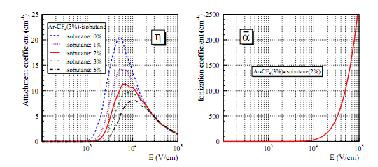
Fast gas: Ne-CF₄?
CF₄ exhibits electron attachment near and in the amplification region, leading to further gain fluctuations
Kobayashi et al,
arxiv.org/pdf/1008.5068.pdf
In addition, the compatibility of CF₄ with all materials must be validated, and H₂O must be avoided

Slide 13
Estimate of number of readout channels
At > 1 m drift distance, diffusion of order of ~2-4 mm
Probably can live with 4 mm wide pads for IROCs
Reduce the OROC pads (6 mm) to 2-3 mm
This results in roughly a factor 2 more pads: 1-1.5 M
Anyway, position resolution can be somewhat relaxed. PID is important

Slide 14
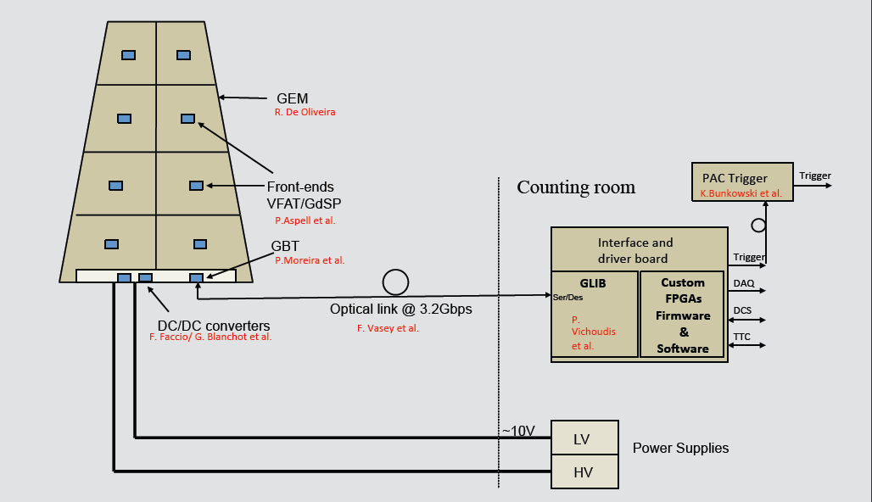
CMS High Eta Upgrade Electronics System

Slide 15
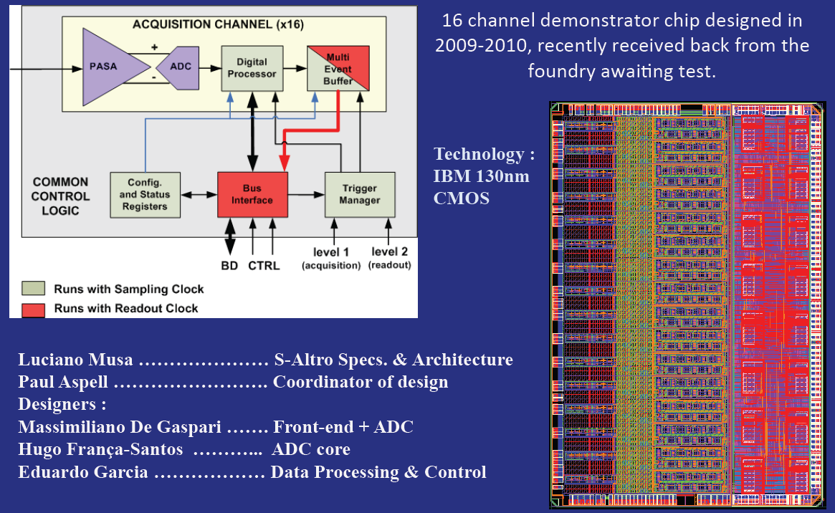
The SALTRO Demonstrator Chip
Charge amplifiers, ADC, digital processing all in one chip

Slide 16
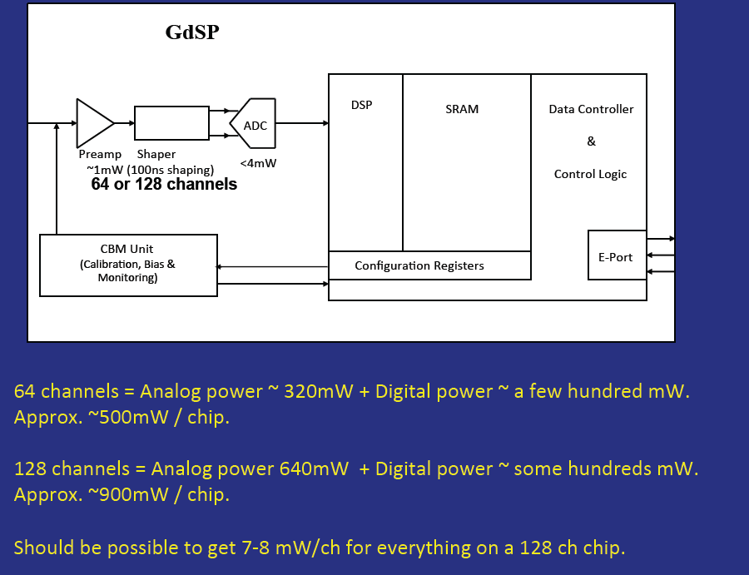
Further evolution for CMS/LCTPC
(could support continuos readout)

Slide 17
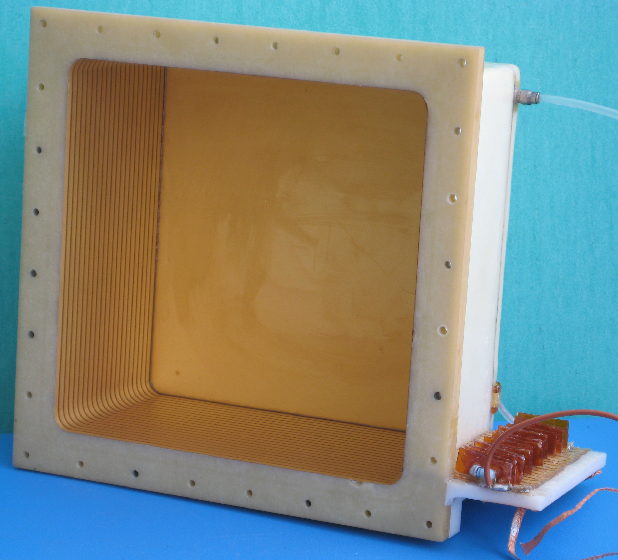
Short-term plans
Prepare a small set-up for laboratory measurements (with RD51)
  ion mobility
  ion back-flow
  gain stability
  gas mixtures
  cluster size
  field configuration
  ageing: 0.1 C/cm²/month Pb-Pb (100 times more!)
Prepare an IROC with GEMs to be exposed to p-Pb in the cavern
  main goal is to prove stability of GEMs under LHC conditions (unfortunately no Pb-Pb), including gain behavior
  exact running conditions to be worked out now

Slide 18
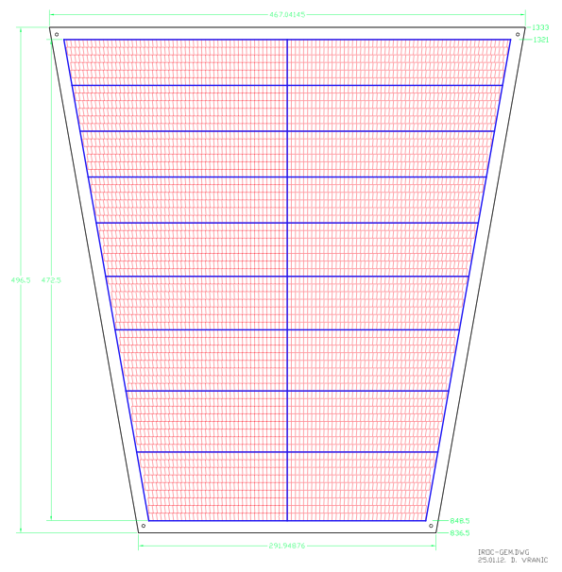
Fit a triple GEM into a spare IROC
GEM foils being designed by the Munich group
No problem to produce single-mask full surface GEMs
  perhaps thin frames in the active area are needed to prevent sag
Enough feed-throughs in chamber support to power 6 electrodes
Segmentation (≤100 cm²) results into 19 segments
FC box needs a ‘last resistor’ to match the drift field to the potential of 1st GEM
1-2 chambers will be prepared

Slide 19
Schedule
2012: prepare, and carry out, test in the ALICE cavern and basic R&D
  decision to go ahead
  define the project: chambers and readout
2012: build Collaboration
2012-2017: design, produce, test
2018: installation

Slide 20
Conclusions
Use existing Field Cage with GEM readout and new electronics for continuous readout in Pb-Pb at 50 kHz
Start tests now; put a prototype in the experiment
Staying with the current, slow gas would save short-term R&D on
  ion mobility
  ‘PRF’
  compatibility with materials and water
  electron attachment
Start search for collaborators now

Slide 21
BACKUP SLIDES

Slide 22
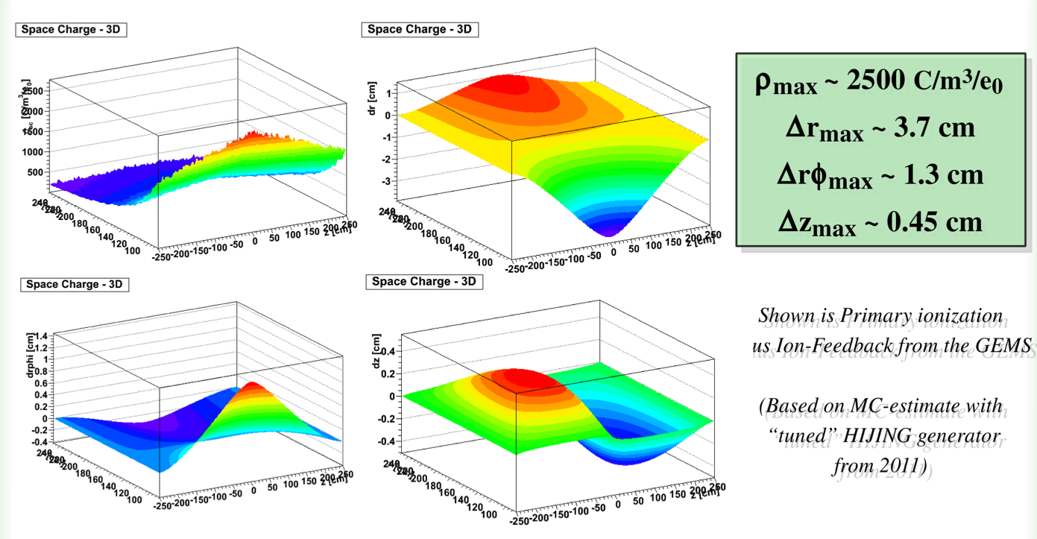
GEM with Ne-CO₂ – Space-charge distortions
50 kHz Pb-Pb, 4 ions leakage per primary electron
S. Rossegger

Slide 23
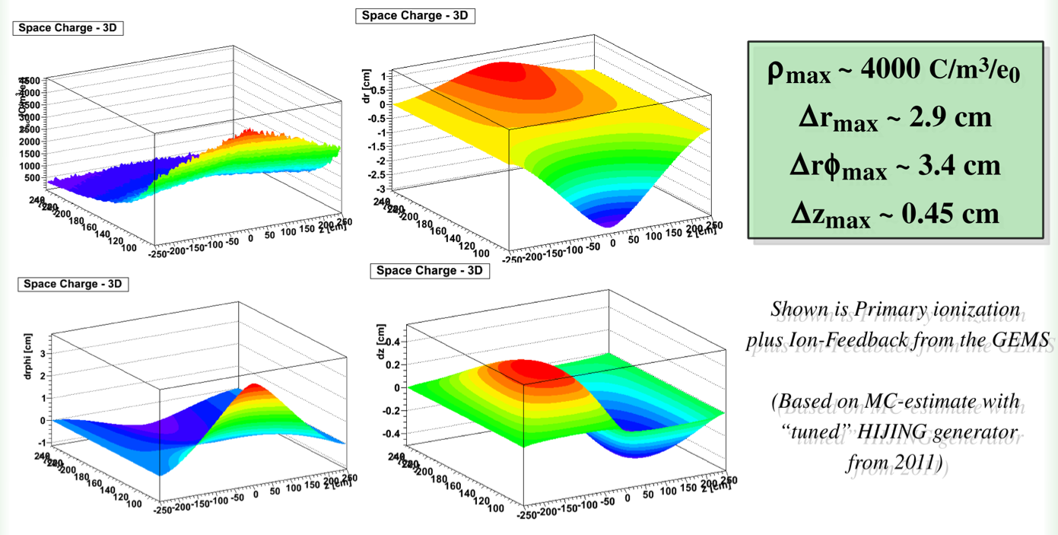
GEM with Ne-CF₄ – Space-charge distortions
S. Rossegger
50 kHz Pb-Pb, 4 ions leakage per primary electron

Slide 24
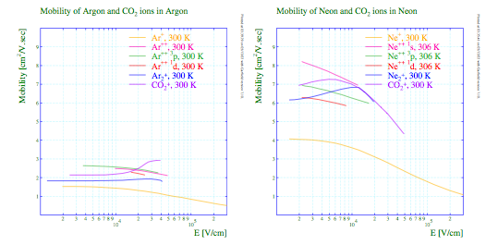
Ion mobility in Ar and Ne
No information found on ion mobility of Ne-CF₄ mixtures. It must be measured

