Slide 1
Thin and high-pitch laser-etched mesh manufacturing and bulking"
RD51 Common Projects
(INFN Bari, CEA Saclay, CERN)
V. Berardi, P. Colas, Rui de Oliveira

Slide 2
Motivation
Thin foil (5 micron Cu for instance) to maximize the gain
High pitch (>1000 lpi) to reduce ion backflow (see NIM A 535 (2004) 226)
As a conclusion it is expected that the optimal ion backﬂow conditions will be fulﬁlled with a 1000 lpi mesh for 100 micron gap, and with a 1500 lpi mesh for 50 micron:

Slide 3
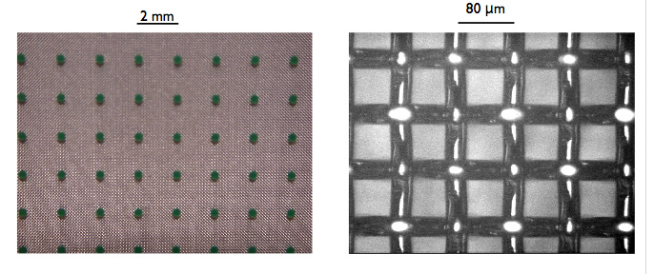
Bulking of thin meshes
Presently ‘bulk’ Micromegas are made with woven meshes, 380-450 lpi.
Let us try electroformed thin meshes

Slide 4
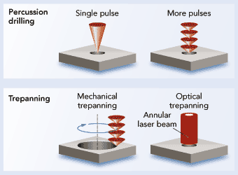
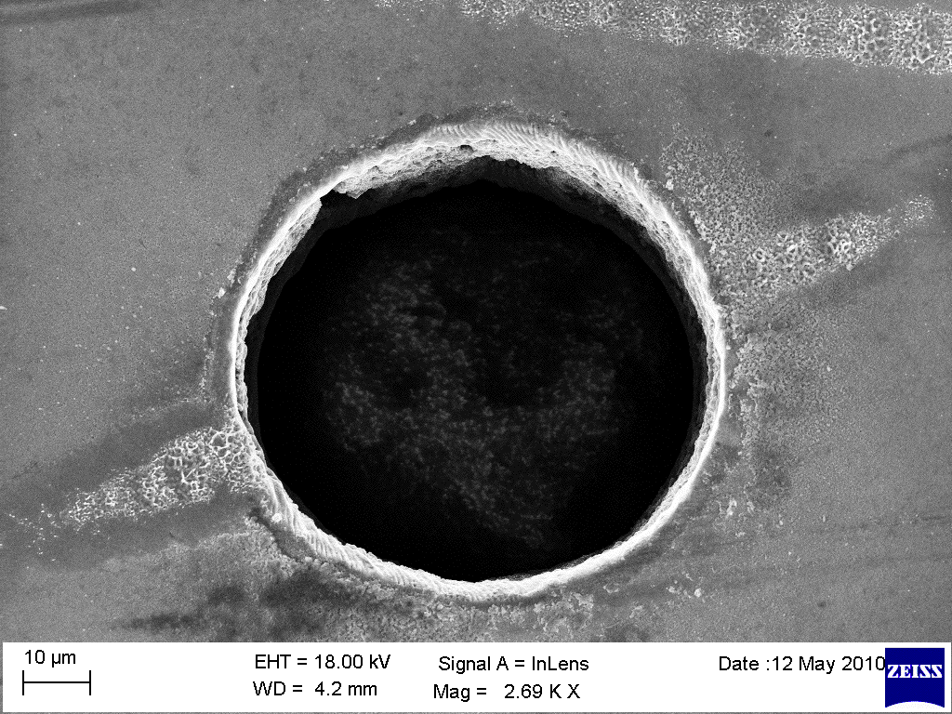
Ultrafast laser drilling
New high-rate ‘fs’ lasers make it possible to drill more perfect holes (no melting) in quantities.
Might replace wet etching for some materials (ceramics) or down to 10 µ diameter
Various processes at various time scales
fs
ps
ns
µs
Laser trepanned hole

Slide 5
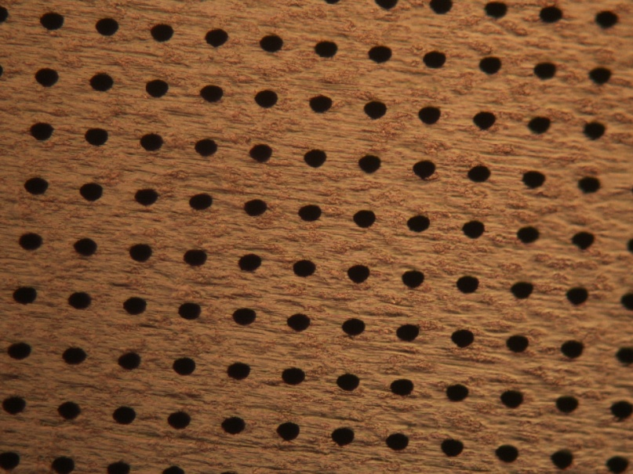
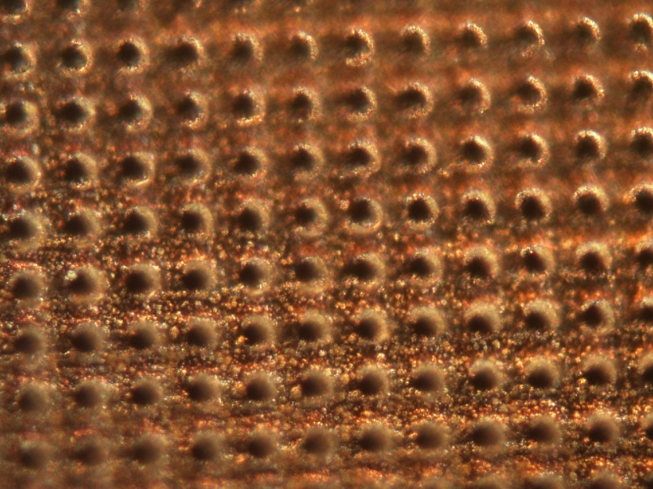
Fori Cu 20x20_50ms_500mW_inf_50x
Fori Cu 20x20_50ms_500mW_50x
Fori 50ms_700mW_50x

Slide 6
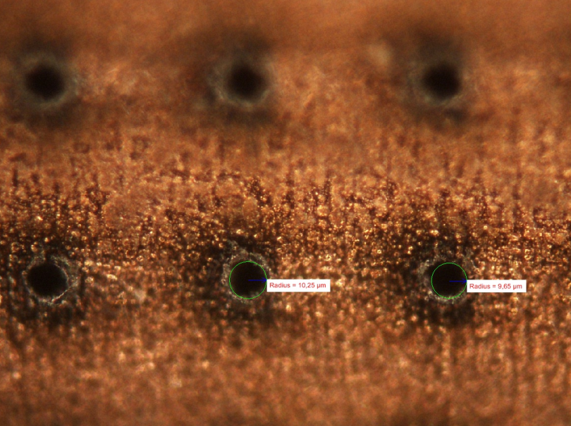

Slide 7
Duration, Milestones and Funding
The project is for an initial duration of 1 year, starting Feb. 15, 2012
There will be presentations in every collaboration meeting (mid-June and early October)
The tasks will be shared as follows:
  Bari : improve laser punching technique
  CEA Saclay : test of meshes, gain ion back-flow
  CERN: bulking with various meshes
Funding: 19 000 CHF (8 000 Bari, 5000 Saclay, 6000 CERN)

