Slide 1
The design and preliminary tests of microstrip-microgap RPC
(M-M-RPC)
P. Fonte¹, R. Oliveira²,G. Paic^{2,3}, V. Peskov^{2,3}
F. Pietropaolo⁴, P. Pichhi⁵
¹LIP, Coimbra, Portugal
²CERN, Geneva, Switzerland
³UNAM, Mexico
⁴ INFN Padova, Padova, Italy
⁵INFN Frascati, Frascati, Italy

Slide 2
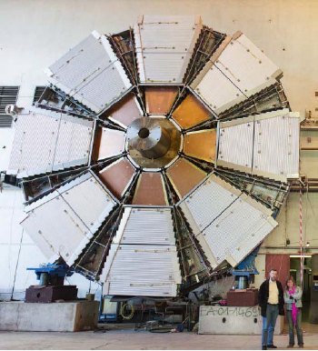
There are some experimental conditions which require detection of particles or gammas with high position and time resolutions
Typical example: upgrade ATLAS wheel, TOF PET, X-ray scanners
Today we will report about the first step in this direction:
development high position and time resolutions detectors

Slide 3
1. Detector design

Slide 4
M-M- RPC manufacturing steps:
Multilayer PCB with a Cu
layer on the top and
one layer of readout strips
on the bottom, 0.5 pitch
a)
b)
v
v
Upper Cu layer etching
0.035mm
c)
The grooves were then
filled with resistive paste
(ELECTRA Polymers
0.5 mm
0.2mm
d)
Removal of the Cu
Resistive strips
If necessary, filling with
Coverlay (an option)
e)
Readout strips
0.1mm

Slide 5
Top view:
Contact
pad
A
Surface resistivity
100kΩ/□ (can be
adjusted to exper.
needs)
Total resistivity of
the zone B 500MΩ
(adjustable)
Resistivity of
zones A and C
500MΩ (adjustable)
B
C
Contact
pad
Resistive strips

Slide 6
This plate is in fact a reproduction of the resistive MICROMEGAS anode board
The idea is to assemble from these plates a parallel- plate detector (M-M-RPC), so that mesh is not used

Slide 7
Artistic view of the M-M RPC
PCB sheet
Current
Inner signal strips
Orthogonal
resistive strips
From these plates RPC were assembled with gaps ether 0.5 or 0.18mm

Slide 8
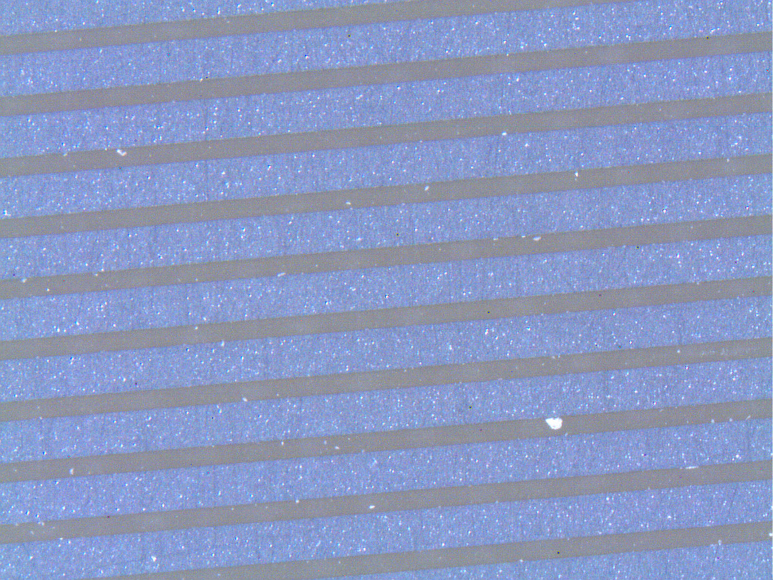
Magnified photograph of the inner surface of the M-M- RPC

Slide 9
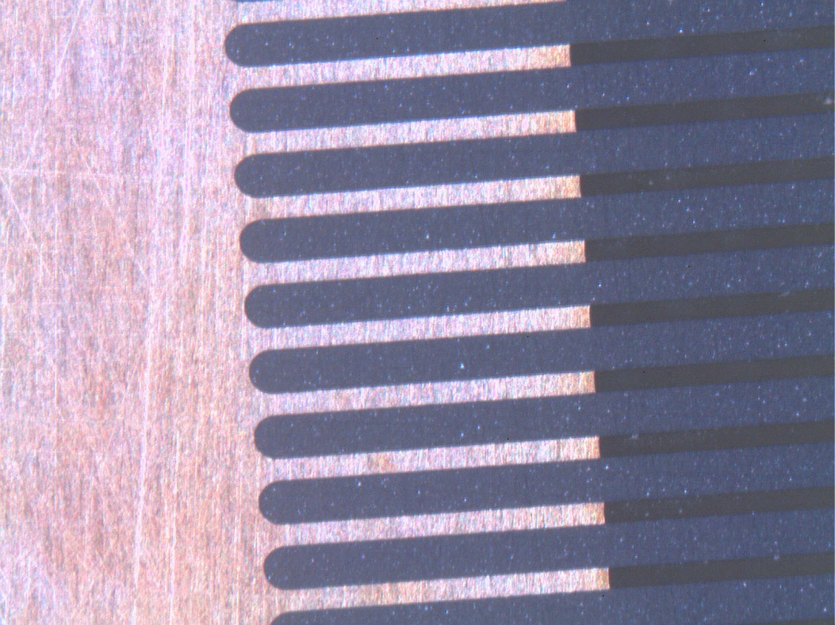
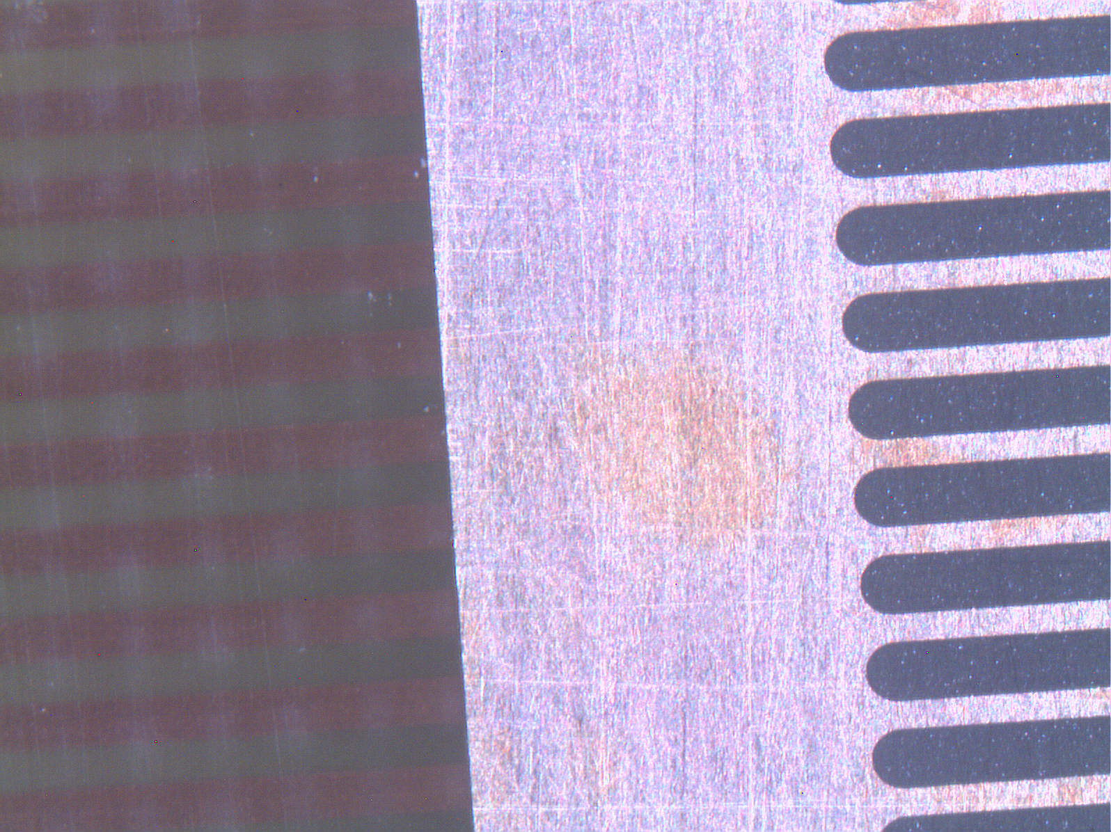
Resistive strips
Readout strips
located below the resistive strips

Slide 10
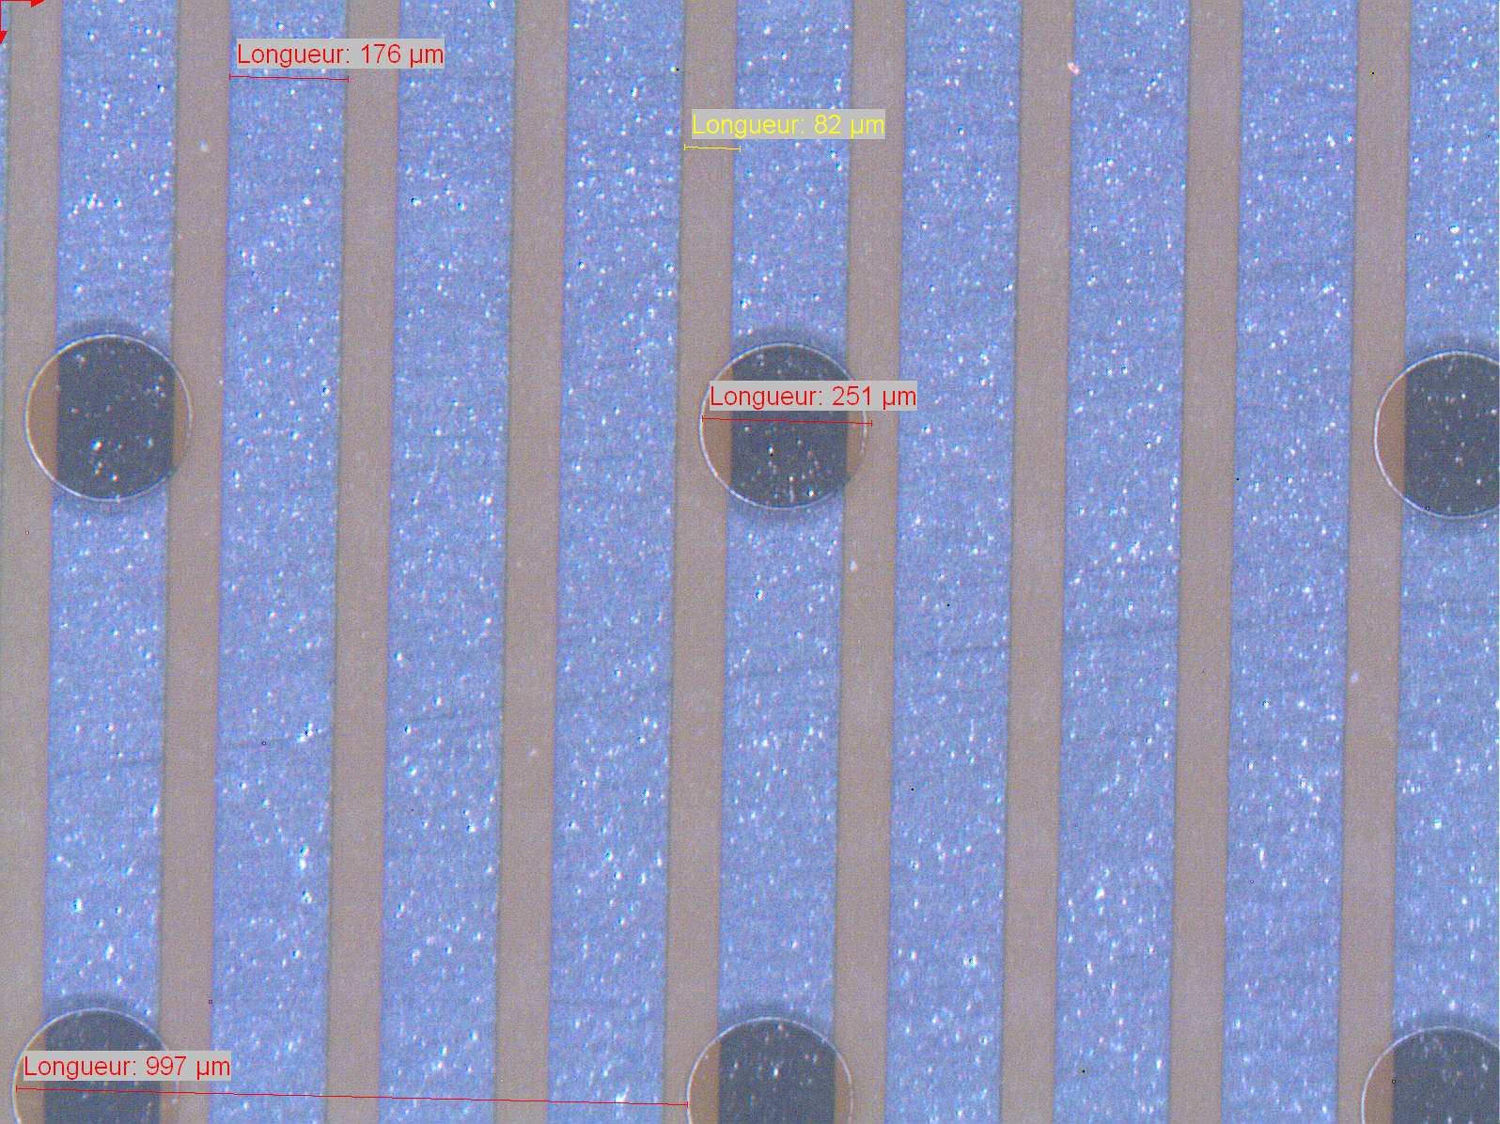
An option with pillars

Slide 11
A fundamental different between “classical “ RPC and M-M- RPC
Usual
RPC
“Signal”
electrodes
Current
500MΩ
M-M-RPC
Film resistor
Current
Orthogonal
resistive strips
Inner signal strips
M-M-RPC offers high2D position resolutions (with orthogonal strip or various stereo
strip arrangements to avoid ambiguity) and good timing properties

Slide 12
2. Experimental setup

Slide 13
Sr source
Window
Collimator
UV lamp or X-ray gun
Betas
V_{c}
V_{a}
M-M-RPC
Inner strips
Gas chamber
Signal pickup
strips
Charge-sensitive amplifiers (a possibility)

Slide 14
3. First results
(Preliminary measuremenst of basic characteristics: gas gain, induced charge profile in Ar+ethane and Ar+CO2 in order to compare with results obtained with mesh RPC and with resistive MICROMEGAS)

Slide 15
3.1. Gain measurements

Slide 16
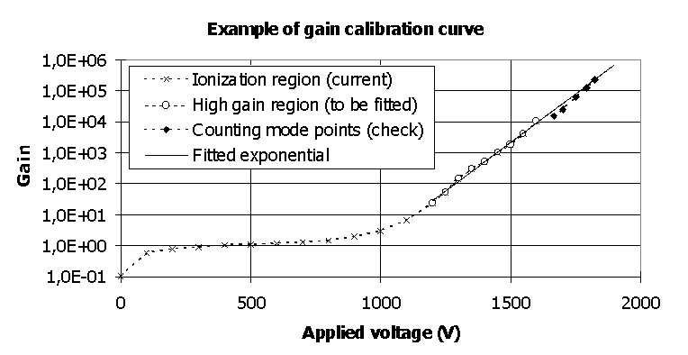
Gain estimation in detectors with a cathode mesh:
Drift mesh
Cathode mesh
X-rays
Anode
P. Fonte et al., arXiv:physics/9803021, 1998

Slide 17
Gain estimation in an RPC geometry:
Photoelectron tracks
0.5mm
X-rays
Fe anode
0.1-0.2mm
UV
CsI layer
Due to the time constrains the CsI coating was done by a spray technique

Slide 18
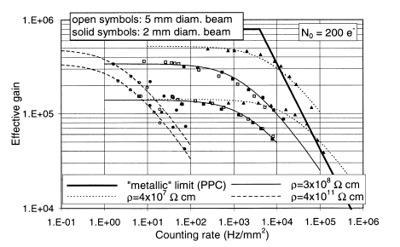
P. Fonte et al., NIM A431,1999, 154

Slide 19
R-R-RPC with spacers in corners
Preliminary estimations:
no good plateau, charging up(?), space charge( ?)…

Slide 20
The highest gains were obtained among all resistive micropattern detectors
(to be discussed)

Slide 21
3.2.Charge profile measurements
The current prototype have not connectors allowing to readout all strips independently

Slide 22
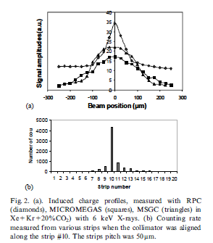
Preliminary (step-strip scan)!
Anode strip
Induced signal profile measured with 0.5mm gap M-M-RPC in Ar+25%CO2
Cathode strip
I. Crotty et al., NIM A505, 2003, 203

Slide 23
Preliminary: R-R-RPC with pillars
Region of current instability
More studies should be done
(Changes in CsI? Problem with pillars?)

Slide 24
Conclusions:
•Preliminary it looks like M-M-RPC can be an interesting alternative to R-MICROMEGAS
• Certainly more work should be done to prove this.
• Potential advantages: good position and time (much below ns) resolutions, possibility to apply automatic procedure to build large area M-M-RPC (no mesh)
Nearest plans:
More test with pillars and tests with Miranda CsI
Test of new designs (currently in manufacturing process)
Large- area M-M-RPC
Tests in “standard” RPC gases ensuring high time resolution
( in these studies Ar based mixtures were chosen
to compare to PPAC and resistive MICROMEGAS )
Study CsI coating as a sec. electr. emitter
Work more closely to J. Wotschack and P. Fonte
group on applications for muon detection and TOF PET

