Slide 1
Development of
GridPix Detector for Dual Phase Noble Gas
Time Projection Chambers
M. Alfonsi, N. van Bakel, M. P. Decowski, H. van der Graaf, G. Hemink, R. Schön

Slide 2
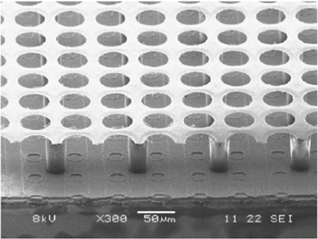
The GridPix detector
The GridPix is a Micro-Pattern Gaseous Detector made of an aluminum mesh (grid) built over a Timepix, a pixelated CMOS chip.
Gas amplification is produced in the 50 µm gap between the grid and the chip.
The Timepix chip provides readout with a matrix of 256 x 256 pixels, 55 µm pitch.
A thin resistive layer protects the chip against discharges.

Slide 3
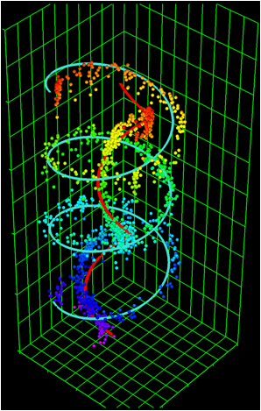
GridPix features
Single electron detection efficiency > 98 %
< 20 µm spatial resolution
Time coordinate (µTPC)
Low noise electronics: threshold ~1000 electrons
See special session tomorrow!

Slide 4
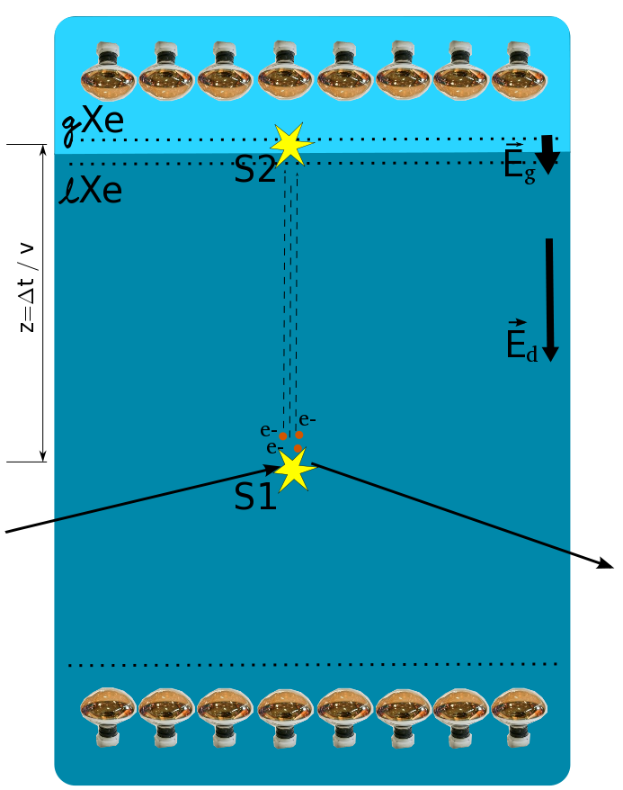
Dual phase noble gas TPC
Prompt light (S1) is collected by photodetectors arrays, electrons drift to liquid surface
Charge is converted to light in the gas phase by proportional scintillation (S2)
Time Projection Chamber:
Z from S2 – S1 time delay
S1/S2 ratio: large discrimination power between electronic and nuclear recoils

Slide 5
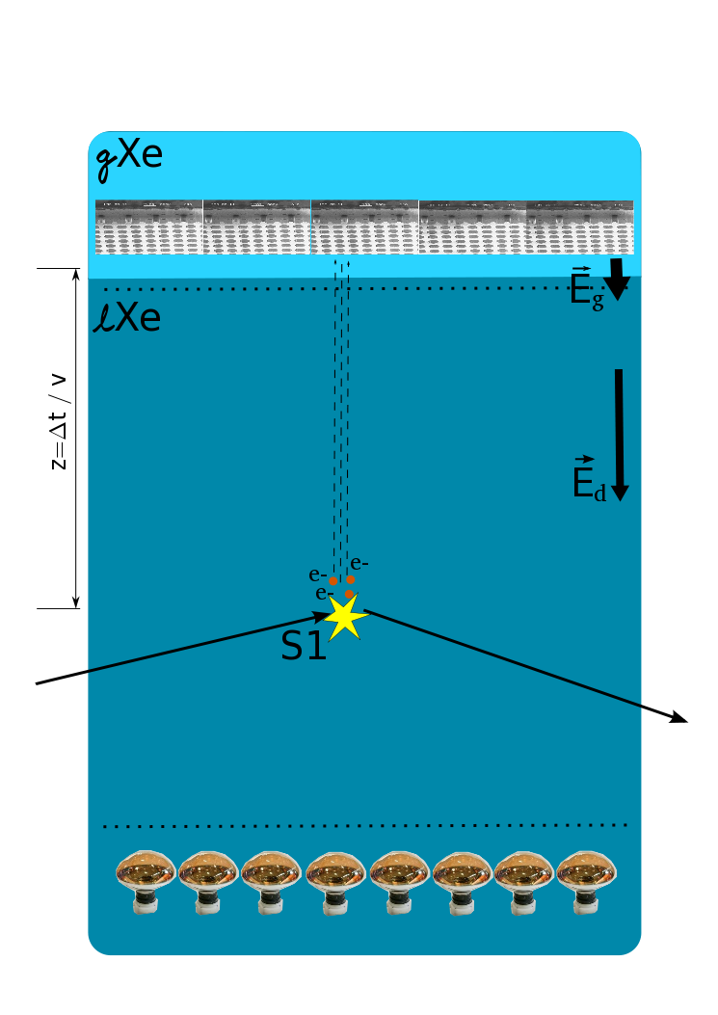
Direct charge readout
Within the DARWIN Consortium [arXiv:1012.4767], direct charge readout is under investigation: GridPix technology is one candidate
The trade-off for worse S1 light collection must be a high single electron efficiency!

Slide 6
GridPix in Dual Phase TPC
Main challenges for the technology:
Cryogenic environment
Stable operation in pure noble gas
Low outgassing properties
Material radiopurity

Slide 7
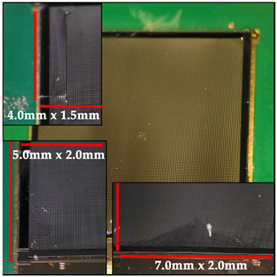
Cryogenic robustness
Thermal stress along the border due to materials with different thermal expansion properties

Slide 8
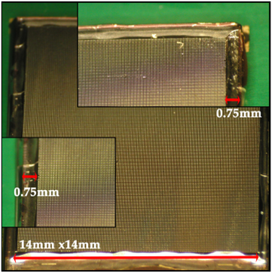
Cryogenic robustness
The border has been reinforced with glue
Thermal stress along the border due to materials with different thermal expansion properties

Slide 9
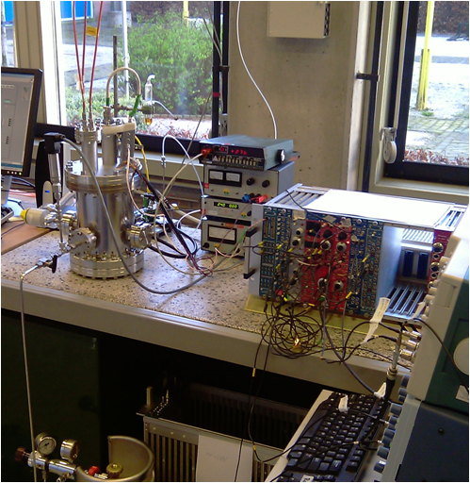
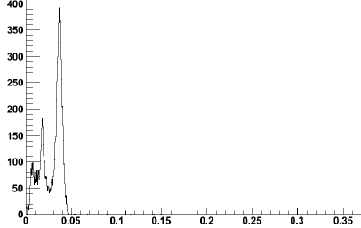
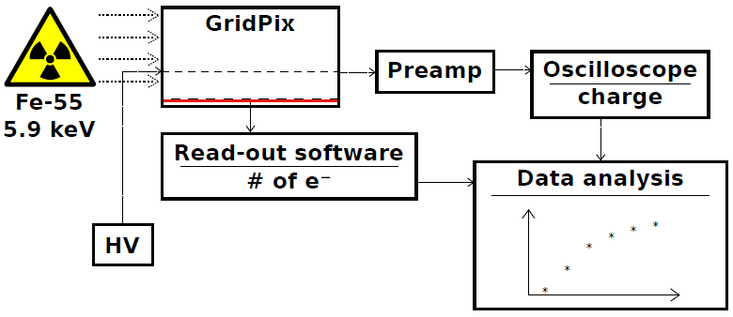
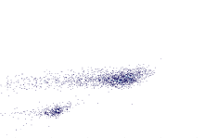
Room temperature measurements @ Nikhef
Trigger
Q
N_{e-}
The signal on the grid has been read out and used to trigger the pixel readout.

Slide 10
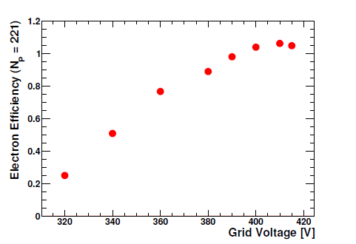
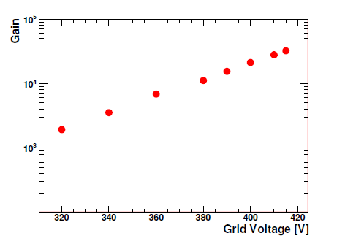
Reference mixture: Ar/isobutane 90/10
The gain is measured from the signal collected on the grid, comparing it with a calibration pulse
10⁴
Single electron efficiency
N_{primaries} detected
N_{primaries} reported in literature
10³

Slide 11
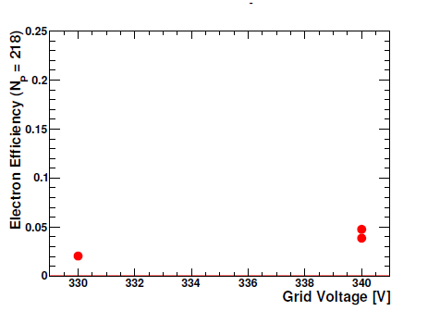
Argon without quenchers
Without quenchers sparking begins already at moderate voltages. The maximum achievable gain can be extrapolated to be around 100.

Slide 12
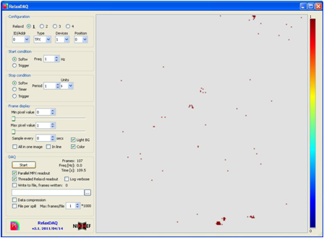
Argon without quenchers
Without quenchers sparking begins already at moderate voltages. The maximum achievable gain can be extrapolated to be around 100.
In very pure (1 ppm level) argon the signal on the grid is too low to trigger: events are shown using long integration window

Slide 13
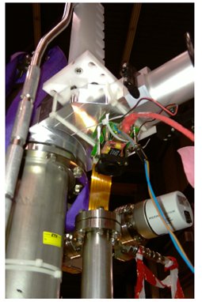
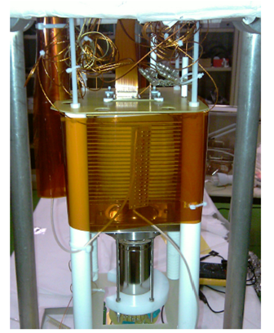
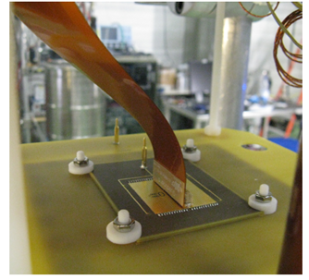
Measurements @ CERN
In collaboration with the ETH Zurich:
gaseous warm / cold argon TPC.
dual phase argon TPC.

Slide 14
Room temperature argon
CERN results confirm the observations @ Nikhef
PMT allows to trigger and select single events.

Slide 15
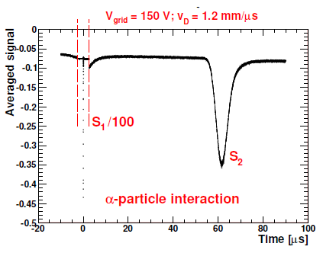
Cold argon gas
The amplification of the GridPix can be verified in the light detected by PMT.
Average waveform (A.U.)

Slide 16
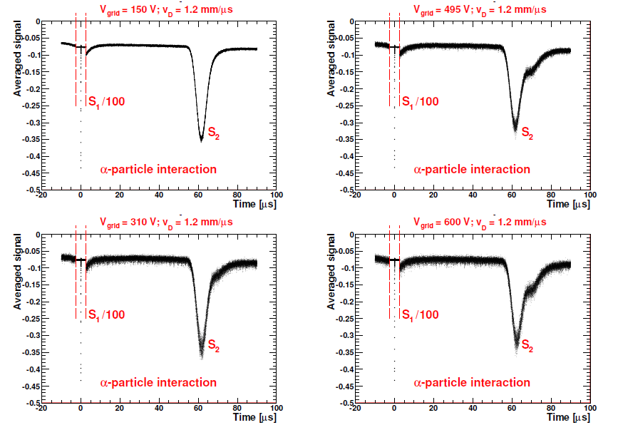
Cold argon gas
Average waveform (A.U.)
Average waveform (A.U.)
Average waveform (A.U.)
Average waveform (A.U.)

Slide 17
Towards dual phase argon
In a cold gas environment the higher gas density (almost 3 times) requires higher grid voltages to achieve the same gain.

Slide 18
Towards dual phase argon
In a cold gas environment the higher gas density (almost 3 times) requires higher grid voltages to achieve the same gain.
Before going to dual phase argon, we pushed the detector beyond specification. Unfortunately a spark damaged the threshold circuitry of the chip.
Hereafter we filled the TPC with liquid argon: the detector still sustained the high voltage, but when we warmed up and opened the vessel…

Slide 19
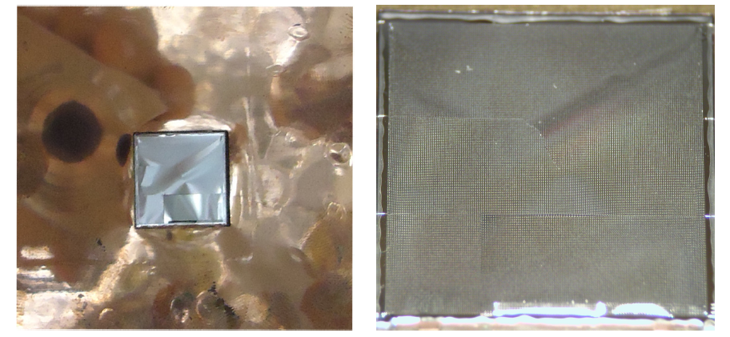
Damaged grid
… the grid showed wrinkles and ruptures in several spots
The reason of the damage cannot easily be inferred (during the warm up? the liquid argon boiling during filling? even before?)

Slide 20
Lessons learned so far
The technology in the current status does not fulfill the requirements. On the other hand, nanotechnology employed in production gives many possibilities.
The materials composing the device can be chosen and should have similar thermal expansion properties.
Different geometry can help to reduce spark probability.
In literature you find:
  Closed geometries to limit photon propagation
  Resistive electrodes

Slide 21
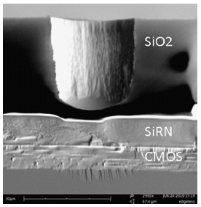

Towards full ceramics
Recently efforts are on-going towards full ceramics devices:
  SiO2 as insulator
  SiRN is the resistive material already employed in the protection layer
Matching thermal expansion properties
Interesting also for outgassing properties and radiopurity

Slide 22
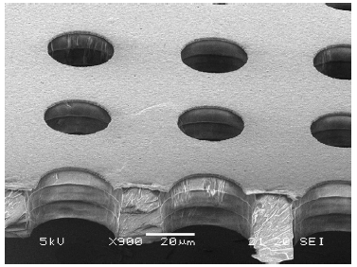
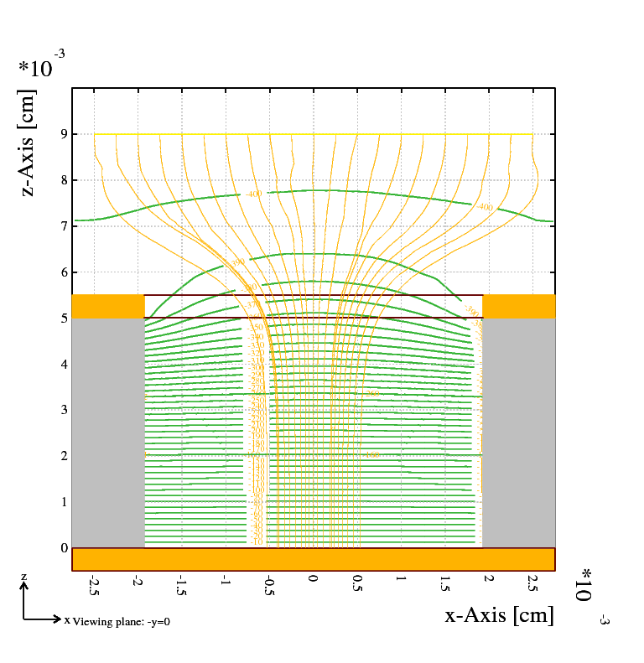
Closed geometries
First test on old “GEMGrid” prototypes (no Timepix – aluminum anode)
  Too small gain even with quenchers: small holes constrained avalanche?
Test planned with a GEM placed very close to a Timepix.
R&D on ceramics GridPix can produce GEMGrids as side product
(stop SiO₂ etching earlier)

Slide 23
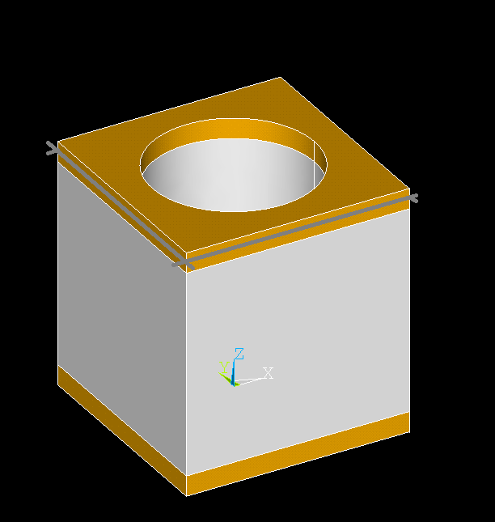
Resistive grid
A resistive grid can limit the charge available for a spark to only one cell.
An embedded conductive network can distribute voltage uniformly
1 μm corona, 20 μm radius
C ≈ 0.01 fF
Q ≈ 10000 e⁻ @ 300V
20 μm

Slide 24
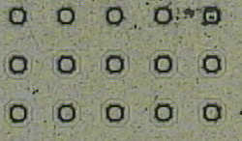
Resistive grid
A resistive grid can limit the charge available for a spark to only one cell.
An embedded conductive network can distribute voltage uniformly
1 μm corona, 20 μm radius
C ≈ 0.01 fF
Q ≈ 10000 e⁻ @ 300V
20 μm
Note: double pitch (w.r.t. pixels pitch) maybe helps first prototypes production

Slide 25
Crazy idea
Raise liquid level till inside holes:
Can liquid (ε_{r}^{liq} > ε_{r}^{gas}, λ_{r}^{liq} < λ_{r}^{gas}) dump streamer propagation to electrodes?
Can ions drift back to grid?
Enough gas recirculation?
…
Readout
-
-
-
-
-
-
-
-
-
-
-
-
-
-
-
-
-
-
-
-
+
-
-
-
-
-
-
+
-
+
+
+
+
+
+
+
?
Grid

Slide 26
Crazy ideas
Raise liquid level till inside holes:
Can liquid (ε_{r}^{liq} > ε_{r}^{gas}, λ_{r}^{liq} < λ_{r}^{gas}) dump streamer propagation to electrodes?
Can ions drift back to grid?
Enough gas recirculation?
…
Readout
-
-
-
-
-
-
-
-
-
-
-
-
-
-
-
-
-
-
-
-
+
-
-
-
-
-
-
+
-
+
+
+
+
+
+
+
?
Grid
Concept can be investigated at first with larger size
(e.g. THGEM-like) structures.

Slide 27
Conclusion and plans
First measurements highlighted the crucial points to achieve the operation of GridPix in dual phase noble gas TPC:
  The device must be built out of materials with similar thermal expansion properties.
  The proper geometry must be found in order to achieve high and stable gain.
The development can follow the general R&D on ceramic GridPix devices and several solutions have been proposed.
Finally, the operation in xenon has not been verified yet:
it is less demanding in the cryogenics aspects and it can be favorable for achieving higher gains.

Slide 28
Acknowledgements
André Rubbia’s ArDM group, especially Filippo Resnati and Devis Lussi
Bas vd Heijden and Henk Boterenbrood
Joop Rövekamp and Berend Munneke
Peter Thobe and Herman Boer Rookhuizen
.. and thanks for your attention!

Slide 29
Backup

Slide 30
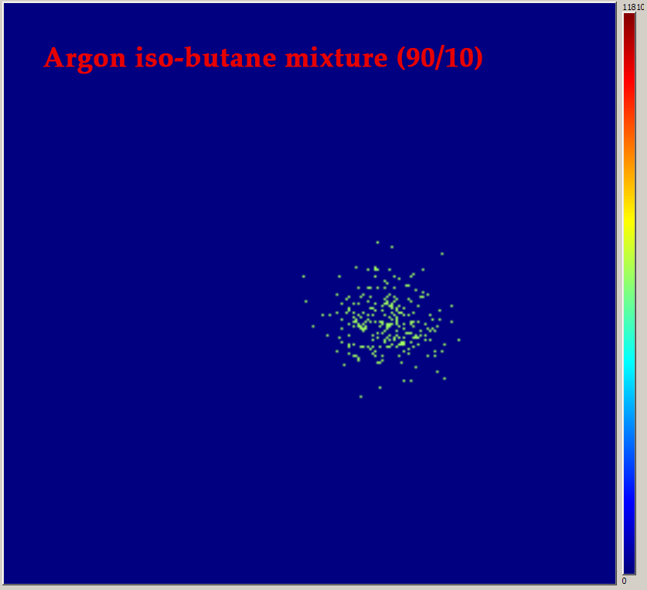
Argon/Isobutane event

Slide 31
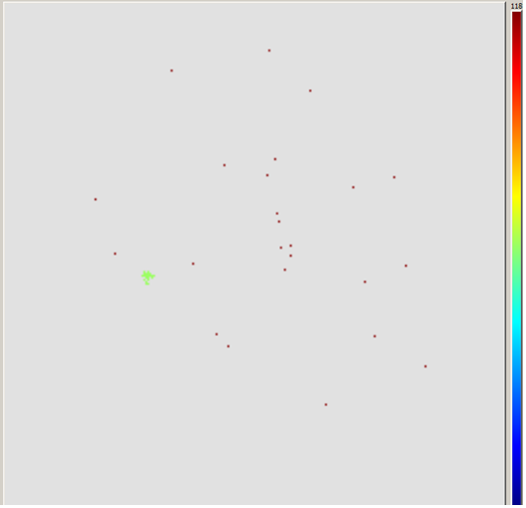
Argon 99.997% event

