Slide 1

Micromegas Operation at high presssure in a Xe+Trimethylamine mixture.
Diana Carolina Herrera Muñoz
University of Zaragoza
9th RD51 Collaboration Meeting
20-22 February 2012
CERN (Geneve, Switzerland)

Slide 2
Content
Introduction
Experimental Set-up
Optimum Fraction determination of TMA
Gas Gain and Energy Resolution at High
Pressure
Conclusions
References
1
2
3
4
5
Notes:
My presentation consist of
Briefly Introduction
Main characteristics of Experimental setup
TMA Optimum fraction determination
Energy resolution at high pressure
Conclusions
An finally The references.

Slide 3
Introduction
Xenon- filled TPCs have been studied during last years due to their interesting applications:
X-ray astronomy.
Rare decays searches: Neutrinoless double beta decay
We are interested in studying the performance of a Micromegas-HTPC for neutrinoless double beta decay in ¹³⁶Xe [1].
One of the most important challenge is to have an excellent energy resolution
Energy resolution required
Xe-TPC at 10 bar:
(~1-2 % FWHM) at Q_{ββ} (2457 keV)
Previous results in a pure Xe Micromegas-TPC at 10 bar [4]:
- Energy resolutions around 3 % at Q_{ββ} (2457 kV)
- Gas gain above 10².
The main interest was to improve this results:
One possibility is to use an additive gas.
We explore this option

Slide 4
Introduction
Previous Experimental Results
Micromegas
Xe-based Penning Mixtures
Good characteristics for rare events searches.
Low Radioactivity .
Tracking Capability.
Large areas of detector
Remarkable improvements in gas gain and energy resolutions have been observed at low pressure.
Specifically Xe-TMA mixture have shown the strongest Penning effect measured up to now.
Motivated by this earlier works a small TPC prototype has been used in order to do a systematic measurements at high pressure.
This work shows preliminary studies in a
Migromegas HP TPC.
Xe+TMA mixture
Experimental measurements consisted of two parts:
Optimum fraction was determined at 1, 5 and 8 bar.
Systematic measurements of gas gain and energy resolutions were realized
with a Xe+TMA optimum Penning mixtures for pressures between 1 and 10 bar

Slide 5
Introduction
Penning Mixture
Penning Mixture: Mixture formed by
Inert Gas + Molecular Gas
The ionization potential of additive gas must be lower and closer to the first metastable level of the primary gas.
Penning Effect: The excitation energy of the primary gas is transferred to additive gas by collisions then an increase in ionization is yield.
IP of 2nd gas is so closer to 1st M L of 1st gas
Resonance interaction is produced .
Lower values in energy resolution
Higher gas gain
Xe+TMA mixture have shown the strongest Penning effect
(see reference [3])
.
Xe
ION= 12.1 eV
TMA
1 M. LEVEL= 8.4 eV
ION = 8.32 eV

Slide 6
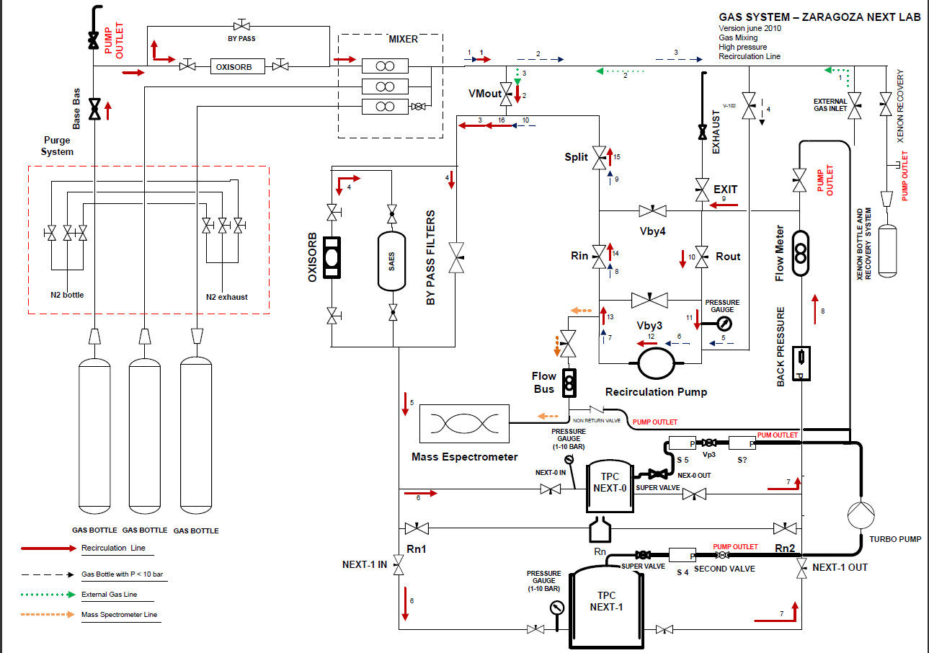
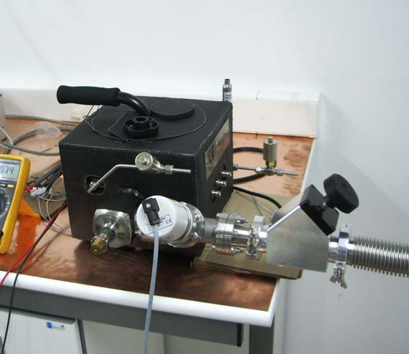
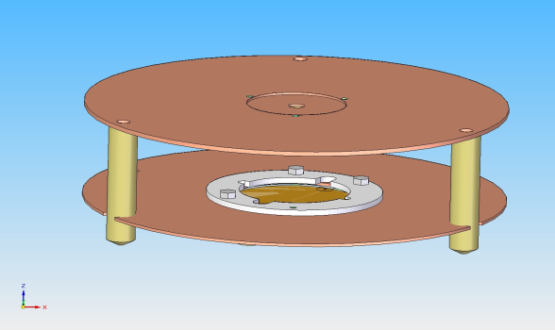
Experimental Set-up
Gas System
Turbo-molecular pump (~10⁻⁵)
Xe Recovery system
OmniStar Quadrupole Mass spectrometer
Recirculation pump
Experimental Scheme
Recovery System
2. Time Projection Chamber-2.4 L
- Built in stainless steel
- Specially treated for low outgassing rate.
- Able to workup up to 12 bar pressure.
The conversion drift
region was 10 mm
Micromegas detector
- 35 mm of diameter
- 50 um of gap

Slide 7
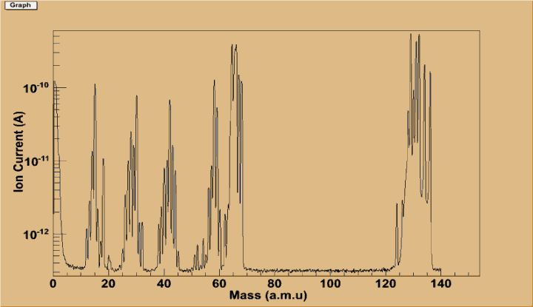
Determination of the Optimum fraction of TMA
Experimental procedure:
Measurements with a ¹⁰⁹Cd source (22.1 keV X-rays)
The TMA fraction was systematically varied at 1, 5 and 8 bar.
The mixture was continuously circulated through purifier at 5 and 8 bar.
For each mixture the following operations were realized
Measurements of gas gain and energy resolution:
Amp. voltage was systematically varied keeping Constant=Edrift/Eamp
For each voltage configuration the Energy Spectrum of ¹⁰⁹Cd was acquired
– Offline analysis gas gain and energy resolution
TMA quantification and level estimation of electronegative molecules.
At the end of each set of measurements
Energy Spectrum taken at 1 bar
Mass Spectrum Xe + TMA mixture

Slide 8
Optimum fraction at 1 bar
TMA fraction was varied from 1.7 to 12,3 %
Gas gain as a function of amplification field at 1 bar.
The gas gain increases with the TMA fraction
Gas gain reaches a maximum value
around ~ 3.4% TMA.
Energy resolution (%FWHM) as a function of gas gain at 1 bar.
Notes:
In the second one, We observe the energy res as a function of Gas gain, where is possible to observe that the energy resolution deteriorates at higher gas gains whereas at higher TMA concentrations

Slide 9
Optimum fraction at 5 bar
Fraction of TMA from 1 to 10 %
1%
2,6%
10%
Gas gain as a function of amplification field at 5 bar.
Gas gain reaches a maximum value around
~ 2.6 %.
Energy resolution (%FWHM) as a function of gas gain at 5 bar.

Slide 10
Optimum fraction at 8 bar
Fraction of TMA from 1,8 to 6,7 %
2.3%
1,8%
6,7 %
Gas gain as a function of amplification field at 8 bar.
Gas gain reaches a maximum value around
~ 2.3 %.
Energy resolution (%FWHM) as a function of gas gain.

Slide 11
Experimental Results-Optimum Fraction
~3.4%
8 bar
5 bar
~2.6 %
~2.3 %
1 bar
The gas gain was normalized to the maximum value for each pressure for a fix value of amplification field.
The best energy resolution for each mixture was selected.
We note a similar trend of the gas gain and energy resolution as function of fraction of TMA .
We define the optimum mixture as that showing the maximum gain at constant field
Optimum fraction of TMA decrease at higher pressures
Notes:
In this two graphics is possible to observe a summary of the measurements realized in order to determine the optumum fraction of TMA,
In the first one the gas gain was normailized to the maximum value for each pressure for a fix value of amplification field.
We can observed for each pressure that the gas gain rise up to reach a maximum value then star to drop down,
The energy resolutions start to deteriorate at higher TMA concentrations, but the degradation is stronger at high pressures, is necessary to take measurements at lower TMA concentration for seeing the complete tenºdency

Slide 12
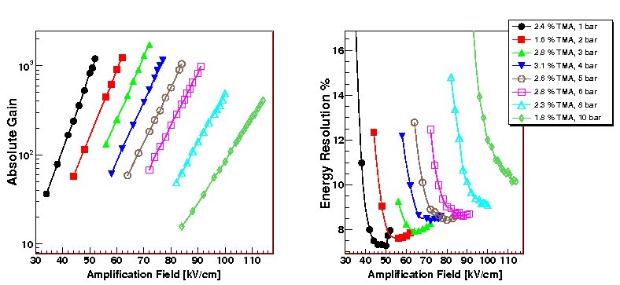
Results at high pressure
Based in these results an optimum fraction of TMA for pressures between 1-10 bar was selected (except at 2 , 7 and 9 bar ).
Gas gain
Gas gain and energy resolution (%FWHM) as a function of amplification field.
Maximum gas gain is above of 10³ for pressures between 1-6 bar
Best value of energy resolution was 7.1 % at 1 bar and de lowest value at 10 bar was 10,2 ± 0.1 %.

Slide 13
  Best Result at 1 bar
¹⁰⁹Cd Energy Spectrum at 1 bar with 6.4 % TMA
6,9 ± 0.1% at 22.1 keV
X-Rays Cu
Energy Spectrum of ¹⁰⁹Cd obtained with a mixture of 7.6 % TMA at 1 bar, where an energy resolution of 6.9 % at 22.1 keV is achived.

Slide 14
  Best Results at 10 bar
¹⁰⁹Cd Energy Spectrum at 10 bar 1,8 % TMA
10,2 ±0.1 % at 22.1 keV
X-Rays Cu
Energy Spectrum of ¹⁰⁹Cd obtained for a mixture of 1,8 % TMA at 10 bar, where is achieved an energy resolution of 10.2 % at 22.1 keV.

Slide 15
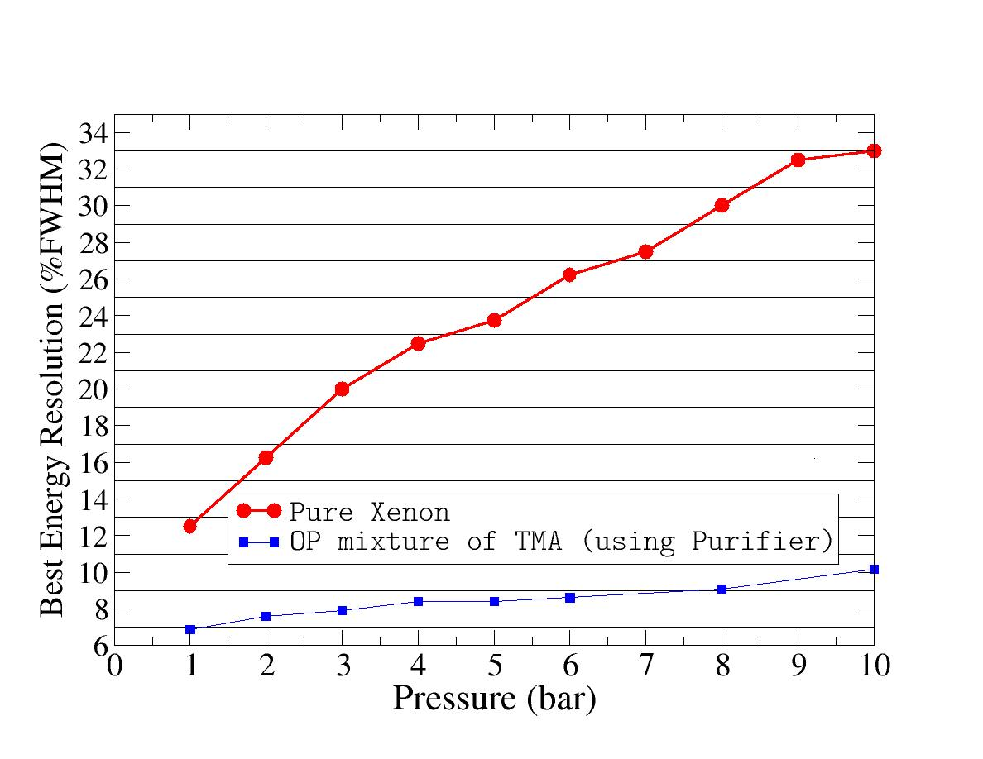
  Summary-Energy resolutions
Press (bar) | Xe+TMA | Pure Xe
1 | 6,86 | 12,5
2 | 7,61 | 16,3
3 | 7,92 | 20,0
4 | 8,4 | 22,5
5 | 8,42 | 23,75
6 | 8,61 | 26,25
8 | 9,08 | 30
10 | 10,16 | 32,5
Data taken for pure Xe Micromegas (Portugal).
Ref [4]
Data acquired in Zaragoza setup
Optimum Penning mixtures
Table I. Comparative values of energy resolution of micromegas between pure Xe and Xe+TMA mixture.
Energy resolution in function of pressure, for pure Xenon and a optimum Penning mixtures of Xe+TMA.

Slide 16
Conclusions
The tendency of gas gain as a function of fraction of TMA has the same behavior at low and high pressures, however the optimum value of TMA decreases as pressure is increased, this result is very interesting and should be studied in depth in future measurements.
Pressuere [bar] | Approximately Optimum fraction of TMA
1 | 3.4 %
5 | 2.6 %
8 | 2.3 %
The Xe+TMA mixture permits to improve the gas gain by a factor of around 3 for pressures between 1-6 bar, further at 10 bar the gas gain is around a factor 5 higher than the value obtained with pure Xe. Moreover the amplifications voltages necessary for getting this higher values of gain are almost a 30 % lower than the applied with pure Xe.
The energy resolutions in a Xe+TMA mixture is improved with respect to pure Xe from a factor of around 2 at 1 bar (12.5%→ 6.86 %) up to a factor of around 3 at 10 bar (32.5% →10.16%).
This results show that Micromegas Xe+TMA filled HPTC detector offers several advantages which make it attractive for many applications specifically for neutrinoless double decay search in ¹³⁶Xe.
Diana Carolina Herrera Muñoz
9th RD51 Collaboration Meeting

Slide 17
REFERENCES
Elliot, S., Vogel, P., Ann. Rev. Nucl. Part. Sci., 52, 115-151 (2002)
Giomataris, Y., Rebourgeard P., Robert J., Charpak G., Nucl. Instr. And Meth., A 376, 29 (1996).
Ramsey, B., Agrawal, P., Nucl. Instr. And Meth., A 278, 576-582 (1989)
Balan,C., Freitas, E. et al, Jinst, 6 P02006.
Nygren, D., J. Phy. Conference Series, 309 012006, (2011).
White, K., Fenton, A., Nucl. Instr. And Meth., A 260, 443-446 (1987)
Cebrián, S. et al, Astropart. Phys. 34, 354-359 (2011)
Cebrián, S. et al, J. Cosmol. Astropart. Phys. 10, 10 (2010)
Dafni, T. et al, Nucl. Instr. And Meth., A 608, 259 (2009)
Thank you

