Slide 1
Academia INDUSTRY matching event (AIME) on mPGD technologies
Hartmut Hillemanns, Renaud Gaglione, Catherine Adloff, Frederique Chollet
RD51 Collaboration Meeting, February 20, 2012

Slide 2
Context of the AIME
Various initiatives within the HEPTech MPGD pilot over the last 2 years:
  Technology inventory (incl. patents, production methods, lab facilities)
    Technology offer (individual and joint offers)
  Identification of potential application domains:
    Large area detectors for n and gamma imaging in homeland security applications
    Burning Plasma diagnostics (started)
    High neutron fluxes (tbd)
    Muon tomography (pre-industrial prototype, ongoing)
  Identification of opportunities for applied research projects
    User requirements (mainly homeland security)
    Identification of potential project partners
    Project submissions (CLASP, FP7, CERN KT Fund, CTI)
Further examples
  Scalable Readout System SRS
  ³He replacement

Slide 3
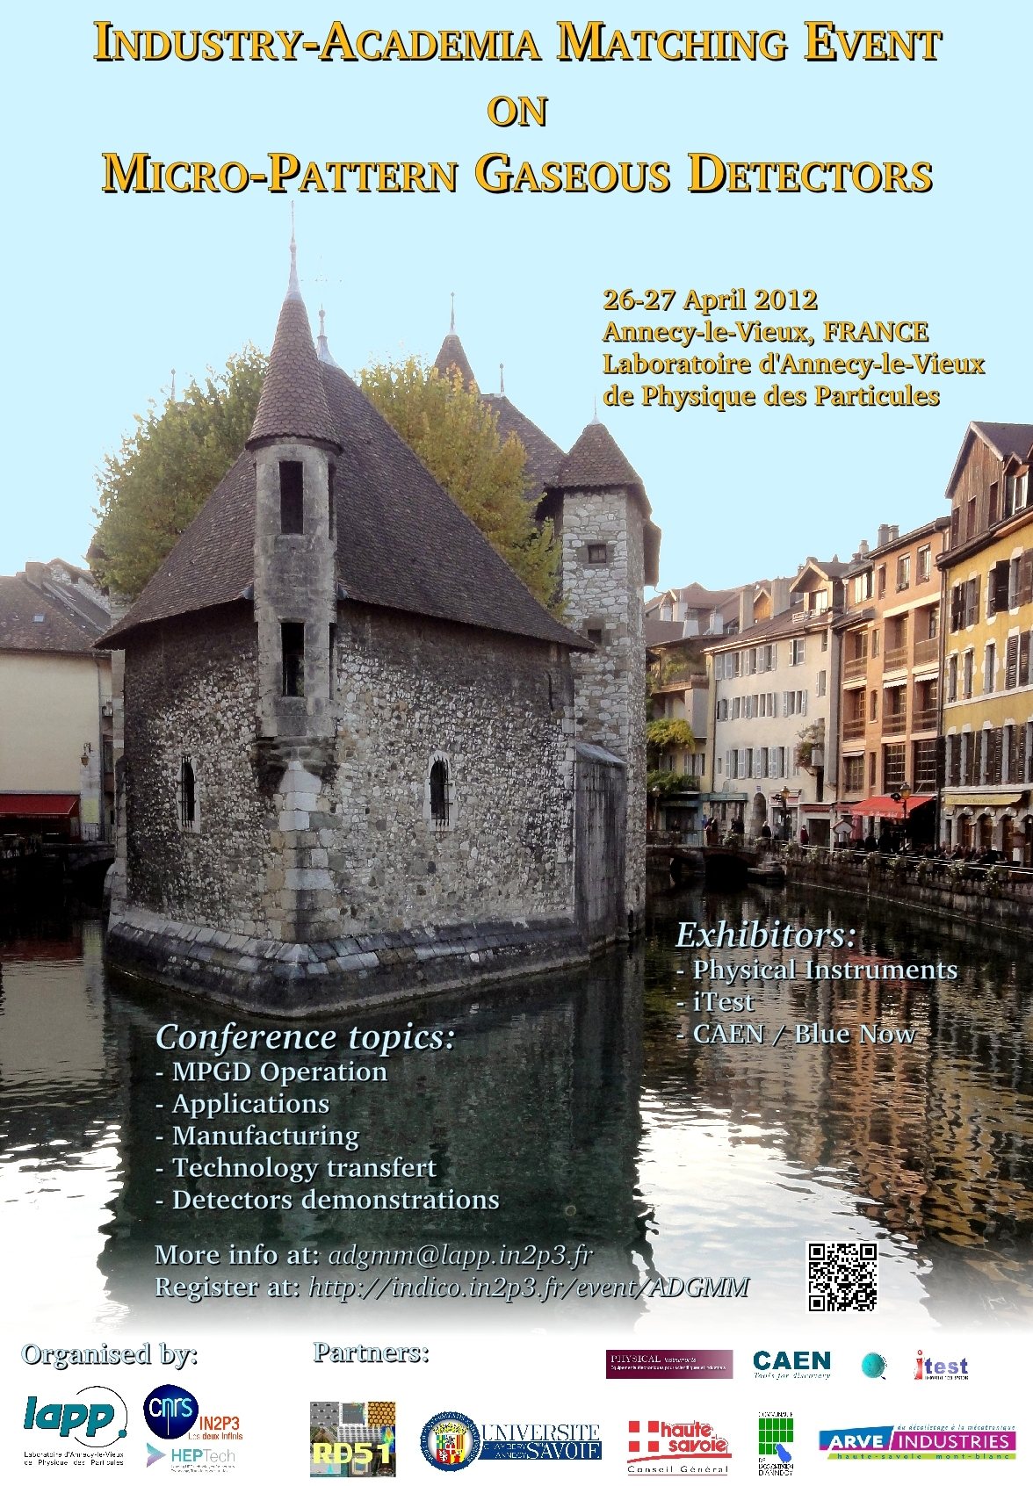
  Lessons learned in this initiative
  Building full commercial systems is unrealistic for HEP laboratories
  Seek public funding for demonstrator prototypes that “solve issues” in application domains:
    Small and manageable projects (be aware of resource needs !!!)
    Synergies with more experienced partners in the field
    Gain expertise and credibility
    Concentrate on the core competencies of HEPTech nodes
    Network building
  Demonstrate production capabilities of key MPGD technologies at industrial scale (GEM, THGEM, MicroMegas, SRS)
  Enhance visibility and brand of MPGD technologies and expertise and its community through dedicated events:
Academia Industry Matching Event (AIME):

Slide 4
Event Description (1/2)
Bringing together MPGD experts from academia, application domain users and high tech companies
Provide an overview on state-of-the-art MPGD technologies
Provide an overview on industrial partners potentially interested in collaborative R&D
Identify opportunities and define a roadmap towards collaborative R&D on key solutions for MPGD in different application domains

Slide 5
Event Description (2/2)
Date: April 26/27 2012, 9am – 4pm
Venue: Laboratoire d’Annecy-le-Vieux de Physique de Particules (LAPP, Annecy, FR)
Program elements:
  state-of-the-art MPGD technologies
  Production methods
  Prospects of MPGD in applied research
  Demonstrators and booths
  Peer-to-peer discussions, social event,…
More information:
  http://indico.in2p3.fr/event/ADGMM
  Mail: adgmm@lapp.in2p3.fr
  Registration opens soon !!

