Slide 1
CTGF
Clock and Trigger Generator and Fan-out for
Scalable Readout System

Slide 2
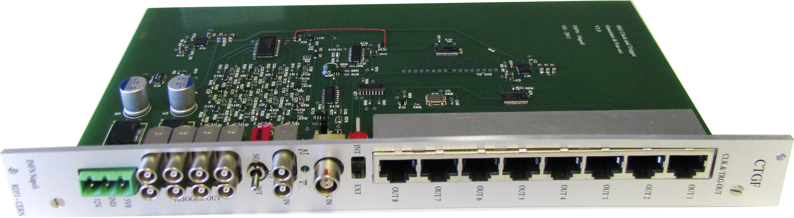

Slide 3
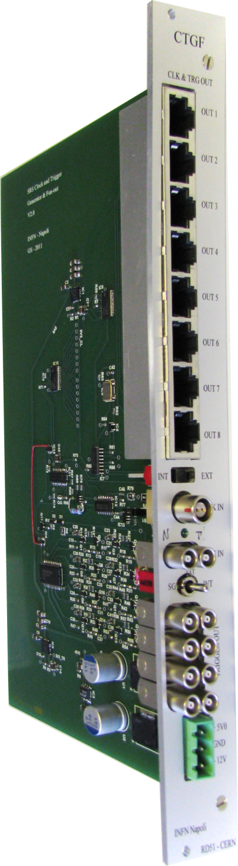
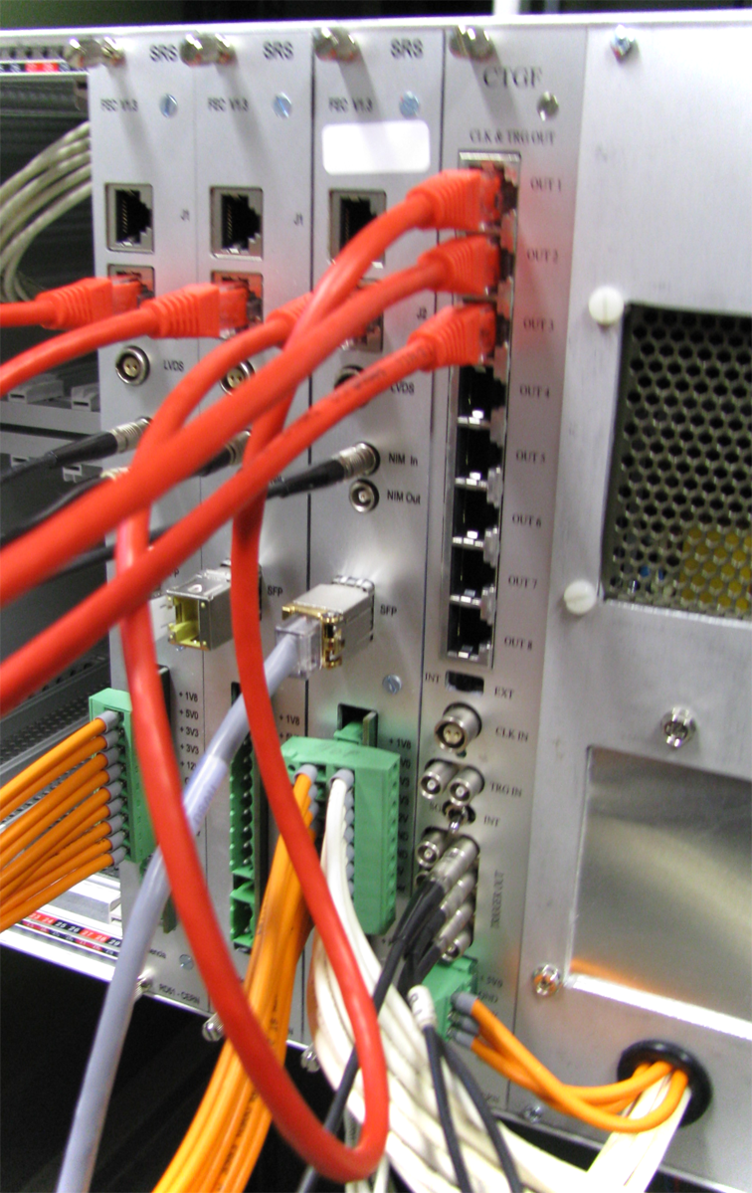

Slide 4
8-port RJ45 connector for Clock and Trigger distribution to FECs (LVDS)
Slide switch to select Internal/External 40 MHz clock source
External 40 MHz clock Input (LVDS)
External Trigger Input (NIM & TTL)
3 position Toggle switch to select External/Internal/Single Trigger
NIM Trigger fan-out
Power input (+5, -12)

Slide 5
40 MHz
INT
LVDS splitter
8-port RJ45 connector
8 LVDS pairs
Clock
EXT
10 Hz
TTL
LVDS splitter
EXT
INT
30-300 nS
TRG
8 LVDS pairs
SGL
NIM
NIM splitter
NIM outputs

Slide 6
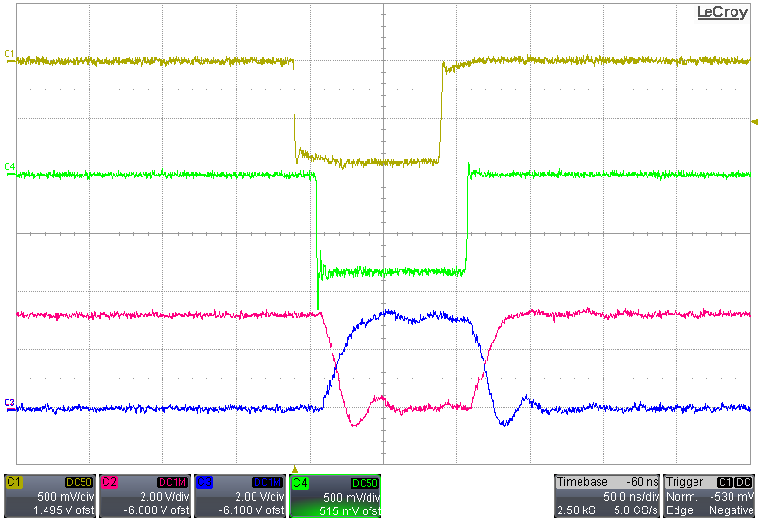
NIM input
NIM output
~15 nS
LVDS output
~40 nS

