Slide 1





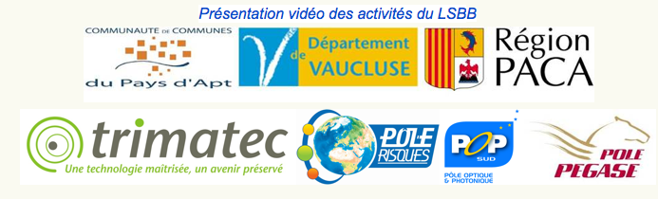
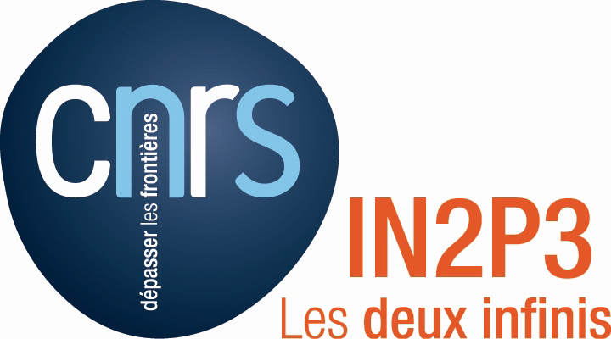

T2DM2* : Status & Progress
*Temporal Tomography Densitometric by the Measure of Muons
Collaboration Project
Funded by
Stéphane GAFFET, Pierre SALIN*
OCA-Observatoire de la Côte d’azur - UMR GEOAZUR – UMR Artemis - UMS LSBB
COLLABORATION
CERN - CEA/IRFU - CPPM (Université de la Méditerranée) – SHEFIELD UNIVERSITY - GÉOSCIENCES Montpellier – IPGP (Géophysique Spatiale et
Planétaire), EMMAH (Université d’Avignon et des Pays de Vaucluse) - *APC (Astroparticules et Cosmologie Université Paris7) - CFN Lisbonne
INTERDISCIPLINARITY
ASTROPARTICULES - SEISMIC IMAGERY – GRAVIMETRIC - HYDRO GEOLOGY - ROCK MECHANICS - EM IMAGERY
*On behalf of the T2DM2 collaboration

Slide 2
SUMMARY
GOALS
REMINDER OFF THE METHOD
THE WORK ALLREADY DONE
THE WORK ON PROGRESS
THE WORK OFF THIS YEAR
CONCLUSIONS : FUTURE

Slide 3
GOALS
New measurement ability (km of lateral extent, multi-hm thickness) of the spatial and temporal evolution of rock density function of water saturation, total porosity, mechanical condition and damage at in situ scale
Monitoring of aquifer resources and reserves
Monitoring the stability of volcanoes
Monitoring the stability of underground vacuum and rock mass instabilities
Qualification of the prototype telescope developed in 2009-2011 at GEOAZUR & LSBB in collaboration with the consortium RD51/CERN, new and innovative tool to complement field exploration and monitoring

Slide 4
REMINDER OFF THE METHOD

Slide 5
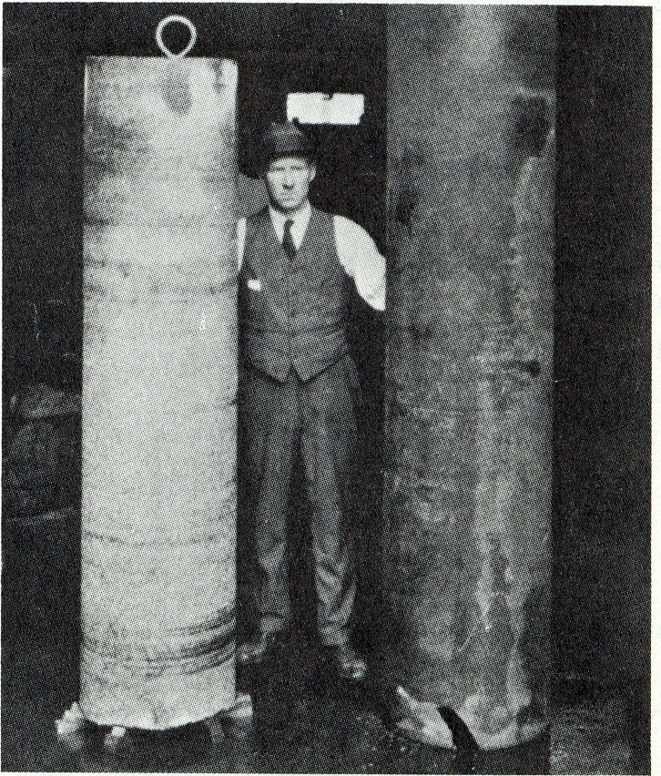
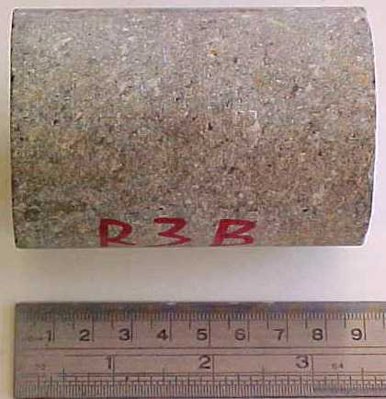
FUNDAMENTAL QUESTION:
What are the mechanical parameters of rock across a cluster?
Measurements on samples of small scales or large sizes
The mechanical parameters are unknown to a mass scale:
Effective stress?
Friction effective?
Damage?
Empirical methods
Qualitative description of the rock mass
(scale fracturing, alteration, hydraulic ...)
Measure:
Mechanical parameters in small scale
Estimation:
Mechanical parameters at large scale
Bieniawski (1976), Hoek & Brown (1980)

Slide 6
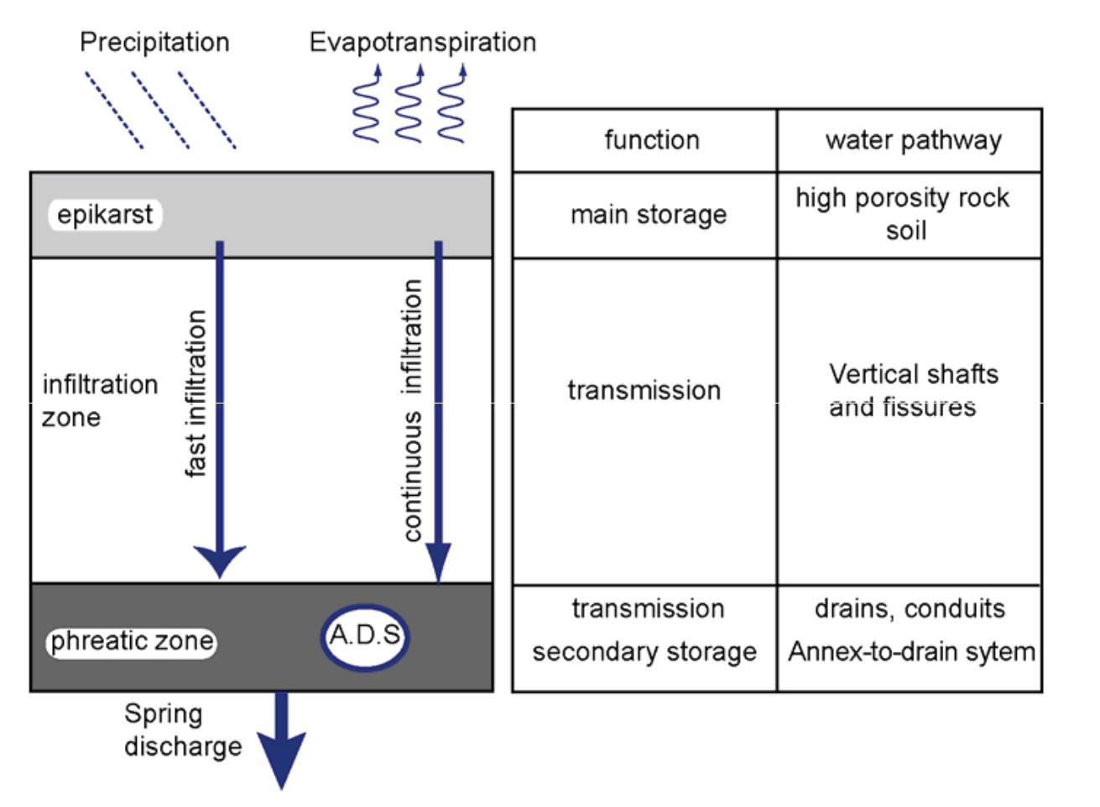
DETERMINE ρ, open a new measure field at natural scale
Description of the rock in the elastic approximation :
Lamé parameters and density : λ, μ, ρ
Wave velocity in soil : α = ( (λ+2μ) / ρ )^{1/2} , β = ( μ / ρ )^{1/2}
Young's modulus and Poisson's ratio : E, ν
Uniaxial stress (σ = E ε), E = ( 3λ+2μ ) μ / ( λ+μ ), ν = ( 2−(α/β)² ) / ( 2−2 (α/β)² )
Compressibility coefficient and shear modulus: K, G
Modules and elastic coefficients are related: 1/E = 1/9K + 1/3G
Problems of real massive
A complex building
Damage (evolution of the fracture, internal erosion, ...)
Traffic fluid (chemical alteration, variation of porosity...)
A temporal evolution
Ante/post-eruptive volcanoes phases
Managing resources and reserves (environment, hydrology karst)
Midfielder cashing storage (CO₂, chemical waste, nuclear, ...)
Underground Engineering (structures, mining)
Jacob et al. (2008)

Slide 7
THEORICAL PRINCIPLES

Slide 8
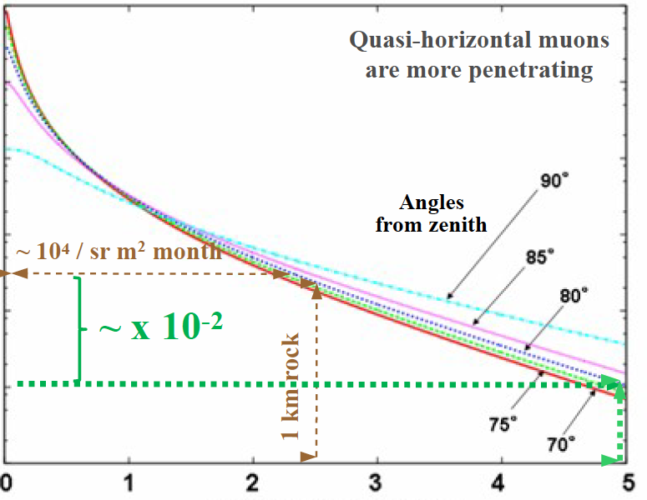
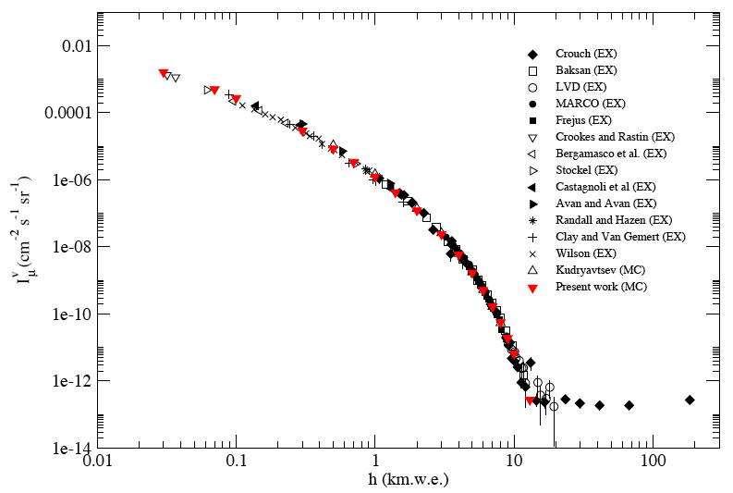
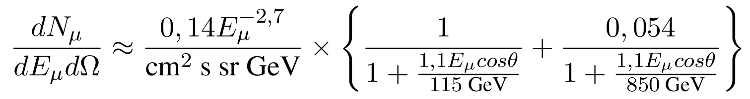
OPEN SKY MODELS at SEA LEVEL are NUMEROUS
The model of muon flux are required to:
to simulate the experiment,
to normalize experimental
measurements from open sky results
Tanaka et al. (2005)
Lesparre, N., D. Gibert, J. Marteau, Y. Déclais, D. Carbone & E. Galichet, Geophysical muon
imaging: feasibility and limits, Geophysical Journal International (2010) 181, 1-14.

Slide 9
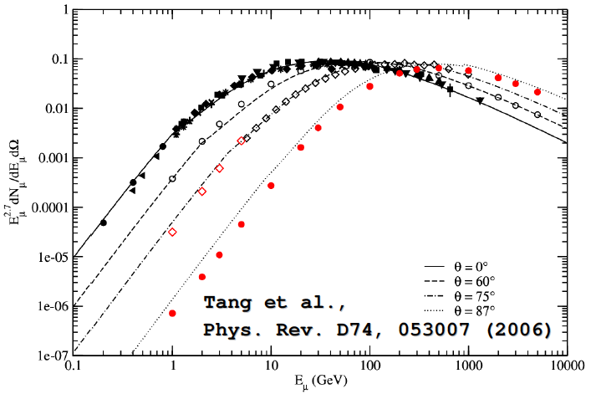
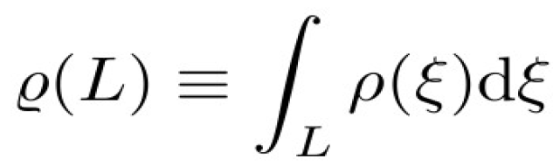

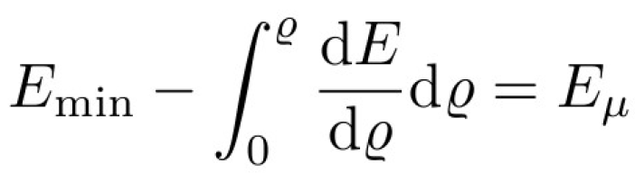
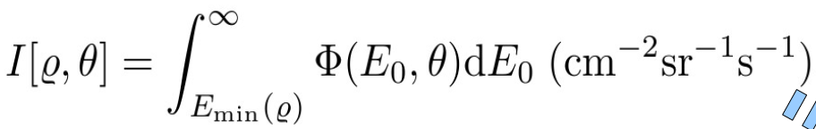

Opacity
Energy loss
Threshold energy
Exiting muon flux
Number of muon detected

Slide 10
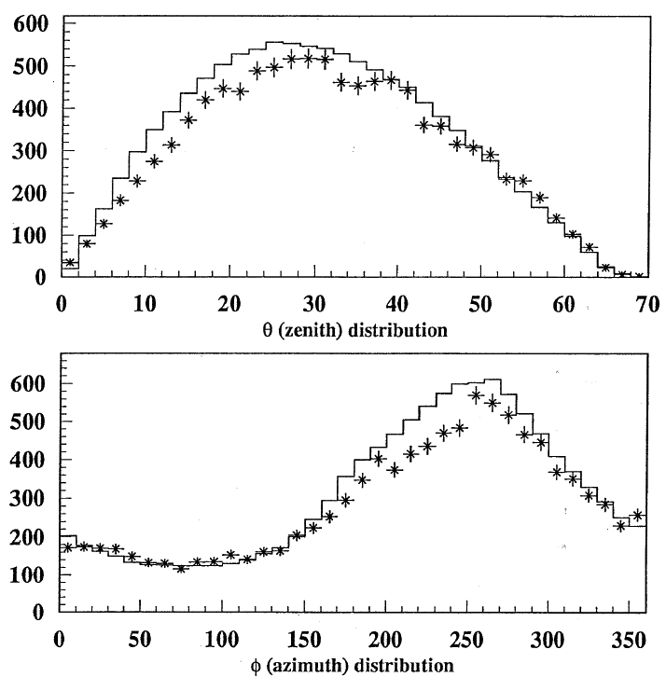
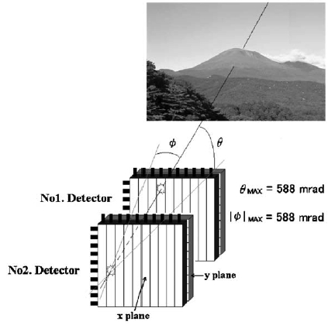
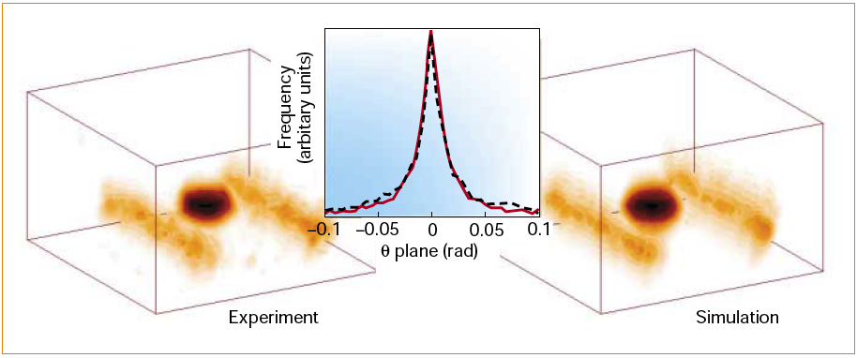
OLDER & RECENT EXPERIMENTS
Neutrino CHOOZ experiment
Highlighting some of azimuth differences between the flux of muons expected and actual flows measured at the detector at the site of the Chooz experiment. Baldini et al. (1995)
This difference is attributed to crossing a geological level higher density for these specific azimuth and zenith.
Other experiments
In the case of Asama volcano Tanaka et al. (2005), shows that it is possible to distinguish the density contrasts of the order of 1 to 3%.
Control for cross-border transport of nuclear materials.
Radiographic imaging with cosmic-ray muons. NATURE-Vol422- (20 march 2003)
Natural background particles could be exploited to detect concealed nuclear materials.

Slide 11
MUON TOMOGRAPHY REQUIREMENTS
MEASUREMENT WITH STRONG CONSTRAINTS
Muon Tomography mean:
low flux
high efficiency detector
high sensitivity
high angular resolution
low background noise (radiation and detector)
► Precise tracking capabilities
► Redundant tracking
Improvements in background rejection
► muon direction discrimination (FW-BW)
► Event-by-event detailed analysis
(hits multiplicity, pulse heights, t.o.f.)
Long and stable operation (few months => few years) in
difficult environments

Slide 12
OBJECTIVES OF THE PROJECT T2DM2
Accessing a new measure for characterizing geosciences mechanics of subsurface materials
Develop a versatile and flexible instrument for the geosciences community
Methodology for “muoscopy”
Constraints: Size, solid geometry, time-scale processes, ...
Numerical simulation
MUSIC (Kudryavtsev et al., 2008), GEANT4 prior to calibration:
Duration of exposure vis-à-vis the time scale on the processes observed
Cover and geometric topology of the network of telescopes and precision
field of views and the surface of each detector,
Number of detectors
Spatial resolution possible based on solid geometry / network
Muoscopy – Densitometry
Construction of 4 prototypes and measures
Establishment of codes of tomography inversion / simulation (GEANT4, MUSIC…) & coupling between densitometry imaging and seismic imaging (Young's modulus)
Coupling measures spatial-temporal density and field variations gravity (location, water flow dynamics in the ZNS)

Slide 13
THE WORK ALLREADY DONE

Slide 14
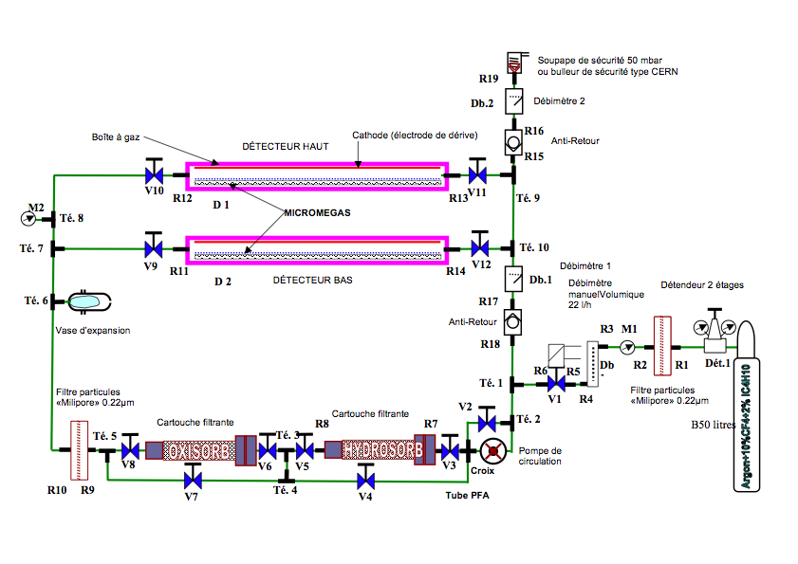
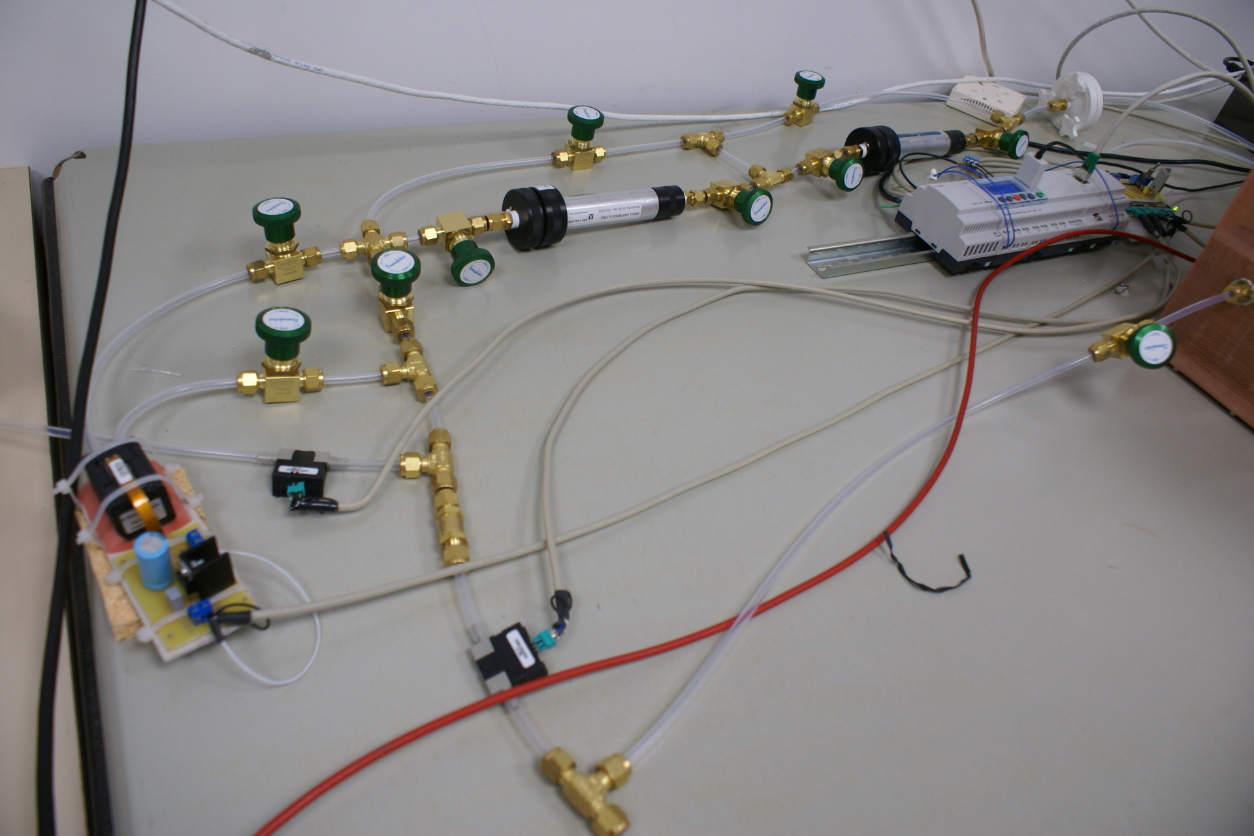
PROTOTYPE GAS-SETUP
GOALS:
Demonstrate experimentally that it is possible to maintain the functional quality of gas for several months up to a year with a few tens liters reserve (10 l/day)
Determine the gas mixture the more suitable (drift speed, gain, stability) to obtain the best angular and spatial resolution

Slide 15
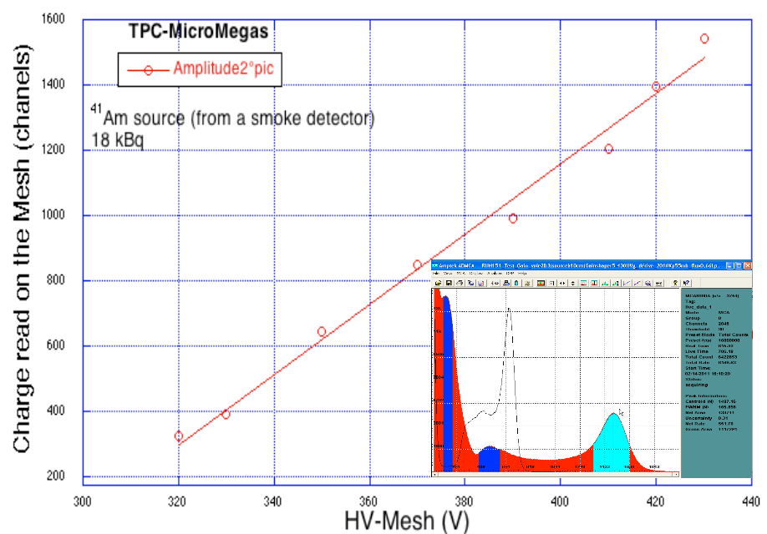
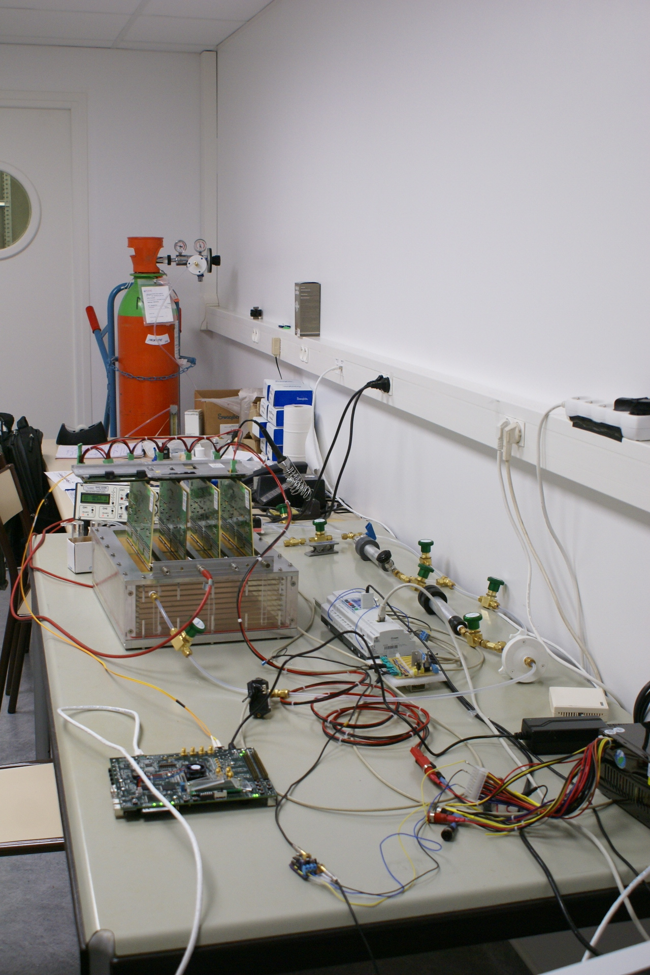
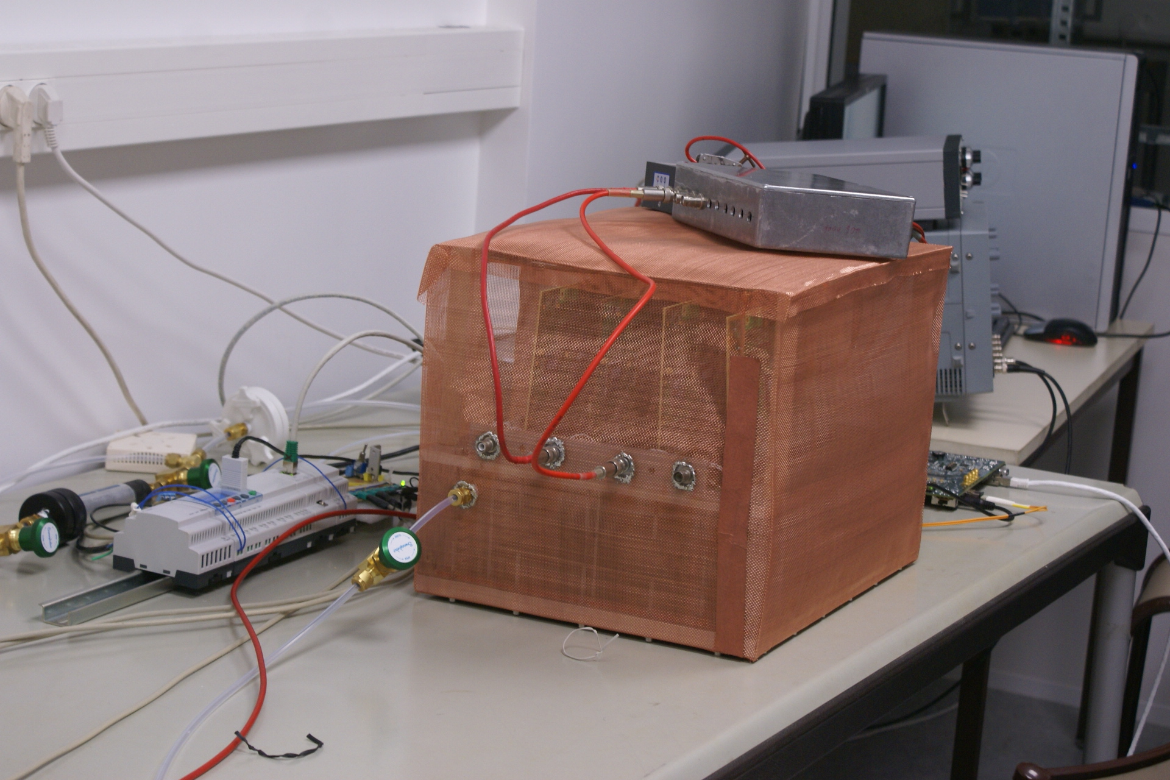
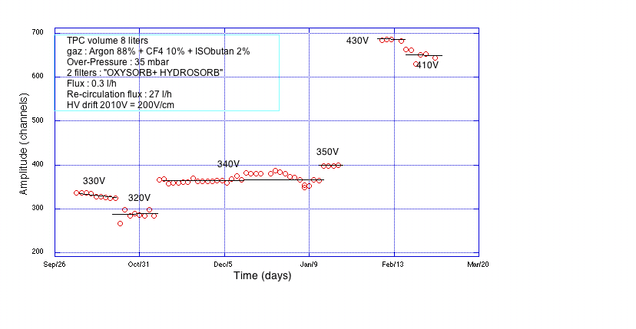
DESIGN OF TELESCOPE AND TECHNOLOGY CHOICES
Micromegas-Bulk in TPC mode
µ
Combine triggering and tracking functions
Spatial resolution ~ 100 μm (Θ_{track}< 45°)
Good double track resolution
Time resolution ~ 5 ns
Efficiency > 98%
Rate capability > 5 kHz/cm²
Potential for going to large areas (1 x 2 m² with industrial processes)
Cost effective
drift (-HT 2)
E ~ 0.7/cm
e⁻
10 cm
mesh (-HT 1)
~ 120 µm
E ~ 50 kV/cm
strips
APV25+SRS
DATE+LabVIEW
« Micromegas in a bulk » NIM A 560 (2006) 405–408

Slide 16
THE WORK ON PROGRESS

Slide 17
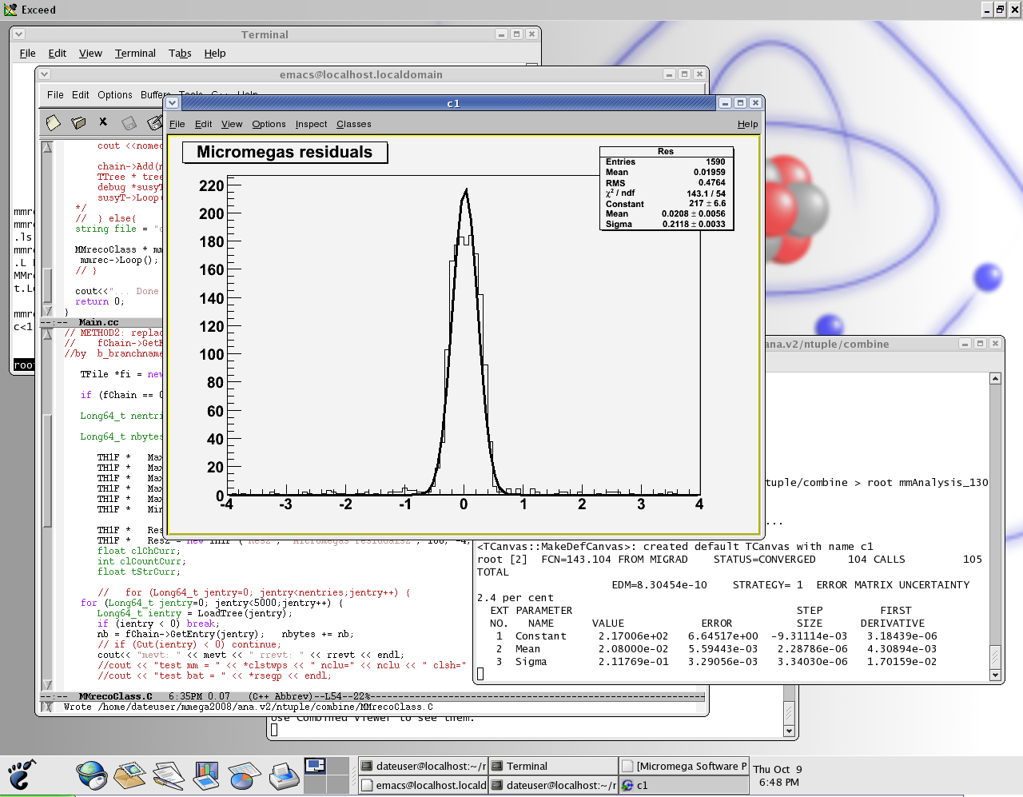
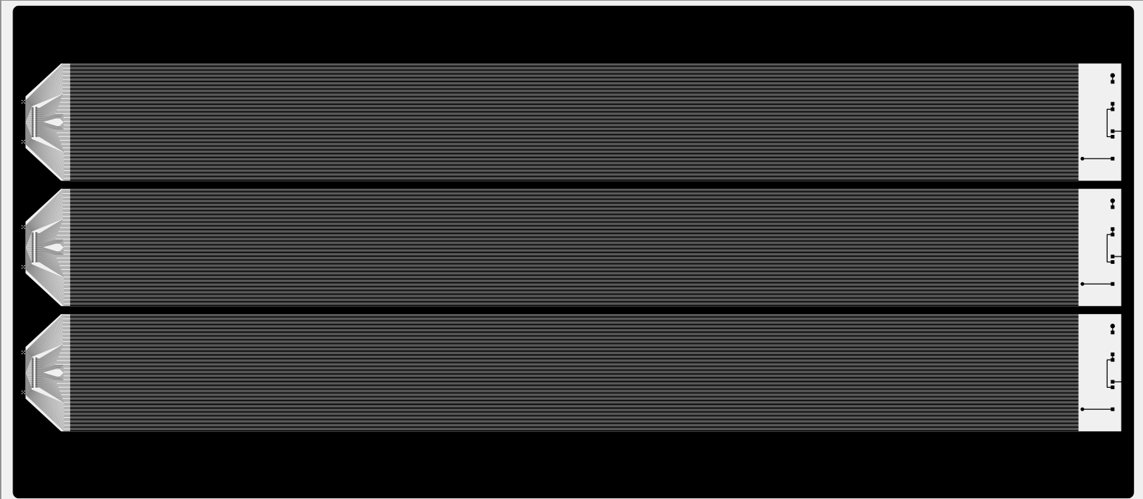
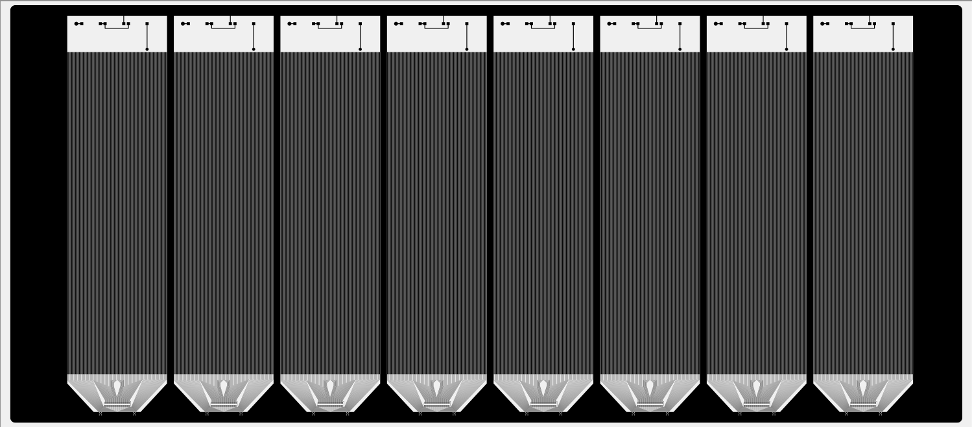
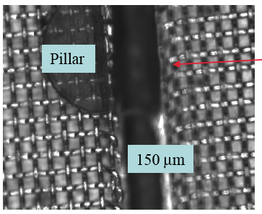
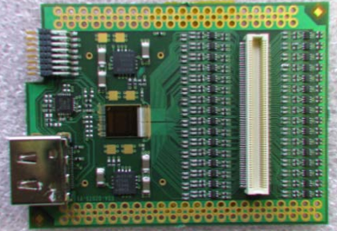
TECHNOLOGY & DIMENTIONAL CHOICES
Track inclination: 40°
Ar:CF₄:iC₄H₁₀ (95:3:2)
Drift field: 360 V/cm
v_{d} = 8.4 cm/us
σ: 212 um
σ_{MM}: 203 um
Drift path (mm)
Strip pitch: 1000 µm
Strip width: 900 µm
Drift time (ns)
P. Lengo – IEEE-NSS 21 October 2008, Dresden
PROTOTYPE DETECTOR
DOUBLE SIDES “X” &” Y” µMEGAS-BULK
Segmentation on both sides: smallest capacitance

Slide 18
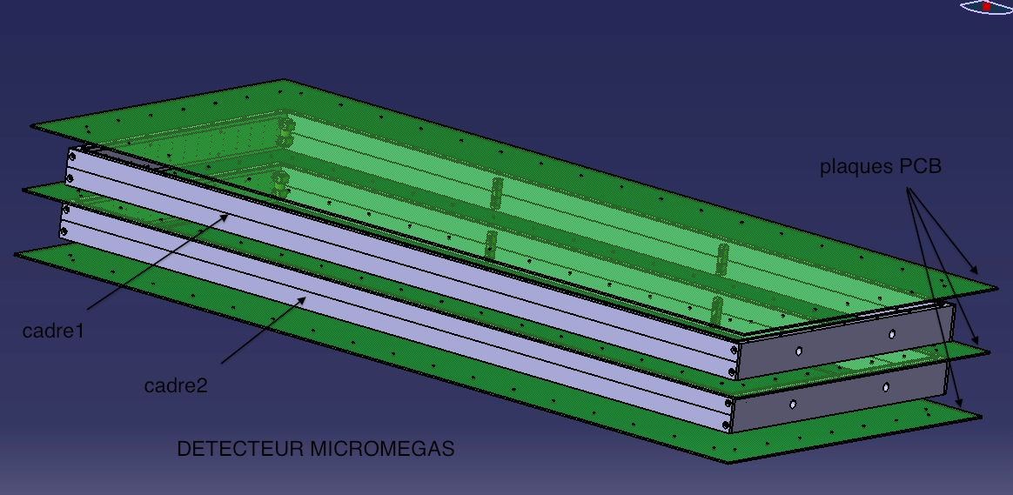
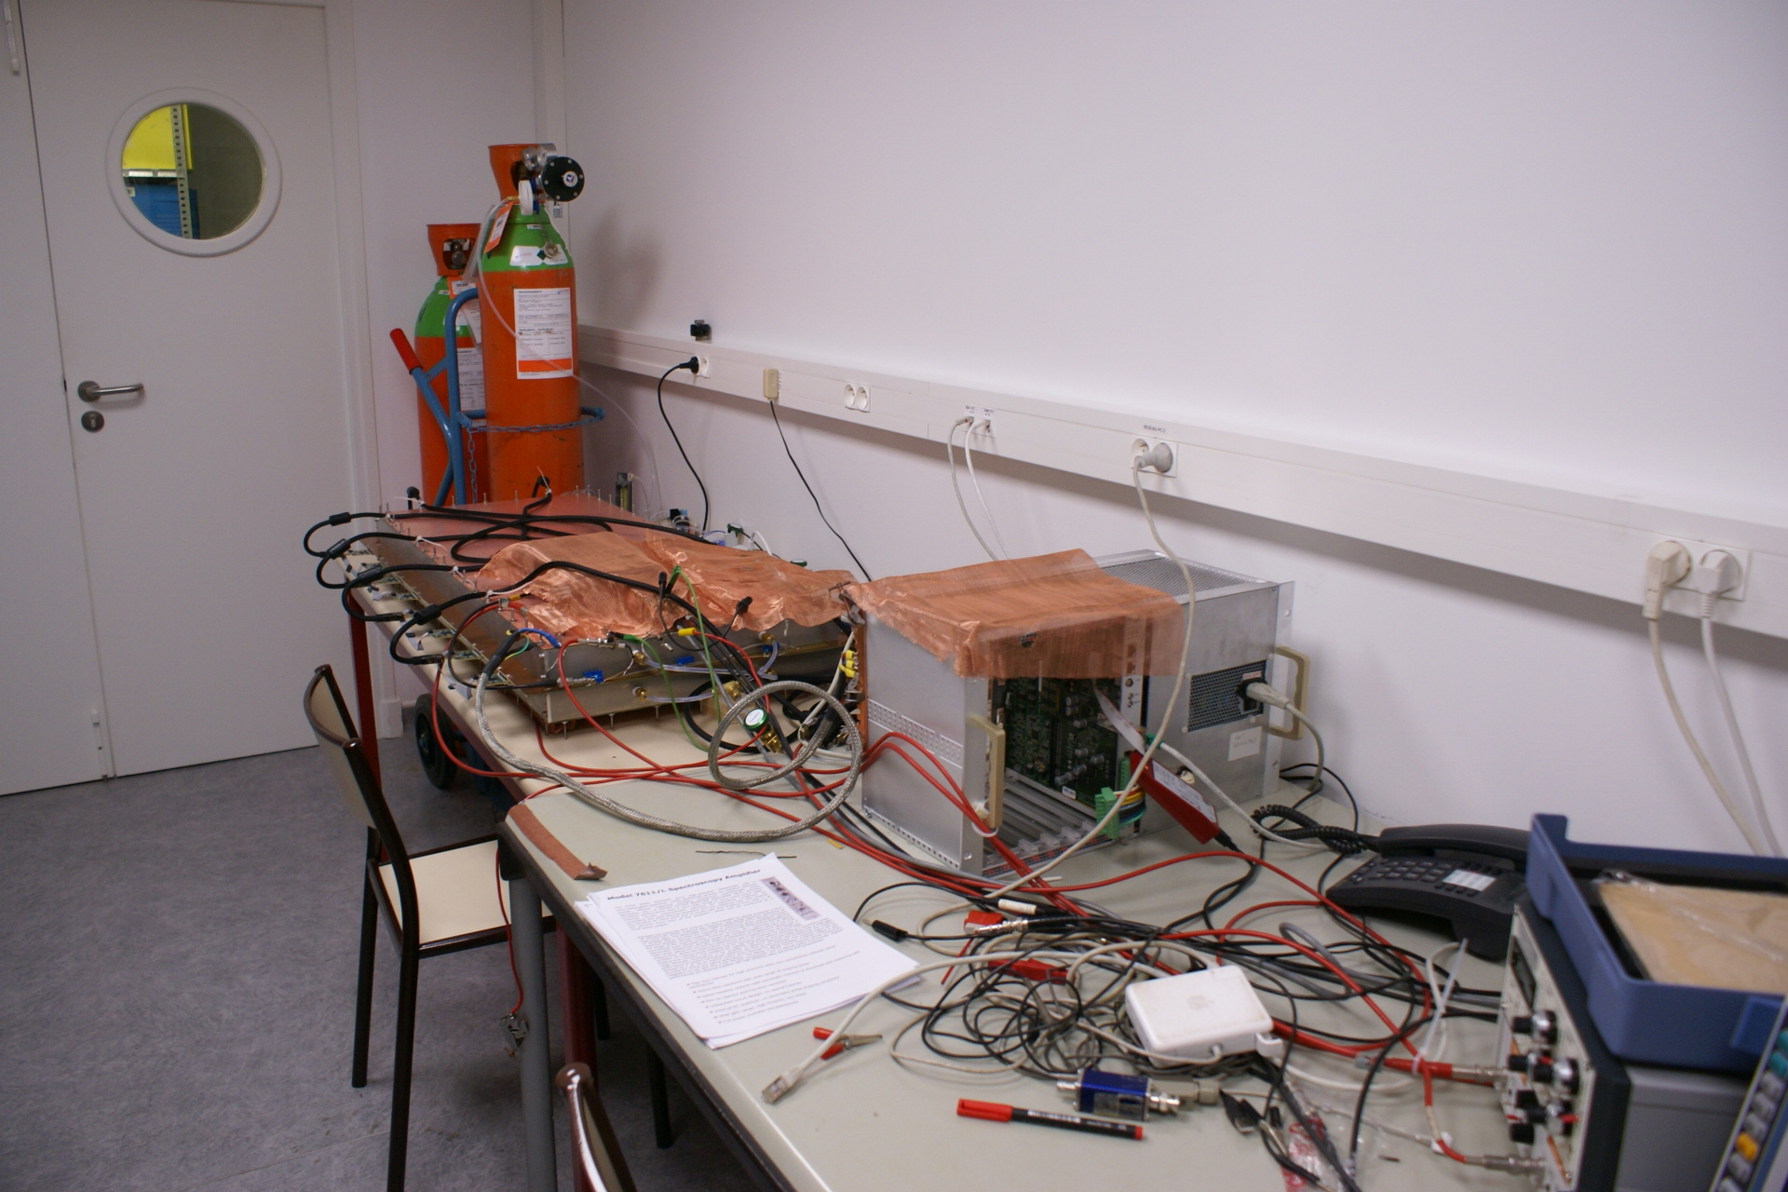
NEW TELESCOPE DESIGN AND TECHNOLOGY CHOICES
Double sides µMegas-Bulk TPC (5 cm drift space)
on the same printed-board
“Y” & “X” segmented
Inconvenient: 2 meshes & more expensive
ADVANTAGE: compactness and easy coincidence

Slide 19
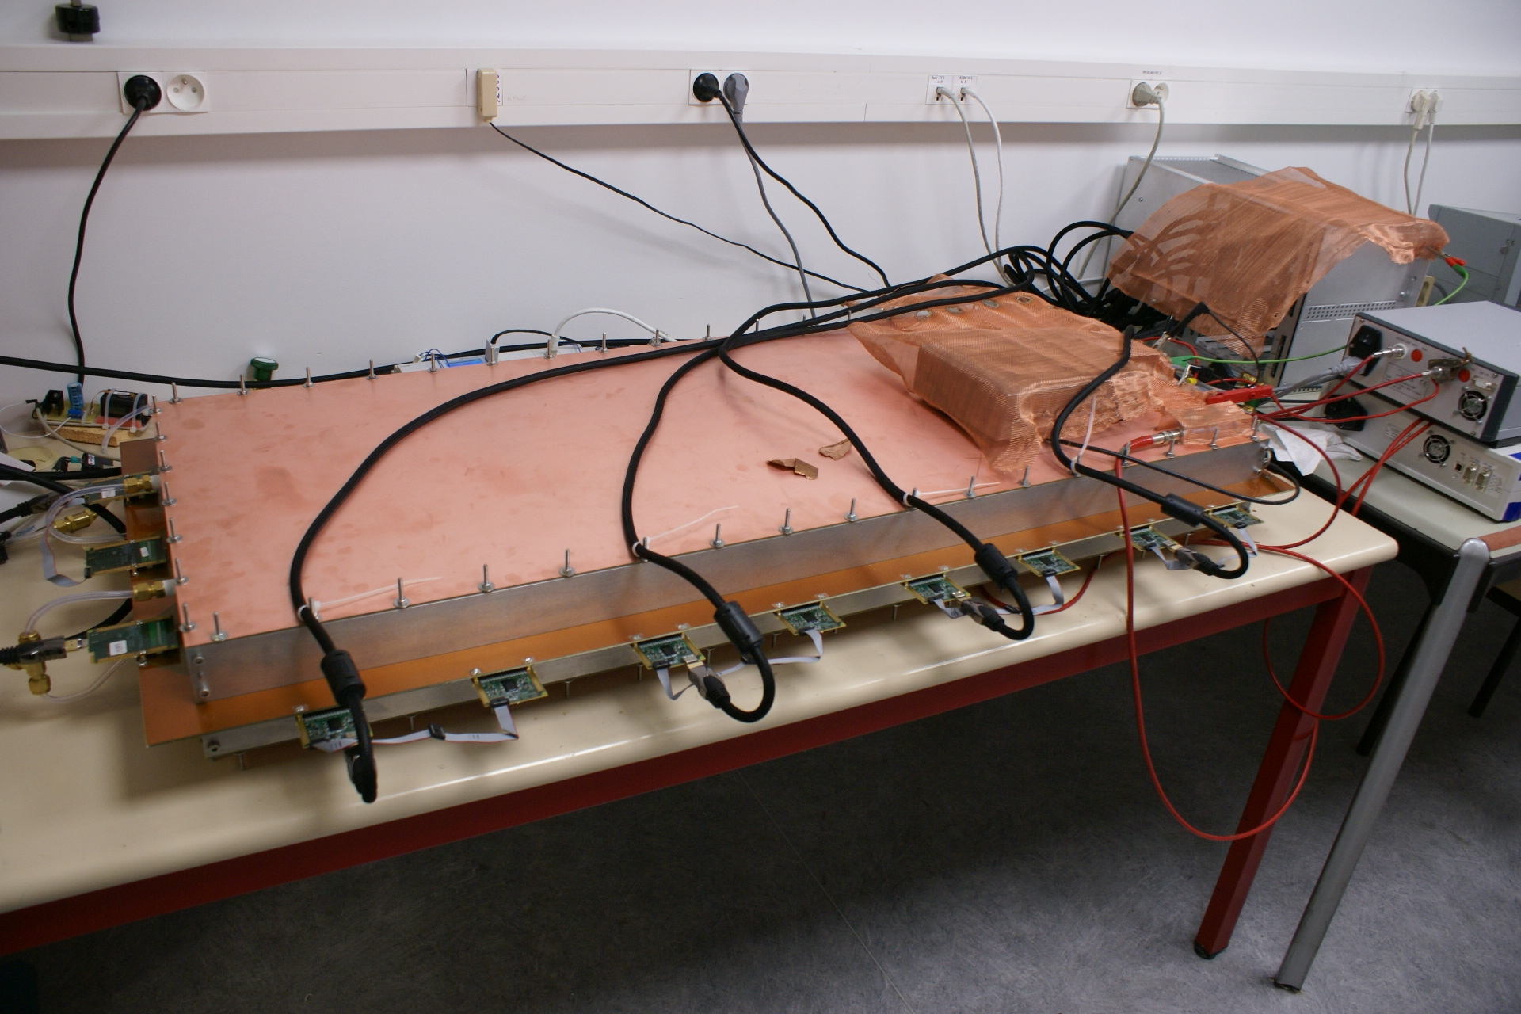
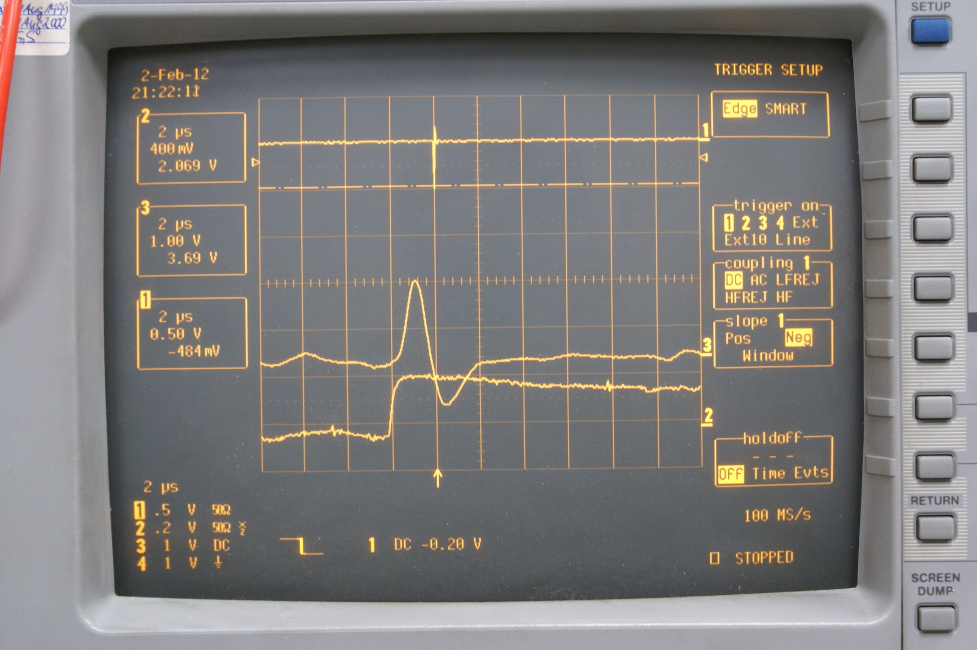
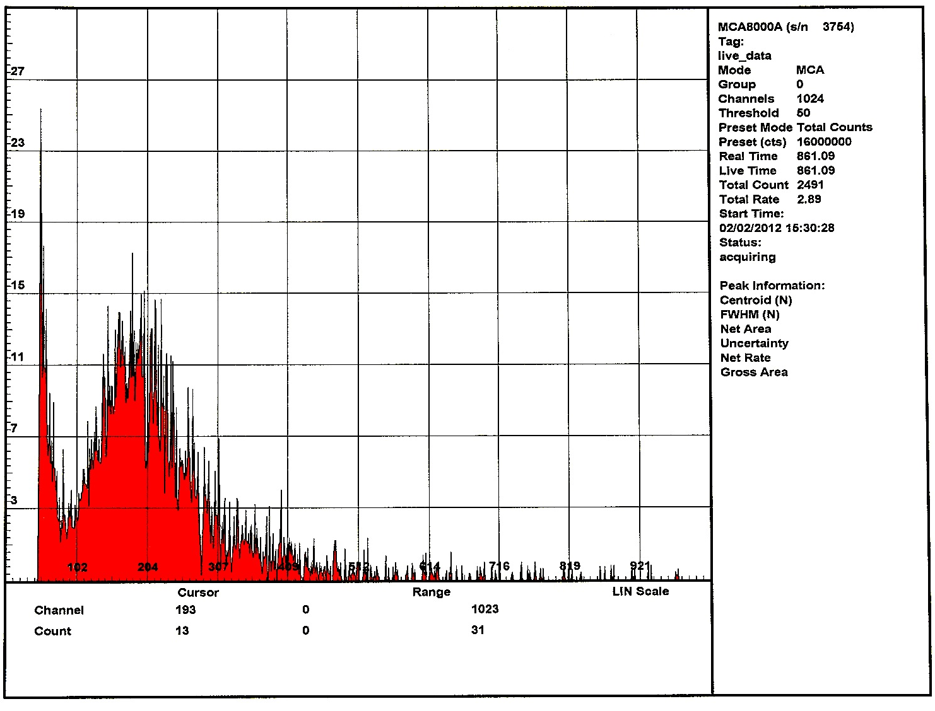
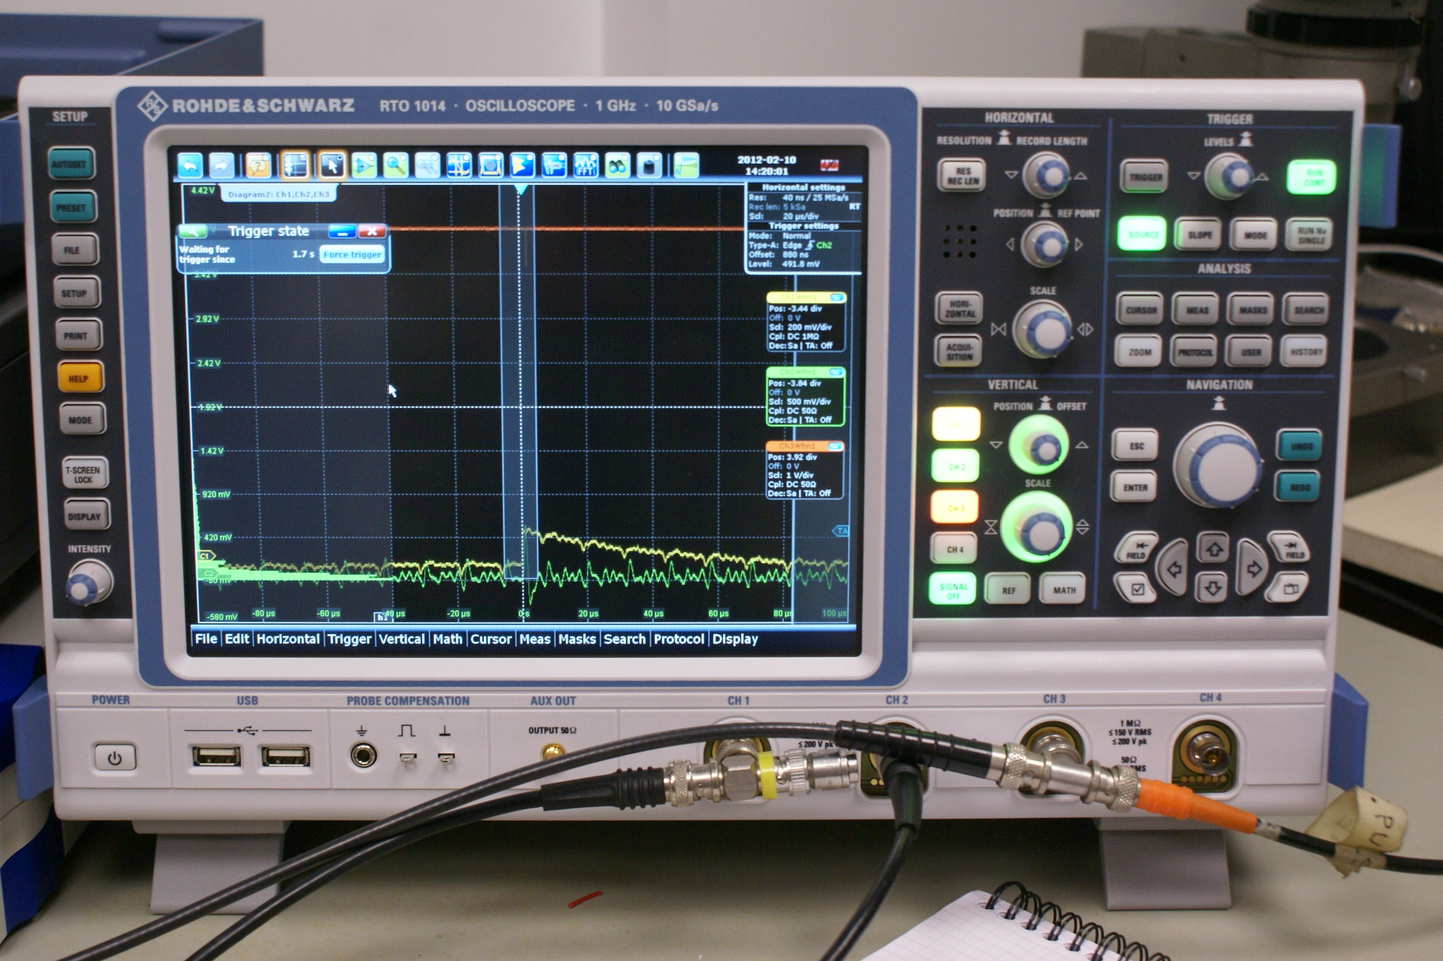
“X” & “Y” TPC
Ar + 10 % CF₄ + 2 % iso-C₄H₁₀
10 mbar over pressure, 10 l/day
Trigger from the mesh signal Canberra 2002C
charge amplifier followed by a “Silena” shaper
Histogram of the cosmic flux

Slide 20
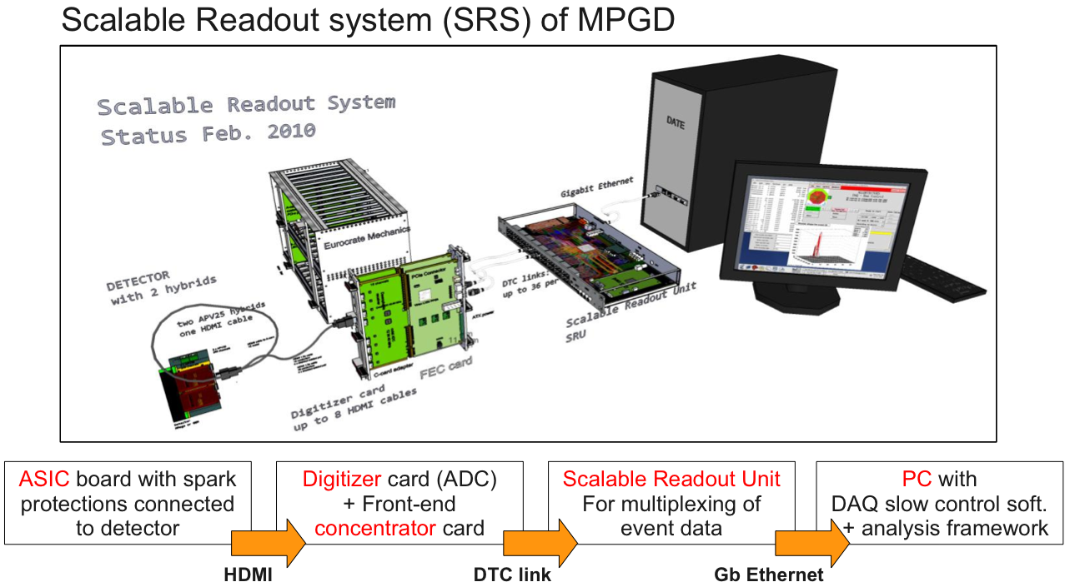
ELECTRONIC & DAQ
SLC-5.7
DATE
LabView
SDC
Small problems
with the ungrounded SRS crate.
I will use isolation transformer with double electrostatic screen and case grounded (noisy ground)

Slide 21
NEXT YEAR WORK:

Slide 22
PROPOSED STRUCTURE FOR COLLABORATION
GEOPHYSIC IMAGING
INSTRUMENTS & MUON SIMULATION
IMAGING
GEOAZUR
UNICE
ELECTRONIC
TESTS
CERN+BNL
RD51
TELESCOPE
DESIGN
MECANIC
DAQ
GEOSCIENCES
Montpellier
THESIS
Fanny HIVERT
Start 1rst March
BEAM-TEST
SIMULATION ??
CEA-IRFU
Saclay
GRAVIMETRY
UAPV
Montpellier
THEORY
SIMULATION
MONITOR
CPPM
Marseille
HYDROLOGY
LSBB (PI)
T2DM2
EXPERIMENTAL PLACE
PROPOSITION for INTEGRATOR
STANEO
BUILDERS: ELTOS, CIREA, NIKHEF, PRIMA,…

Slide 23
NEW FUNDING TO BUILD A 80 TELESCOPES ARRAY
FUNDING
ANR
THEMATIC
MAIF
RESEARCH
BUILD
4 TELESCOPES
ARRAY
DEMONSTRATOR
THESIS
3 years
2 CDD
80 TELESCOPES ARRAY
TRIMATEC + OSEO AOP « PACA »
50% + 50%
Industrial confidentiality
STANEO
integrator ?

Slide 24
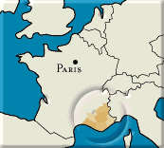
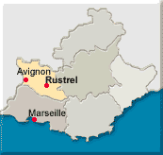
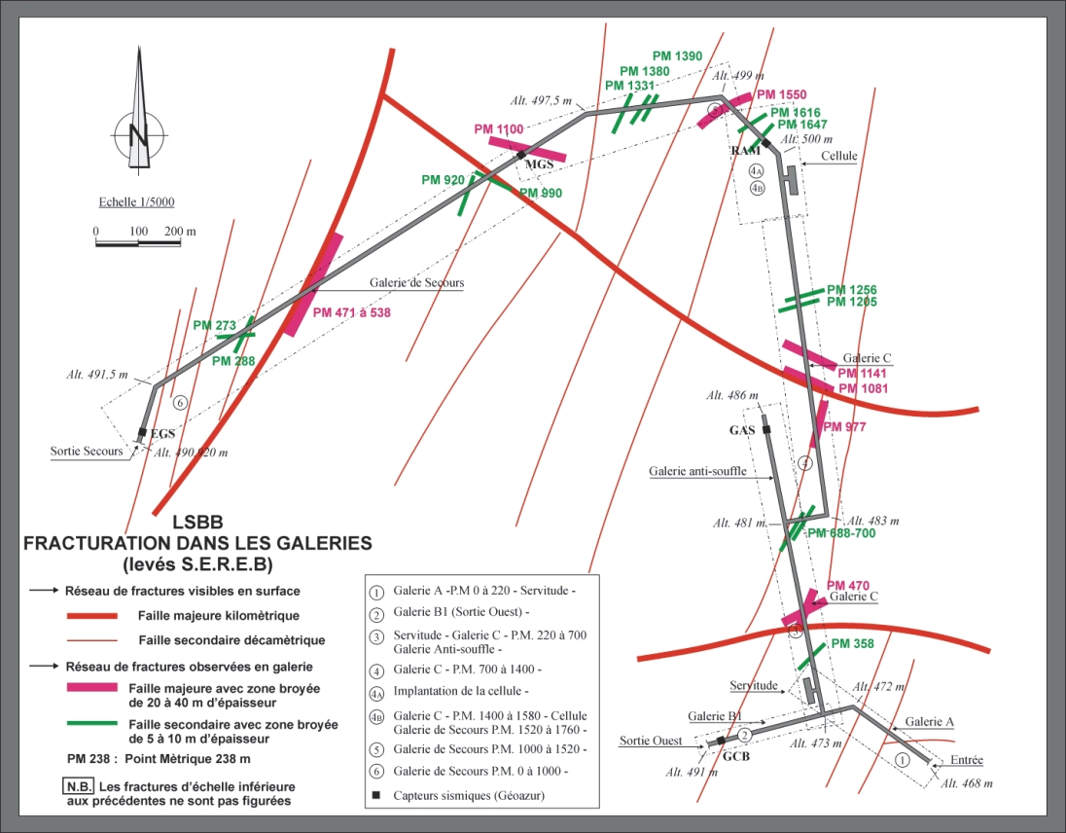
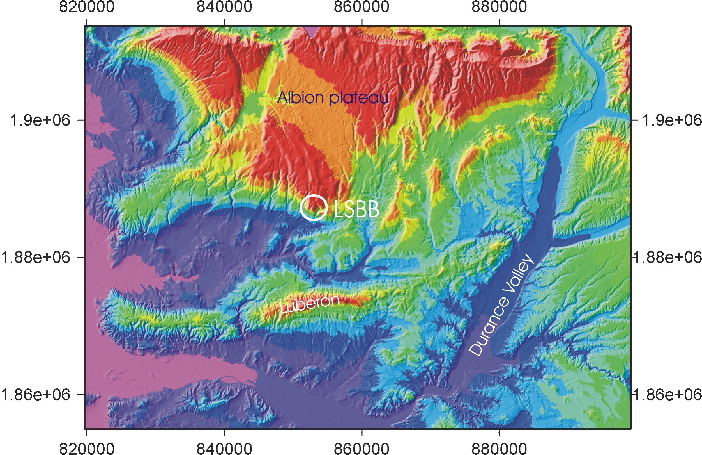
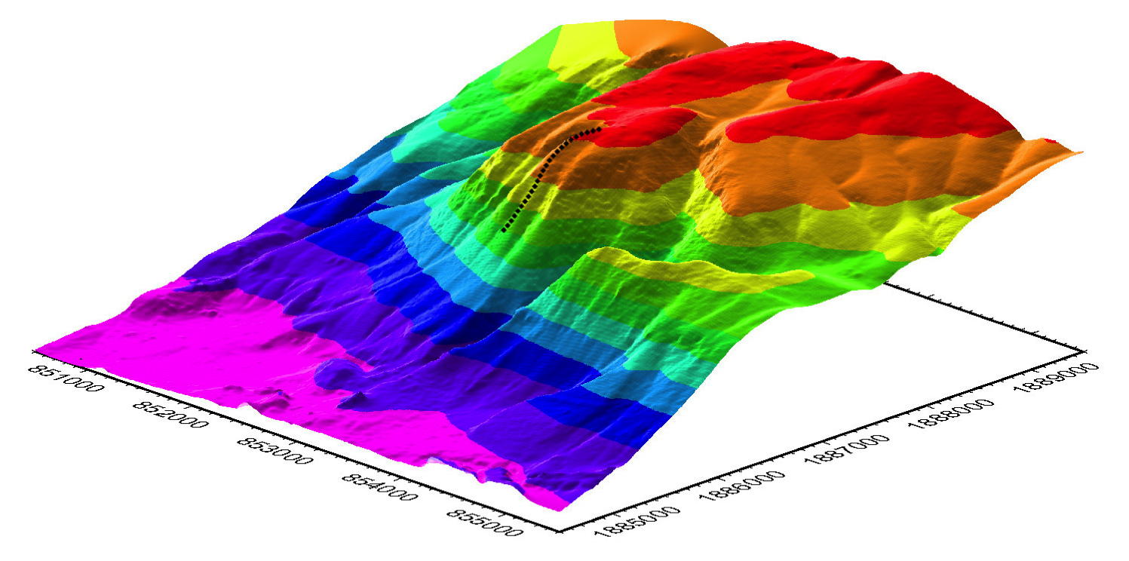
PROTOTYPE DEVELOPPEMENT AND TUNING
Experimental development at LSBB (karst) to benefit from the combination of multi-parametric measurements from different scientific projects conducted in the laboratory
Nice
20 km

Slide 25
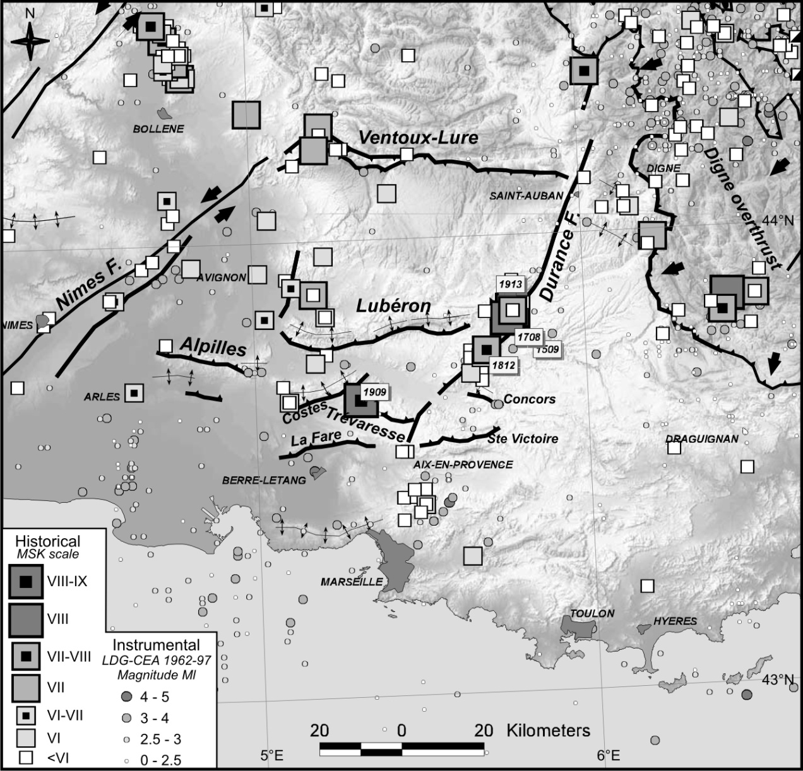
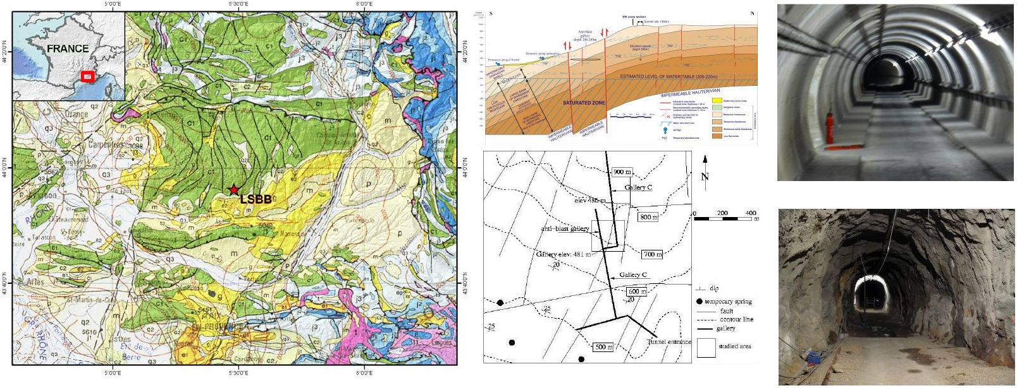
STS2 3D antenna
1%
SQUID² magnetometer
Hydro acquisition
2%
LSBB
2%
From Baroux et al. (2003)
At the heart of one of the major seismogenic regions of South-Eastern France
Unsaturated zone of karst aquifer Fontaine de Vaucluse
Carbonate reservoir

Slide 26
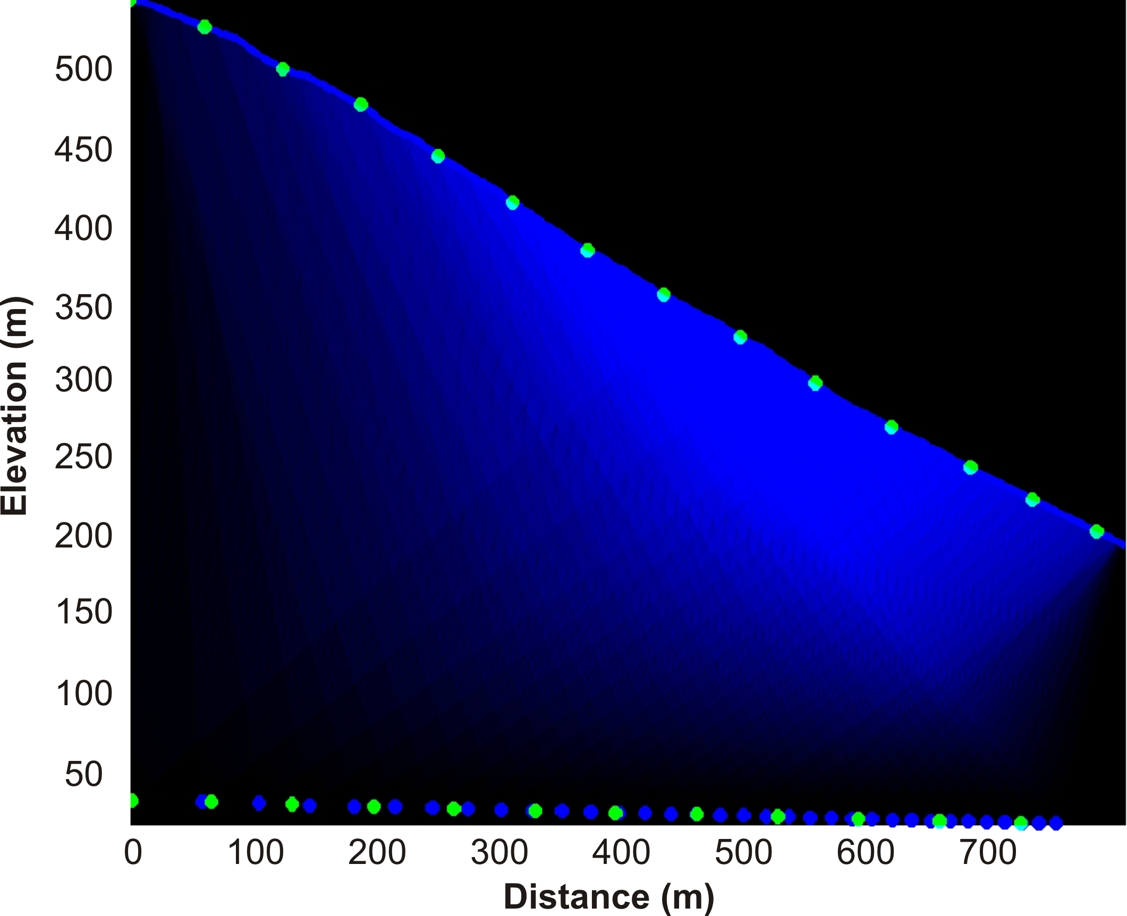
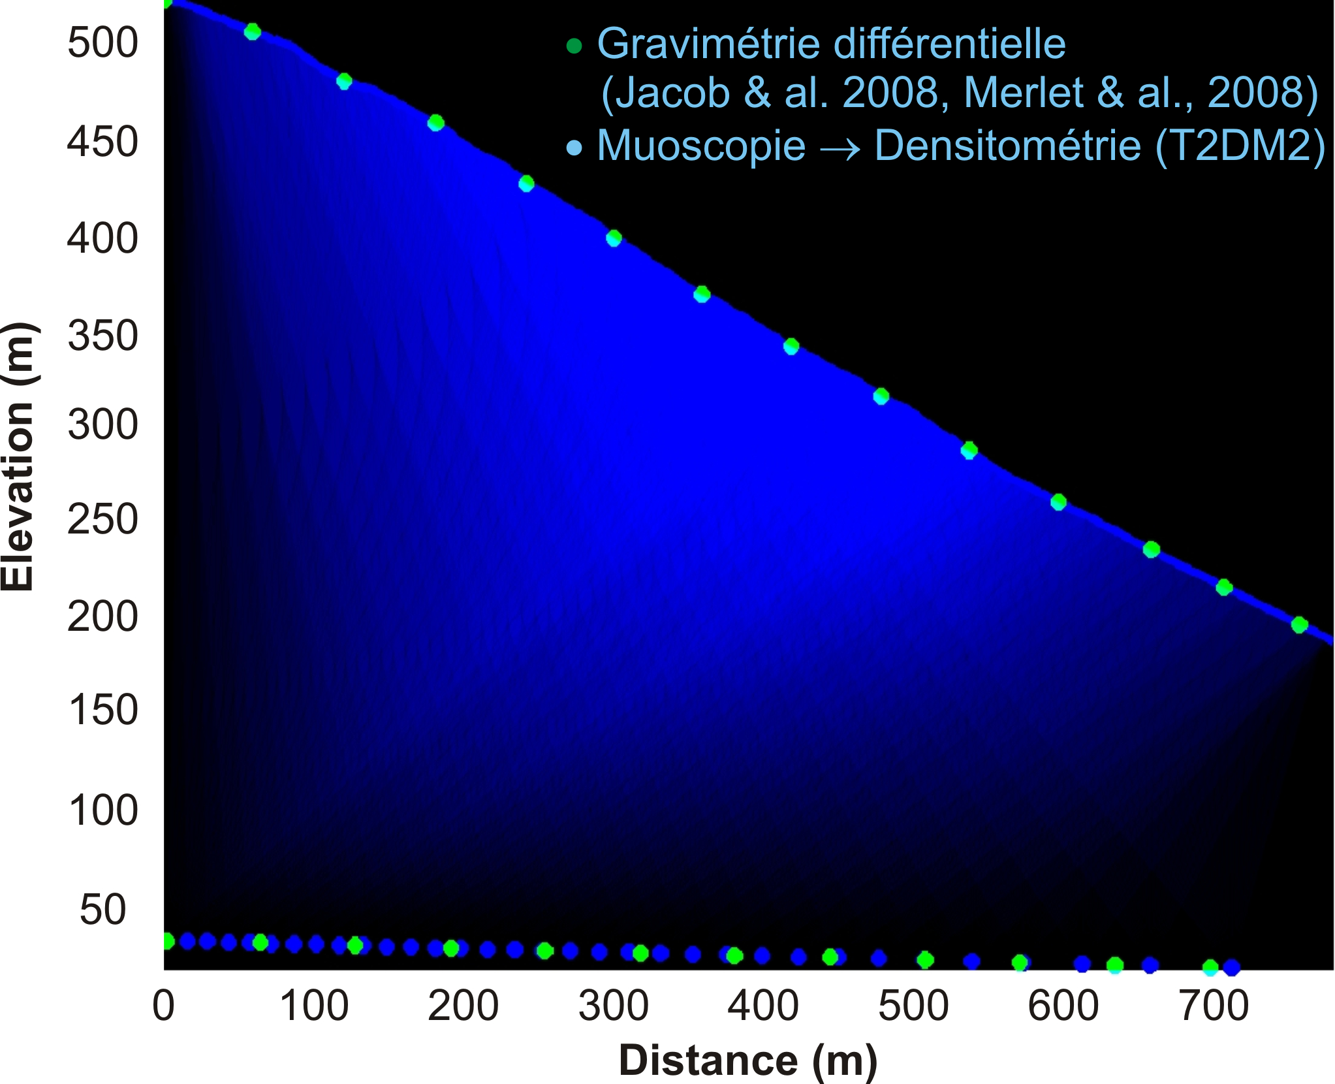
DESIGN OF TELESCOPES TO NETWORK BASED ON THE SIMULATION
    Network design:
    Spatial resolution and number of detectors
Tomography requires redundancy absorption measurements under different zeniths and / or azimuths to get a good lighting environment. Binding global opening and the angular resolution of each telescope, the network topology to deploy and the number of telescopes.
Simulation:
Optimizing coverage
Surface, aperture and resolution
Inversion:
Iterative process involving modeling muons flux expected from the topology
(MUSIC, Kudryavtsev et al. 2008)

Slide 27
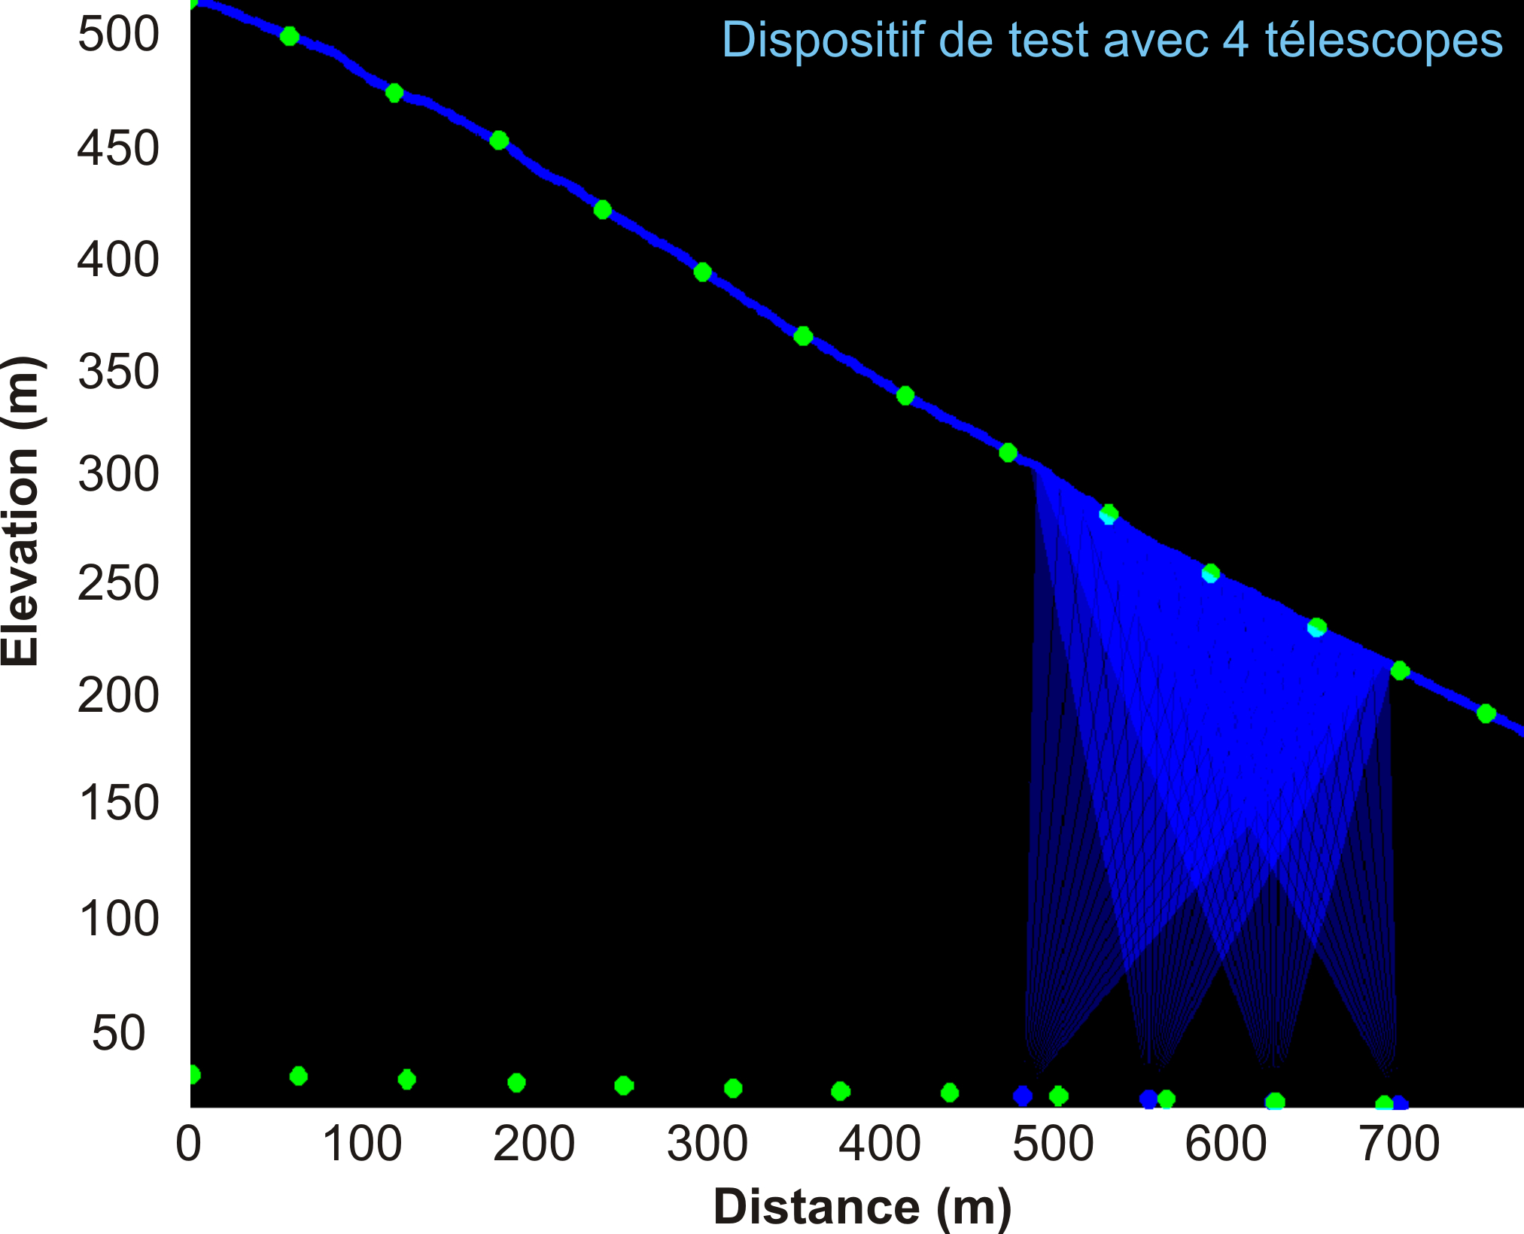
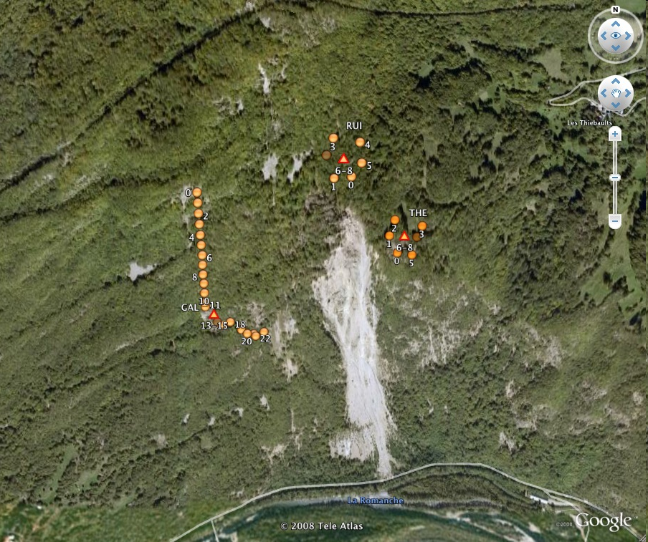
PROSPECTIVE MEDIUM AND LONG TERMS
Développement méthodologique avec 4 télescopes et monitoring gravimétrique
Through the project T2DM2:
Provide tools for digital modeling of device acquisition and reversal
Develop a website to disseminate knowledge of this measure Federate a community of interest and define the outline fundamental questions that can be studied with the muoscopy
Tunnel 250m
Beyond Project T2DM2:
Exploration of different problems: corruption within the gravitational movements (eg tunnel Séchillienne, gneiss), environmental monitoring in underground storage (Bures, clays) or even oil exploration. Create a national network of portable telescopes (number 50 to 100 telescopes?)
Generation Project, ANR, Region, Europe
Séchilienne, OMIV

Slide 28
CONCLUSIONS
Technological choices:
  To have smaller pixels: monitoring and survey of civil engineering structures, wells (gas, oil, water, storage, ...)
  To have an overall height reduced through a measuring time on pixels (Equipment Gallery)
Applications:
  Involvement hydrogeology : hydraulic flow
  Involvement CO² stockage : macroscopic properties of the rock
  Tunnel survey
Calendar:
  Methodology and test LSBB 20012-2013 ==> new funding for extension up to 80 telescopes==>Financial support from the region
  Deployment then mine (water monitoring) and landslides (monitoring of damage, tunnels)
Our needs :
  Embed a group for modeling aspects
  Generate an R&D project to develop a network of observation from 40 to 80 telescopes
We research collaborations and related applications into existing programs
ANY HELP WILL BE WELCOME!!

Slide 29
SUMMARY
New measurement ability (km of lateral extent, multi-hm thickness) of the spatial and temporal evolution of rock density function of water saturation, total porosity, mechanical condition and damage at in situ scale
Monitoring of aquifer resources and reserves,
Monitoring the stability of volcanoes,
Monitoring the stability of underground vacuum and rock mass instabilities
Qualification of the prototype telescope developed in 2009-2011 at GEOAZUR & LSBB in collaboration with the consortium RD51/CERN, new and innovative tool to complement field exploration and monitoring
Next steps …
Strong partnership and technology transfer possibility in collaboration with CEA / IRFU, the consortium RD51 (http://rd51-public.web.cern.ch), the group MAMMA (ATLAS Muon Micromegas Activity) and with support from the poles TRIMATEC and RISQUES (http://www.pole-trimatec.fr, http://www.pole-risques.com) and the association AFTES (http://www.aftes.asso.fr) to install a demonstrator at LSBB
Beyond T2DM2, the goal is to create a network of telescopes that will be installed and used in a first phase as a methodological demonstrator within the Low Noise Underground Laboratory (LSBB, http://www.lsbb.eu) before its future operation in other works and underground spaces and monitoring of unstable cliffs and gravitational movements.

Slide 30
BACKUP-SLIDES

Slide 31
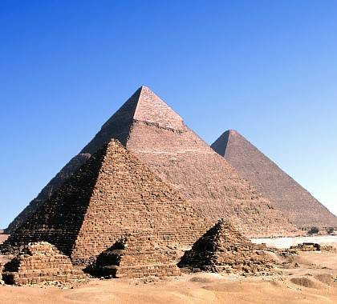
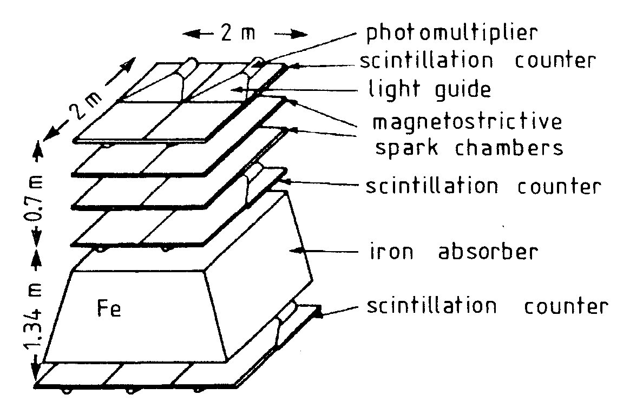
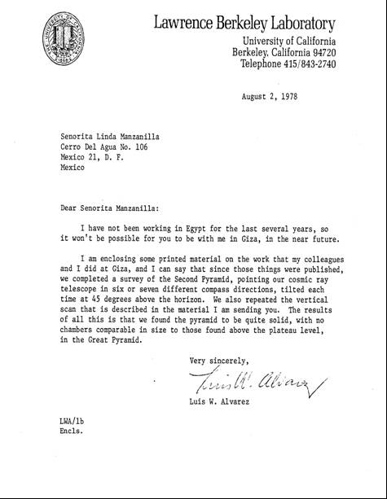
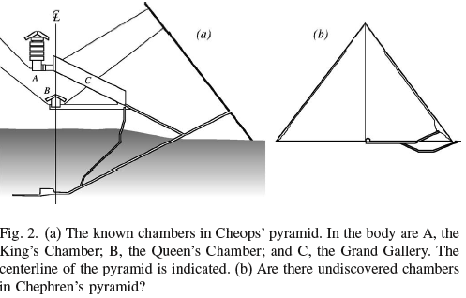
THE HISTORICAL AND RECENT EXPERIMENTS
Muons flux measure
Pyramid
Using cosmic rays in order to detect the presence of a secret chamber in the Pyramid of Chephren, experiment was install in the Belzoni chamber. Muons through a cavity lose less energy by interaction compared to crossing the limestone composing the pyramid.
Luis Alvarez et al. (1970)
“the results of all this is that we found the pyramid to be quite solid, with no chambers comparable in size to those found above the plateau level, in the Great Pyramid.”
Chephren
Cheops
Mykerinos

Slide 32
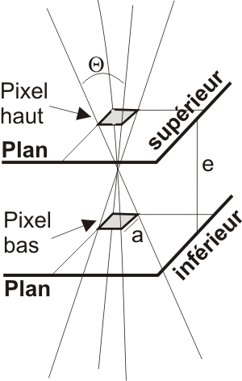
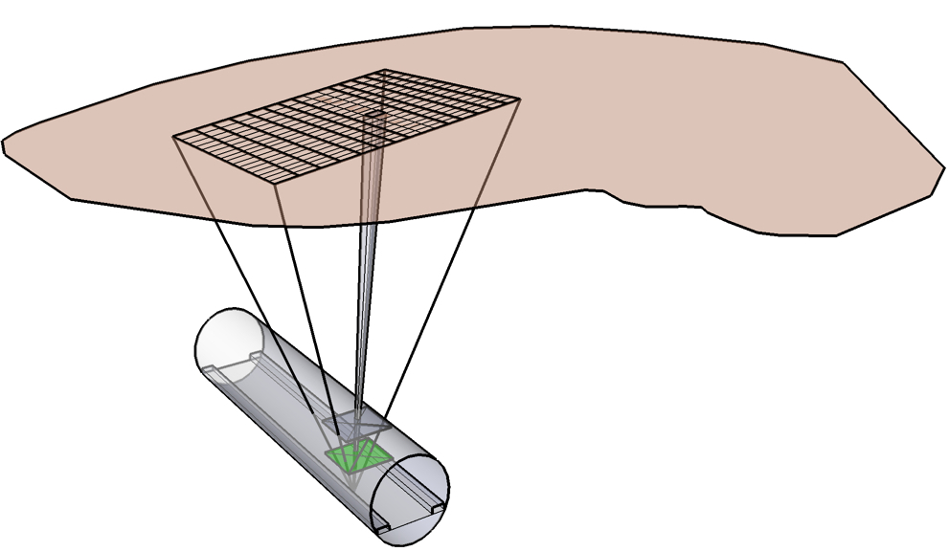
DESIGN OF TELESCOPES TO NETWORK BASED ON THE SIMULATION
Build the network:
Pixelization (strips X & Y)
The angular resolution and the distance between planes require the pixel size.
The number of pixels and the electronics require (real time processing, discrimination and signal acquisition) forcing the cost.
The time measurement requires the surface of the telescope.
The angular resolution, the aperture, the exposed surface can vary for each, we must design a versatile and flexible telescope

Slide 33




DESIGN OF TELESCOPES NETWORK TO BASED ON THE SIMULATION
Count rate:
Number of muons (m⁻² day⁻¹sr⁻¹): depending on the thickness, density & atomic compound of materials encountered
Malmqvist et al. (1979)
Average vertical muons intensity Iv µ(h) versus vertical depth h beneath a flat surface in standard rock.
arXiv:hep-ph/0604078 v2 25 Aug 2006

Slide 34



DESIGN OF TELESCOPES TO NETWORK BASED ON THE SIMULATION
For each telescope:
Exposure versus surface of the telescope
The temporal resolution depends on the speed physical processes observed, which are varying density, and duration of resilience of the environment. The required area depends on the time scale processes and counting rate.
Blondel (2008)
Residence time and exposure times depending on the depth and accuracy of measurement desired

Slide 35


U. Nice Sophia-Antipolis
U. d’Avignon et des
Pays de Vaucluse
U. Provence
(U. Méditerranée)
CNRS/INSU – DR20, DR12
U. Paul Cézanne
Observatoire de
La Côte d’Azur
(U. Sud Toulon Var)
U. Savoie
LSBB
PLATFORM PARTNERSHIP
whose development is based on structural actions of these partners
ONERA
LBNL/ESD, Berkeley
IRSN
UBC, Vancouver
CEA/DASE
CFN, Lisbonne
Oxford
CCPA
PACA
CG84

