Slide 1
Commissioning of
SRS for > 20 teams
RD51 Collaboration Meeting, CERN Feb 20, 2012

Slide 2
Teams interested in SRS
ALICE upgrade, Calorimeter backend, SRS electronics & DATE Online system
ATLAS upgrade, MAMMA project for Micromegas small wheel CSC , min Bias , Muon upgrade
CMS upgrade CMS GEM collaboration, Muon Endcaps Technical Proposal
Bari testlab and TOTEM upgrade with GEMs
BNL GEM detectors, RCDAQ Online software for SRS
Bonn Phys. Inst. SRS Timepix readout, R&D towards TPC for ILC
Budker INP, Novosibirsk, Deuteron Experiment at VEPP-3
Florida Inst Tech. Muon Tomography with GEMs
Géosciences Azur-CNRS-UNSA Valbonne-FR , µMEGAS for geology - tomography
GDD lab RD51, CERN, general MPGD development lab
HIP, HELSINKI, Finland , characterization of gas detactors
INFN Napoli, ATLAS. SRS readout electronics and Firmware
Jefferson Lab, Virginia UVa , 40k channel GEM system
LAPP, Annecy, SRS hybrid with MicroROC chip for ATLAS
NA62 CERN straw tracker upgrade tests with MMega
NEXT Collaboration, Spain, small Xenon TPC with PM and Si PMs, SRS readout electronics
Radcore LTD Republic of Korea, GEM production
SAHA Inst Nucl Phys,KOLKATA, IN , Laboratory for characterization of MPGDs
Stony Brook, Univ NY, 10x10 triple GEM
Tsinghua Univ. China , R&D on GEM Imaging detectors
USTC Shanghai, CN , characterization of GEM and MicroMega with SRS
UNAM, MEXICO, MX , THGEM readout
Univ . Texas, DOE proposal with 18 GEMs
WIS , Israel MPGD validation
Yale University , GEM development single plane 3-coordinate
In blue: already SRS user or developer
of SRS systems produced by CERN in 2011

Slide 3
Some visible HEP experiments
SRS test system for GEMs at BNL ( PHENIX )
SRS test system for Focal detector with Beetle hybrid ( ALICE)
GEM readout system for TPC ? ( ALICE)
MicroMega readout system for Muon upgrade ( ATLAS)
GEM readout of Endcaps via VFAT hybrid and SRS (CMS )
R&D on Timepix SRS readout for TPC at Bonn Univ ( ILC )
potential for large systems

Slide 4
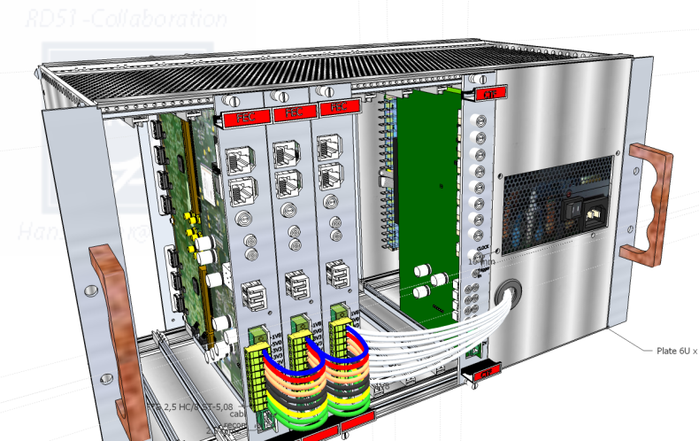
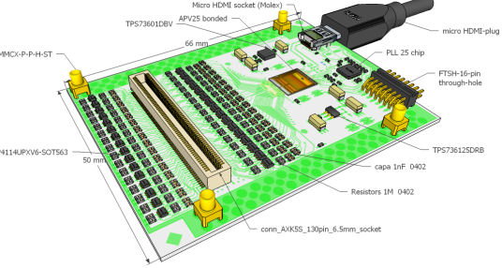
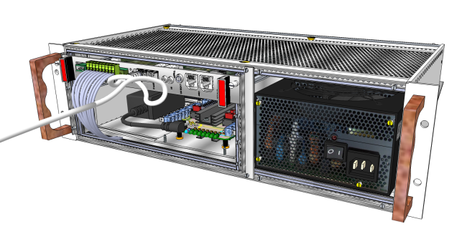
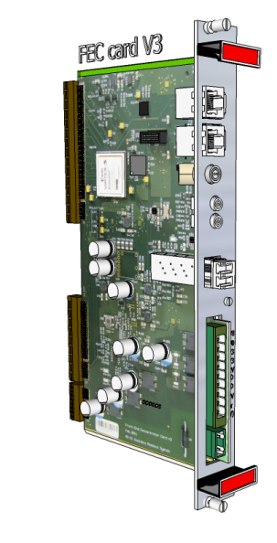
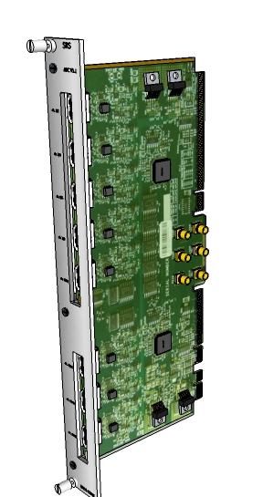
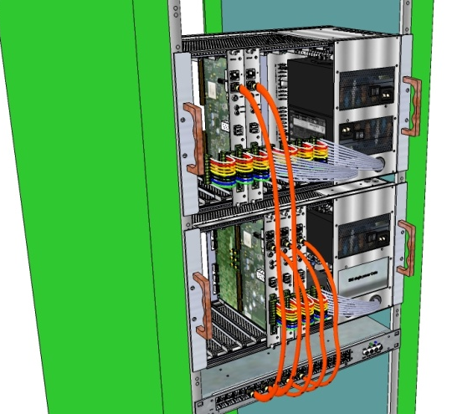
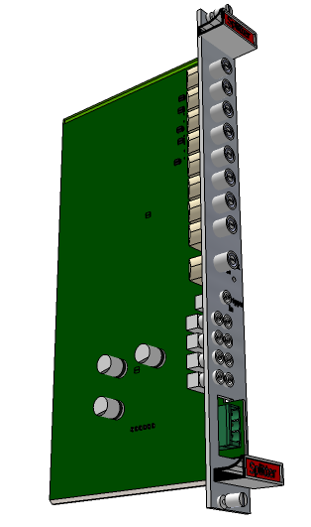
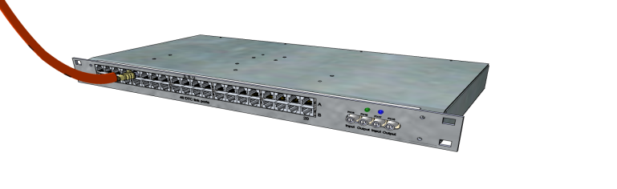
SRS order status Feb. 2012
530 APV hybrids
Expect Beetle and VFAT versions
13 powered Euro-Crates
3 Versions HP, FP, SR
Minicrates
2 versions 2k /4 k channels
FEC cards
2 versions
40 ADC cards
8 CTF cards
32 SRU for large Systems
DRC link based Rreadout
Outsourcing to industrial production and sales via CERN store

Slide 5
SRS production schedule 2012
A.) Short term Q1 ( ongoing production / closed orders)
6 Minicrates A max. 2k channels
10 Eurocrates HP max. 8k channels
24 ADC cards + 24 FEC cards V3
3 ATX adapters
500 APV hybrids V4
34 SRU ( inhouse production so far)
8 CTF ( inhouse production so far)
B.) Medium term (Q3 ) overhang A + new orders
min. 2 Minicrates
min. 3 Eurocrates FP max. 16 k channels
min. 16 ADC cards
min. 37 FEC cards V6 (new)
min. 10 CTF
O(500 +) APV hybrids
O(500 +) Beetle hybrids
O(500 +) VFAT hybrids
O(10) SRU
c.) Long term (Q4) extrapolation with first large system users
expect multiples of Q3

Slide 6
SRS price/channel
SRS cost is comparatively very low cost
channel prices of up to 100 Eu can be found in many existing detectors
SRS channel price for large systems ( Eu)
Example: 82k channel SRS system ( 1 Rack, 5 crates, 1 SRU )
640 hybrids ~ 65 k hybrids 34%
5 Crates full power ~ 6 k electronics + cables 66%
SRU in Alu box ~ 3 k
FEC + ADC cards ~ 83 k
320 cables (HDMI+Flat) ~ 6 k Total 163 k
Channel cost (82 k) ~ 1.98 Eu

Slide 7
SRS manpower status
FTE = full time equivalent
a.) RD51 CERN
1 until summer 2012 - > continuation needed into 2013
b.) CERN experiments
1.5 ALICE + ATLAS -> continuity + more from CMS
c.) RD51 teams
1 NEXT+ FIT + INFN in 2011 -> BNL & UVa starting
New manpower SRS vital for smooth continuation

Slide 8
Job description
min, 1 year as from Summer 2012
maintain regular contact with SRS users and SRS producers
update the SRS FAQ and maintain SRS user manual
maintain SRS resource base
Consult RD51 management in SRS priorities and actions to be taken
maintain and update SRS team requests database (Excel)
and consult CERN store in procurement volumes
assist in selection and procurement of SRS parts
- standard electronic parts, - special chips, - standard
mechanical parts & kits - special mechanical parts
assist SRS users and teams with hardware problems,
consult with repair, replacement and upgrade
organize or participate in electronic design of new SRS devices
(acquire) expertise in Labview testing of SRS electronics
(acquire) expertise in Sketchup-Pro 3D modelling
participate and/or rganize in SRS Firmware development /upgrade
follow up on technical questions and problems from the production site

Slide 9
SRS Resources
a.) Firmware
binaries for FEC update (free download), sources ( for developers )
contact: S.Martoiu@cern.ch
b.) Software
DATE & AMORE Online and Data quality default for RD51 (Linux and Windows)
MMDAQ Online ATLAS MAMMA , Linux ( and MAC)
RCDAQ New Online BNL Linux
SDC Scalable Detector Controls
SRS -Labview Online small systems ( Windows, Mac, Linux)
SRCTS New Configuration and Conformance suite, Labview
c.) Documentation
SRS User manual ( in preparation )
SRS hardware definitions http://dl.dropbox.com/u/31352454/SRS_Hardware_Specs.zip
SRS –FAQ http://dl.dropbox.com/u/31352454/SRS%20-FAQ%20%20%20Feb%202012.pdf
SDC http://dl.dropbox.com/u/31352454/SDC_George.pdf
SRS SC Registers http://dl.dropbox.com/u/31352454/SRS_SC_Registers_v02.pdf
d.) Publications
NSS 2011 , IEEE paper S.Martoiu et al.
RD51-NOTE-2010-004. – 2010 , Submitted to IEEE , K.Gnanvo et al.

Slide 10
SRS-FAQ
Whilst preparing the SRS user manual, an SRS FAQ (monthly update ) is here
http://dl.dropbox.com/u/31352454/SRS%20-FAQ%20%20%20Feb%202012.pdf
Detailed References, changes / updates to hardware and
firmware are communicated via the FAQ

Slide 11
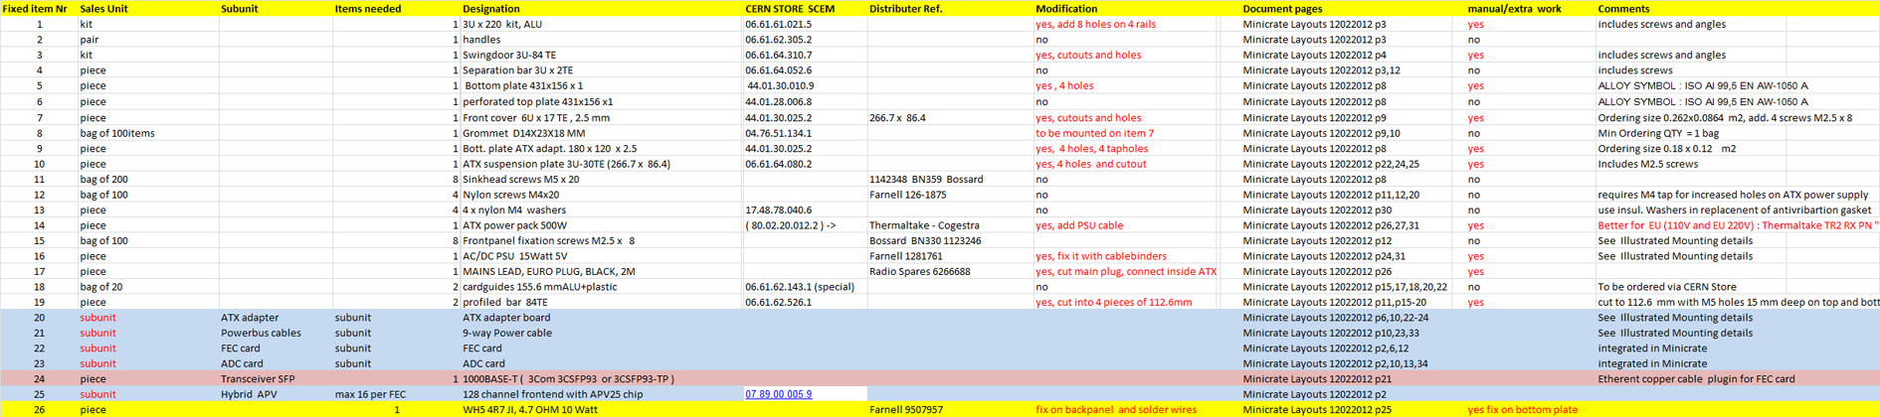
Part lists
For every SRS module we maintain a very detailed part list database (Excel)
with ordering references. As time goes, some parts become unavailable
and replacements have to be found
Example partlist Minicrate

Slide 12
Actions and Problems
PRISMA awaiting final component shipment from CERN store
WIS is awaiting green light for Beetle hybrid production
CERN store needs more APV and PLL chips hybrid production
CERN store trying to find ALU cooler bars that are out of stock
RD51 to discuss imminent SRS manpower bottleneck with teams
RD51 radhard chip export issue still not solved

Slide 13
SRS via CERN store
CERN store is starting SRS in the online catalogue under 07.89.00.
Inititially APV hybrids
Standard SRS parts (Crates, cards ) to follow very soon
SRS accessories: 130 pin Panasonic connectors, MMXC plugs etc
Defective SRS cards and crates:
all parts have been tested for conformity using the SRCTF suite
CERN store has no infrastructure for repair or conformity recheck
handle cards carefully, repair can only be done by your own resources

Slide 14
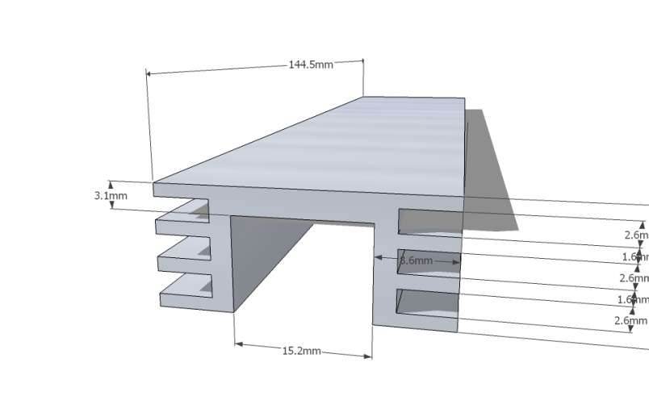
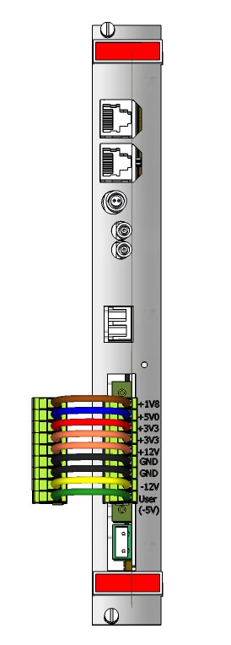
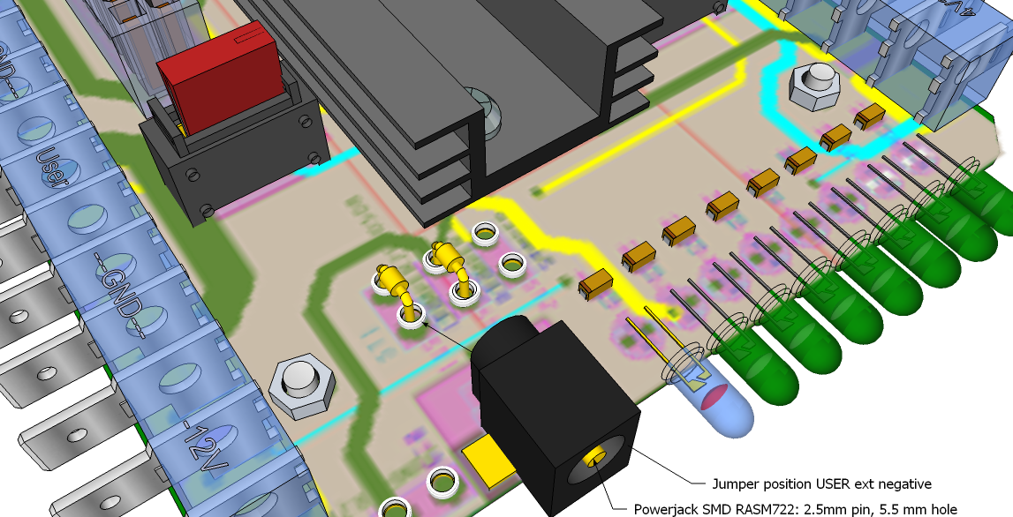
3D modelling
(re)-design of mechanical parts
with CAD file generation for
production
Electronic detail for documentation
and revision of parts
Front panels
for documentation and
redesign
CAD file generation

Slide 15
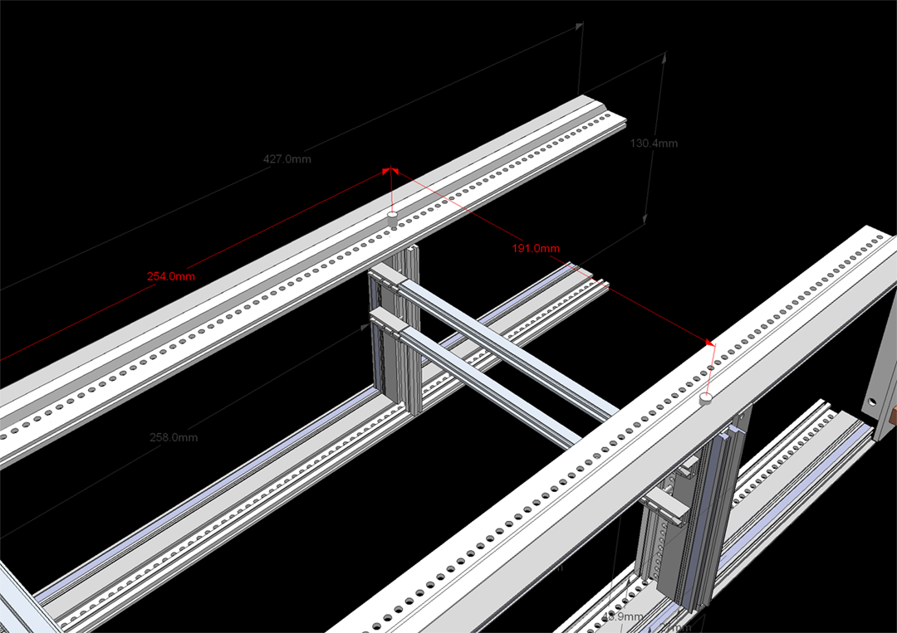
Crate design
The SRS crates have been designed with parts from teh CERN store. Some of these
these have to be specially machined before they can be used. Parts for future crates
should be ordered as already machined parts, for this we need the CAD models to
be made.
CAD view of Minicrate
Internal structure

Slide 16
Priority of SRS developer projects
Zero supression and peak detection firmware = works ( to be released )
Revised SRU V3 = PCBs and Components received ( production imminent )
CTF Clock-Trigger-Fanout card = Prototypes (final revision for production released)
Labview SRS = basics work ( beta tester needed )
SRTSC Configuration and Conformance Suites = basics work ( release expected )
DTC links FEC –SRU = proto link works ( upgrade to 1 Gbit/s started)
New FEC card V6 = schematics done ( PCB layout awaiting offer )
Beetle hybrid prototype production= PCB layout done ( waiting for feasibility OK)

Slide 17
SRS Firmware
Common SRS Firmware for FEC cards and for SRU
Core firmware not to be changed by Developers
API Interface to Core firmware allows for satellite modules
SRS users can develop application specific satellite modules
API Coordination and documentation needed

Slide 18
User support
SRS teams consist of USERS and DEVELOPERS
communication between Users and Developers very open and active
the step towards industrial SRS requires to maintain Openness
Central SRS database and FAQ needs updating and organization
Most SRS diversity exists in area of online systems
Concentrate on agreed default Online system (DATE )
Maintain common development between different Online systems

Slide 19
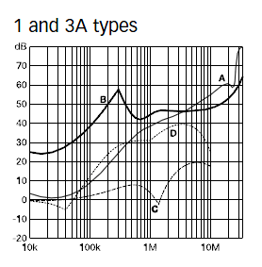
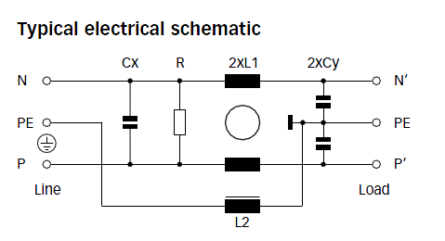
SRS-crate grounding issue
Ideal rule:
ground the detector and use floating power supplies for the electronics
In practise not possible: parasitic grounds are unavoidable at
the crate level , i.e via grounded from cables or from AC power cable.
First 2011 SRS crate prototypes had the AC power cable earth disconnected
with explicit request to ground the crate via a cable to the detector ground
→ This principle cannot be maintained, not safe, users forget -> static discharge <-
All new SRS crates are grounded via the earth pin of the AC mains plug
We recommend to insert AC + Earth filters ( as shown) into the power cable
Schaffner FN9222E inlet filters
* Please return proto crates such that we can reconnect the GND

Slide 20
Summary
24 teams interested in SRS, 11 already have SRS proto systems
Some teams with potential
Industrial SRS Production with sales via CERN store
Short term production organized and pre-financed by CERN
Medium term production 100% by PRISMA and CERN store
Cost/channel ~2 Eu for large systems 82k ch and more
SRS manpower 3.5 FTE soon dropping soon below critical
Job description for fellow to deal with
SRS-Firmware, Hardware and Online Software
+ resources, FAQ, Actions, CERN-store,3D modelling, priorities
Crate grounding issue, recall proto systems

