Slide 1
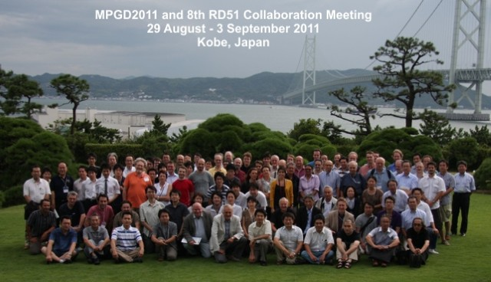
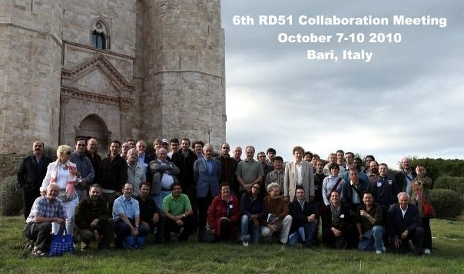
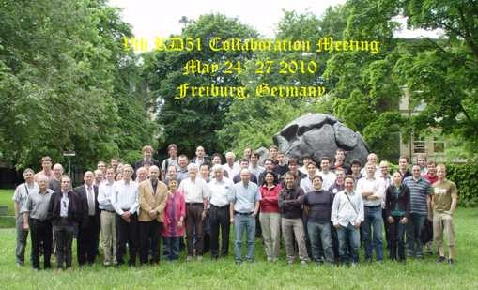
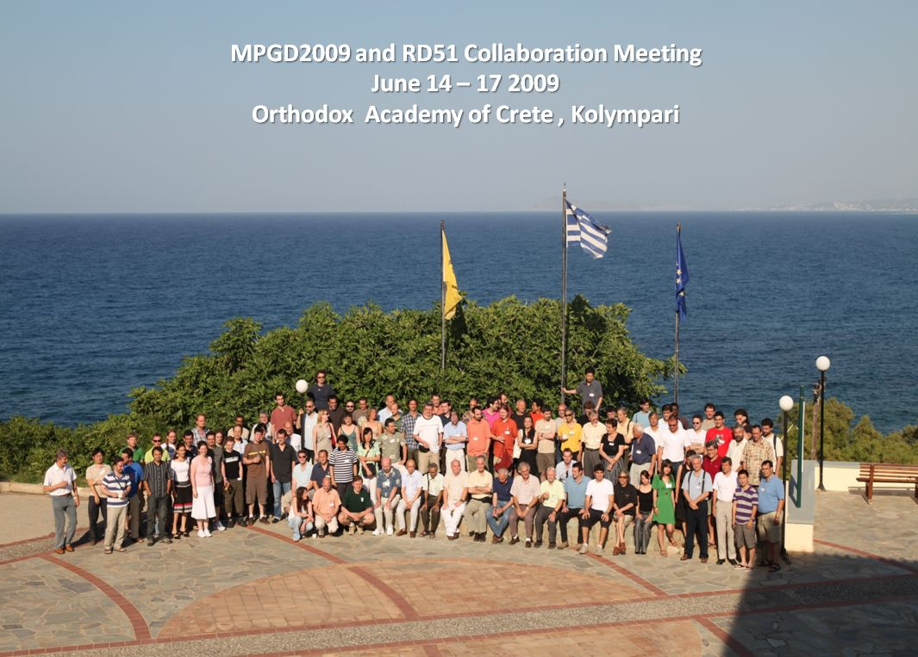
RD 51 Collaboration News
Leszek Ropelewski (CERN), Maxim Titov (CEA Saclay)
80 RD51 Member Institutes; ~ 450 Participants
9th RD51 Collaboration Meeting, CERN, February 20-22, 2012

Slide 2
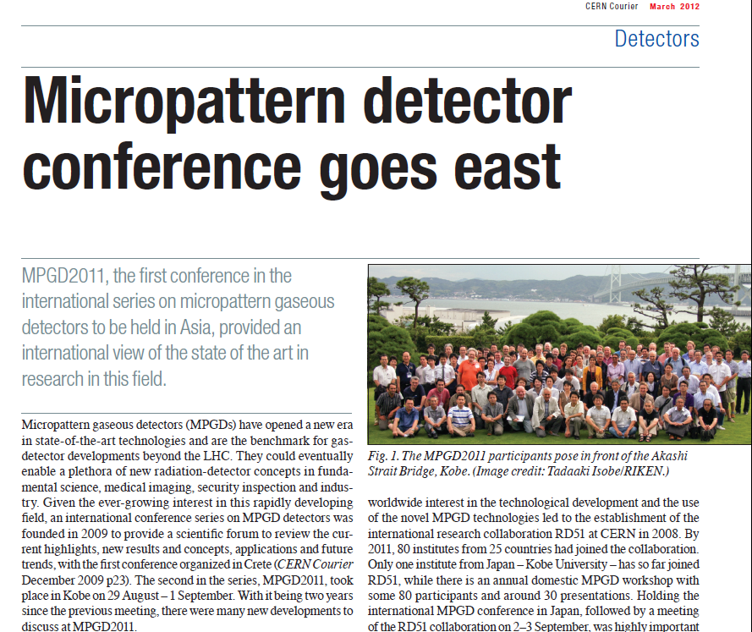
→ To appear in the CERN Courier, March 2012

Slide 3
9th RD51 Collaboration Meeting (CERN, February 20-22, 2012):
https://indico.cern.ch/conferenceTimeTable.py?confId=176664#all
New format:
no WG parallel sessions → no WG summaries (for the first time)
Monday, February 20 (BE Auditorium Meyrin, CERN)
09:00 - 12:00 Opening session
14:00 – 19:00 WG5 Electronics
19:00 - 20:30 Collaboration Board Meeting
WG2 - Physics issues
Tuesday, February 21 (BE Auditorium Meyrin, CERN)
09:00 - 12:30 WG1 – MPGD Technologies and New Structures
14:00 - 19:00 WG2 – Physics Issues
19:00 – 23:00 Collaboration Dinner → please register/sign, if not done yet;
Wednesday, February 22 (BE Auditorium Meyrin, CERN)
09:00-11:00 WG7 - Test beam
09:00-12:30 Special InGrid/Gridpix meeting
14:00-19:00 WG4 - Simulation & software

Slide 4
RD51 Collaboration Meetings and Events in 2012:
20 – 22 February: RD51 Collaboration Meeting (CERN)
26 – 27 April: Industrial Applications of Micro-Pattern Gaseous
Detectors – Annecy → see C. Adloff/H. Hillemanns plenary talks
13 June: RD51 Presentation to LHCC
13 - 15 June: RD51 Mini-Week (CERN)
Two very strong proposals to hold 2012 RD51 Coll. Meeting outside CERN:
(the SINP/VECC Kolkata proposal has been greatly appreciated as
tested by the distribution of votes inside the MB):
1 – 4 October: RD51 Collaboration Meeting (Stony Brook)
→see K. Dehmelt plenary talk
November – December: RD51 Mini-Week (CERN)

Slide 5
RD51 WG Conveners, CB / MB Minutes
Welcome to New Working Group Conveners !!!
Eraldo Olivieri/Siena - new WG7 co-convener (join Y. Tsipolitis)
Carlos de Oliveira/Aveiro - new WG4 co-convener (join R. Veenhof)
RD51 Official Communications:
RD51 Collaboration Meetings Agenda:
http://rd51-public.web.cern.ch/RD51-Public/Meetings/CollaborationMeetings.html
CB minutes:
https://espace.cern.ch/test-RD51/CB%20meeting%20minutes/Forms/AllItems.aspx
MB minutes:
https://espace.cern.ch/test-RD51/MB%20meetings/Forms/AllItems.aspx

Slide 6
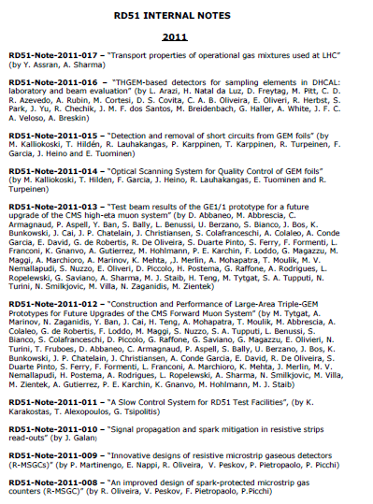
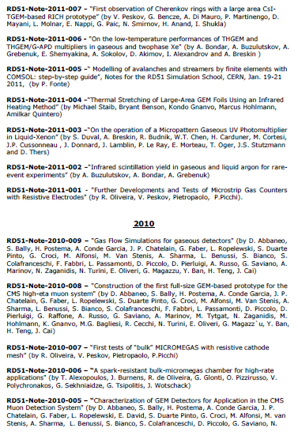
RD51 Collaboration Notes
https://espace.cern.ch/test-RD51/RD51%20internal%20notes/Forms/AllItems.aspx
RD51 Notes: 17 in 2011;
9 in 2010;
7 in 2009
We encourage everybody to submit results of your work (before journal publication)
and internal documentation as RD51 internal notes

Slide 7
RD51 Common Projects in 2011 and 2012
2011: 4 proposals approved under the call for Project Funding from the RD51 CF
Thin and high-pitch laser-etched mesh manufacturing and bulking (Saclay / CERN / Bari)
Development of innovative resistive GEM alpha detectors for earthquakes prediction
and homeland security (INFN Bari / UNAM, Mexico / INFN Padova / INFN Frascati)
MPGDs technology laboratory for training, development, fabrication, applications
and innovation (Universidad Antonio Nariño, Columbia / Brookhaven National Laboratory/
Helsinki Institute of Physics / HEPTech / GSI Helmholtzzentrum)
A low mass microbulk with real XY strips structure (NCSR Demokritos / Saclay/ Laboratorio
de Física Nuclear y Astropartículas, Universidad de Zaragoza / CERN )
→ See P. Colas, V. Peskov, R. Gutierrez and T. Geralis plenary talks
2012: New Call for 2012 Common Project Proposals → deadline June 15, 2012
→ Selection/decision by the time of the RD51 Collaboration Meeting in October

Slide 8
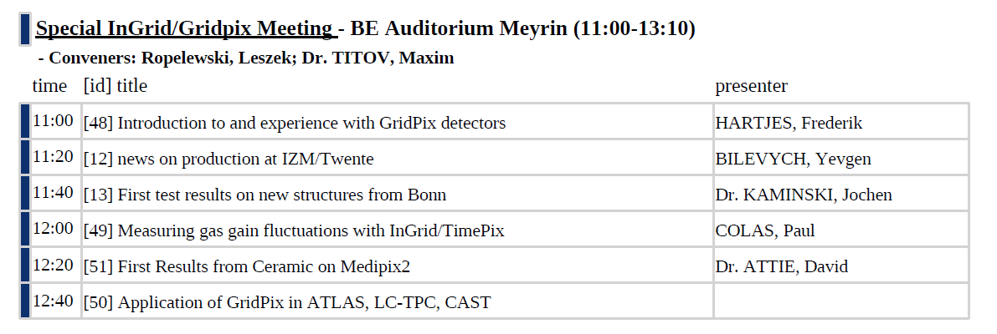
Special “InGrid / Gridpix” Meeting
The purpose of this meeting (February 22, 11:00-14:00) is two-fold:
Discuss state-of-the-art “InGrid” technology & Progress in the development of
“InGrid” structures on the wafer-scale level & next R&D steps
Statements from RD51 groups about their interest in “InGrids” & Applications
Please contact us if you would like to contribute by making presentation !!!

Slide 9
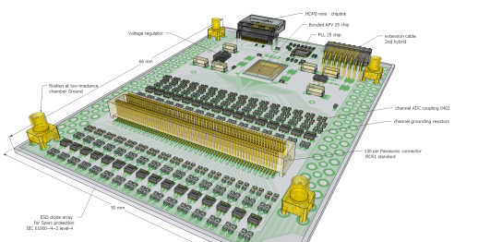
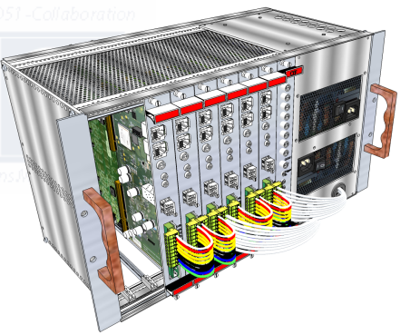
WG5 – Electronics & Scalable Readout Systems
CERN experiments
ATLAS CSC upgrade MMegas ( 5kCH- APV -SRS systems for testbeams delivered, MMDAQ )
ATLAS CSC upgrade Mmegas, (BNL chip readout via SRS, SRS Adapter by Arizona Univ under test )
ALICE EMCaL , SRU-based readout backend ( 25 SRU for ALICE EMCaL upgrade, ongoing collaboration)
NA62 ref. tracker with Micro-Megas (1kCH-SRS Minicrate delivered, MMDAQ)
CMS high Eta, VFAT hybrid and VFAT SRS adapter design started, manpower needed
HEP experiments
NEXT Coll., dual Beta decay, SiPM, PM (Coll. on SRS hardware, FEC cards delivd, DATE)
BUDKER,INP,Deuteron,triple-GEM
BNL GEM detector readout ( 2kCH. APV Minicrate delvd. PHENIX DAQ port to SRS )
Jeff. Lab Virginia Univ. GEM prototyping, 1kCh APV Minicrate delivered, DATE ( Kondo)
APV hybrid 128ch
Applications with Cosmic Tomography
FIT Florida, Muon Tompography for homeland security, GEMs ( 16 kCh full SRS Crate delivered, DATE )
Geoscienes CRNS- Waterquality, MMegas ( 5kCh SRS Crate delivered, DATE , Labview)
R&D with MPGD’s ( small systems )
Tsinghua Univ, GEM Imaging
Bonn/Mainz Univ, Timepix readout ( starting Nov. 2011 , 1 FEC /ADC combo )
Helsinki HIP, GEM-MMega eval. (2kCh SRS Crate delivered )
MEXICO UNAM, THGEM ( 500ch SRS Minicrate delivered , DATE )
C.E. Saclay, Micromegas ( 2k Ch SRS Minicrate delivered, MMDAQ)
SRS crate 16k ch.
New orders ( commercial SRS)*
RD51 lab, WIS, USTC, SAHA, INFN Bari, INFN Napoli, Radcore, Stony Brook, UPV Valencia, ATLAs upgrade + more
* SRS Production 2012 (commercial): PRISMA, Alexandoupulis Gr, sales via CERN store, CERN contract KTT in prep.
( 250 Ch SRS Minicrate delivd. as Ref. System, Labview*

Slide 10
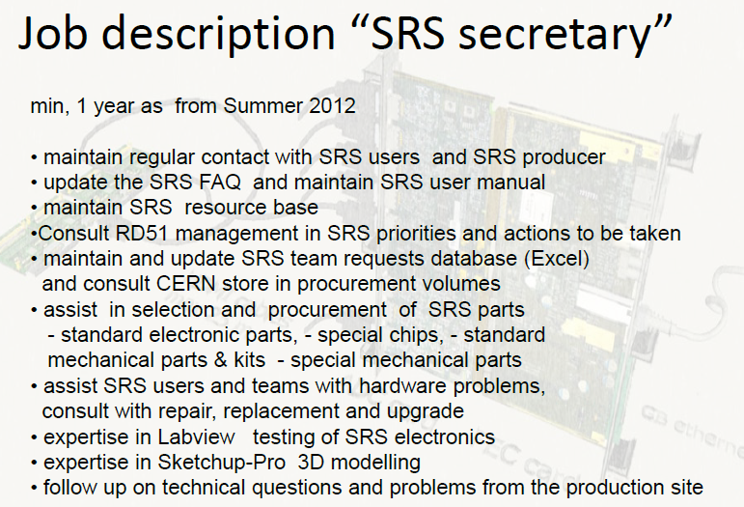
WG5 – Electronics & Scalable Readout Systems
Overhelming interest in the RD51 Community → Commissioning of SRS Systems
for more than 20 teams → can not be handled anymore by Hans Muller /CERN Team
SRS systems will be produced by PRISMA (to be purcharged via CERN store)
PRISMA Production should start soon → a lot of work/time for Hans/CERN Team
to order components for PRISMA (for initial SRS production);
Need a person/fellow who
is (mostly) based at CERN
→ Discussion in WG5
Monday (Feb. 20,
14:00-19:00)
→ to ensure timely
delivery of the SRS to the
RD51 users

Slide 11
WG6 – MPGD Technology & Industrial Partners
THGEM Technology – ELTOS S.p.A. (Italy)
PRINT ELECTRONICS (Israel)
GEM Technology
New Flex (Korea, Seoul)
Tech-ETCH (USA, Boston)
Techtra (Wroclaw, Poland)
Scienergy (Japan, Tokyo)
Keerthi Industries (India)
MicroMetal GmbN (Germany, Muellheim)
Micromegas Technology
TRIANGLE LABS (USA, Nevada)
ELTOS S.p.A. (Italy)
SOMACIS (Italy, Castelfidarco)
CIREA (France, CHOLET)
Many new developments / results → see F. Formenti plenary talk
Summary of Recent Contacts with NewFlex, ELTOS, Techtra, Cirea, Tech Etch
Status of License Agreements
Future Organizational Steps (interface to industry for technology transfer)
Manpower needs

Slide 12
WG7: RD51 Common Teat-Beam in 2012
If you participated in the 2011 RD51 Test-Beam, please send your report to Yorgos
about results/experience (if not done yet)
RD51 Test-Beam Slow Control System: https://twiki.cern.ch/twiki/bin/view/MPGD/SloCSy
June (15 days)
Late July/ August (15 days)
October / November (15 days)
Three RD51 Test-Beam Periods
are requested for 2012:
No 2012 test-beam schedule is available yet
Test-beam requests to SPS exceeds by a large factor a total available
test-beam time → follow-up discussion with SPS coordinator
Possibility of financial support from AIDA for test beam (not RD51-related):
(http://aida.web.cern.ch/aida/activities/access/ )

Slide 13
RD51 Future (beyond 2013):
The initial validity of the present RD51 MoU covers the period
until the 31st of December 2013
If RD51 would like to continue beyond 2013 → need to ask for
extension LHCC and CERN Research Board (RB);
If RD51 CB makes a positive decision → ask LHCC for extension for
another 3-5 years term (to avoid prolongation on the yearly basis);
Preliminary discussions with LHCC → will not need to write new
RD51 proposal →prepare executive summary (5-10 pages) to
describe future RD51 program
Document to be submitted to the LHCC by the end of 2012 →
extension discussed/(approved) by LHCC/RB in March/June 2013;

Slide 14
RD51 Future (beyond 2013):
Draft List of Topics for continuation of RD51 Collaboration Activities beyond 2013:
MPGD Industrialization (GEM, Microgemas, Thick GEM)
Further Support of the LHC Upgrade Projects (ATLAS MAMMA, CMS GEM, ALICE TPC, …)
Generic R&D (new structures, ideas, detector physics ) and R & D Developments for Future Projects:
…
e. g. Special “InGrid/Timepix” meeting on Feb. 22 to discuss RD51 interest
Software Support
RD51 Common Projects
Maintenance of the RD51 Test-Beam Infrastructure
→ Please send your inputs by June 1, 2012

Slide 15
9th RD51 Collaboration Meeting (CERN, February 20-22, 2012):
https://indico.cern.ch/conferenceTimeTable.py?confId=176664#all
Monday, February 20 (BE Auditorium Meyrin, CERN)
09:00 - 12:00 Opening session
14:00 - 19:00 WG5 Electronics
19:00 - 20:30 Collaboration Board Meeting
WG2 - Physics issues
Tuesday, February 21 (BE Auditorium Meyrin, CERN)
09:00 - 12:30 WG1 – MPGD Technologies and New Structures
14:00 - 19:00 WG2 – Physics Issues
19:00 – 23:00 Collaboration Dinner
Wednesday, February 22 (BE Auditorium Meyrin, CERN)
09:00-11:00 WG7 - Test beam
09:00-12:30 Special InGrid/Gridpix meeting
14:00-19:00 WG4 - Simulation & software

