Slide 1
The EMMA Project
Rob Edgecock
STFC Rutherford Appleton Laboratory & Huddersfield University
*BNL, CERN, CI, FNAL, JAI, LPSC Grenoble, STFC, TRIUMF

Slide 2
Outline
Why we needed to build EMMA
How we got to where we are
Design of the machine
Construction
Commissioning
Conclusions

Slide 3
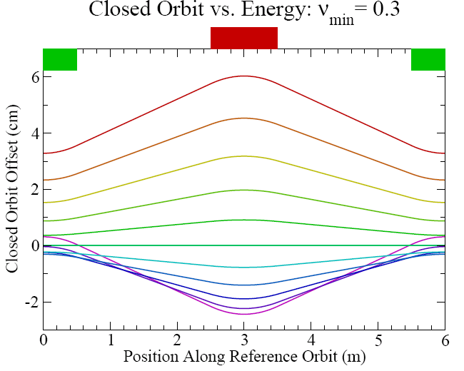
Motivation for EMMA
EMMA: linear non-scaling Fixed Field Alternating Gradient accelerator
~ cyclotron
Strongly focussed cf cyclotrons

Slide 4
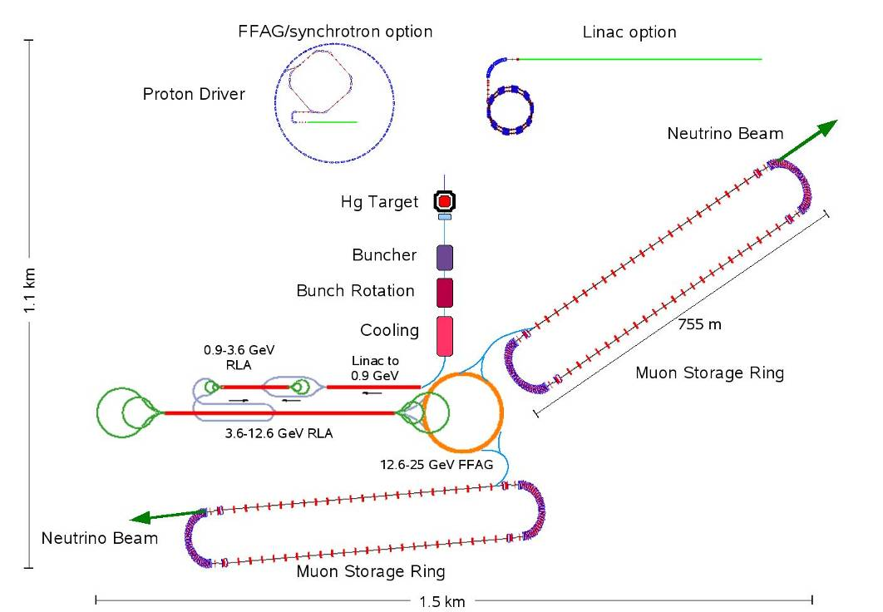
Motivation for EMMA
Linear non-scaling FFAG - invented 1997/9, C.Johnstone et al - for muon acceleration in a Neutrino Factory
Neutrino Factory
Acceleration
Must be fast
Large acceptance

Slide 5
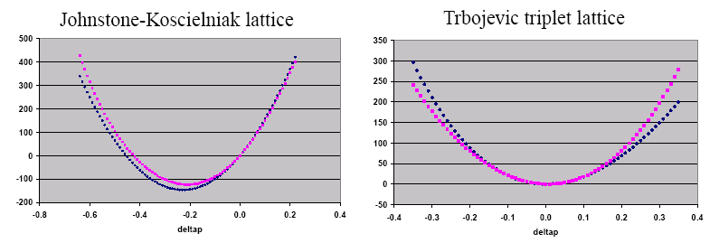
Motivation for EMMA
Linear non-scaling FFAGs: - invented 1997/9 - for muon acceleration in a Neutrino Factory
- large dynamic aperture
- small orbit excursion – higher frequency RF - CW acceleration
Path length
Travel time
/p
/p

Slide 6
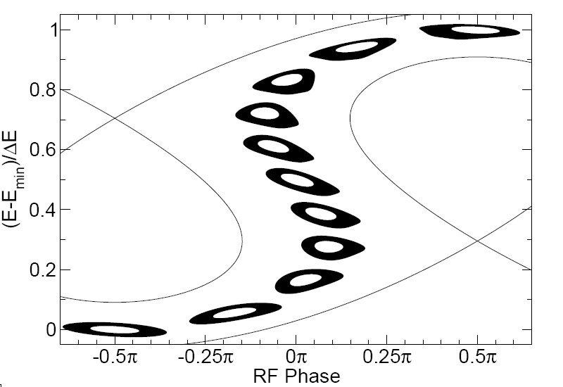
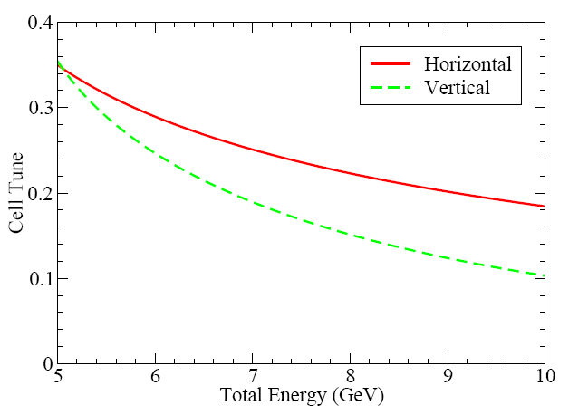
Motivation for EMMA
Serpentine, bucketless, asynchronous, etc acceleration
27
Fast resonance crossings
14
8

Slide 7
Motivation for EMMA
Realised early on:
  Other potential applications: - hadron therapy - ADSR - other high power proton beam applications
  One or two issues: - tiny momentum compaction - unique longitudinal dynamics - possible transverse dynamics problems - resonance crossings - constraints on construction - standard tracking codes not applicable - purpose built codes need benchmarking
Must build one!
Hence, EMMA

Slide 8
EMMA Time Line
1997/99 - NS-FFAGs invented
~2003 - First discussion of electron model
2004 - ALICE & ALICE hall selected
2005 - First funding attempt (FP6)
2006 - Second funding attempt
2006-2009 - Final design
CONFORM Consortium
RCUK Basic Technology Fund
Three work packages: EMMA PAMELA Other applications
Ran from April 2007 to March 2011
Successful in all areas

Slide 9
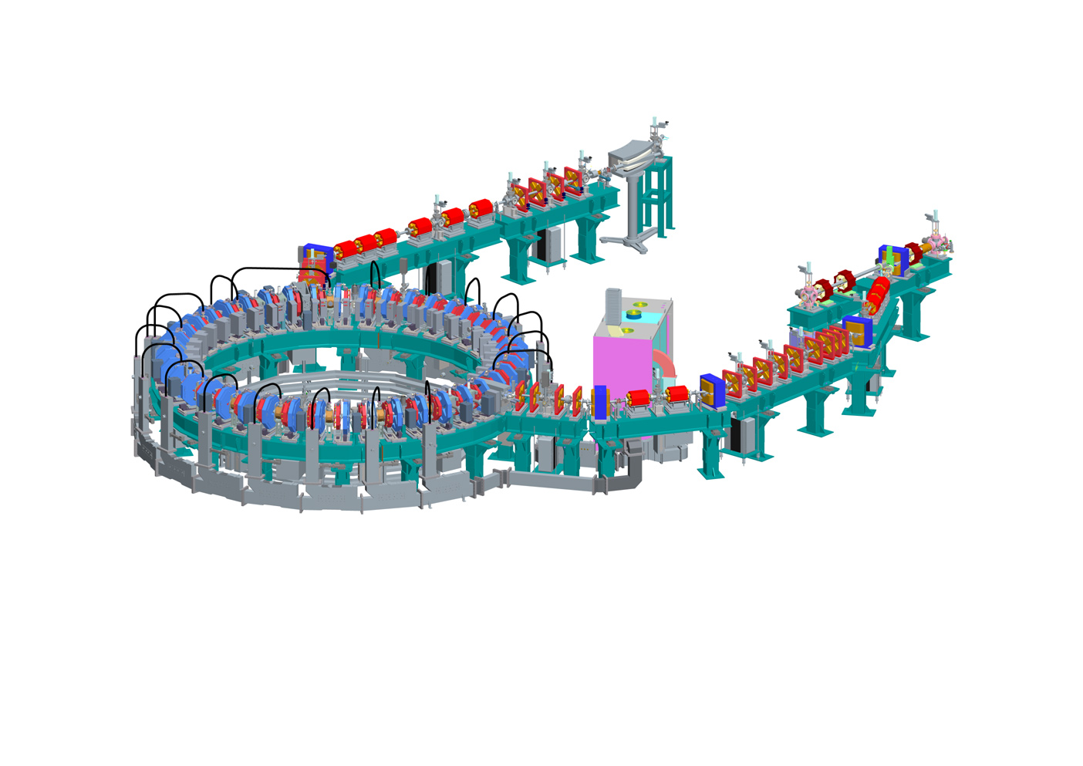
EMMA Layout
EMMA
10-20 MeV
42 cells, linear doublet lattice
19 RF Cavities, 1.3GHz
Lots of diagnostics
Diagnostics beam line
Section of ALICE
Injection line
EMMA ring

Slide 10
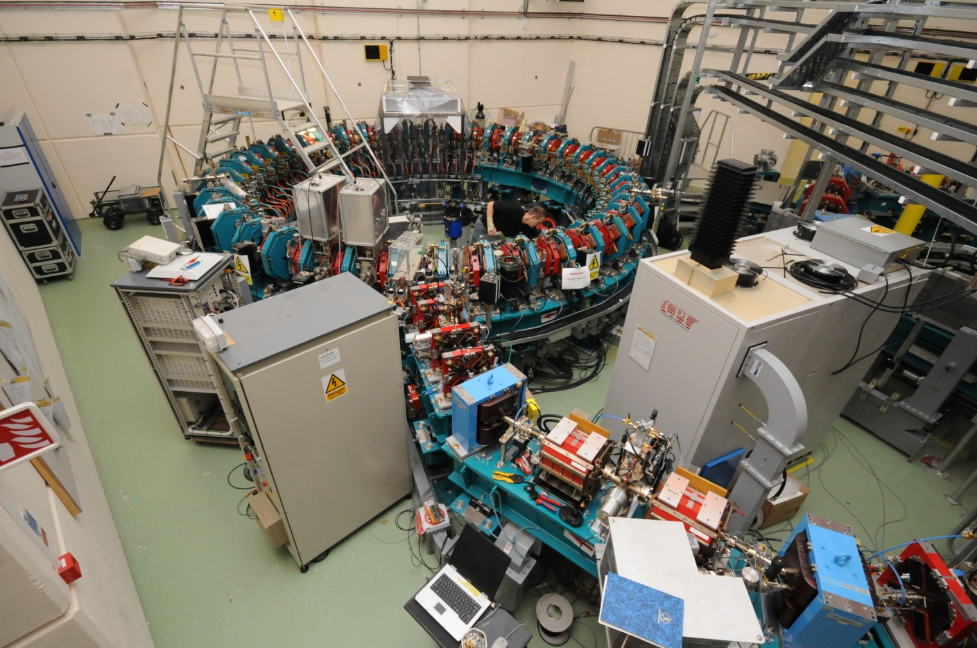
EMMA Time Line
2007-2011 - Construction
March 2010 - Injection line complete. First beam on 26th March
18th June 2010 - Ring “complete” i.e. all sectors in place, but one not connected. 4-sector commissioning

Slide 11
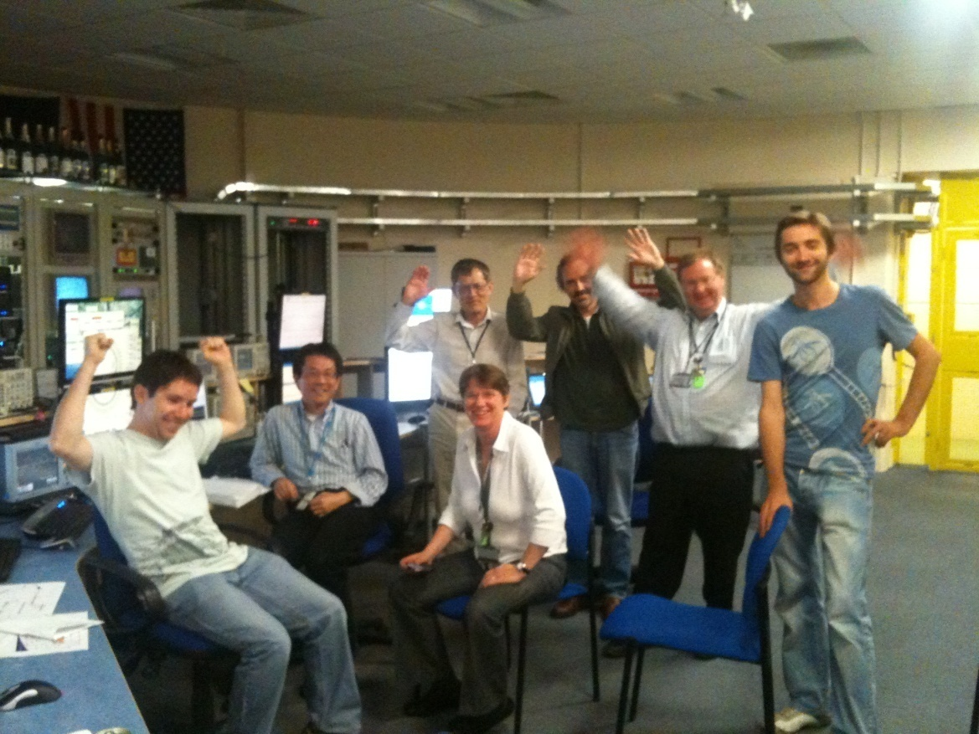
EMMA Time Line
2007-2011 - Construction
March 2010 - Injection line complete. First beam on 26th March
18th June 2010 - Ring “complete” i.e. all sectors in place, but one not connected. 4-sector commissioning
22nd June - Beam to end of 4-sectors
July 2010 - Ring construction complete
Aug-Oct 2010 - First commissioning period
Feb 2011 - Diagnostics line complete
Feb-April 2011 - Second commissioning period

Slide 12
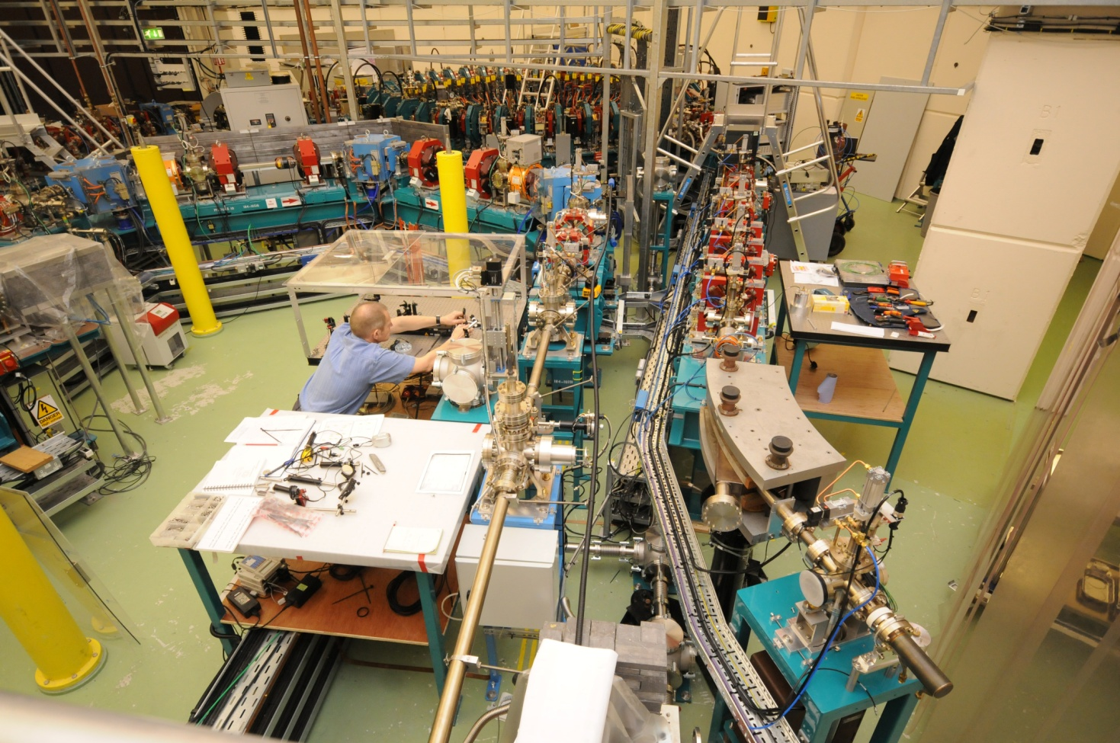
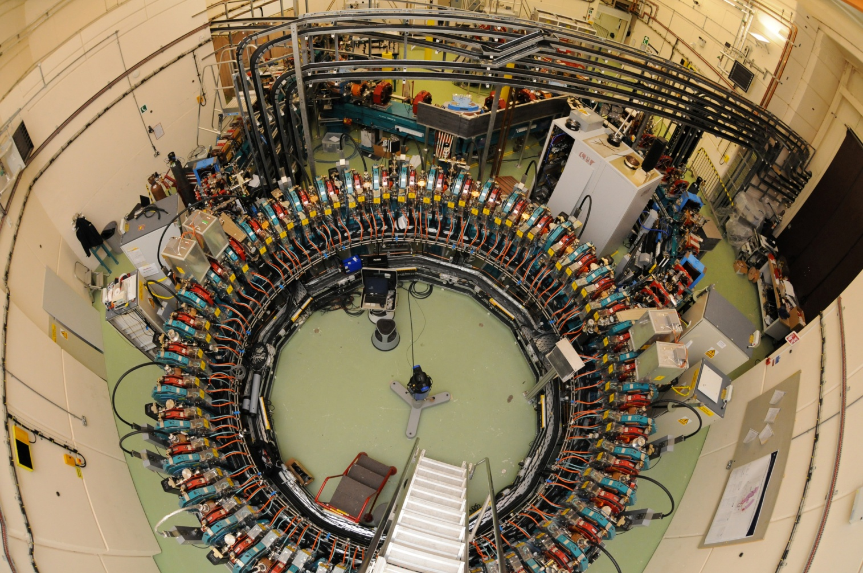
EMMA Time Line

Slide 13
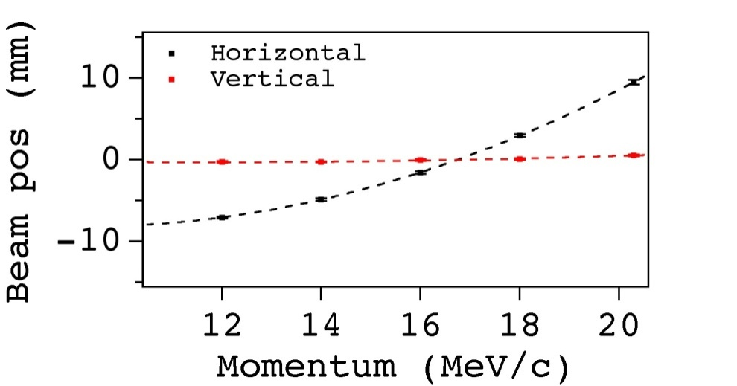
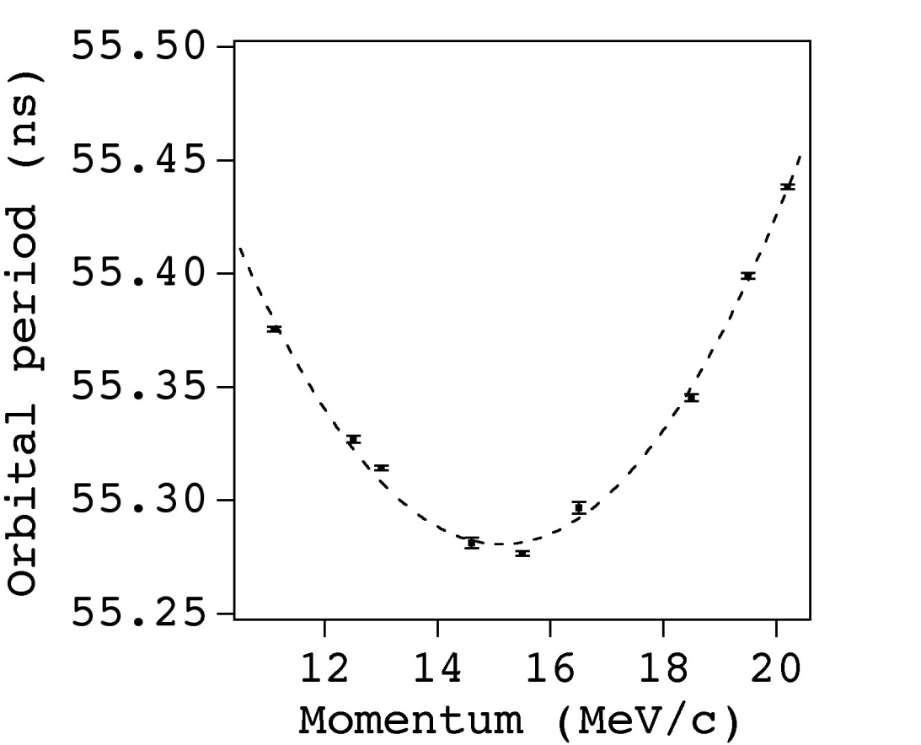
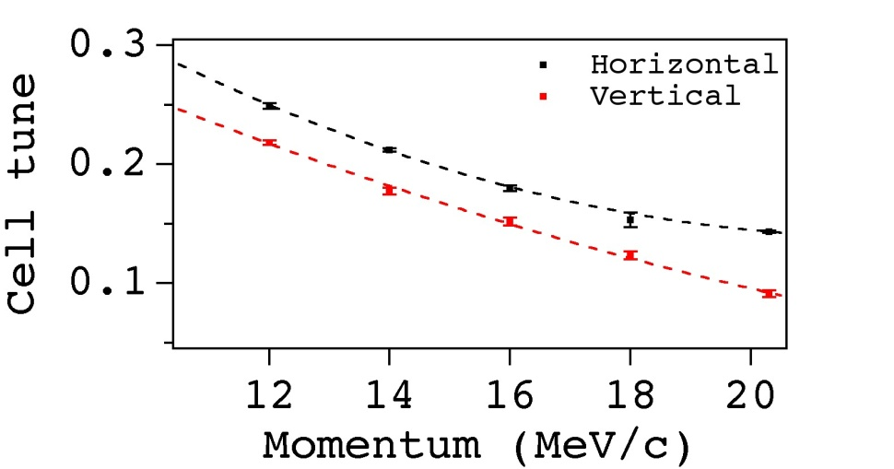
2nd Commissioning Period
Real energy: 12 MeV
Measurements at equivalent
Mean positions
Time of flight
Tunes

Slide 14
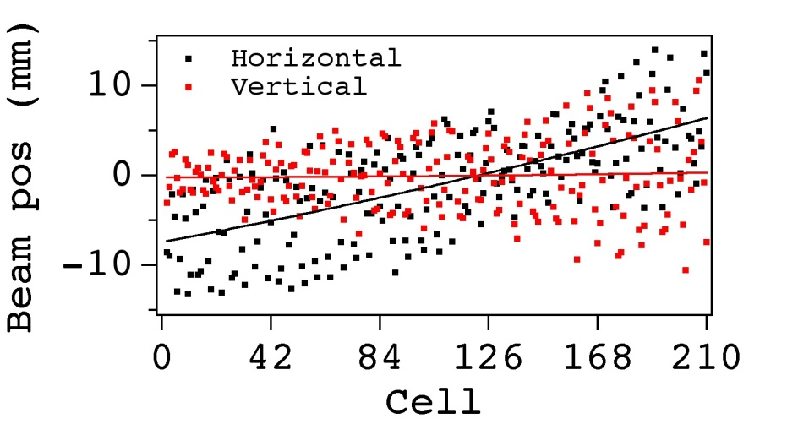
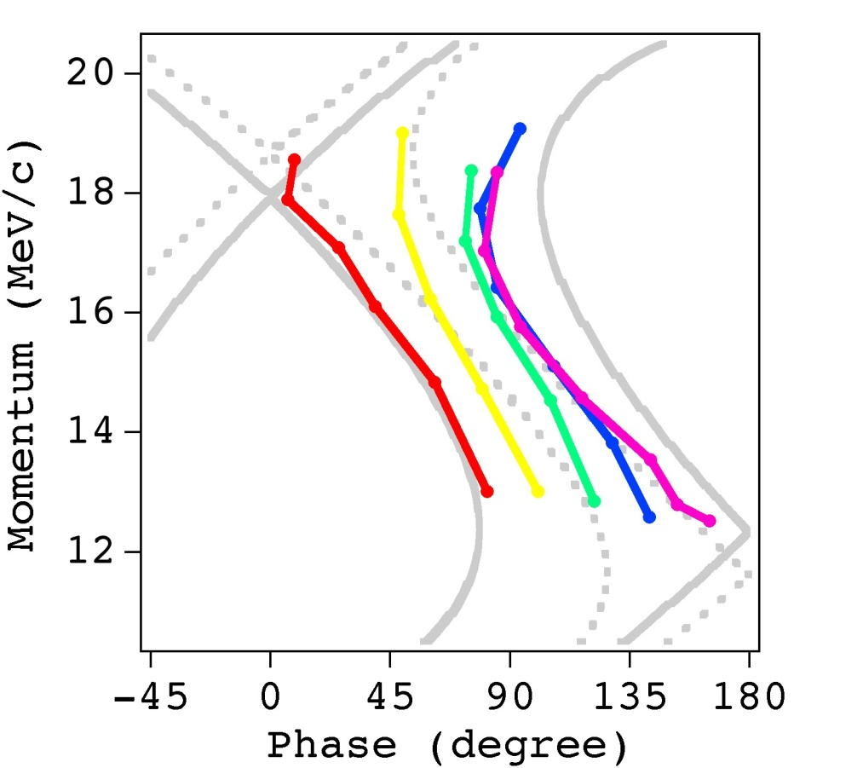
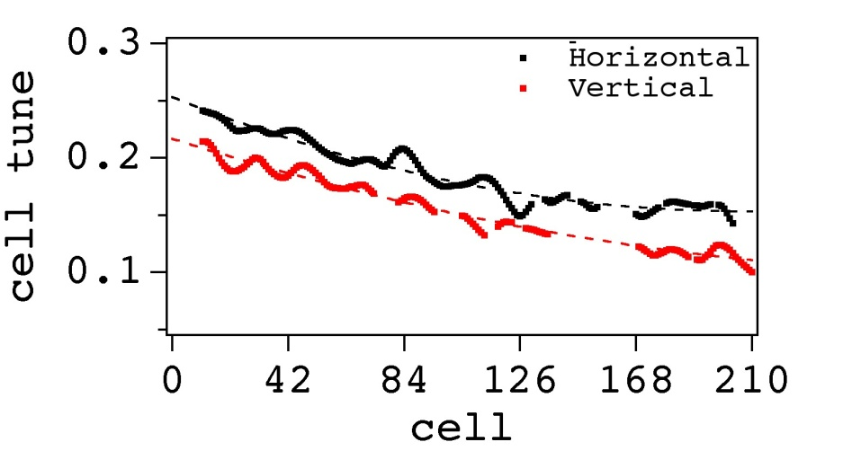
Acceleration
Beam positions
Longitudinal phase
Tunes

Slide 15
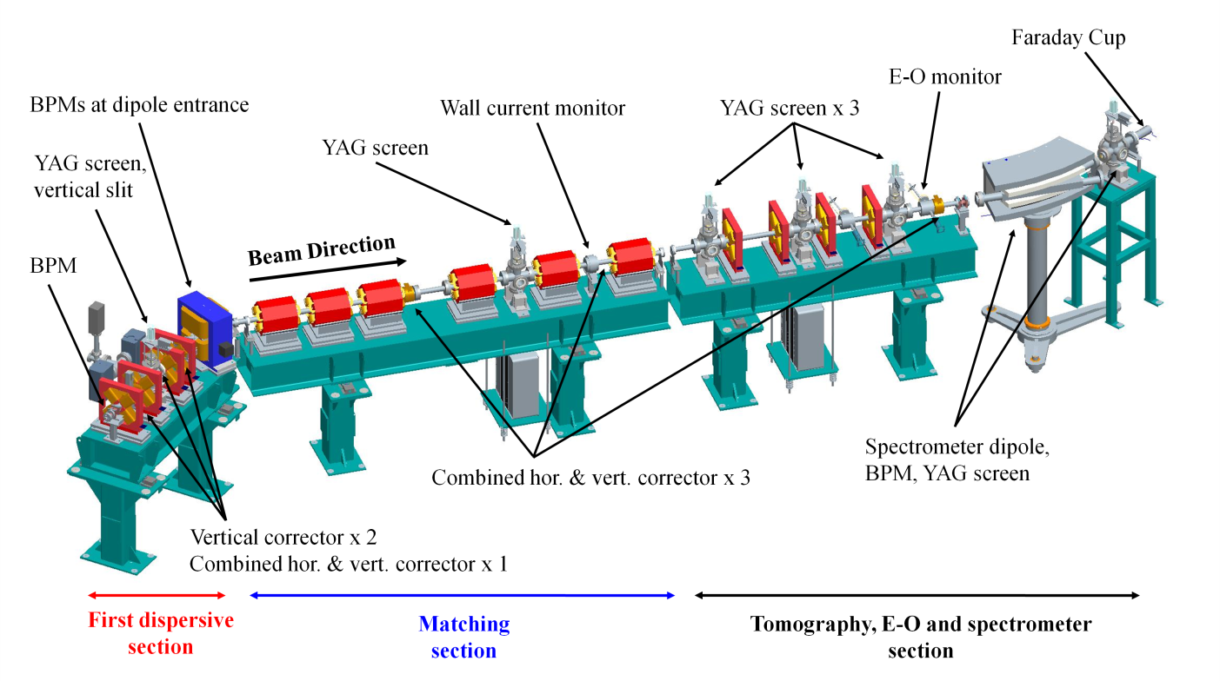
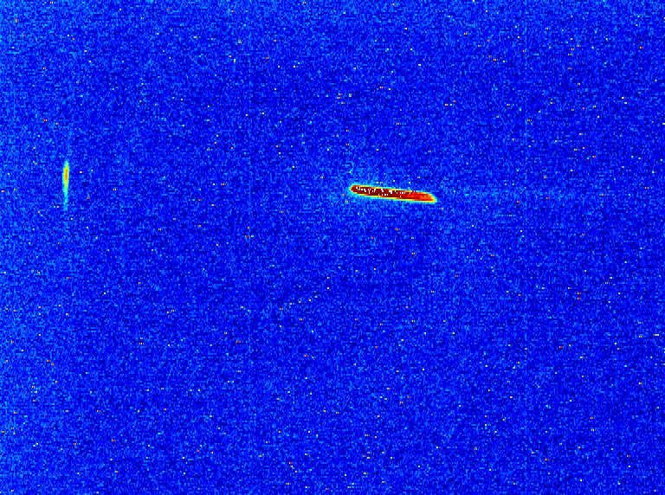
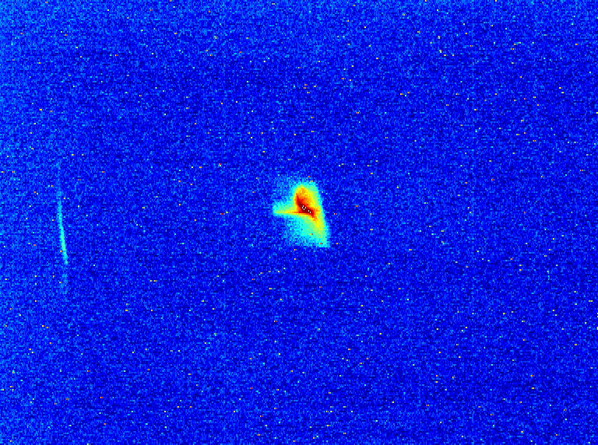
Extraction line
No RF
Septum = 12 MeV
With RF
Septum = 20.2 MeV

Slide 16
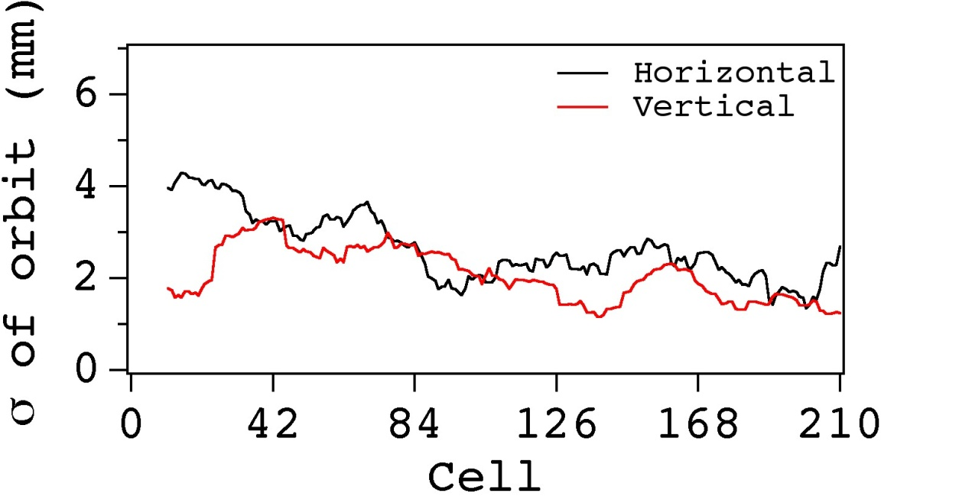
Resonances
During acceleration: - both horizontal and vertical cell tunes change by > 0.1 - ring tune changes > 4.2 - 4 integer tunes crossed
The σ of beam orbit oscillations

Slide 17
Conclusions
EMMA is the proof-of-principle non-scaling FFAG
Construction was a challenge - novel machine - very compact: “…everything takes 5 times longer in EMMA…”, Neil Bliss, project manager
Commissioning has been successful: - EMMA works! - Beam accelerated from 12 to 18 MeV/c in 6 turns - Small orbit excursion ~10 mm - Many resonances crossed, no observable growth in beam oscillation amplitude
Long way to go: full experimental programme started
Upgrades planned: - improve EMMA performance - learn more for applications

