Slide 1
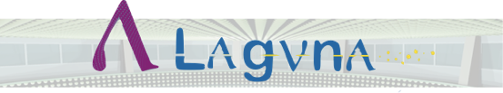


LAGUNA summary
Neutrino Town Meeting
CERN, 14 – 16 May 2012
Wladyslaw H. Trzaska
on behalf of LAGUNA – LBNO

Slide 2

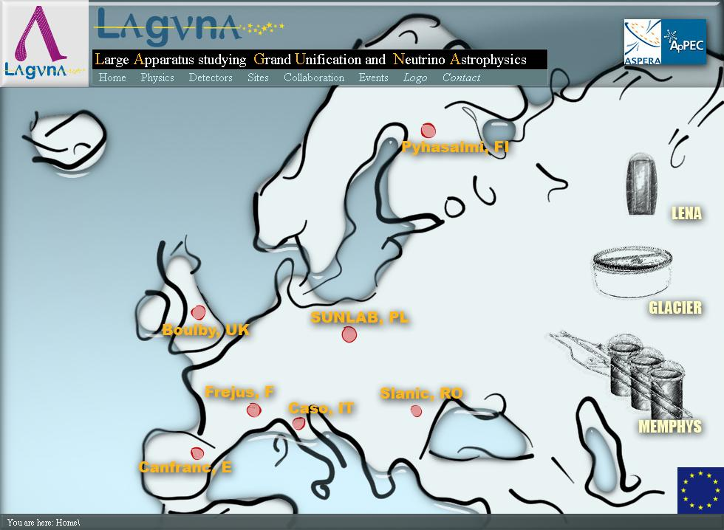
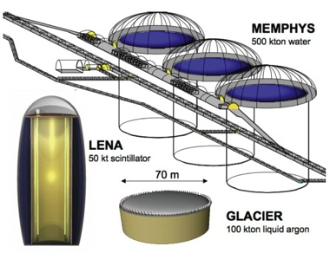
Reminder
L arge
A pparatus studying
G rand
U nification and
N eutrino
A strophysics
LAGUNA http://www.laguna-science.eu/

Slide 3
The main (physics) goals of LAGUNA
Deep underground science facility for neutrino physics and proton decay
  Next generation of very large volume neutrino detectors (at least an order of magnitude improvement over the current generation)
  Next generation of (very) long baseline flavor oscillations with neutrino beams from CERN
Scientific impact / technical feasibility / safety issues / price tag / outreach / realization plan

Slide 4
LAGUNA – LBNO talks today
(in addition to several posters yesterday and the talk tomorrow on
Opportunities for new beams at CERN by Ilias Efthymiopoulos)
LAGUNA summary ← this talk
LENA – Low Energy Neutrino Astronomy
Whitepaper on the LENA Experiment
  Speaker: Caren Hagner
MEMPHYS
  Speaker: Alessandra Tonazzo
A very long baseline neutrino oscillation experiment (LBNO)
  Speaker: Andre Rubbia

Slide 5
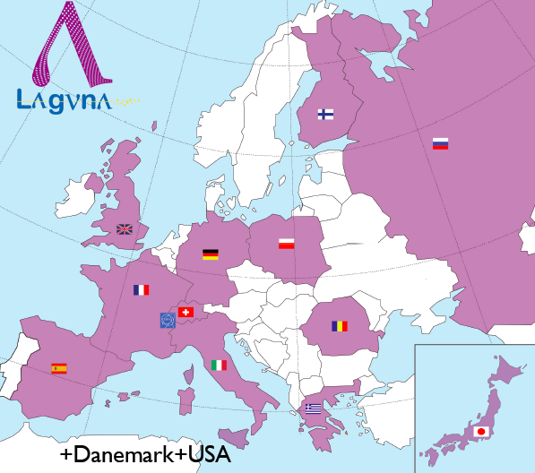
LAGUNA consortium
LAGUNA DS (Design Study)
  2008 – 2011
  ~100 members; 10 countries
  EU funding (FP7) 1.7 M€
LAGUNA-LBNO (Long Baseline
Neutrino Oscillations)
  2011 – 2014
  ~300 members; 13 countries
  EU funding (FP7) 4.9 M€

Slide 6
What is new in LAGUNA-LBNO vs. DS?
Input from LAGUNA DS
Focus on LBNO
Magnetization (bimagic baseline)
Clear milestones in the timetable
  2013 – European Strategy Update for Particle Physics
  2014 – end of LAGUNA-LBNO
  2018 – expected end of excavations in the Pyhäsalmi mine; depletion of the main ore will free the infrastructure to become fully dedicated to the construction and instrumentation of LAGUNA
Prioritization
Incremental approach

Slide 7

Outcome of LAGUNA DS
Required caverns are technologically feasible
  The required caverns can be constructed at a reasonable cost and in relatively short time
  Safety requirements can be fulfilled at all stages of the project (excavation, instrumentations, operation)
  There were no show-stoppers encountered
Cavern construction is not the dominant cost (10 – 20 %) ➔ more caverns?
Physics factors should determine site selection

Slide 8
Site specific physics factors:
Distance from CERN (or other accelerator)
  Topic of LAGUNA – LBNO
Overburden , in general – the more the better
  Must meet the criteria required by the detector
    GLACIER ≥ 2500 m.w.e (900 m of rock)
    LENA ≥ 4000 m.w.e (1400 m of rock)
    MEMPHYS ≥ 3000 m.w.e (1100 m of rock)
Reactor neutrino background & geo-ν flux
  Relevant only to LENA (geo-neutrinos, diffuse SN)

Slide 9
7 European sites exemplified by 3 and prioritized to 1:
Pyhäsalmi Finland (mine),
Sieroszowice Poland (mine),
Boulby UK (mine),
Slanic Romania (mine),
Fréjus France (road tunnel),
Canfranc Spain (road tunnel),
Umbria Italy (a virgin site).
← Highest priority!
← 2nd priority
← 3rd priority

Slide 10
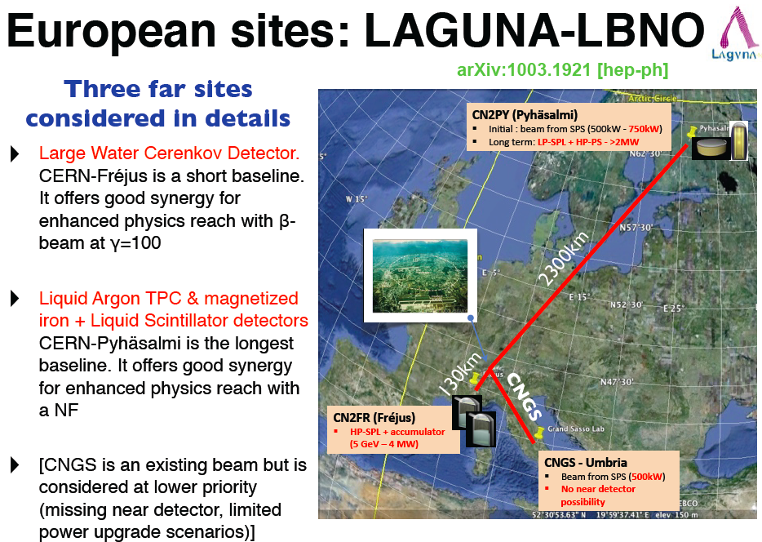

Slide 11
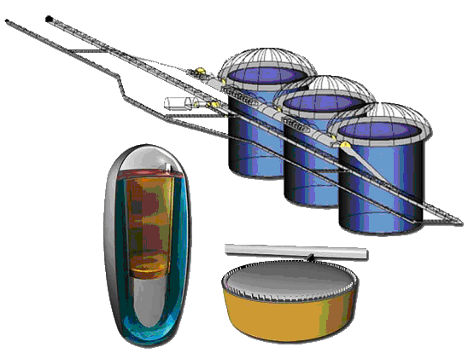
Three detector options
MEMPHYS
(Water Cherenkov)
2nd Priority
GLACIER
(Liquid Argon)
LENA
(Liquid Scintillator)
1st Priority

Slide 12
Main events over the past 6 months
LAGUNA-LBNO kickoff meeting at CERN
17 – 19 October 2011
Visit & evaluation of the mine, 16 – 19 January 2012
Dedicated detector meetings in February 2012
  MEMPHYS on the 15th in Paris
  LENA on the 20th in Hamburg
  GLACIER on the 22nd at CERN
General meeting in Paris, 12 – 14 March 2012
NEXT General Meeting → Oxford, 2 – 4 July 2012

Slide 13
The main developments
Consensus among the technical partners about the suitability of the Pyhäsalmi site in Finland
Both detectors would be located at the deepest level (1400 m)
  Presence of excellent infrastructure at that depth
Modified layout of the caverns was proposed
Expression of Interest to SPSC (talk by A.Rubbia)
  To be submitted in June 2012
Input to the update of European Strategy for Particle Physics
  To be ready by the end of Summer
Funding in Finland for extensive Site Investigation

Slide 14
In Pyhäsalmi most of the desired conditions are satisfied simultaneously
Excellent rock quality (the best among the investigated sites)
One of the deepest and coolest locations in Europe
(+22 C and dry at 1400 m ≈ 4000 m.w.e)
The distance from CERN (2300 km) offers unique long baseline opportunities, not found elsewhere in Europe or in the world.
The lowest reactor neutrino background in Europe (important for the scintillator option)
Two modes of access: via shaft and decline
Infrastructure in perfect condition (one of the most modern and mechanized mines in the world)
Unusually small footprint of the ore; no water problem; minimal maintenance costs.
Perfect timing between the end of excavations (~2018) and the proposed start of the LAGUNA instrumentation phase.
Excellent cooperation between the scientists and the mine management (help, advice, friendly approach, …)

Slide 15
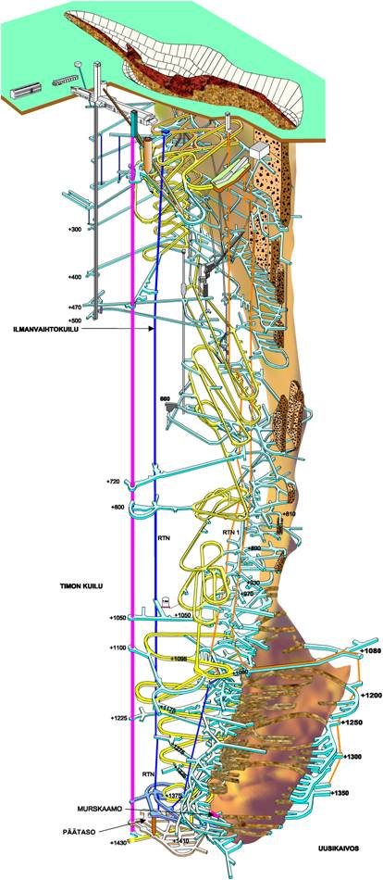
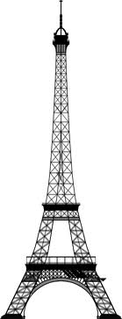
Pyhäsalmi mine
Basic facts and the essential infrastructure
Notes:
Eiffel Tower: antenna spire 324.00 m (1,063 ft)

Slide 16
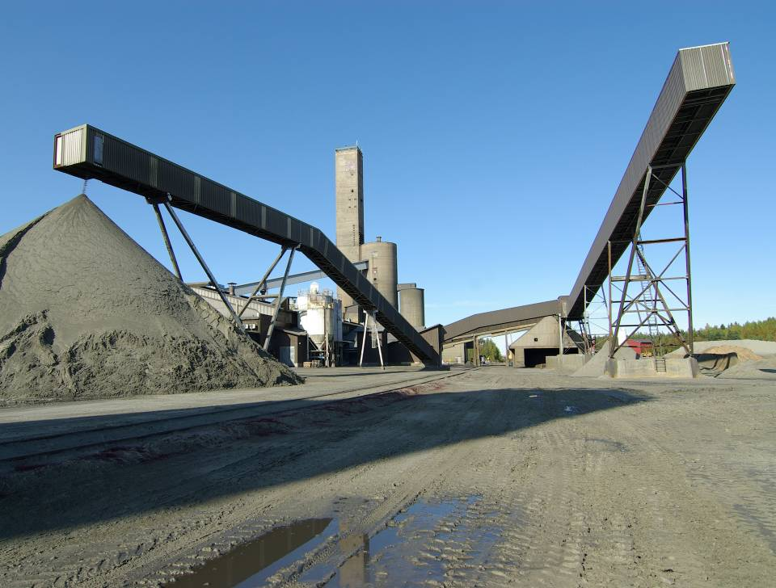
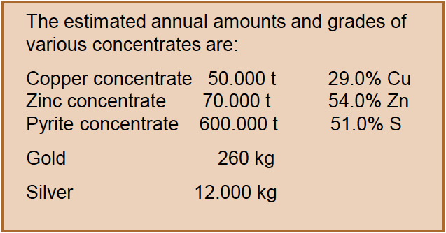
Surface infrastructure

Slide 17
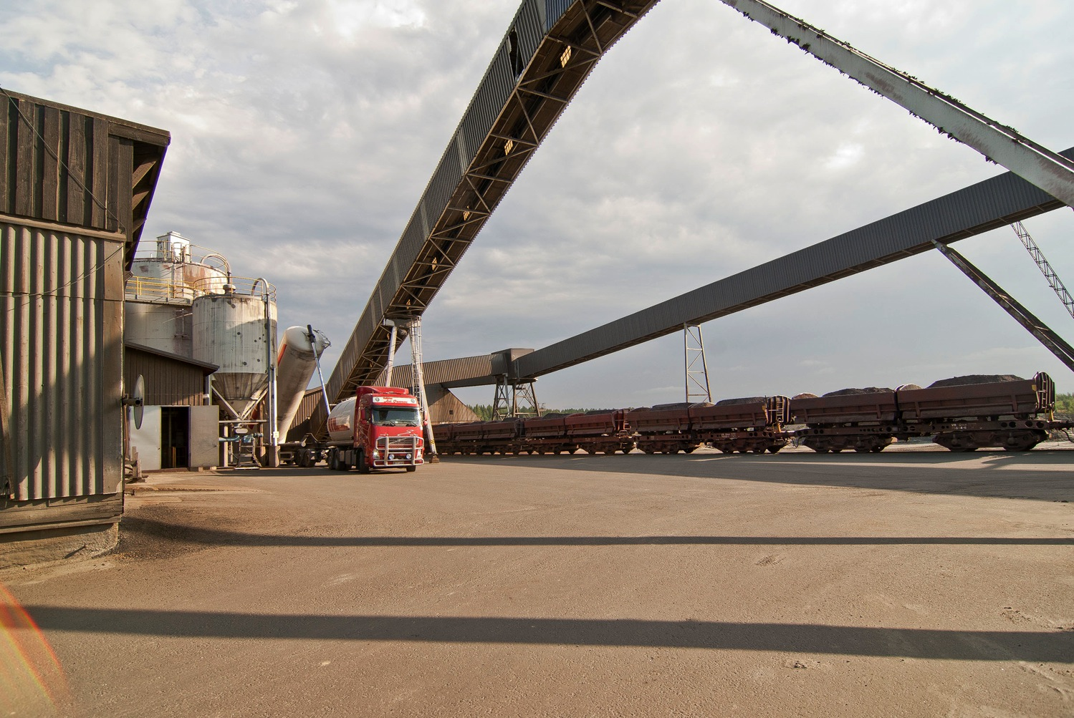
Excellent access by truck and train

Slide 18
Pyhäsalmi is among the most automatized and efficient mines in the world

Slide 19
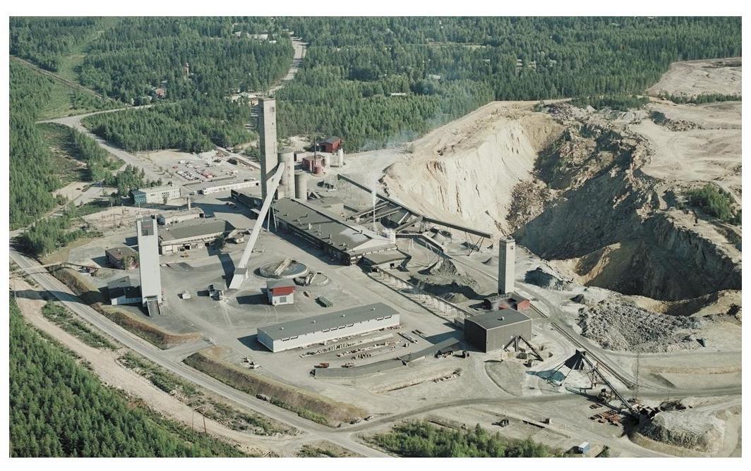
TIMO shaft
Old shaft no longer in use
VT (ramp) entrance

Slide 20
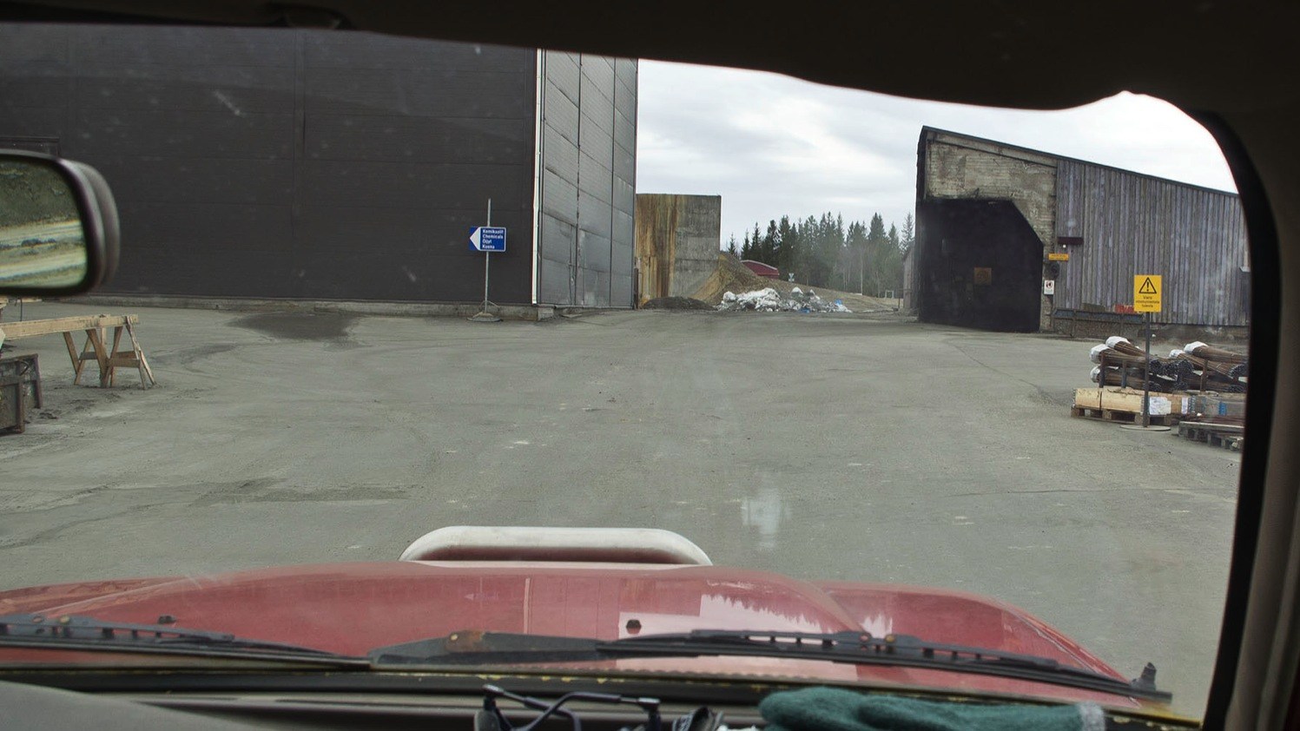
VT (ramp or decline) entrance at the surface

Slide 21
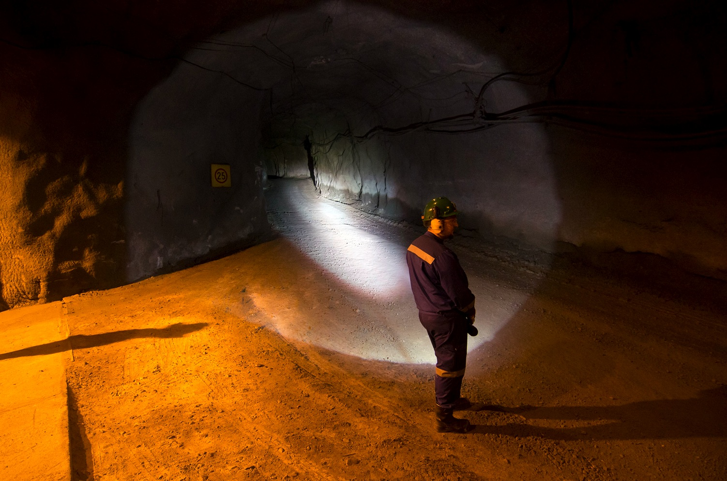
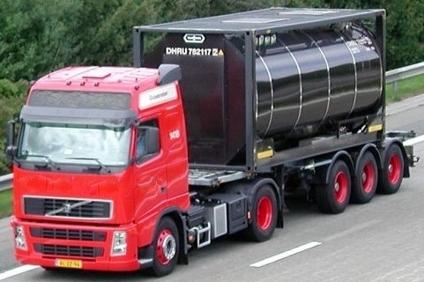
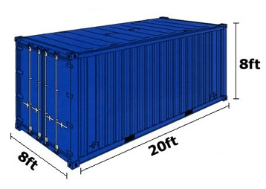
VT (ramp or decline) exit near the bottom level

Slide 22
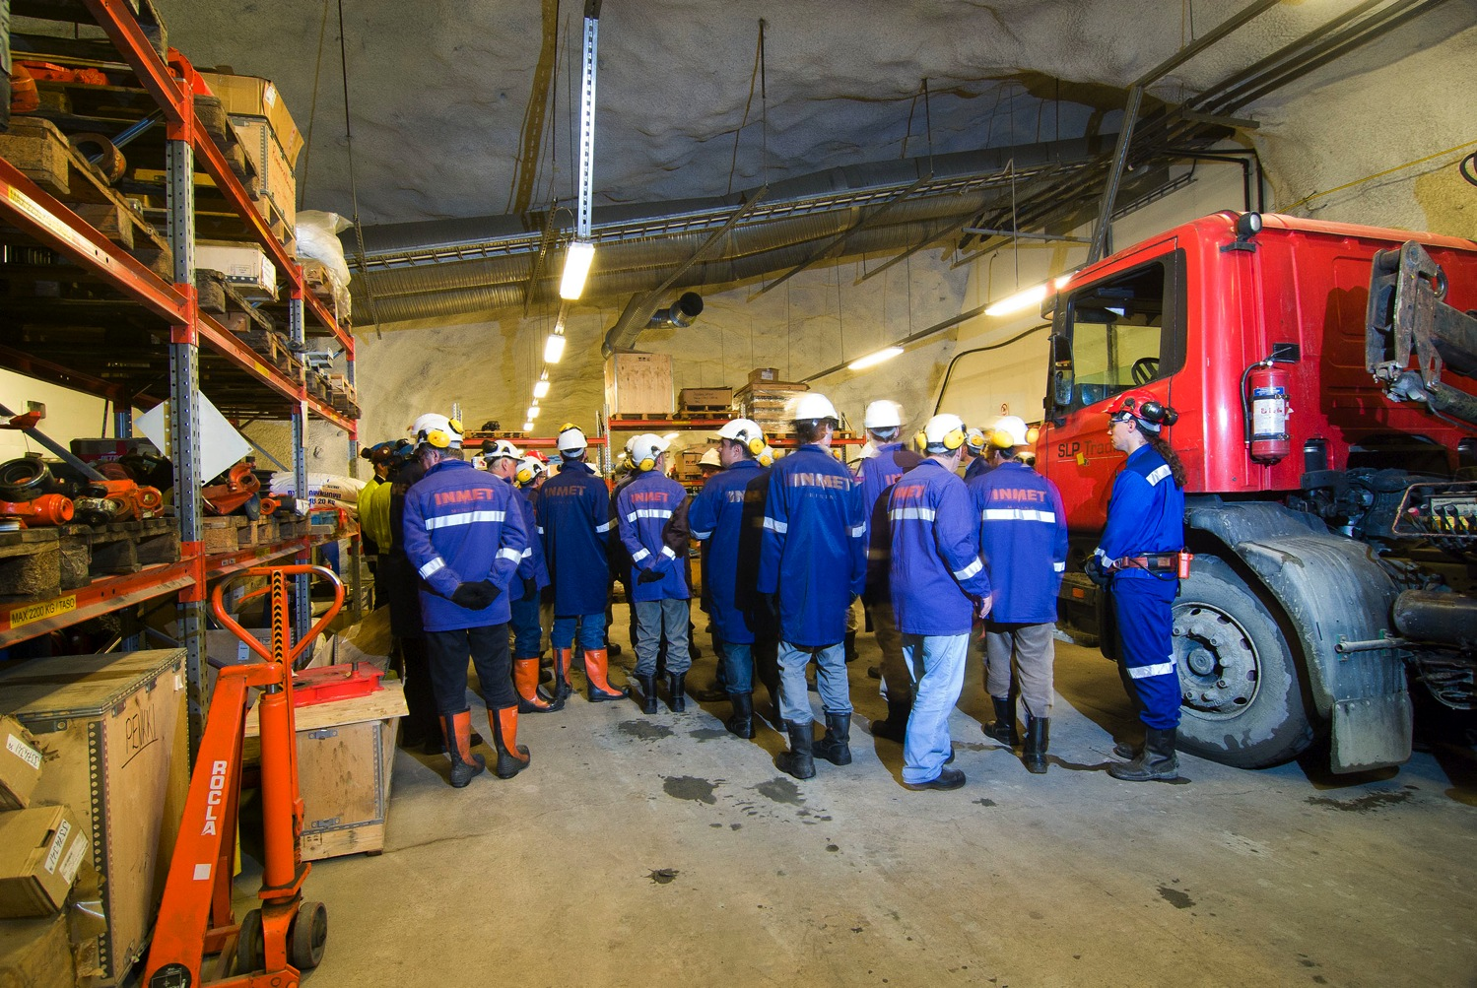
Delivery trucks drive down to the 1400 m level on a daily basis

Slide 23
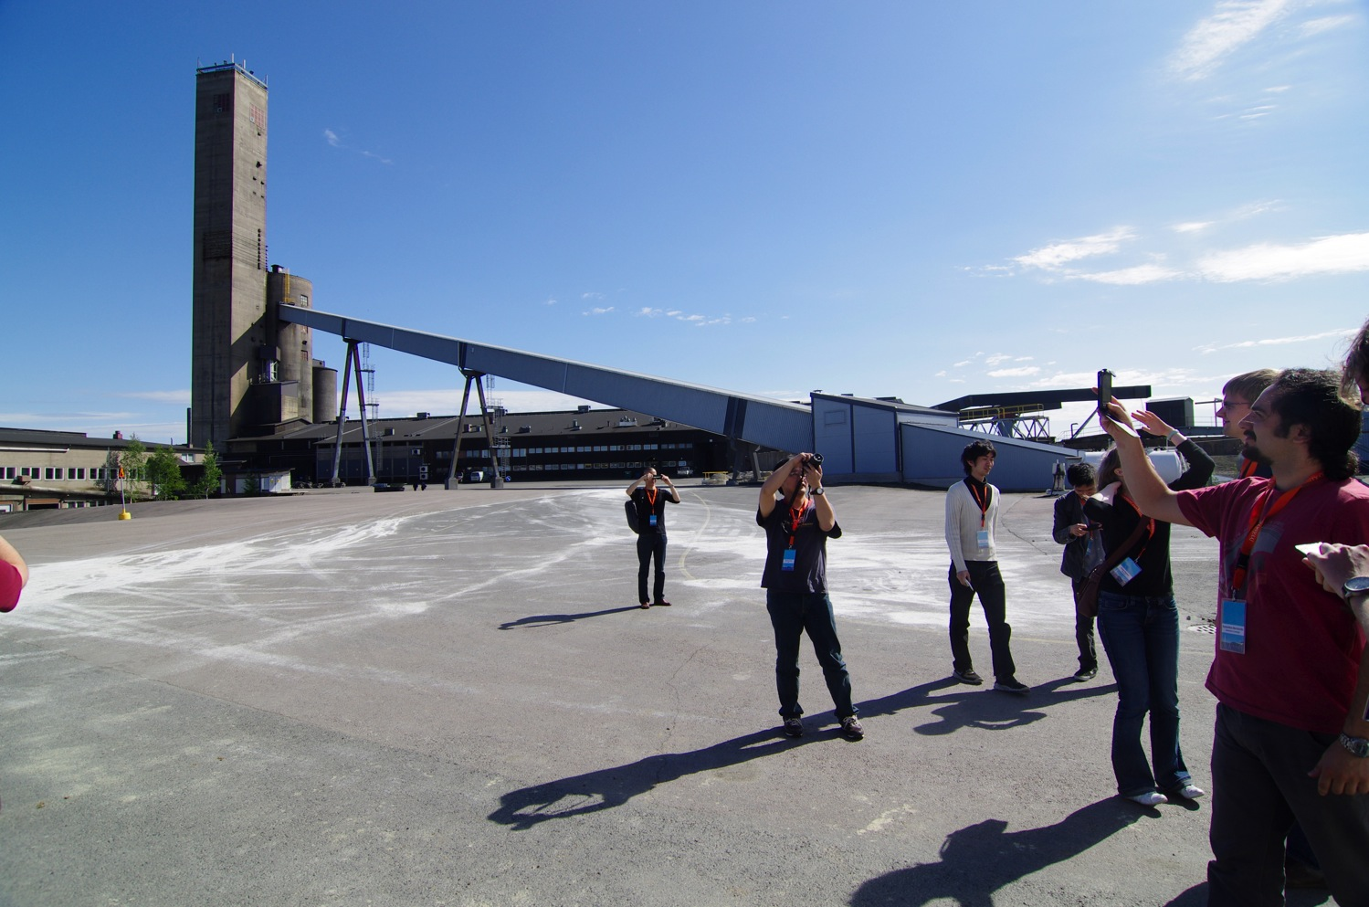
The old shaft (the tallest tower) is not in use any more

Slide 24
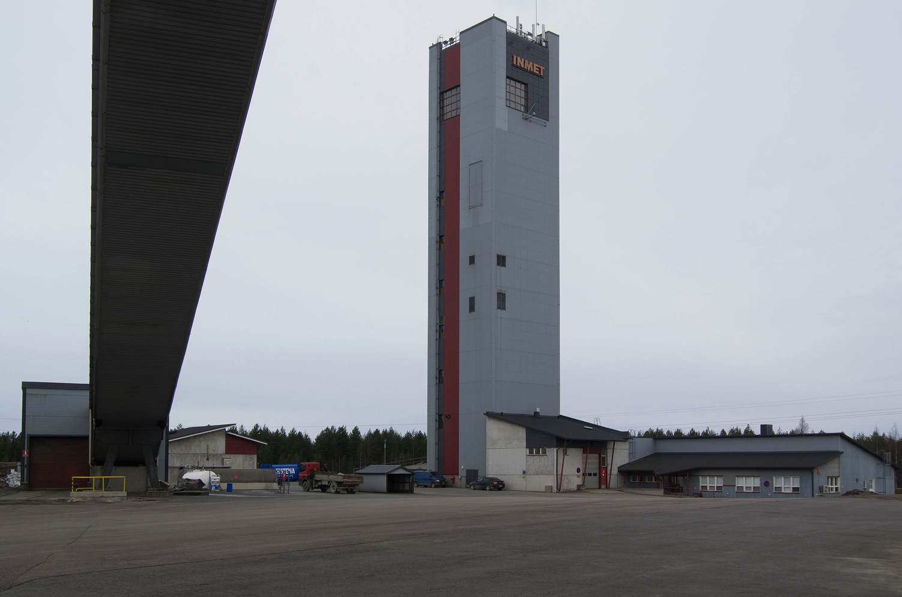
Tower of the (new) TIMO shaft

Slide 25
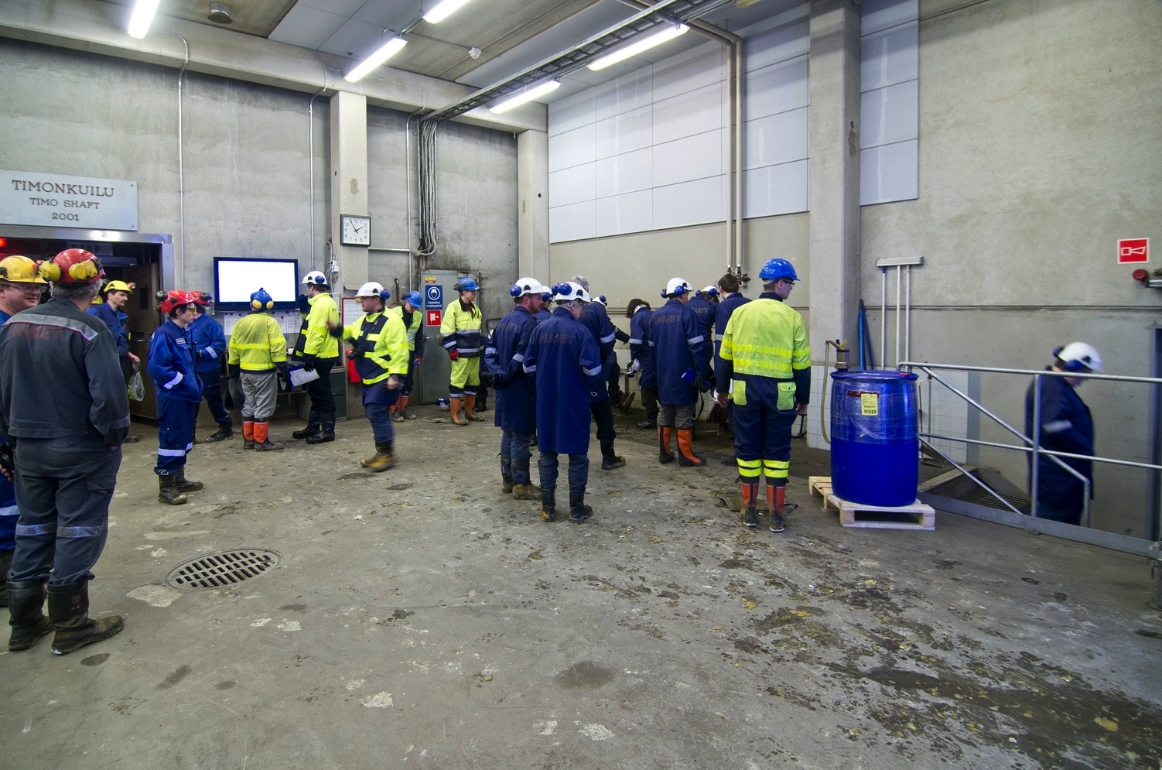
Entrance to the (new) TIMO shaft at the ground level

Slide 26
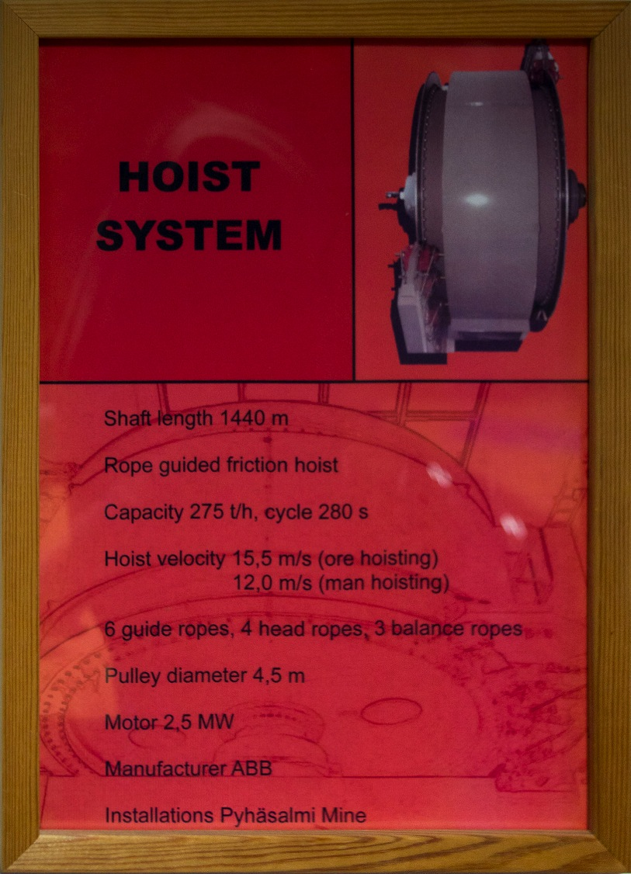
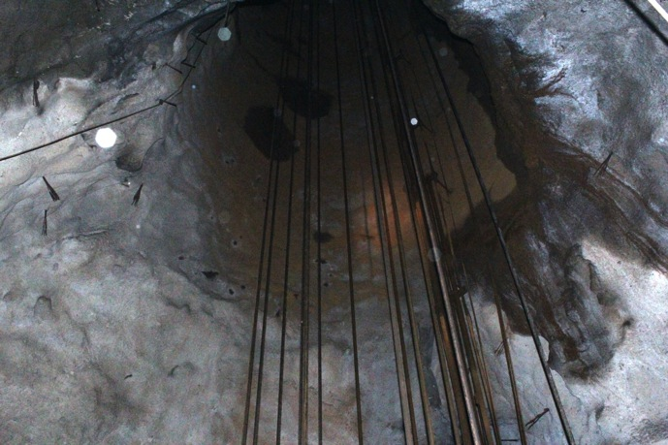
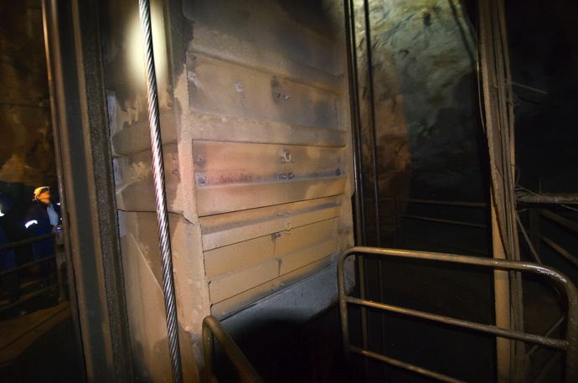
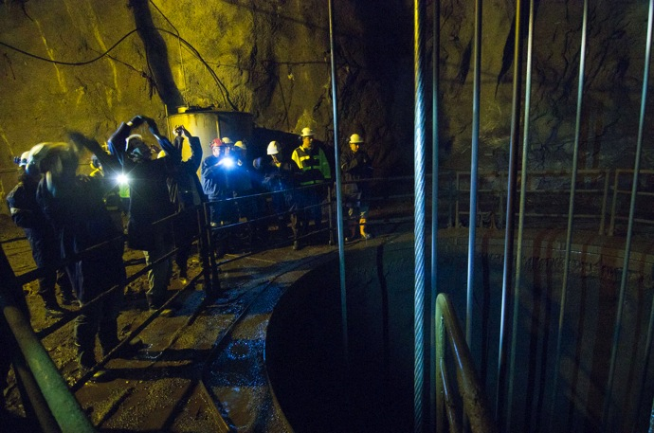

Slide 27
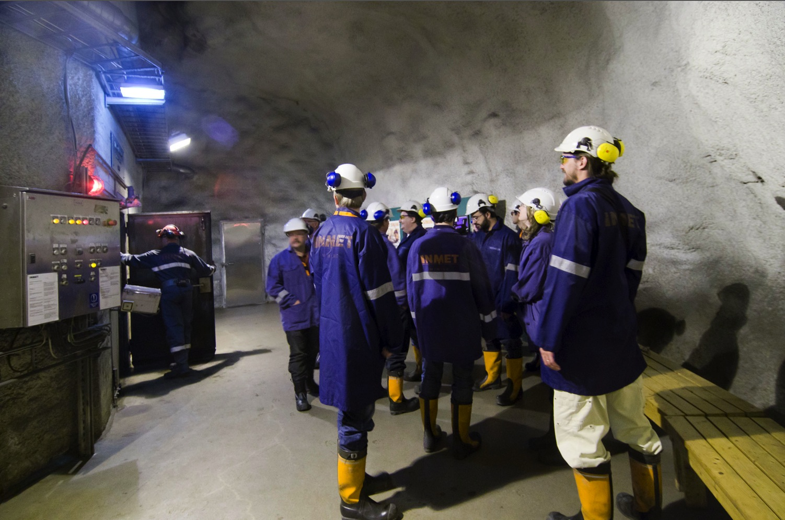
Entrance to the TIMO shaft at the bottom level (1410 m)

Slide 28
At 1400 m below the ground
Available infrastructure in the Pyhäsalmi mine

Slide 29
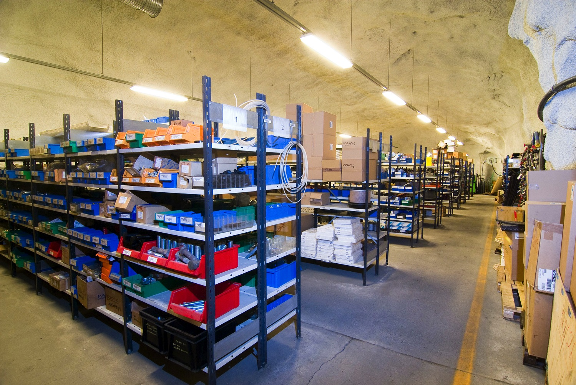
Ample storage space

Slide 30
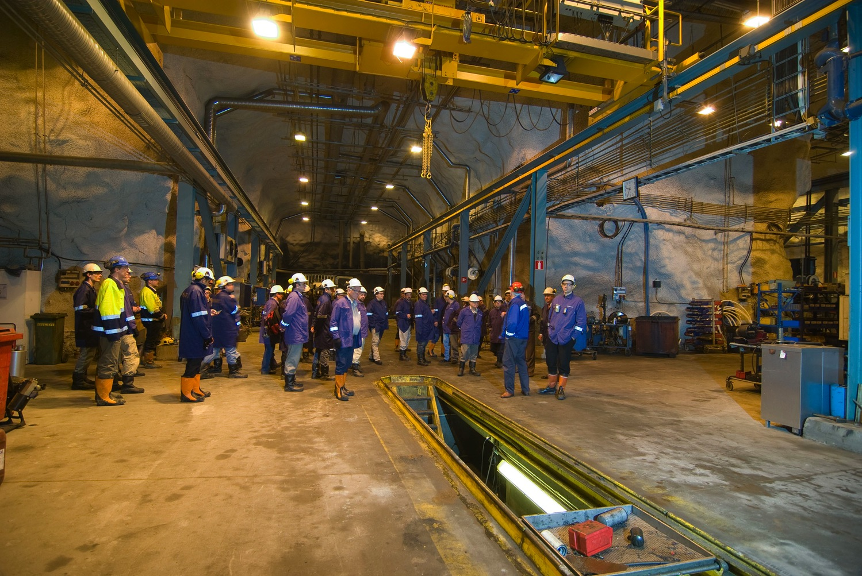
Spacious, fully equipped halls with over-head cranes, etc.

Slide 31
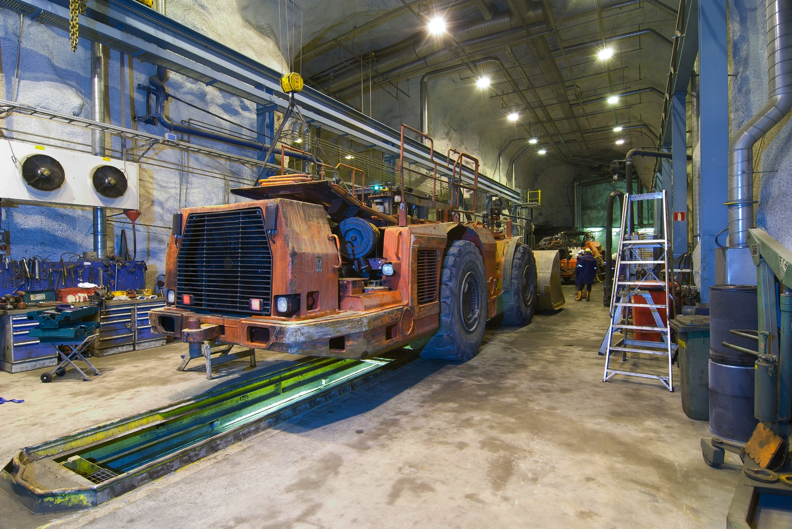
Workshops suitable to service even the largest equipment

Slide 32
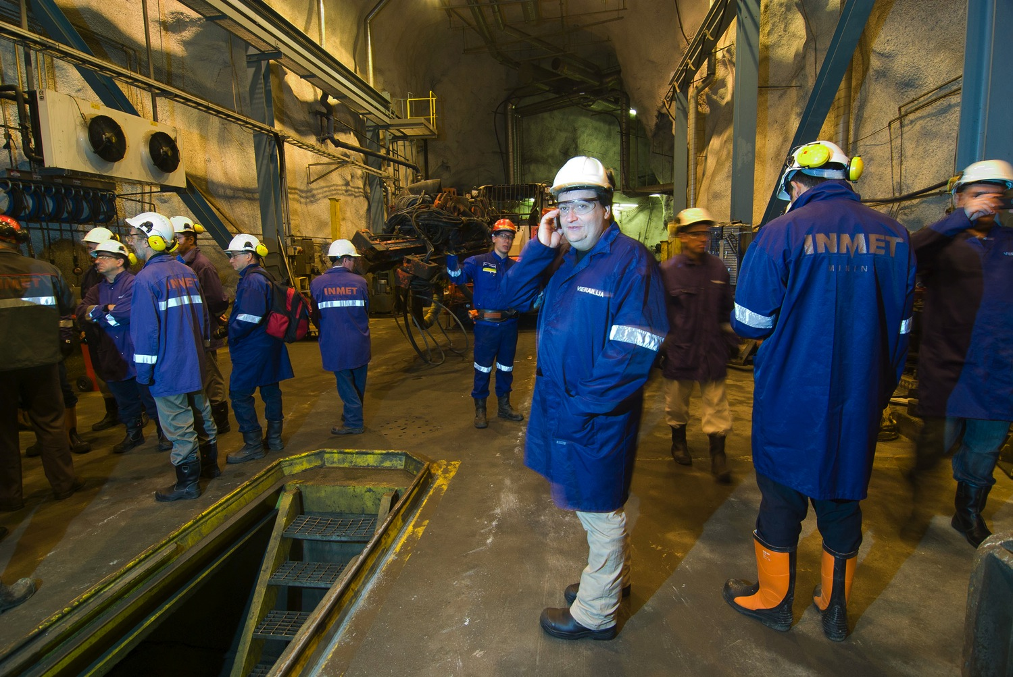
Regular mobile phones work at 1400 m!

Slide 33
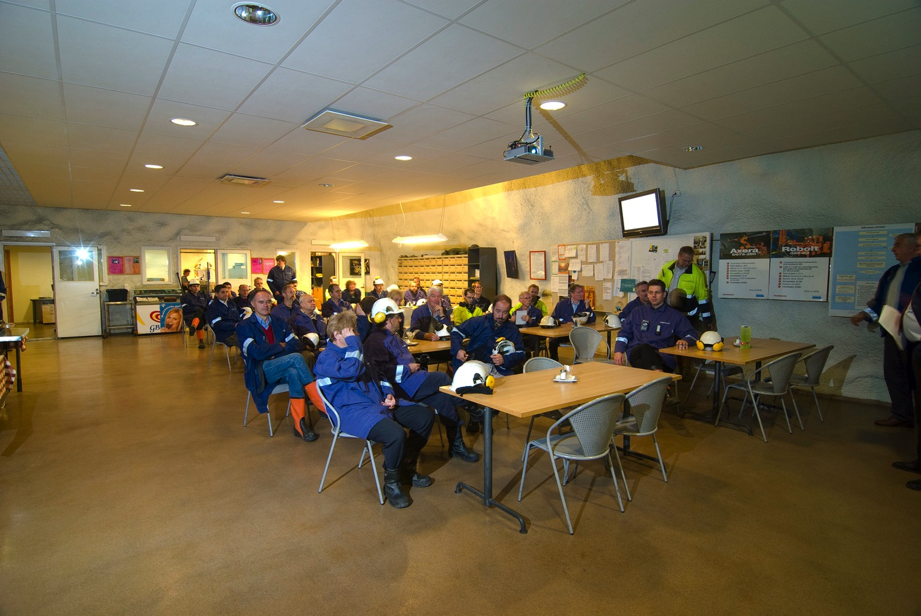
Social area includes a canteen and the deepest sauna in the world

Slide 34
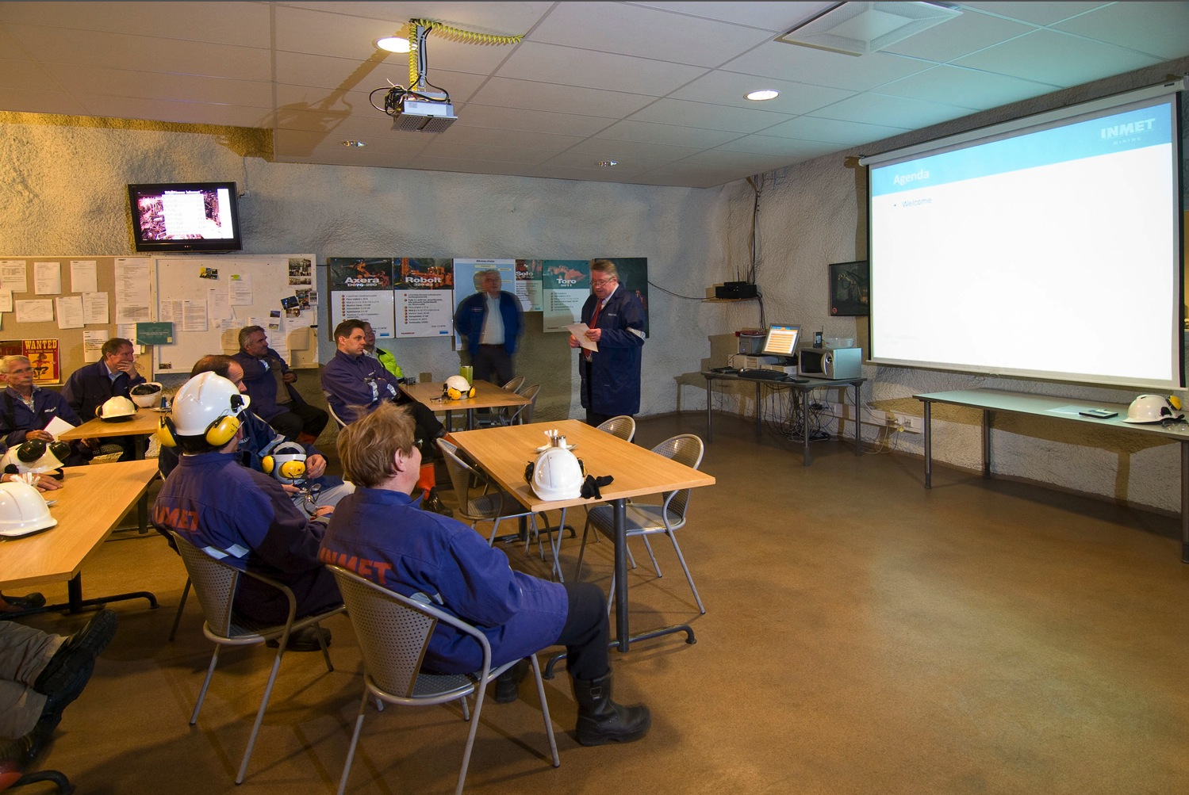
Canteen also works as a meeting room

Slide 35
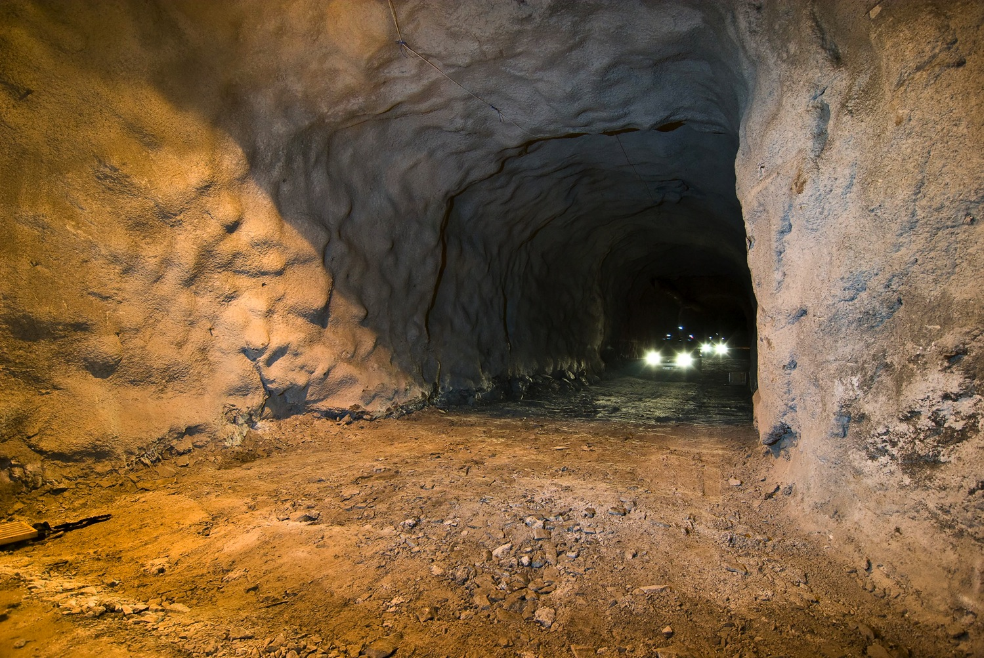
250 m of tunnel was excavated towards the proposed LAGUNA caverns

Slide 36
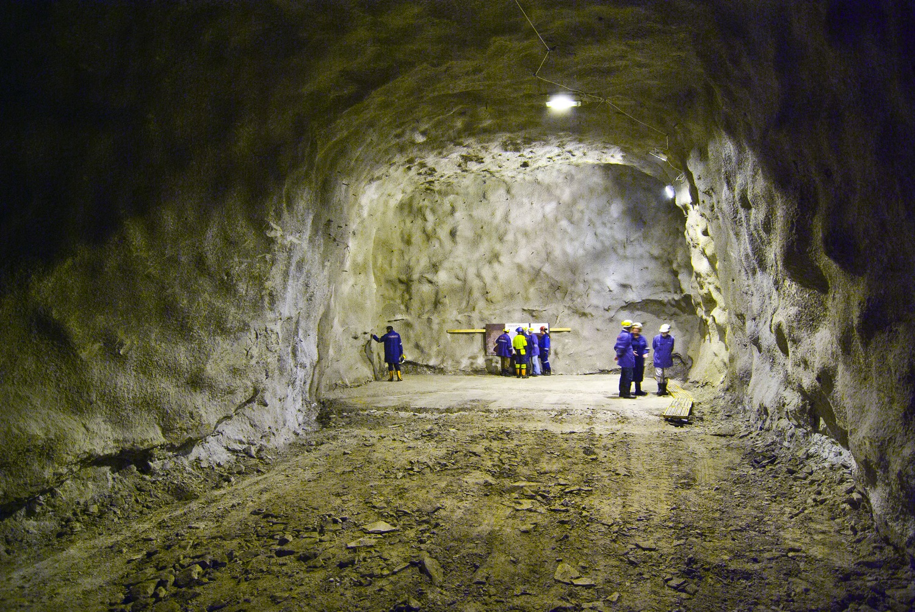
250 m further in this direction the first giant cavern will be made

Slide 37
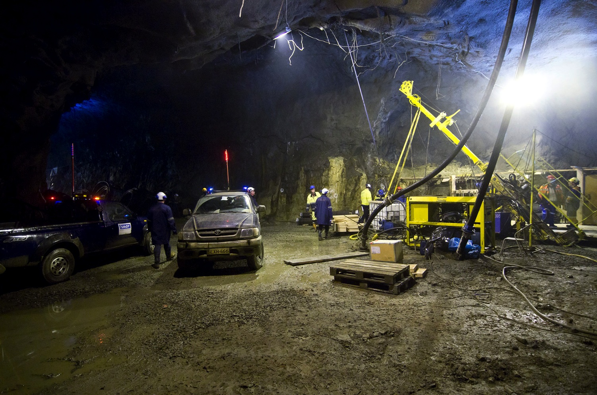
Sampling with a core drill

Slide 38
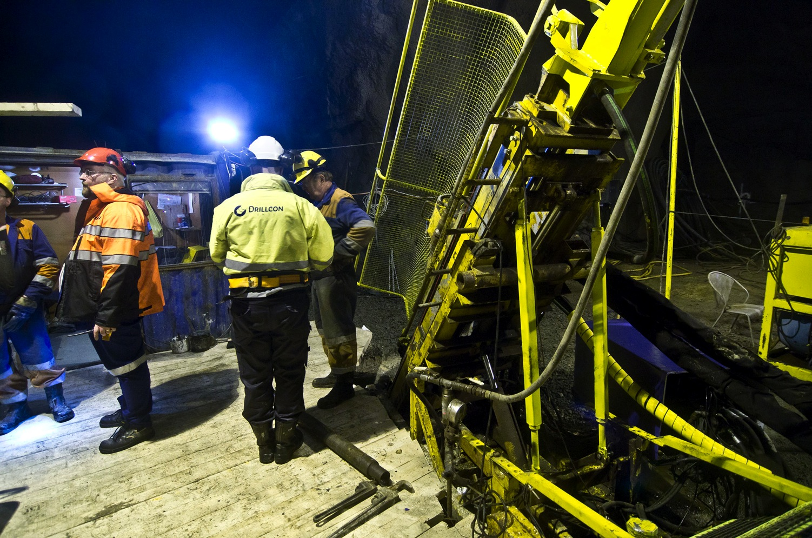
Sampling is done by subcontractors

Slide 39
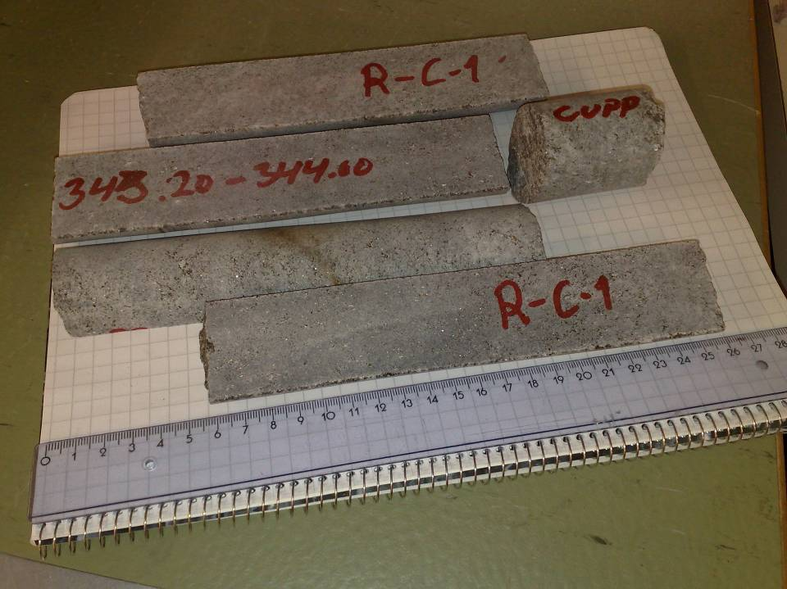

Slide 40
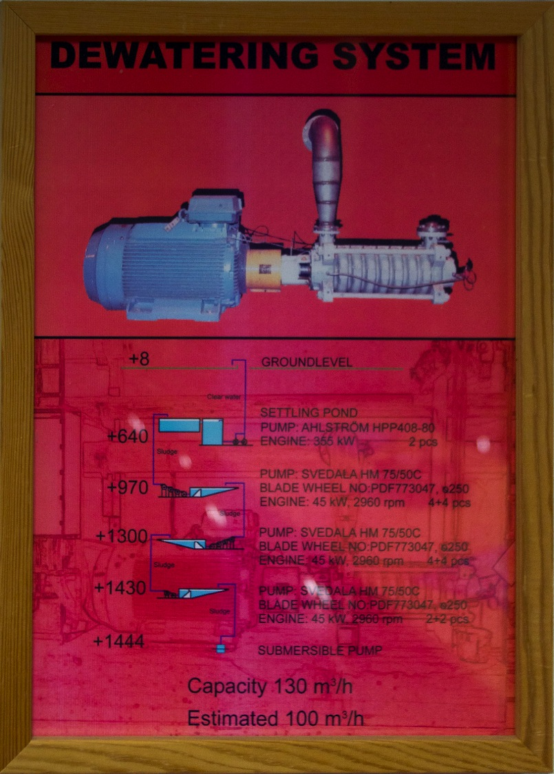
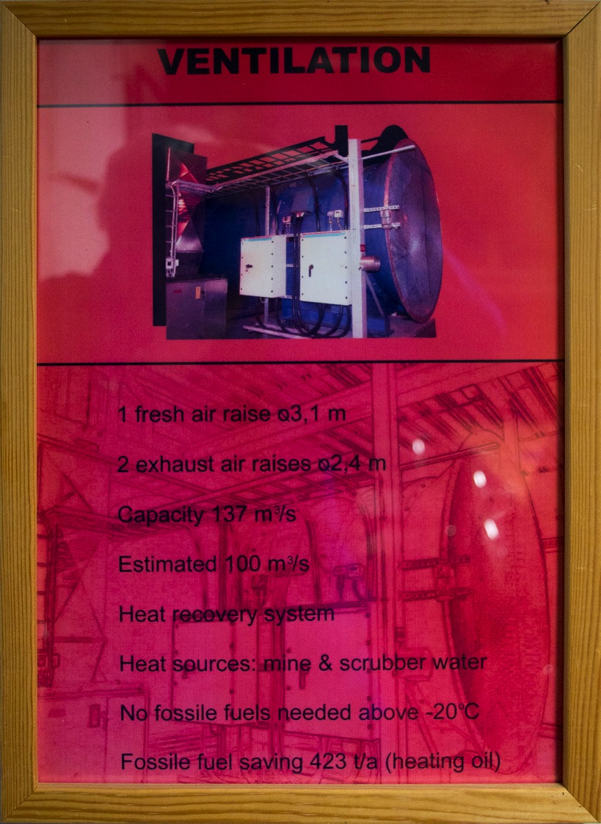

Slide 41
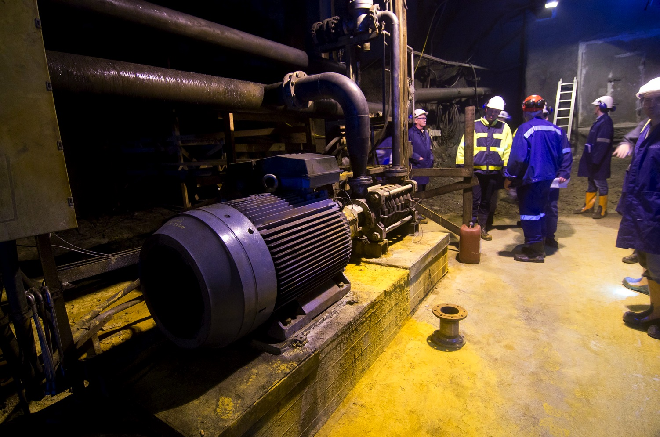
This pump alone takes all the water from 645 m to the surface

Slide 42
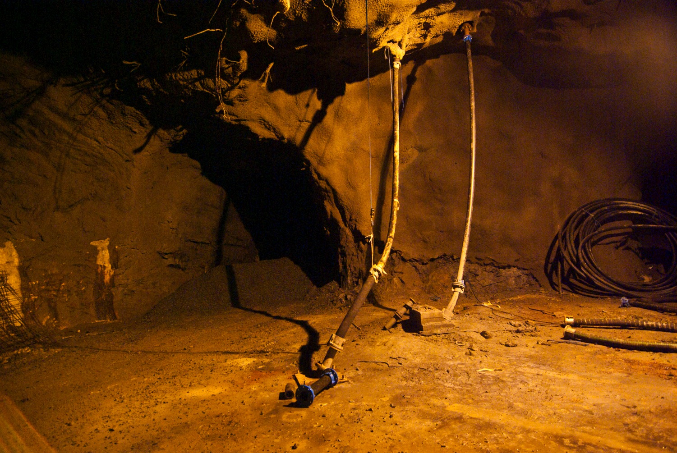
Dedicated pipelines deliver fuel, water and concrete down to 1400 m

Slide 43
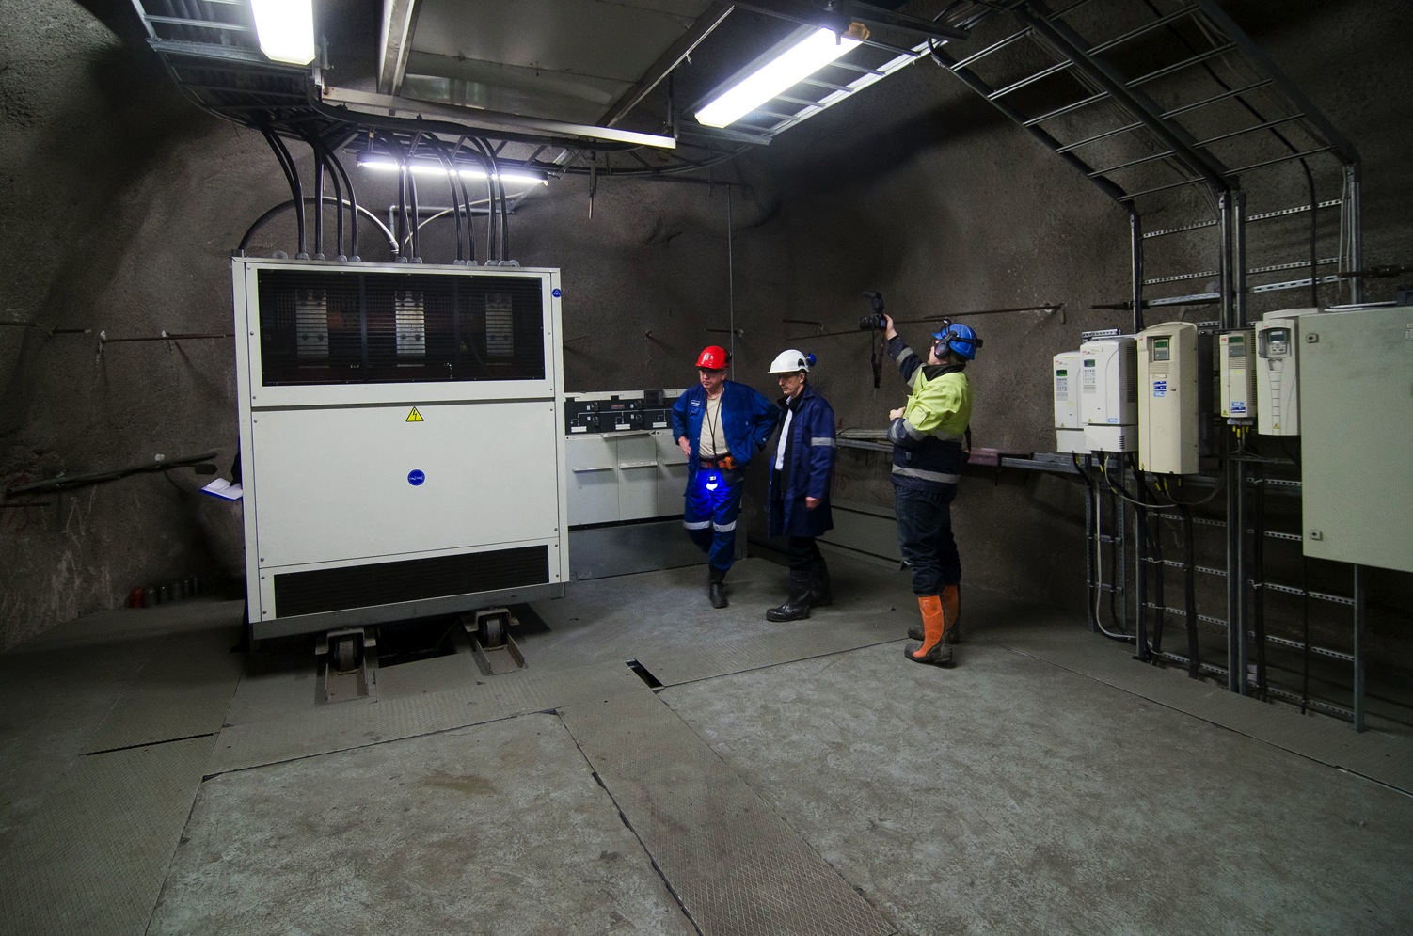
The main transformer in the mine

Slide 44
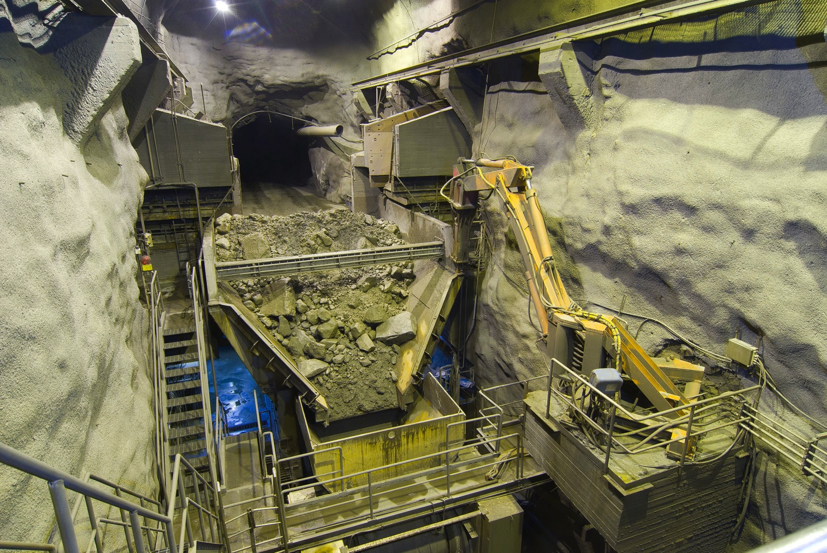
The crusher: grinding and pre-enriching of the ore at 1400 m

Slide 45
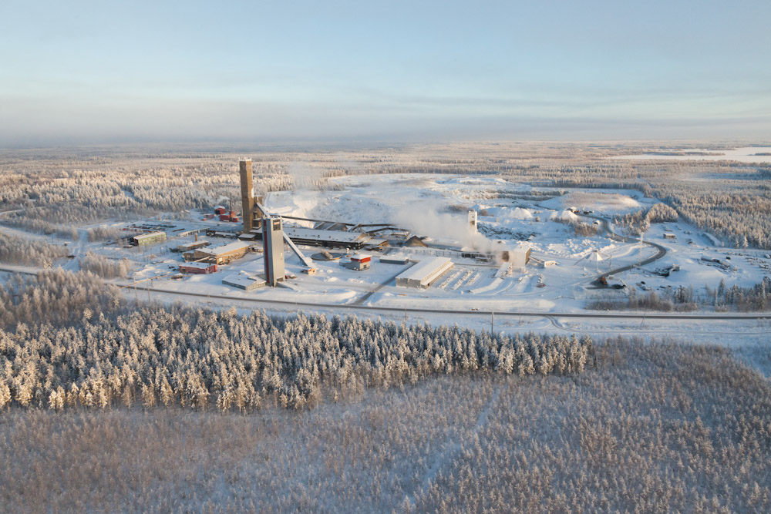
The LAGUNA caverns will be located beneath the forested area on the viewer’s side of the road.

Slide 46
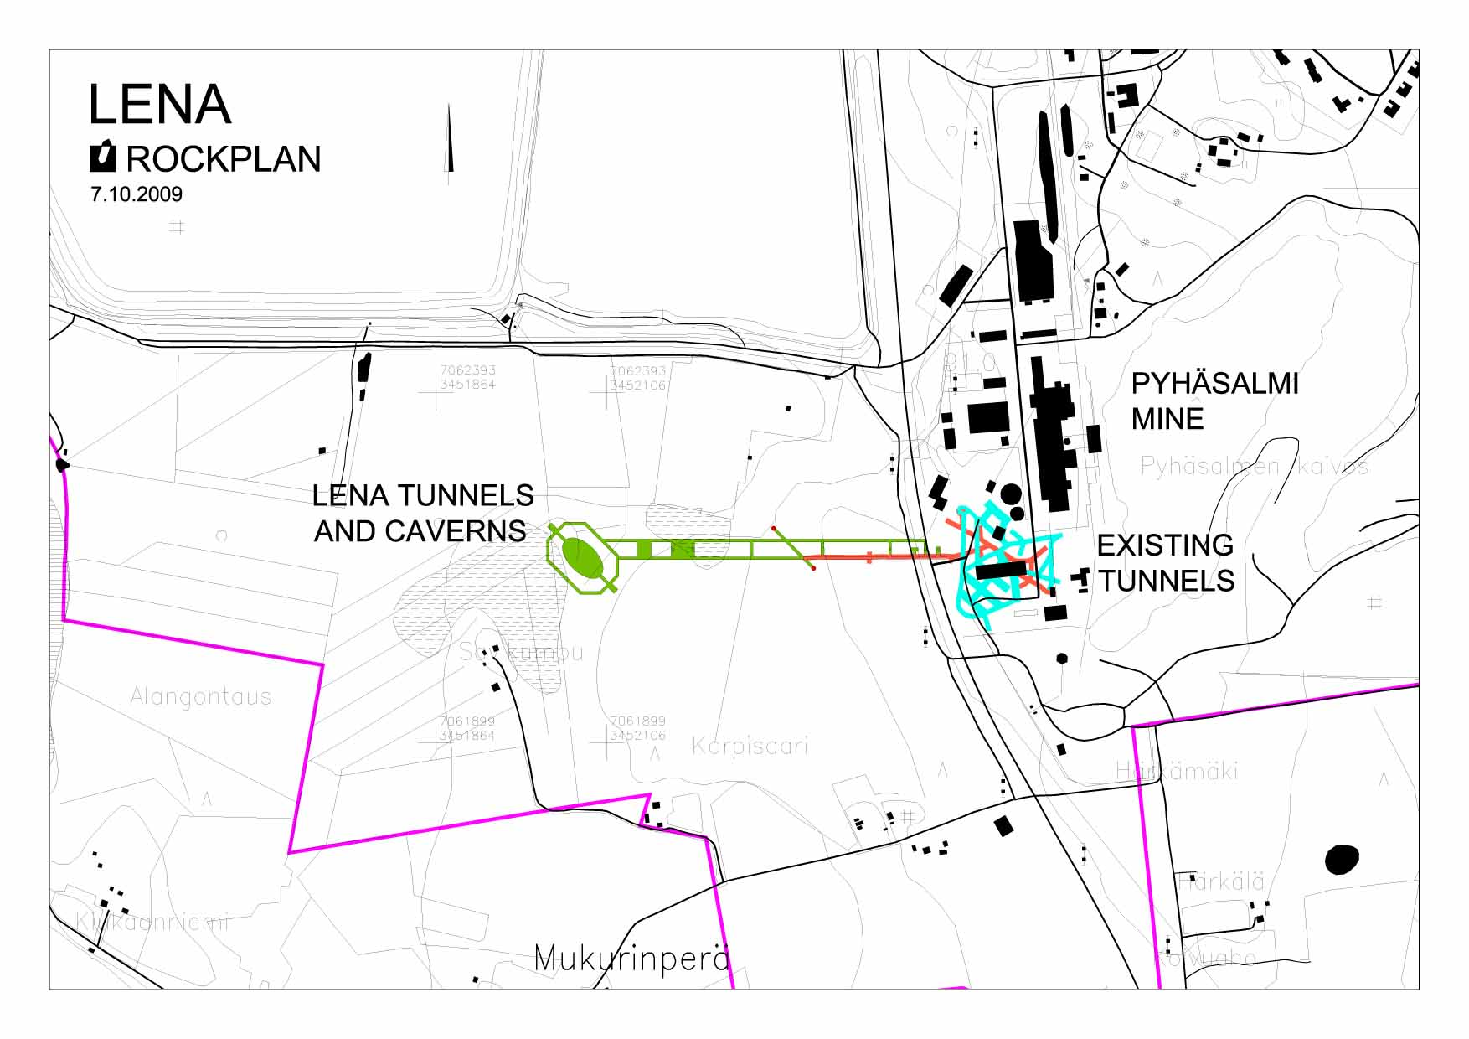
The caverns at the depth of 1400 have to be oval shaped due to the presence of a horizontal stress

Slide 47
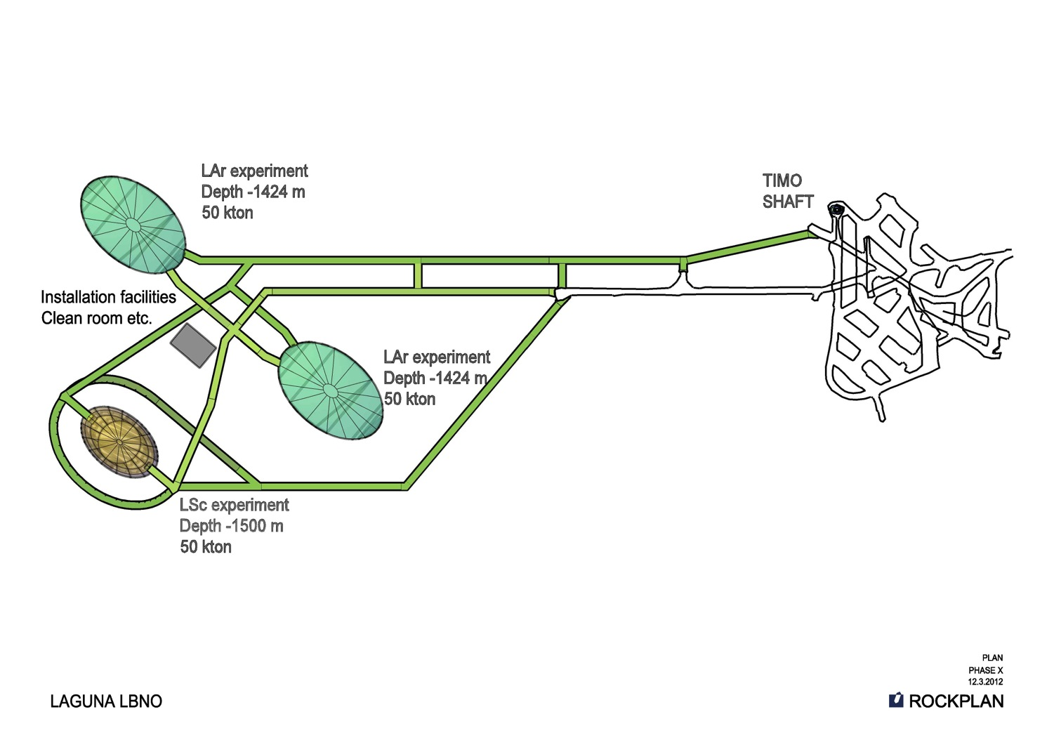
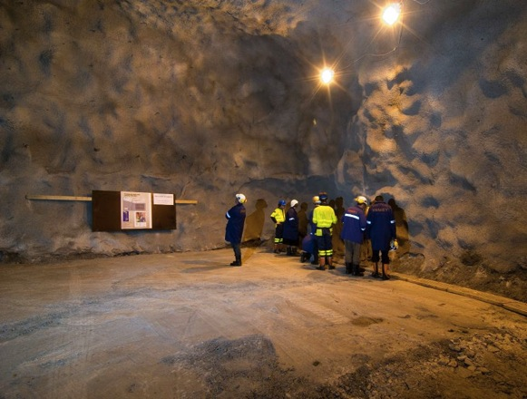

Slide 48
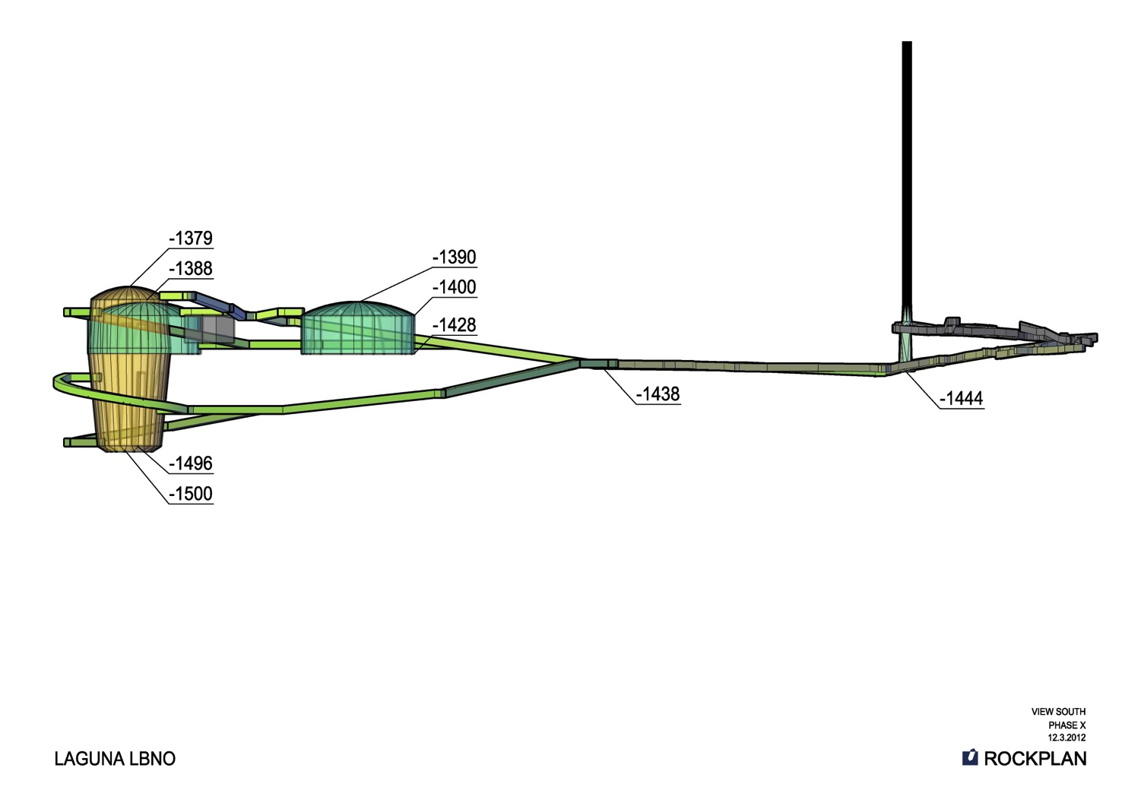
Notes:
The Tower's Dimensions
It stands 985 feet 11 inches (300.5 meters) on a square base measuring 328 feet (100 meters) on each side.
The first story platform is at 189 feet (57.6 meters), with sides 232 feet (70.7 meters) long. The second story platform is at 379 feet (115.5 meters), with sides 134 feet (40.8 meters) long.
There is an intermediate platform at 643 feet (196 meters) -- this is only a point to change elevators. The third story platform is at 905 feet (275.8 meters).
Later a 66-foot (20-meter) television antenna was attached, which extended the tower's total height to 1052 feet (320.7 meters).

Slide 49
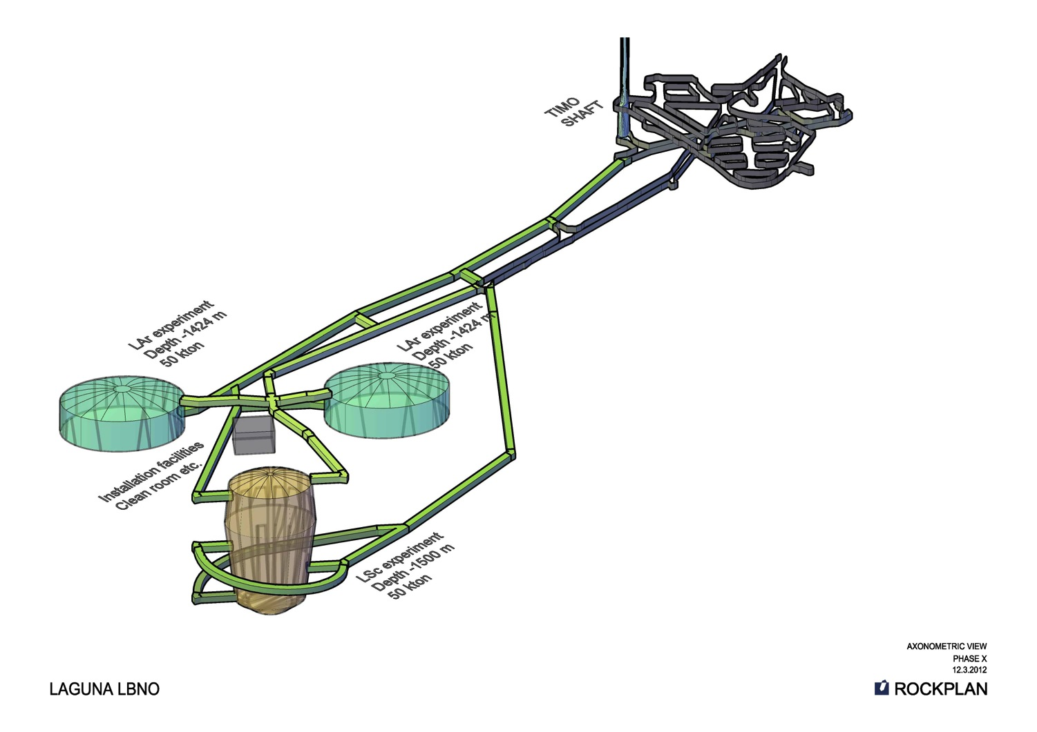

Slide 50
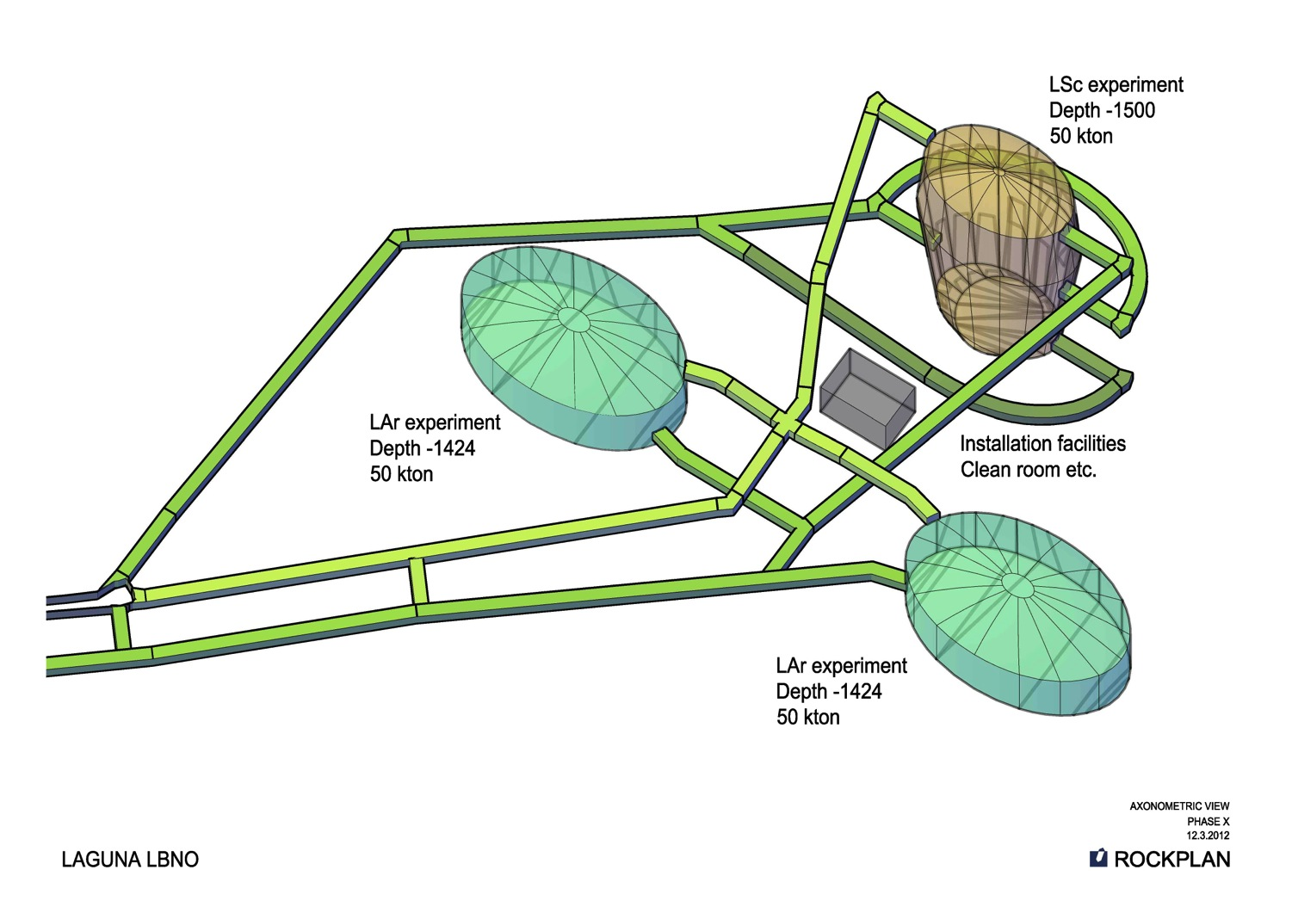

Slide 51
EMMA experiment
Scientific activity in the Pyhäsalmi mine
For more details see, for instance, Timo Enqvist’s talk at nuTURN2012:
http://agenda.infn.it/conferenceOtherViews.py?view=standard&confId=4722

Slide 52
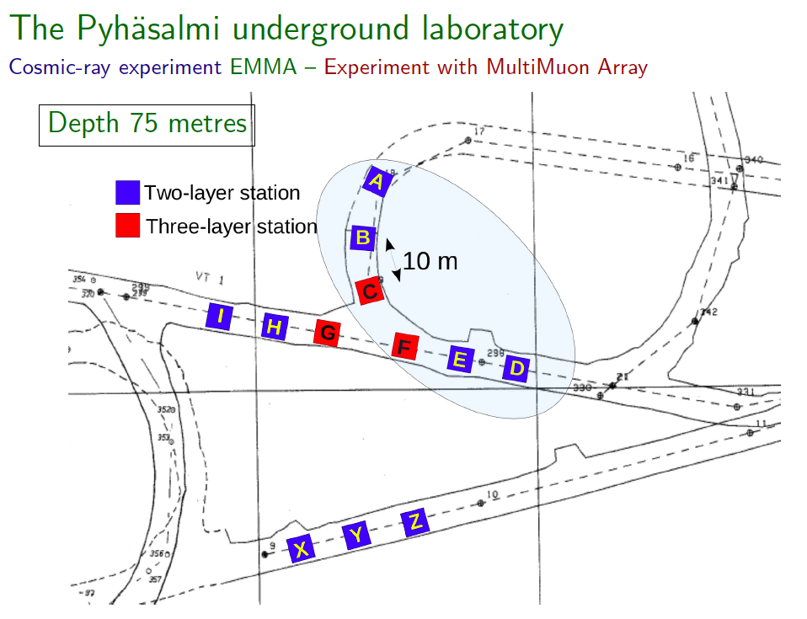

Slide 53

Network of cottages at 75m housing the EMMA detectors

Slide 54

Construction of a steel support structure for the next cottage

Slide 55

Transportation of the muon detectors

Slide 56


Slide 57

CUPP surface laboratory ~5 km from the mine

Slide 58

Detector testing and repair in the CUPP Surface Laboratory

Slide 59

Scintillator detectors designed jointly with Russian Academy of Sciences

Slide 60

CUPP office space in the mine complex has just been modernized

Slide 61
LAGUNA in Pyhäsalmi Timeline
2007 – 2008 LENA Pre-Feasibility Study (preparatory site investigation to locate a 50 kton detector at the depth of
1400 m in a 220 000 m³ cavern)
2008 – 2011 LAGUNA DS
2011 – 2014 LAGUNA – LBNO
2012 – 2013 Extensive drill core sampling and analysis of the cavern area
2015 – critical decision?
2016 – 2018 excavation?
2018 – 2021 tank construction?
2022 – 2023 instrumentation and start of the first physics run?

Slide 62
Conclusions
LAGUNA is well on track
  Thanks to the prioritization, EoI to SPSC and input to the strategy update will be ready by the summer of 2012
  By the end of 2014 a complete evaluation (in the form of deliverables) for both the Pyhäsalmi and the Frejus site will be done
Pyhäsalmi offers an excellent location and infrastructure for the neutrino laboratory of the next generation

Slide 63
Acknowledgments
FP7 Research Infrastructure “Design Studies”
  LAGUNA (Grant Agreement No. 212343 FP7-INFRA-2007-1) and
  LAGUNA-LBNO (Grant Agreement No. 284518 FP7-INFRA-2011-1)

