Slide 1
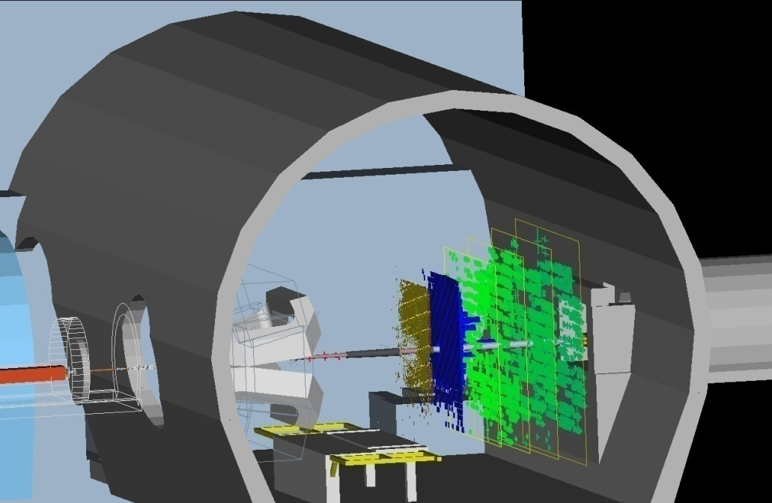

(Towards) First Physics with LHCb
Physics at LHC 2008
Split, Croatia, 29 Sep - 4 Oct 2008
Beam induced “splash” in LHCb
Introduction
Detector overview and performance
Extracting physics from (very) first data
presented by
Andreas Schopper (CERN)
on behalf of the
Collaboration

Slide 2
LHCb is a heavy flavour precision experiment searching for new physics in CP-Violation and Rare Decays
New Physics models introduce new particles, dynamics and/or symmetries at a higher energy scale (expected in the TeV region) with virtual particles that appear e.g. in loop mediated processes
?
?
New
Physics
Box diagram
Penguin diagram
B-physics measurements probe New Physics and are complementary to direct searches
will allow to understand the nature and flavour structure of possible New Physics

Slide 3
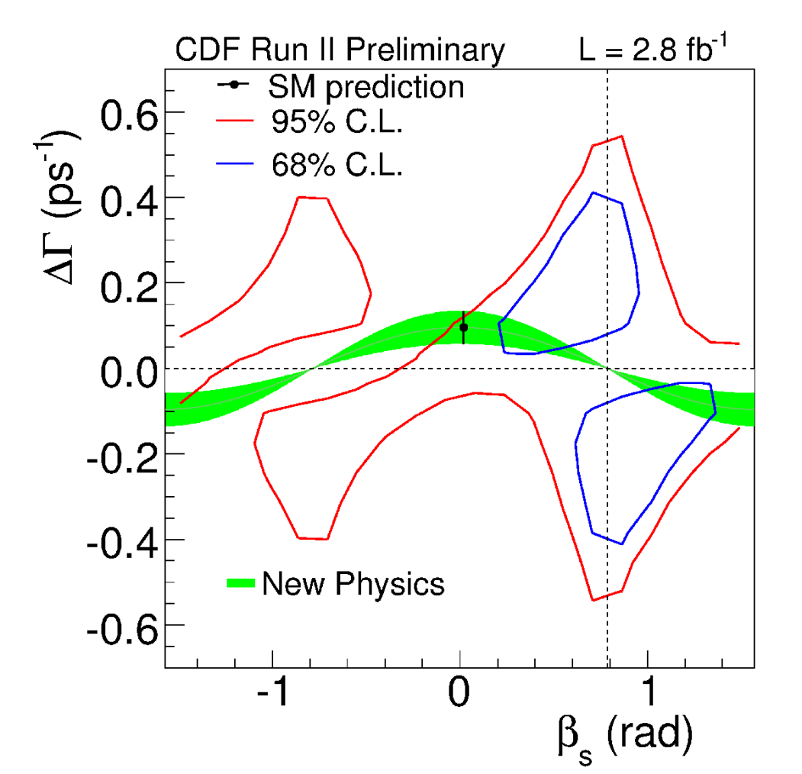
Search for New Physics
are New physics already around the corner?
LHCb key measurements
CDF Public Note 9458 (August 2008)
In CP–violation:
  B_{s}-B_{s} mixing angle φ_{s}
  weak phase γ in trees
  weak phase γ in loops
In Rare Decays:
  branching ratio of B_{s}→ μμ
  forward-backward asymmetry in B → K*μμ
  polarization of photon in radiative penguin decays
see talks by Andrei Golutvin, Alessia Satta, Val Gibson, William Robert Reece and poster by Lesya Shchutska and Bogdan Popovici
(φ_{s}=-2β_{s})
SM consistency at 7% level

Slide 4
B production in LHCb
bb pair production correlated and sharply peaked forward-backward
  Single-arm forward spectrometer : θ~15-300 mrad (rapidity range: 4.9>η>1.9)
  Cross section of bb production in LHCb acceptance: σ_{bb} ~ 230 µb
  B⁺ (40%), B⁰ (40%), B_{s} (10%), b-baryons (10%), B_{c} (< 0.1%)
LHCb limits luminosity to few 10³² cm⁻²s⁻¹ instead of 10³⁴ cm⁻²s⁻¹ by not focusing the beam as much as ATLAS and CMS
  maximizes probability of a single interaction per crossing
  design luminosity soon after start-up
pp interactions/crossing
n=0
LHCb
boost
n=1
collect 2fb⁻¹ per nominal year
~ 10¹² bb pairs produced per year

Slide 5
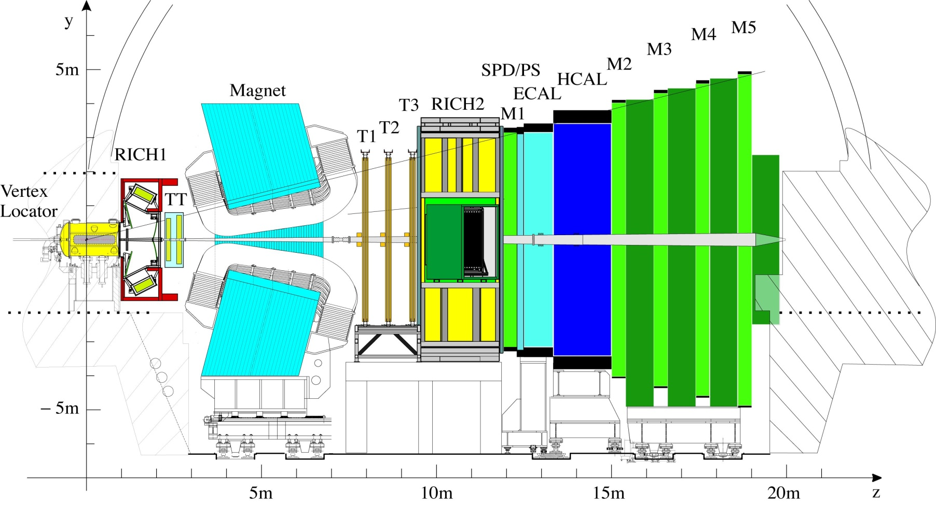
Detector overview and performance
walk through the detector
with the example of a B_{s}→D_{s}K decay

Slide 6

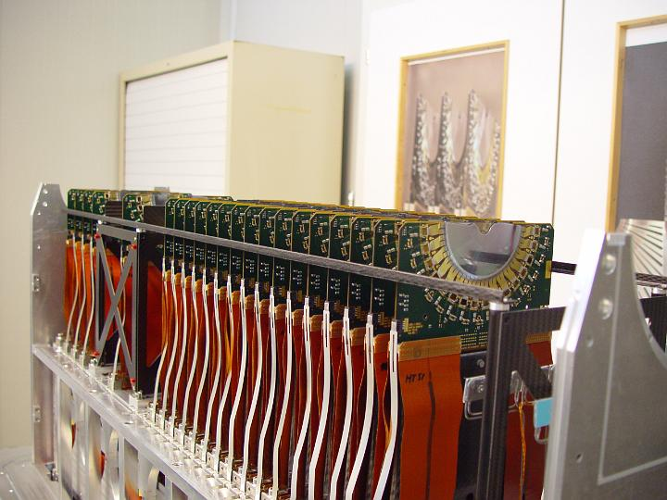
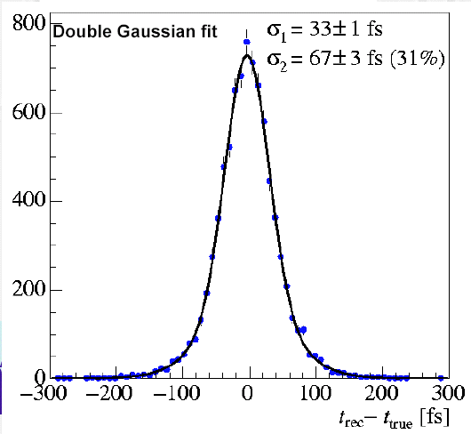
B-Vertex Measurement
Example: B_{s} → D_{s} K
144 μm
σ(τ) ~40 fs
47 μm
K⁺
B_{s}
K⁺
D_{s}
K⁻
Primary vertex
π⁻
d~1cm
440 μm
Decay time resolution = 40 fs
Vertex Locator (Velo)
Silicon strip detector with
~ 5 μm hit resolution
→ 30 μm IP resolution
Vertexing:
trigger on impact parameter
measurement of decay distance (time)

Slide 7
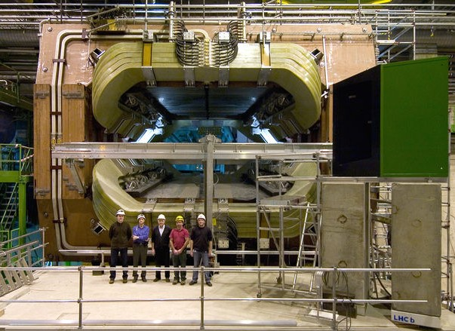
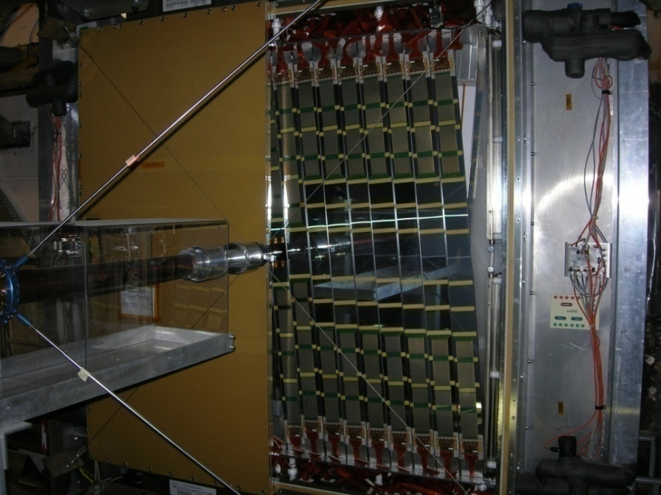
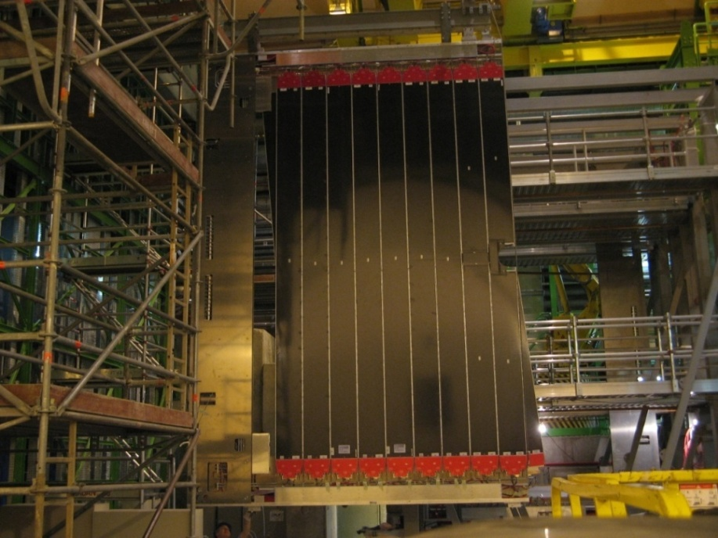
Momentum and Mass measurement
Momentum meas. + direction (VELO): Mass resolution for background suppression
Mass resolution
σ ~14 MeV
Bs→ Ds K
Bs →Ds π
π⁺, K⁺
B_{s}
K⁺
D_{s}
K⁻
π⁻
Primary vertex
b^{tag}


Slide 8
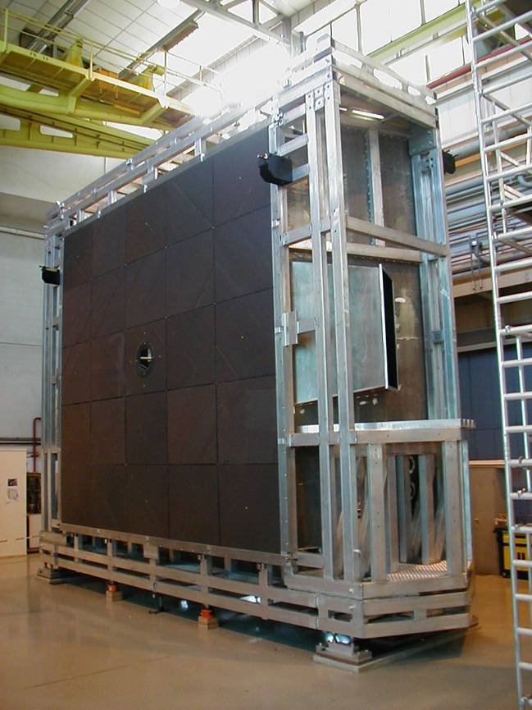
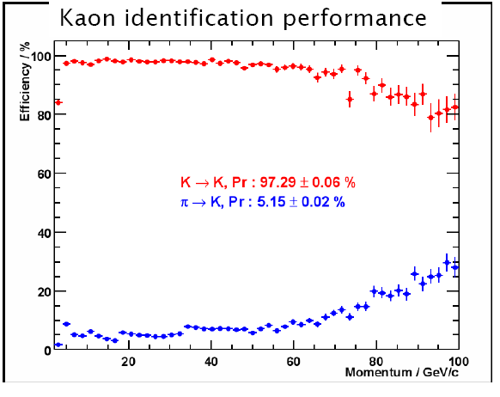
Particle Identification
RICH: K/π identification using Cherenkov light emission angle
Bs → Ds K
π⁺,K⁺
B_{s}
K⁺
K→K : 96.77 ± 0.06%
π→K : 3.94 ± 0.02%
D_{s}
K⁻
π⁻
Primary vertex
b^{tag}

RICH1: 5 cm aerogel n=1.03
  4 m³ C₄F₁₀ n=1.0014
RICH2: 100 m3 CF4 n=1.0005

Slide 9
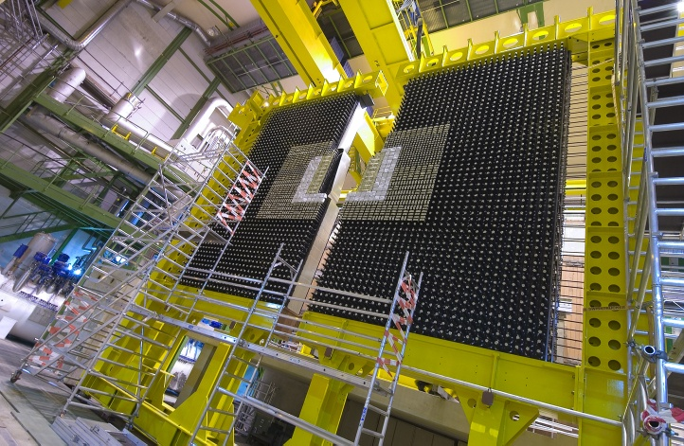
Particle identification and L0 trigger
e
h
ECAL (inner modules): σ(E)/E ~ 8.2% /√E + 0.9%
Calorimeter system :
Identify electrons, hadrons, π⁰ ,γ
Level 0 trigger: high E_{T} electron and hadron
K⁺
B_{s}
K⁺
D_{s}
K⁻
Primary vertex
b^{tag}
π⁻

Slide 10
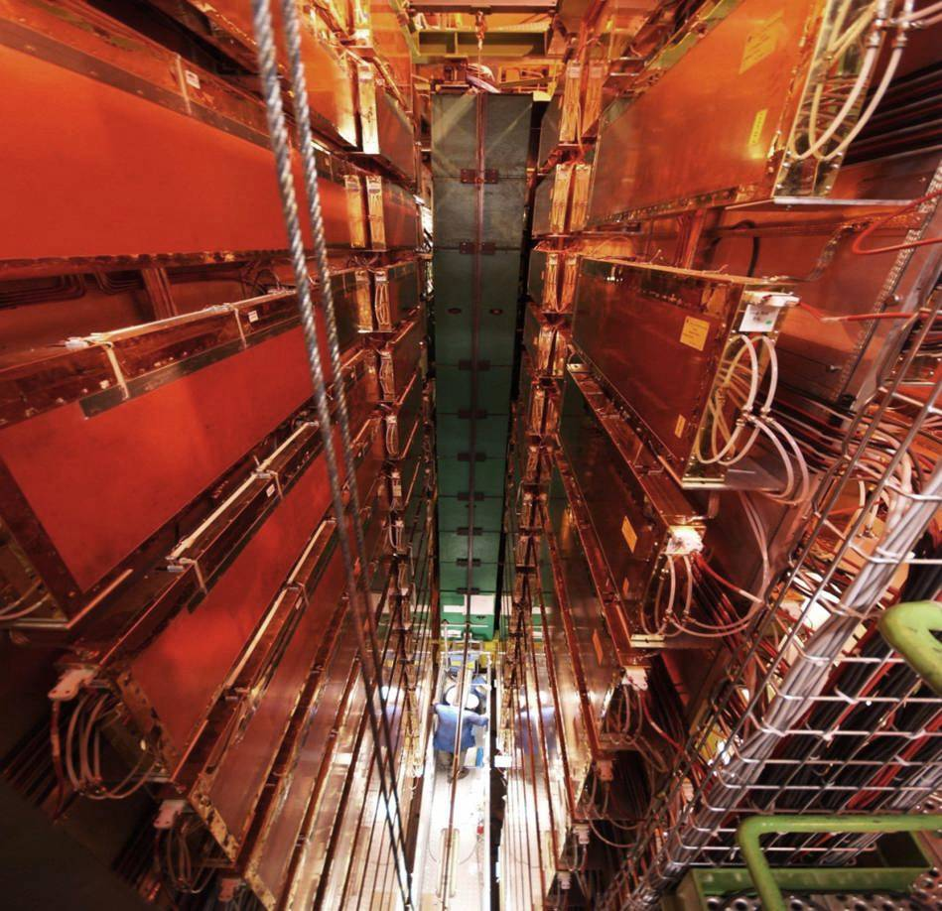
Particle identification and L0 trigger
μ
Muon system:
Level 0 trigger: High P_{t} muons
contributing to flavour tagging: εD² = ε (1-2w)² ≈ 6%
K⁺
B_{s}
K⁺
D_{s}
K⁻
Primary vertex
b^{tag}
π⁻

Slide 11
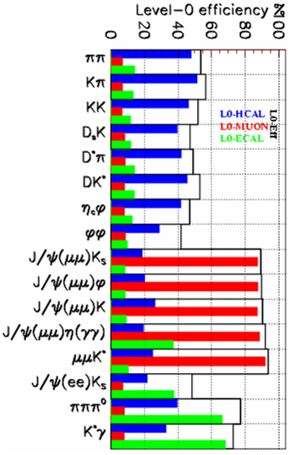
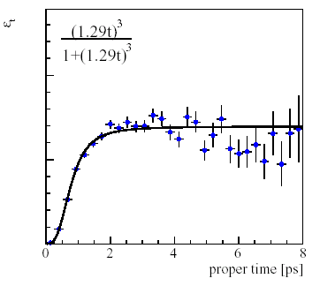
LHCb trigger
L0 efficiency (%)
Detector
40 MHz
L0: high p_{T} (μ, e, γ, h) [hardware, 4 μs]
1 MHz
HLT: high IP, high p_{T} tracks [CPU farm]
then full reconstruction of event
2 kHz
Storage (event size ~ 35 kB)
Note: decay time dependent efficiency: eg. B_{s} → D_{s} K
Efficiency →
HLT rate | Event type | Physics
200 Hz | Exclusive B candidates | B (core program)
600 Hz | High mass di-muons | J/ψ, b→J/ψX (unbiased)
300 Hz | D* candidates | Charm (mixing & CPV)
900 Hz | Inclusive b (e.g. b→μ) | B (data mining)
B_{s}
K⁺
D_{s}
K⁺
K⁻
Primary vertex
π⁻
b^{tag}
Proper time [ps] →
11

Slide 12
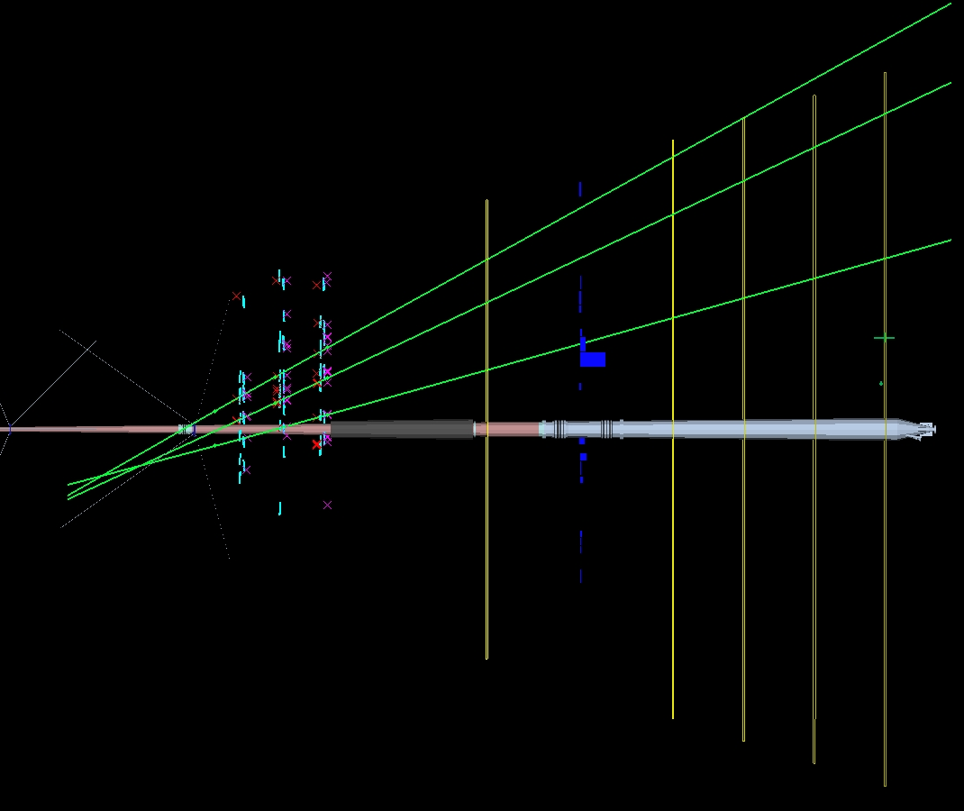
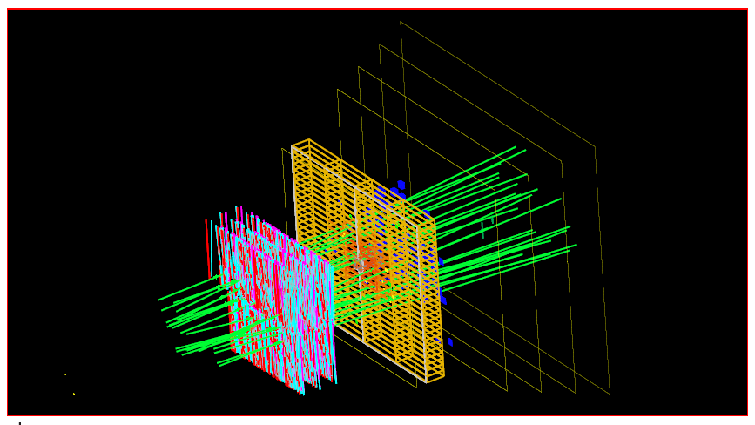
Status of LHCb
(→ see talk by Olivier Callot)
LHCb detector fully installed and commissioned (except M1), including L0 trigger
All sub-detectors have undergone the first time and space alignment with cosmics & LHC beam induced particles
Top view
Muon
Events with LHC beam induced particles
OT
Calo
Side view
Splashy event from lost particles (not all tracks reconstructed...)
Calo
OT
Clean event from halo muons
Muon
Split, 2 October 2008
12

Slide 13
Extracting physics from (very) first data
Exploit minimum bias data
σ∙ε
Number of selected signal events:
S=
σ_{mb}
∙N_{mb}
10⁸ minimum bias @ 2kHz

Slide 14
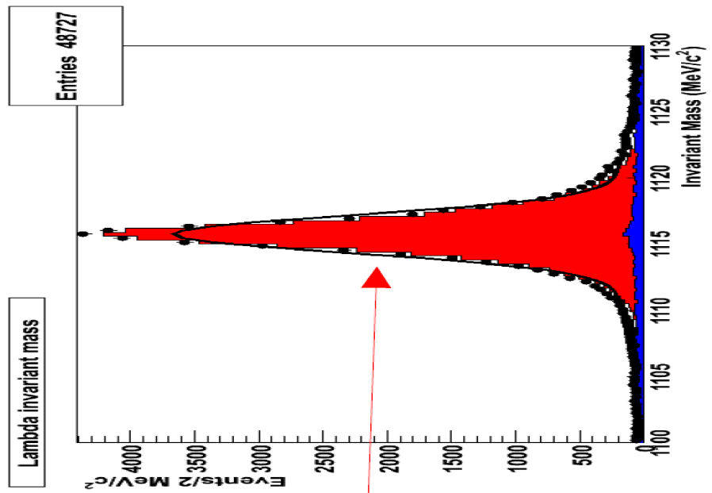
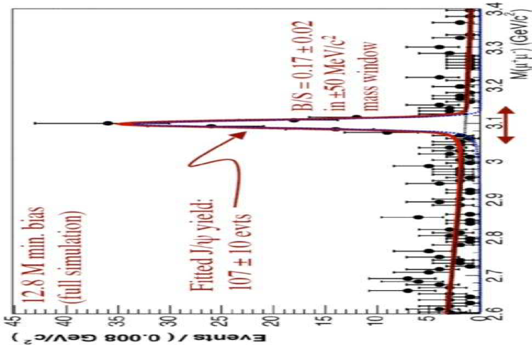
Exploiting minimum bias data
~ 40 mins @ 10³¹ cm⁻² s⁻¹
→ ~50k Λ→pπ events
in 10⁸ minimum bias events
      plenty of K_{s}→ππ and Λ→pπ
      95% purity with kinematical and vertex cuts only
      → clean & unbiased sample for PID studies
      study hadron identification performance
      collect 1400 J/ψ→μμ
      use triggered J/ψ data with p_{t}-cut on single muon
      → second muon unbiased for PID studies
      study muon identification performance
      search for D→Kπ, Kπππ, K⁰_{S}ππ, Kππ⁰
      → assess background levels, resolutions & relative efficiencies
      demonstrate capability to reconstruct first final states
Λ→pπ

Slide 15
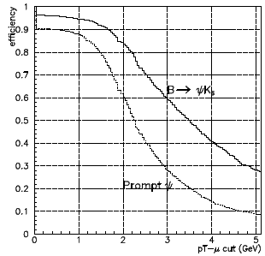

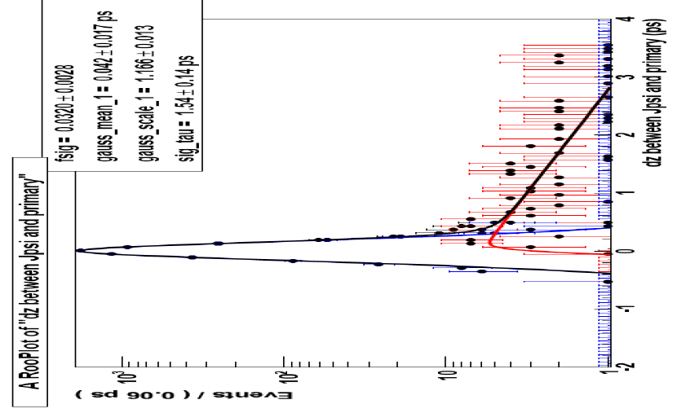
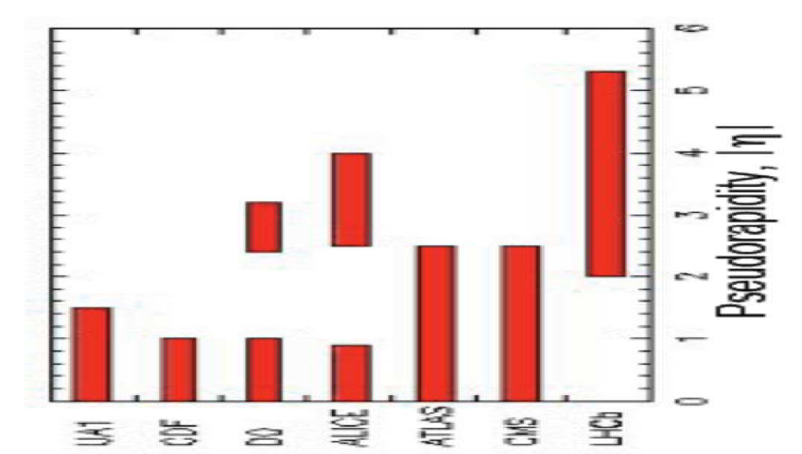
Exploiting first muon trigger data
      applying J/ψ trigger with p_{t}-cut on single muon
      expect ~10⁶ J/ψ→μμ with 1 pb⁻¹
μ⁺
Reconstruct J/ψ→μμ and disentangle fraction of prompt and detached J/ψ’s
μ⁻
discriminating variable:
dz
PV
Measure prompt J/ψ and bb cross section in a region not accessible to other collider experiments
study proper time resolution with prompt component

Slide 16
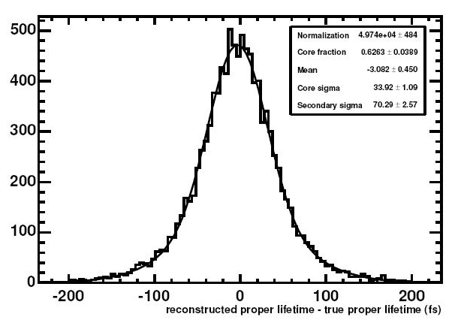
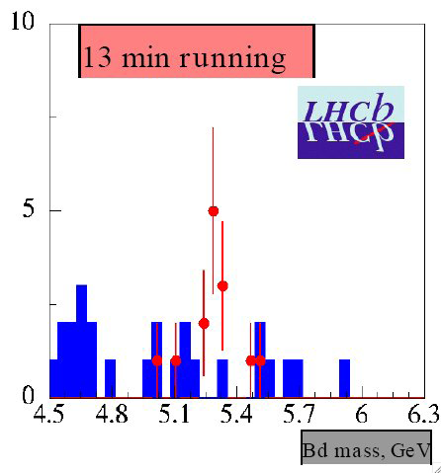
Exploiting ~5 pb⁻¹ of data with full trigger
(~days of data taking)
23k B⁰→ D*μν
  tagging studies with flavour specific modes
3.2k B⁺→J/ψK⁺
  selection does not require lifetime cut
  unbiased lifetime distribution to determine resolution
4.3k B⁰ → D⁻(K⁻ π⁺π⁻) π ⁺
  measure B⁰ lifetime
  reach current precision (0.009 ps) with 60k events
A(t)
Oscillation plot with 3 pb⁻¹ of B⁰→ D*μν
13 min. running
σ(τ) ~34 fs
~0.2 pb⁻¹
Select first 285 B_{s}→J/ψφ
B→ K*γ
B⁰ → D⁻(K⁻ π⁺π⁻) π ⁺
Invariant mass of
B_{s}→J/ψ(μμ)φ
t_{rec}-t_{true}(fs)‏
σ(B_{s})=13 MeV
3.7k B→ K*γ
  reference channel for all radiative loop decays
2.3k B→J/ψK*
  exercise fit machinery for analysis of B_{s}→J/ψφ

Slide 17
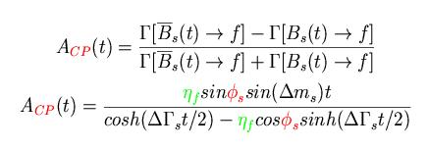
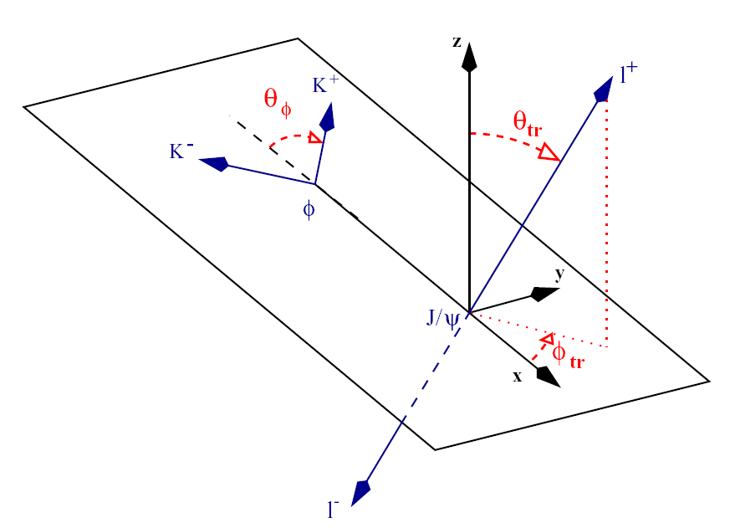
Exploiting ~0.5 fb⁻¹ of data with full trigger
(1/4 of a nominal year)
measure B_{s}-B_{s} mixing phase φ_{s} in B_{s}→J/ψ(µµ)φ
Sensitive to New Physics effects in mixing
    φ_{s} = φ_{s}(SM) + φ_{s}(NP)
+NP?
η_{f} = +, - 1 CP eigenstates
Θ_{tr}= angle between l⁺ and normal to φ decay plane
  in SM: φ_{s} = – 2β_{s} = –arg(V_{ts}²) ~ –0.04
J/ψφ is not a pure CP eigenstate (2 CP even, 1 CP odd amplitude)
  need to fit angular distributions of decay final states as function of proper time
with 28’500 reconstructed B_{s}→J/ψ(µµ)φ signal events (before tagging)
→ σ_{stat}(φ_{s})~0.06 with 0.5 fb⁻¹

Slide 18
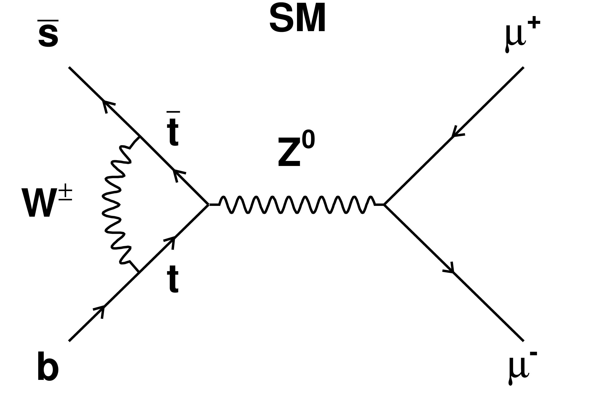
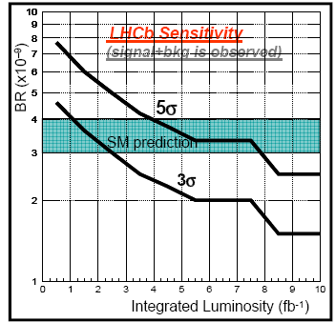
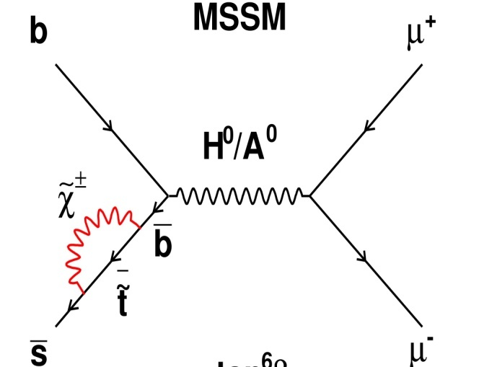

Exploiting ~0.5 fb⁻¹ of data with full trigger
measure BR of rare decay B_{s} → μ⁺μ–
(1/4 of a nominal year)
Very rare loop decay, sensitive to New Physics
BR ~ 3.5×10^{–9} in SM, can be strongly enhanced in SUSY
Main issue is background rejection:
  dominated by B→μ⁺X, B→μ⁻X decays
  good mass resolution and PID essential
LHCb expected performance:
  → with 0.5 fb^{–1}: exclude BR values down to SM value
  → with 2 fb^{–1}: 3σ evidence of SM signal
  → with 10 fb^{–1}: > 5σ observation of SM signal
?
?
Current limit from CDF
BR(B_{s}→μμ) < 4.7×10⁻⁸
MSSM

Slide 19
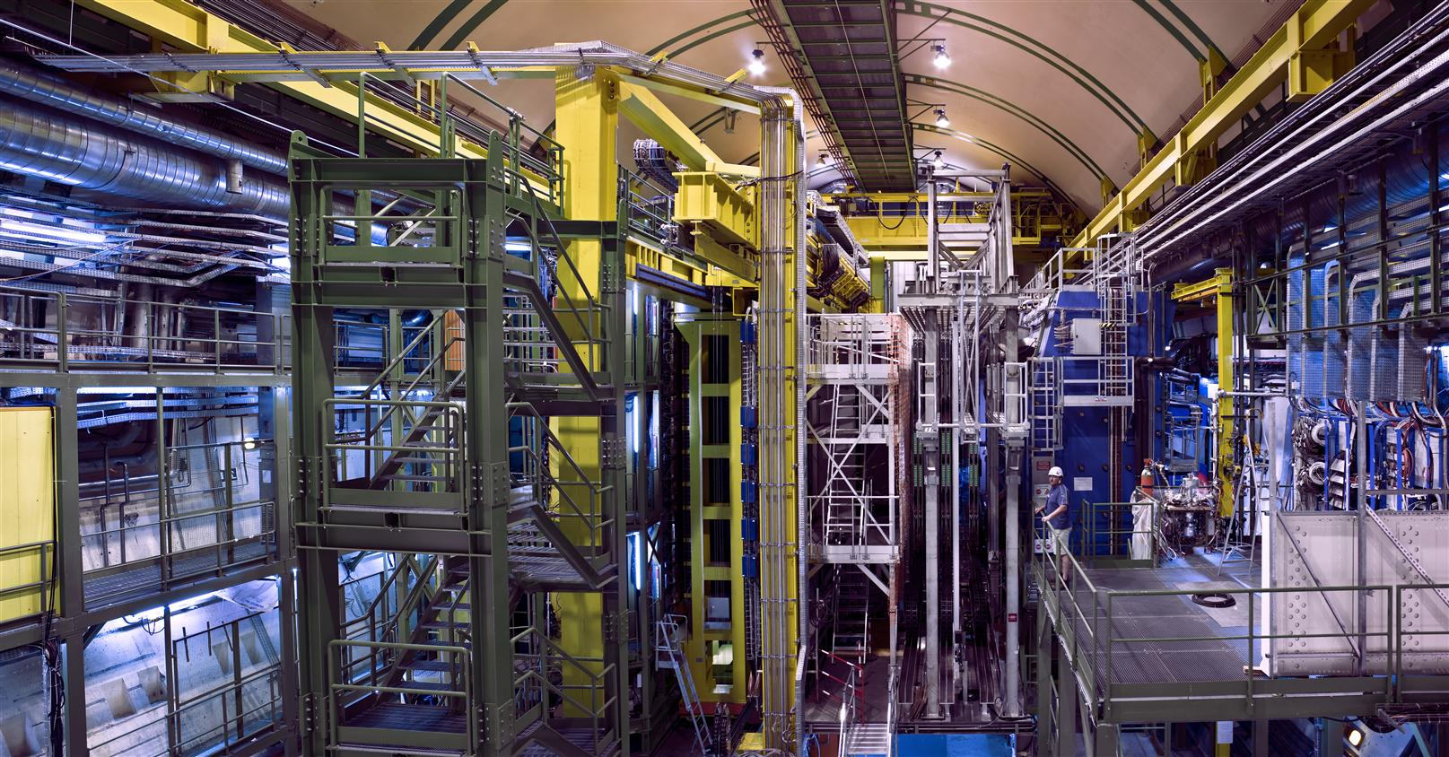
Conclusion
LHCb is a heavy flavour precision experiment searching for New Physics in CP-violation and rare decays
The experiment is ready for data taking with first collisions
Very first data can be exploited to validate the expected detector performance
With fraction of a 1 years nominal data set LHCb can already perform important key measurments probing New Physics

