Slide 1


Super-LHC
W. Scandale, F. Zimmermann
We acknowledge the support of the European Community-Research Infrastructure Activity under the FP6 "Structuring the European Research Area" programme (CARE, contract number RII3-CT-2003-506395)
CERN

Slide 2
outline
motivation & staged approach
3 upgrade scenarios
luminosity levelling
injector upgrade & schedule
detector upgrade
crab cavities
beam-beam & e-cloud mitigation
complementary advanced schemes
strategy for “phase-2”

Slide 3
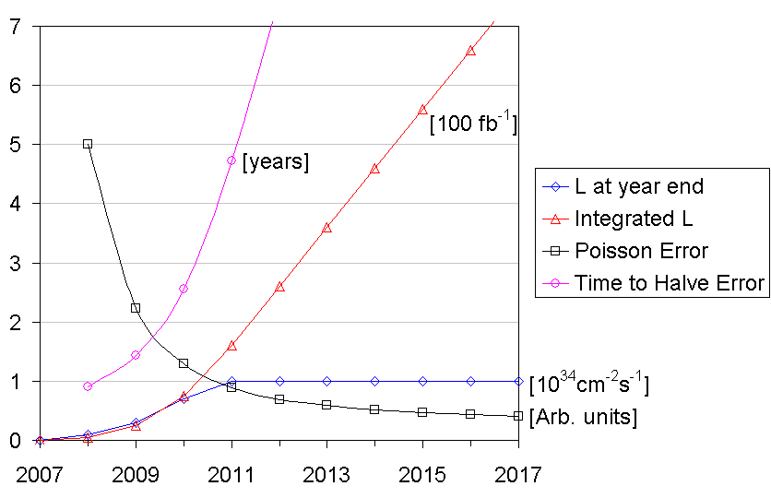
Three Strong Reasons for LHC Upgrade
J. Strait 2003
hypothetical luminosity
evolution
1) after few years, statistical error hardly decreases
2) radiation damage limit of IR quadrupoles (~700 fb⁻¹) reached by ~2016⇒ time for an upgrade!
3) extending physics potential!

Slide 4
staged approach to LHC upgrade
“phase-1” 2013:
new triplets, D1, TAS, β*=0.25 m in IP1 & 5,
reliable LHC operation at ~2-3x luminosity;
beam from new Linac4
“phase-2” 2017:
target luminosity 10x nominal,
possibly Nb₃Sn triplet & β*~0.15 m
complementary measures 2010-2017:
e.g. long-range beam-beam compensation,
crab cavities, new/upgraded injectors, advanced
collimators, coherent e- cooling??, e- lenses??
longer term (2020?): energy upgrade, LHeC,…
+ injector
upgrade
phase-2 might be just phase-1 plus complementary measures

Slide 5
LHC upgrade paths for IP1 & IP5
early separation (ES)
full crab crossing (FCC)
L. Evans,
W. Scandale,
F. Zimmermann
J.-P. Koutchouk
New!
stronger triplet
magnets
stronger triplet
magnets
D0 dipole
small-angle
crab cavity
small-angle
crab cavity
ultimate beam (1.7x10¹¹ protons/bunch, 25 spacing), β* ~10 cm
early-separation dipoles in side detectors , crab cavities
→ hardware inside ATLAS & CMS detectors,
first hadron crab cavities; off-δ β-beat
ultimate LHC beam (1.7x10¹¹ protons/bunch, 25 spacing)
β* ~10 cm
crab cavities with 60% higher voltage
→ first hadron crab cavities, off-δ β-beat
larger-aperture triplet magnets
large Piwinski
angle (LPA)
50 ns spacing, longer & more intense bunches
(5x10¹¹ protons/bunch)
β*~25 cm, no elements inside detectors
long-range beam-beam wire compensation
→ novel operating regime for hadron colliders, and for beam generation
wire
compensator
F. Ruggiero,
W. Scandale.
F. Zimmermann

Slide 6
parameter | symbol | nominal | ultimate | Early Sep. | Full Crab Xing | L. Piw Angle
transverse emittance | ε [μm] | 3.75 | 3.75 | 3.75 | 3.75 | 3.75
protons per bunch | N_{b} [10¹¹] | 1.15 | 1.7 | 1.7 | 1.7 | 4.9
bunch spacing | Δt [ns] | 25 | 25 | 25 | 25 | 50
beam current | I [A] | 0.58 | 0.86 | 0.86 | 0.86 | 1.22
longitudinal profile |  | Gauss | Gauss | Gauss | Gauss | Flat
rms bunch length | σ_{z} [cm] | 7.55 | 7.55 | 7.55 | 7.55 | 11.8
beta* at IP1&5 | β∗ [m] | 0.55 | 0.5 | 0.08 | 0.08 | 0.25
full crossing angle | θ_{c} [μrad] | 285 | 315 | 0 | 0 | 381
Piwinski parameter | φ=θ_{c}σ_{z}/(2*σ_{x}*) | 0.64 | 0.75 | 0 | 0 | 2.0
hourglass reduction |  | 1.0 | 1.0 | 0.86 | 0.86 | 0.99
peak luminosity | L [10³⁴ cm⁻²s⁻¹] | 1 | 2.3 | 15.5 | 15.5 | 10.7
peak events per #ing |  | 19 | 44 | 294 | 294 | 403
initial lumi lifetime | τ_{L} [h] | 22 | 14 | 2.2 | 2.2 | 4.5
effective luminosity (T_{turnaround}=10 h) | L_{eff} [10³⁴ cm⁻²s⁻¹] | 0.46 | 0.91 | 2.4 | 2.4 | 2.5
 | T_{run,opt} [h] | 21.2 | 17.0 | 6.6 | 6.6 | 9.5
effective luminosity (T_{turnaround}=5 h) | L_{eff} [10³⁴ cm⁻²s⁻¹] | 0.56 | 1.15 | 3.6 | 3.6 | 3.5
 | T_{run,opt} [h] | 15.0 | 12.0 | 4.6 | 4.6 | 6.7
e-c heat SEY=1.4(1.3) | P [W/m] | 1.07 (0.44) | 1.04 (0.59) | 1.04 (0.59) | 1.04 (0.59) | 0.36 (0.1)
SR heat load 4.6-20 K | P_{SR} [W/m] | 0.17 | 0.25 | 0.25 | 0.25 | 0.36
image current heat | P_{IC} [W/m] | 0.15 | 0.33 | 0.33 | 0.33 | 0.78
gas-s. 100 h (10 h) τ_{b} | P_{gas} [W/m] | 0.04 (0.38) | 0.06 (0.56) | 0.06 (0.56) | 0.06 (0.56) | 0.09 (0.9)
extent luminous region | σ_{l} [cm] | 4.5 | 4.3 | 3.7 | 3.7 | 5.3
comment |  | nominal | ultimate | D0 + crab | crab | wire comp.
large Piwinski angle (LPA)
full crab crossing (FCC)
early separation (ES)

Slide 7
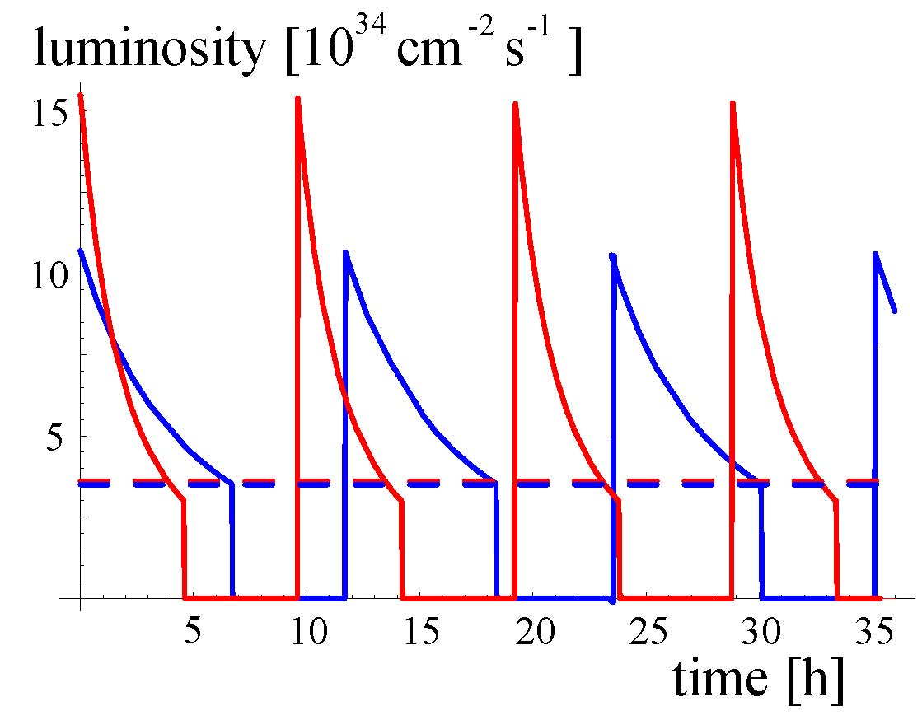
luminosity leveling
initial luminosity
peak may not
be useful for
physics
(set up &
tuning?)
ES or
FCC
LPA
experiments prefer ~constant luminosity, less pile up at start of run, higher luminosity at end
average
luminosity
how can we achieve this?
ES or FCC: dynamic β squeeze, or dynamic θ change (either IP angle bumps or varying crab voltage)
LPA: dynamic β squeeze, or dynamic change of bunch length

Slide 8
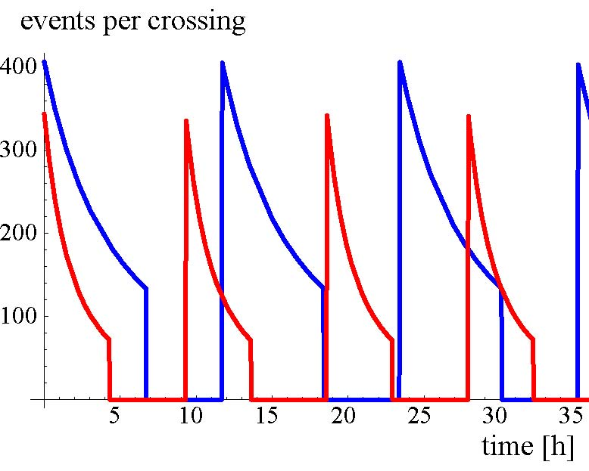
IP1& 5 event pile up for 25 & 50-ns spacing w/o leveling
ES or
FCC
50 ns
spacing
25 ns
spacing
LPA

Slide 9
upgrade bunch structures
nominal
25 ns
ultimate
& 25-ns upgrade
(ES & FCC)
25 ns
50-ns upgrade (LPA),
no collisions in LHCb!
50 ns
50-ns upgrade
with 25-ns
collisions
in LHCb
50 ns
25 ns

Slide 10
experimenters’ choice
(LHCC July 2008)
no accelerator components inside detector
lowest possible event pile up
possibility of easy luminosity levelling
→ full crab crossing upgrade
New!

Slide 11
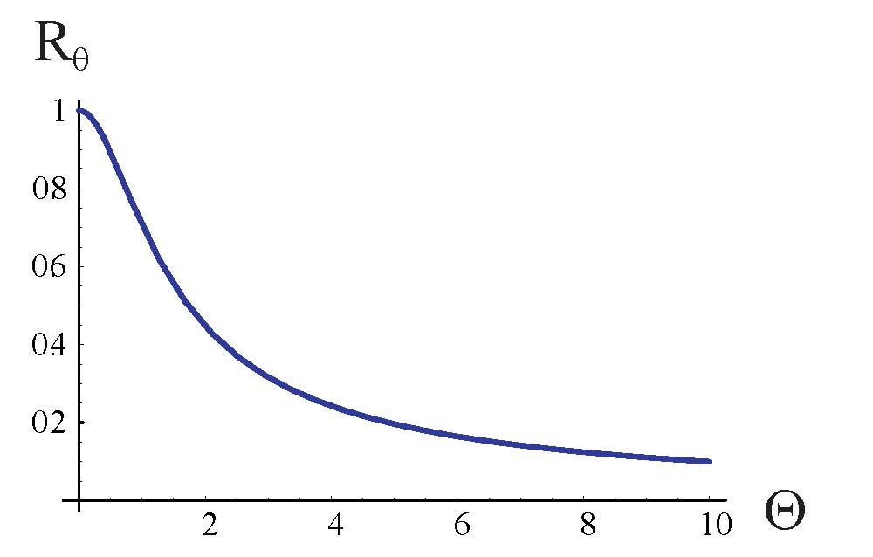
crab cavity motivation
“Piwinski angle”
θ_{c}/2
luminosity reduction factor
without crab cavity
nominal LHC
effective beam
size σ→σ/R_{φ}
“LPA” upgrade
“FCC”
upgrade

Slide 12
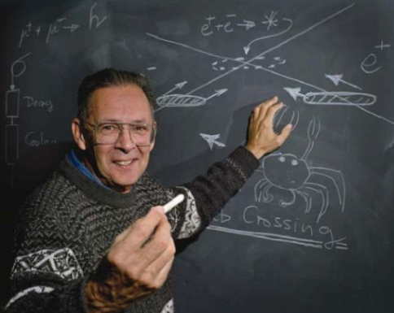
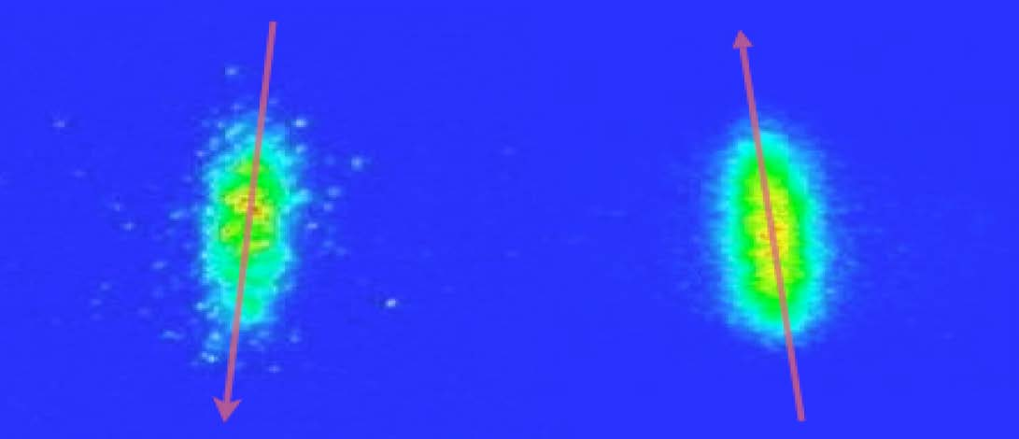
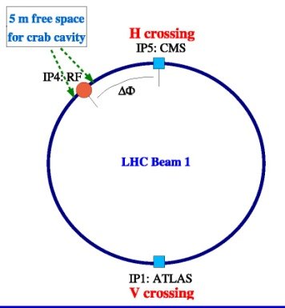
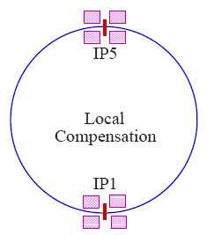
CARE-HHH
LHC Crab Cavity Validation Mini-Workshop, 21 August 2008
New!
invention
1988
first use in operating
ring collider 2007
crabbed beams in KEKB
Bob Palmer
KEKB experience
R&D plan
phased approach:
(1) prototype
(2) “global” crab cavity test in IR4,
(3) “local” crab cavities in IR1 & 5
EuCARD, US-LARP & international collaboration
LHC
global crab
LHC
local crab
global & local schemes considered for LHC

Slide 13
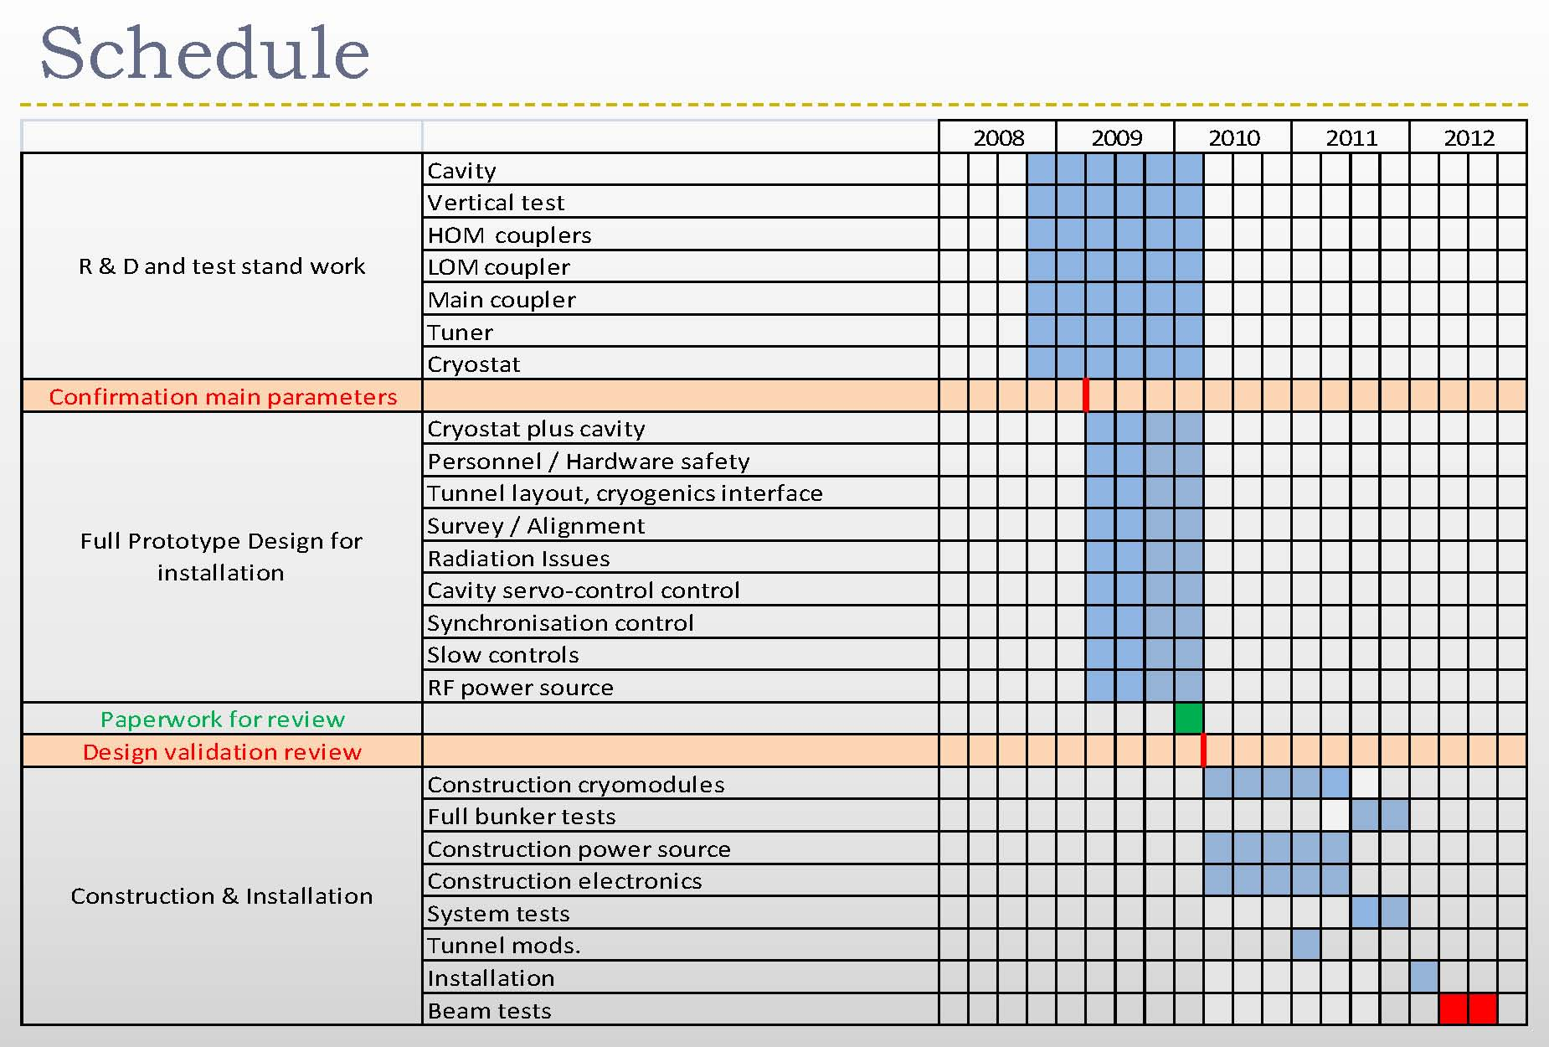
tentative schedule for crab-cavity prototype & first beam tests schedule
New!
T. Linnecar, HHH Crab-Cavity Validation Workshop August 2008
local crab cavities together with IR phase-2 ~2017 ?

Slide 14
LHC injector upgrade
Reasons:
need for reliability:
  accelerators are old
  [Linac2: 1978, PSB: 1975, PS: 1959, SPS: 1976]
  they operate far from their design parameters and close to hardware limits
  the infrastructure has suffered from the concentration of resources on LHC during the past 10 years
need for better beam characteristics
Roland Garoby, LHCC 1July ‘08

Slide 15
present and future injectors
Proton flux / Beam power
50 MeV
Linac2
Linac4
160 MeV
PSB
(LP)SPL
1.4 GeV
4 GeV
(LP)SPL: (Low Power) Superconducting Proton Linac (4-5 GeV)
PS2: High Energy PS
(~ 5 to 50 GeV – 0.3 Hz)
SPS+: Superconducting SPS
(50 to1000 GeV)
SLHC: “Superluminosity” LHC
(up to 10³⁵ cm⁻²s⁻¹)
DLHC: “Double energy” LHC
(1 to ~14 TeV)
26 GeV
PS
PS2
50 GeV
Output energy
450 GeV
SPS
SPS+
1 TeV
LHC /
SLHC
DLHC
7 TeV
~ 14 TeV
Roland Garoby, LHCC 1July ‘08

Slide 16
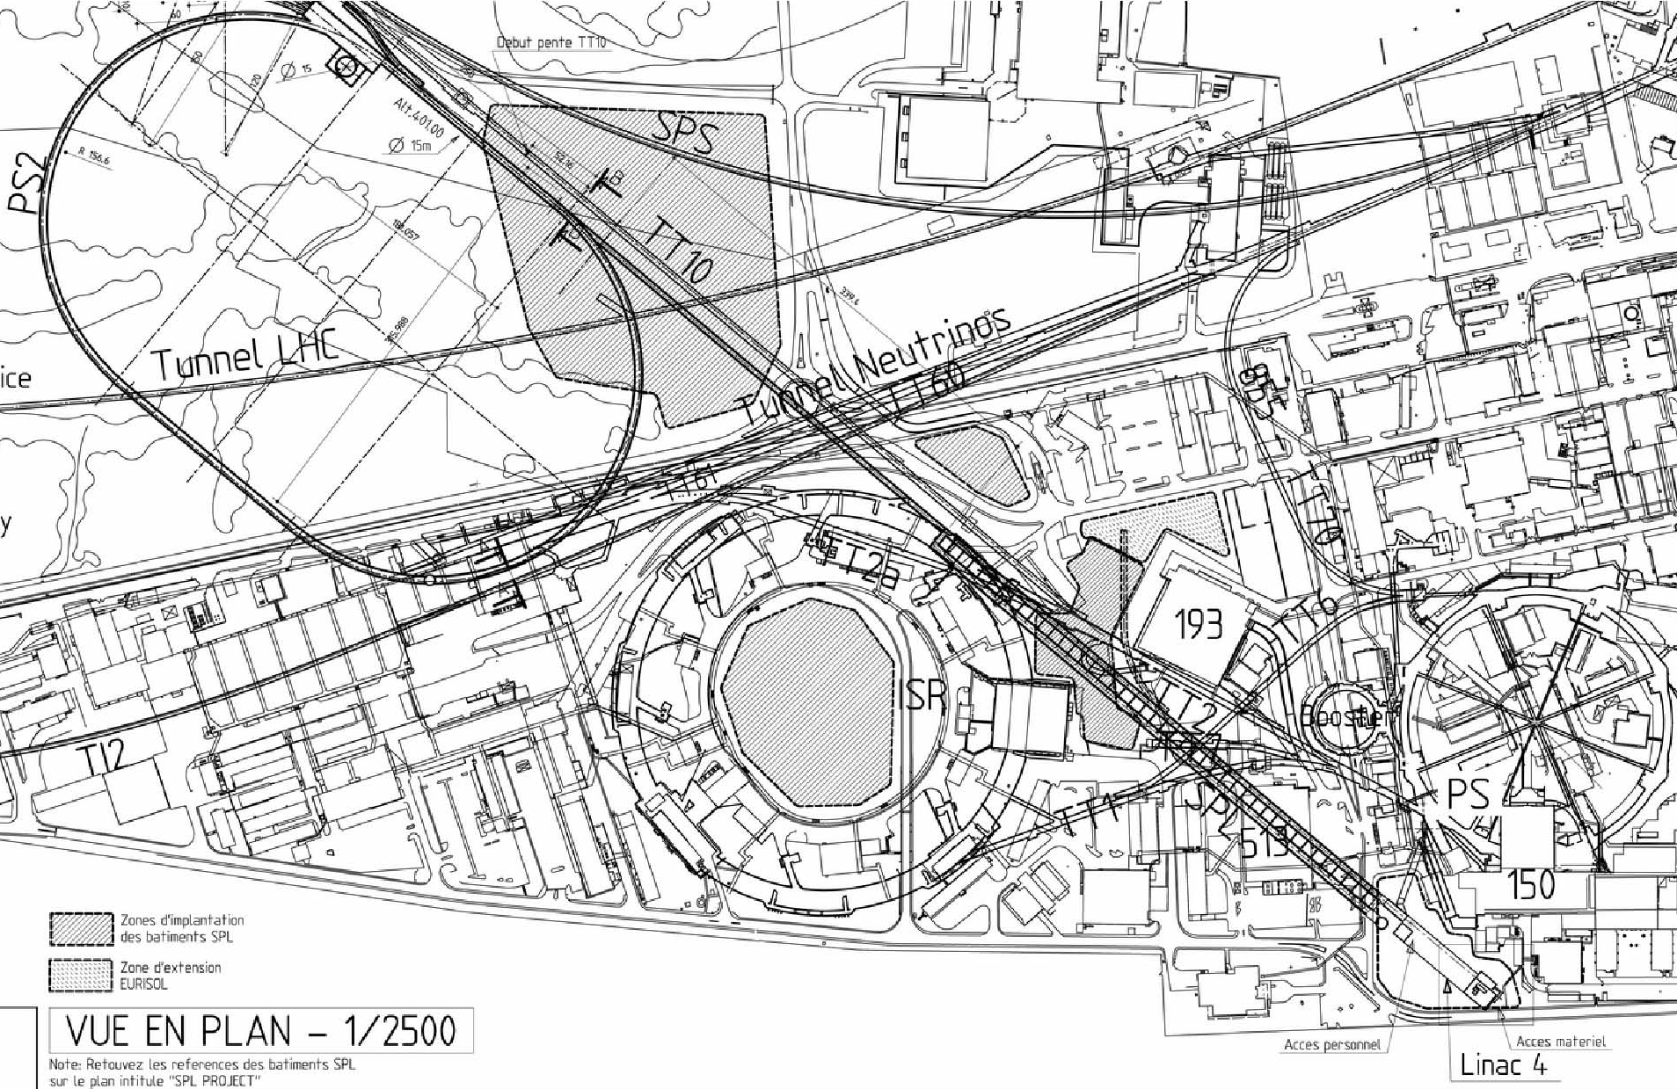
layout of the new injectors
SPS
PS2
SPL
PS
Linac4
R. Garoby, CARE-HHH BEAM07, October’07; L. Evans, LHCC, 20 Feb ‘08

Slide 17
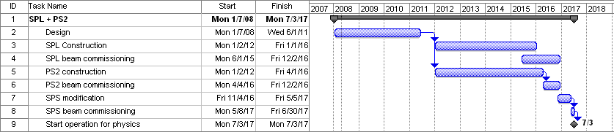
injector upgrade schedule synchronized with LHC IR upgrades
R. Garoby,
LHCC 1 July 2008
LHC IR phase 1
LHC IR
phase 2

Slide 18
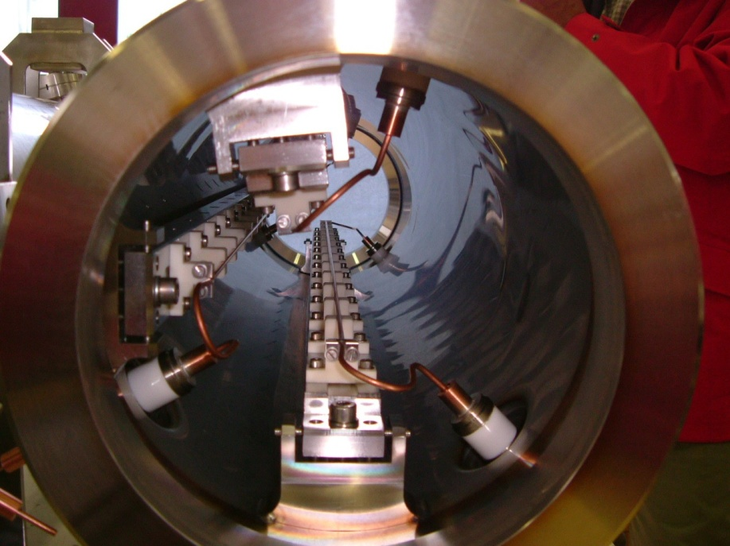
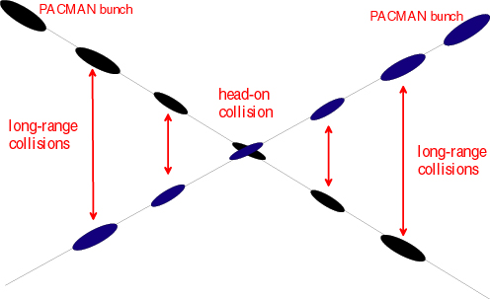
long-range beam-beam compensation
LR beam-beam in LHC
prototype
compensator
in the SPS
G. Sterbini, J.-P. Koutchouk U. Dorda, et al, SPS MD August 2008
inverse relative loss at various tunes
New!
New!
distance [mm]

Slide 19
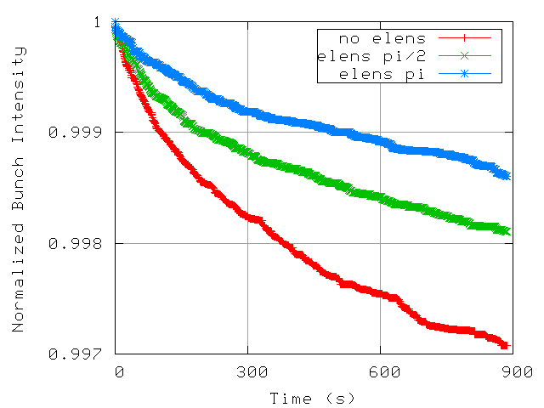
electron lens
use of e-lens as tune-spread compressor improves
simulated LHC beam lifetime (phase to IP important)
A.Valishev,
CARE-HHH
mini-workshop
on beam-beam
Compensation,
28 August 2008
New!

Slide 20
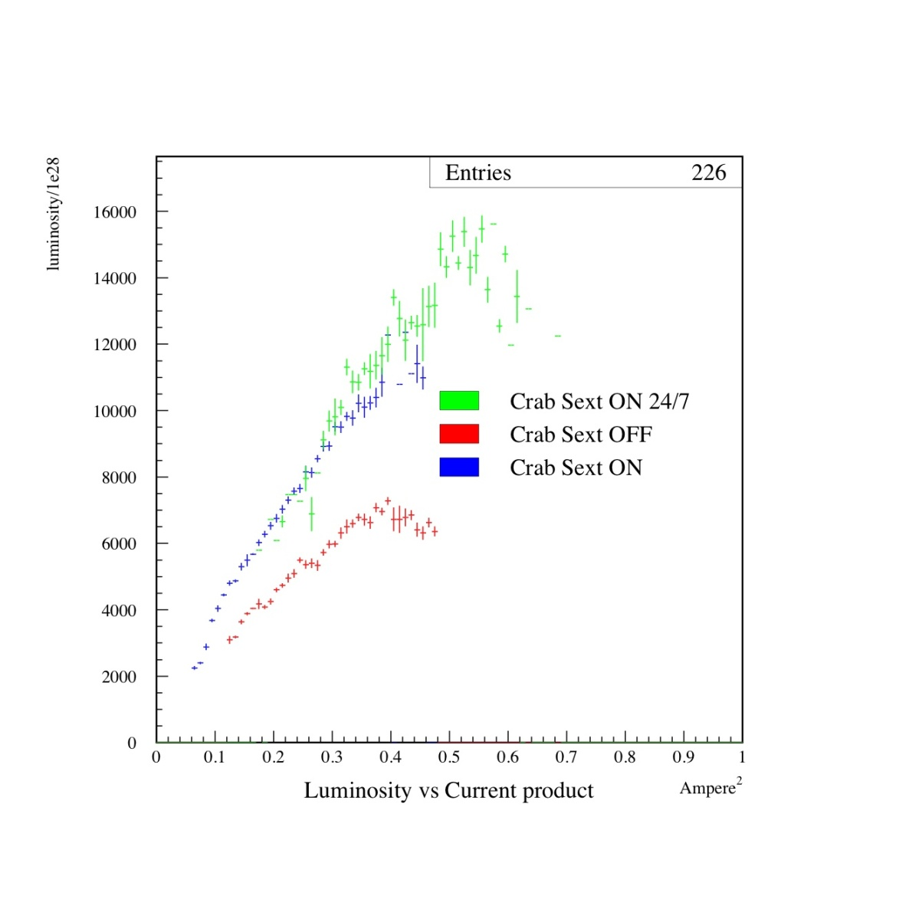
“crab-waist” collisions at DAFNE
(note: no crab cavities but sextupoles!)
C. Milardi
luminosity
New!
with
crab
waist
can we make
use of
crab waists
at the LHC?
w/o crab waist
current product

Slide 21
crab waist in LHC?
K. Ohmi
one example:
φ=3.5 in LPA option
β_{y} squeezed to σ_{x}/φ=2.1cm (extreme!)
→ L increases (14/2.1)^{1/2}=2.6 times
→ ξ_{y} decreases and ξ_{x} is small for LPA
→ “crab waist has a chance to work!”
CARE-HHH
mini-workshop
28 August ‘08
New!

Slide 22
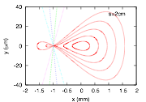
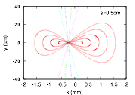
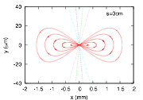
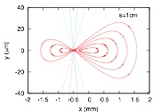
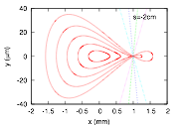
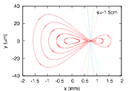
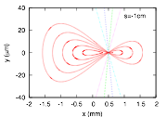
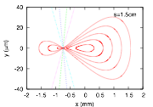
crab-waist collisions
K. Ohmi
New!
vertical focus moves through the beam horizontally

Slide 23
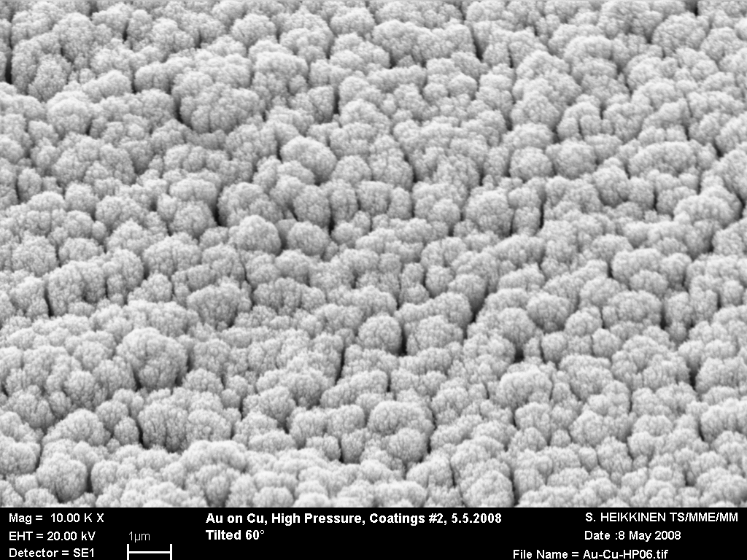
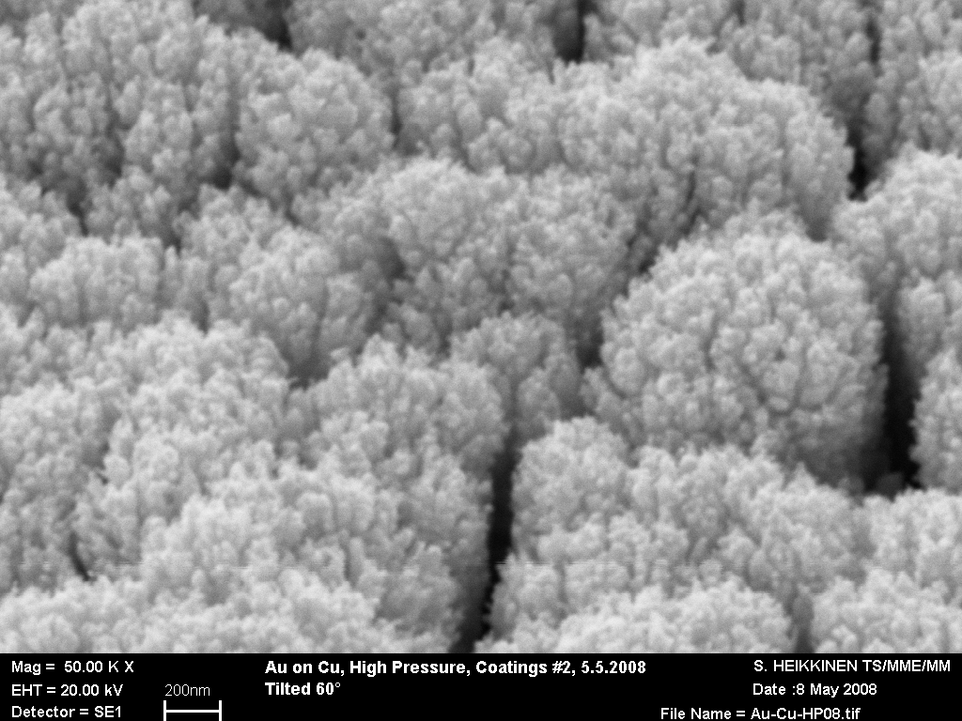
e-cloud mitigation
Evaporation of metals in relatively high pressure of a rare gas produces very rough and porous films. Already mentioned in the literature, “gold black” has been produced and characterized.
Gold black deposited by evaporation in Kr (0.5 mbar)
New!
for PS2 and SPS
upgrade;
effort triggered by HHH ECL’2 workshop
P. Chiggiato
et al
promising:
graphite coating on
black gold substrate
no dependence on time of exposure to air

Slide 24
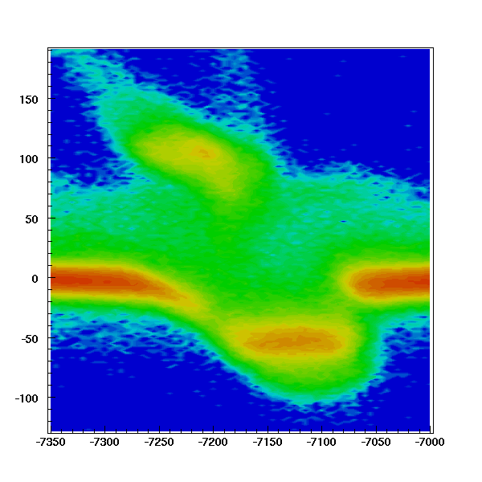
crystal collimation
experiments
in SPS North
area since 2006
2008 result:
crystal deflection
of 450 GeV protons with an array of five aligned crystals
parallel simulation
effort
approved experiment
in SPS ring proper
New!
W. Scandale et al

Slide 25
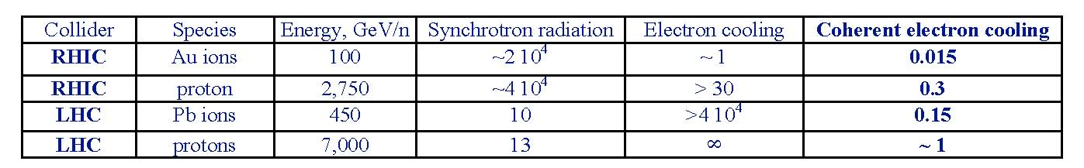
lower beam emittance
can compensate for luminosity loss due to
large crossing angle [R. Garoby]
may be provided by new injectors
and/or by “coherent e- cooling” [V. Litvinenko]
damping times in hours:
CeC proof-of-
principle
experiment
at RHIC in
2012
promise of
1-hr damping
time at 7 TeV!

Slide 26
strategy for “phase 2”
pursue vigorous R&D program for larger-aperture higher-field magnets
parallel crab-cavity development and testing
design, production & installation of wire compensator already in phase-0
exploration of complementary schemes, like crab waist, coherent e-cooling, e-lenses, crystal collimation; integrate them into upgrade plan when they become available
establish generation method long flat bunches
identify main limitations of the real LHC
LHC machine studies to explore upgrade scenarios, e.g. large Piwinski angle
close coordination with detector upgrades

