Slide 1

Prospects for at LHCb
William Reece
Imperial College London
Physics at the LHC, 3rd October 2008

Slide 2


Introduction
FCNC quark transitions occur via a loop
New physics (NP) can enter the loop
Treat with Operator Product Expansion
  Model independent approach
Wilson Coefficients give short range Physics
  Measure to discover or exclude entire classes of NP

Slide 3

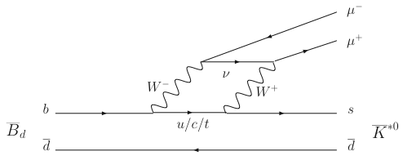
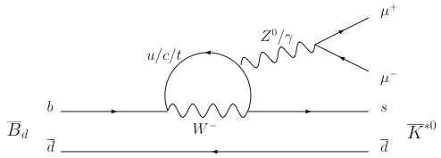


First observed at Belle
Particles in Loop
  Both neutral and charged NP
  (replace W±, Z⁰/γ, u/c/t)
Sensitive to NP
  Dominated by C₇, C₉, C₁₀
  Studied with NP from SUSY,
  Littlest Higgs, Randall-Sundrum,
  Universal Extra Dimensions etc
Laboratory for Studying NP
  Complementary to direct searches
  Offers NP model discrimination
  for any LHC discoveries
O_{7γ}
O_{9,10}
Notes:
Need to go pretty quickly here

Slide 4


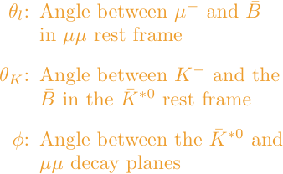
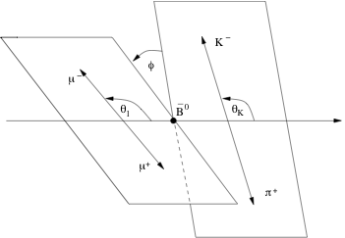
Decay Kinematics
See e.g. arXiv: 0807.2589
Decay in terms of 3 Angles and 1 Invariant Mass
  θ_{l}, θ_{K}, φ and q², the invariant mass squared of μ pair

Slide 5
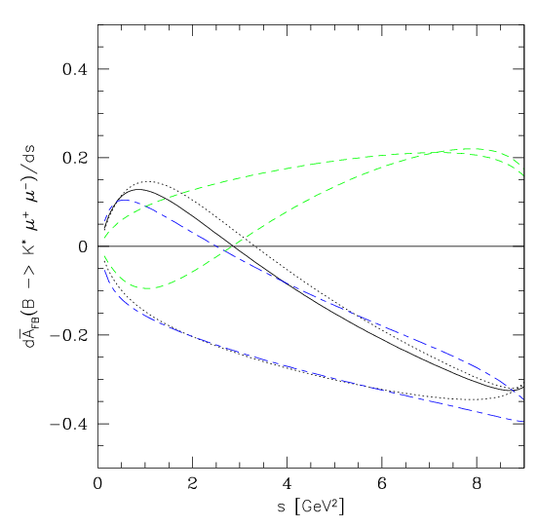
What to Measure?
Angular observables
  Small theory error
  Experimentally accessible
E.g. forward-backward asymmetry of μμ
  Sensitive to interference
  between C₇, C₉ & C₁₀
Plausible NP models
  Large deviations
Zero crossing point (q²₀)
  Accessible with small integrated luminosities (~0.5fb⁻¹)
  Form factors cancel
  at leading order
C₁₀ = -C₁₀SM
A_{FB}
SM
C₇ = -C₇SM
q² (GeV²)
Ali et al, PR D61:074024 (2000)
Notes:
The solid line denotes the SM prediction. The dotted (long-short dashed) lines correspond to the SUGRA (the MIA-SUSY) model, using the parameters given in Eq. (6.4) (Eq. (6.10)) with the upper and lower curves representing the C7 eﬀ < 0 and C7 eﬀ > 0 case, respectively. The dashed curves indicating a positive asymmetry for large s correspond to the MIA-SUSY models using the parameters given in Eq. (6.11), i.e. the ”best depression scenario” with C> 0.

Slide 6
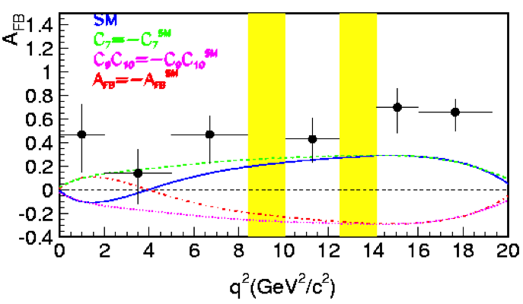
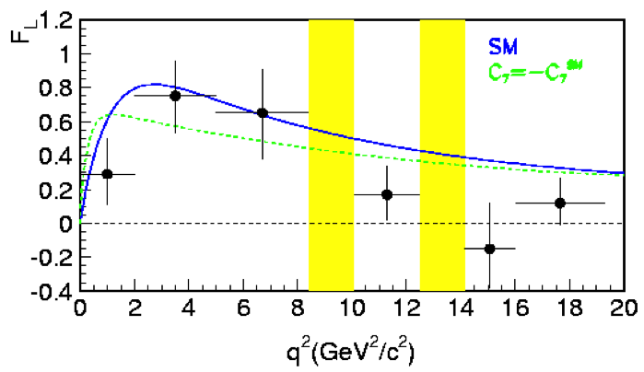
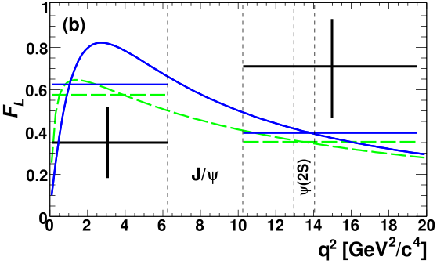
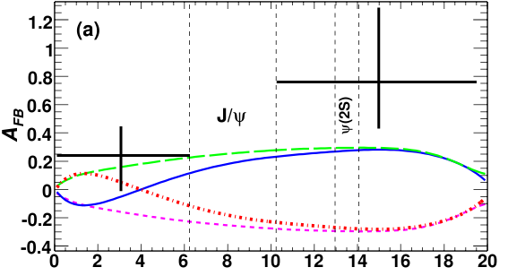
Current Status – Interesting Hints?
Belle (2008) - ICHEP
BaBar (2008) – 0804.4412
Belle 657 BB Pairs
Opposite sign convention w.r.t. LHCb
F_{L} – longitudinal polarization of the K*
BaBar 384 BB Pairs
Notes:
The color scheme is the same for all the plots
Plots of our results for AFB and Fl for the decay B→K∗ℓ + ℓ− showing comparisons with SM (solid); C7=−C SM 7 (longdash); C9C10=−C SM 9 C SM 10 (short-dash); C7 =−C SM 7 ,C9C10 =−C SM 9 C SM 10 (dash-dot). Statistical and systematic errors are added in quadrature. Expected FL values integrated overeachq 2 region are also shown. The FL curves with C9C10 =−C SM 9 C SM 10 are nearly identical to the two curves shown

Slide 7
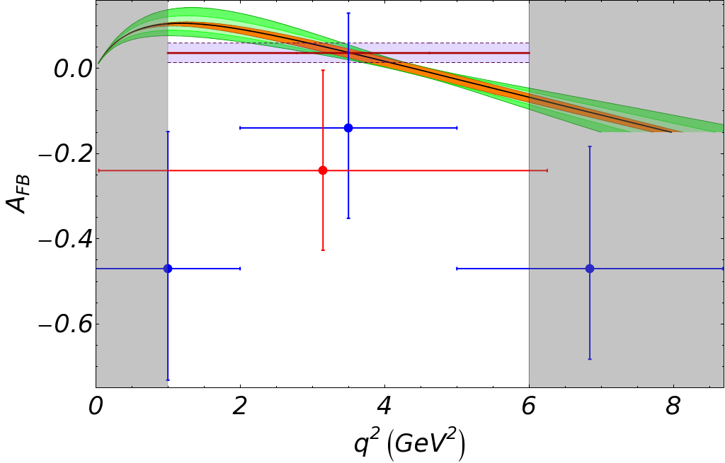
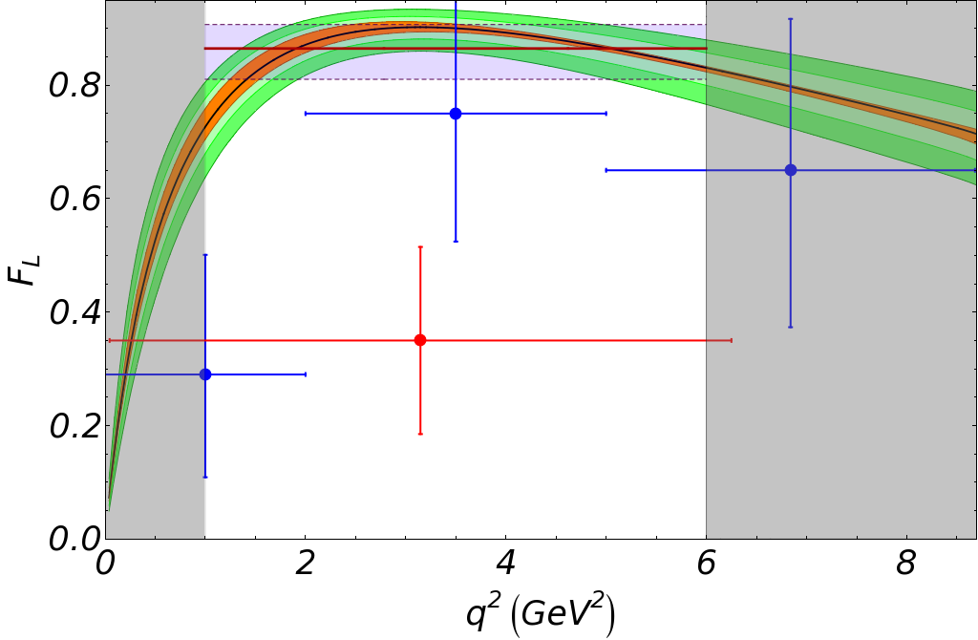
Current Status – Zooming In
Belle (2008) - ICHEP
BaBar (2008) – 0804.4412
AFB
FL
Observables only reliably calculable in q² region 1-6 GeV²/c⁴
Up to LHCb to see what is really going on!
(SM + Errors from arXiv: 0807.2589)
BaBar (2008) ~100 events, Belle (2008) ~ 200 events
Less than 0.1fb⁻¹ will give same statistics as currently available
LHCb (2fb⁻¹) ~ 7.2k events

Slide 8
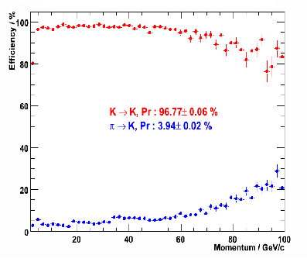
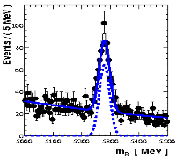
Selecting the Signal at LHCb
Challenging Environment
  LHCb Optimized for B-physics
L0 μ trigger
  μ p_{T} threshold ~ 1GeV
B_{d} vertex res. ~130μm
Track momentum ~0.5%
  B_{d} mass res. ~ 18 MeV
Good μ ID performance key
π/K separation from RICHs

Slide 9
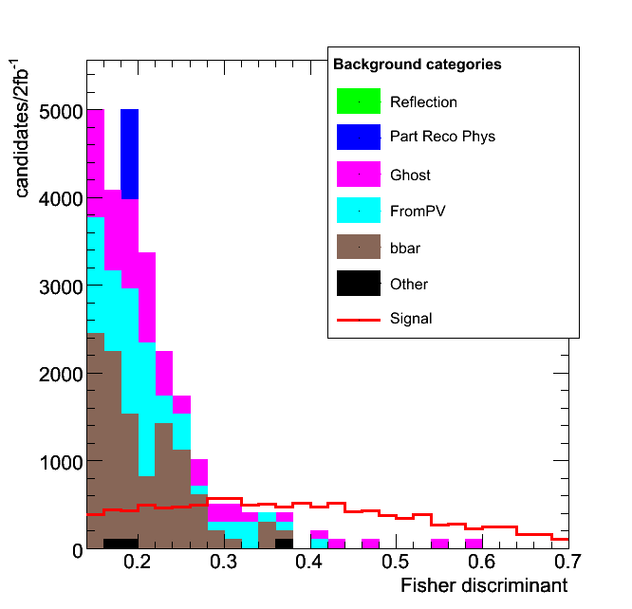
Signal Yields
Latest full MC studies:
  Total selection eff. 1.1%
  ~7.2k per 2fb⁻¹ (full q² range)
    ~3.7k per 2fb⁻¹ (q² < m_{J/ψ}²)
  ~1.1k of background events
    See CERN-LHCb-2007-038
Use multivariate techniques
  B_{d} flight distance, IP,
  PID likelihoods
2 fb⁻¹ is the expected integrated luminosity for one nominal year of smooth LHCb data taking

Slide 10
Background at LHCb
background from:
b→μ b→μ
No. of Events
Dominated by genuine μ from B_{d}
  Little μ mis-ID in MC
dominant contribution
  Symmetric in θ_{l}, scales A_{FB} observed
significant
  Asymmetric in θ_{l}, affects A_{FB}
Non-resonant
thought to be small
  Limits set from
  Will measure in data
θ_{l} / rad
background from:
b→μ + c, c→μ
No. of Events
θ_{l} / rad

Slide 11
Analysis Timeline (2fb⁻¹ means 1 nominal year!)
A_{FB} first – can do a counting experiment
  Zero crossing also accessible
  CERN-LHCb-2007-039
Perform fits to decay angles → F_{L}, A_{T}⁽²⁾
  Fit just to θ_{l} or all three angles
  CERN-LHCb-2007-057
Full angular analysis
  Many observables + improved resolution
Steps limited by understanding not statistics
0.5 – 2 fb⁻¹
2 – 4 fb⁻¹
3 – 10 fb⁻¹

Slide 12
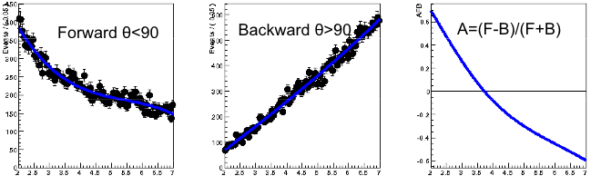
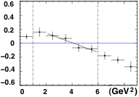
Counting Experiments for AFB
Binned in q²
Simple Counting
Can extract A_{FB} by counting
forward and backward μ
  Relatively simple
  Requires only small integrated
  luminosity
Allows zero-crossing extraction
  σ(q²₀) ~ 0.8 GeV²/c⁴ (0.5 fb⁻¹), 0.5 GeV²/c⁴ (2 fb⁻¹)
σ(q²₀) α A_{FB} gradient
Find A_{FB} from
polynomials
Useful cross-check
between methods
+ more robust
Unbinned in q²
Beyond Simple
Counting
Fit polynomials
Notes:
Here I need to present the two methods as being a useful cross-check for each other. The binned approach will be easier to calibrate, but the unbinned approach will produce slightly better results once the systematics have been understood.

Slide 13
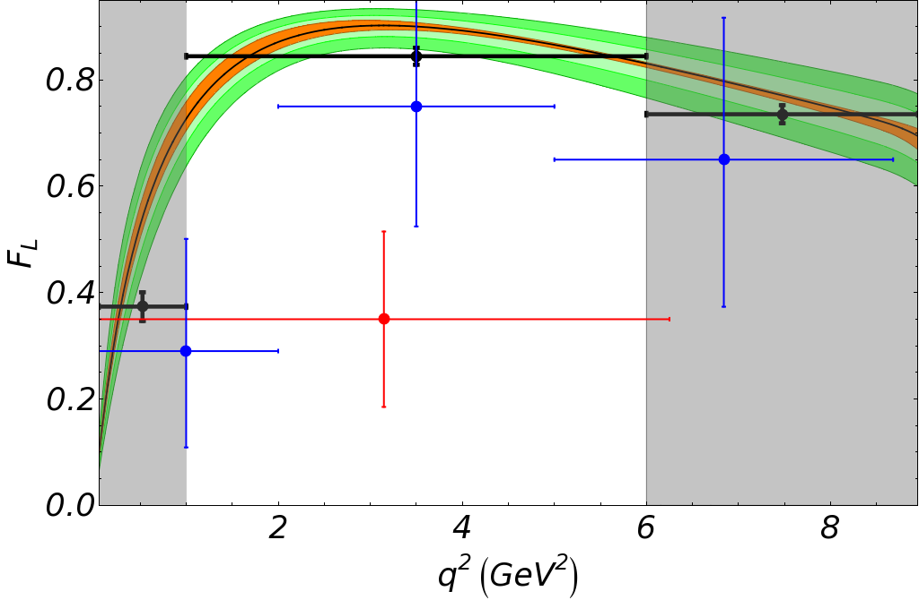
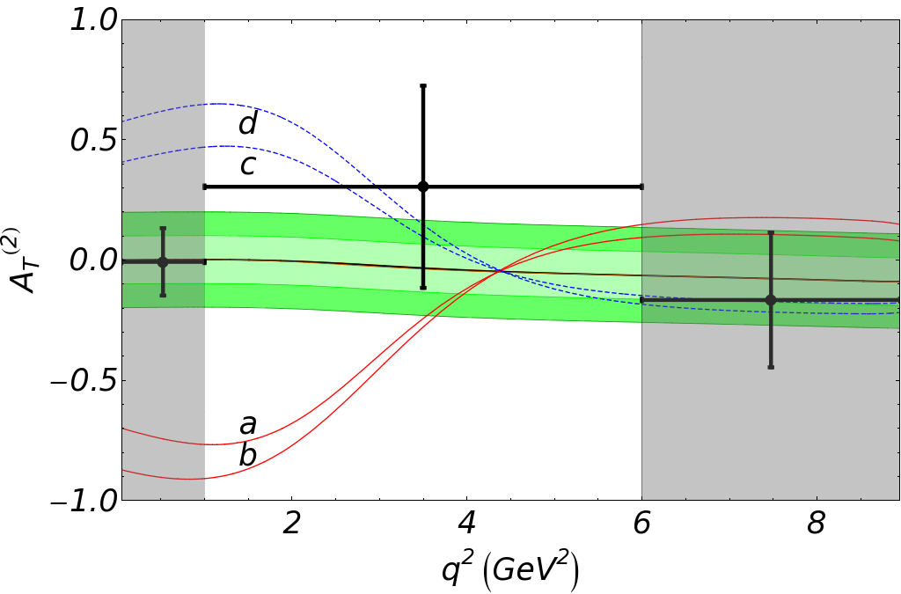


Projection Fits
Three decay angles → beyond θ_{l}
  Angular projections of θ_{l}, φ, θ_{K} dist.
Perform simultaneous fit in q² bins
Improve precision on A_{FB} by ~2
F_{L} precision also improved
Measure new observable A_{T}⁽²⁾
with poor resolution in 1-6 GeV²/c⁴
region due to (1-F_{L}) suppression
SM input
+ errors
LHCb 2fb⁻¹ BaBar Belle 08
[CERN-LHCb-2007-057]
[Lunghi et al, JHEP 0704 (2007) 058]

Slide 14


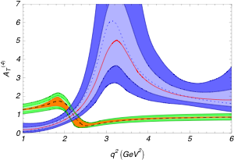

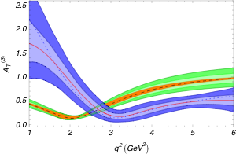
Full Angular Analysis
SM Theory Distribution
Toy fits to SUSY model b (C’₇ != 0) 1, 2σ
CERN-LHCb-2008-041
arXiv 0807.2589
parameterized by
K* spin amplitudes
Perform fit for amplitudes
  Assume polynomial q² variation
Calc. observables from amplitudes
  New observables A_{T}⁽³⁾ A_{T}⁽⁴⁾
  10fb⁻¹ sensitivities for SUSY input
    JHEP 0704 (2007) 058 – model ‘b’
MC Fits converge with 2fb⁻¹
  Acceptance a challenge
LHCb 10fb⁻¹

Slide 15
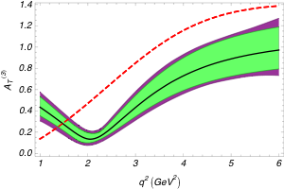
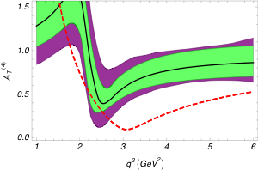
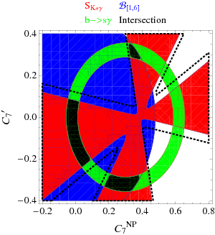
Finding NP in C₇
A_{T}⁽³⁾
TH + LHCb 10fb⁻¹
Egede, Hurth,
Matias, Ramon,
WR. Preliminary
SM
A_{T}⁽⁴⁾
TH + LHCb 10fb⁻¹
(0.083,-0.21)
Allowed regions - C₇ real
JHEP 0807:106,2008
After 10fb⁻¹ FA analysis?

Slide 16

Summary
Excellent prospects for discovery of NP
  Hints from B-factories + theory
Expect 7.2k signal events per year
over whole q² range
Exciting Physics program
Many observables to study
  Counting experiments, projections, full angular
  Real discriminating power for NP
Exciting times ahead!

Slide 17

Back UP Slides

Slide 18
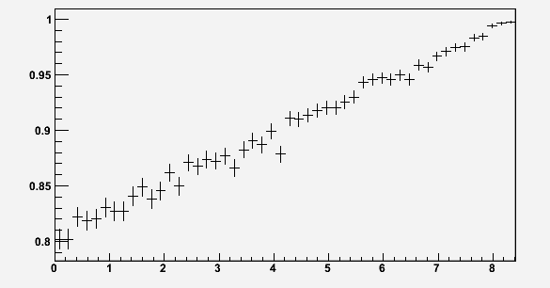
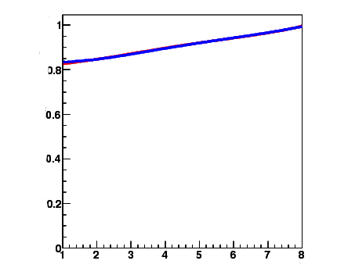
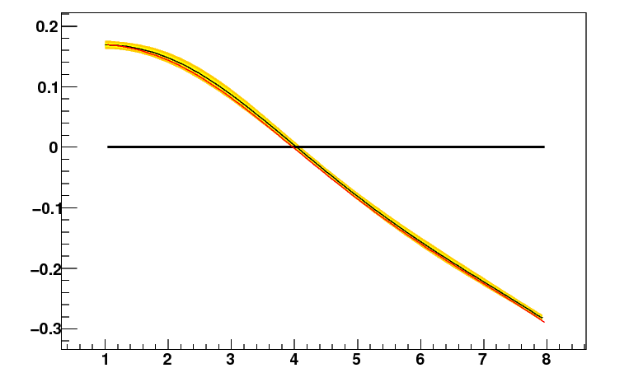
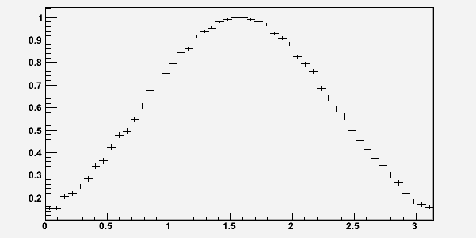
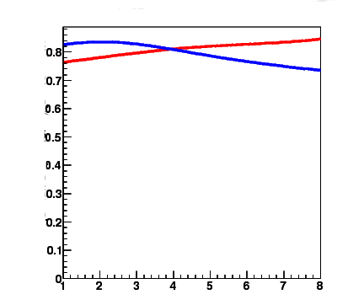
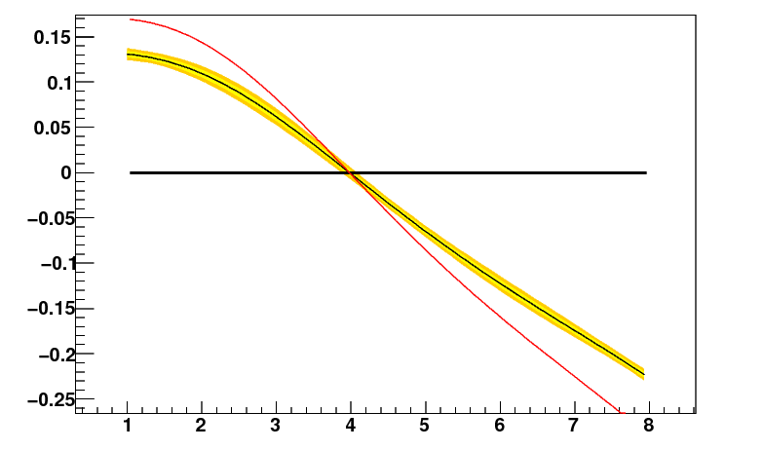
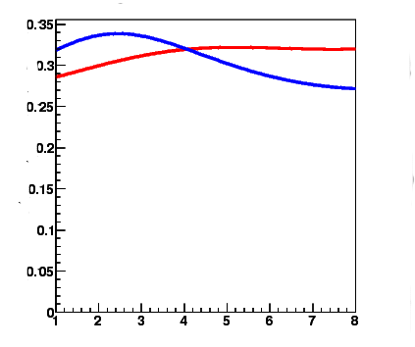
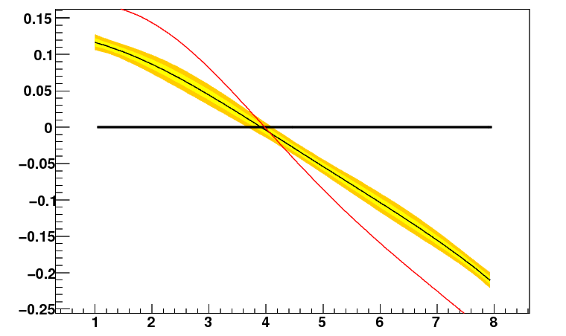
Acceptance Effects for A_{FB}
ε backward
A_{FB}
ε forward
Efficiency ε / a.u.
Efficiency ε / a.u.
q²/GeV²
q²/GeV²
q²/GeV²
ε backward
A_{FB}
Input
ε forward
Efficiency ε / a.u.
Efficiency ε / a.u.
output
θ_{l}/rad
q²/GeV²
q²/GeV²
ε backward
A_{FB}
In all cases, no bias on 0-pt
ε forward
Efficiency ε / a.u.
Efficiency ε / a.u.
θ_{K}/rad
q²/GeV²
q²/GeV²
Take toy efficiencies for q², θ_{l}, θ_{K}
  θ_{K} biases A_{FB} even though are only using θ_{l} directly

Slide 19
Outside the Theoretically Clean Region
B → Vector form factors large source of theoretical uncertainty
  Dominated by low energy effects
  7 independent functions of q² – V, T_{1,2,3}, A_{0,1,2}
Use SCET to reduce 7→ 2 at Leading Order
  Only valid in range 1-6 GeV²/c⁴
  Can not handle resonances or low q² region
Observables where 2 remaining FF cancel
  A_{T}^{(2,3,4)} and AFB zero-crossing point
Uncertainties outside region much greater
See Beneke et al, Nucl. Phys. B612 (2001) 26-58

Slide 20
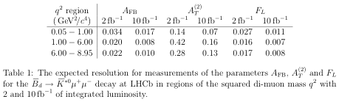
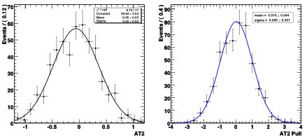
Projection Fit Resolutions
Results from CERN-LHCb-2007-057

Slide 21





Observables

Slide 22
Drell-Yan Backgrounds
Not significant background at LHCb
Full simulation study:
  decays dominant source of μμ in mass range
  Drell-Yan production much lower
Reconstruction Efficiency:
  Fake signal → need a K* from elsewhere
  Wrongly associate this with μμ vertex
  Miss-ID rate should be very low

Slide 23
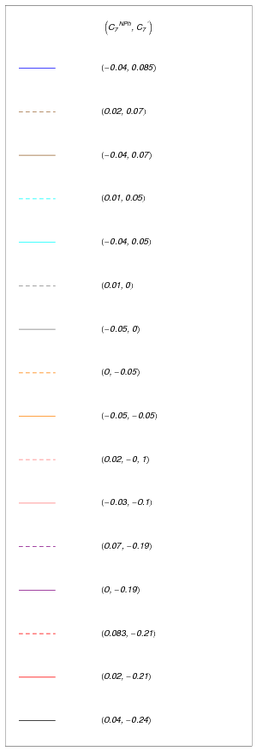
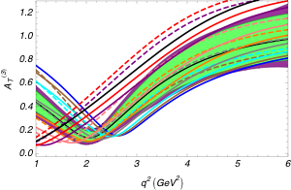
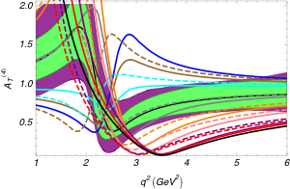
NP in C₇ Legend

Slide 24
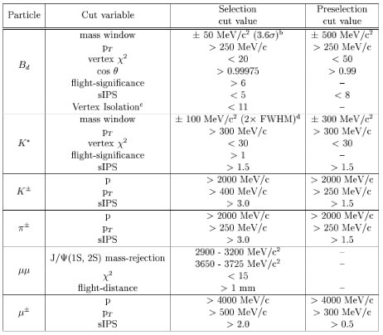
Selection Cuts from LHCB-2007-038

Slide 25

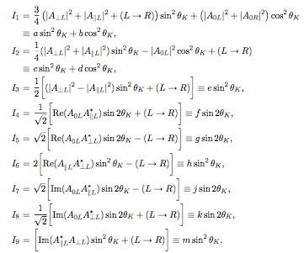
Angular Distribution

Slide 26
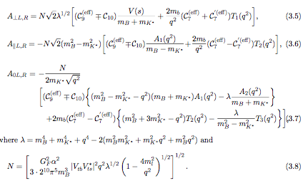
Physics Sensitivity to K* Spin Amplitudes

Slide 27
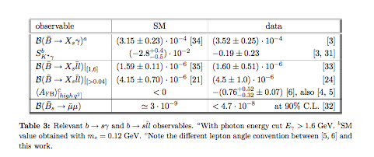
Experimental Constraints for C7 Plot

