Slide 1
Operational Experience with
Phase Switches
Piotr Skowroński

Slide 2
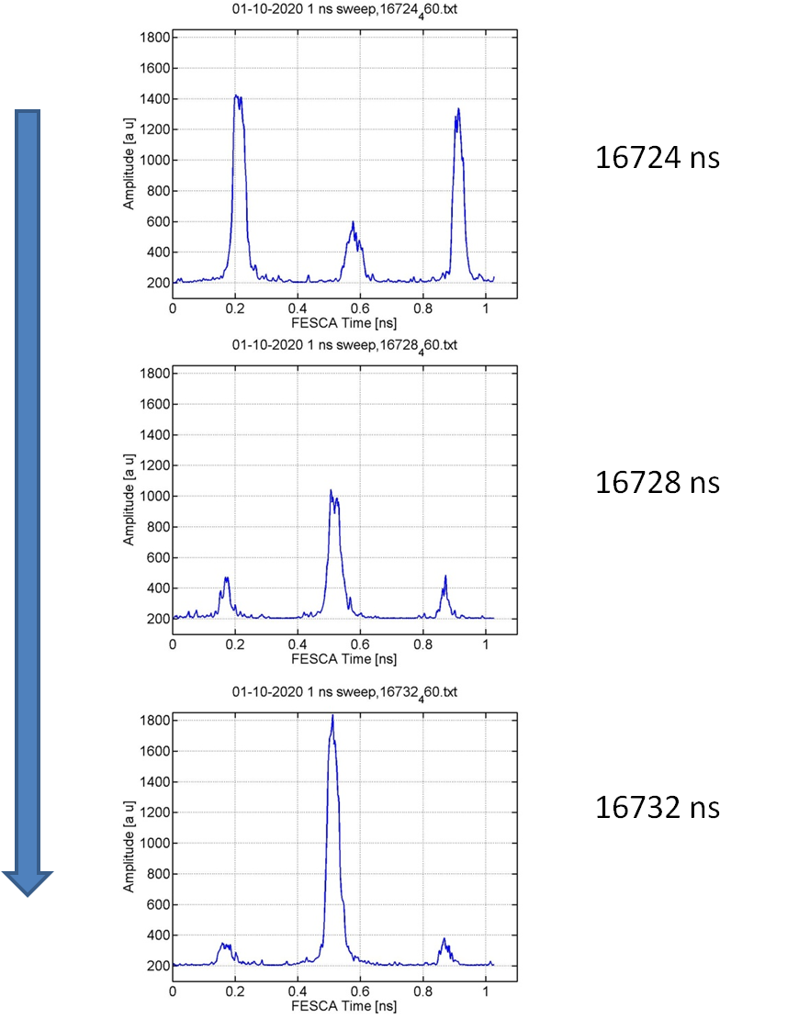
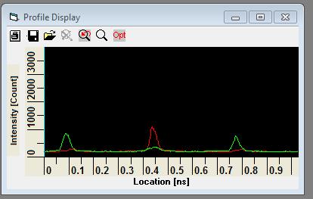
PHASE SWITCH IS FAST, below 10ns
Fri 01-10-10 Streak Camera measurements
Streak camera data under the following link
https://ab-dep-op-elogbook.web.cern.ch/ab-dep-op-elogbook/elogbook/secure/attach.php?attachId=1111118&type=zip&fname=1n.zip
think we found the phase switch
we think that the phase switch occurs over 7/8 ns {to be checked offline}
measured from: 16724 460 to 16742 460
Misplaced?

Slide 3
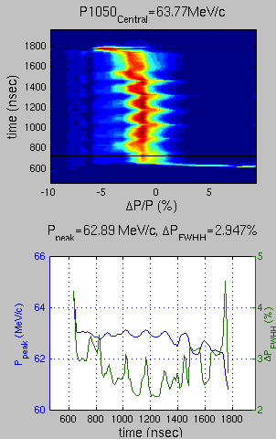
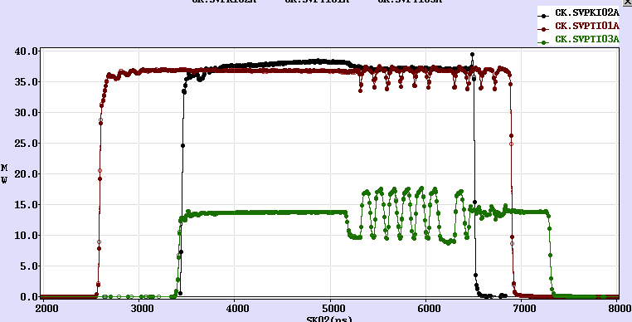
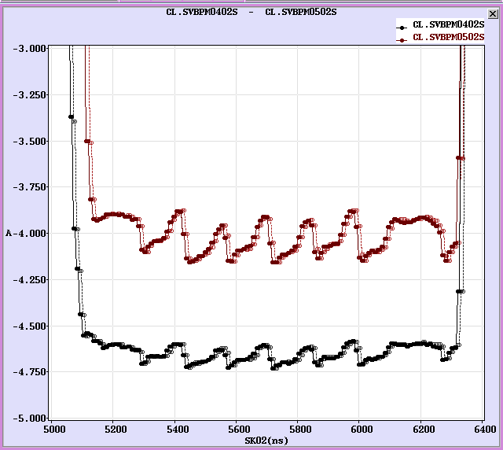
After phase switch we observe more than 100ns transient on
TWT output (only if beam present)
SHB output (only if beam present)
Bunch length
Beam current (capture efficiency)
It gives effect on energy
And position in dispersive sections
Pulse needs more space

Slide 4
Beam energy

Slide 5
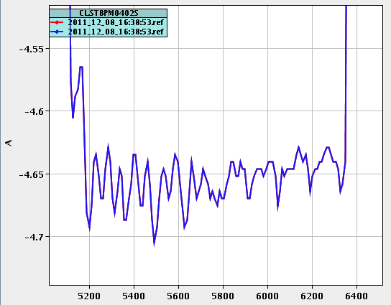
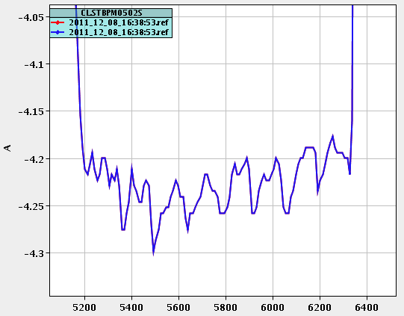
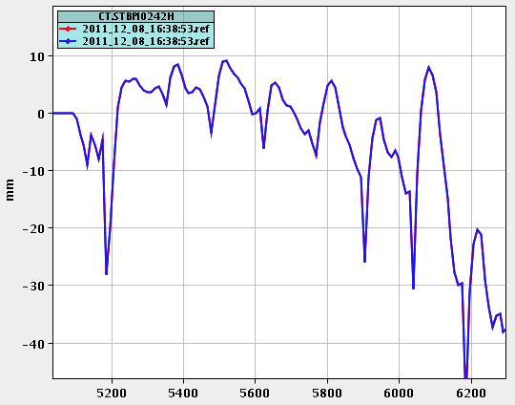
Beam current, 2011 factor 8 ref

Slide 6
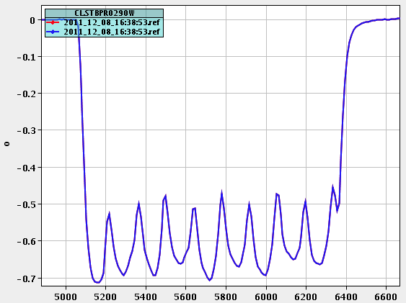
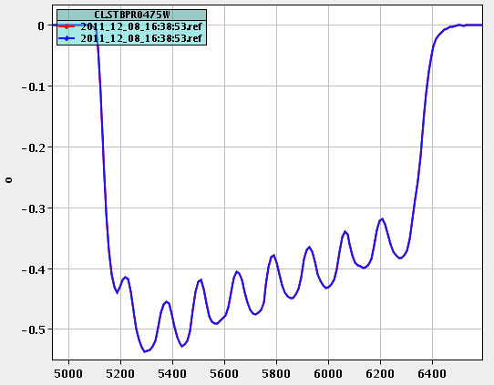
BPR-W

Slide 7
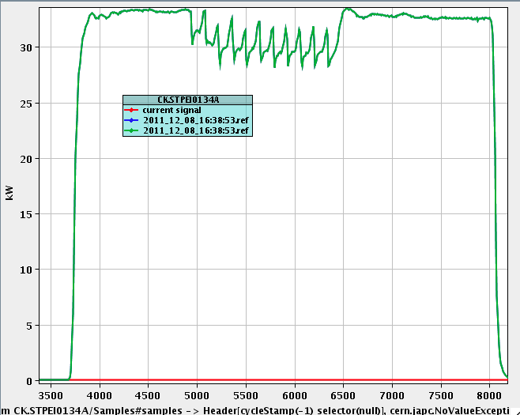
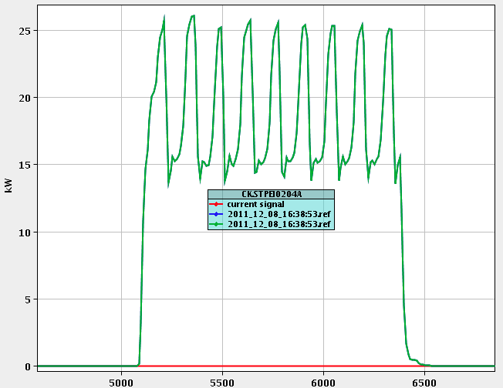
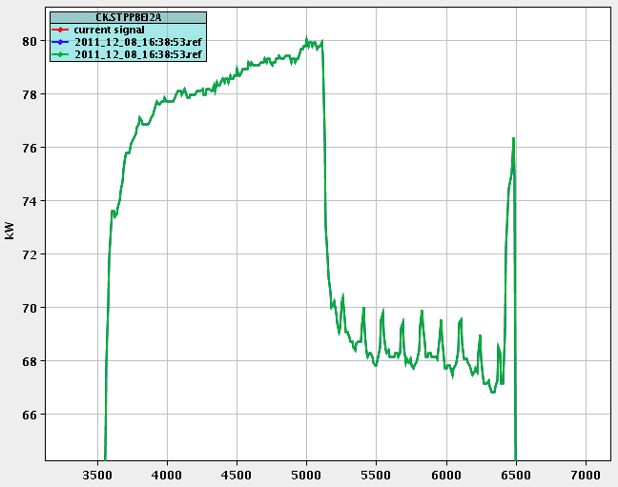
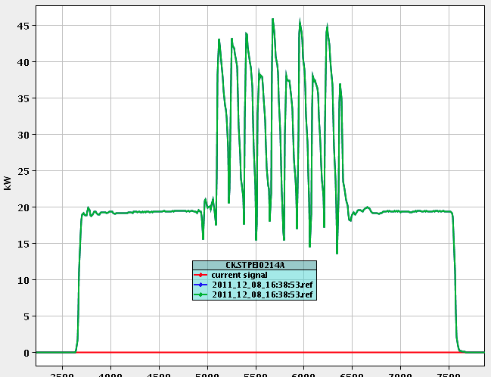
Cavity Exit, 2011 factor 8 ref
Pre-Buncher

Slide 8
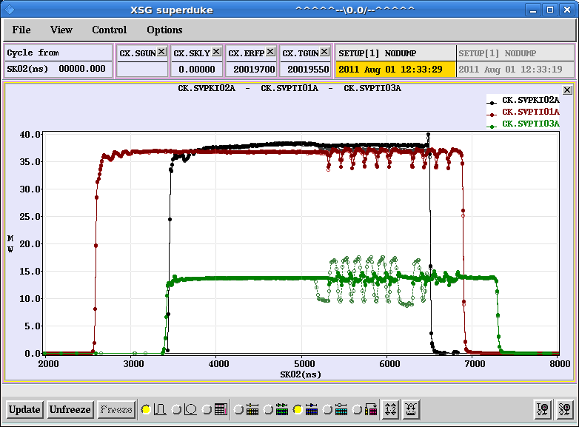
TWT exit, w. and w.o. beam
No change on TWT1
Big change on TWT3
  Related to beam loading

Slide 9
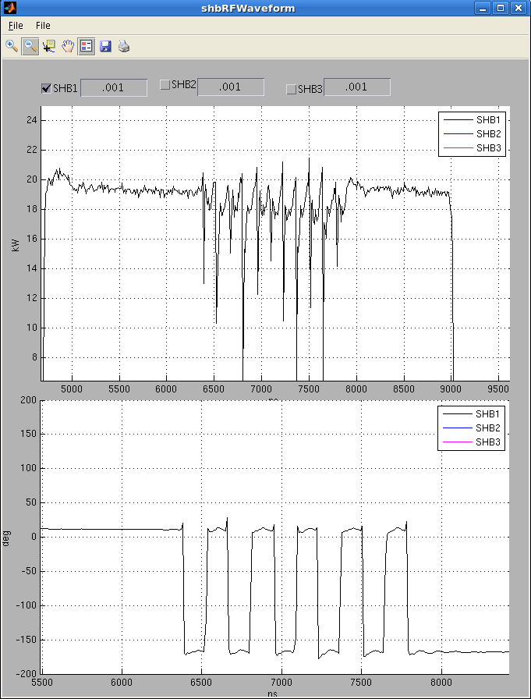
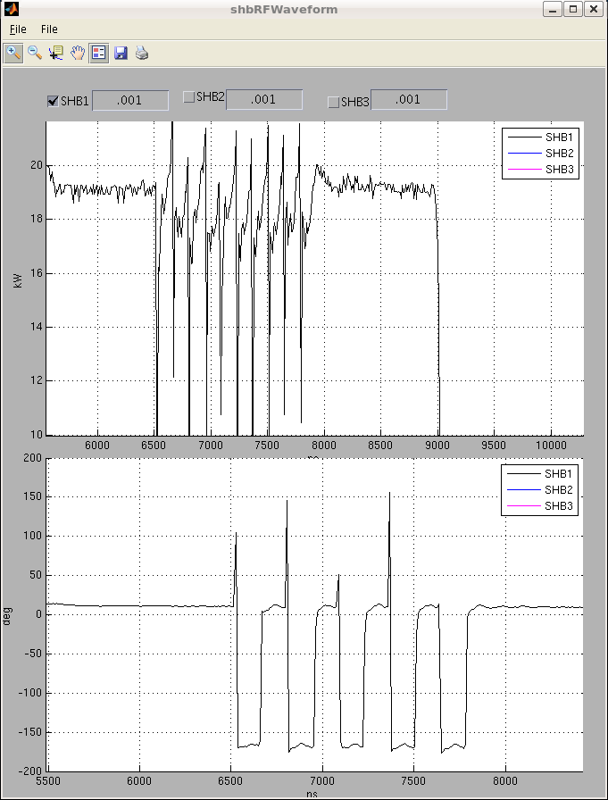
IQ measurement
Monday 19-Sep-2011

Slide 10
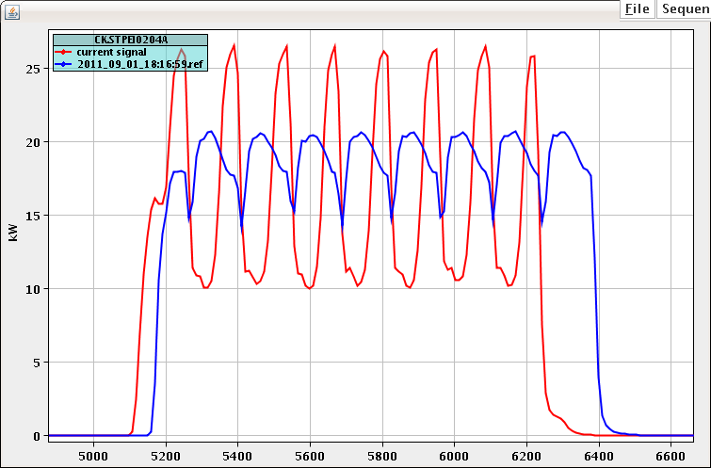
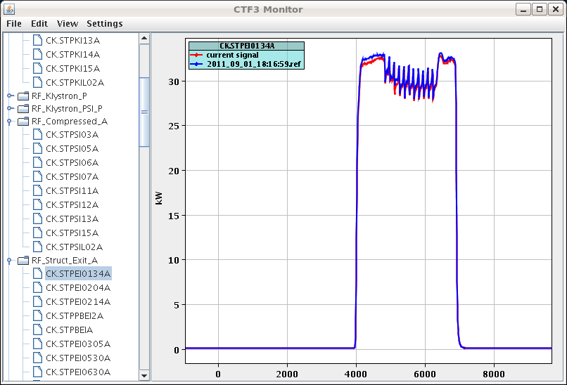
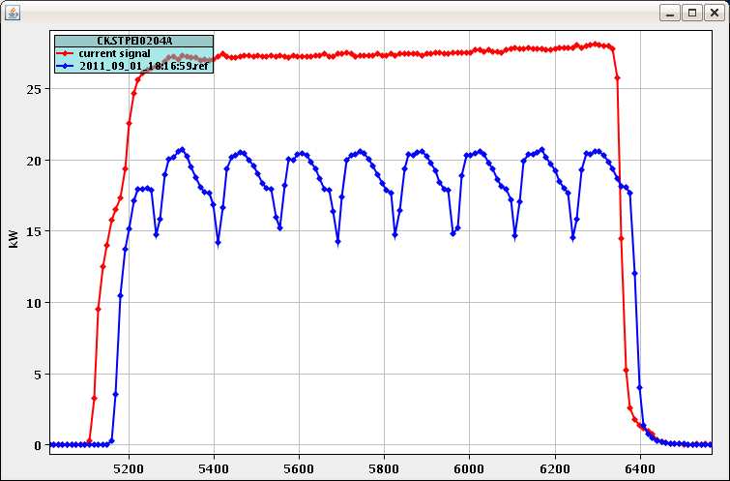
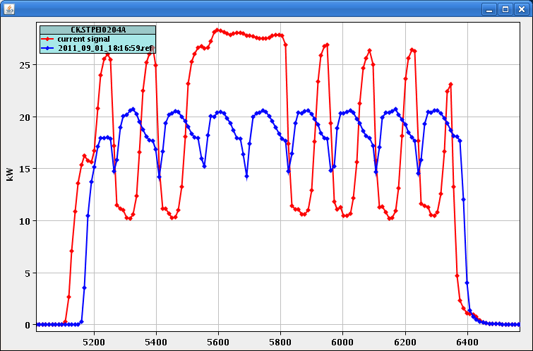
SHB exit, effect depends on phase
Friday 09-Sep-2011

Slide 11
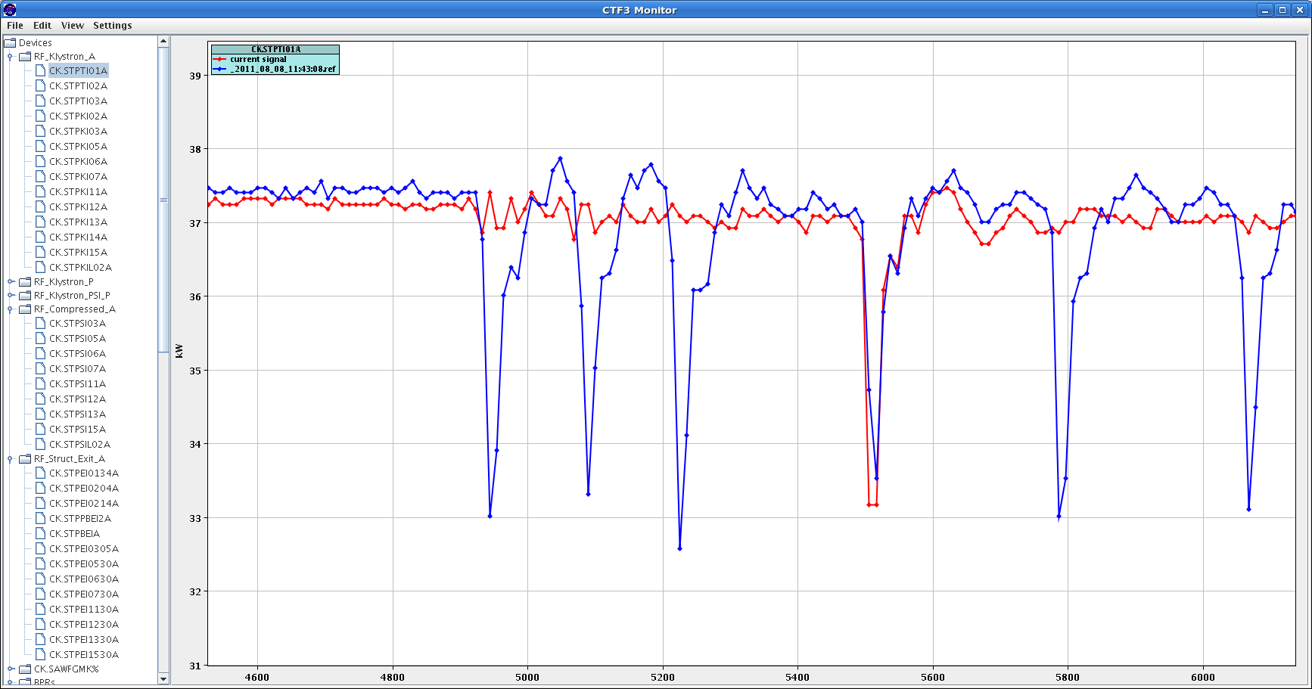
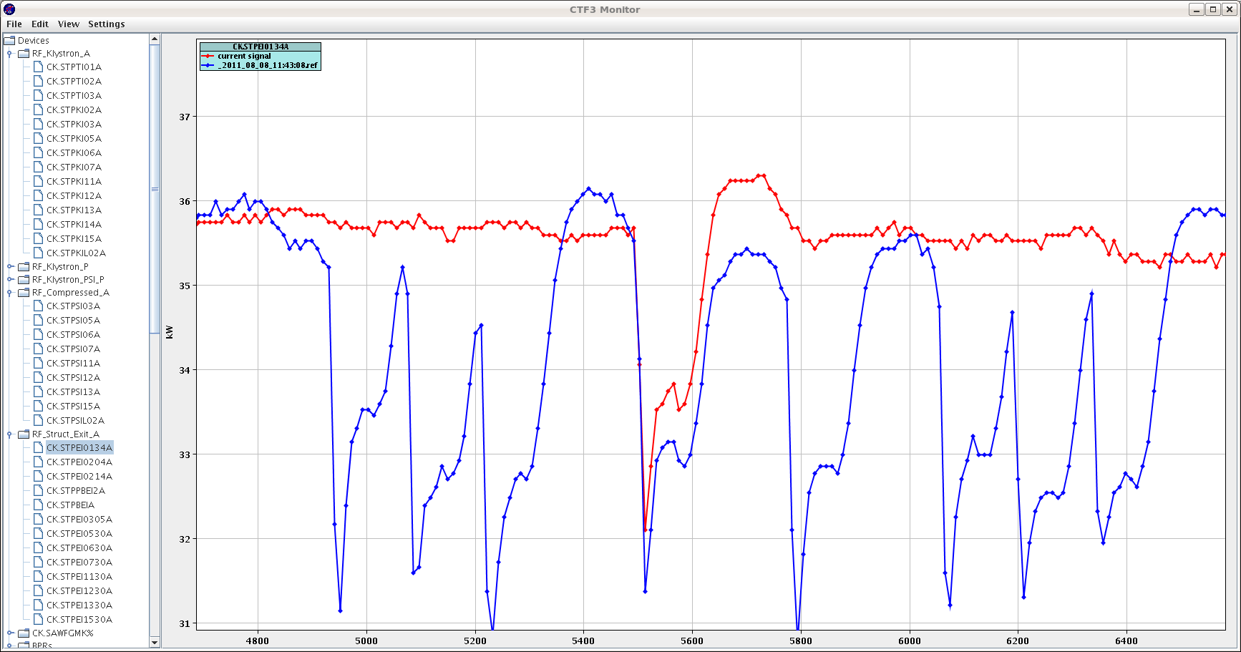
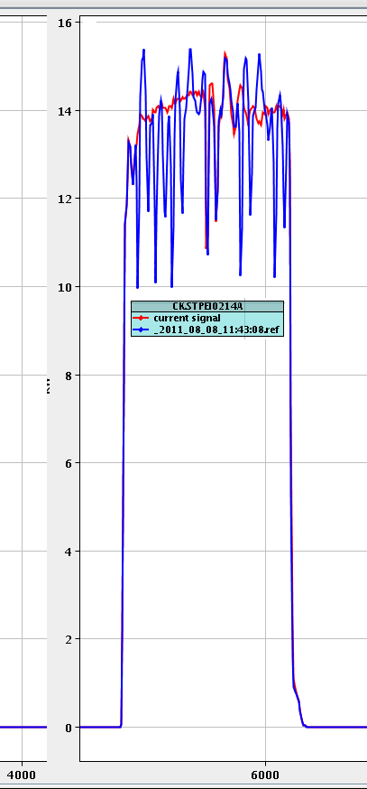
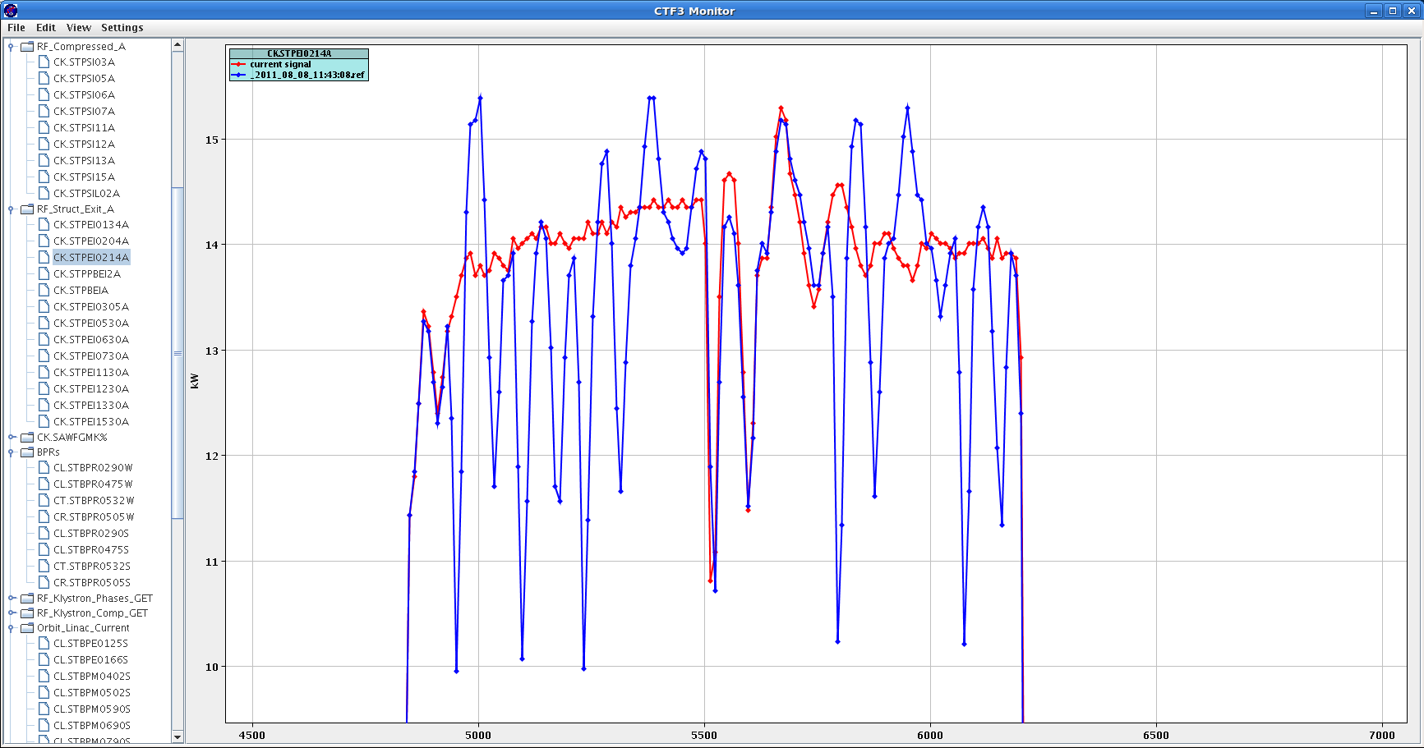
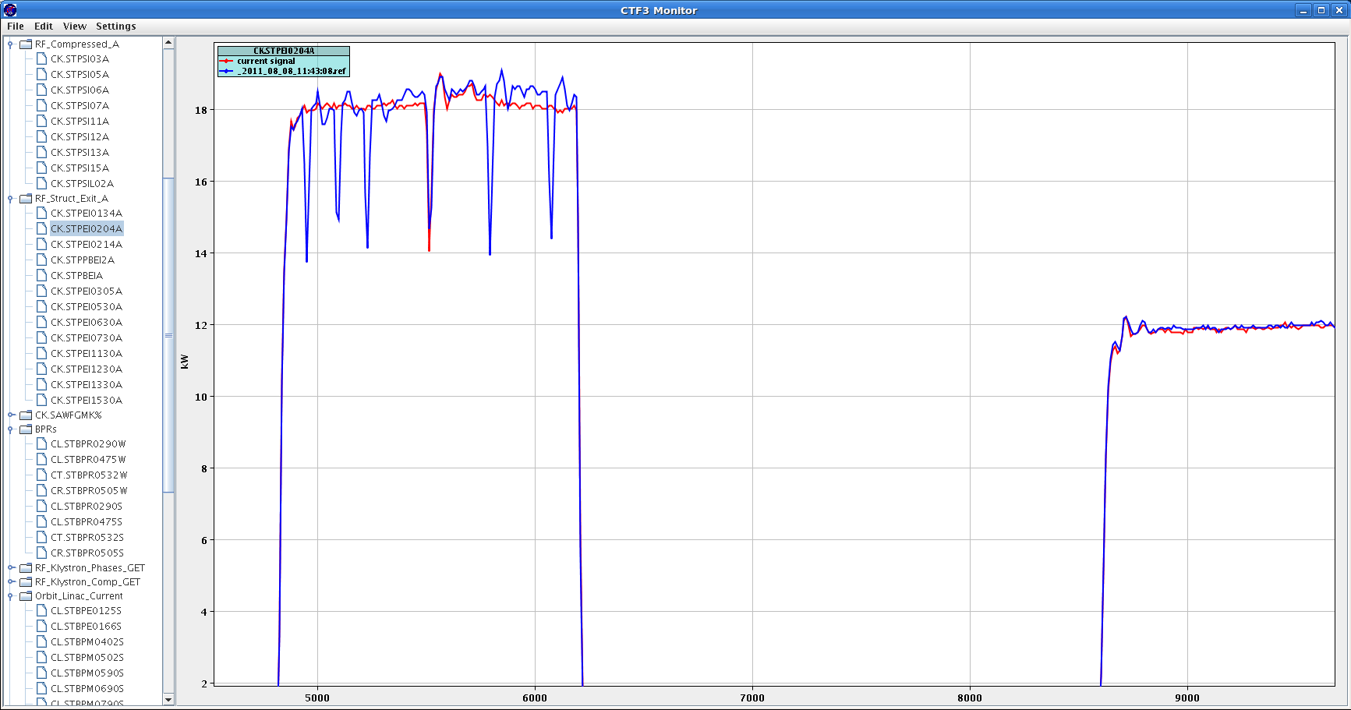
08-Aug-2011 Just one switch with only first SHB. (PS FT)
Ringing after a switch can take as long as 500ns

Slide 12
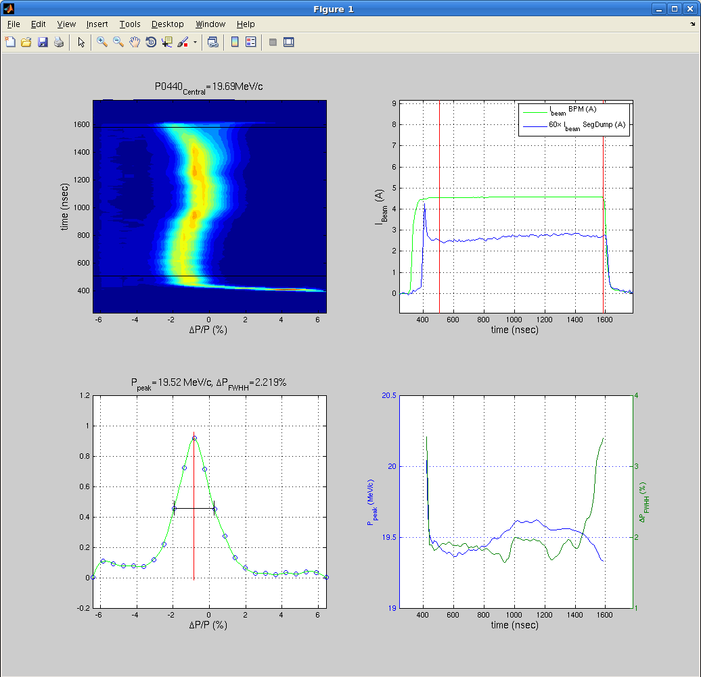
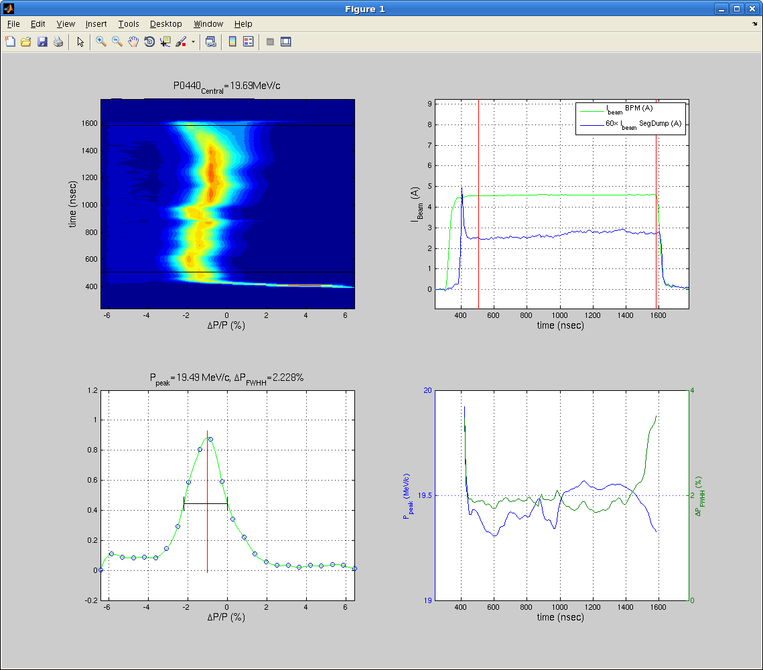
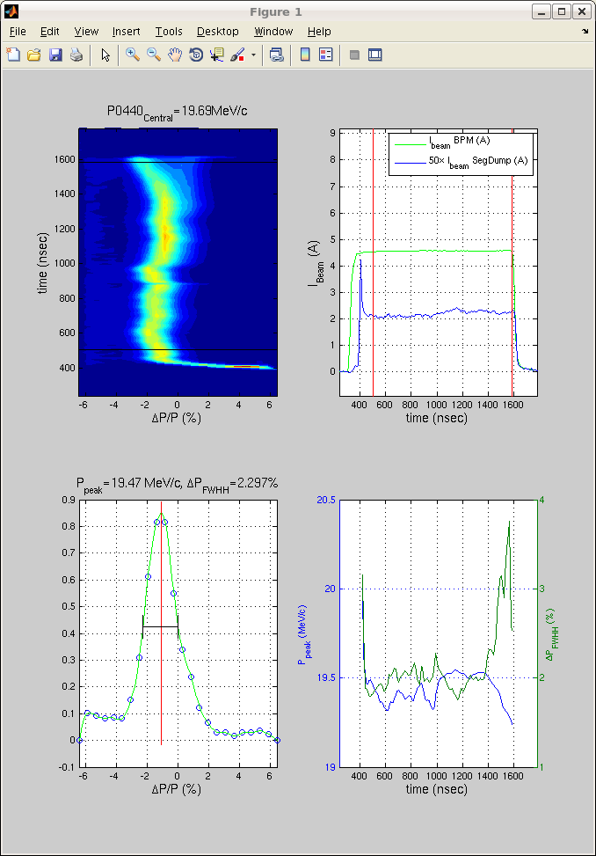
Fri 29-07-11 The same as previous, Spectro 4
No switch
1 switch in

Slide 13
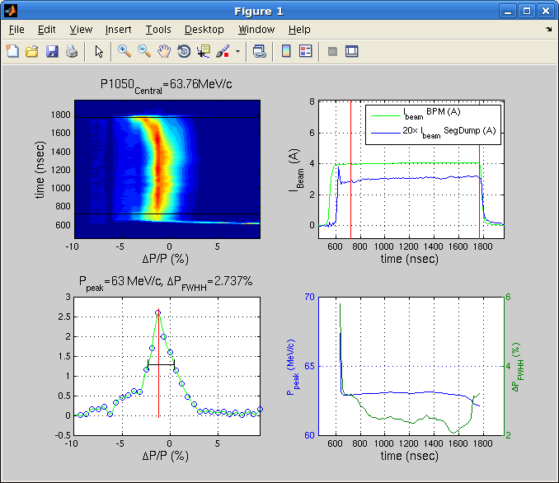
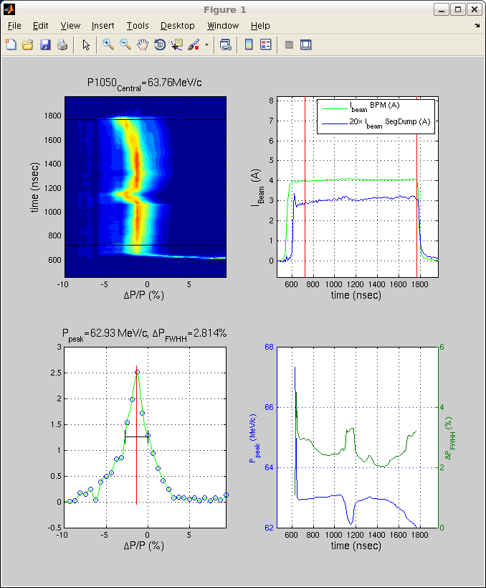
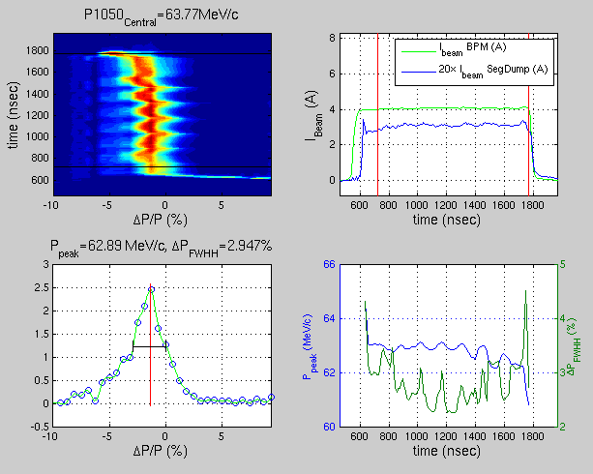
Fri 29-07-11 The same as previous, Spectro 10

Slide 14
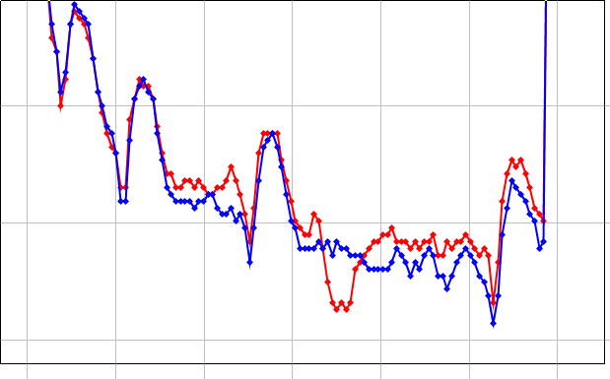
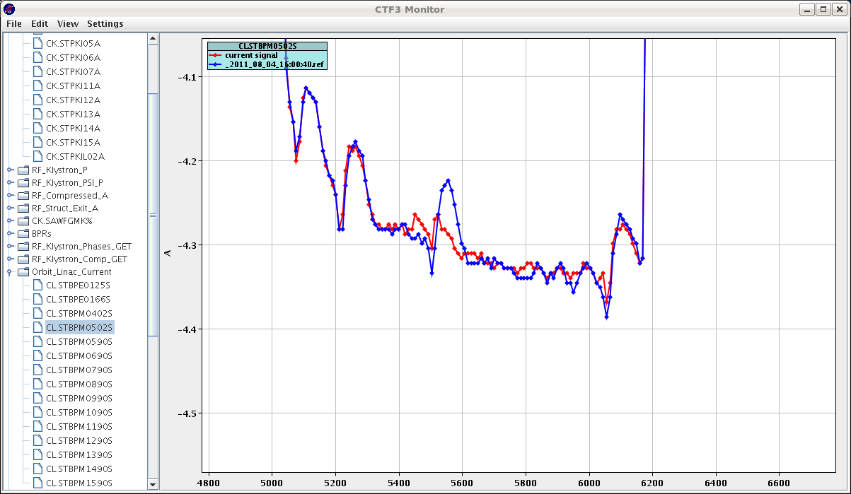
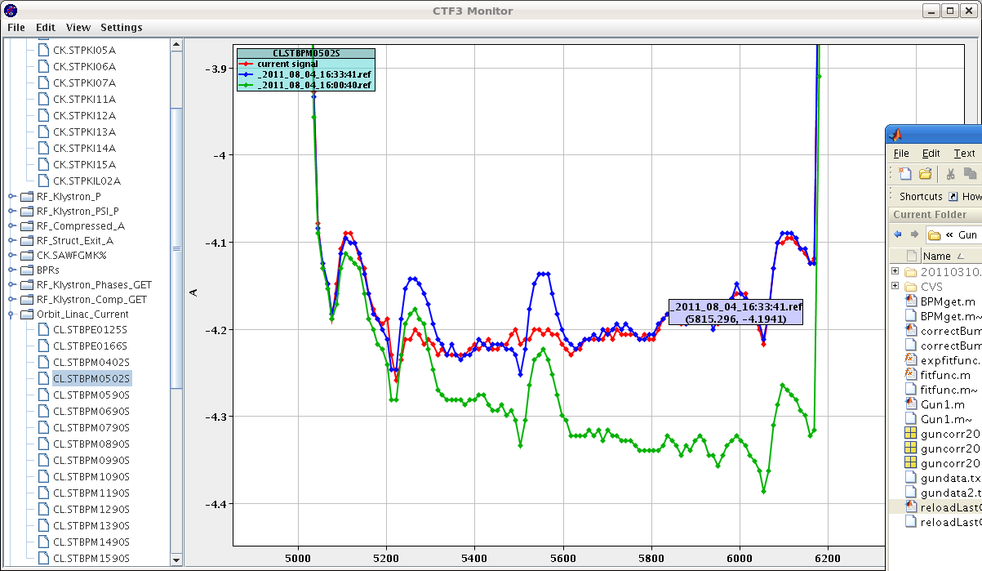
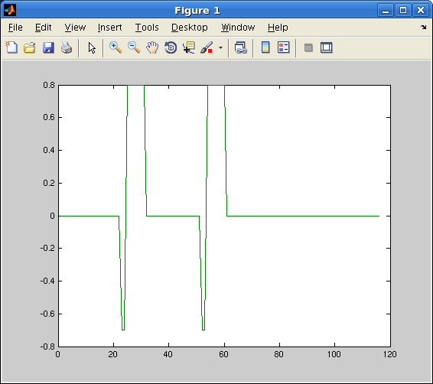
Corrections from the gun
2 spike corrected

Slide 15
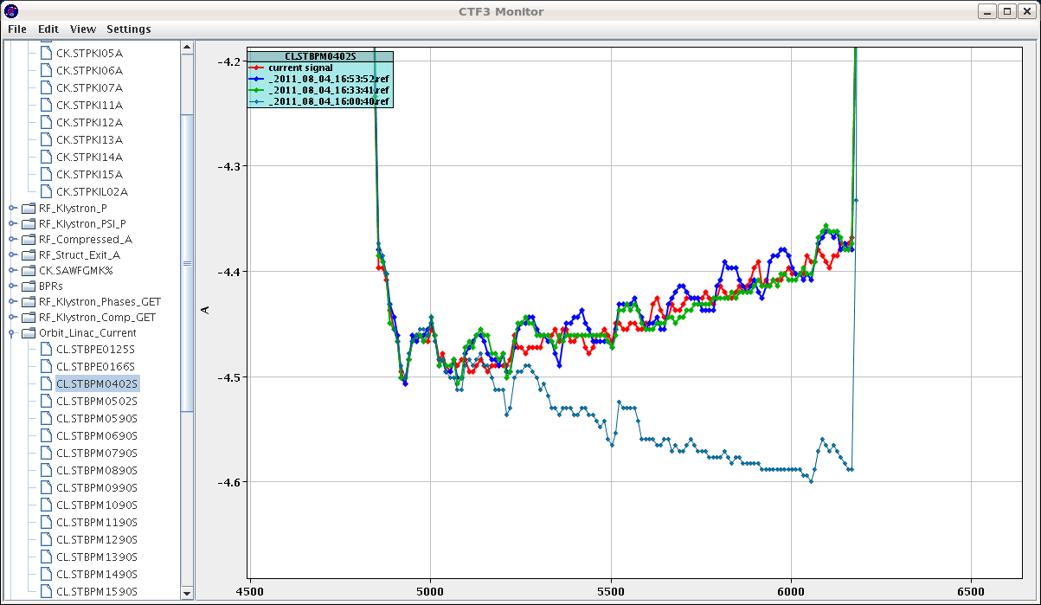
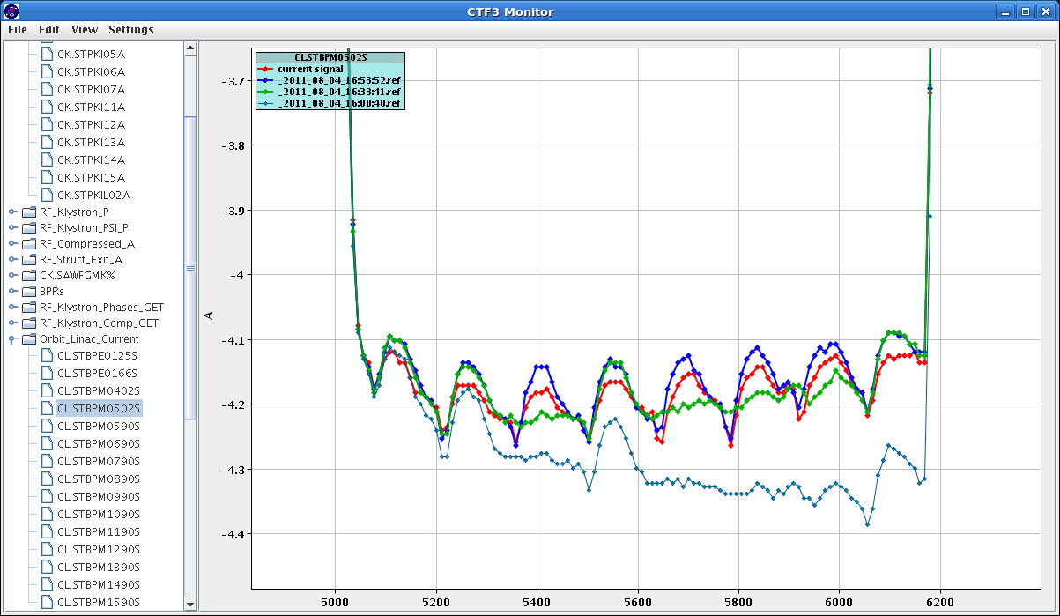
Corrections from the gun
402 with switches and with correction

Slide 16
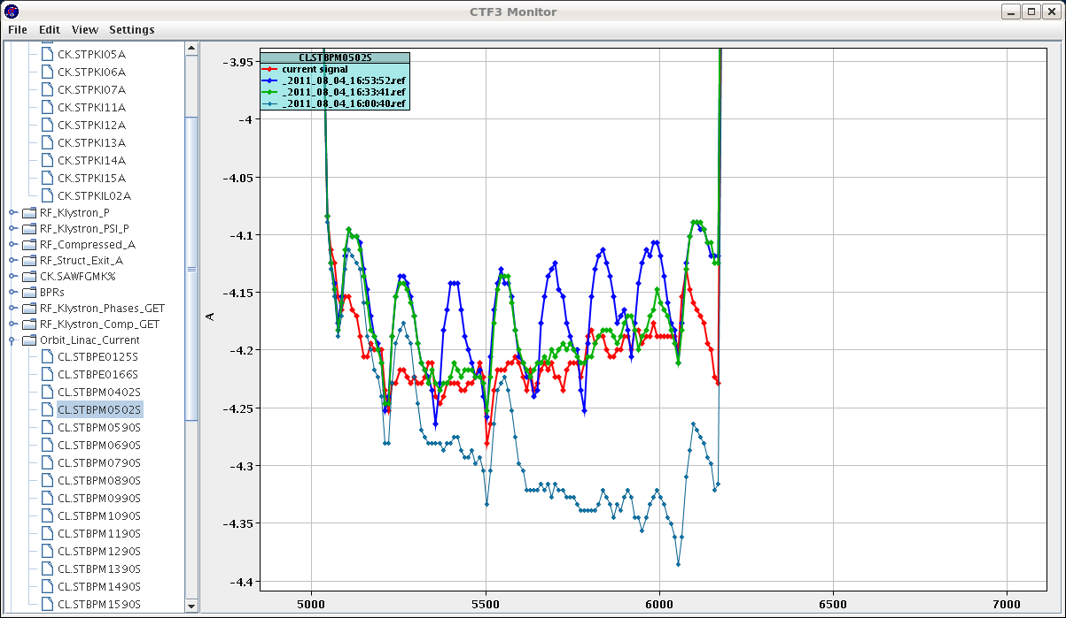
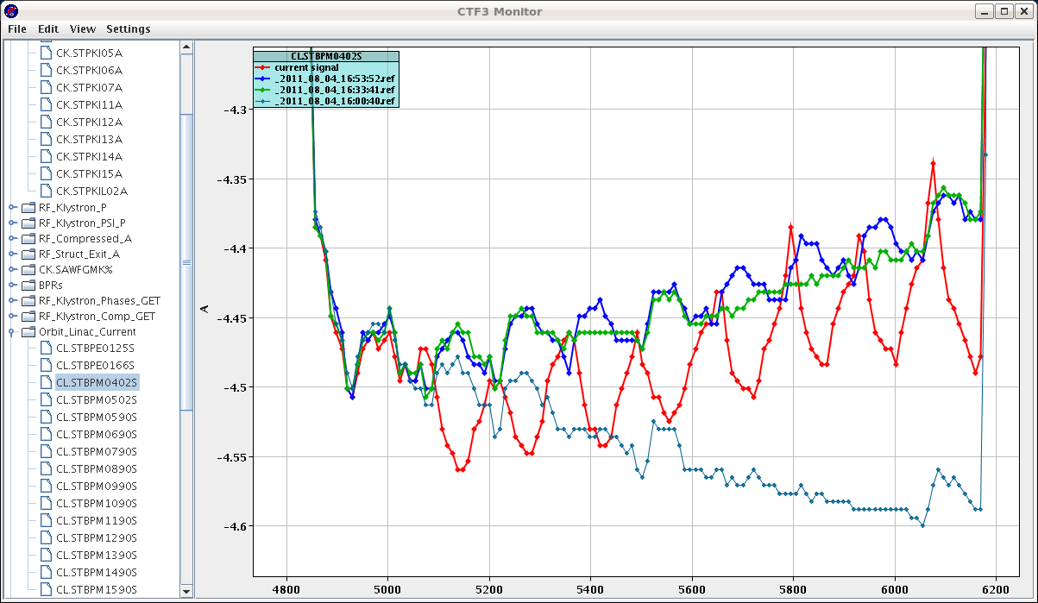
Corrections from the gun
To get 502 flat we have to overcompensate 0402

Slide 17
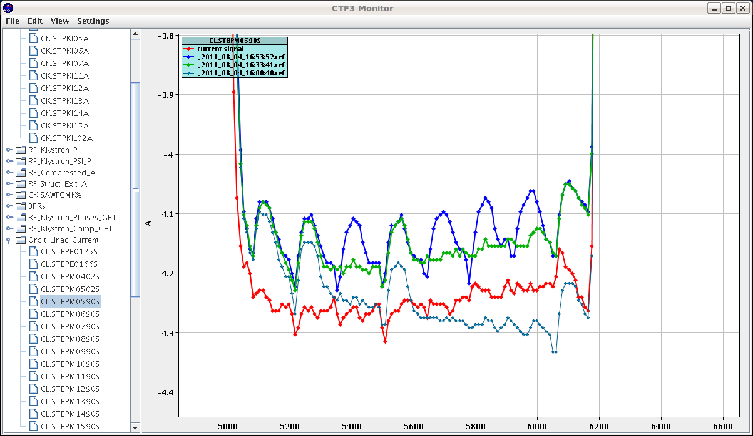
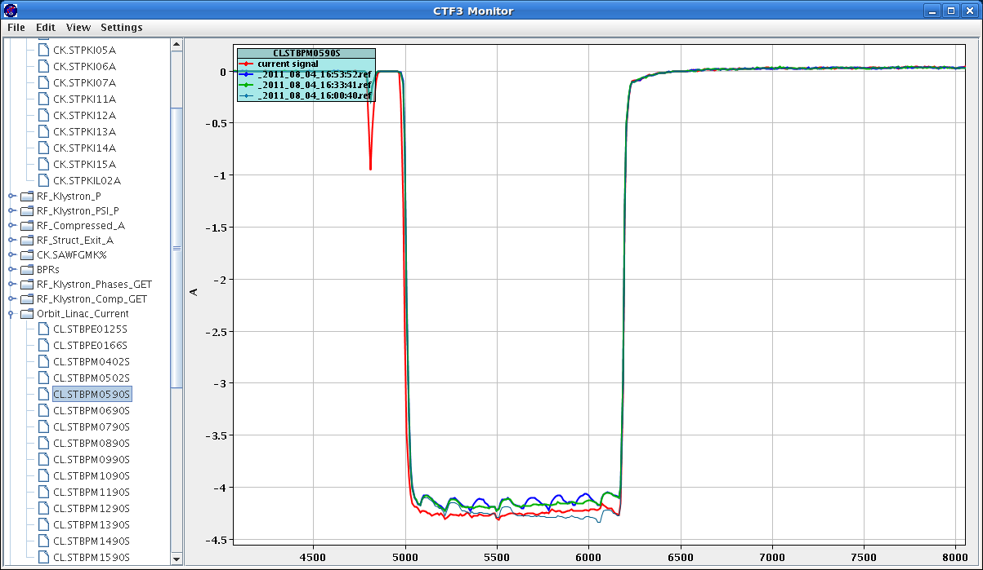
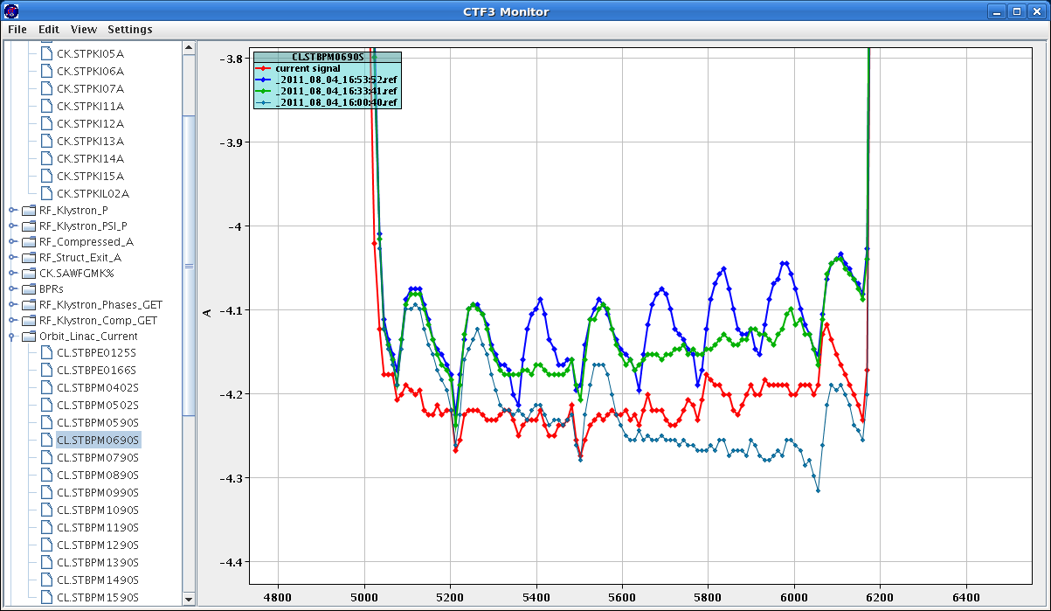
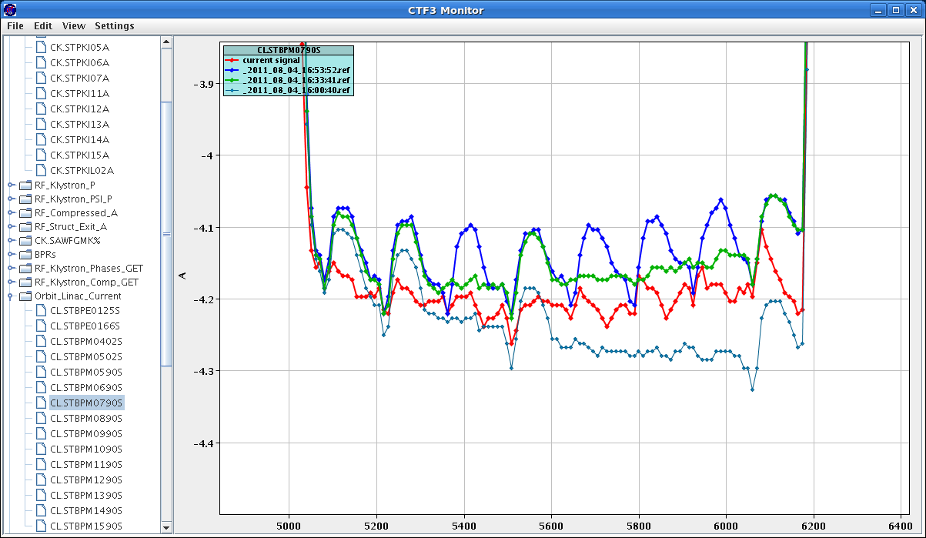
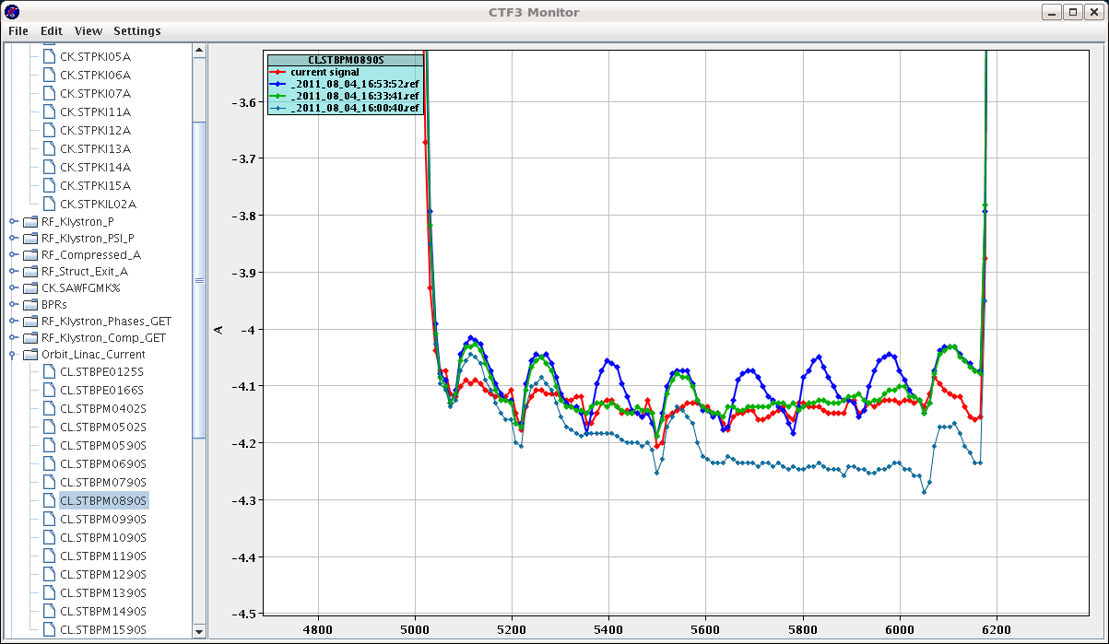
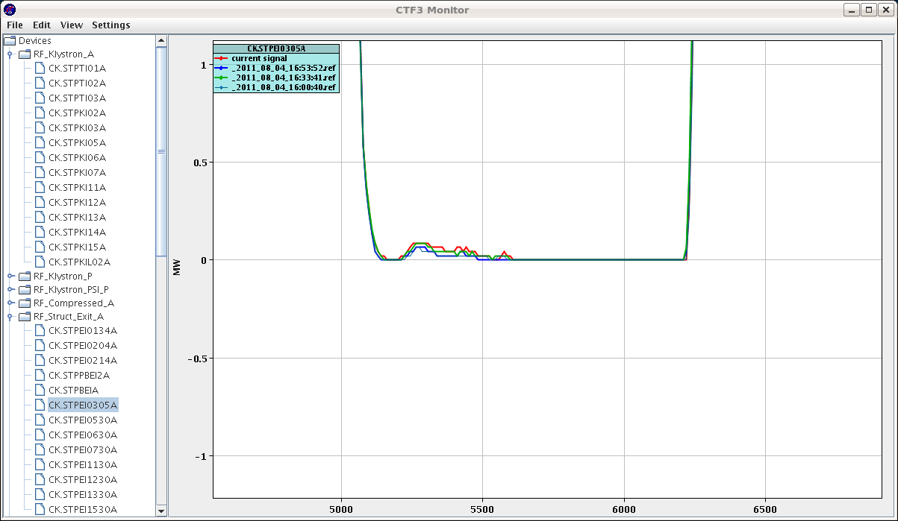
Corrections from the gun
At the moment the gun has no range to correct both, the droop and the switches effect

Slide 18
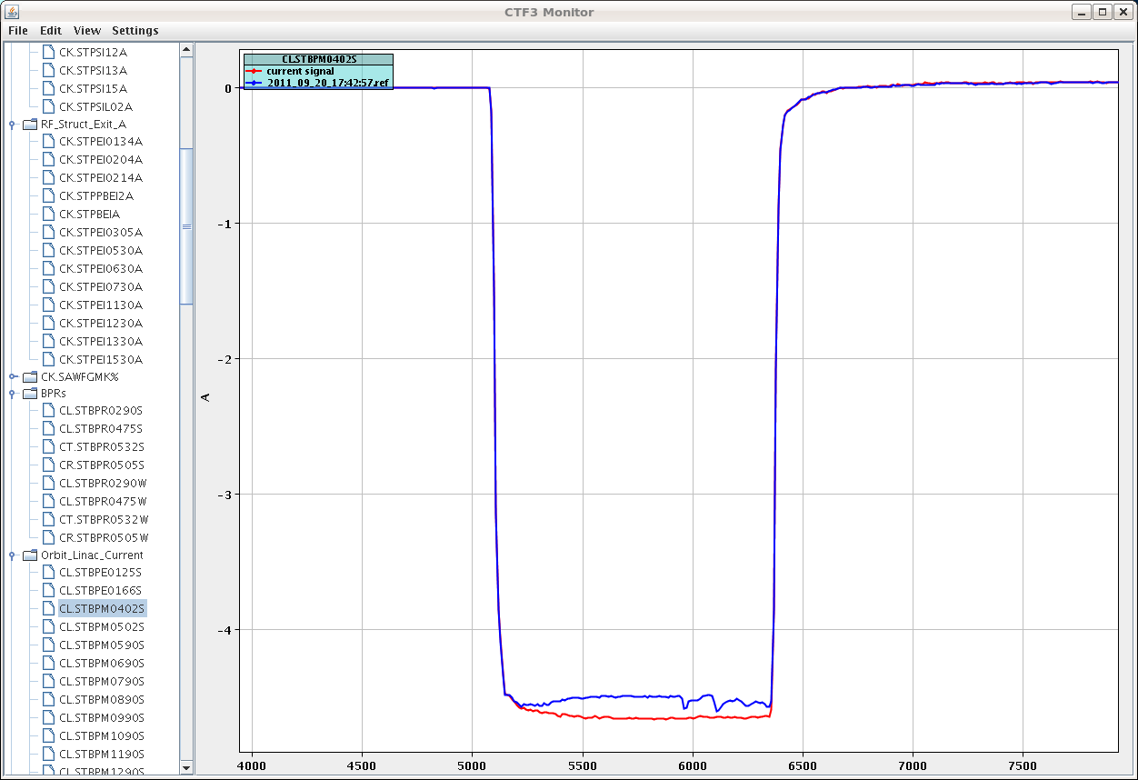
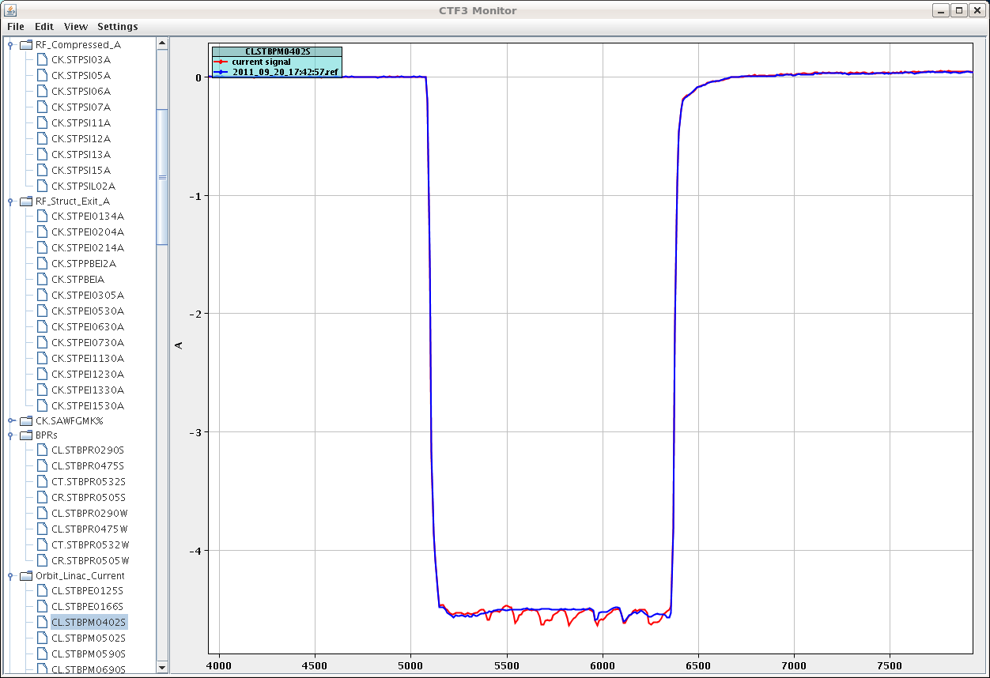
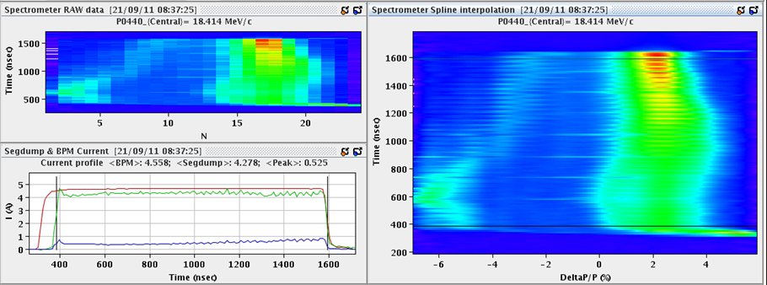
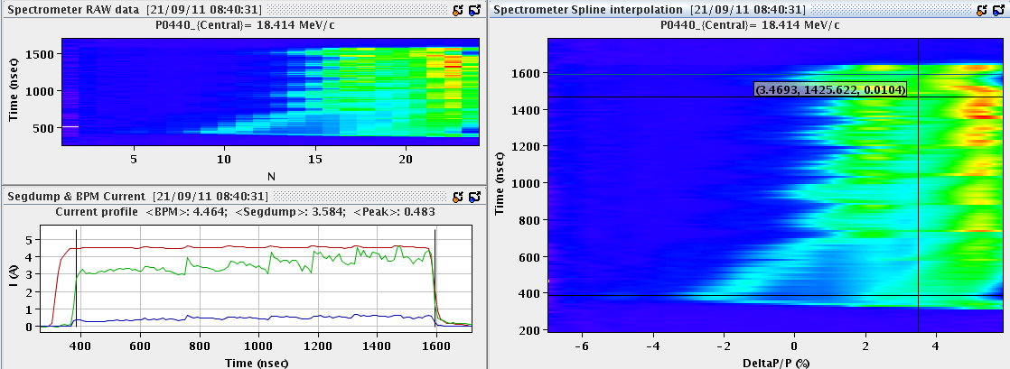


Wednesday 21-Sep-2011 DAY
Problem only with cavity 1?
Only SHB03 in. (TP)
Only SHB01 in. (TP)
Bot SHBs in. (TP)

Slide 19


Δ= 0.731dB
UP: CW RF signal produced by switching system n.1 (modulator n.1 RF input);
DOWN: pulsed RF output of TWT1.
Signal induced by the beam on SHB3 output.

Slide 20



Slide 21

08-Aug-2011
Luca measured the output of the TWT01 and it shows the ringing, as well. In the image: UP is the signal TWT1_out; DOWN is the LLRF signal on ch1

Slide 22



Slide 23









Slide 24



Thu 28-07-11
Programmed a 20 degree phase step on TWT01
Ringing at the beginning of the pulse

Slide 25



Slide 26





Slide 27


Slide 28


Slide 29

Satellites 0.6A

Slide 30



Friday 09-Sep-2011
“Delayed TWT03 after the beam and put switches on again (still two missing, as before). Loading on SHB03 looks reasonable. So is there a problem with SHB02 or only the measurement there? “

Slide 31


Monday 19-Sep-2011
The raising time after a switch to nominal power is ~130 ns. We disable every second switch to let the power to get back to nominal. However the come back to a higher power instead.

Slide 32


Monday 19-Sep-2011
Effect of phase correction in the amplitude.

Slide 33


Monday 19-Sep-2011

Slide 34




Wednesday 21-Sep-2011

Slide 35





08-Aug-2011
The effect of switches strongly depends on pre-buncher phase

Slide 36





08-Aug-2011
The effect of switches strongly depends on pre-buncher phase +70 units

Slide 37





08-Aug-2011
The effect of switches strongly depends on pre-buncher phase, adjusted to minimize the effect

Slide 38



04-Aug-2011

Slide 39








Slide 40





Fri 29-07-11 Kind’a extreme situation, when the phases are not adjusted properly

Slide 41


Fri 29-07-11 The same as previous, but
TWT1 moved away
TWT3 moved away

Slide 42





Mon 15-11-10 Production x8 Beam
Combined with DL

Slide 43







Fri 01-10-10 Streak Camera measurements
Trying to optimize SHB switch synchronisation.
Disabled two switches, so there is a switch only every 280ns, so I can see the steady state.
-1st plot: cable length 2ns to TWT1, 4ns to TWT3
-2nd: 4+10+16=30ns to TWT3
-3rd: 2+10+16=28ns to TWT1, 4ns to TWT3
-4th: 2/4ns as initially with all switches enabled.
As a conclusion, the 2/4ns configuration looks the best. But there is an apparent amplitude transient of ~50ns on TWT3 which is reflected in a loading transient in SHB03 of the same length.
TWT1 does not show this effect (see plot #5) (FT)
Piotr suggested to check without beam: the variation on TWT3 is gone (plot #6).
Having another look at the loading of SHB02 now: there is a 2-3 step behaviour in the signal after each phase switch. (PSk+FT)

Slide 44


Fri 01-10-10 Streak Camera measurements

Slide 45
Fri 01-10-10 Streak Camera measurements
Streak camera data under the following link
https://ab-dep-op-elogbook.web.cern.ch/ab-dep-op-elogbook/elogbook/secure/attach.php?attachId=1111118&type=zip&fname=1n.zip
think we found the phase switch
we think that the phase switch occurs over 7/8 ns {to be checked offline}
measured from: 16724 460 to 16742 460
Misplaced?

Slide 46

Fri 01-10-10 Streak Camera measurements

