Slide 1
Results of the screens measurement campaign and action for this shutdown
Benoit BOLZON
CTF3 working meeting, 09/02/2012

Slide 2
Outline
1. OTR screens at CTF3
2. Vignetting: origin and methods for mitigation
3. Screen scan measurements and action for this shutdown

Slide 3
1. OTR screens at CTF3

Slide 4
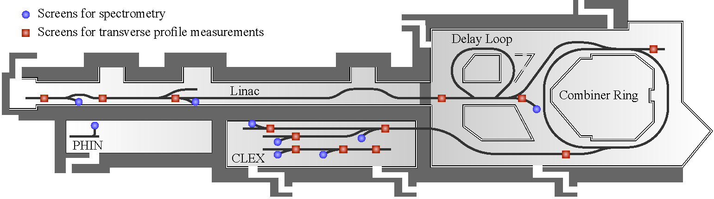
Screens | Screen type | Materials | Energy (MeV) | Current (A)
CT.MTV0435 | Flat, reflective | Al, C | 118.5 | 3.5
CL.MTV0500 | Flat, reflective | Al,C | 18.5 | 3.5
CL.MTV1026 | Flat, reflective | Al, C | 65.4 | 3.5
CC.MTV0253 | Flat, reflective | Si, SiC | 118.5 | 28
CC.MTV0970 | Flat, reflective | Si, SiC | 118.5 | 28
CTS.MTV0550 | Flat, reflective | Si, SiC |  | 7
CLS.MTV0440 | Flat, reflective | Al |  | 3.5
CLS.MTV1050 | Parabolic | Al | 60-75 | 3.5
CTS.MTV0840 | Flat, diffusive | Al | 100-150 | 7
CCS.MTV0980 | parabolic | Al | 100-150 | 28
CMS.MTV0630 | parabolic | Al | 100-150 | 28
CBS.MTV0300 | Flat, diffusive | Al | 60-150 | 28
Emittance screen
Spectrometer screen
Different screen shapes, screen materials, energies, current and optical lines
Notes:
Say that we have spectrometer and emittance screens with different energies, different materials and important: different optical lines…

Slide 5
2. Vignetting: origin and methods for mitigation

Slide 6
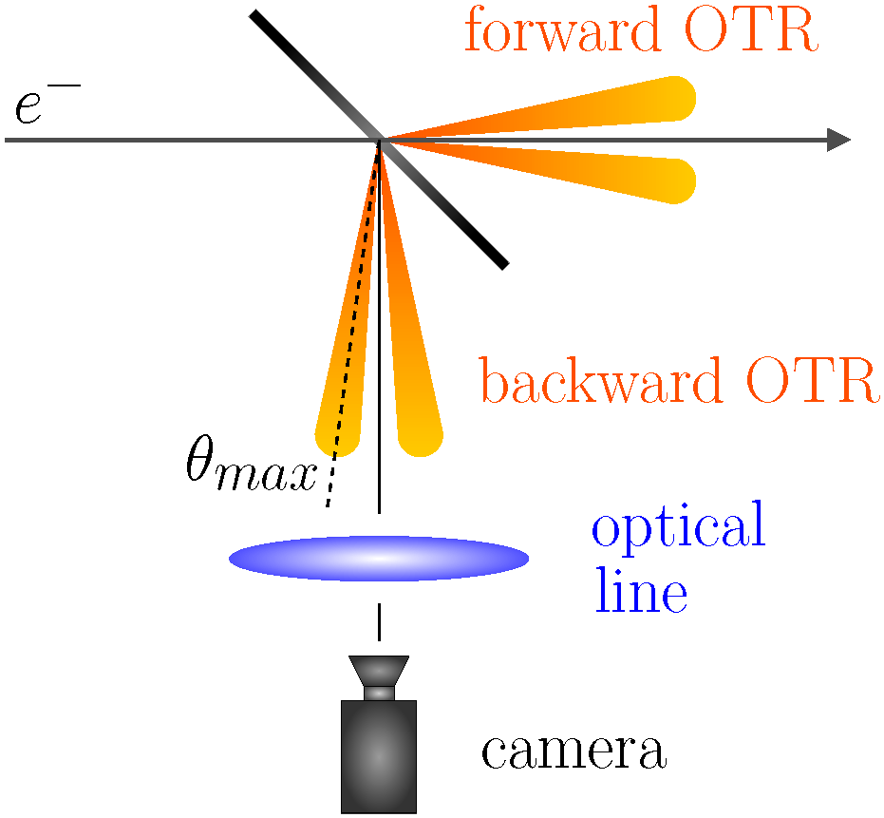
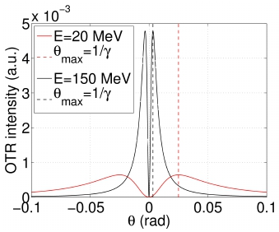
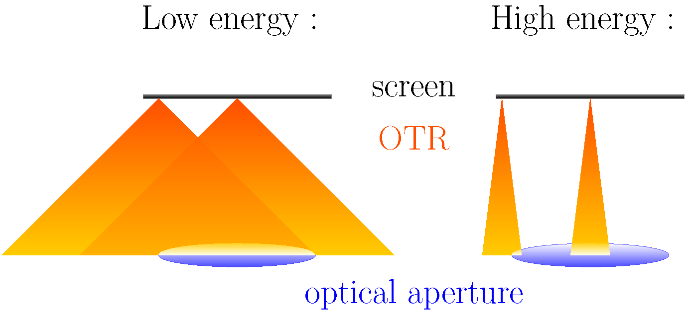
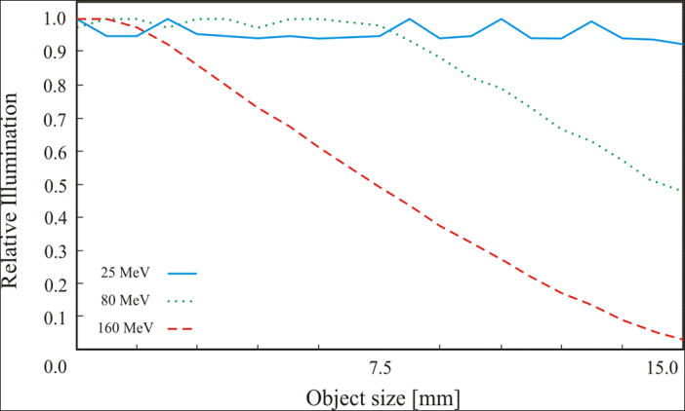
Vignetting effect
OTR radiation is emitted in forward and backward direction, of which the latter is generally used due to easier extraction.
OTR Angular distribution
➔ Emitted light cone gets narrower with increasing beam energy.
Vignetting: less light collected from the edges of the screen due to the finite optical aperture of the optical system (first lens: strong limiting factor) and the screen size
Effect stronger for higher beam energy, due to the distribution of the OTR emission.
Zemax simulation
6

Slide 7
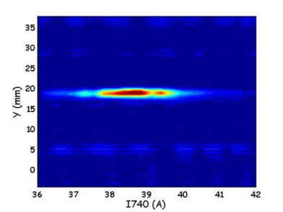
Mitigation
Mitigating the effect means removing the correlation between position on the screen and the amount of light seen by the camera.
Two ways: concentrate the light (parabolic screens) or diffuse the light (diffusive screens).
Parabolic screen: it is possible to – already from the emission point – concentrate the light onto the optical aperture.
Curvature: z=x²/f (f: distance between the screen and the first lens)
Beam (hitting the screen at 3 locations)
Diffusive screen: A depolished screen will diffuse the generated light.
Flat (regular)
On average, this leads to a more isotropic light emission and the low energy scenario is recovered

Slide 8
3. Screen scan measurements

Slide 9
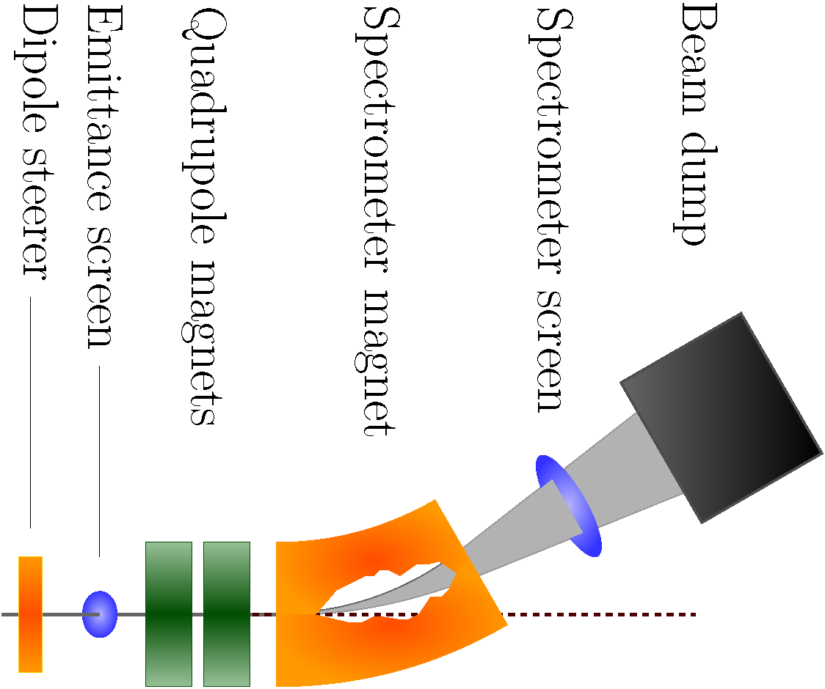
Goal of these measurements
Analysis of the linearity in position for all of the CTF3 screens (vignetting)
Can help identifying other problems like screen damages, misalignments…
Dipole scan technique: The dipole current is increased by small steps, moving the beam across the screen (for each screen, 2 scans: in X and Y directions)
For each setting, an image is acquired. Assuming constant beam properties, these images will help quantifying the variation in response across the screen.
Intensity normalization by BPMs reading, background subtraction, jitter measurement
Notes:
Check vignetting, but also other staffs we don’t know like misalignment, damage
Put less text, more pictures

Slide 10
Emittance screens
Beam size relatively small (order of few mm) for emittance screens
Vignetting effect should be much less important than for spectrometer screens
Emittance screen: beam size ~ 5mm
Spectrometer screen: beam size ~ few cm
Results: Variations of the measured beam size (across the screen) was within ±10% for almost all the screens except for CL.MTV0500 and CL.MTV1026

Slide 11
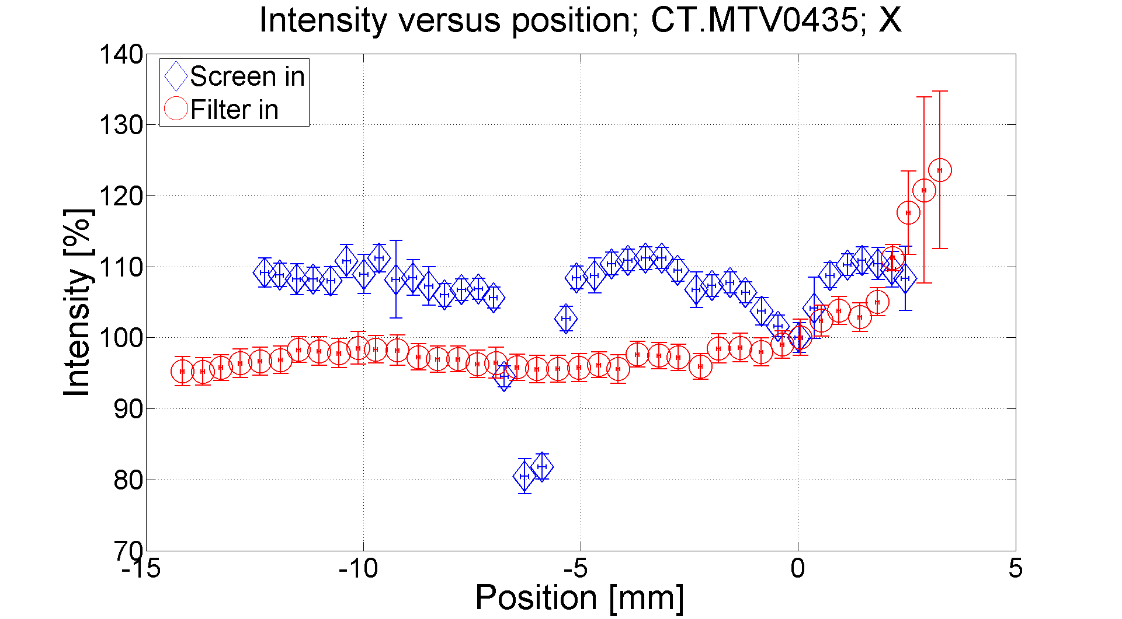
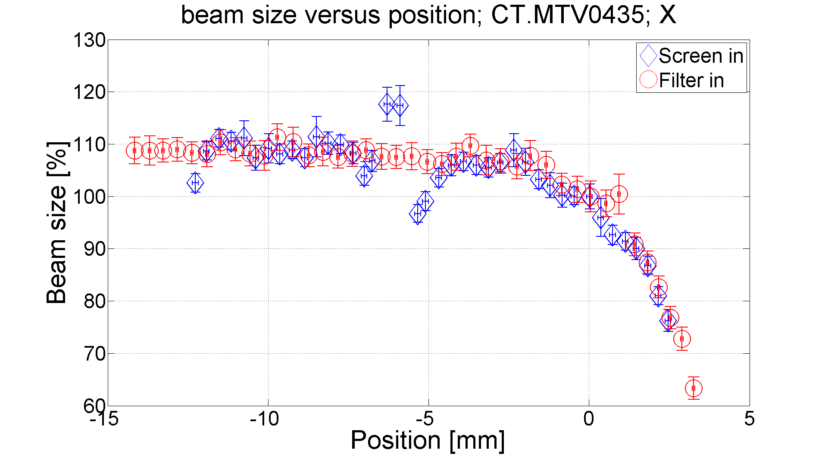
Emittance screens
Investigation of damage
Damage observed on the Al screen (screen in) at the position -6mm (high charge)
Fall of the light intensity of 30%
Increase of the beam size of 10%
Screen scan: Good tool to observe screen damage and to know the impact on the measured beam size
Notes:
Maybe not put the plot of beam size since it is obvious not to do measurements with a damaged screen

Slide 12
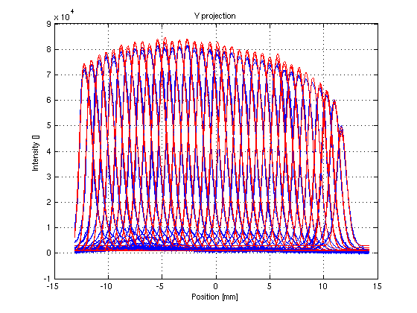
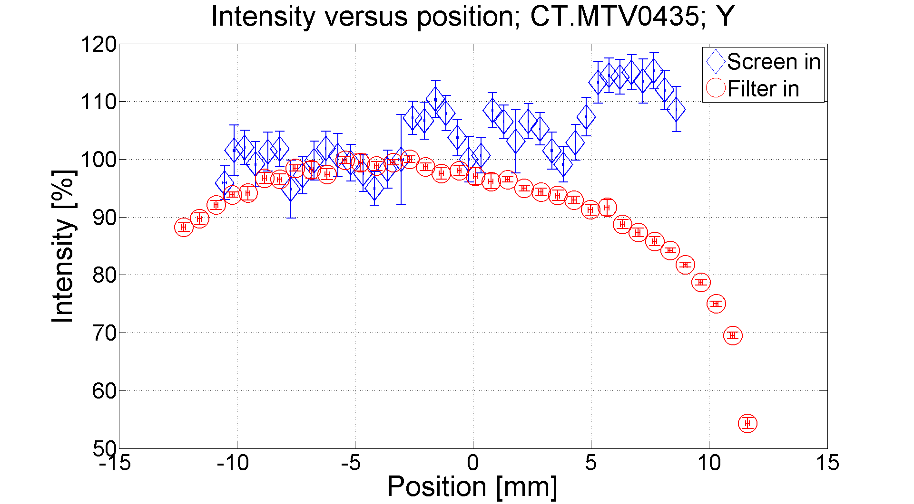
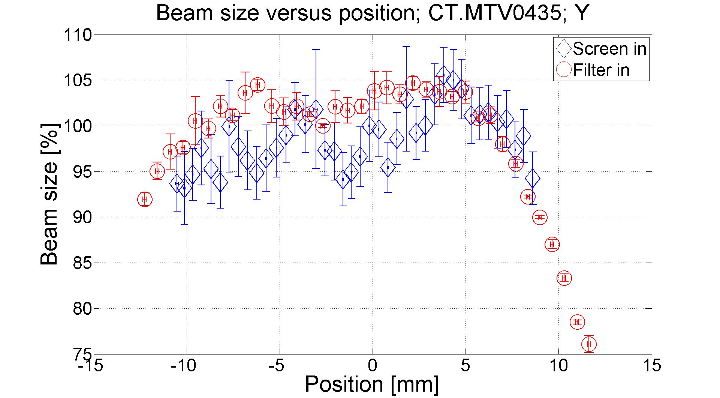
Emittance screens
Investigation of vignetting and alignment
Decrease of the intensity when approaching the screen edges
Beam profile modified
➔ Beam size underestimated at the screen edges
However, beam size constant within 5% in the range of 1cm

Slide 13
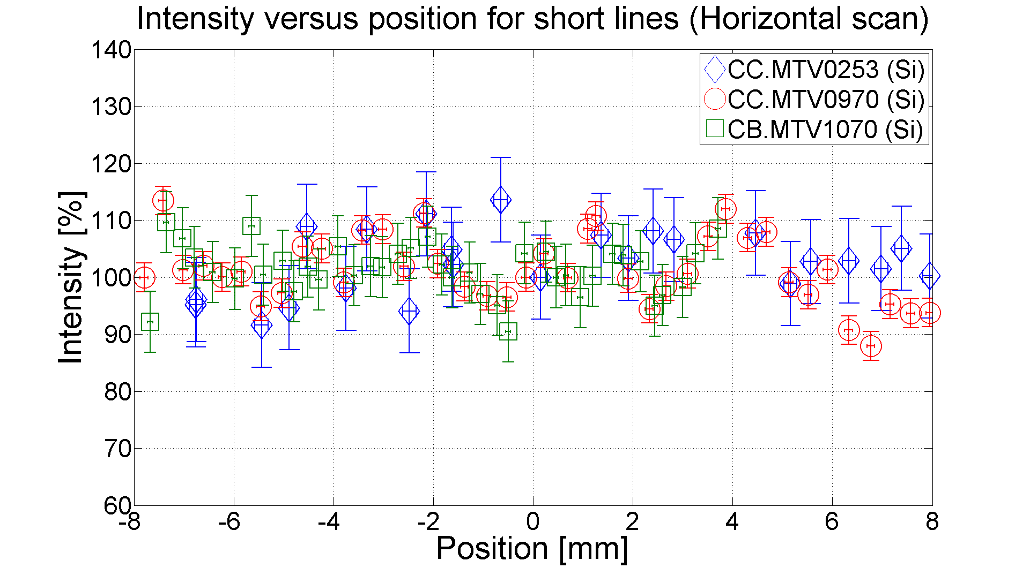
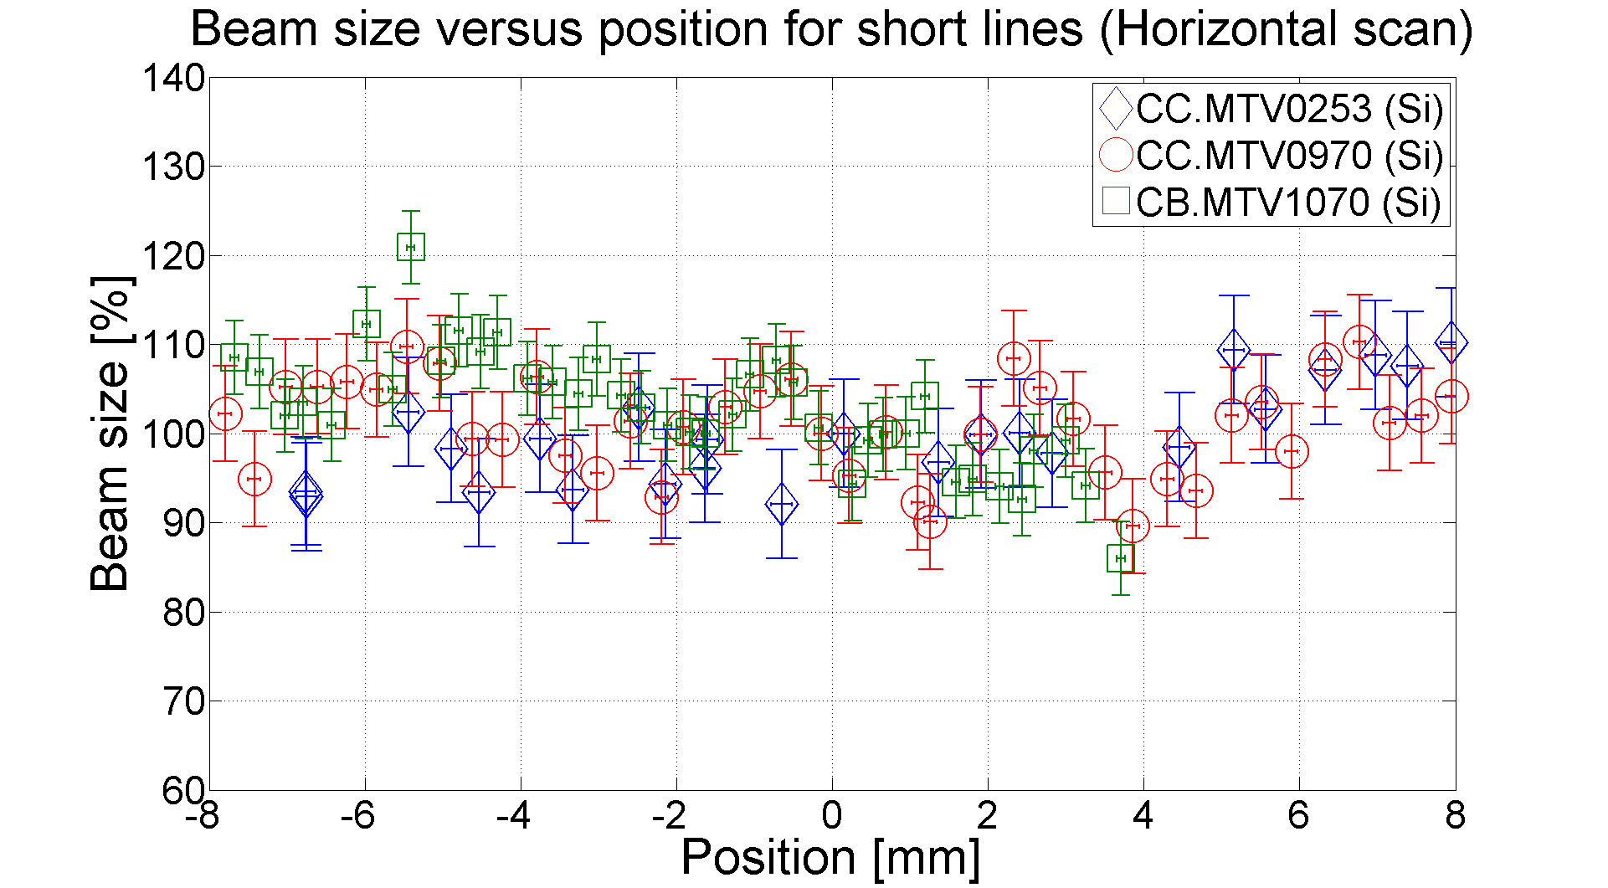
Emittance screens
Investigation of vignetting and alignment for short lines (CLEX system)
MTV system of CLEX: new design allowing shorter lines (less lenses and mirrors) and more accurate alignment
No position-dependent response observed with short lines contrary to long lines
Beam size stays constant within ±10%
New MTV systems of CLEX give better results in terms of vignetting

Slide 14
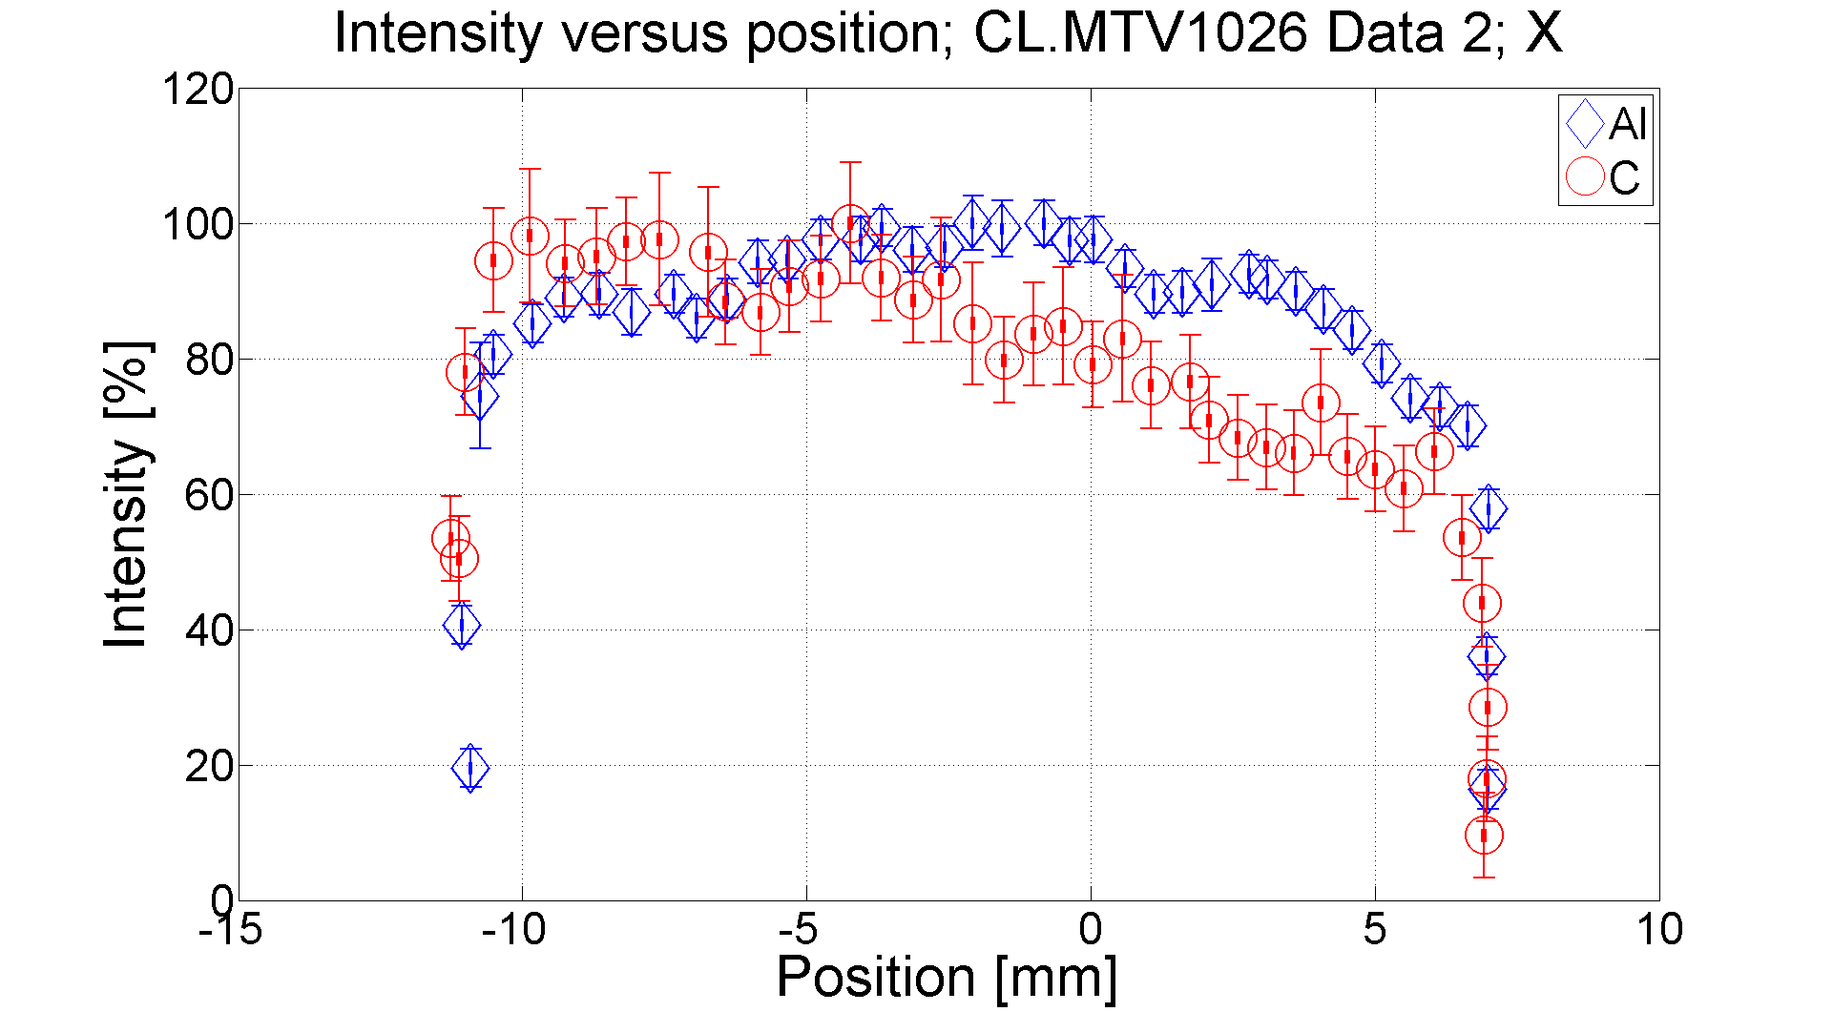
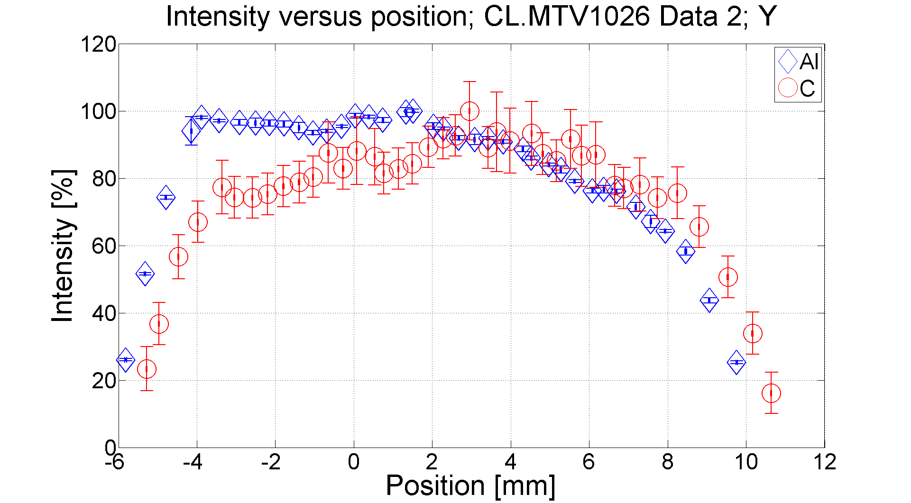
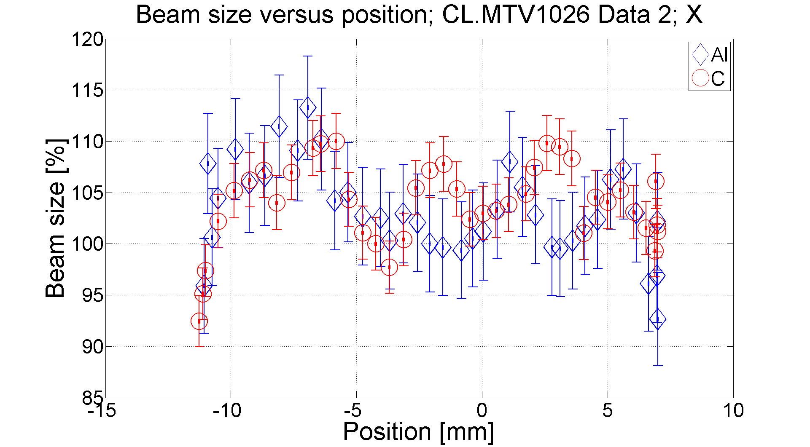
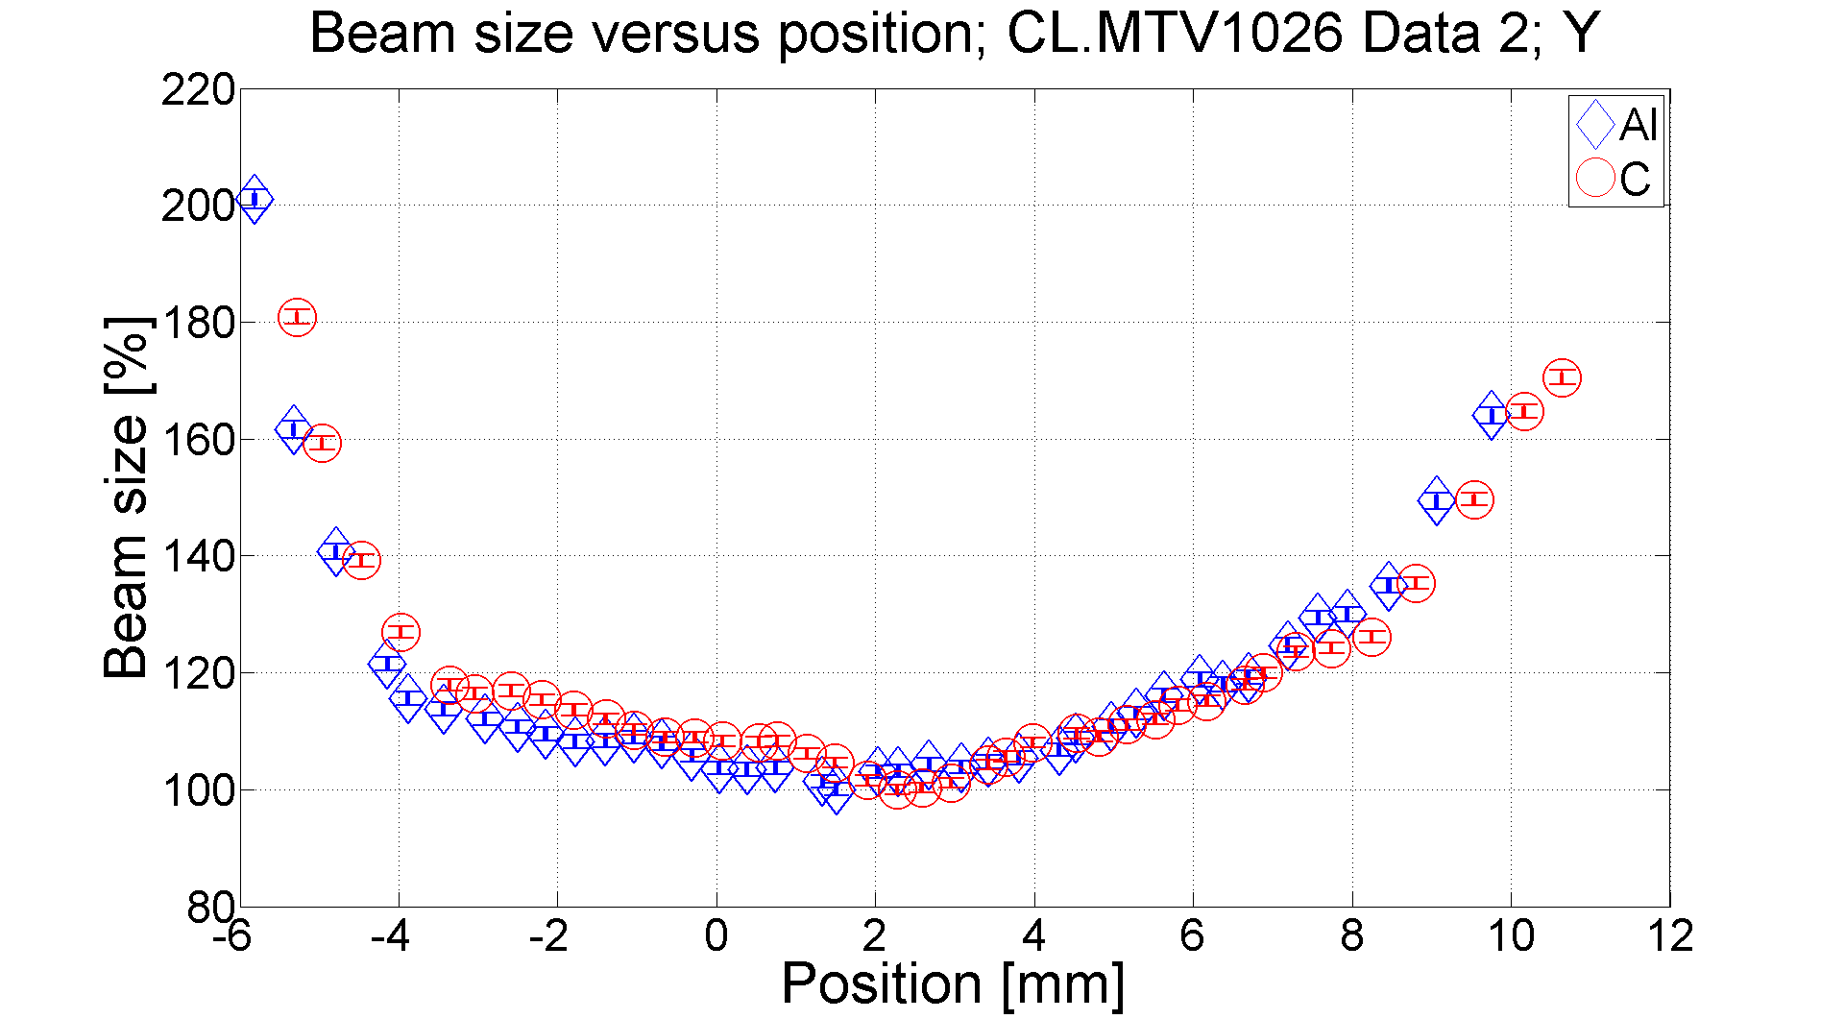
Emittance screens
Case of CL.MTV1026
Vignetting in X and Y for both screens
Beam size variation of ±10% over the whole range
Beam size variation of ±20% over a range of 12mm, and much bigger at the screen edges

Slide 15
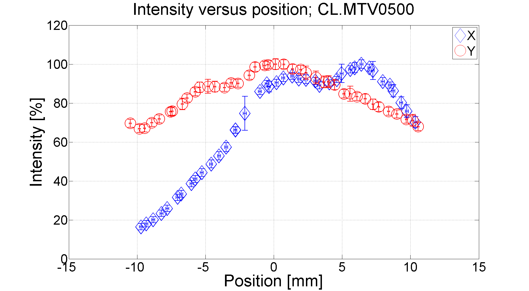
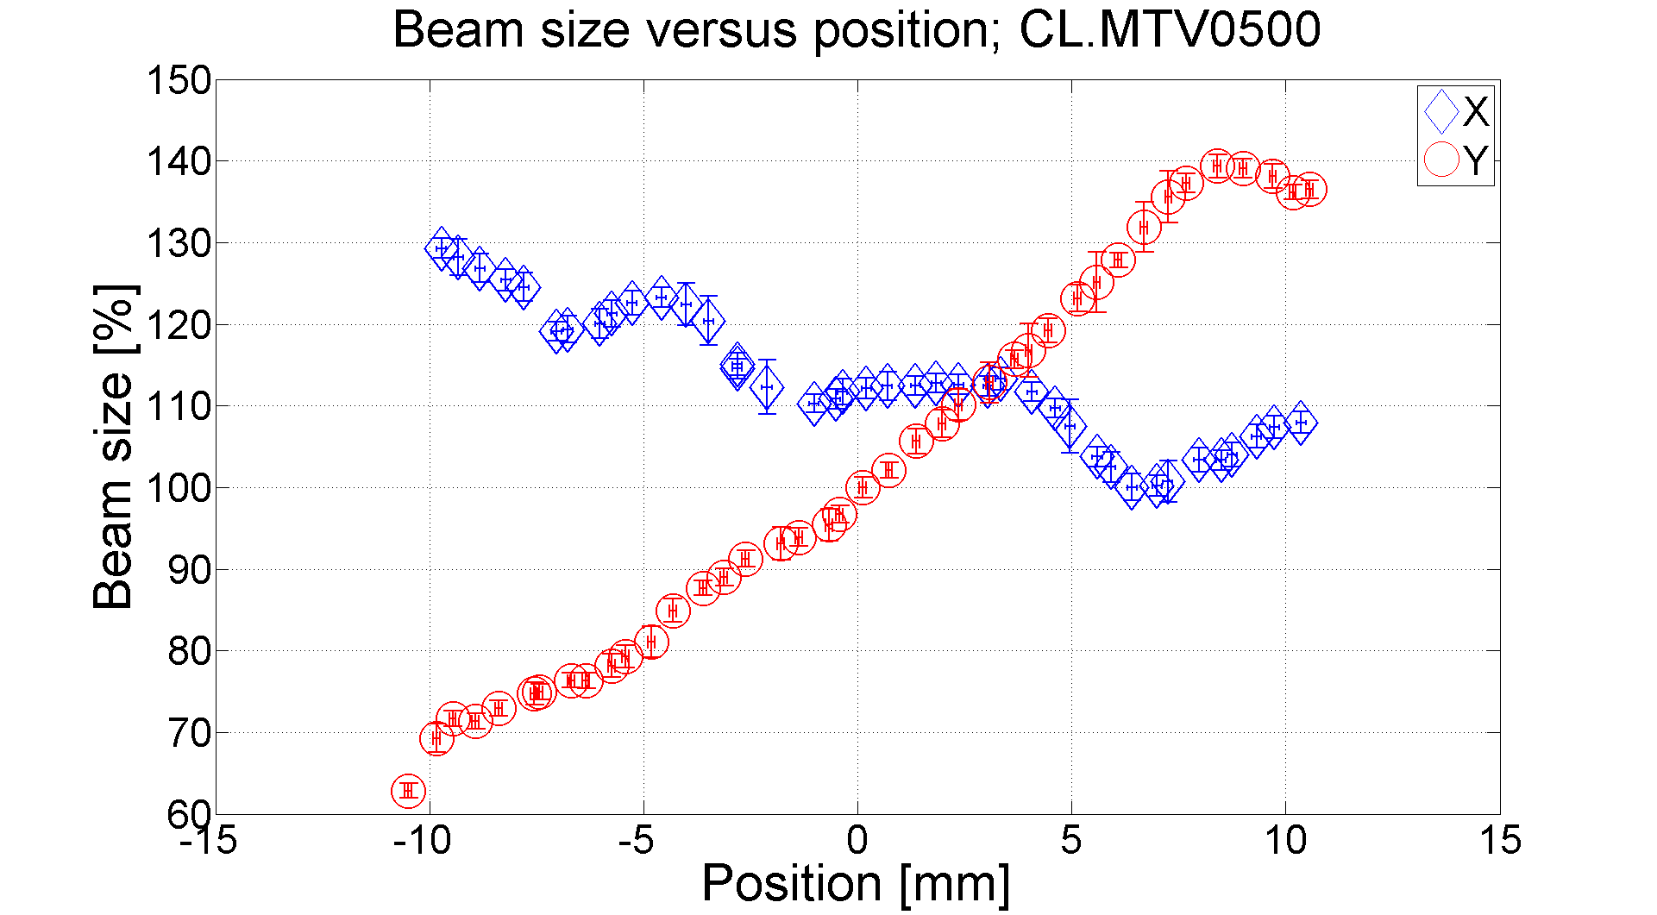
Emittance screens
Case of CL.MTV0500
Y: Vignetting but no misalignement (maximum of light intensity at center)
X: Vignetting and misalignment ➔ Intensity fall of 55% for a position of -5mm from the center of the screen
X and Y: Beam size variation of 20% for a position of -5mm from the screen center

Slide 16
Emittance screens
Actions during the shutdown
Screen name | Screen type | Problem | Actions
CT.MTV0435 screen in | Flat, reflective (Al) | Damaged | Change screen
CL.MTV0500 | Flat, reflective (Al, C) | Big misalignment in X, big vignetting effect in X and Y | calibration?
CL.MTV1026 (Both screens) | Flat , reflective (Al, C) | Big misalignment and vignetting effect in Y | calibration?
For CL.MTV0500 and CL.MTV1026, we are investigating some solutions like the calibration of the intensity measured by the camera in order to correct the beam profile…
Notes:
Don’t put the results of the calibration since it does not work but says that we are investing some solutions for CL.MTV1026 and CL.MTV500 (calibration or other things)

Slide 17
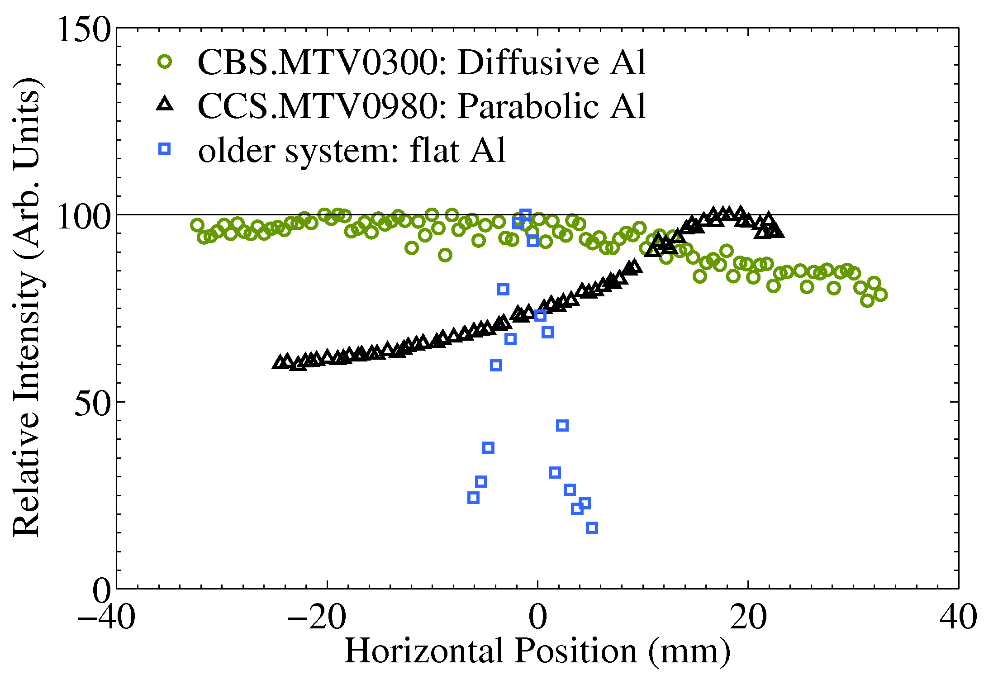
Spectrometer screens
Beam size relatively large (order of cm) for spectrometer screens
Vignetting effect should be important with standard high reflectivity flat screens
➔ Parabolic and diffusive screens have been installed in order to mitigate vignetting
Results
Parabolic
Diffusive
The vignetting effect is reduced
The vignetting effect is efficiently reduced compared to a standard flat screen
But maximum of light intensity when the beam is off-centered
Misalignment on both screens certainly
Conclusion
Harder requirements for manufacturing and alignment.
Parabolic screens should only be considered where light intensity is an issue.
In terms of manufacturing and installation, this is a less complicated improvement, compared to parabolic screens. Where the light density allows it, diffusive screens should be the primary choice.
Notes:
Older system: Linac or tl1 (kind of system like in spectrometer 4)

Slide 18
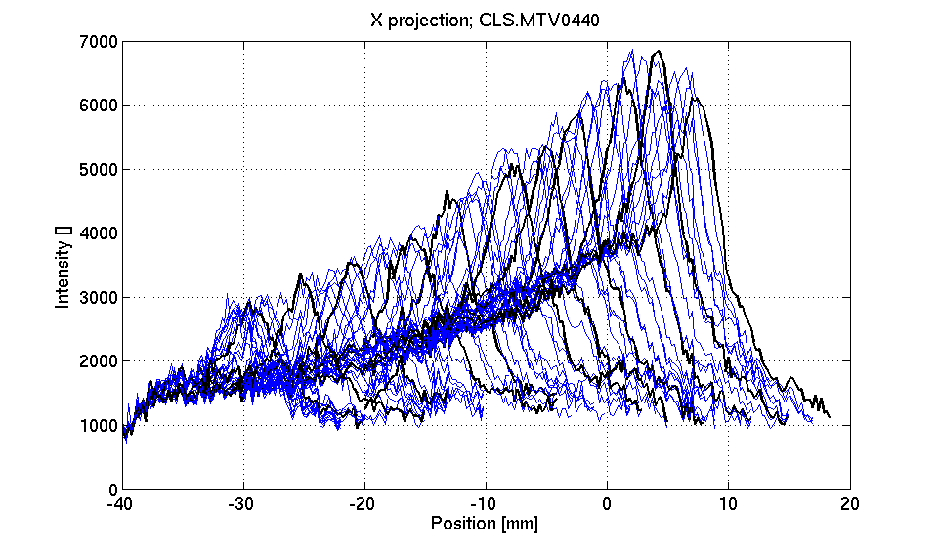
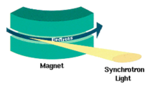
Spectrometer screens
Actions during the shutdown
Screen name | Screen type | Problem
CLS.MTV1050 | Parabolic | Damaged, misaligned
CCS.MTV0980 | Parabolic | Misaligned
CMS.MTV0630 | Parabolic | Misaligned
CLS.MTV0440 | Flat | Misaligned, synchrotron radiation
Actions: change parabolic screens by diffusive screens except for CLS.MTV0440
All screens have carbon foil to stop synchrotron radiation except CLS.MTV0440.
For CLS.MTV0440, a carbon foil will be added. But the screen will stay a flat, high reflective screen since light intensity is already very low with the existing screen
Generated on the left part of the beam profile
➔ Asymmetric gaussian

Slide 19
Additional slides

Slide 20
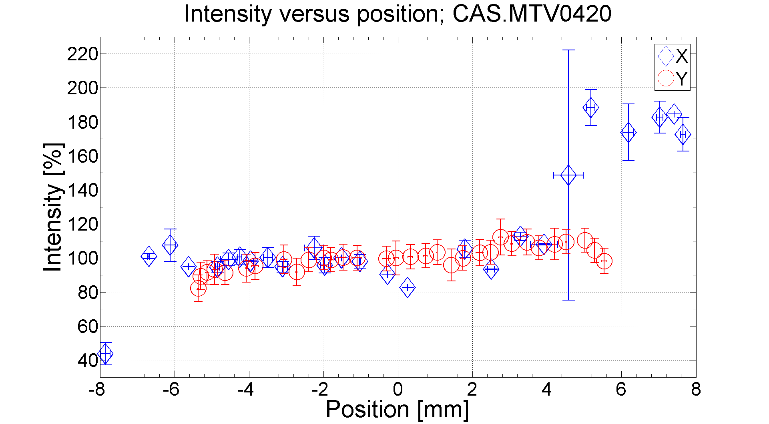
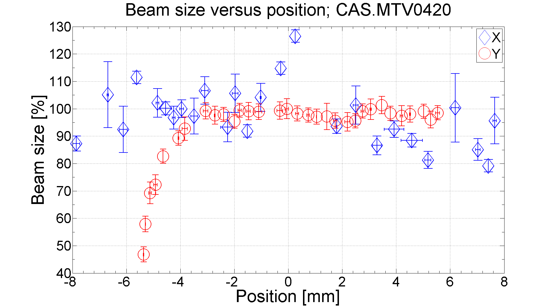
CALIFES spectrometer screens
CAS.MTV0420

Slide 21
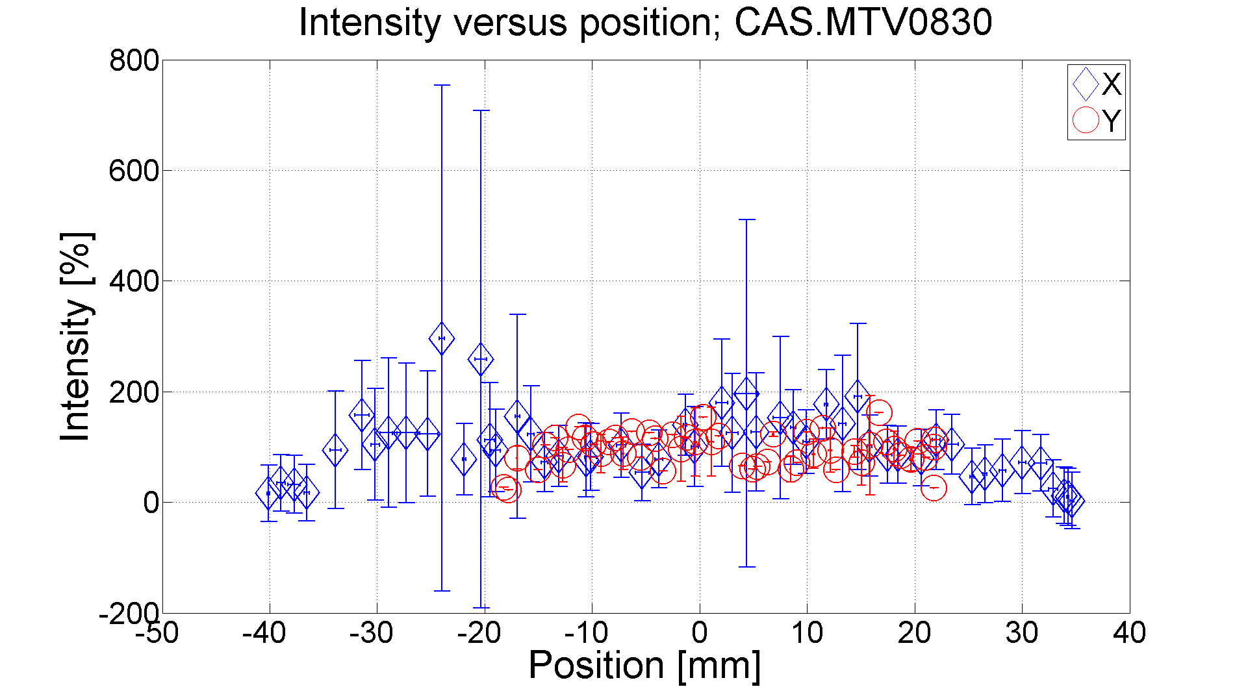
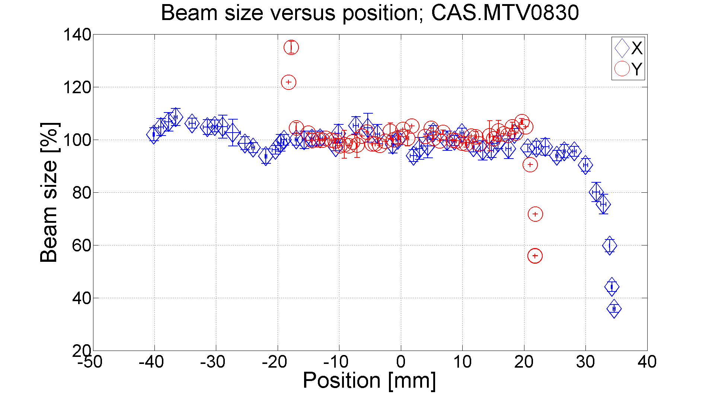
CALIFES spectrometer screens
CAS.MTV0830

Slide 22
Choice of OTR for CTF3
Beam intensity: from 3.5 A during 1.4 µs, to 28 A, 140 ns. Beam size
~1 mm, pulse repetition rate up to 5 Hz
Thermal load too high for scintillating screens
High intensity compensates for lower light yield
Up to coherence, perfectly linear with beam charge (no saturation)
Femto-second time resolution possible
Allows for longitudinal profile imaging (bunch length)
Due to properties of the emitted light, it can be used to determine
several beam properties.

Slide 23
Requirements of OTR at CTF3
Small beam size typically of the order of few mm:
High thermal load due to the high charge
For quad scan measurements, beam size can increase consequently
In the spectrometer lines, large beam size of the order of ~ cm
Large vignetting factor can decrease the accuracy of measurements
➔ Measurements of the linearity in position for all of the CTF3 screens due to problems of acceptance and vignetting
Test Beam Line (TBL) at CTF3: a small-scale test of the CLIC decelerator.
High energy spread: need to investigate the accuracy of measurements

Slide 24
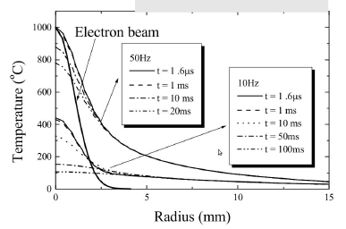
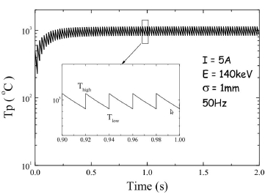
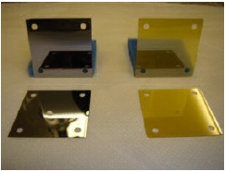
Screen damages
CTF3 high intensity electron beam constitutes a high thermal load on intrusive devices – even OTR screens
Solution: Thermally resistant materials as
radiators, at the expense of total light intensity (reflectivity). Specific heat capacity, melting temperature, and thermal conductivity key properties.
Intensified camera
where necessary.
Si and SiC tested
successfully.
Si
SiC

Slide 25
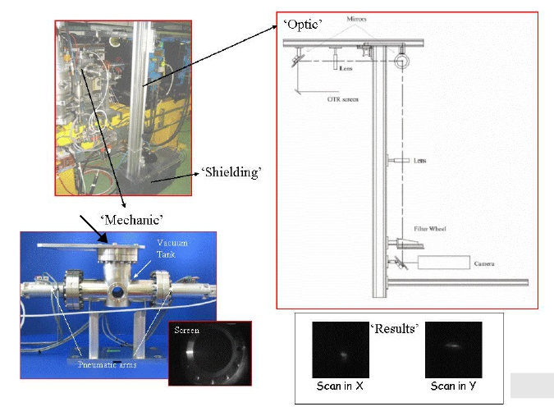
OTR screen system at CTF3
In the past: radiation hard cameras directly on top of the tank
Optics of “all” systems was modified in order to replace these types of cameras by CCD cameras to improve the sensitivity of the measurement
“Standard” system (subject to local variation)
2
1. Tilted screen(s)
inside a vacuum tank
2. View port, mirrors
and achromat lenses
3. Filter wheel for light
attenuation
4. CCD camera, digitization box and shielding
1
view port
3
4
Resolution 70-200µm
N.B: in this scheme, the line is said “long” (1.5m) since the light is first transported to the top and then go down to the camera (old system)

Slide 26
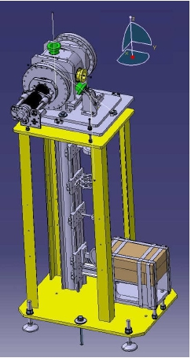
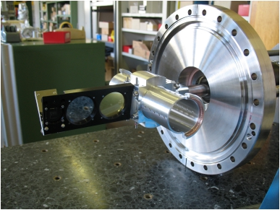
OTR based emittance measurements
Beam size typically of the order of few mm:
Active size of the screens: diameter of 3cm
Improved design for high current (28-30A) when the beam is combined
Special shielding designed for the camera – huge radiation at CTF3.
Screen - beam angle reduced to minimize field depth errors
Shorter lines and better alignment designed: the light is transported directly down to the camera (less lenses and mirrors)
➔ Less light losses (vignetting)
Screen system with four
different positions:
1. Calibration target
2. Highly reflective screen (Si)
4
.
3. Less reflective, thermally
resistant screen (SiC)
4. Replacement chamber to
reduce beam impedance
while not in use.
1
.
2 3
. .

Slide 27
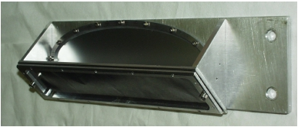
Screens for spectrometry
Beam size typically of the order of 1 cm:
Active size of the screens: 10cm*4cm
Synchrotron radiation can increase highly the background for energies above 80MeV and makes the beam profile to be much asymmetric
Beam energy | # SR photons/e | # OTR photons/e
50MeV | 1.5E-09 | 7.7E-03
80MeV | 5.0E-04 | 8.6E-03
100MeV | 4.0E-03 | 9.0E-03
All systems for spectrometry have fixed aluminum screens
New standard: block synchrotron radiation using a carbon foil
Generated on the left part of the beam profile
➔ Asymmetric gaussian
50 µm foil thickness

Slide 28
2. Vignetting effect

Slide 29
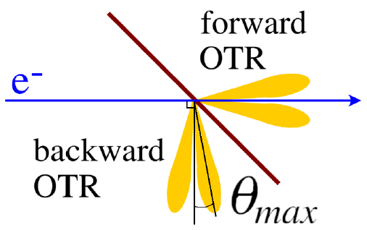
Angular distribution of OTR emission
OTR emitted when a charged particle
goes from a medium to another with
different dielectric properties.
Radiation is emitted in forward and backward direction, of which the latter is generally used due to easier extraction.
For ultra-relativistic particles:
Angular distribution of
OTR emission
By differentiating this equation:
➔ Emitted light cone gets narrower with increasing beam energy.

Slide 30
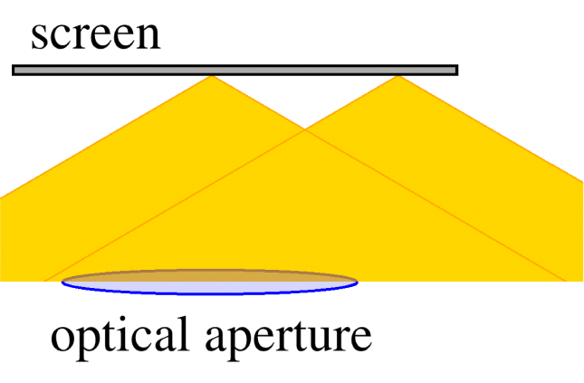
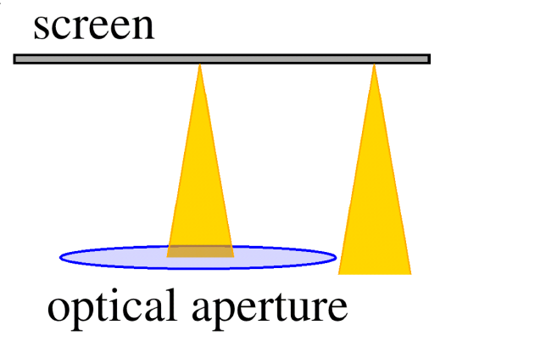
Vignetting effect
In optics: less light collected from the edges of a system.
Here: less light collected from the edges of the screen due to finite optical aperture of the optical system (the first lens being a strong limiting factor) and the screen size
The effect is stronger for higher beam energy, due to the distribution of the OTR emission.
Low energy
High energy
Zemax simulation
The effect is also enhanced if the beam angle is stronger
Beam (hitting the screen at 3 locations)
Optical aperture

Slide 31
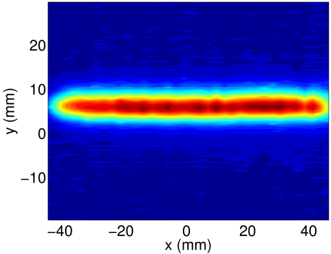
Mitigation
Mitigating the effect means removing the correlation between position on the screen and the amount of light seen by the camera.
Two ways: concentrate the light (parabolic screens) or diffuse the light (diffusive screens).
Parabolic screen: it is possible to – already from the emission point – concentrate the light onto the optical aperture.
Curvature: z=x²/f (f: distance between the screen and the first lens)
Beam (hitting the screen at 3 locations)
Diffusive screen: A depolished screen will diffuse the generated light.
Diffusive
Flat (regular)
On average, this leads to a more isotropic light emission and the low energy scenario is recovered

Slide 32
Mitigation
The effect should be higher in the spectrometer lines since the beam size is larger
The optical acceptance decreases rapidly as the beam position changes
Parabolic and diffusive screens have been tested in such lines at CTF3
Emittance screen: beam size ~ 5mm
Spectrometer screen: beam size ~ few cm

Slide 33
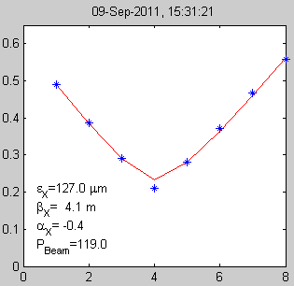
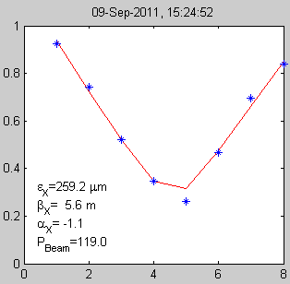
Goal of these measurements
For emittance screens
Since the beam size is relatively small (order of few mm) for the emittance screens, the vignetting effect should not be very high
Try to apply a correction on the beam size for all the screens from these measurements (instead of changing standard flat screens by other screens)
Narrow range
Large range
➔ Important in the linac for quad scan measurements:
-Large range on quad current: large beam size
➔ Vignetting effect underestimating beam size!!
➔ Emittance overestimated!!
ε_{x}=127µm
ε_{x}=259µm
r
Help also to analyse misalignments and screen damages
Comparison between different energies, between short and long lines, between screens of different materials…
To understand all these results, need to perform optics simulations… not yet done…
but some examples of measurements are shown

Slide 34
Goal of these measurements
For spectrometer screens
Beam size relatively large (order of cm) for spectrometer screens
Vignetting effect should be important
➔ Parabolic and diffusive screens have been installed in CTF3
Screen scan measurements can reveal which system is the most efficient

Slide 35
4. Large energy spread

Slide 36
What’s next?
Extrapolate from CTF3 to CLIC parameters
Drive Beam: higher energy, higher intensity, larger energy spread
Main beam: higher energy, smaller beam size, shorter bunches
Error in size/emittance due to energy spread?
Develop cheap and robust systems

Slide 37

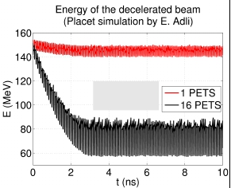
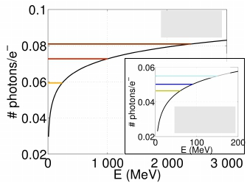
Large energy spread beams
The beam in the CLIC Drive Beam decelerator will go from an initial energy of 2.4
GeV to 0.24 GeV (90 % energy extraction), with a large intra-bunch energy spread.
Test Beam Line (TBL) at CTF3: a small-scale test of the CLIC decelerator.
To be investigated: how “wrong” we measure transverse profile using standard OTR screens.
#OTR photons – beam energy
CLIC
240 MeV
1.0 GeV
2.4 GeV
TBL
60 MeV
90 MeV
150 MeV
CLIC
transient
max
transient
max
min
Emin
Emax
Etransient
TBL
min
high energy transient
TBL
6% (1σ) intra-bunch energy spread

Slide 38
Large energy spread beams
Comparison between scintillating screens (YAG) and OTR
For this screen system (CA.MTV0390), there are two types of screens, YAG and OTR, whose mechanical supports are similar
In terms of light intensity, scintillating screens are much more stable than OTR screens as expected
However, in terms of beam size accuracy, OTR screens are as good as YAG screens (+-10% of variation over a range of 12mm)
➔ YAG could be a good compromise: almost not sensitive to beam energy fluctuations

Slide 39
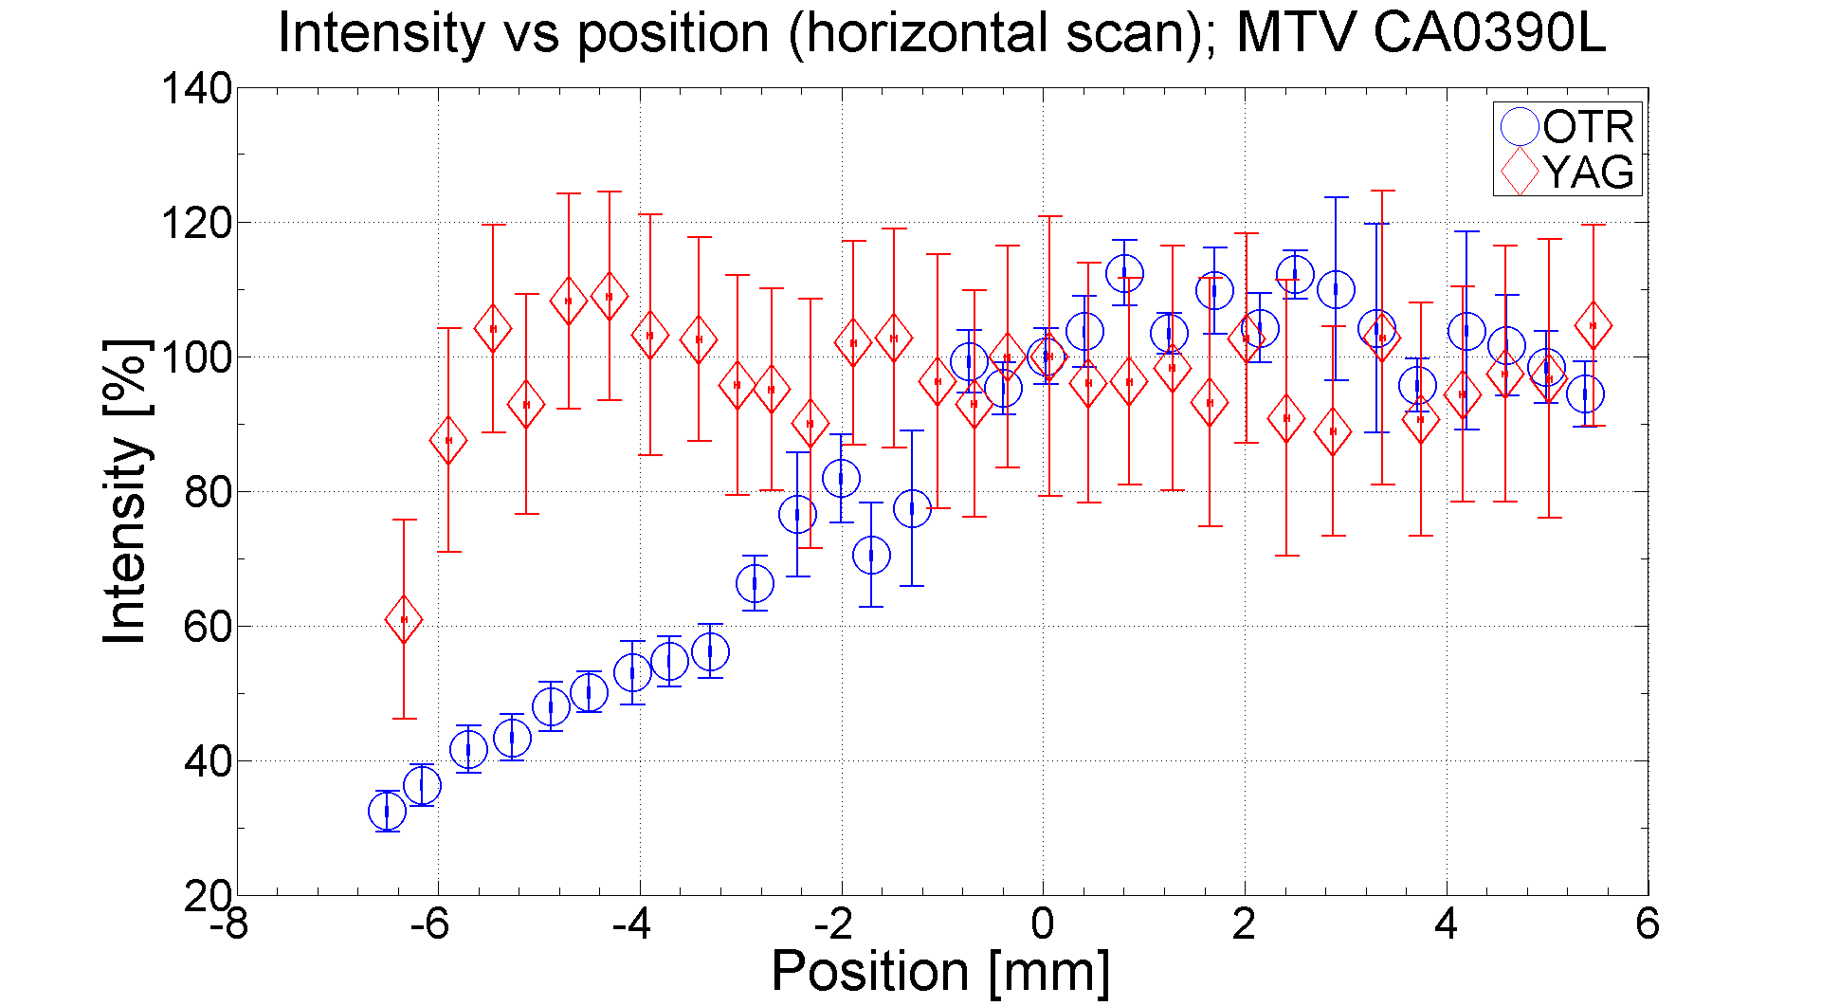
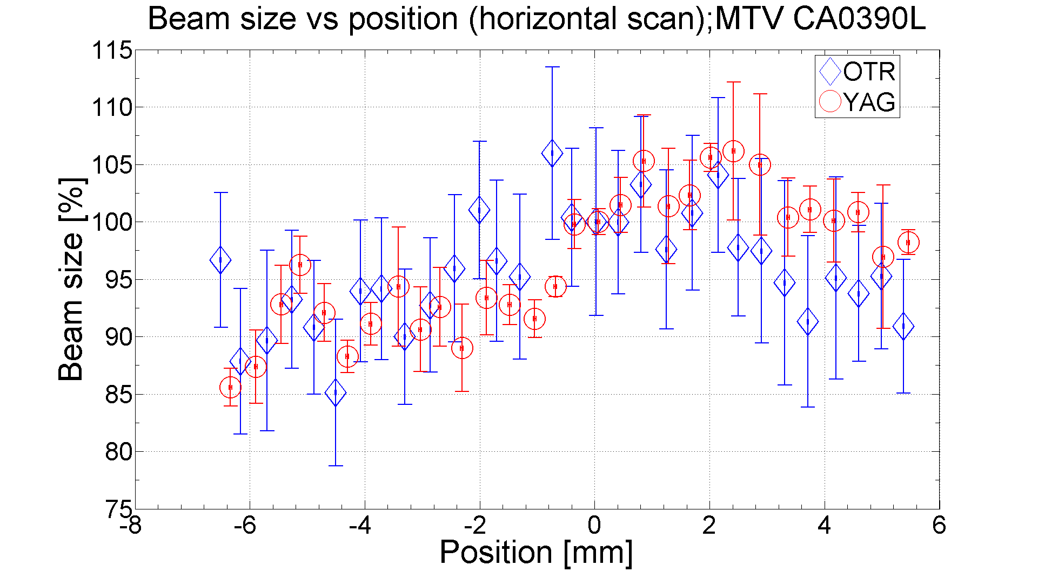
CALIFES emittance screens
Comparison between scintillating screens (YAG) and OTR
For this screen system (CA.MTV0390), there are two types of screens, YAG and OTR, whose mechanical supports are similar
In terms of light intensity, scintillating screens are much more stable than OTR screens as expected
However, in terms of beam size accuracy, OTR screens are as good as YAG screens (+-10% of variation over a range of 12mm)
➔ YAG could be a good compromise: almost not sensitive to beam energy fluctuations

Slide 40
5. Conclusion

Slide 41
OTR screens important tool in everyday operation of CTF3
Enough light intensity, better for high intensity beams
OTR screens will be a basic tool for imaging system as well as for emittance measurements in CLIC
Screen scan measurements performed on all the screens of CTF3 to analyze vignetting effects, misalignments, damages…
For emittance screens: deeper studies must be done with optics simulation
However, first studies show that vignetting effect does not have a big impact on the beam size (except on the very edges of the screen)
Calibration versus position will be anyway done thanks to these studies (very important for quad scan measurements in the linac)
These studies will help to identify misaligned and damaged screens

Slide 42
For spectrometer screens: parabolic and diffusive screens recover performance which decreases with standard flat screens when going to higher beam energy
  Parabolic screen: no light losses but manufacturing and alignment are tricky
  Diffusive screen: very easy to install and should be the primary choice when light density allows it
Next step: focus on OTR based diagnostics for beams of large energy spread

