Slide 1
Drive Beam Status and Issues
Drive beam quality
Dispersion tuning
Emittance
Combination issues
Piotr Skowroński

Slide 2
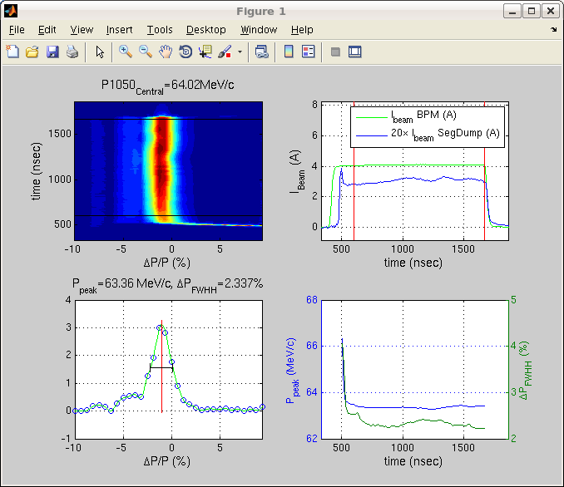
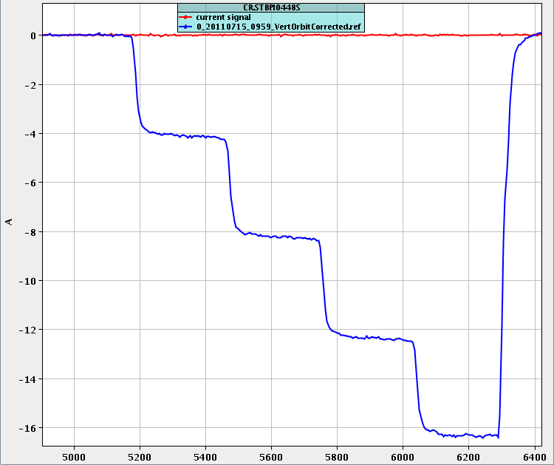
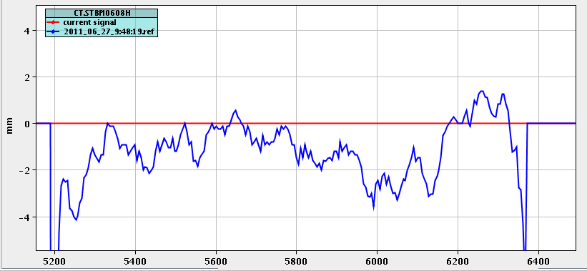
2011 Improvements
Gun pulse flattening
All RF phase sags made the same, including TWTs and MKS02
Allowed for very quick setup of the factor 4 recombination
CTF3 Monitor: watches all signals stability, complete references, …
Feedbacks
Increased recombined beam stability
The recombination is now much less vulnerable to drifts and jitters
14A in CLEX, 13A routinely

Slide 3
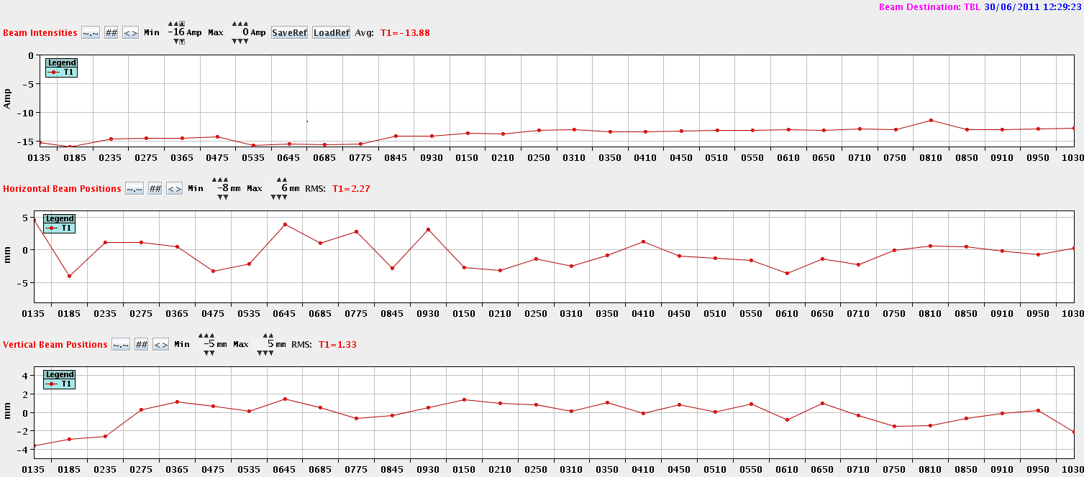
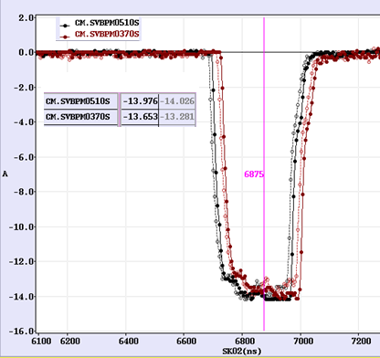
Drive Beam in CLEX
Routinely delivered 13A, up to 14 A
10% losses at CR ejection
  Difficult (very strong) optics given by the building geometry
Minor differential losses along TL2
Issue with BPIs calibration
  They measure 10% more current then BPMs and BPS’s
BPIs
BPMs
BPIs
BPMs
BPS’s

Slide 4
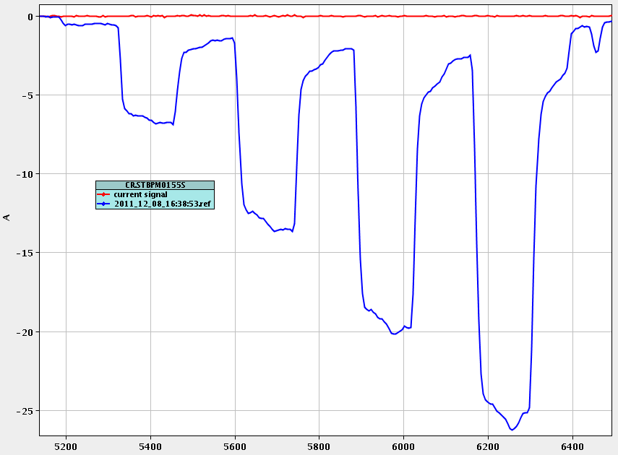
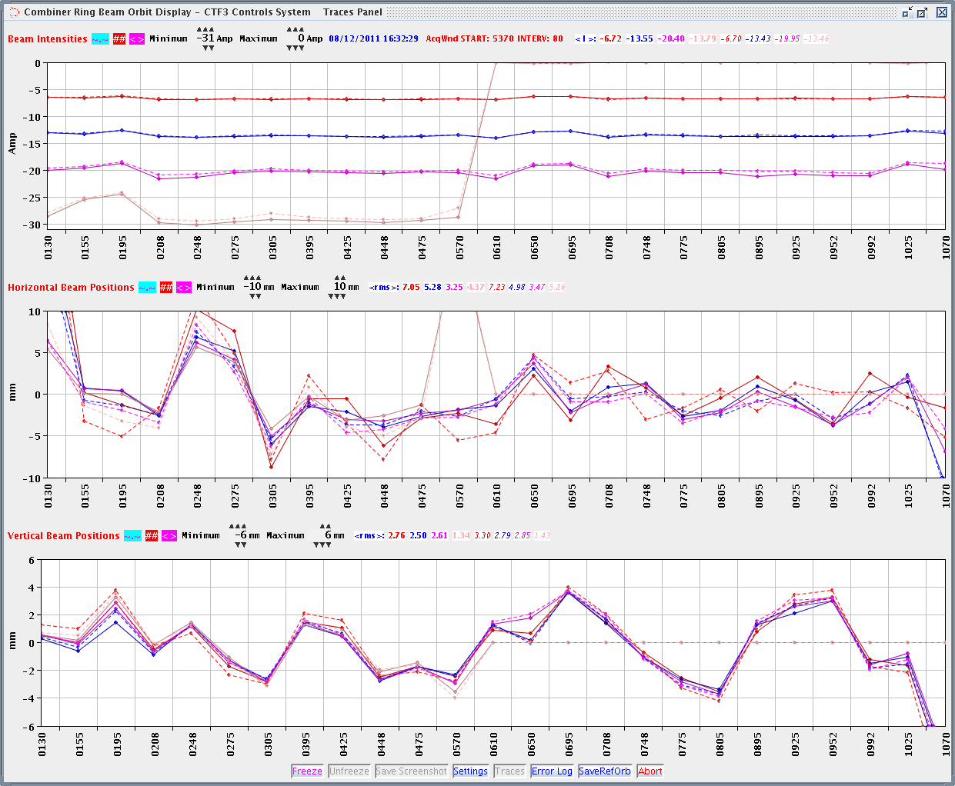
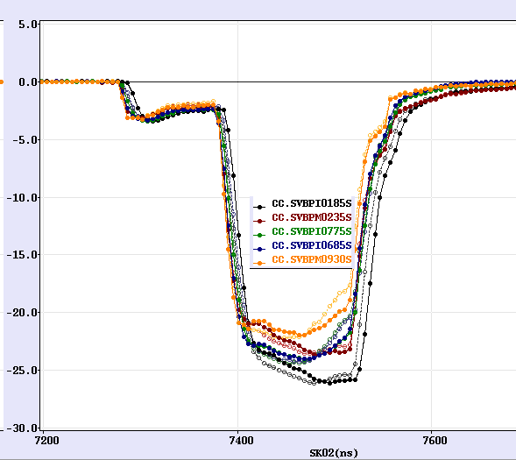
Factor 8
26A out of 6.5 injected
20A delivered to CLEX

Slide 5
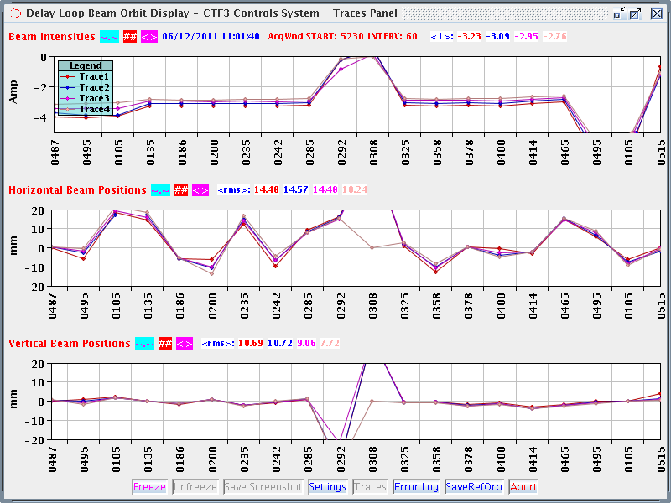
Issue with DL
This year the setup of the DL was extremely difficult
The orbit that gave good transmission has large amplitude
Any losses on straight section induced alarm at the doors
  After long fight we found a setting that gave good recombination and no losses, but it was extremely sensitive to any drift
We suspect misalignment quad/BPM misalignment at the beginning of the Loop after leak repair in summer 2011

Slide 6
Control of the optics
The optics was verified with help of Response Matrix and Dispersion measurements (up to CR)
  Achieved satisfactory agreement with the Machine Model in the horizontal plane
  The disagreement in vertical plane suggests that fringe fields of the bends are not sufficiently understood
Ben performed more sophisticated measurements
  To be summarized tomorrow
  No issue found, see details tomorrow
The checks in TL2 and TBTS were not completed
  Simona tried very hard to get it in 2009 and 2010, but it was extremely difficult to do (experimental LAPP BPM electronics)
  We did not find time to do it in 2011

Slide 7
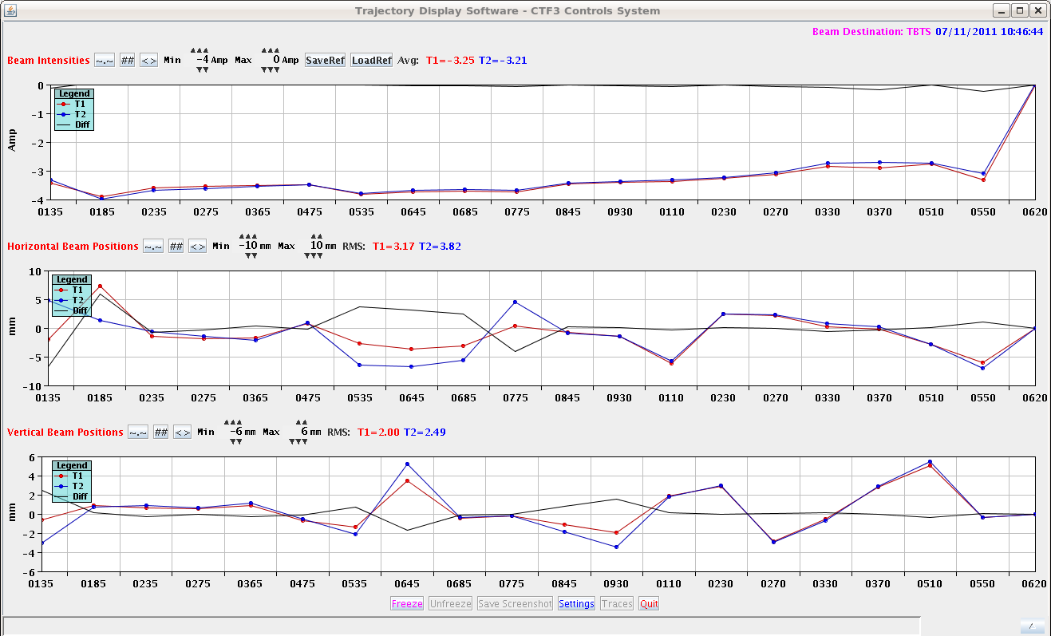
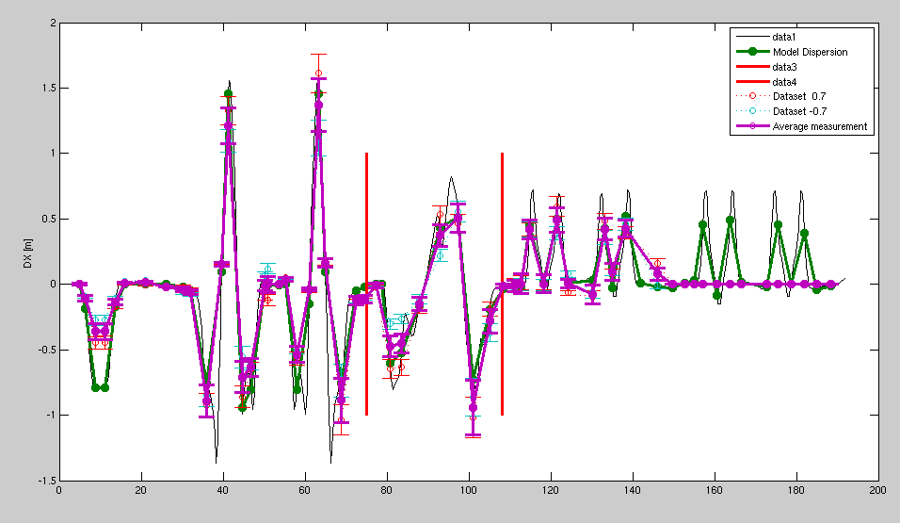
Dispersion
The most effective way to tune the dispersion is generation of a beam pulse with energy step within
  By adjusting the RF compression for girder 15
  There should be no step visible in position traces where dispersion should be null
  Often, strong steerers introduce spurious dispersion
Dispersion is also measured by
  Scaling all the magnets
  Changing beam energy by changing phase of klystron 15 or changing compressed power level for girder 15
Dispersion is well controlled, no issue here
DL
TL1
CR

Slide 8
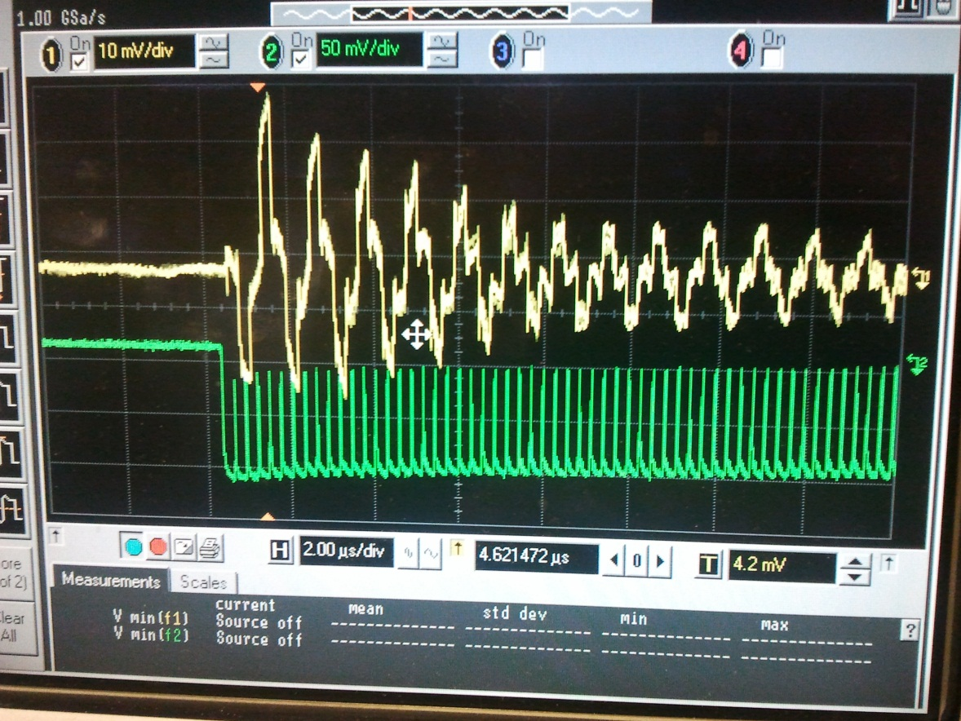
The Ring and the Loop Length
Time of flight over the Delay Loop is measured with BPR, which is not very accurate, but good enough
  It is fine tuned to maximize the 12GHz power production
For Combiner Ring we use coasting beam, and we can get very accurate measurement with doing FFT of the BPR signal
However, the orbit length is very sensitive to the beam energy
  It is virtually impossible to keep it on the set point
  Hopefully, the feed-back closed on the produced RF power will help

Slide 9
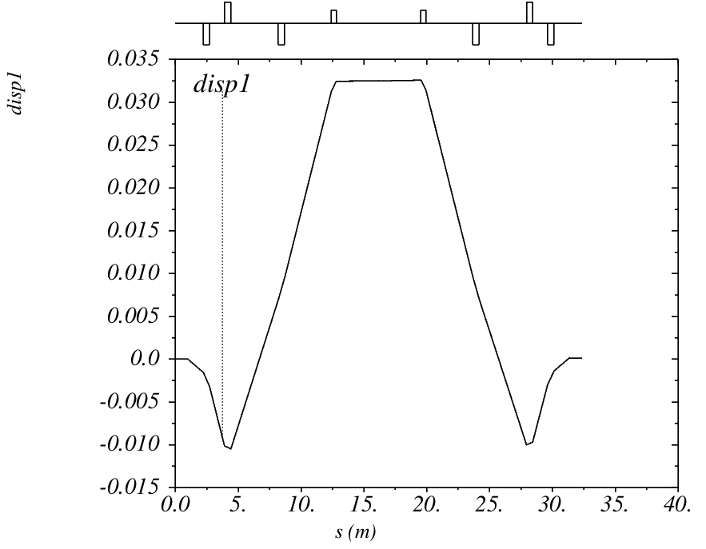
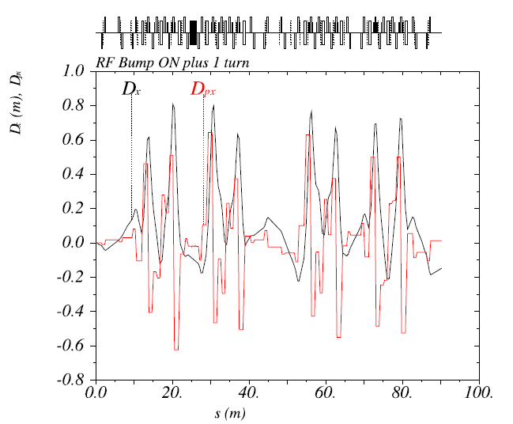
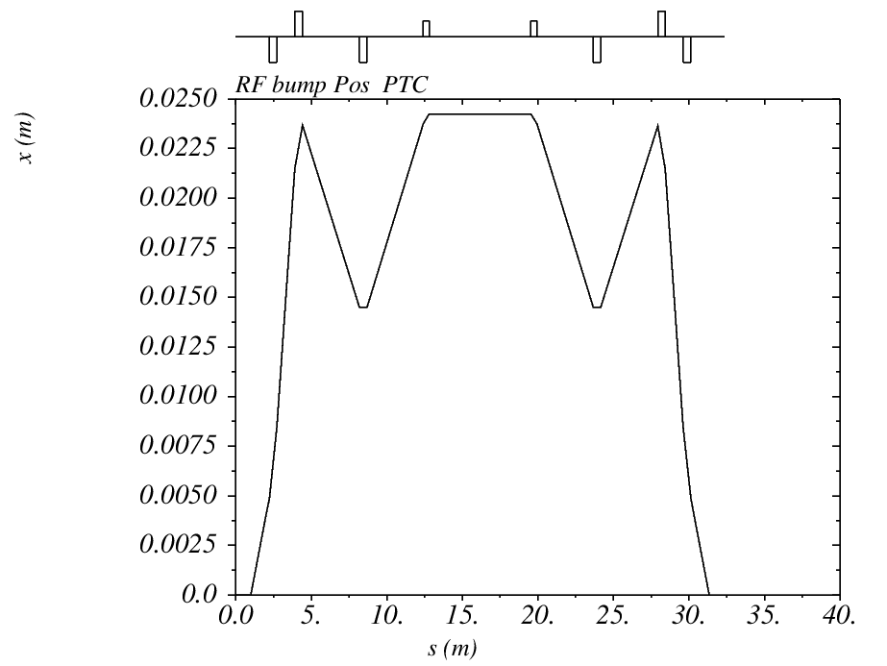
Flaw in RF bump design
The RF bump in CTF3 is not achromatic
  On 3rd turn it spoils the dispersion
    inevitably giving rise to the emittance growth
Only solution would be to install sextupoles in the bump

Slide 10
CR Optics
The optics that is in use in the Combiner Ring is not suitable for
3rd order corrections because it is not symmetric along the cell
  While sextupoles are placed and connected symmetrically
  It was made to be as easy as possible in the times we were fighting with the instability from the RF deflectors
  Appropriate optics is prepared (even more than one)
    It was even quickly checked and it looks OK
    However, due to very tight schedule there was never time to perform the switch and
current
new

Slide 11
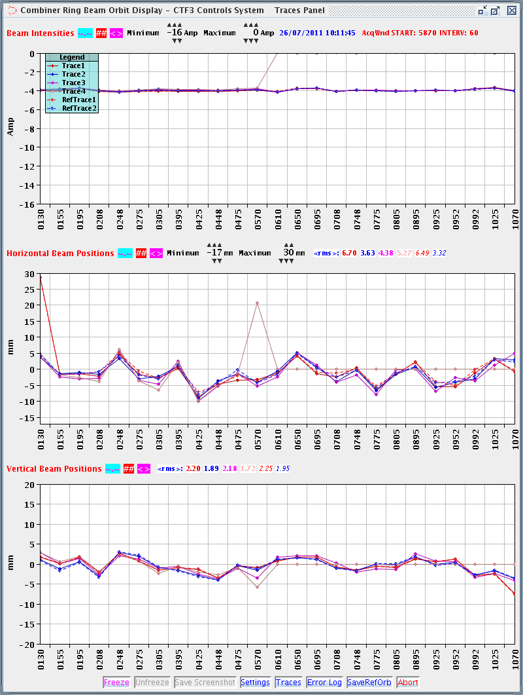
Orbit and Closure
Improvement of the orbit all over the machine: thanks to Guido
  Summary tomorrow
Some issues persists
  Complication from droop in BPI’s that are all over the arcs
    BPM’s are OK
  A few problematic points
    Steering after the first and before the last bend
    At the beginning of the long straight section it seems we have iverted BPI/corrector or optics error
      Must be investigated further
Computer program to close the orbit out of DL is also in preparation by Davide

Slide 12
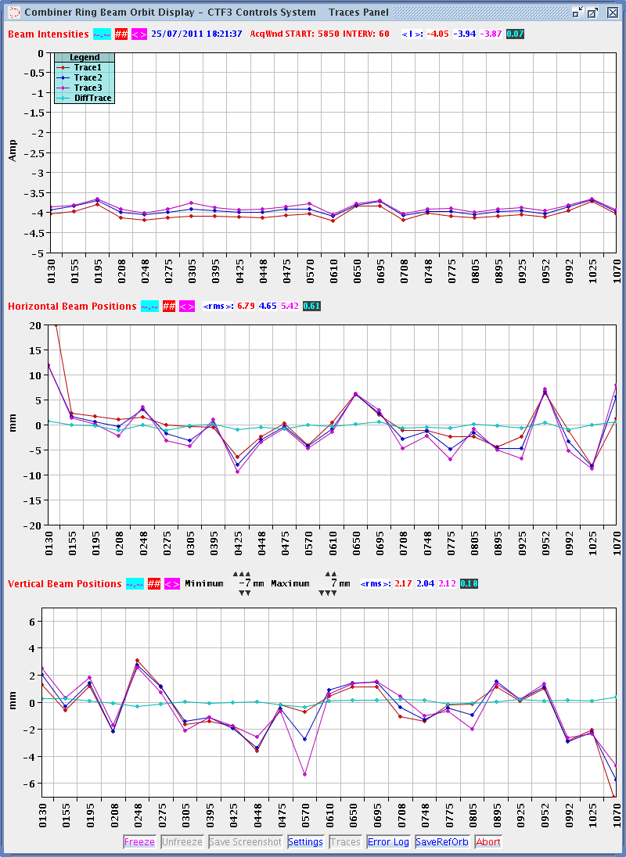
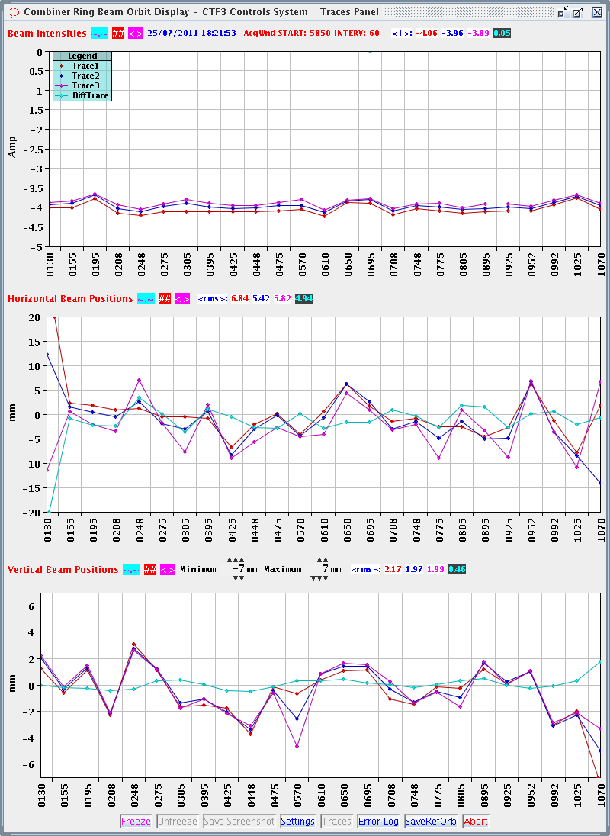
RF Deflectors in CR
Most probably the RF deflectors in CR are dis-balanced
Ben measured optics to check if it is not phase advance problem (must be 180deg), but he found no problem
RF defl stopped on 2nd turn
RF defl on 3rd turn
Red: 1st turn
Blue: 2nd turn
Magenta: 3rd turn
Cyan: 3rd minus 2nd

Slide 13
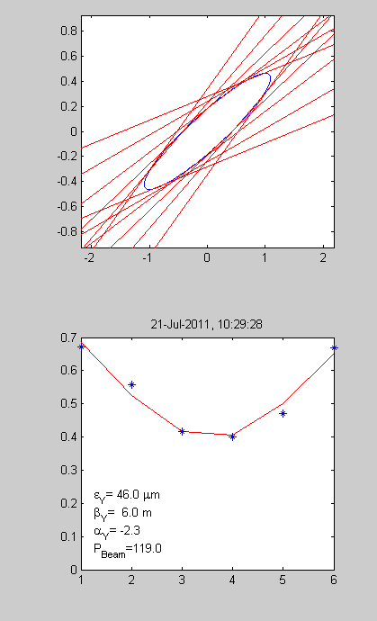
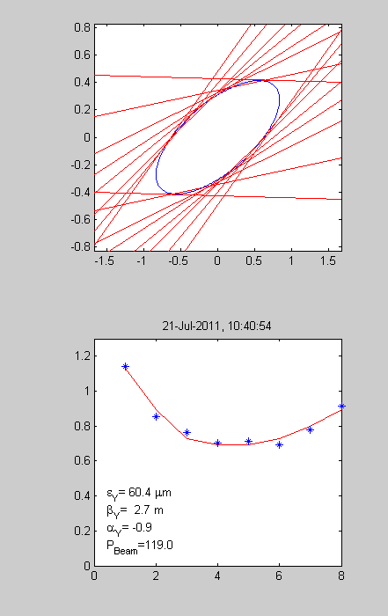
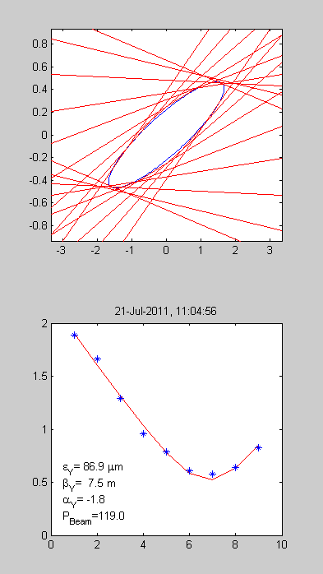
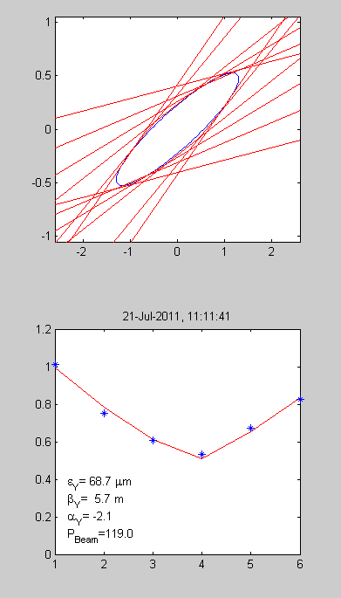
Emittance
The emittance in the linac is 40-50 mm mrad in both planes
It increases in horizontal by 10-20% after Frascati Chicane
We observe emittance growth in the Combiner Ring and TL2
  Remark: Quad Scans just after ejection from the Combiner Ring are very difficult and of not the best quality because
    The optics in the dog leg is very strong to get null dispersion
    The beam is strongly diverging and it is very difficult to find a range
Vertical
Turn 1
Turn 2
Turn 3
Turn 4
46 mm mrad
61 mm mrad
87 mm mrad
69 mm mrad

Slide 14
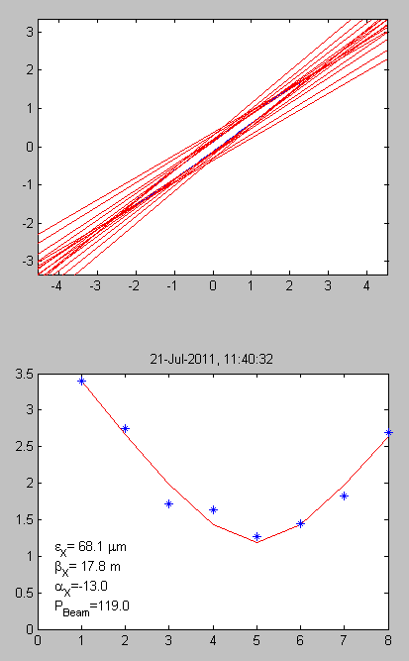
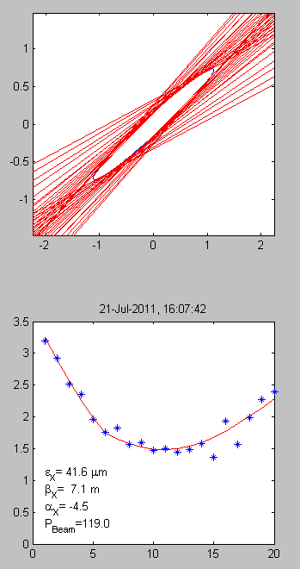
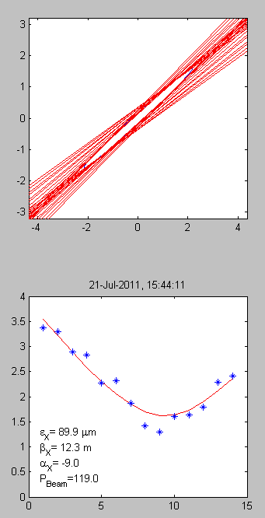
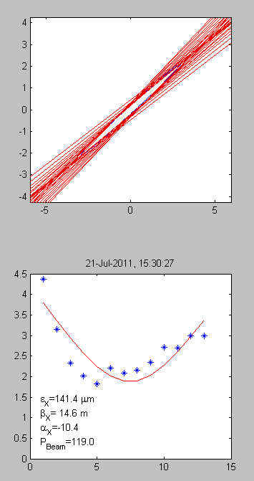
Emittance
The emittance in the linac is 40-50 mm mrad in both planes
It increases in horizontal by 10-20% after Frascati Chicane
We observe emittance growth in the Combiner Ring and TL2
  Remark: Quad Scans just after ejection from the Combiner Ring are very difficult and of not the best quality because
    The optics in the dog leg is very strong to get null dispersion
    The beam is strongly diverging at this point and it is very difficult to find a range
Horizontal
Turn 1
Turn 2
Turn 3
Turn 4
68 mm mrad
42 mm mrad
90 mm mrad
142 mm mrad

Slide 15
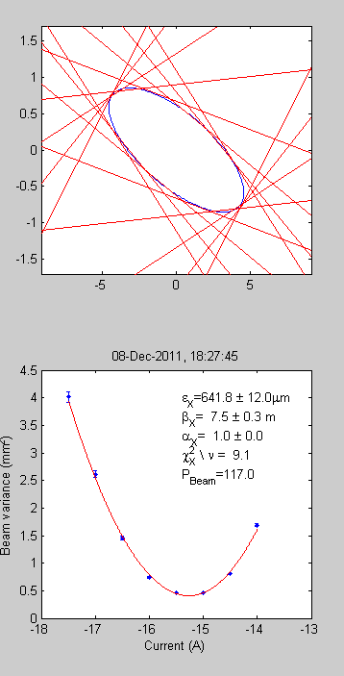
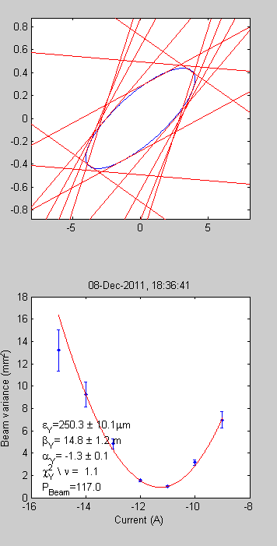
2011 Factor 8 Emittance
Clearly, the biggest issue here is the orbit closure
  We clearly see on the screens that the spot is made of few ones
Not closed dispersion in the RF bump
Bad orbit itself generates dispersion
The large momentum spread combined with strong that we have (due to iso-chronicity requirement) also contributes
  We should check if sextupoles can help here

Slide 16
Summary: Issues and spaces calling for improvements
Switches
Misalignment in the Delay Loop
R56 of Frascati Chicane; Spurious dispersion from Frascati that appeared in Aug 2010
  spent already a lot effort to find the source -> no effect
  Found a work-around by tuning a quad inside
  Might be related to the difficulty of setting op smaller R56
Optics check and control in TL2 and TBTS
Orbit
Closure in DL and CR => Emittance
  Need additional attenuation for the 2nd RF deflector
Chromatic corrections (need good orbit)
Tune measurement and control in CR
For both, DL and CR, beam trajectory is steered down when passing through or passing by the septa

Slide 17
ADDITIONAL SLIDES
ADDITIONAL SLIDES

Slide 18
RF deflector in CR
We found that the RF deflectors in CR are disbalanced
  It was inferred that longer waveguide to RFD1 has higher losses than than the short one with the variable attenuator and variable phase shifter to RFD2
  However, with the minimal setting of the attenuator the kick from RFD1 is still bigger then from RFD2
In principle, the phase advance in between the deflectors different from the nominal 180deg could also the reason
  The phase advance measurements are in preparation
    Tune measurement with quad strength modulation
    Orbit response with 2 correctors (aka phase space painting)
Fixed 3dB attenuator will be installed in the waveguide to RFD1 what will give the full flexibility as it was designed
φ
A
RFD2
RFD1

Slide 19
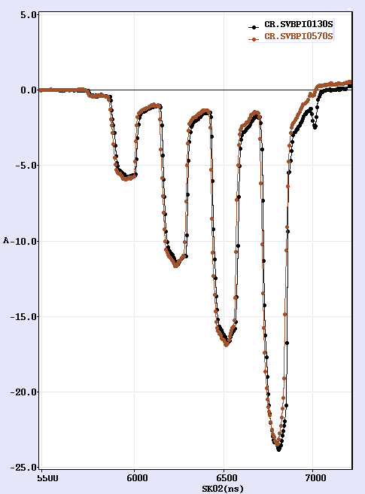
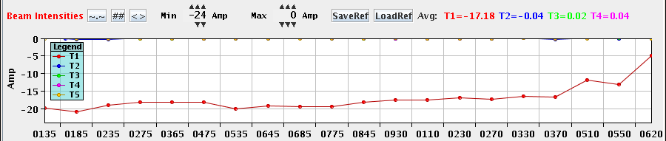
2010 Autumn Run
Recombination factor 8
Routinely delivered 15-16A
  MKS13 was missing
    Only 3.5A was accelerated in the Linac to keep energy 120MeV
  One sub-harmonic buncher not powered due to failure of the power source (Travelling Wave Tube)
The flatness of the pulse still not good
Still losses in CR ejection and TL2
Last week of 2010 run 2nd TWT fails
  Came back from reparation in TMD only in July 2011
    Most of 2011 run was with 3GHz, factor 4 recombined beam

Slide 20
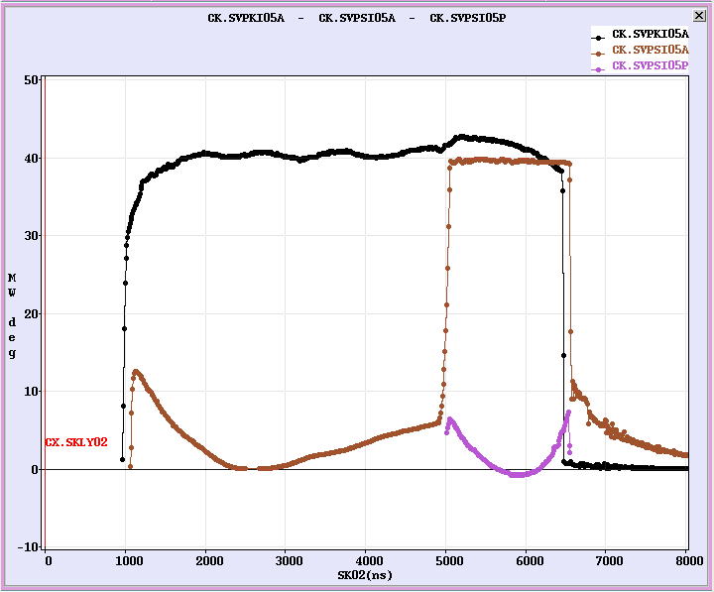
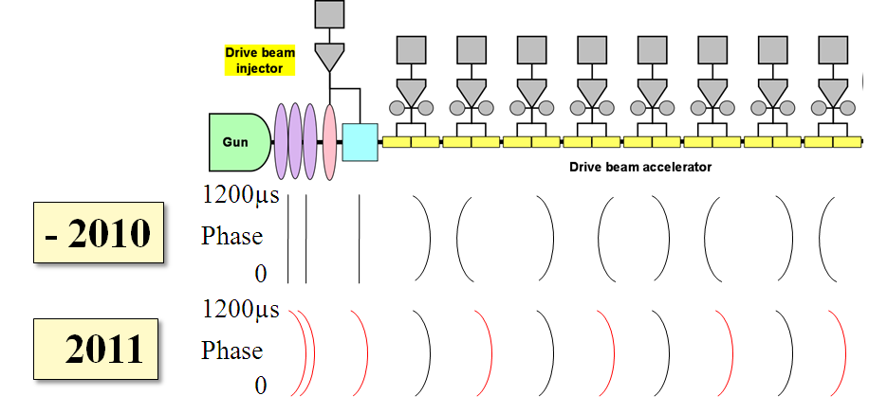
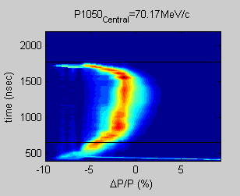
Acceleration RF phase sag
The pulse compression introduces inevitable phase sag of 7-10 deg
Phases are set inversely for consecutive klystrons
  In order to minimize single bunch energy spread variation along the pulse
This leads to energy and bunch spacing variation along the pulse

Slide 21
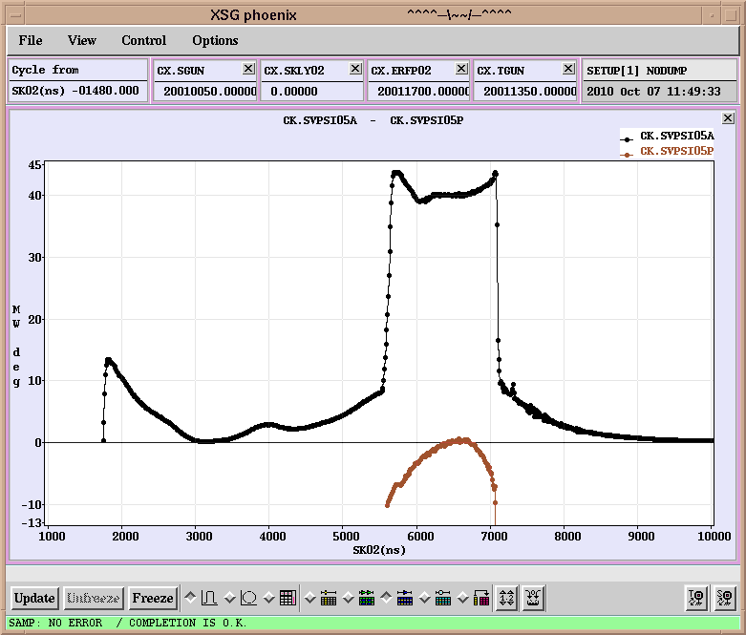
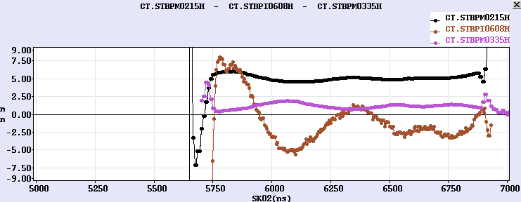
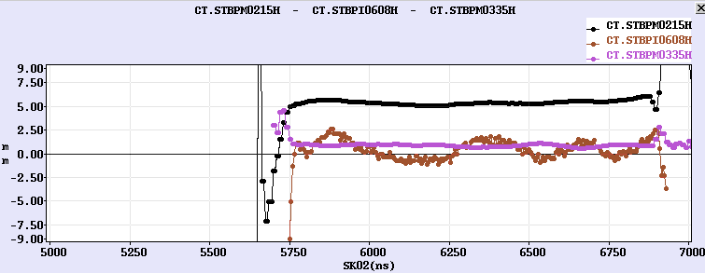
Acceleration RF phase sag
The effects were eventually reduced by shaping power RF
However, large bunch phase variation still present
Before
After correction

Slide 22
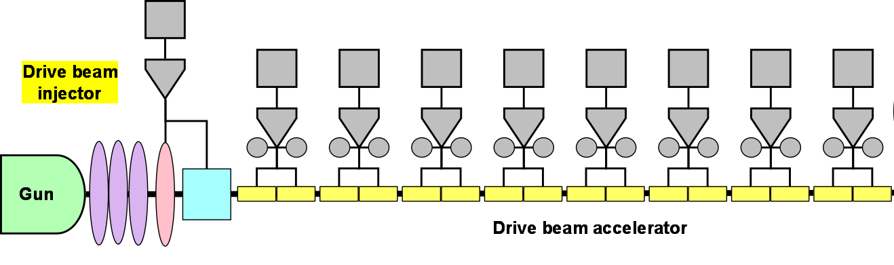
Improved RF setup scheme
This year new scheme was introduced
  All pulses are set the same way
  The same sag is introduced the injector RF
    The RF sources in the injector were equipped with programmable wave form generators to reproduce the sag
1200µs
- 2010
Phase
0µs
1200µs
2011
Phase
0µs

Slide 23
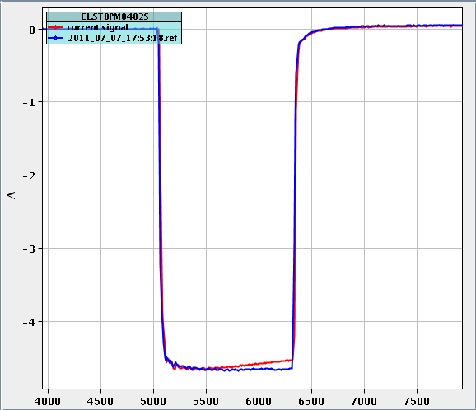
Gun current droop correction
The current delivered from the gun was not constant along the pulse due to high voltage droop
Correction implemented with programmable wave form generator with an amplifier “hooked” to the pulser

Slide 24
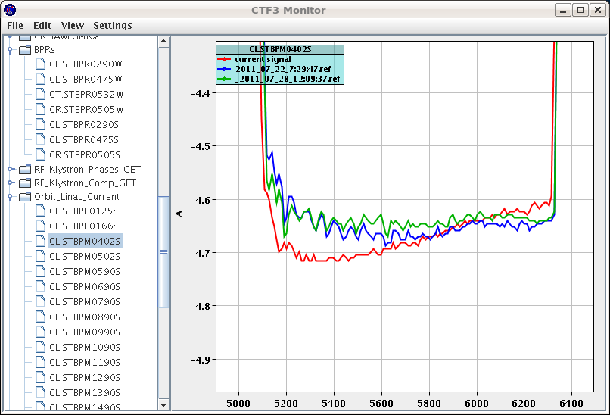
Machine stability and reproducibility
Since autumn 2010 all devices are monitored
  It allows to spot quickly sources of the beam jitter and the drifts
  The same software stores reference for all signals of a given machine configuration
    Permits to recover quickly the desired conditions
Example of CTFMonitor use:
The gun flattening got disabled

Slide 25
Feed-backs
Several drift/jitter sources were identified and feed-backs put in place, predominantly in RF
  Klystron phase
  Coolant temperature for the RF pulse compression cavities correcting the ambient temperature change in the klystron gallery
    Beam was acting as a thermometer of klystron gallery
  RF pulse flatness feedback
  Few others in preparation and tests
    Klystron phase correction to keep constant beam loading
    Phase of injector RF to keep bunch length and the produced 12GHz RF power stable

Slide 26
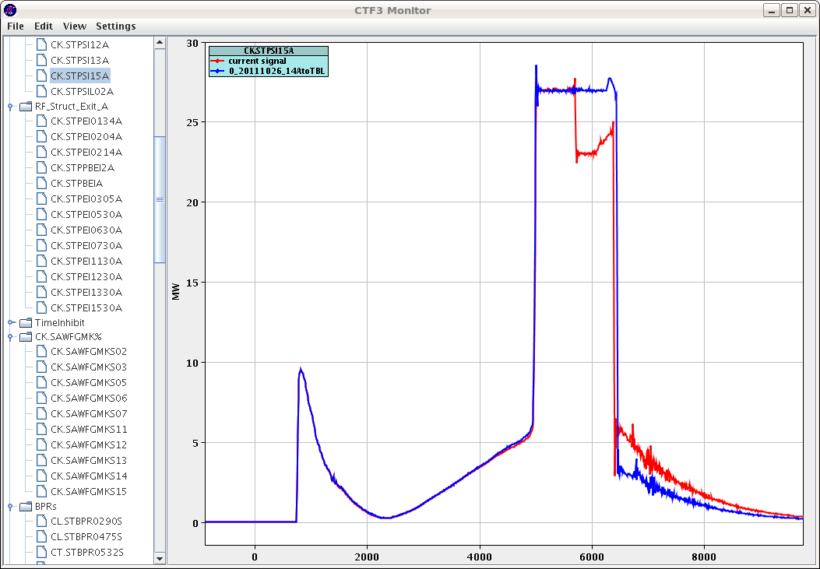
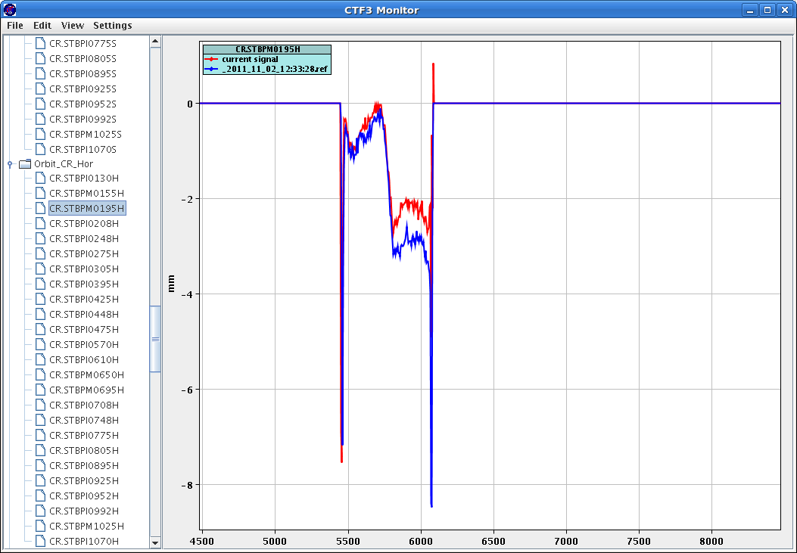
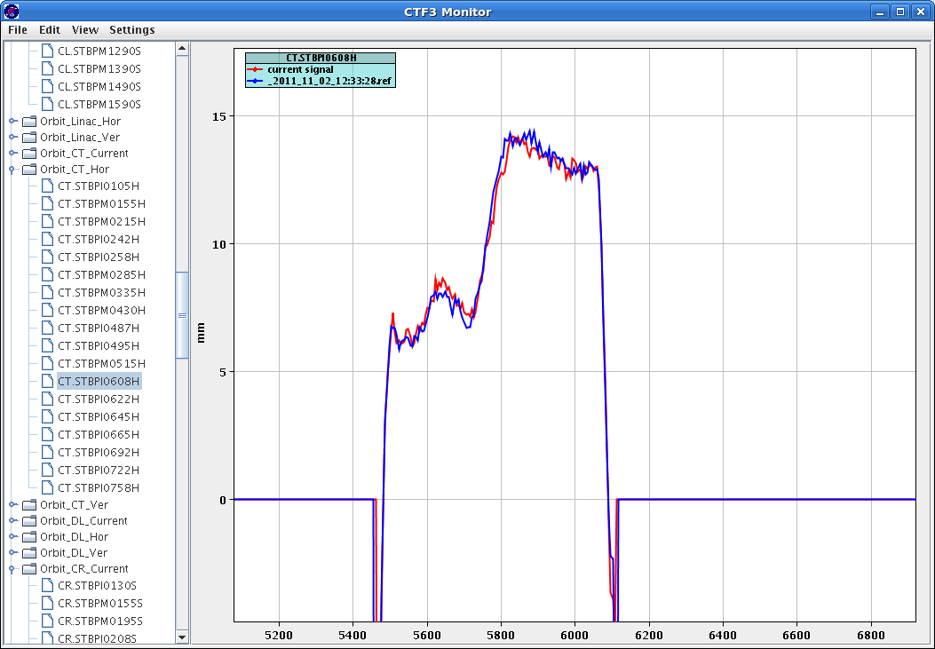
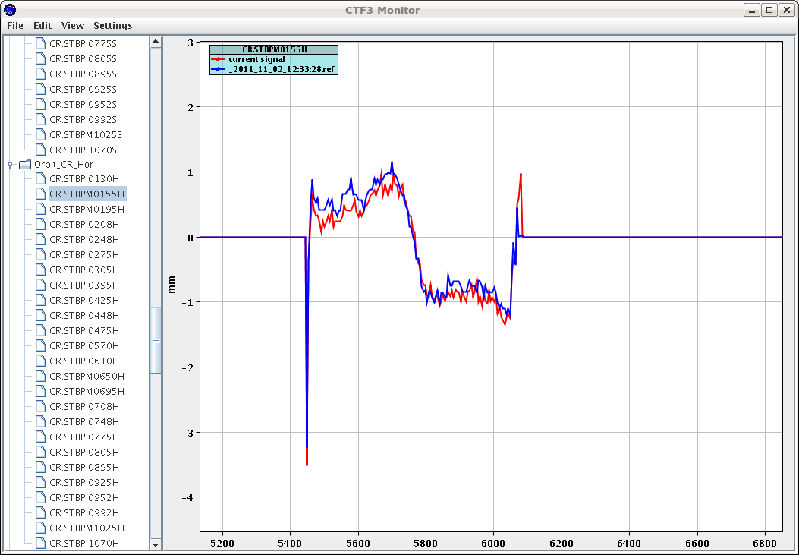
Dispersion: energy step

Slide 27
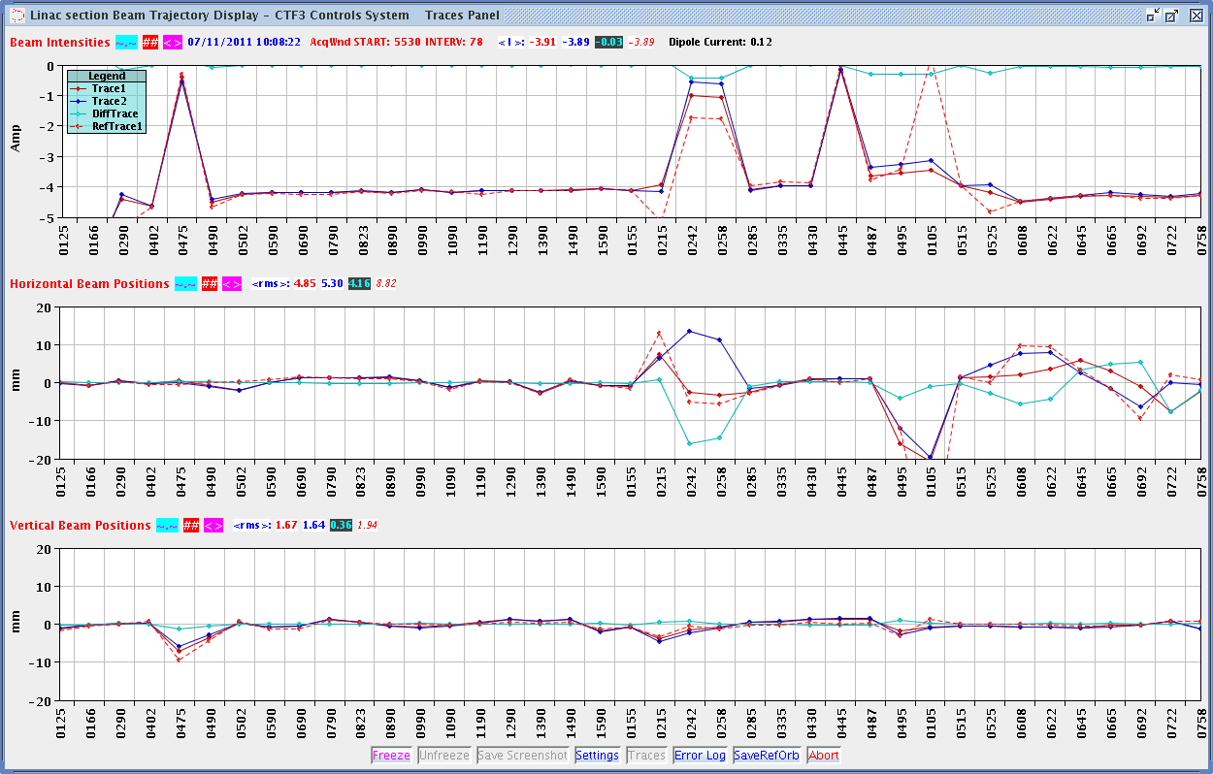
Dispersion with step TL1

Slide 28
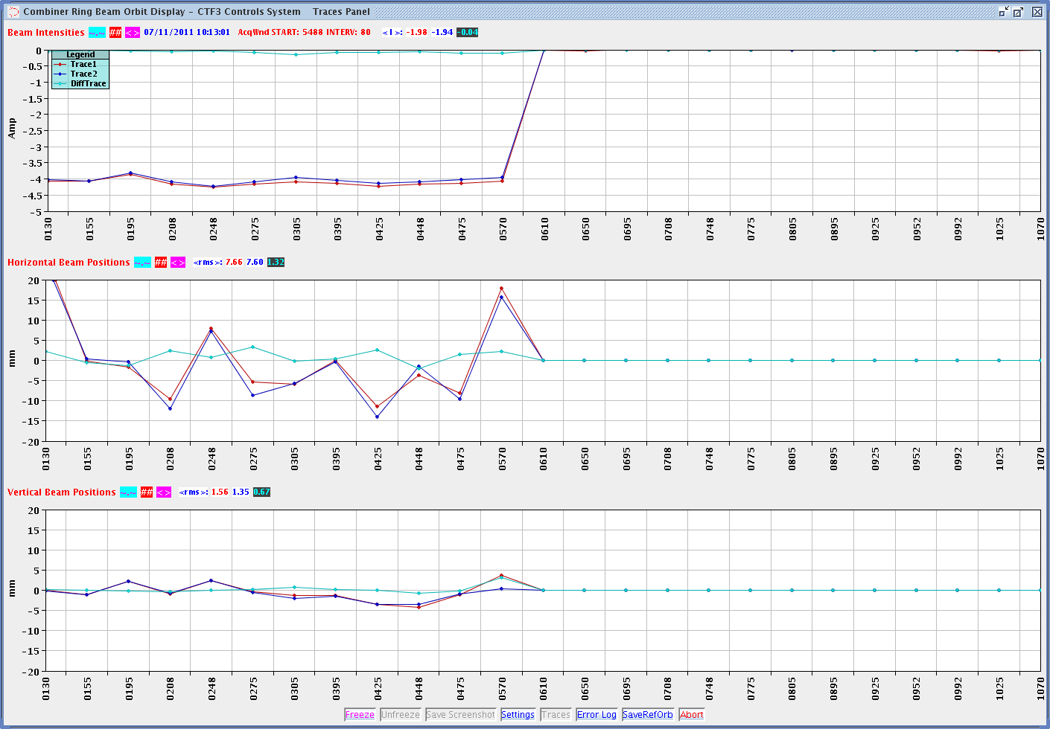
Dispersion with step CR

Slide 29
Dispersion with step TL2

Slide 30
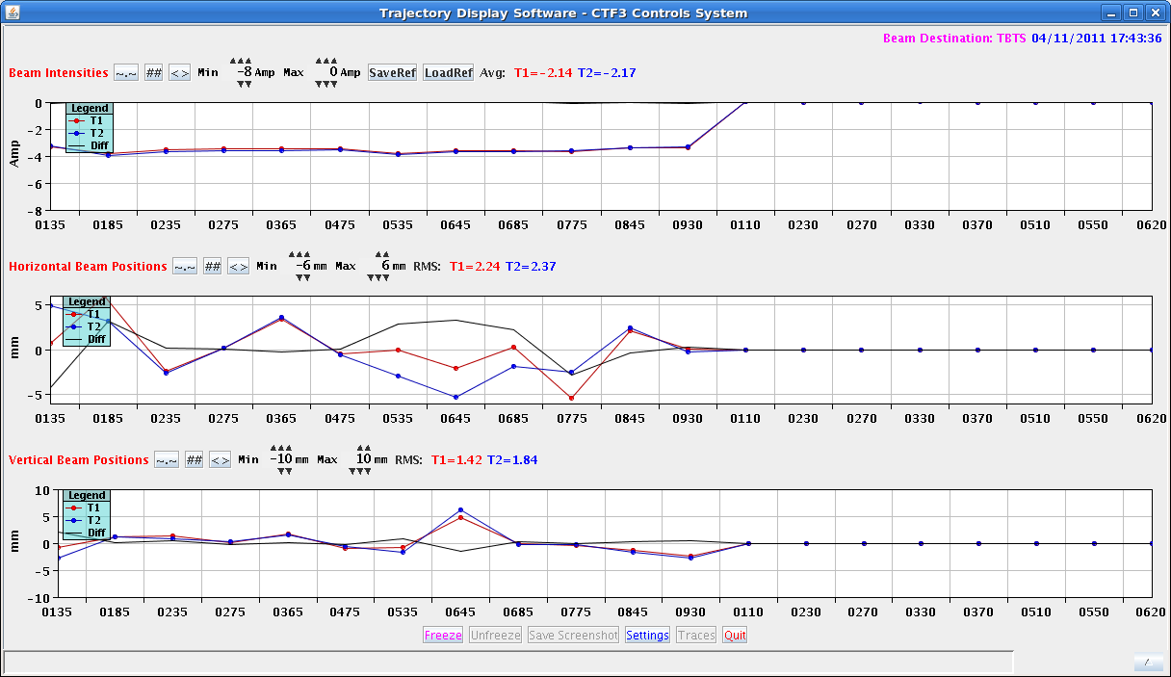
Dispersion with step TL2

Slide 31
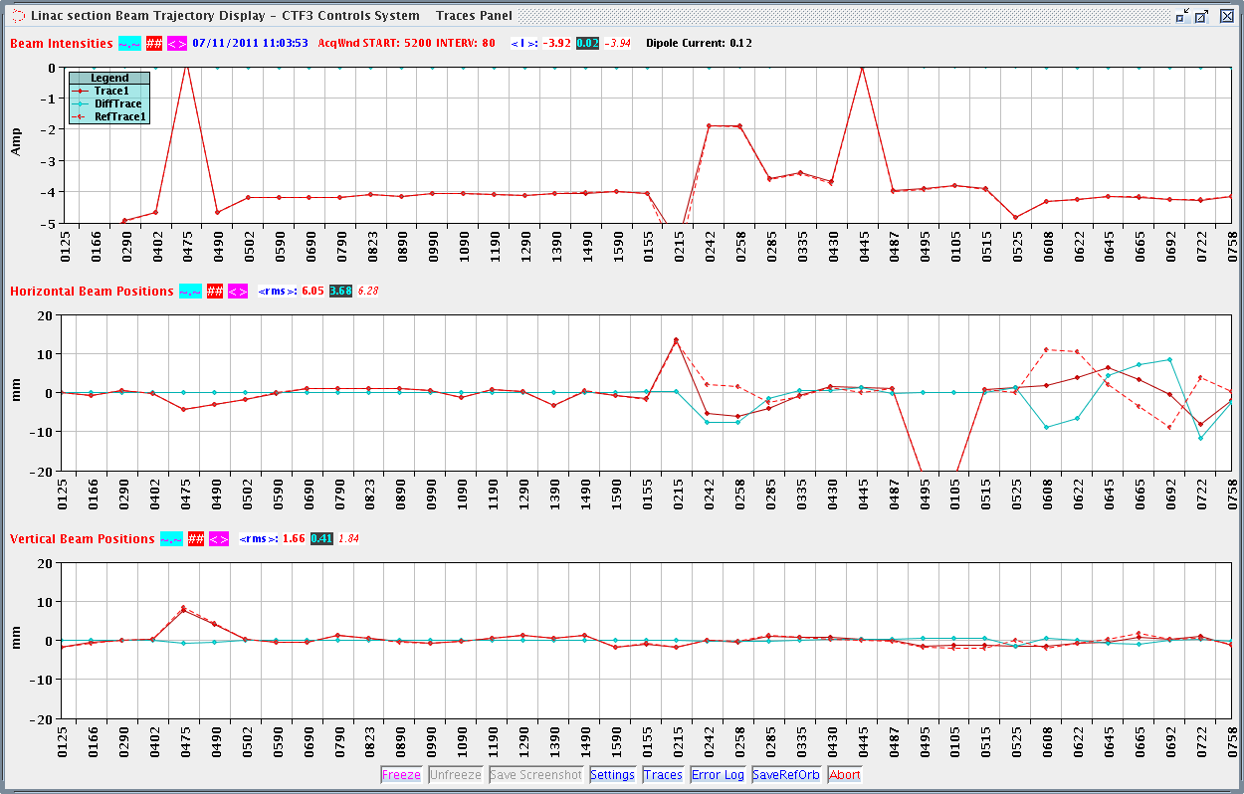
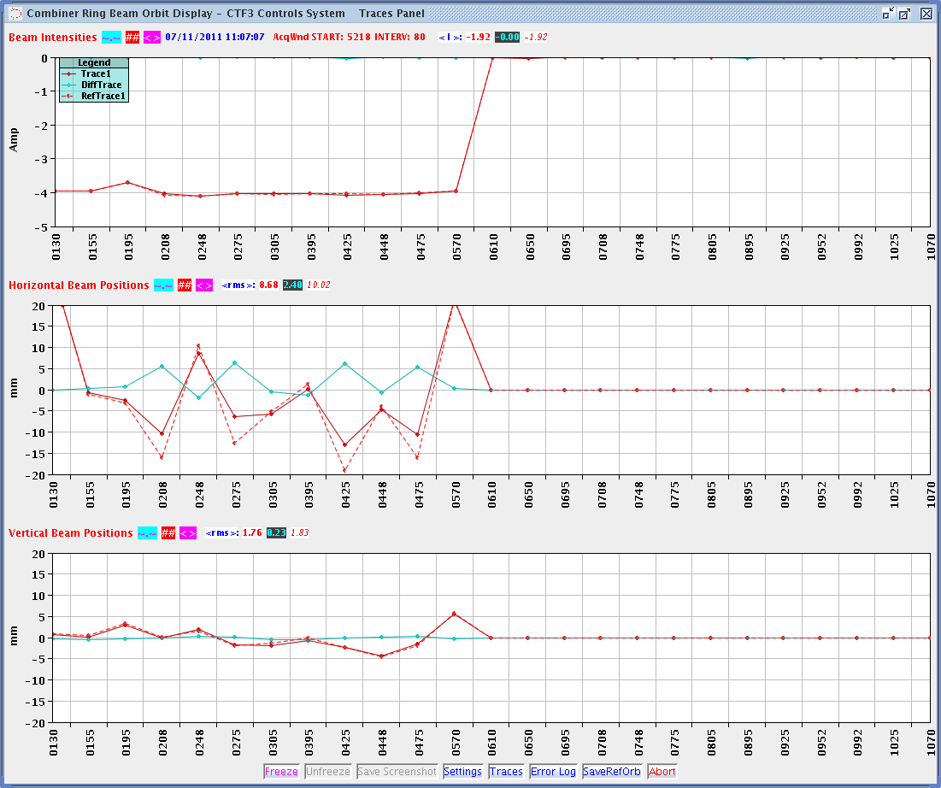
Dispersion girder 15 power change

Slide 32
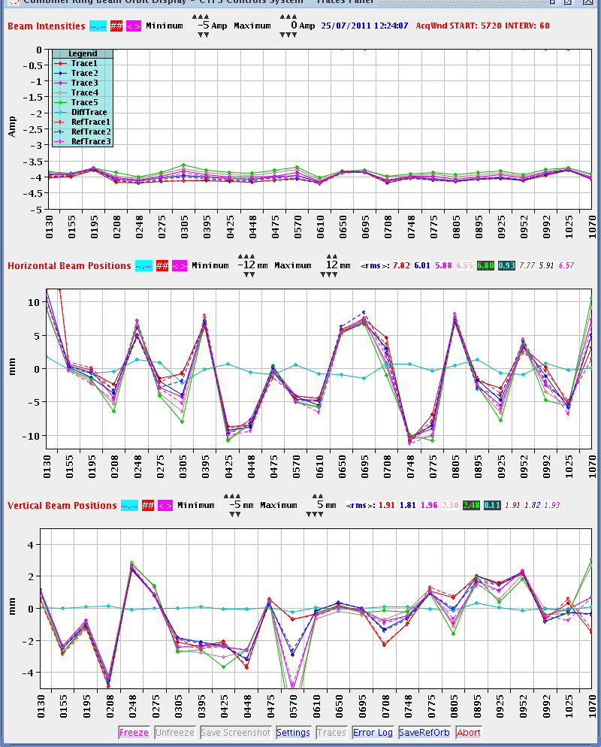
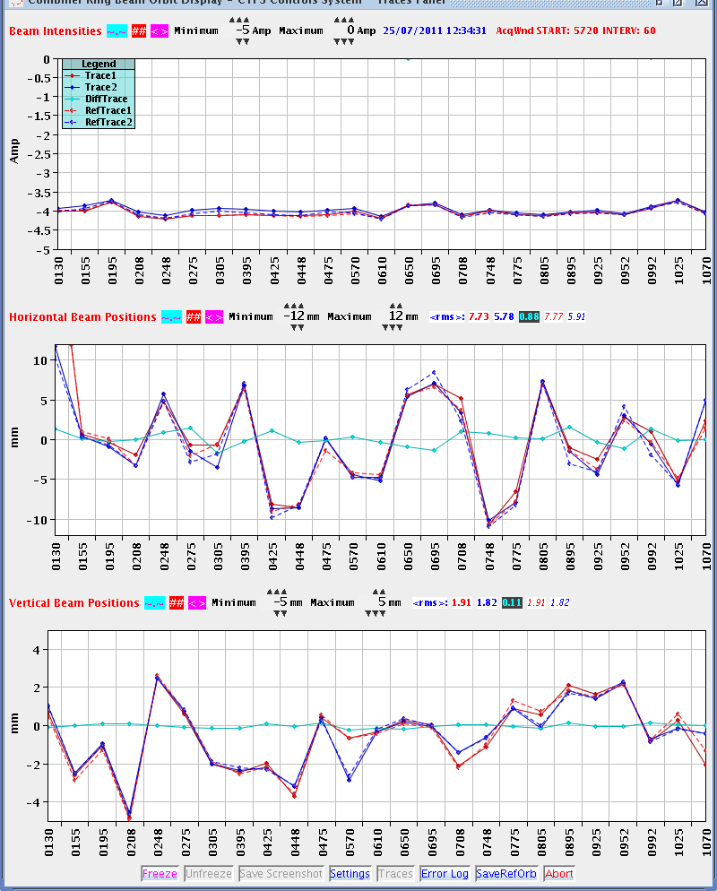
CR closure
Moving RF defl to the 2nd turn does not change the orbit.
Difference is the reference with defl end after inj and the orbit with RF defl in the second turn,

Slide 33

CR closure
Moving RF defl on the 3rd turn. The orbit is clearly changed. Plotted diff of ref of orbit 3 and orbit 3. Min difference at 570 of MKS14-PHAS

Slide 34

CR closure
RF on 4th turn. Can not get 4th turn on the reference.

Slide 35

CR closure
TL2 orbit for different turns

Slide 36

CR closure
TL2 orbit for different turns (2nd)

Slide 37

CR closure
TL2 orbit for different turns (3rd)

Slide 38


CR closure
TL2 orbit for different turns (4th)

Slide 39

CR closure - imroved
TL2 orbit for different turns

Slide 40

CR closure - imroved
TL2 orbit for different turns (2nd)

Slide 41

CR closure – imroved avg
TL2 orbit for different turns (3rd)

Slide 42

CR closure - imroved
TL2 orbit for different turns (4th)

Slide 43


CR closure – improved avg
Combined

Slide 44


Closing CR attempt 2
RF defl stopped after injection

Slide 45

Closing CR attempt 2
RF defl on 2nd turn, adjusted phase of MKS14-PHAS.
Diff is Reference Turn 2 and Turn 2

Slide 46
Closing CR attempt 2
Before and after Rf defl on turn 3
Diff is od Reference Turn 3 and Turn 3.

Slide 47






Traces for above

Slide 48



Closing CR attempt 2
Before and after Rf defl on turn 4

Slide 49


Night operation with remote supervision from CCC
We have reached a sufficient stability to leave the machine operating during nights with remote supervision from the Cern Control Center
  Required implementation of a beam loss interlock
    If current lower than a threshold over more than 30 seconds the gun is disabled
Drive beam current
12GHz RF power

Slide 50

Night operation with remote supervision from CCC
We have reached sufficient stability to leave machine operating during night with remote supervision from the Cern Control Center
  Required implementation of beam loss interlock
    If current lower than a threshold over more than 30 seconds the gun is disabled

Slide 51
Night operation with remote supervision from CCC
We have reached sufficient stability to leave machine operating during night with remote supervision from the Cern Control Center
  Required implementation of beam loss interlock
    If current lower than a threshold over more than 30 seconds the gun is disabled
It allowed for efficient conditioning of the accelerating structure in Two Beam Test Stand and break down rate measurements
  The night operation performance was limited by stability of klystrons that very oftern trip
    Automatic restart procedure was implemented in dedicated computer program
    Still, often human intervention is needed and CCC crew is not always able to react promtly to restore the beam

Slide 52
Bunch length and its control
We measure bunch length of 18ps FWHM using streak camera and rf deflectors + OTR screens
Streak camera measurements shows that the length stays constant over several turns in the Combiner Ring
Newly installed camera in CLEX measures XXX
The level of the 12GHz power production gives form factor 0.85-0.95 that is in agreement with the direct bunch length measurements
Lower R₅₆ setting in the Stretcher Chicane still needs to be commissioned
  We attempted to setup R₅₆=0 previous year but could not get quickly the lossless transmission

Slide 53



Fully Recombined Beam
The quality of factor 8 recombined pulse is much worse than the factor 4
Since 2010 the sub-harmonic bunching introduces a before unseen energy variation
  In 2006-2009 we did not observe it to this level
    Than it is not a fundament
  Till now we do not have its explanation
  The phase itself is switched very quickly
    Streak camera shows below 10ns
  Bunching is disturbed by this transient for over 100ns

Slide 54
Tools in preparation
Dispersion Free Steering for whole machine
Orbit closure for DL and CR

Slide 55


Emittance 2011 Factor 8

Slide 56



Emittance 2011 Factor 8

Slide 57


Emittance 2011 Factor 8
The same as above (Ben’s fitting)

Slide 58

Factor 8 at CC0970

Slide 59


Emittance 2011 Factor 8
DL part killed

Slide 60



Emittance 2011 Factor 8
DL part killed

Slide 61



Emittance Factor 4 in CLEX

Slide 62



Emittance Factor 4 in CLEX

Slide 63

Quad Scans for single turn
Combined 1,2,3,4

Slide 64
Conclusions
The delivered drive beam allowed to perform the key experiments in TBTS and TBL in 2010 and 2011
We demonstrated the recombination concept at the right current level
However, the quality of the drive beam is still not fully satisfactory; many optimizations and studies are still to be done
  The Drive Beam quality optimizations were often sacrificed in order to assure accomplishment of the key experiments
  Therefore, suffered first when unexpected events stopped CTF3 for long periods in 2010 and 2011
  CTF3 is limited by the need of reusing the existing hardware, and therefore has a design and a hardware that is not optimized for its purpose
  We suffer from many operational issues, mainly in stability matters but also in instrumentation, which limit the machine performance
    In the time span of emittance measurement the dispersion and orbit closure are sufficiently spoiled
    We put effort to stabilize the beam by understanding the drift sources and implementing appropriate feed-back

