Slide 1
CTF3 Streak Camera
Results and Improvements
Aurélie Rabiller BE-BI-PM
09.02.2012

Slide 2
Summary
2011 Measurements in CR, DL and CLEX
Optical lines improvements
Streak camera operation
Discussion

Slide 3
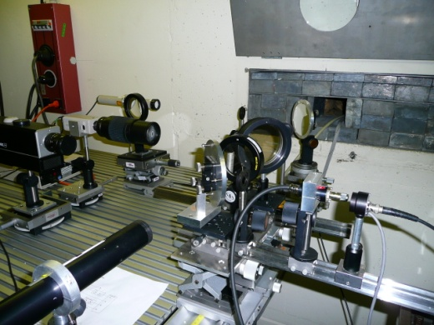
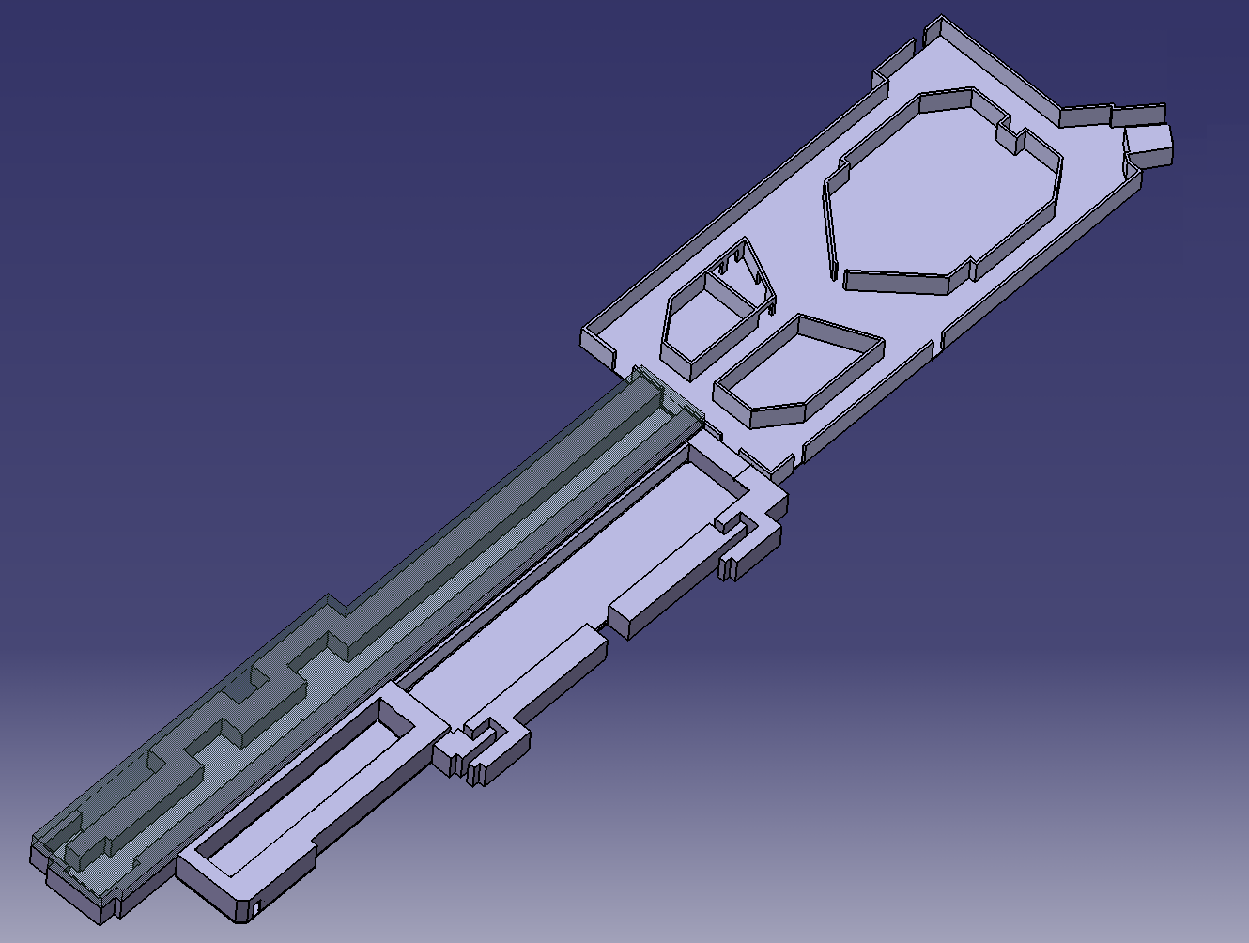
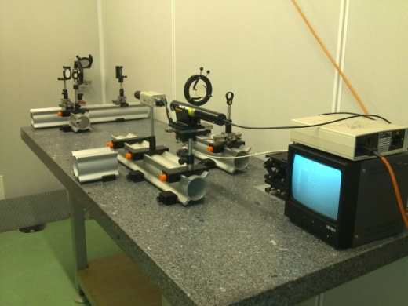
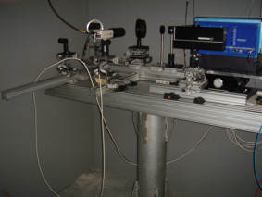
Streak camera optical lines
DL lab
CR lab
CLEX lab
OTR light sources
Synchrotron light sources

Slide 4
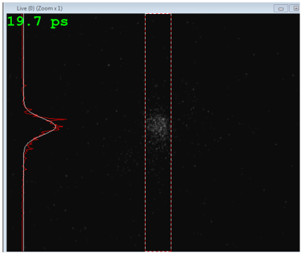
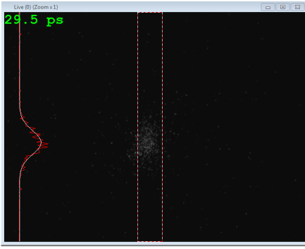
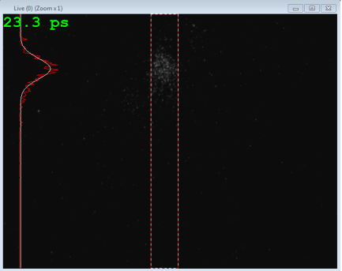
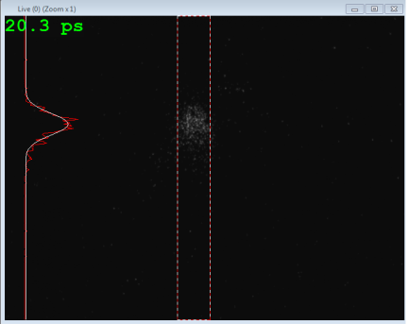
2011 Measurements
Combiner ring: Bunch length stability and bunch spacing
Multi-turn bunch length stability (July)
Bunch length: 200 ps window Turn 1 to Turn 4 (10.06.2011)
Bunch Spacing (July)
Very few measurements this year due to the difficulties to operate the beam
+
Misalignment of the optical line
Bunch spacing : 500 ps window Turn2 and 3 (13.07.2011)

Slide 5
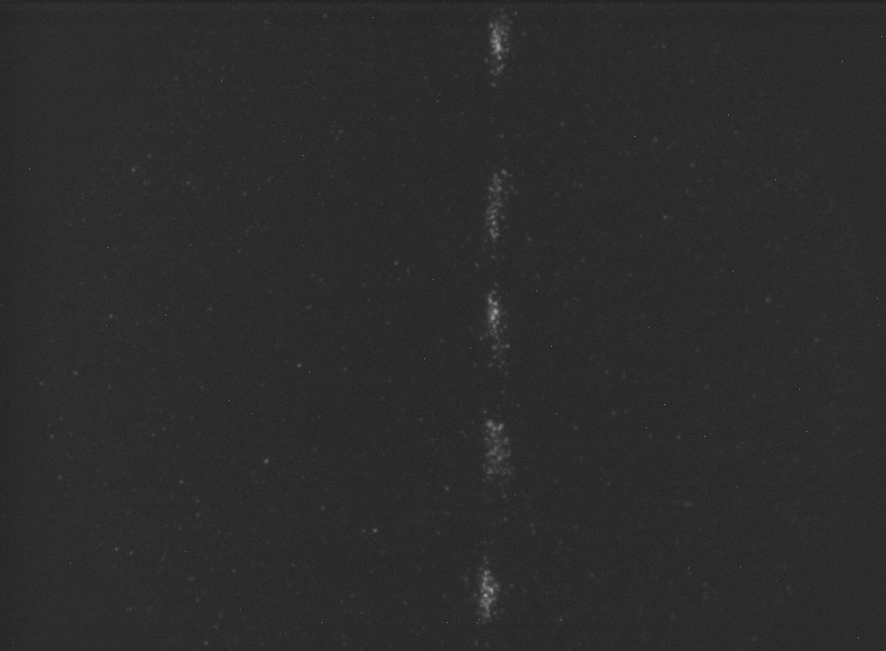
2011 Measurements
CLEX: bunch length and bunch spacing
Bunch length and bunch spacing along the train (July)
Bunch length and bunch spacing along train: 25 ps/mm speed
First measurements with the line done successfully
Need more beam time to finish commissioning

Slide 6
Optical lines improvements
Combiner ring:
re-alignment of the lines => next week
Delay Loop:
re-aligned last year, shoud be ready for measurements
(No measurements last year due to difficulties to send the beam in DL)
CLEX:
- addition of a light shielding => next month
- replacement of the lens by an elliptical mirror => this year
Third streak camera equiped with readout camera => ready
=> One streak camera for each lab

Slide 7
Operation of the streak cameras
General procedure:
spot adjustment in focus mode (no sweep) : the spot should be centered on the slit and as focused as possible
slit reduced to 0.2-0.4mm (depending of the spot size and the light intensity)
In Focus mode, the camera is really sensitive to light
switch in sweep mode with the biggest time window (1ns) to find the train (trigger delays adjustment)
Reduce step by step the time window with trigger and gain adjustment
For this procedure, the presence in the lab is required

Slide 8
Operation of the streak cameras
Old streaks:
Manual control of shutter, slopes and gain
=> For the operation of old streaks, presence in the lab required
no online values => data needed to be processed (Matlab or equivalent)
New streak:
automatic control of shutter, slopes and gain
online bunch length value provided
possibility to use cursors on the graphic window for rough bunch spacing values
possibility to control the camera with LabView application

Slide 9
Discussion
Online processing of the data (Labview application or else)
Remote control of the cameras
...

