Slide 1
TBTS data analysis
Overview of on-going studies
Disclaimer: All results are preliminary and not yet consolidated

Slide 2
Contents
Statistical analysis
  Various BDs detection channels
  BDR – overview of recorded experiments
  BD’s time distribution and Poisson law
  RF exposure time before BD and time power law
Signal processing analysis
  RF signals without BDs
  BDs signatures – RF input reaction
  BDs locations – possible migration of BDs
New diagnostics and possible improvements

Slide 3
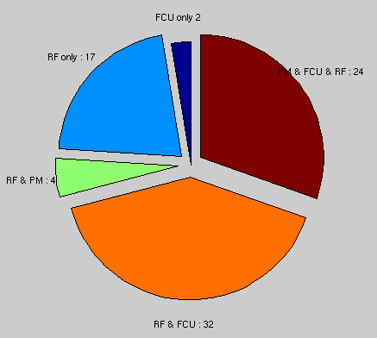
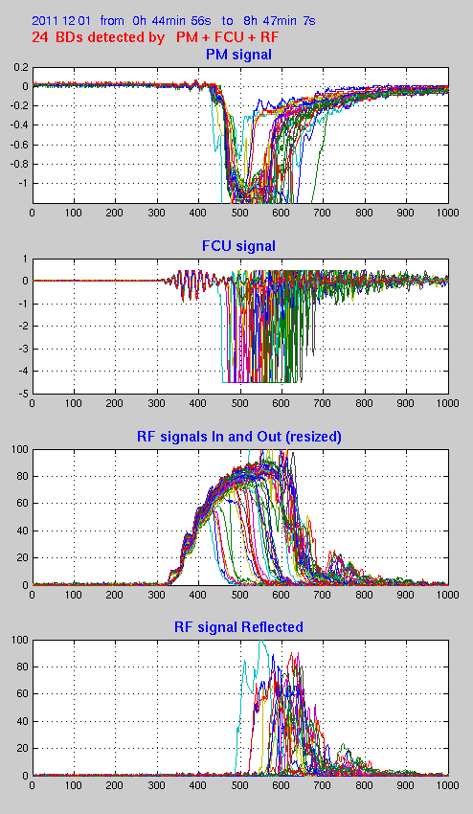
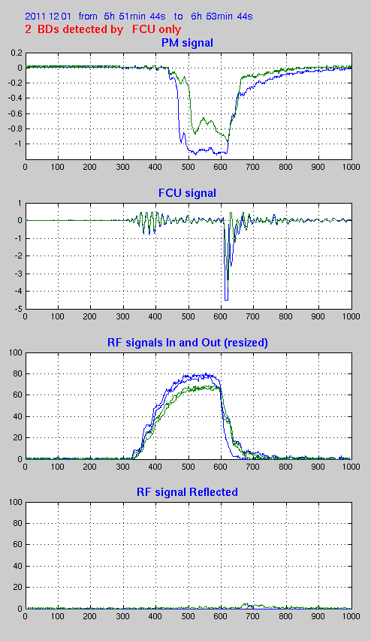
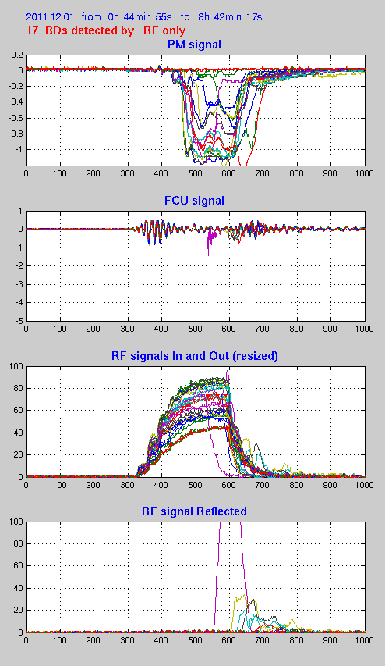
BDs detection triggering data storage
1st Dec 2011 record
3 diagnostics detection
Rare cases of FCU detection only
RF detection only
With the present instrumentation set, most of the BDs are detected by RF signals (Reflected RF and Missing Energy).
PM is jammed by noise (dark current, X-rays ?)
FCU is sensitive to RF noise (like BPMs) and not always inserted (probe beam)

Slide 4
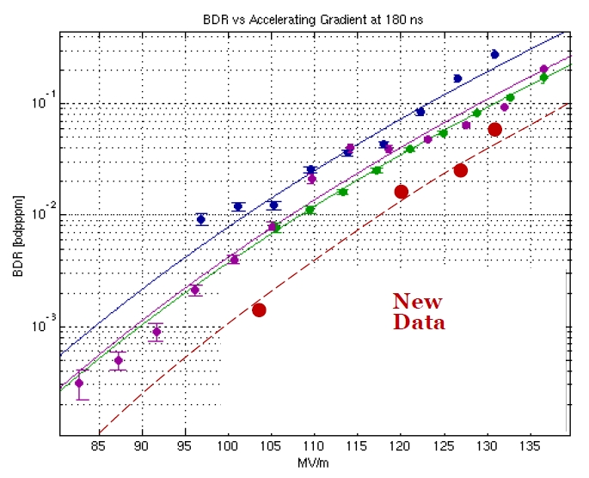
BDR from the last experiments
Date | Start time | Stop time | Power (MW) | Pulse (ns) | BDR
21 Nov. | 22.24 | 22.26 | 70 | 160 | 0.88
22 Nov. | 14.56 | 9.51 | 60 | 240 | 1.7 10⁻²
23 Nov. | 18.41 | 23.20 | 70 | 220 | 1.9 10⁻²
24 Nov. | 00.13 | 9.29 | 80 | 200 | 1.3 10⁻²
30 Nov. | 18.48 | 00.16 | 70 | 175 | 7.4 10⁻³
1 Dec. | 08.55 | 9.09 | 80 | 220 | 4.0 10⁻³
3 Dec. | 01.21 | 14.58 | 50 | 220 | 3.0 10⁻⁴
6 Dec. | 19.42 | 08.25 | 80 | 220 | 5.8 10⁻³
7 Dec. | 20.00 | 21.15 | >100 | 120 | 0.8
8 Dec. | 12.59 | 16.58 | >100 | 150 | 0.15
R. Corsini – CLIC Project Meeting, 9 Dec. 2011
Only few records are meaningful for statistics

Slide 5
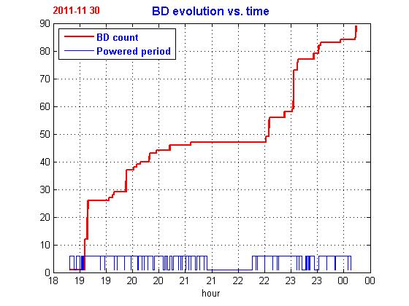
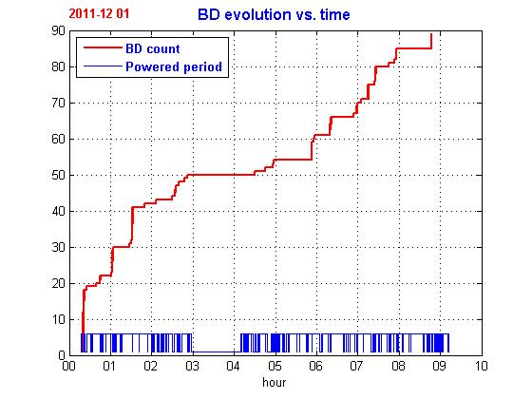
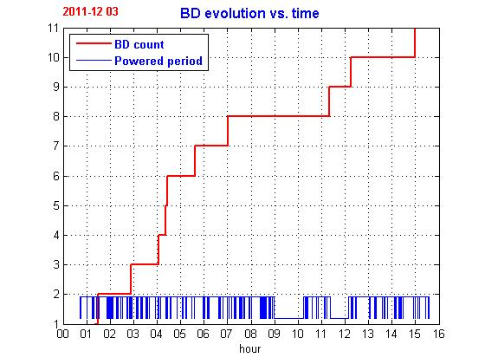
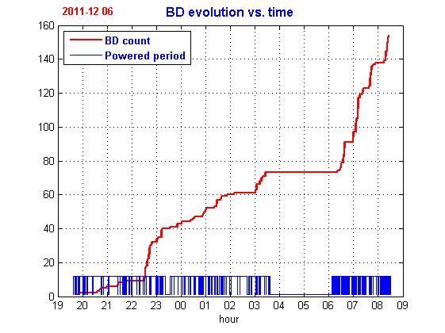
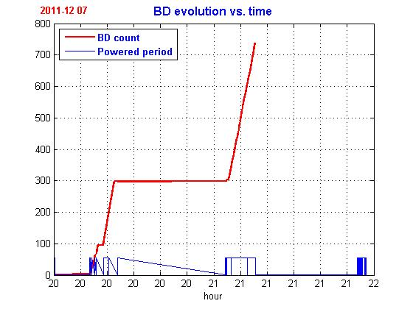
BD count vs. time
Input Power: 70 MW
Pulse length 175 ns
Input Power: 70 MW
Pulse length 220 ns
Input Power: 50 MW
Pulse length 220 ns
Input Power: 80 MW
Pulse length 220 ns
Input Power: 100 MW
Pulse length 120 ns
Due to Drive Beam trips only BDs count vs. “nominal” RF pulses number is meaningful.

Slide 6
Numbers of RF pulses before a BD
Histogram and zoom on bins below 20 showing the cluster effect.

Slide 7

BDs time distribution and Poisson law
High BDR
Low BDR
Randomly distributed events should follow the Poisson law.
                k : number of BDs, λ : BDR x number of pulses
Clusters make the BD probability (BDR) non stationary

Slide 8
Discarding the cluster events
Evolution of mean/σ with the cluster size rejection
(1 for a Poisson distribution)
Rejecting clustered BDs leads the BDs events to be more “Poisson Like”

Slide 9
Probability of one BD within a given number of RF pulses
Clusters rejected up to 20 pulses between BDs
No clusters rejection needed at low BDR
Poisson law for k = 1 and λ computed using the raw BDR (not a fitted one)

Slide 10
RF exposure time before BD
Exposure time before BD
Histogram of exposure time before BD
Exposure time measured on RF transmitted
  Dependent on edge definition (especially with recirculation pulse shape)

Slide 11
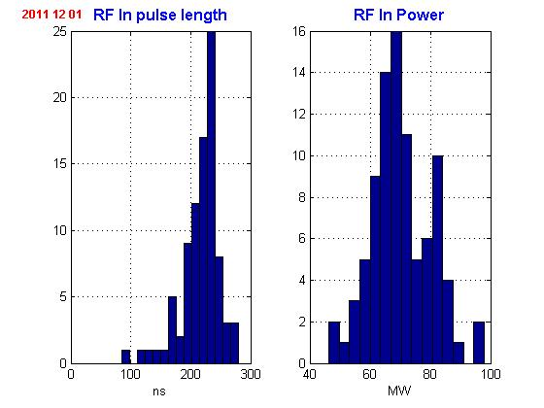
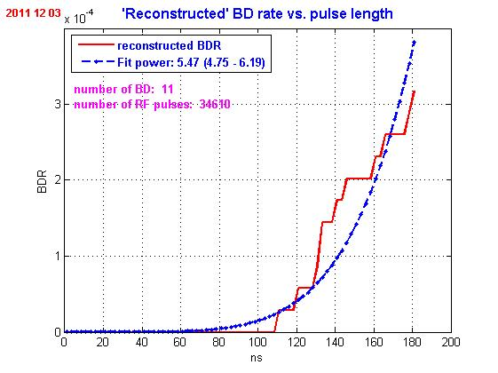
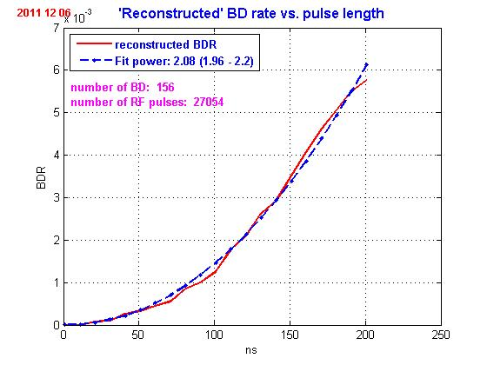
BDR as function of exposure time
Pulse length and energy stability checking
Assumption : BDs occurred before a given time have the same statistic as if the pulse length would have been this time: NO MEMORY EFFECT CONSIDERED

Slide 12
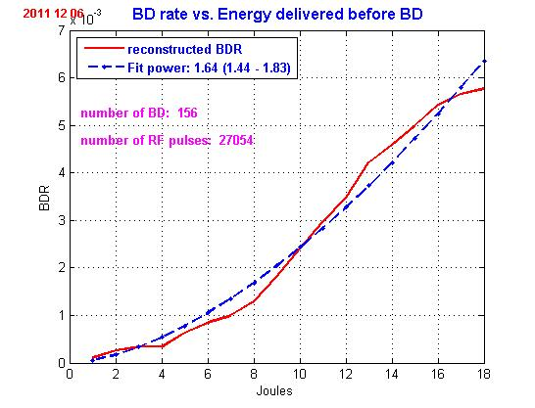
Influence of clusters
With cluster rejection (3)
All BDs occurring before 100 ns exposure time are inside clusters
Alternative dependence law: “Energy delivered before BD” to avoid rising edge problem (thank to Jan Kovermann)
It will be very interesting to draw the same plot at various pulse lengths at low BDR (checking a possible “fatigue” effect)

Slide 13
RF signals without BDs
Quite stable pulse length and power characteristics
100 superposed signals including 1 BD
Average input signal and steps detection showing the recirculation loop delay of 31 ns
RF reflected phase
Without BD all signals are quite stable: good RF power production by the Drive Beam

Slide 14
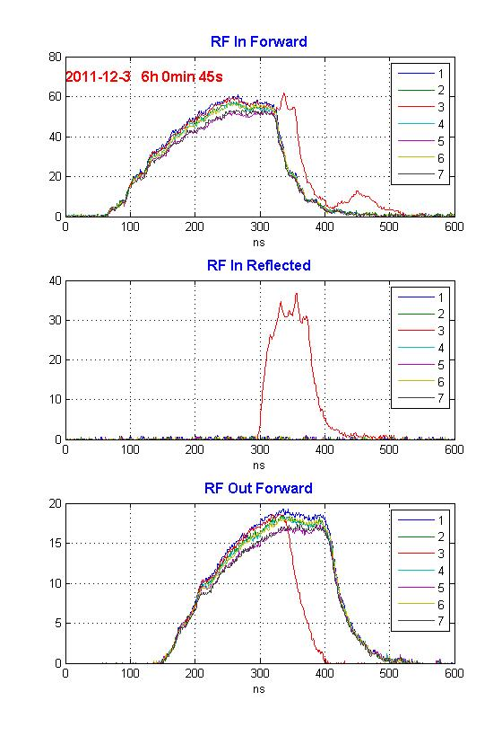
Evidence of ACS BDs effect on RF Input
A BD in the ACS affect the PETS output
Possible bouncing of an early BD reflected power
The reflected power is likely to change the phase of the recirculation loop and consequently modify the PETS produced power

Slide 15
BD location determination
Reflected rising edge
Transmitted falling edge
1st method
By Δt between Reflected rising edge and Transmitted falling edge
(BD start)
Input falling edge
Reflected falling edge
2nd method
By Δt between Input falling edge and Reflected falling edge (echo)
(BD end)
PM and FCU signals could also be used

Slide 16
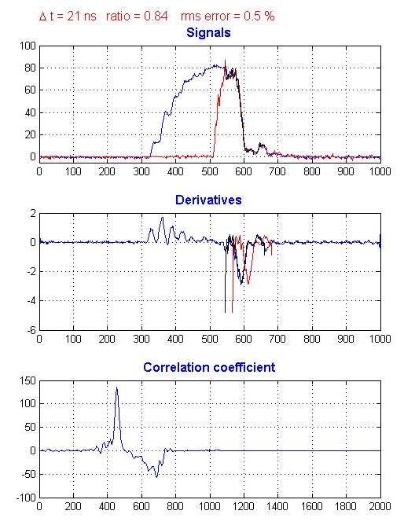
Edge correlation Input - Reflected
Use cross-correlation of the derivatives of the falling edge area to accurately determine the Δ time
Then fit the amplitude minimizing rms difference between shifted signals to determine the attenuation

Slide 17
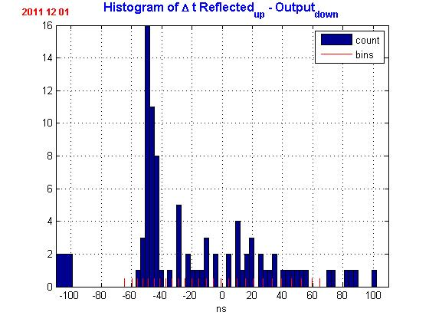
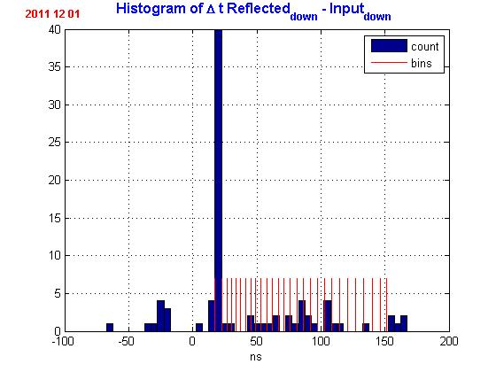
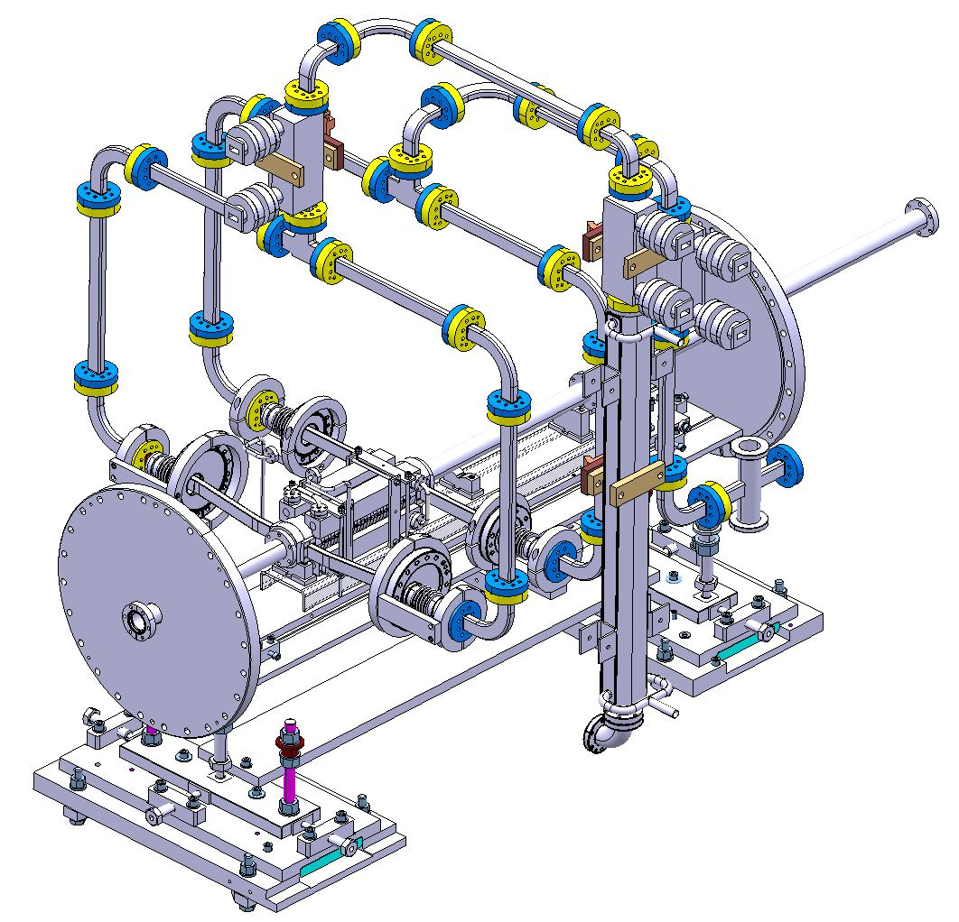
BDs location histograms
L₃₋₄ = 2287.469 mm
1
3
4
2
Anastasiya Solodko
L₁₋₂ = 1589.001 mm
1st method : cell #5 seems more affected
2nd method : cell #1 seems more affected
Cells bins determined by installation and TD24 characteristics TD24_vg1.8_disk 12WDSDVG1.8 CLIC_G disk at 12 GHz A.Grudiev, 25/03/10

Slide 18
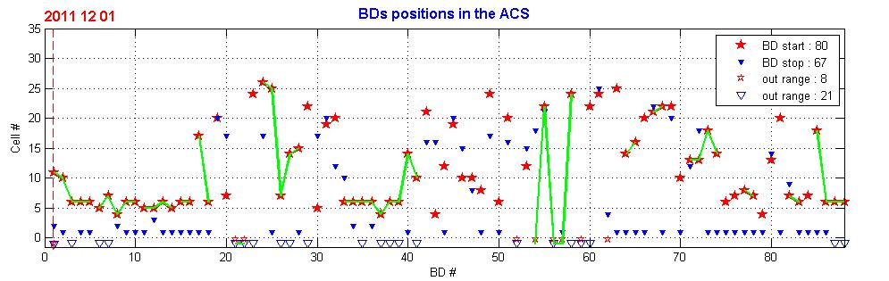
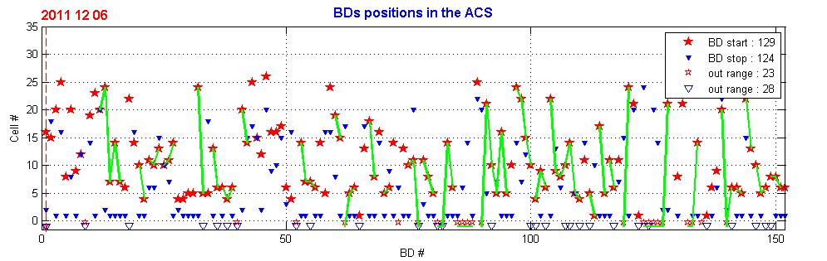
BDs location chart
Green line linked BDs are in clusters
BDs seems to migrate from the initial position to the first cell (from red star to blue triangle)

Slide 19
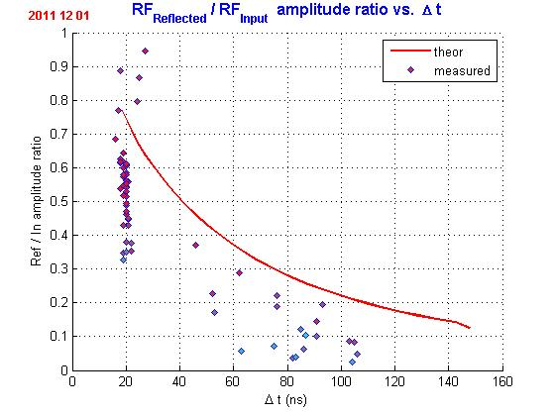
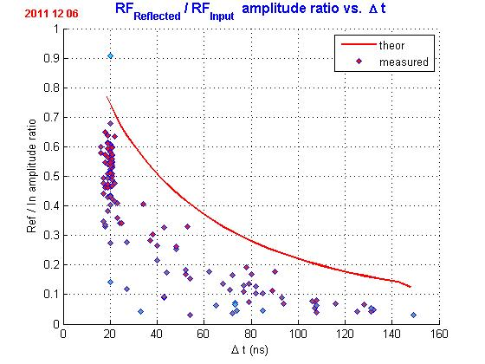
Attenuation vs. BD location
Reflected power is consistent with the detected position of the BD

Slide 20
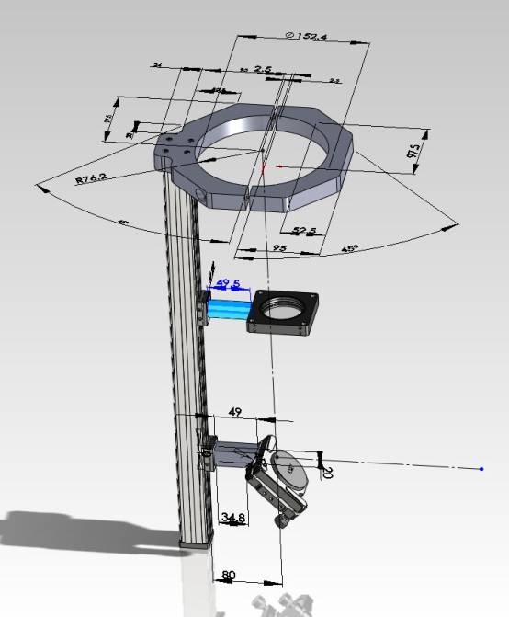
The next run…
Merge Beam Kick measurements with RF characteristics
Use the RF phase information
Collect more data at reasonable BDR
  Long shift at stable power characteristics
  Higher repetition rate
Additional diagnostics
  PM looking inside the TD24 through FCU mirror
  New re-entrant cavity BPMs
Use of
  the Flash Box,
  the Wakefield monitor
  …
Masih Noor
PM optical line

