Slide 1
e¯e⁺-> Z, γ, Z’* ->μ¯μ
Study the sensitivity to a heavy sequential Z’ with a mass above LHC detection capability (as described in James Wells note)
Use whizard2, Z’ model implemented by Jurgen Reuter
For the time only ISR and FSR included, no beamstrahlung yet
Outline
Cuts for e⁺e¯→μ⁺μ¯ background suppression
Cross sections, Forward/Backward and
Left/Right asymmetry for mZ’: 5->30 TeV and gY: 0.05->0.95
Sensitivity to Z’; mZ’ and gY determination -> mZ’, g’a, g’v
Systematic error assumptions at 3 TeV:
μ± reconstruction efficiency an ID : Δσ/σ = 1%
μ± charge confusion : ΔAFB/AFB=1%
Luminosity : Δσ/σ = 0.5 %
Polarization : Δσ/σ = 1%

Slide 2
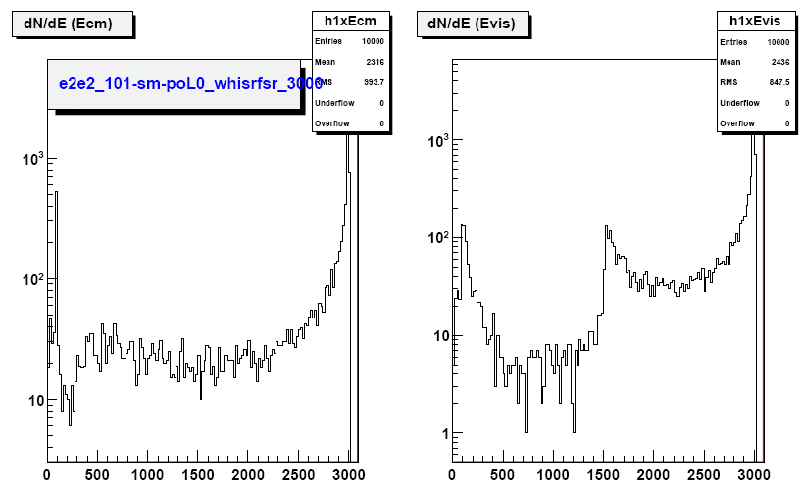
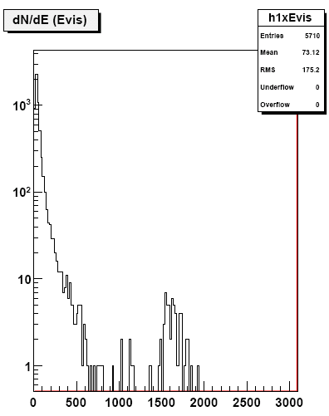
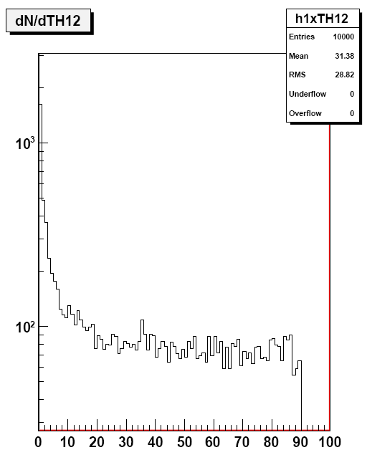
e¯e⁺-> Z, γ ->μ¯μ (SM)
Measurement of σ, AFB and ALR (e¯e⁺->μ¯μ⁺)
requires to suppress other SM processes
with μ¯μ⁺ final states. => Cuts:
Pt(μ±) > 5 GeV, 10< θ (μ±) < 170,
E12(μ¯,μ⁺)>2.5 TeV, θ(P(μ¯μ⁺)) < 5⁰
With these cuts the backgrounds are
negligible
e¯e⁺->μ¯μ⁺ νe νe : 7.32 E+01 fb -> 5.7E-05
e¯e⁺->μ¯μ⁺ νμ νμ : 4.36E+02 fb -> 2.4E-03
e¯e⁺->μ¯μ⁺ e¯ e⁺ : 1.57E+04 fb -> 3.0E-02
e¯e⁺->W¯W⁺ νe νe : 4.08E+02 fb -> 5.0 E-06
e¯e⁺-> τ¯τ⁺ : 3.38E+01 fb -> 3.0E-02
The signal selection efficiency is 48%
σ(e¯e⁺->μ¯μ⁺ ) = 5.2 fb
AFB = 0.46
ALR = 0.074
e¯e⁺->μ¯μ⁺
e¯e⁺->μ¯μ⁺ e¯ e⁺

Slide 3
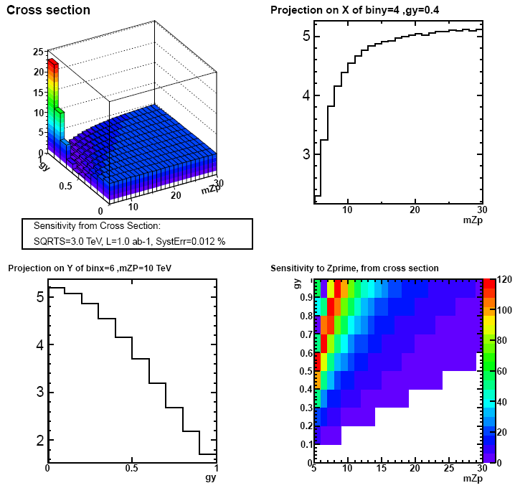
σ (e¯e⁺-> Z, γ, Z’* ->μ¯μ) 3 TeV
σ(BSM)=f(mZ’, gY)
For High values of mZ’ or low values of gY σ(BSM)=σ(SM)
For lower masses or large couplings, σ(BSM)!=σ(SM)
Measurement of σ(e¯e⁺->μ¯μ⁺) allows indirect detection of heavy Z’ and measurement of mZ’ and gY :
To test the sensitivity to Z’
Compare σ(SM) with σ(BSM)
Χ² = (σ(SM)- σ(BSM) )² /(Δσ(BSM)²)
Sensitivity: S=√Χ²
Plot H2(mZ’, gY,√ Χ²) (L=1 fb¯¹)
If prob(Χ²)>0.05 for ndf=1, set S=0
(white region, no sensitivity to Z’ )
Sensitivity up to 20 TeV for gY~0.30
12 TeV for √s=1.4 TeV

Slide 4
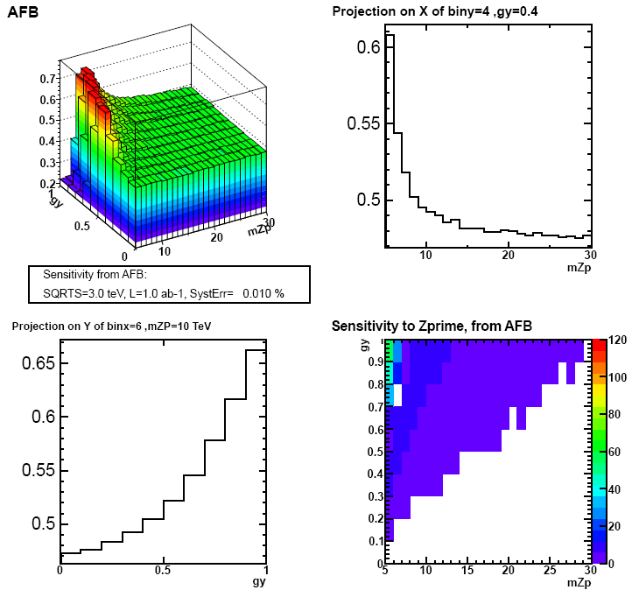
AFB
AFB=(σFW-σBW)/(σFW+σBW)
Plots assuming: 1 ab-1
Χ²=(AFB(SM)-AFB(BSM) )²/(ΔAFB(BSM)²)
AFB(SM)=0.46
Sensitivity: S=√Χ²
Plot H2(mZ’, gY, √ Χ²)
If prob(Χ²)>0.05 for ndf=1, set S=0
(white region)
Sensitivity to AFB weaker than to σ

Slide 5
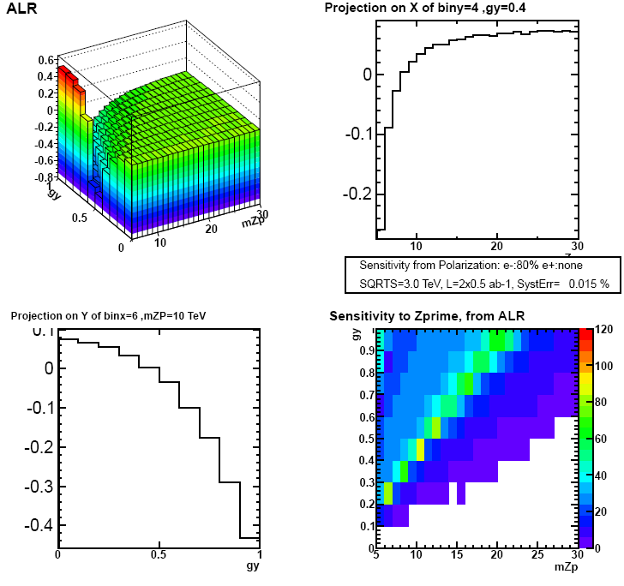
ALX
Assume :
σLX =80% e¯ L polarization, e⁺ none
σRX=80% e¯ R polarization, e⁺ none
ALX=(σLX – σRX)/(σLX + σRX)
For High values of mZ’ or large
values of gY ALX(BSM)=ALX(SM)=0.074
For ↘ mZ’ , ALR ↘ and becomes
negative
Χ²=(ALX(SM)-ALX(BSM) )²/(ΔALX(BSM)²)
Sensitivity: S=√Χ²
Plot H2(mZ’, gY, √ Χ²)
If prob(Χ²)>0.05 for ndf=1, set S=0
(white region)

Slide 6
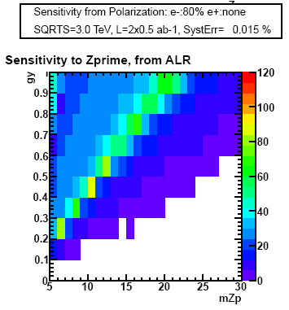
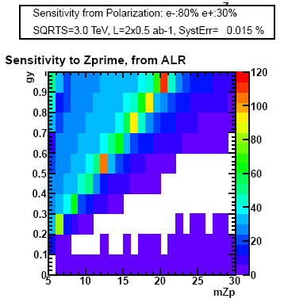
ALX and ALR
Small gain in sensitivity for low gY values, with e⁺ polarization

Slide 7
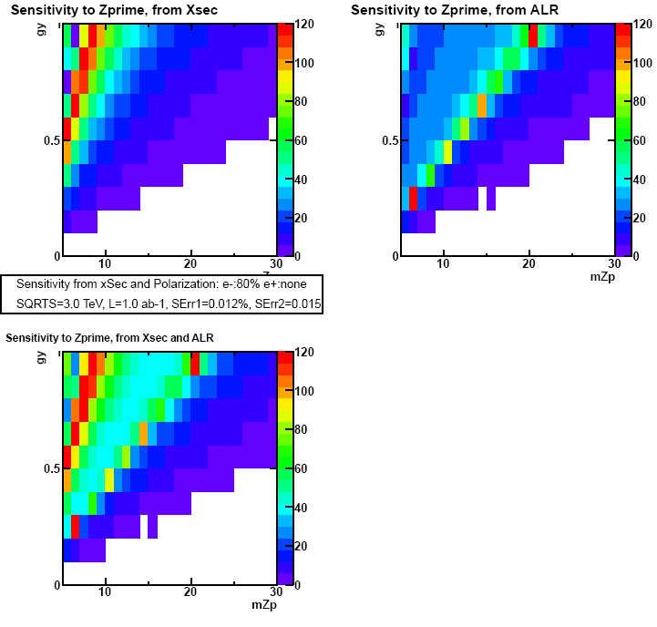
Combined Sensitivity, 1. ab-1
Sensitiviy combining σ and ALR
Χ²1 = (σ(SM)- σ(BSM))²/(Δ σ(BSM)²)
Χ²2 = (ALR(SM)- ALR(BSM))²/(Δ ALR(BSM)² )
Δσ/σ(polarization)=1%
Χ²= Χ²1 + Χ²2
Sensitivity: S=√Χ²
Plot H2(mZ’, gY’,√ Χ²)
If prob(Χ²)>0.05 for ndf=2->S=0
(white region)

Slide 8
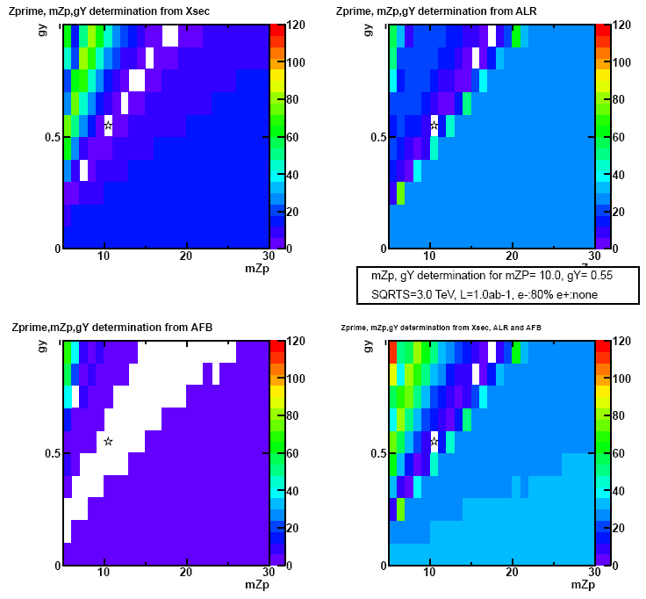
mZp, gY determination
Resolution Power
Assume a Z’ with
mZP= 10 TeV and gY =0.55 (reference)
For each point in the plane, mZP, gY compute:
Χ²1 = (σ(BSMR)- σ(BSMX))²/(Δ σ(BSMX)²)
Χ²2 = (ALR(BSMR)- ALR(BSMX))²/(Δ ALR(BSMX)² )
Χ²3 = (AFB(BSMR)- AFB(BSMX))²/(Δ AFB(BSMX)² )
Χ²= Χ²1 + Χ²2 + Χ²3
Resolution power: S=√Χ²
Plot H2(mZ’, gY’,√ Χ²)
If prob(Χ²)>0.05 ->S=0 (white region)
mZp, gY determination should provide only one solution, the white box with the star.
Sometimes there are more solutions, here mZp=15 TeV and gY=0.85 and
mZp=17 TeV and gY=0.95
ALR has the best resolution power

Slide 9
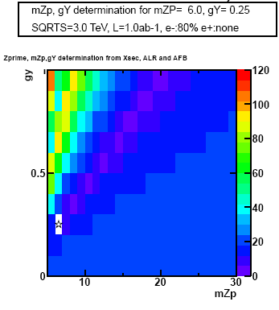
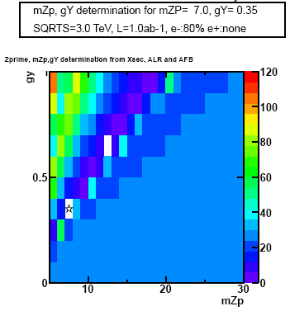
mZp, gY determination
3 TeV
Use the combined χ², scan the plan, keep (mZP, gY) values:
for which the determination is non ambiguous
or keep the lower mZP, gY combination, eg keep 7, 0.35, exclude 12, 0.65

Slide 10
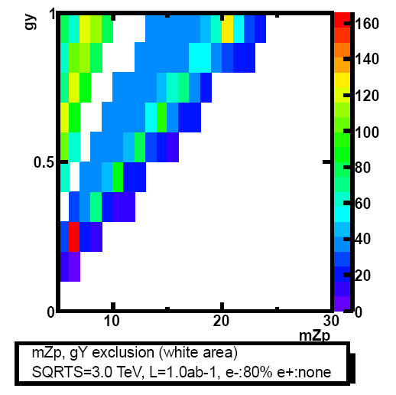
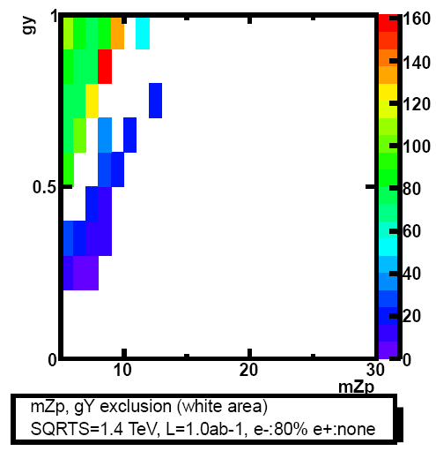
mZp, gY determination
There is gap in the mZp, gY plane where the determination is not possible
4 times more luminosity doesn’t close it,
At 1.4 TeV the reach is not significantly beyond the LHC reach (right plot)

Slide 11
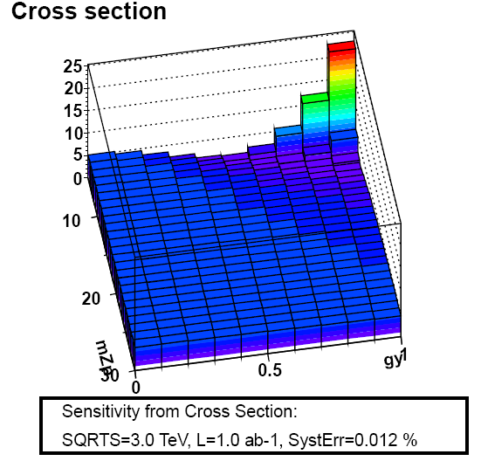
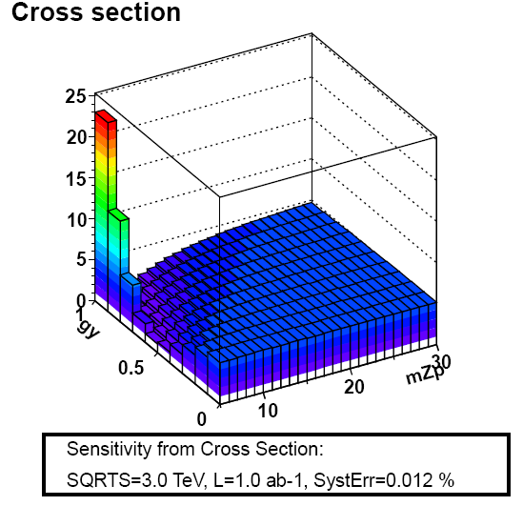
Gap
The gap is caused by a minimum in the cross section, increasing the luminosity doesn’t change the gradient between neighboring cells.

Slide 12
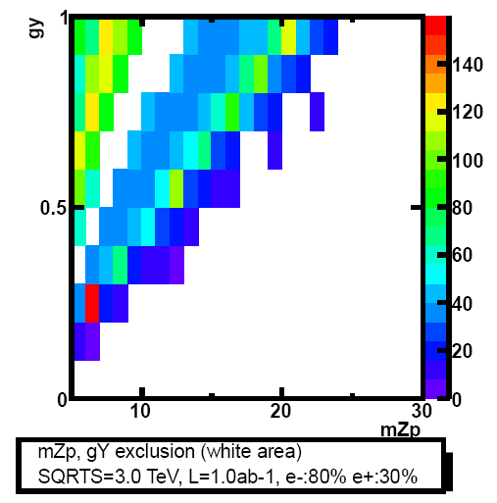
mZp, gY determination
30% e⁺ polarization (right plot) doesn’t increase significantly the reach

Slide 13
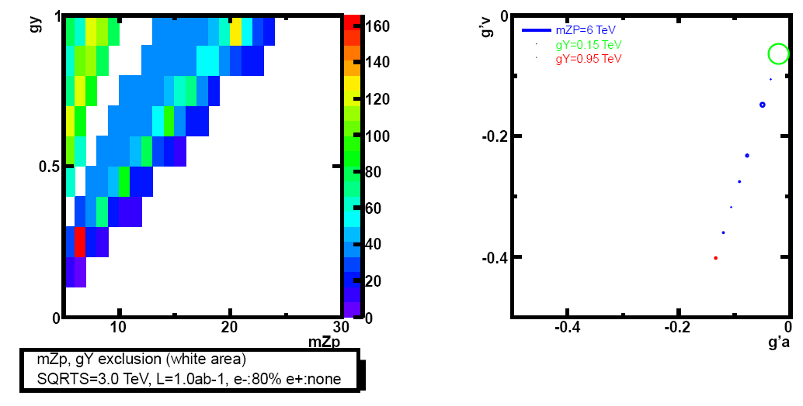
Normalized couplings g’a, g’v
For all non exclude mZp, gy bins
(mZP,gY) -> (g’a, g’v):
gL=gY . YL , YL=-1/2
gR=gY . YR , YR= -1
gL=-0.5.gY, gR=-gY
g'a=0.5(gR-gL)√(s/(mZP²-s)
g'v=0.5(gR+gL)√(s/(mZP²-s)
gR-gL=-0.5, gR+gL=-1.5
Arbitrary size of circles ~ x/√χ²
mZp=6 TeV, gY=0.15, √χ² =6.5
Good resolution power in the plane g’a, g’v

Slide 14
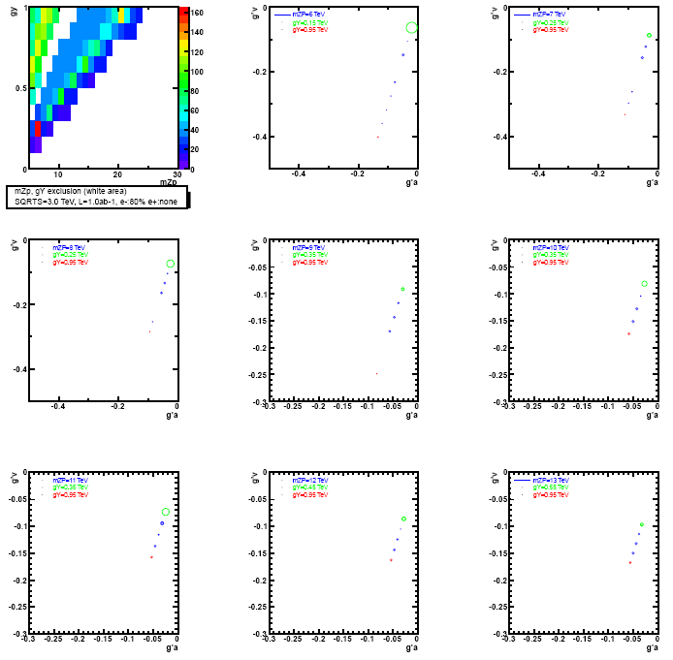
Normalized couplings g’a, g’v

Slide 15
Summary
At 3 TeV, with 1 ab-1, the cross section measurement gives a
sensitivity to a Z’ up to 20 Tev for gY larger than 0.35.
Electron polarization is essential for the determination of the
mass and the coupling
30% positron polarization doesn’t improve significantly the
reach
For a gY value ~ 0.5, mZP can be determined up to ~ 15 TeV.
larger masses can be reached for larger couplings
At 1.4 TeV the reach is not significantly beyond the LHC reach ?
These preliminary results must be checked with beamstrahlung when whizard2 is fixed

