Slide 1
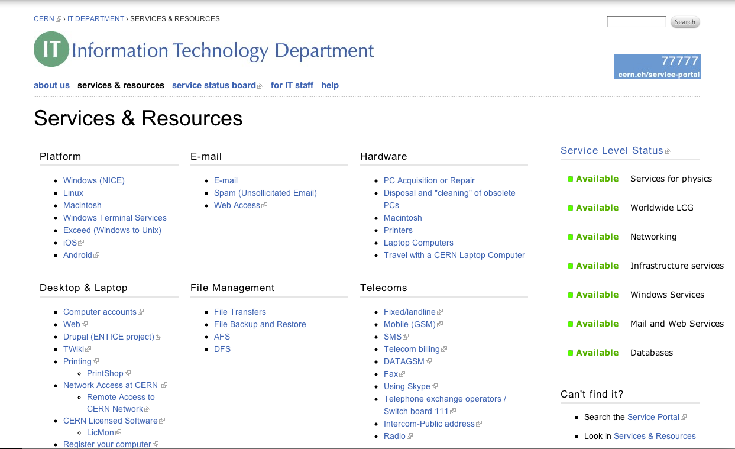
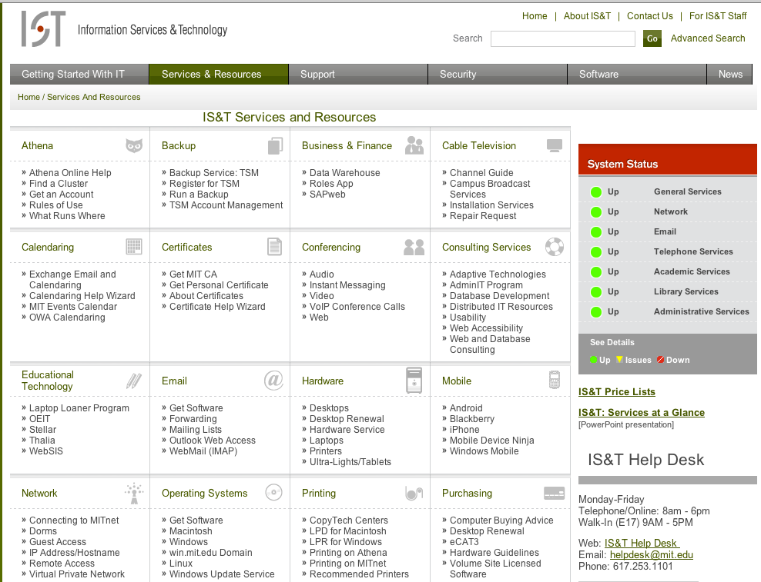
Service & Resources landing area
Themed into user-friendly subject areas

Slide 2
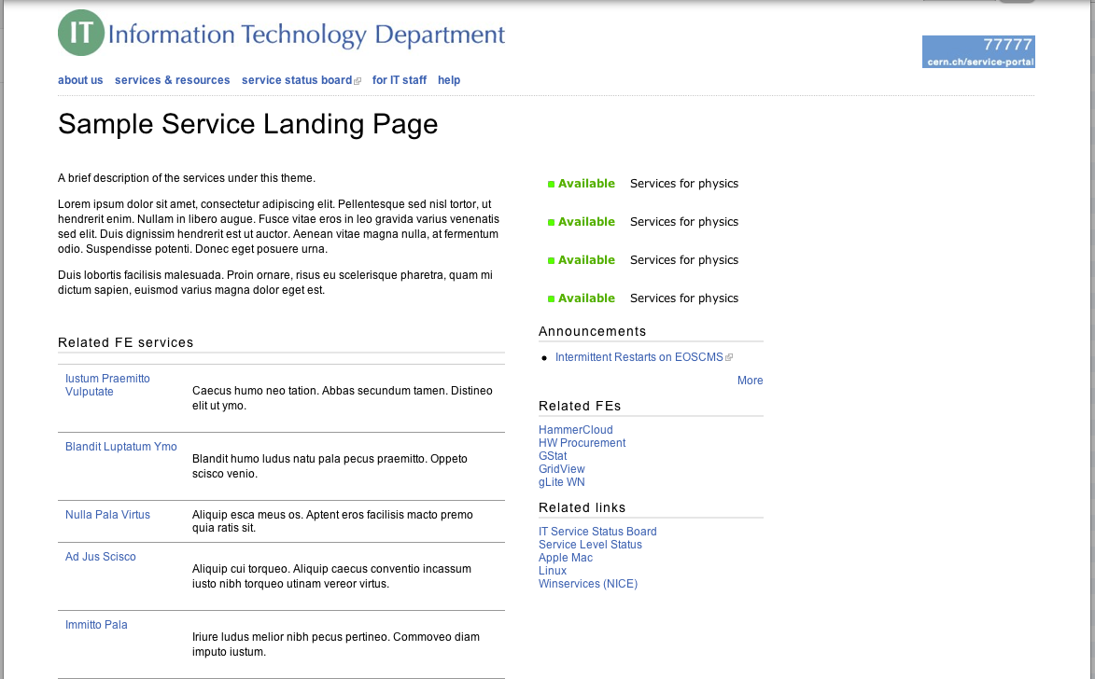
Subject landing area
Relevant services and general overview

Slide 3
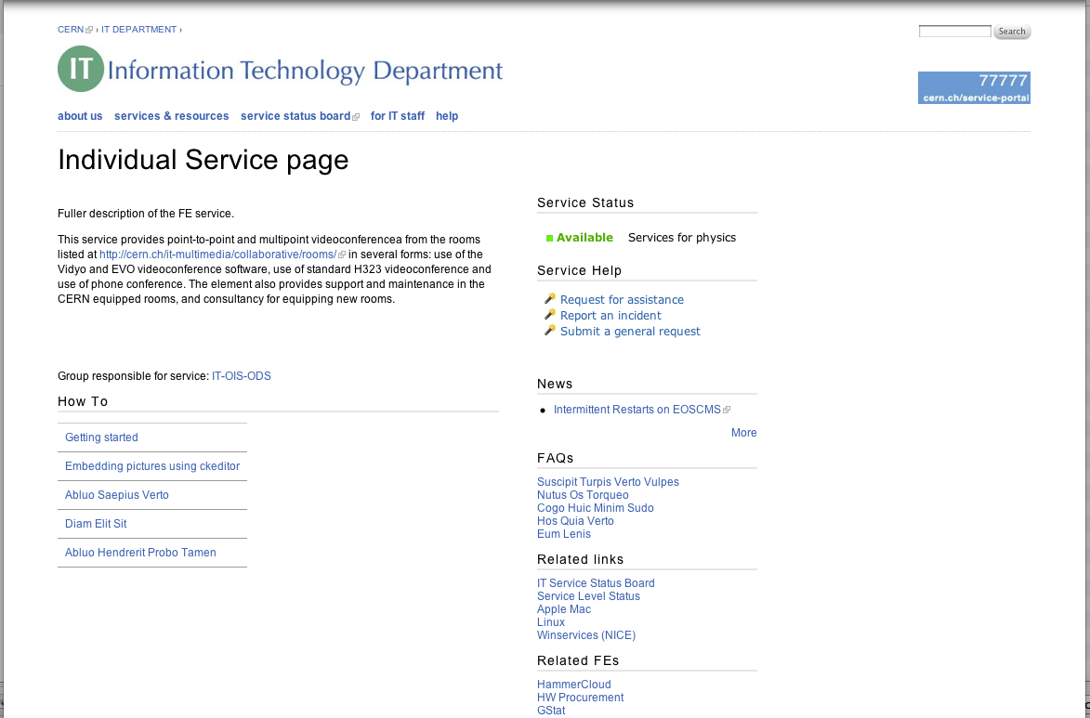
Individual Service pages
Dynamically generated content
Linked to Service Portal

