Slide 1
Breakdown turn-on time from TBTS and KEK
Alexey Dubrovskiy

Slide 2
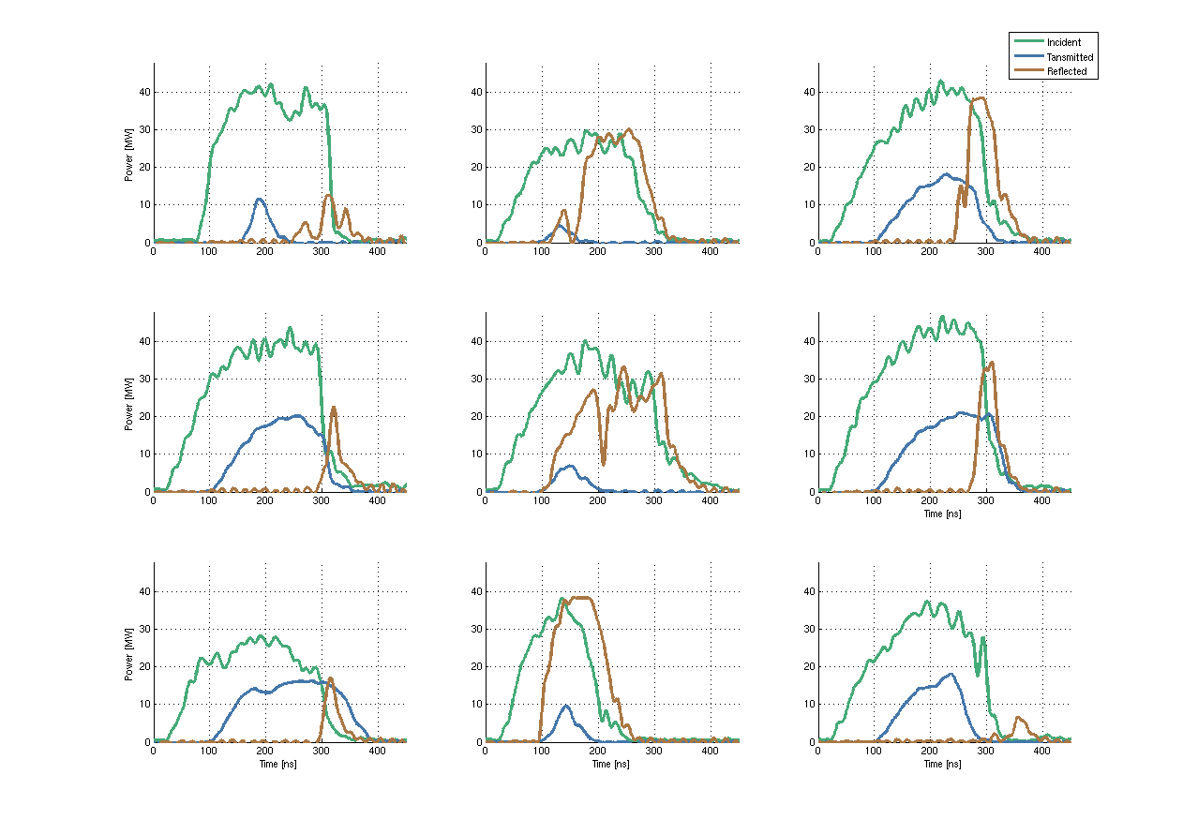
Examples#1 of RF breakdowns
E
M
M
80 ns
80 ns
80 ns
M
B
B
80 ns
80 ns
80 ns
B
B
E
80 ns
80 ns
80 ns
B
at the beginning
at the middle
80 ns = tfill + twavegides + Δtcables, tfill ≈ 65 ns , twavegides ≈ 11 ns , Δtcables ≈ 4 ns
E
BD at the end of the ACS
M

Slide 3
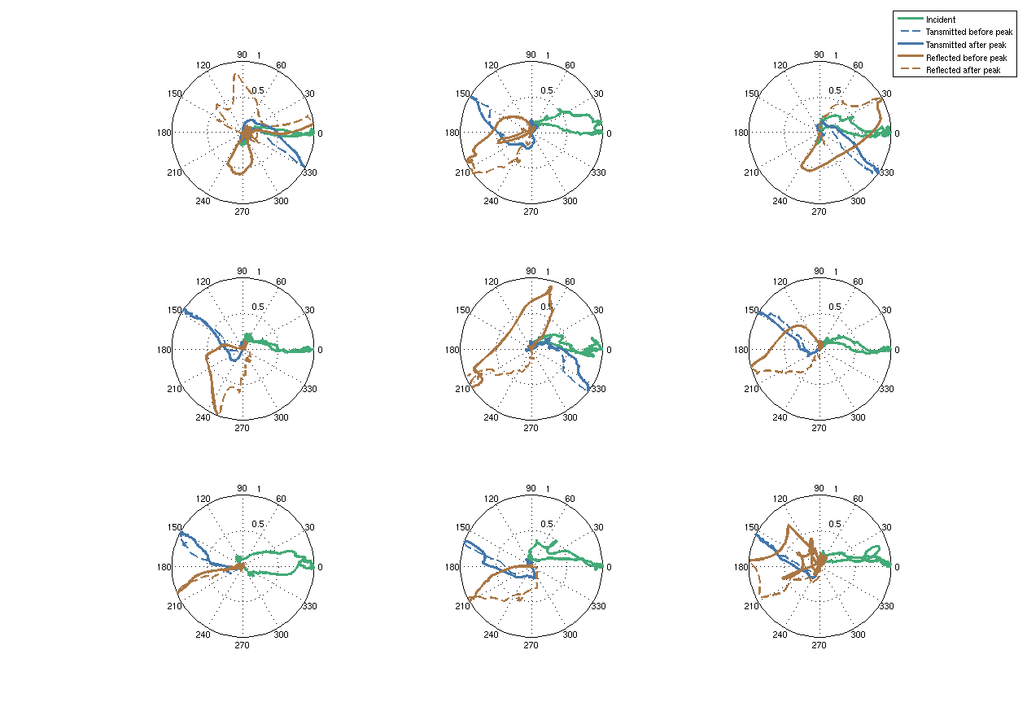

Examples#1 of RF breakdowns
$${\sqrt{Power/max⁡(Power)}e}^{iPhase}$$

Slide 4
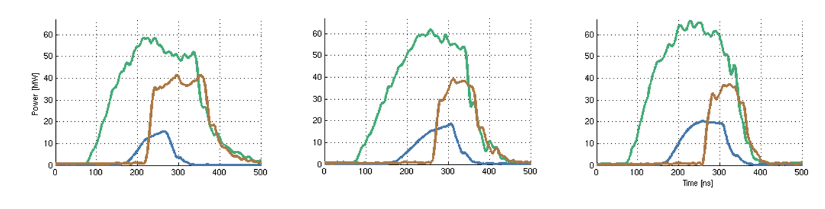
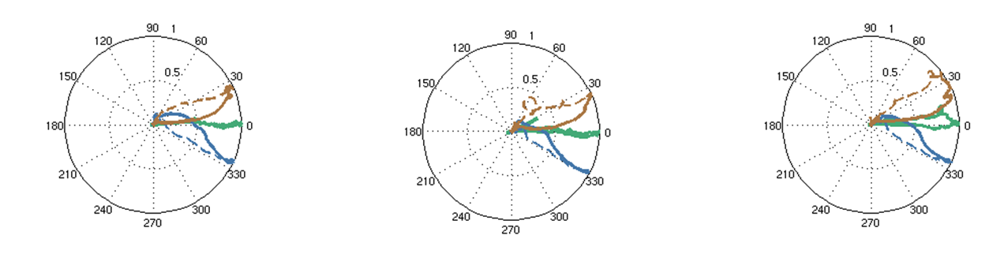
RF breakdowns & RF bandwidth limitation
B
B
B
The rise of the RF reflection is very steep for BDs at the begging of the ACS or maybe even in the waveguide. In these cases the rise time (≈15 ns) can be limited by the RF bandwidth of the ACS.

Slide 5
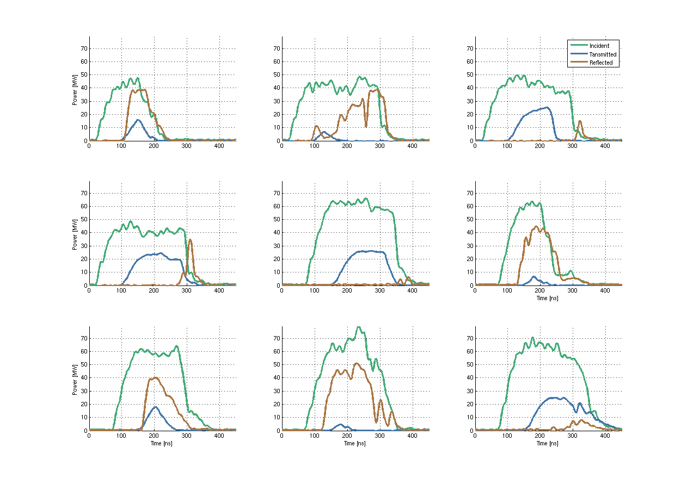
Examples #3 of RF breakdowns

Slide 6
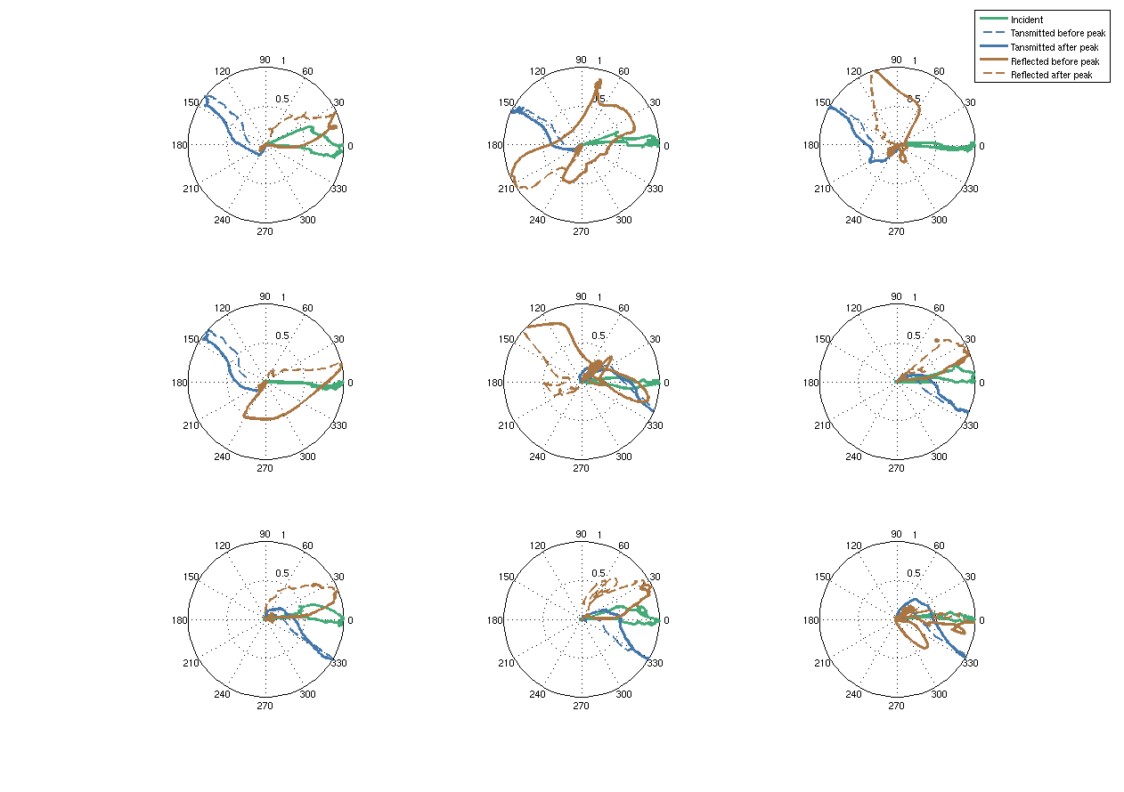
Examples #3 of RF breakdowns

Slide 7
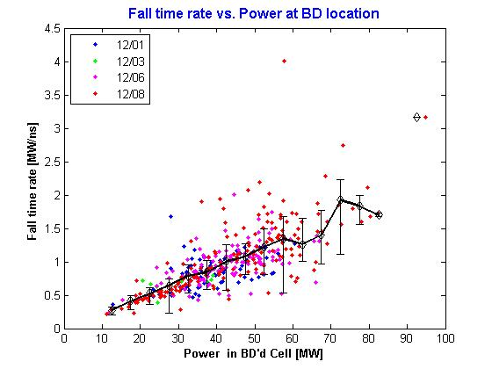
Fall time vs. Power in BD Cell
* Wilfrid Farabolini
Fall rate is linearly dependant with the Power

Slide 8
Cease of the power transmission
The cease of the RF power transmission is associated with a breakdown in the accelerating.
Hypothesis: the speed of cease is proportional to the incoming power.
The RF power transmission is considered to study the falling edge of different pulses:
Transmission (E/T) = Transmitted / Expected
Expected power = Incident - Ohmic losses (~4 dB)+80ns
Data from experiments in CTF/TBTS in summer 2010.

Slide 9
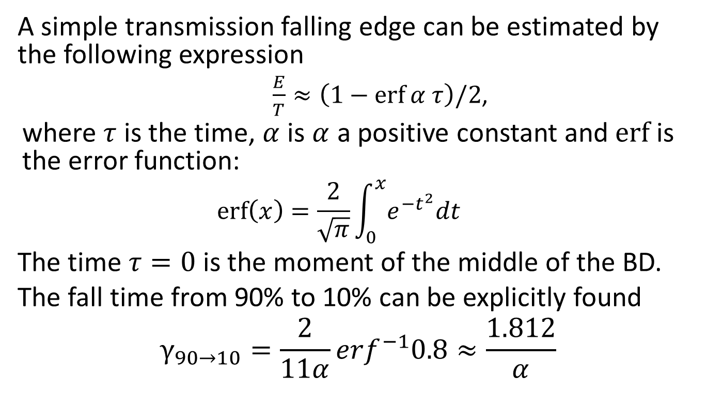
Simple falling edge
A simple transmission falling edge can be estimated by the following expression
$\frac{E}{T}≈\left(1−\operatorname{erf}{α τ}\right)/2$,
where $τ$ is the time, $α$ is $α$ a positive constant and $erf$ is the error function:
$$\operatorname{erf}\left(x\right)=\frac{2}{\sqrt{π}}\int_{0}^{x}{e^{−t^{2}}dt}$$
The time $τ=0$ is the moment of the middle of the BD.
The fall time from 90% to 10% can be explicitly found
$$γ_{90→10}=\frac{2}{11α}{erf}^{−1}0.8≈\frac{1.812}{α}$$

Slide 10
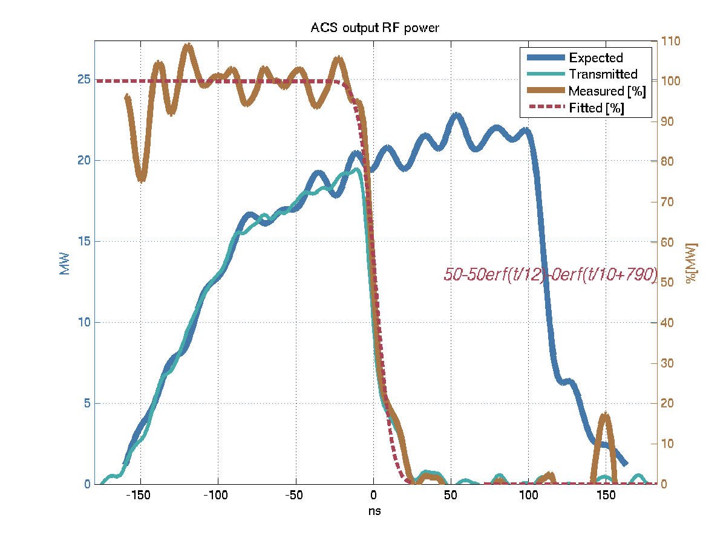

Simple falling edge
$$γ_{90→10}=22ns$$

Slide 11
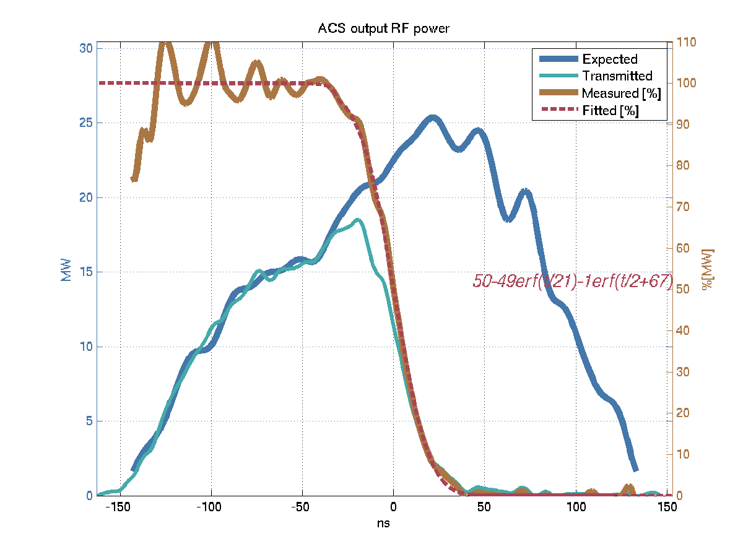

Simple falling edge
$$γ_{90→10}=38ns$$

Slide 12
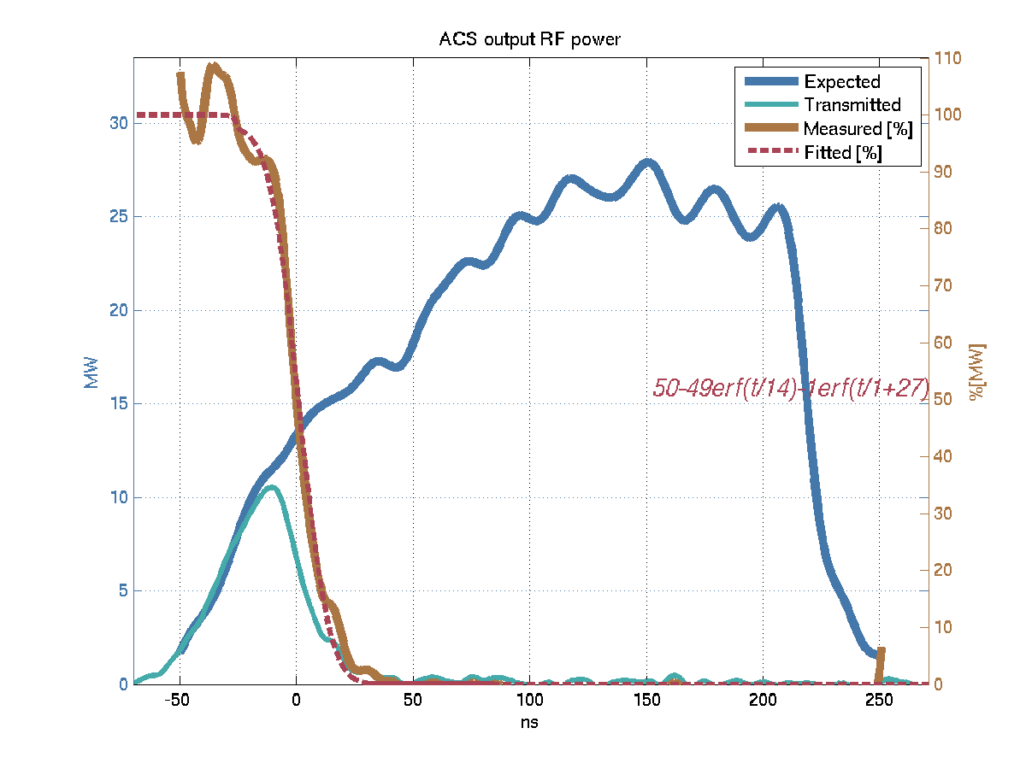

Simple falling edge
$$γ_{90→10}=25ns$$

Slide 13
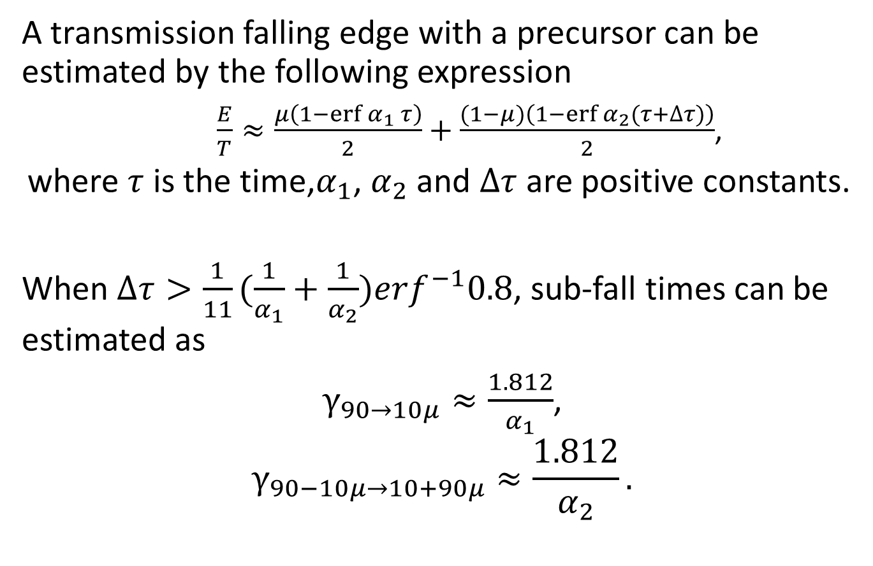
Falling edge with precursor
A transmission falling edge with a precursor can be estimated by the following expression
$\frac{E}{T}≈\frac{μ\left(1−\operatorname{erf}{α_{1} τ}\right)}{2}+\frac{(1−μ)\left(1−\operatorname{erf}{α_{2}(τ+∆τ)}\right)}{2}$,
where $τ$ is the time,$α_{1}$, $α_{2}$ and $∆τ$are positive constants.
When $∆τ>\frac{1}{11}{(\frac{1}{α_{1}}+\frac{1}{α_{2}})erf}^{−1}0.8$, sub-fall times can be estimated as
$γ_{90→10μ}≈\frac{1.812}{α_{1}}$,
$$γ_{90−10μ→10+90μ}≈\frac{1.812}{α_{2}}.$$

Slide 14
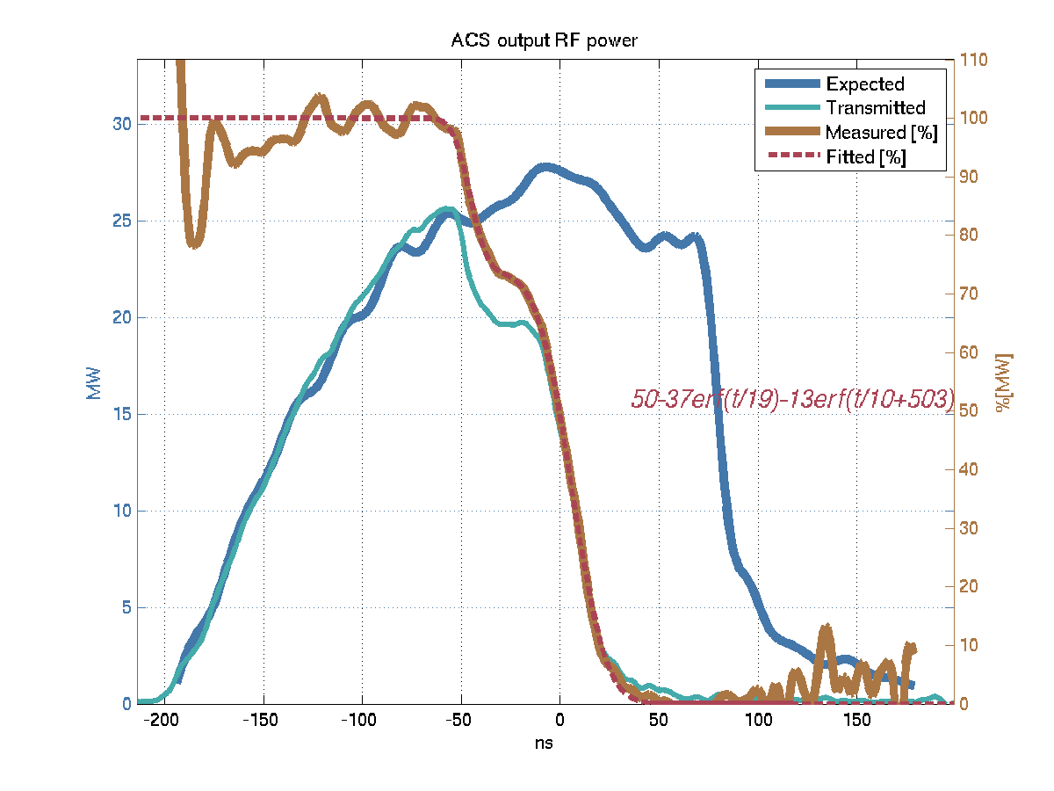



Falling edge with precursor
$$γ_{90→10}≈60ns$$
$$γ_{90→77}≈8ns$$
$$γ_{65→10}≈35ns$$

Slide 15
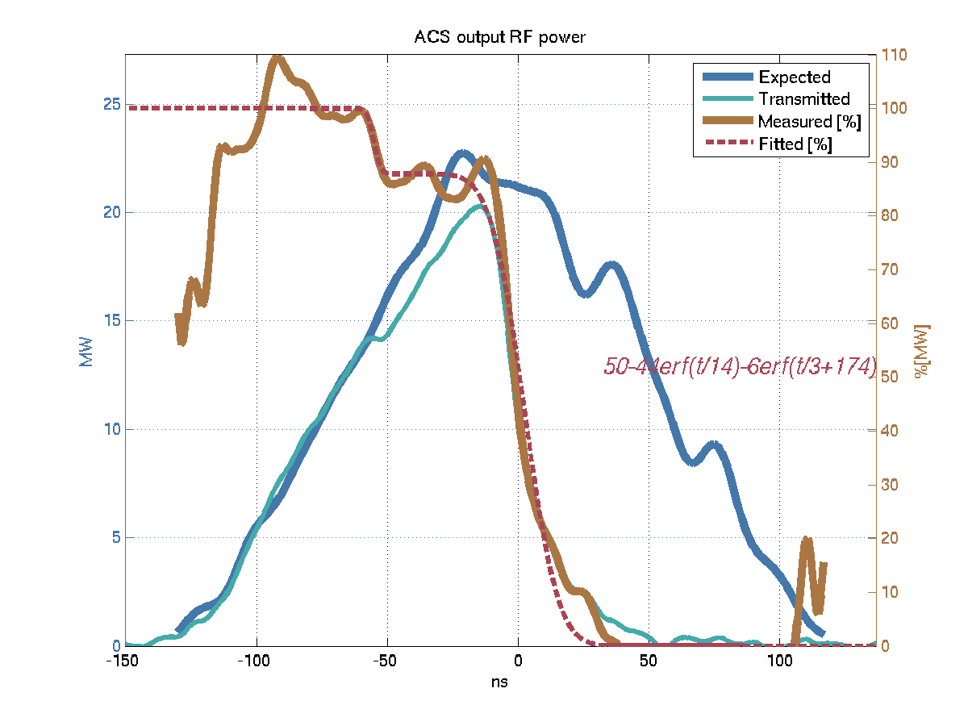



Falling edge with precursor
$$γ_{90→10}≈70ns$$
$$γ_{98→88}≈5ns$$
$$γ_{80→10}≈43ns$$

Slide 16
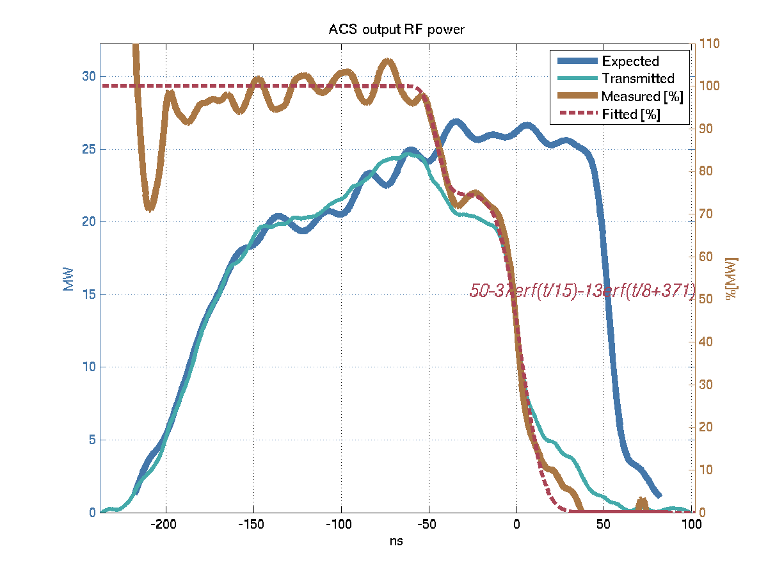
Two-stage falling edge
$$γ_{90→10}≈70ns$$

Slide 17
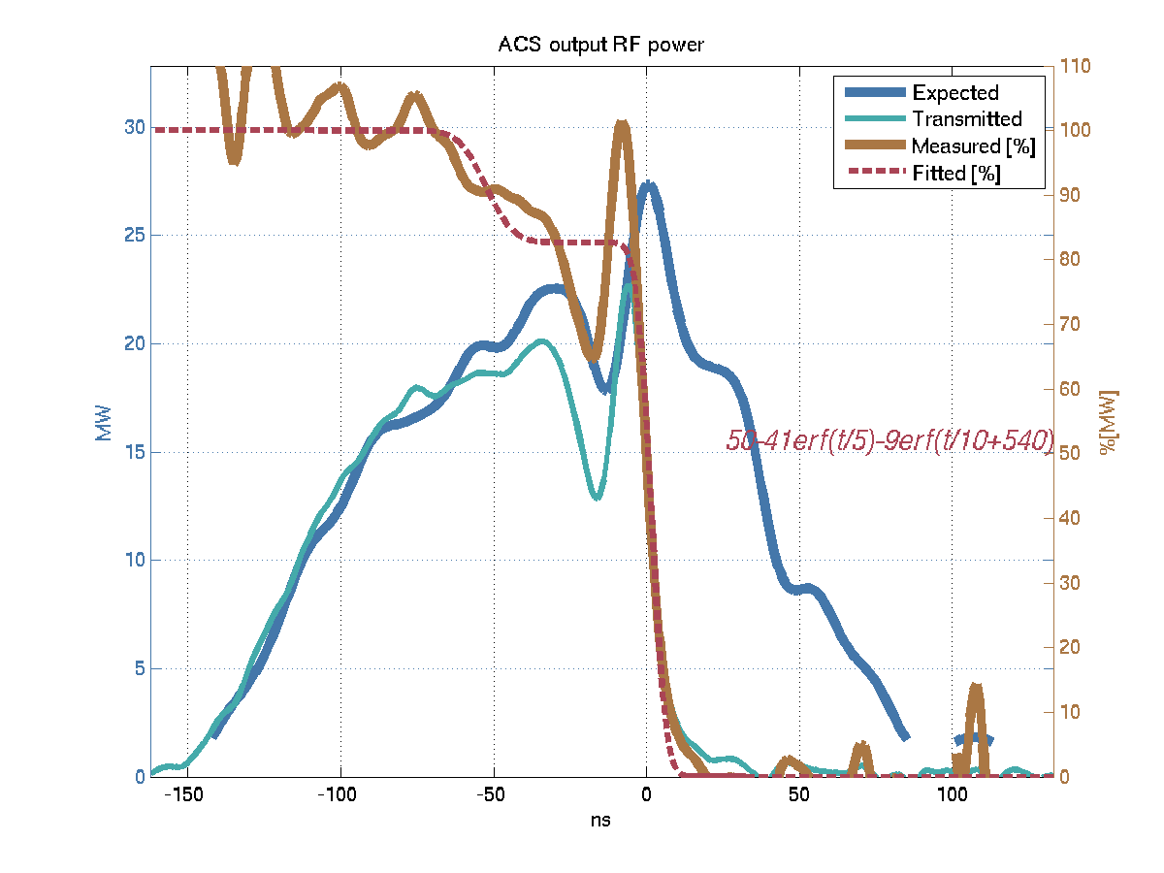
Recovering falling edge

Slide 18
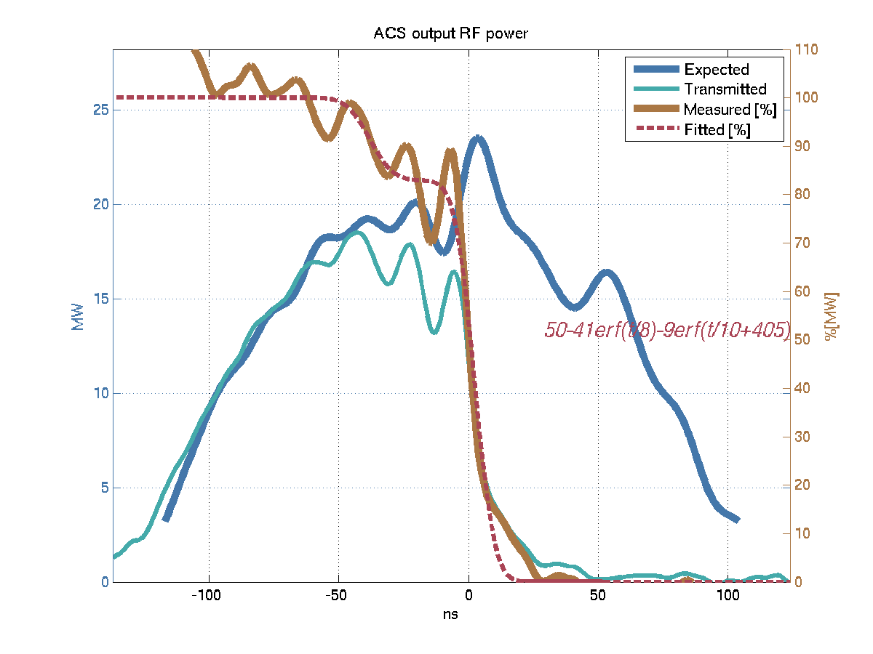
Recovering falling edge

Slide 19
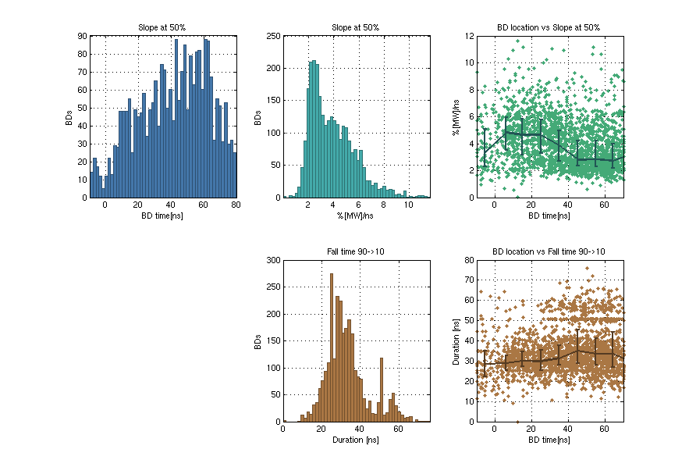
Falling edge duration
90%
Slope [%/ns]
10%
Fall time

Slide 20
KEK / T24 # 3

Slide 21
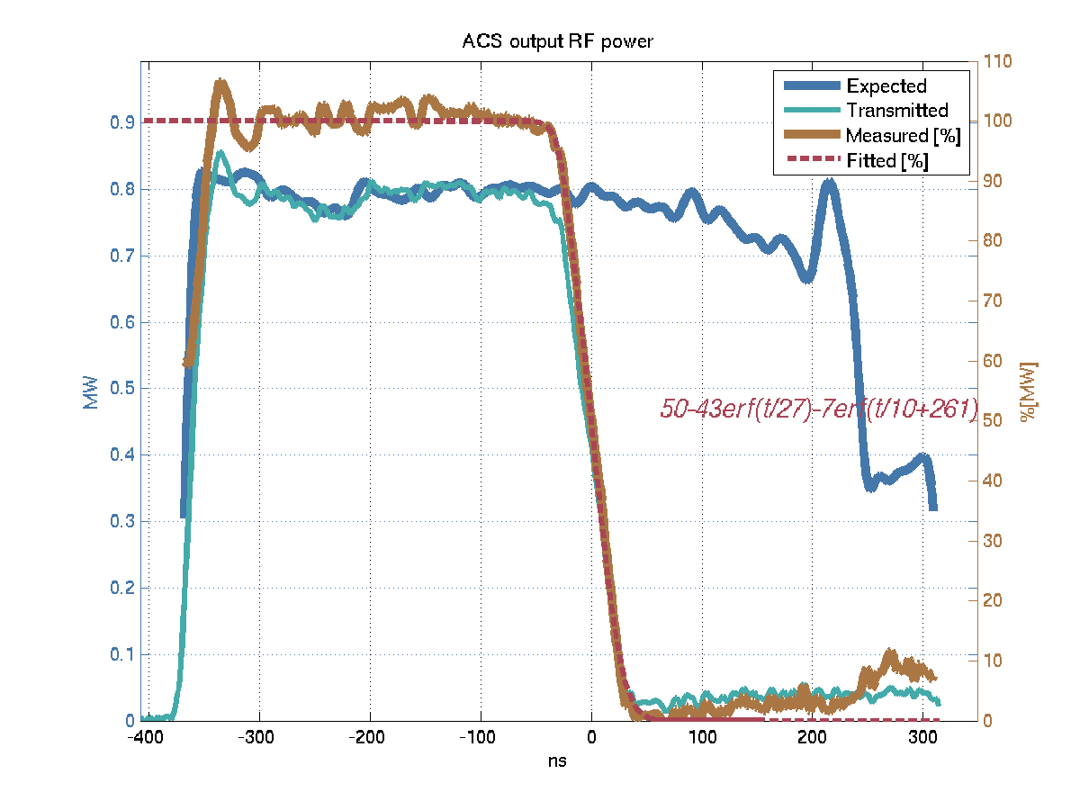

Simple falling edge
$$γ_{90→10}=45ns$$

Slide 22
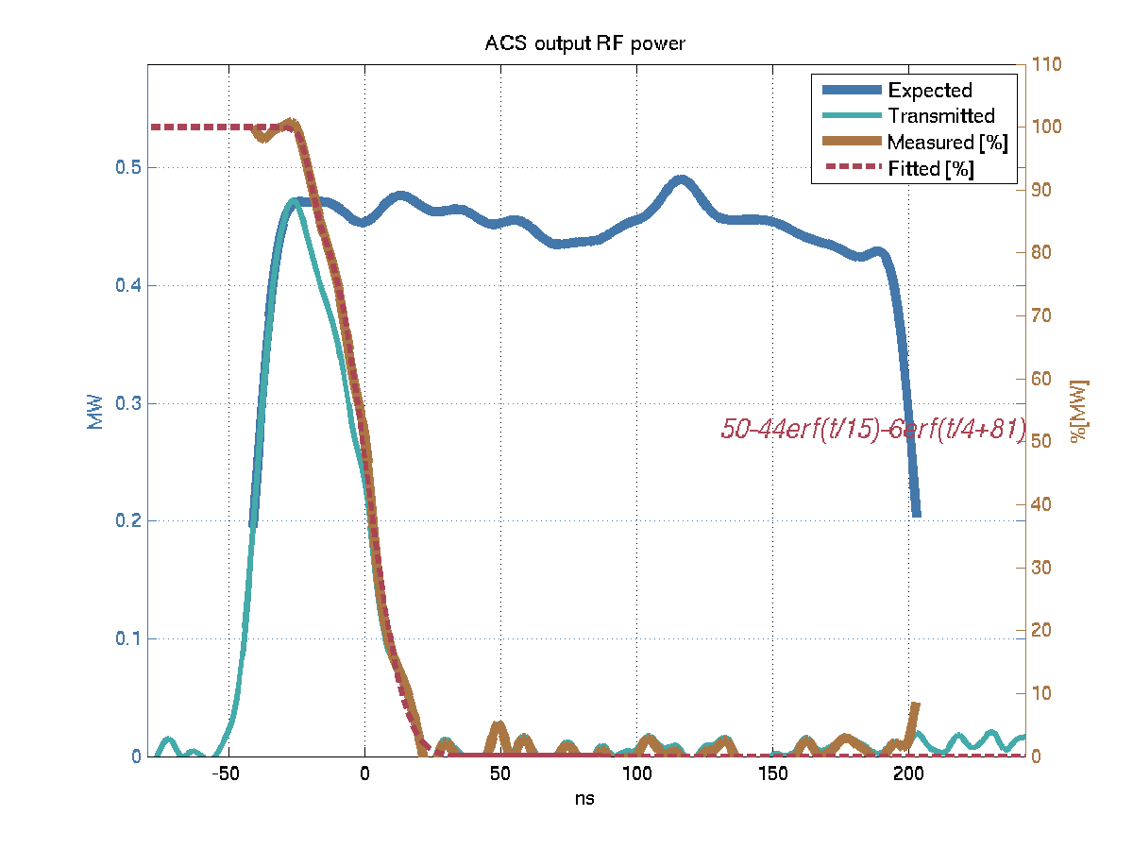

Simple falling edge
$$γ_{90→10}=30ns$$

Slide 23
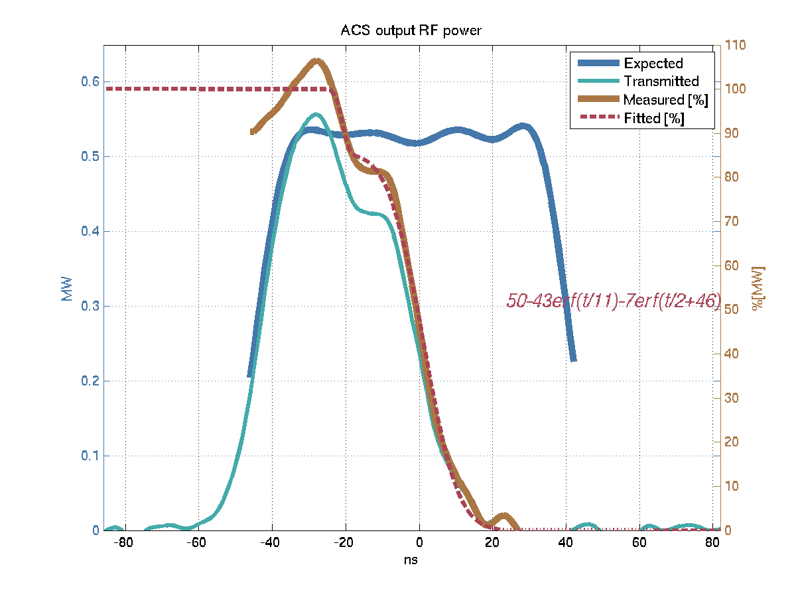

Falling edge with precursor
$$γ_{99→87}≈4ns$$
$$γ_{77→9}≈20ns$$

Slide 24
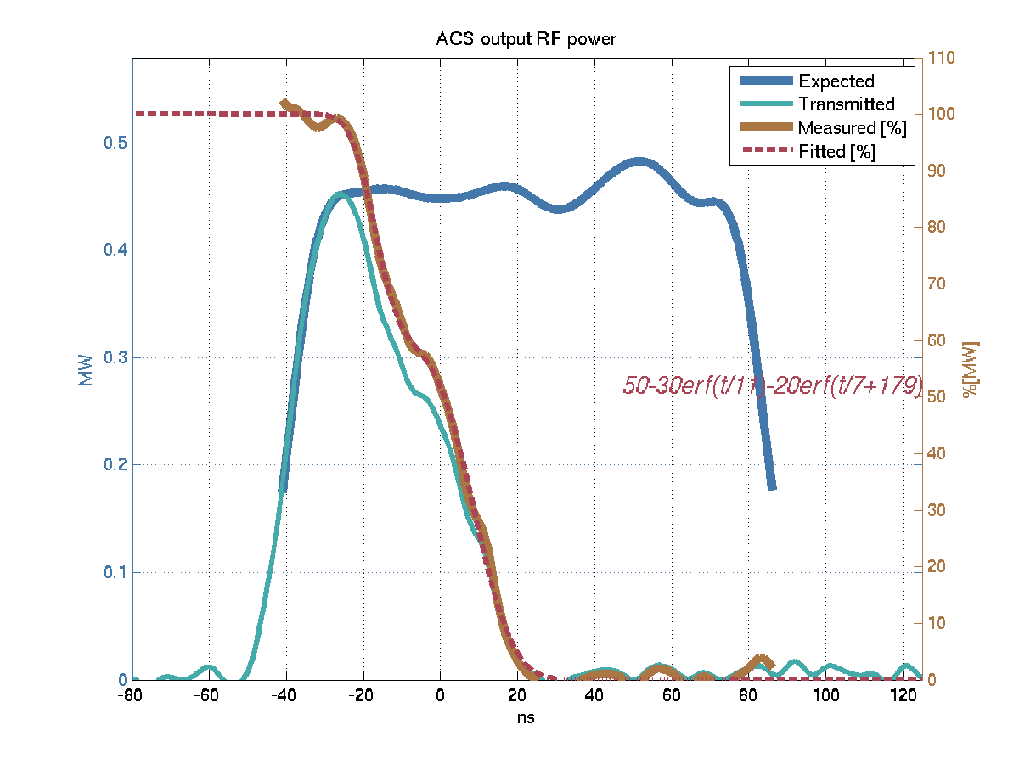

Two-stage falling edge
$$γ_{96→64}≈12ns$$
$$γ_{54→6}≈20ns$$

Slide 25
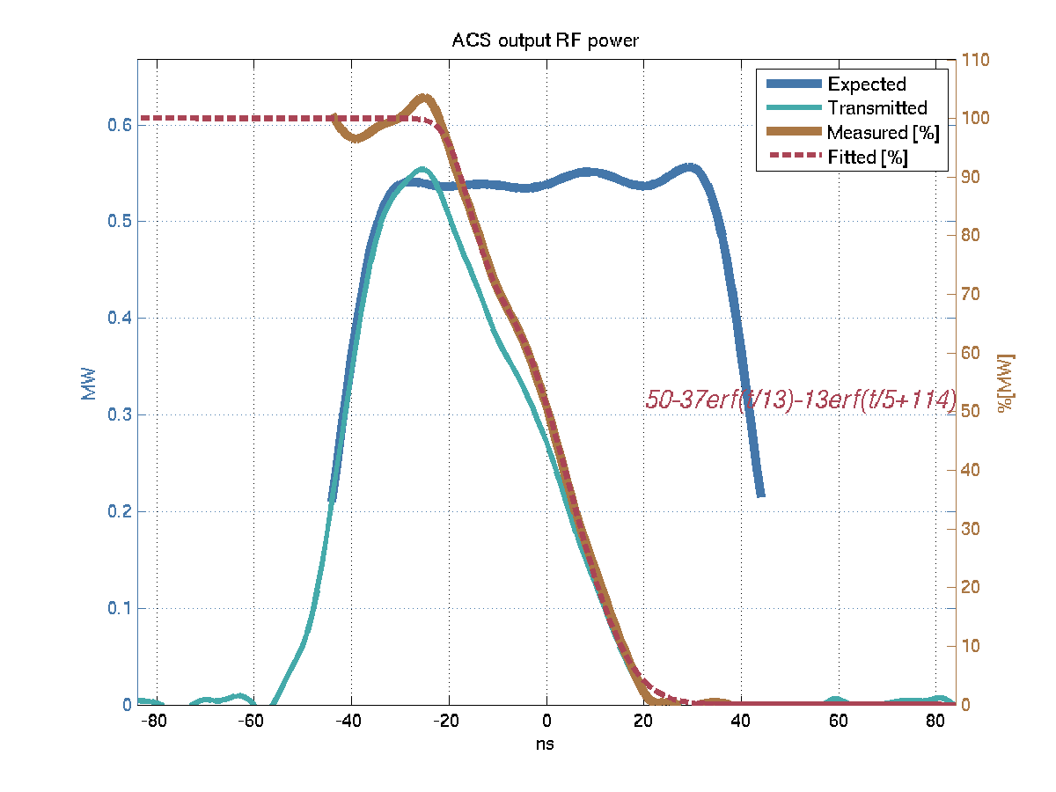

Two-stage falling edge
$$γ_{97→77}=9ns$$
$$γ_{67→7}=24ns$$

Slide 26
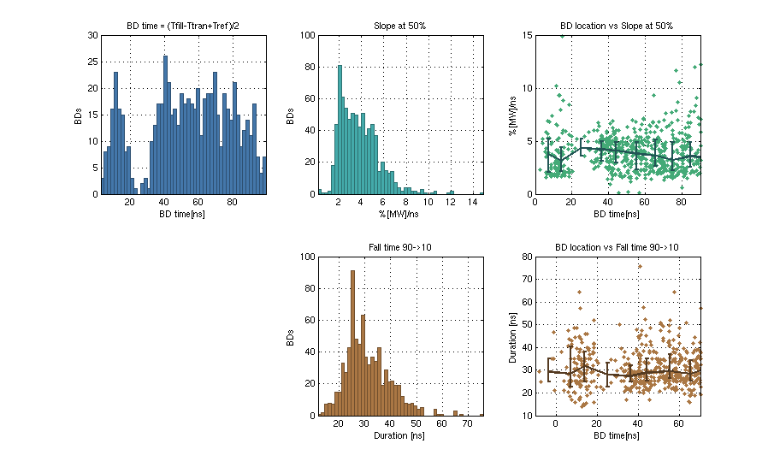
Falling edge duration
90%
Slope [%/ns]
10%
Fall time

Slide 27
Summary
For some BDs the rise time of the RF reflection can be limited by the bandwidth of ACS. But there are many BDs such that the rise time is longer than the time given by the bandwidth.
The phase sweep of the reflected RF suggests that the BD extends towards the input of the structure by a couple of cells. The constant phase of the reflected RF suggests that BDs does not change the RF group velocity towards the output.
The fall time of transmitted RF is independent of the incident power.
In most of the cases the fall of RF transmission can be accurately estimated by a sum of two error functions.
Precursors of the cease of transmission might indicate the high current of emitted charged particles at the initial stage of BDs.
The typical time of the cease of transmission from 90 to 10% is between 25 and 40 ns and it is independent of the location of BD. The similar results have been obtained from the KEK/T24 data.

