Slide 1
FlashBox data analysis
Alexey Dubrovskiy

Slide 2
Layout
Drive beam line
ACS Tank
Corrector
Flash Box
Pick up
318
RF
Lm=251
254
ACS
Ag
7
6
5
4
3
2
1
<0.1
e⁺
19
Da=8
e⁻
18
55
Cu
7
6
5
4
3
2
1
1
Ld = 1381,3
Lg=73,9
Lc=30,25
1451,8
326,4
483,6
Probe beam line

Slide 3
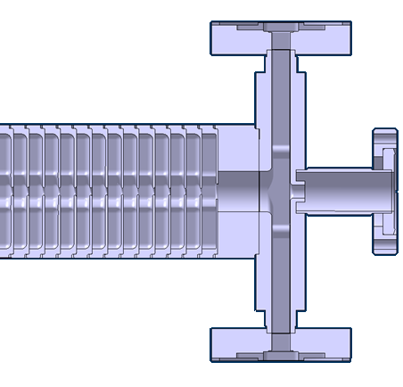
Bounds of emission
# | ACS X | ACS X’ | Mag X | Mag X’
0 | ±7 | ±0,94 | ±20 | 0,02
1 | ±7 | ±0,15 | ±20 | 0,02
2 | ±7 | ±0,116 | ±20 | 0,02
3 | ±7 | ±0,1 | ±20 | 0,02
ACS out
3
2
1
0
 | 0 | 1 | 2 | 3 | 4 | 5
R [mm] | 7 | 7 | 5,6 | 5,6 | 5,5 | 5,5
L [mm] | 15 | 93 | 109 | 127 | 142 | 159

Slide 4
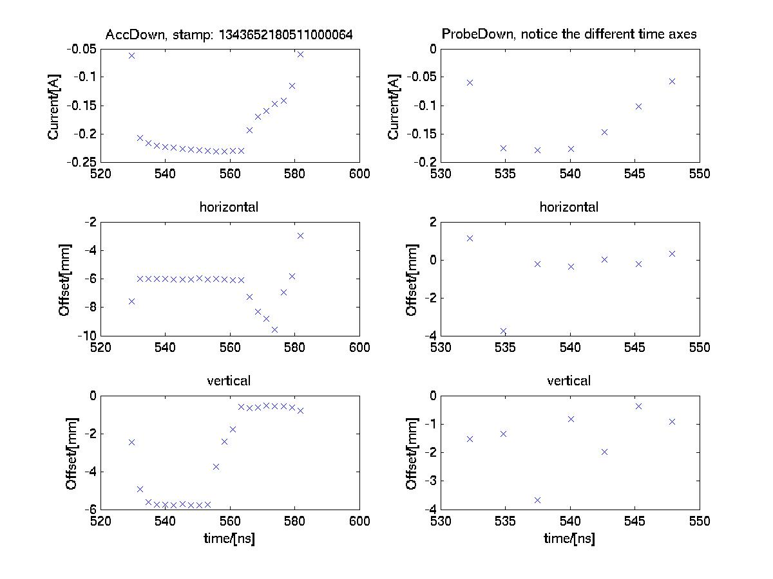
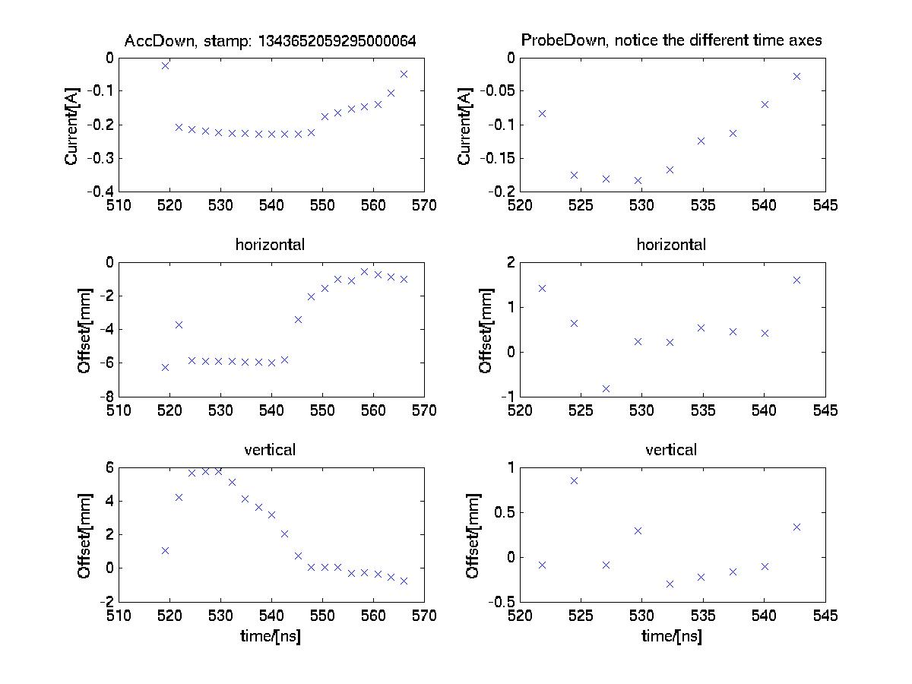
Electron emission
BPM
ProbeDown
BPM
AccDown
ACS
Flash box
Probe beam line
The beam is off
BD #1
BD #2
*Jeppe Trost Nielsen

Slide 5
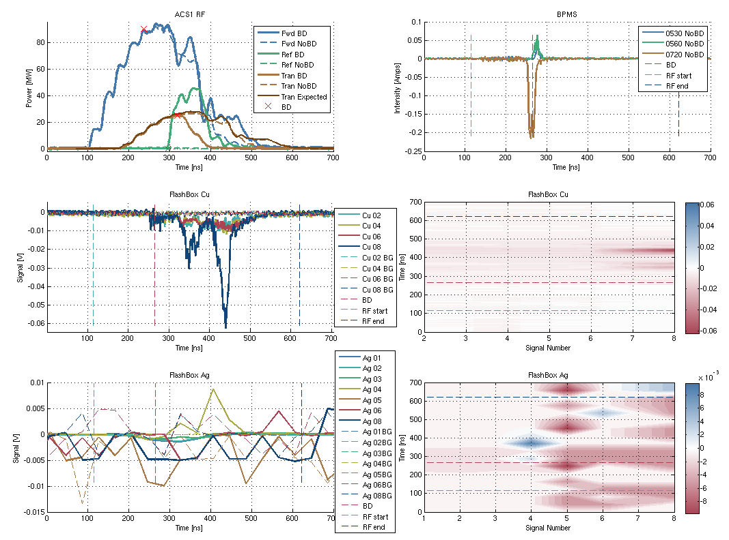
Low energy electrons: measurement
Poor resolution
Noise

Slide 6
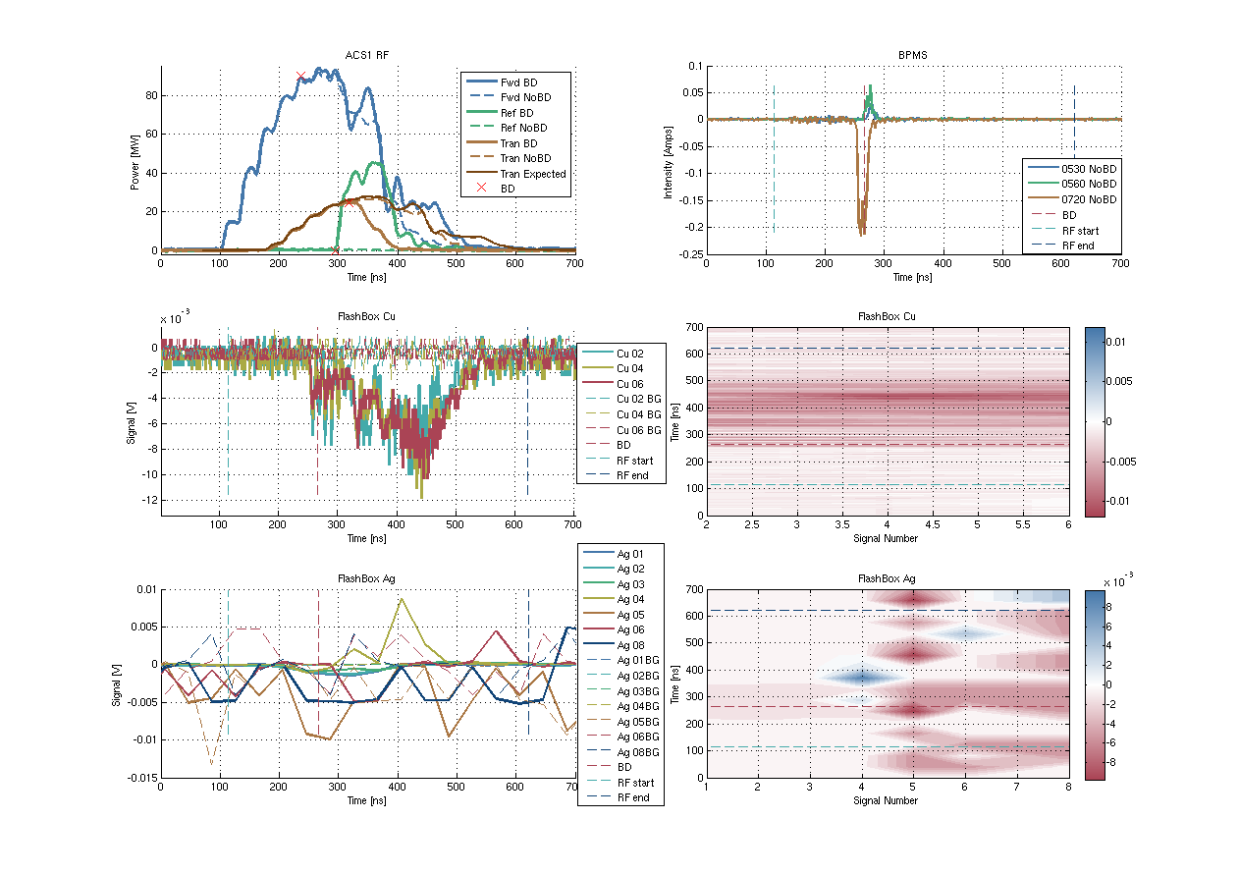
Low energy electrons: measurement
Without channel 8
Electrons
Poor resolution
Noise

Slide 7
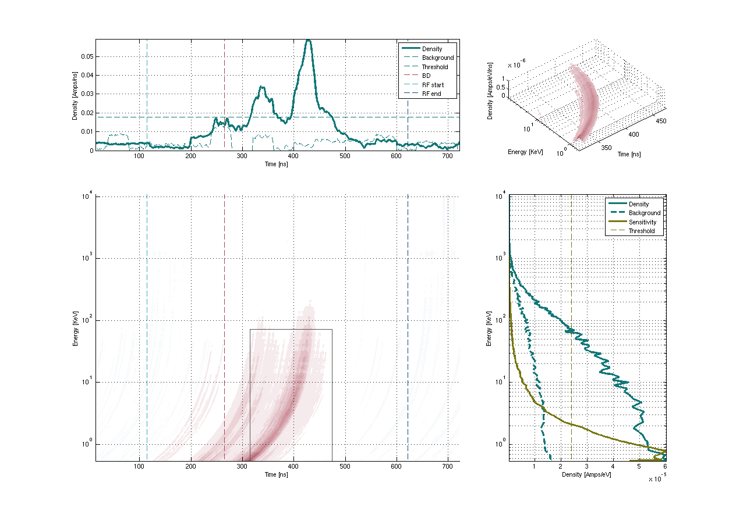
Low energy electrons: distributions

Slide 8
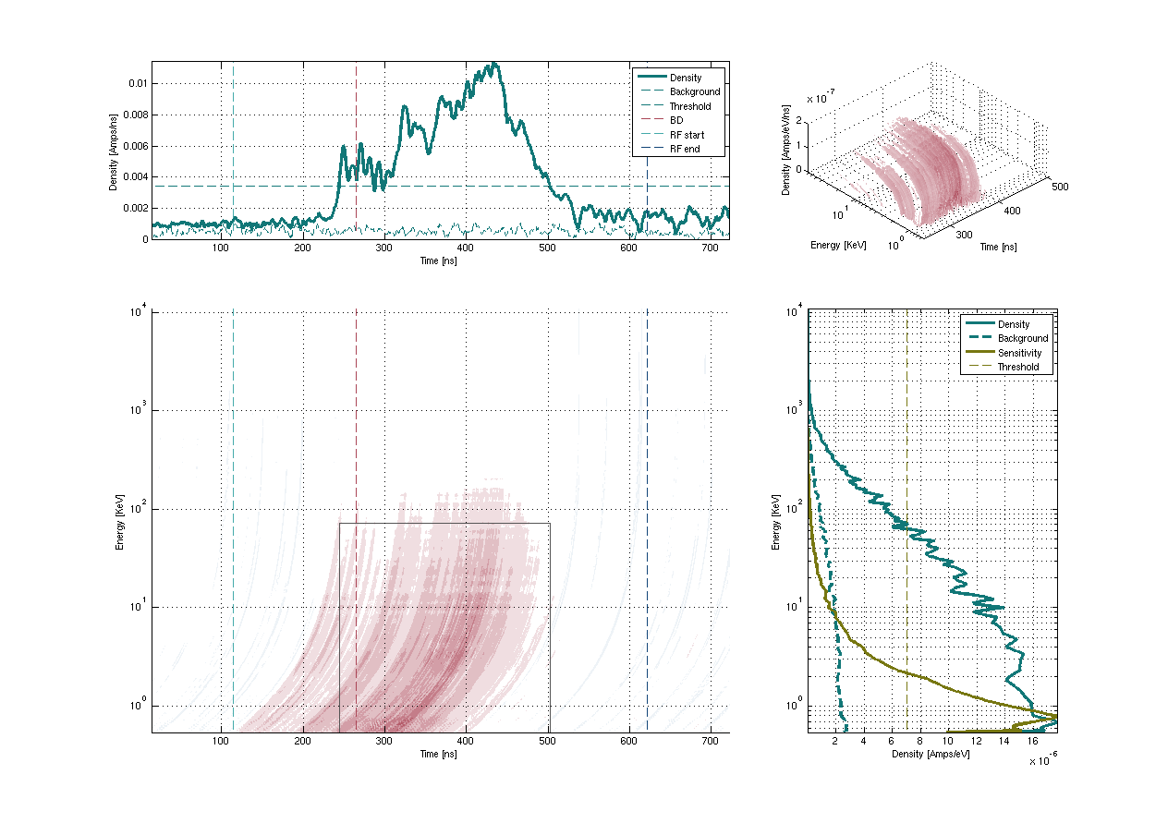
Low energy electrons: distributions
Without channels Cu8, Ag1-8

Slide 9
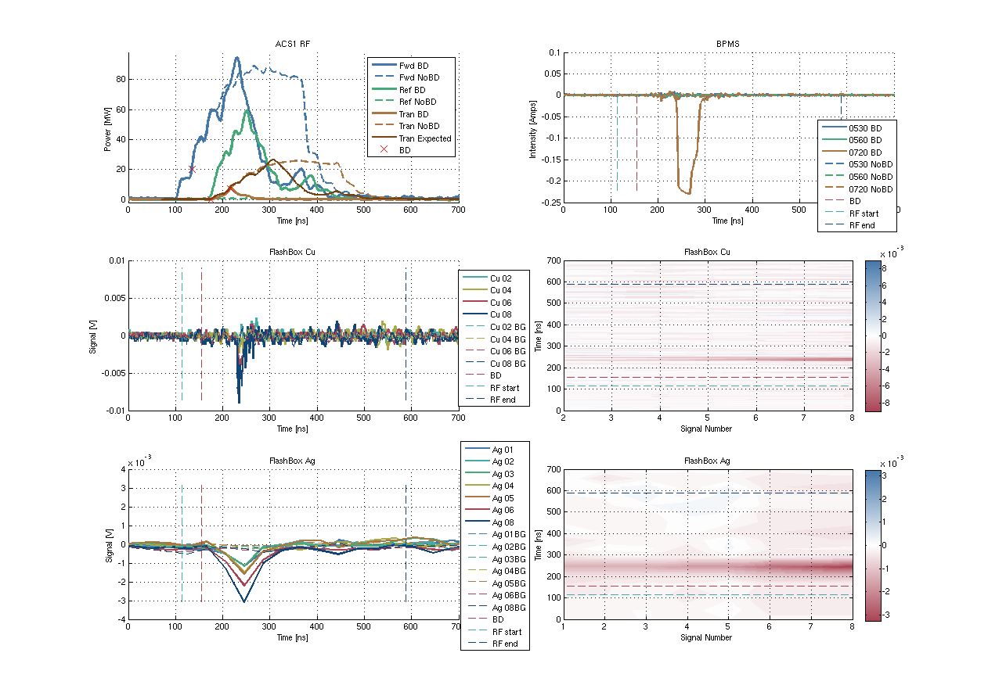
High energy electrons: measurement

Slide 10
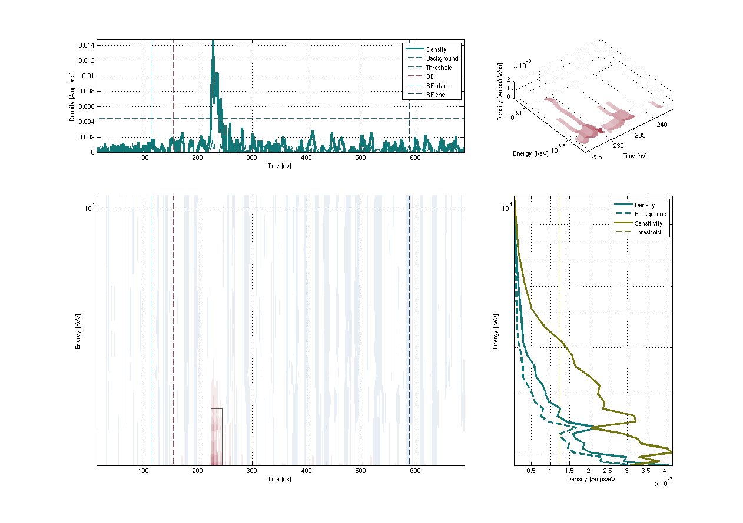
High energy electrons: distributions
10 MeV
3 MeV
2 MeV

Slide 11
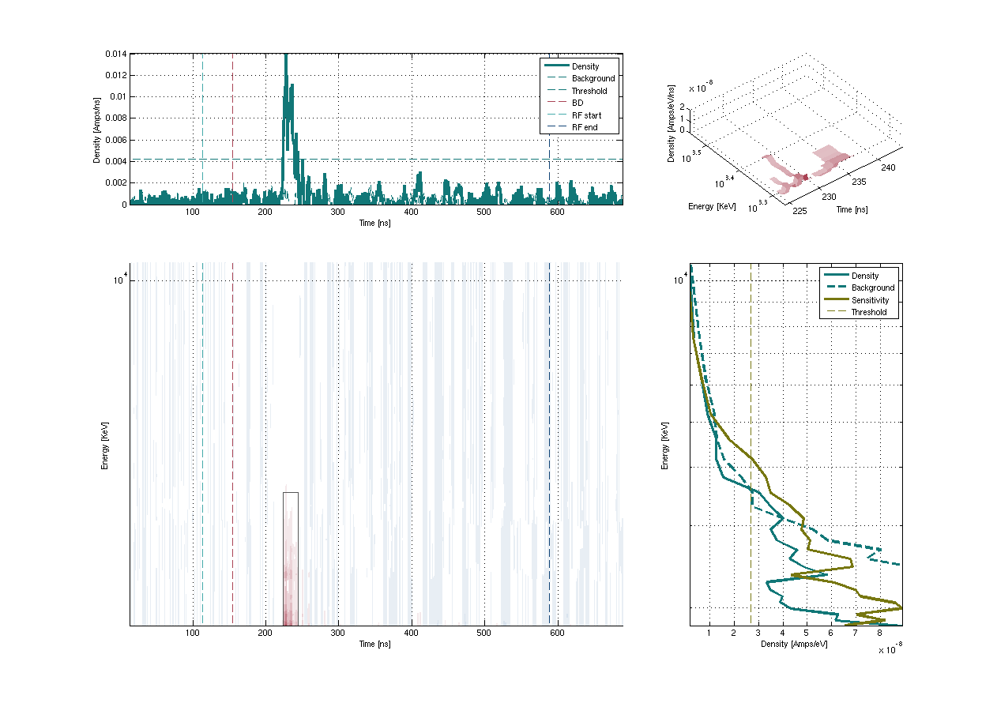
High energy electrons: distributions
Subtracted background
10 MeV
3 MeV
2 MeV

Slide 12
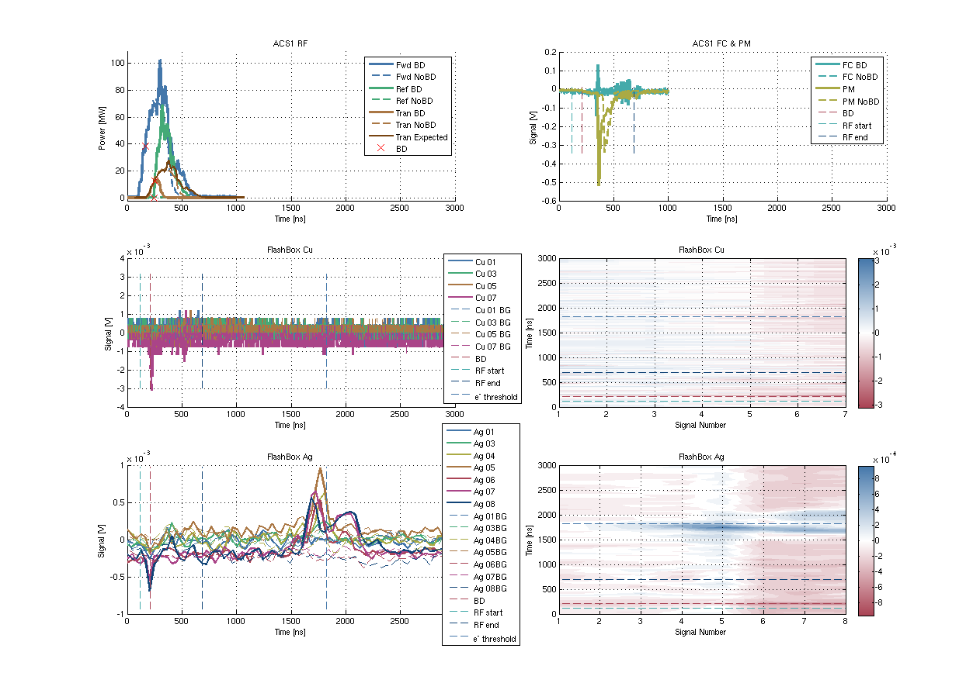
Ions: measurement
V≈1.7m/1480ns=0.38%c
V≈0.125m/80ns=0.5%c
1480 ns
From the magnet: m/e = 2.1-4.5×10³ m_{e}/e⁺:
H₂¹, Cu²⁶⁻²⁹ etc

