Slide 1
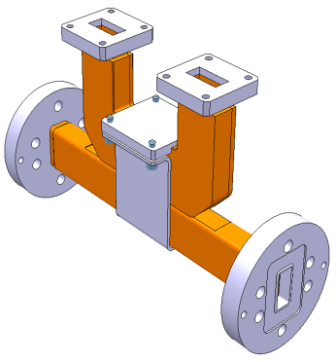

60 dB bi-directional couplers

