Slide 1




C-Band, Siwss FEL and SPARC photo injector high power testing summary
Nicholas Shipman
05/09/2012

Slide 2
Talk Overview
In this talk I will attempt to summarise the work of Riccardo Zennaro, Juergen Alex, Alessandro Citterio and others at PSI who have been carrying out high gradient tests on test structures to study.
I will also compare those from the SPARC photo injector energy upgrade structure which can be found in the following paper:-
Design, Fabrication and high power RF test of a C-Band accelerating structure for feasability study of the SPARC photo-injector energy upgrade.
D. Alesinin et. al.
Tiara-conf-WP8-2011-001
Details of the first test structure tested at PSI, which is not presented here, can be found in the following paper:-
Design, construction and power conditioning of the first C-Band test accelerating structure for SWISSFEL.
R. Zennaro et. al.
THPPC024 IPAC 2012

Slide 3
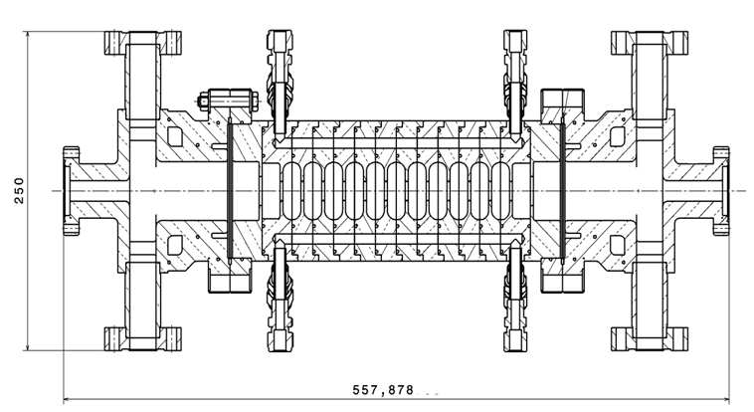
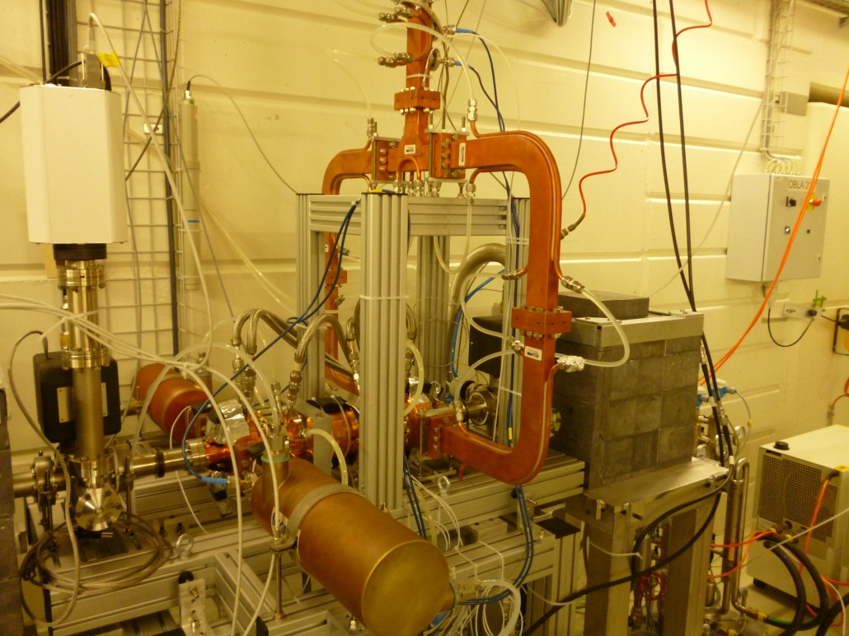
Swiss FEL test setup
Klystron:- newly developed, Toshiba E37210, 100Hz, 50MW, 3us
Modulator:- presently equipped with Scandinova K2-2S
No pulse compressor as of yet.
Mode launchers mechanically connected with flanges, RF chokes provide coupling
Full structure will be linearly tapered, 2m long with 113 cells
Test structures are constant impedance with 11 cells.

Slide 4
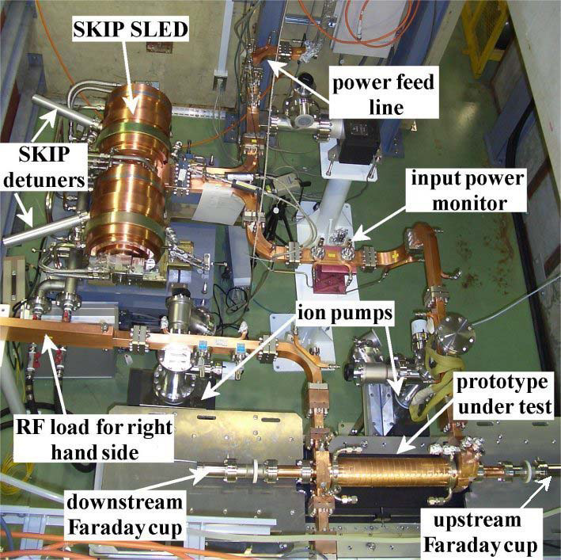
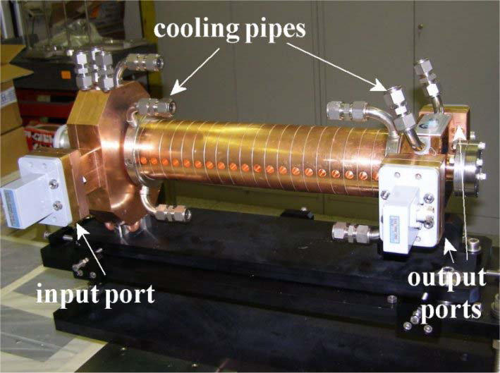
SPARC Test setup
High power tested at KEK
SLED style pulse compressor
Final structure will be 1.4m long with 71 cells
Test structure is 0.54m long with 22 cells

Slide 5
Swiss FEL testing overview
4 test structures have been built.
Structures 1, 2 and 3 have been tested.
Structure 4 has not yet been tested.
Structures 1 and 2 are identical and have large irises
SPARC testing overview
One prototype structure has been tested.

Slide 6
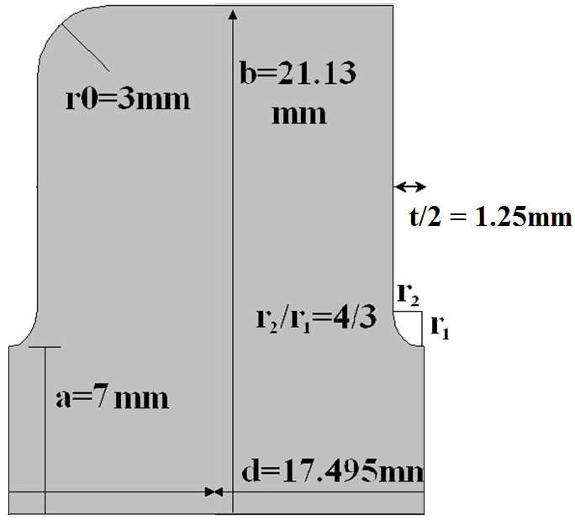
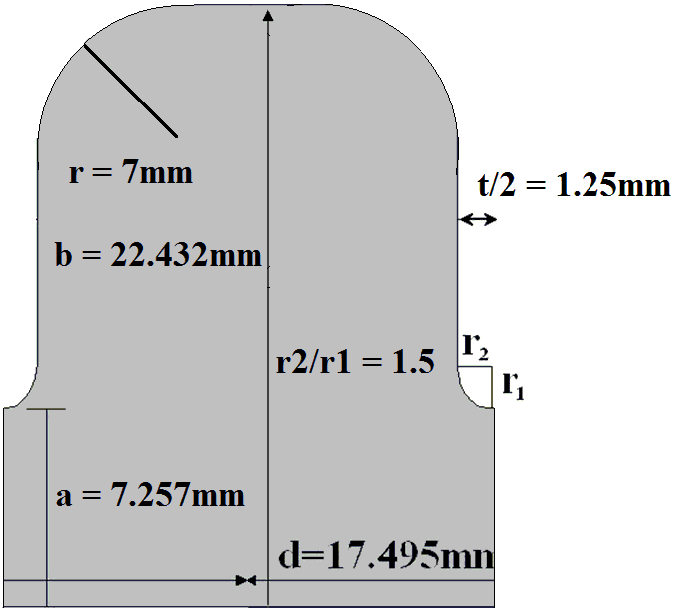
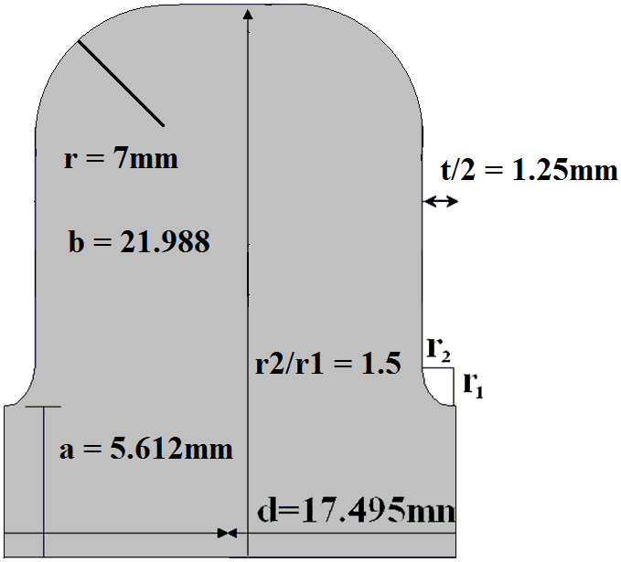
Comparison of cell geometry
SPARC Cell
Swiss FEL Large Iris
(Test structures 1 and 2)
Swiss FEL Small Iris
(Tests structures 3 and 4)
Geometrically the SPARC Cell and the Swiss FEL large iris cell were quite similar.

Slide 7
Comparison of parameters
Parameters | Structure 3 Small iris | Structure 2 Large iris | Sparc
a | 5.612 | 7.257 | 7.0
t | 2.5 | 2.5 | 2.5
b [mm] | 21.988 | 22.432 | 21.13
f [GHz] | 5.7124 | 5.7202 | 5.7107
Q(Cu) | 11007 | 11100 | 10260
vg/c [%] | 1.36 | 3.18 | 2.83
r’/Q [kΩ/m] | 8.518 | 7.2 | 7.487
r’ [MΩ/m] | 93.76 | 79.92 | 76.82
Es/Ea | 2.25 | 2.25 | 2.155
Hs/Ea [mA/V] | 2.84 | 2.51 | 2.58
Sc/Ea² [mA/V] | 0.495 | 0.642 | 0.61
With the exception of the cell dimensions these parameters were calculated using HFSS
Courtesy of Vasim Khan

Slide 8
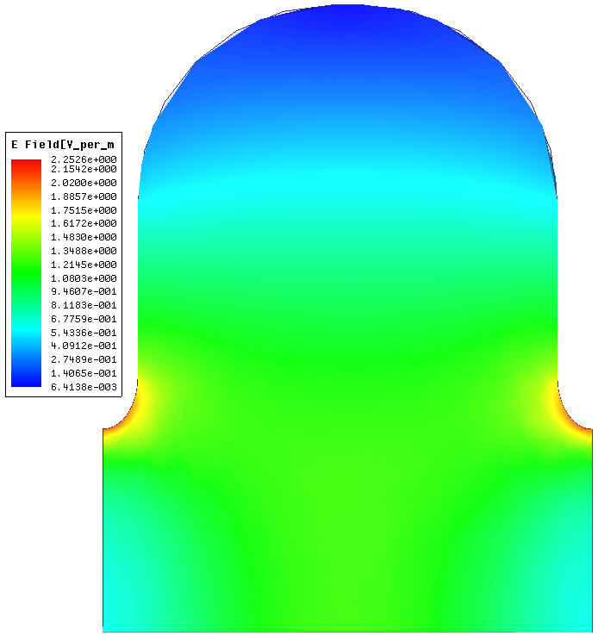
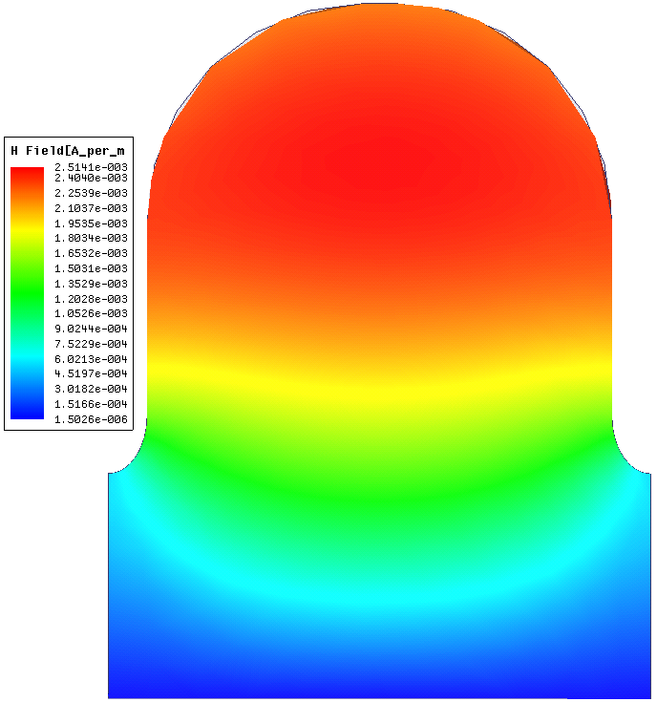
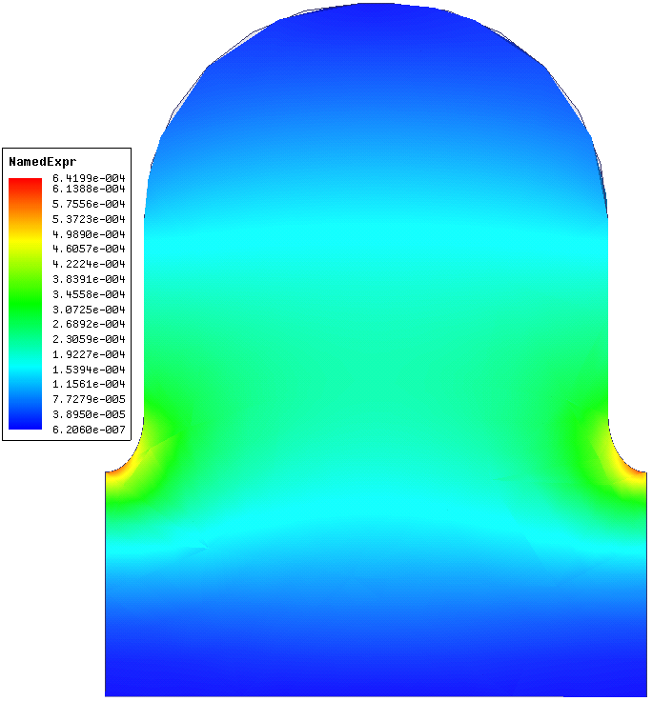
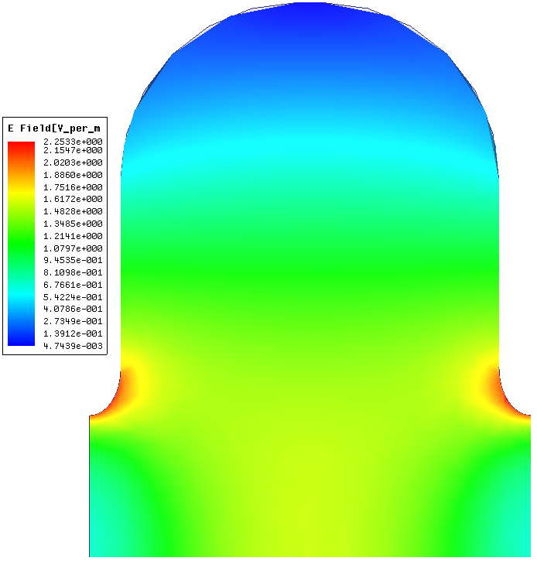
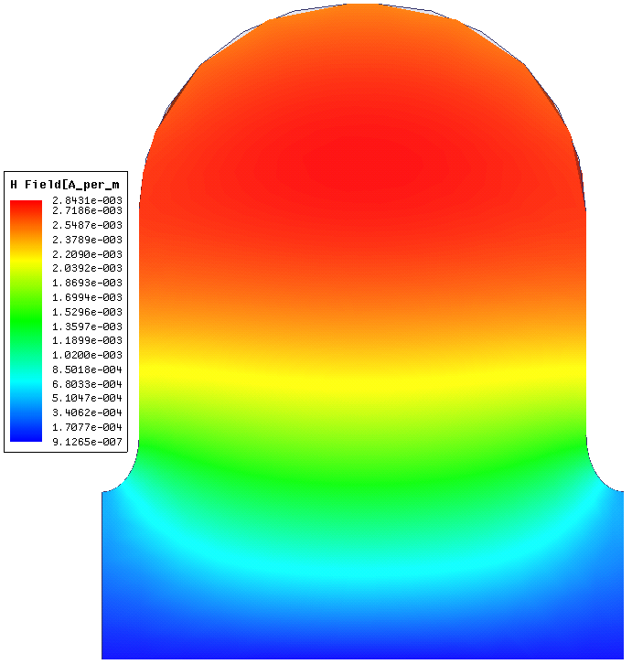
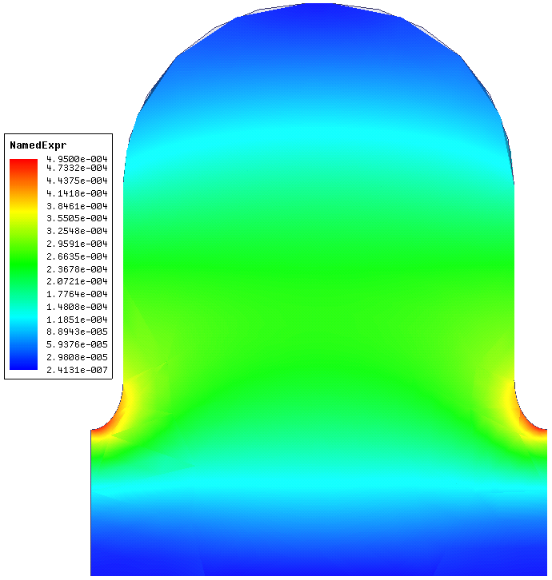
Swiss FEL large iris
E_{s}/E_{a}
H_{s}/E_{a}
S_{c}/E_{a}²
Swiss FEL small iris
E_{s}/E_{a}
H_{s}/E_{a}
S_{c}/E_{a}²
Courtesy of Vasim Khan

Slide 9
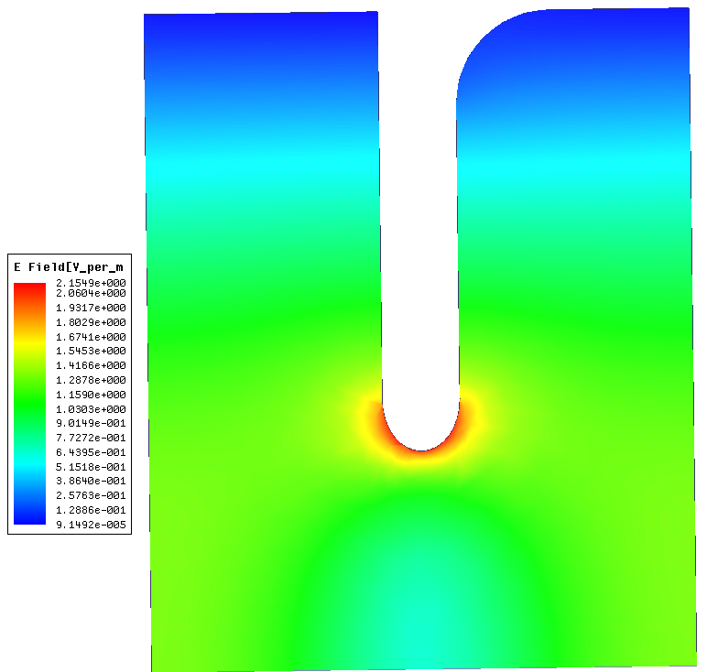
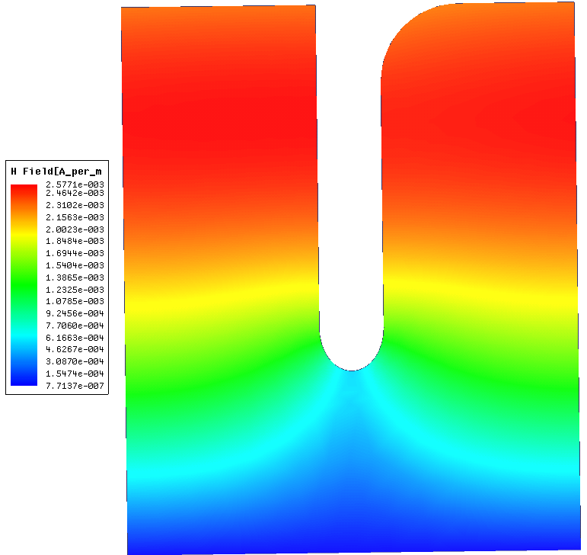
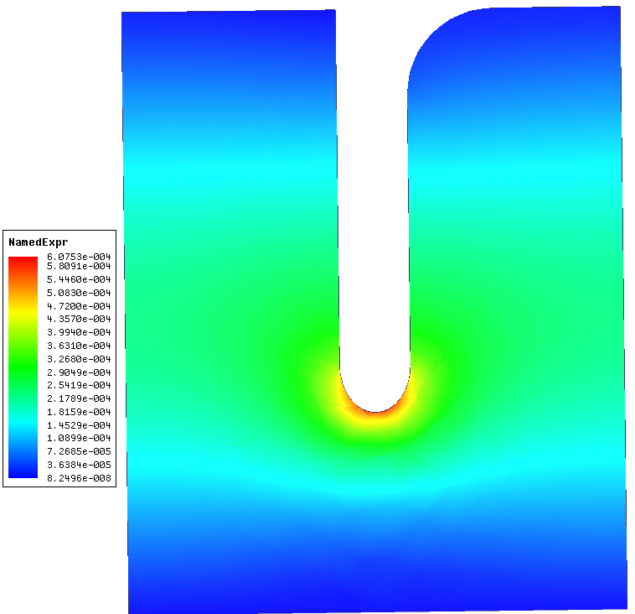
SPARC cell
E_{s}/E_{a}
H_{s}/E_{a}
S_{c}/E_{a}²
The radius of curvatures used for the PSI structures were a ‘best guess ‘ but the parameters calculated form the simulations closely matched the parameters given.
The geometry for the SPARC cell was exact as given in the paper, the calculated parameters agreed well with the exception of the peak surface field which differed by
Courtesy of Vasim Khan

Slide 10
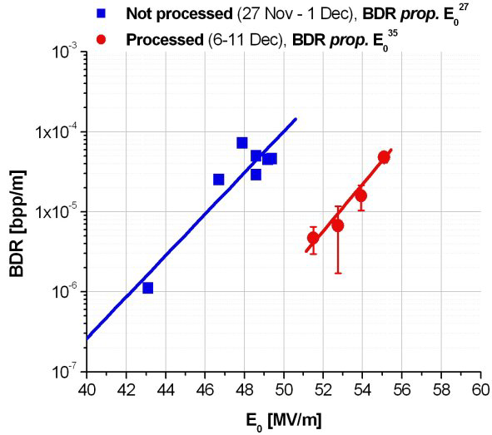
SPARC results
After ~ 1.10⁸ conditioning pulses
Tp = 200ns

Slide 11
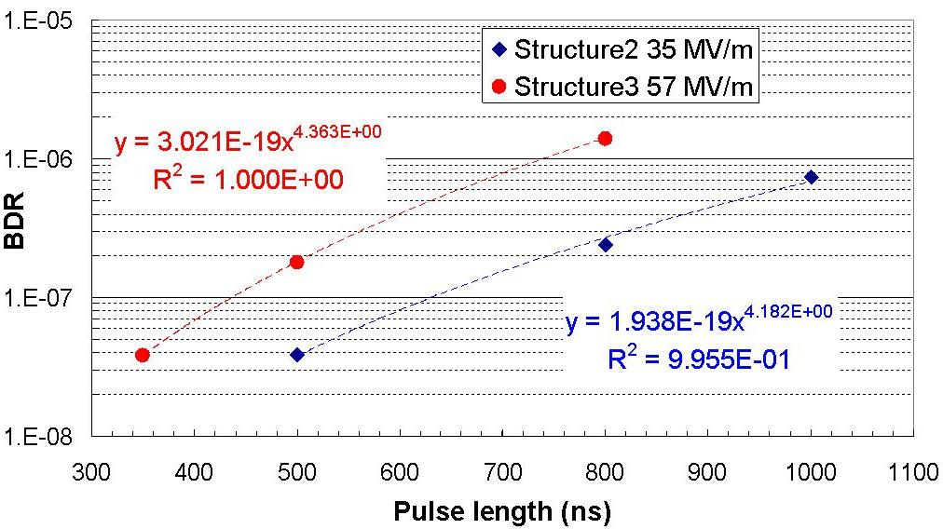
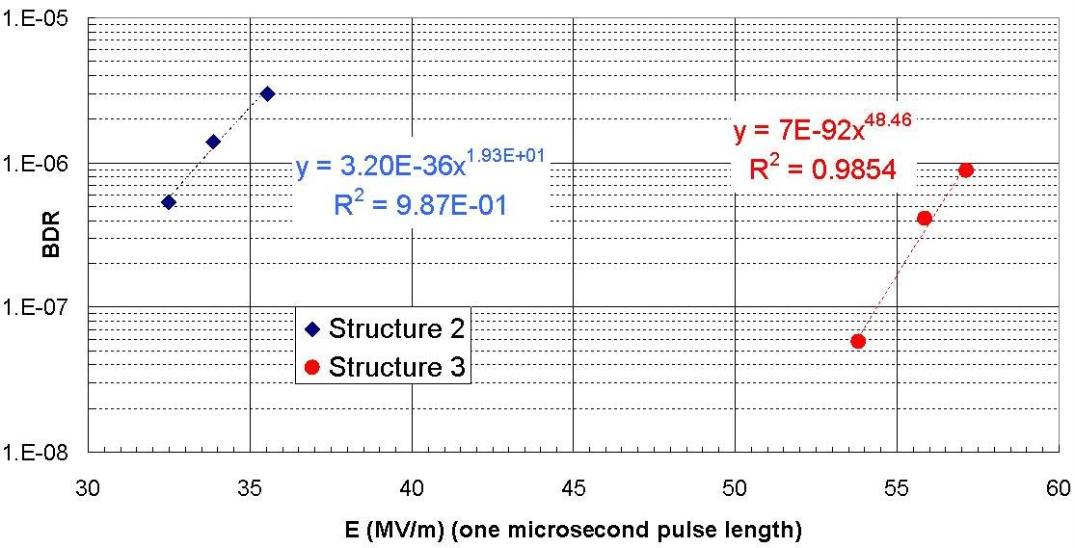
Swiss FEL results
Structure 2 had seen about 7.10⁵ conditioning pulses and structure 3 about 2.10⁶
Before these measurements were taken.

Slide 12
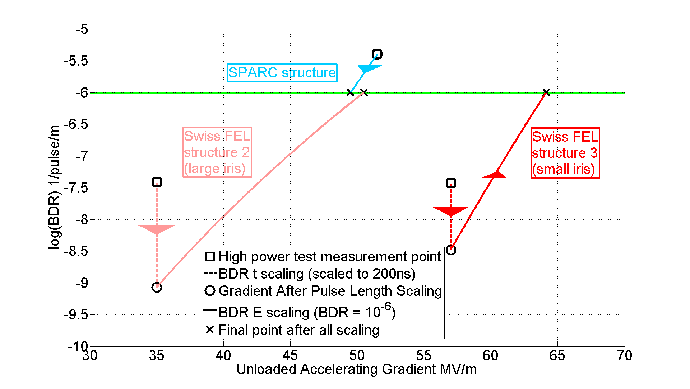
Comparison of different measurements

Slide 13
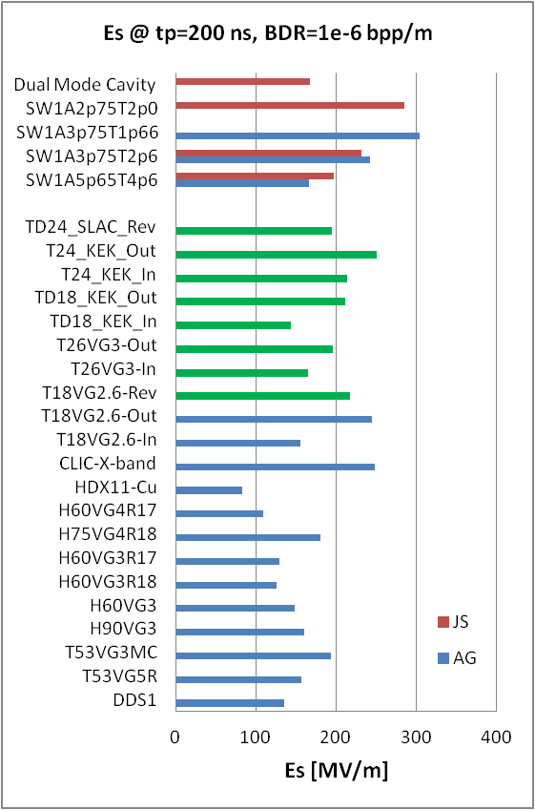
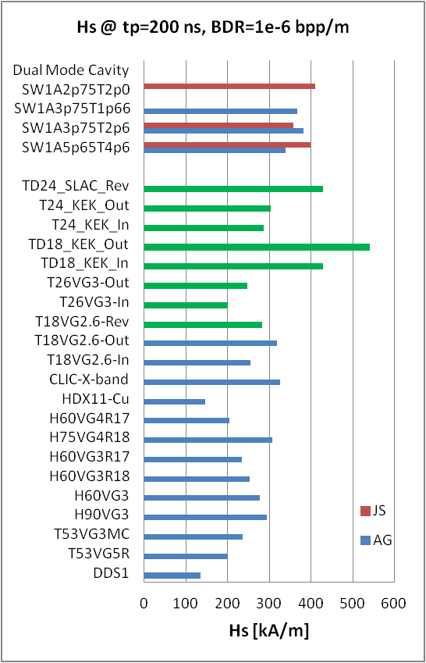
Maximum surface electric and magnetic fields
Waveguide
damped
Es = 250 MV/m or higher has been achieved in several cases: very low or zero group velocity

Slide 14
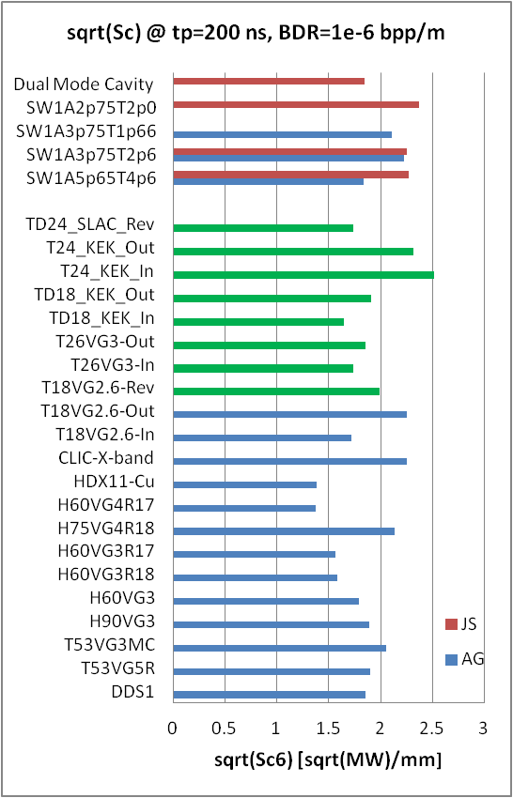
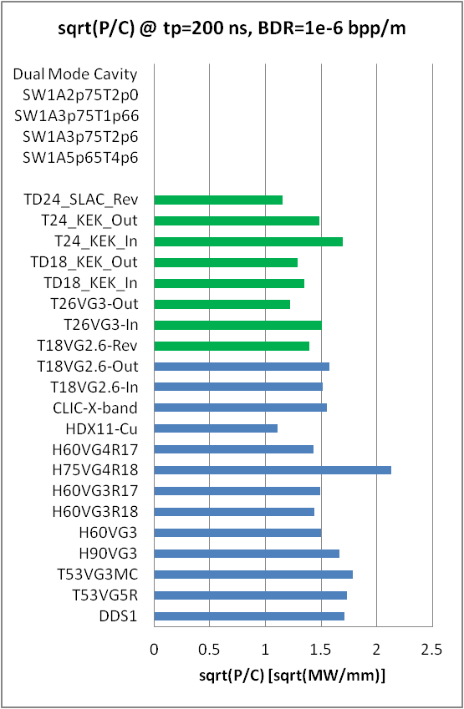
Power flow related quantities: Sc and P/C
Sc = 4 - 5 MW/mm²
P/C = 2.3 – 2.9 MW/mm

Slide 15
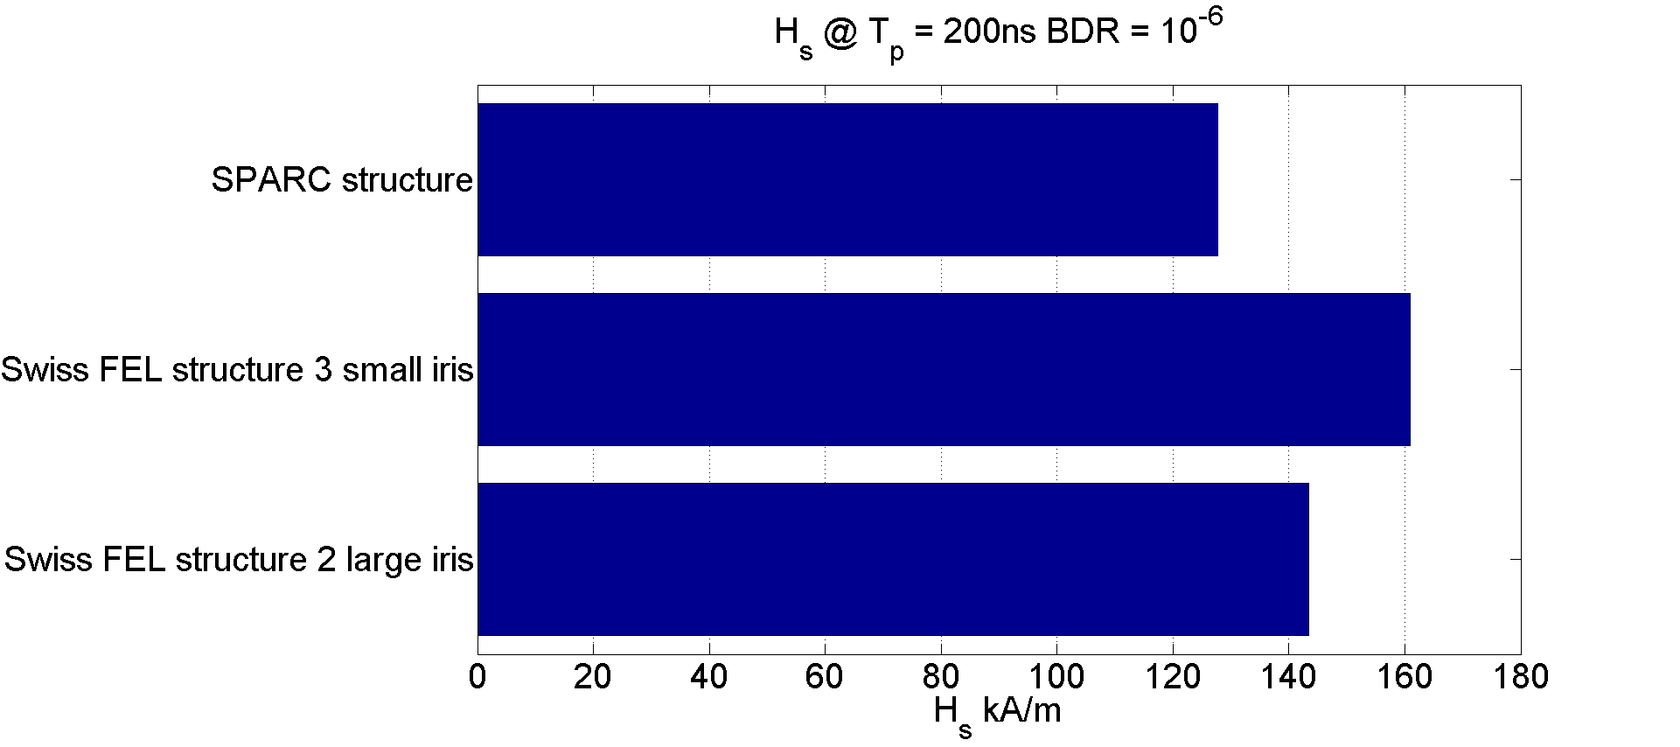
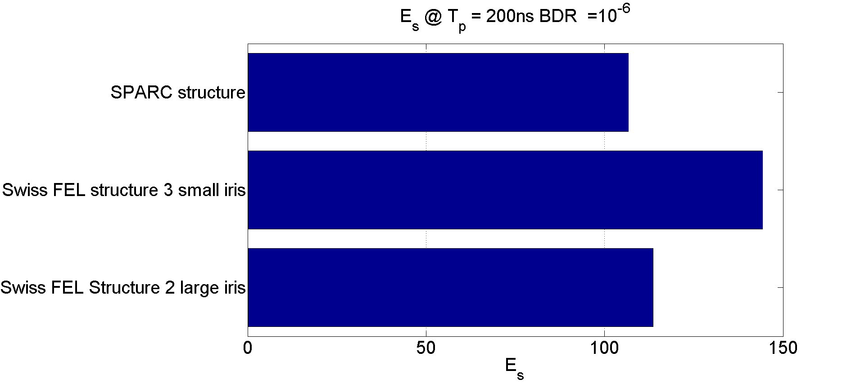
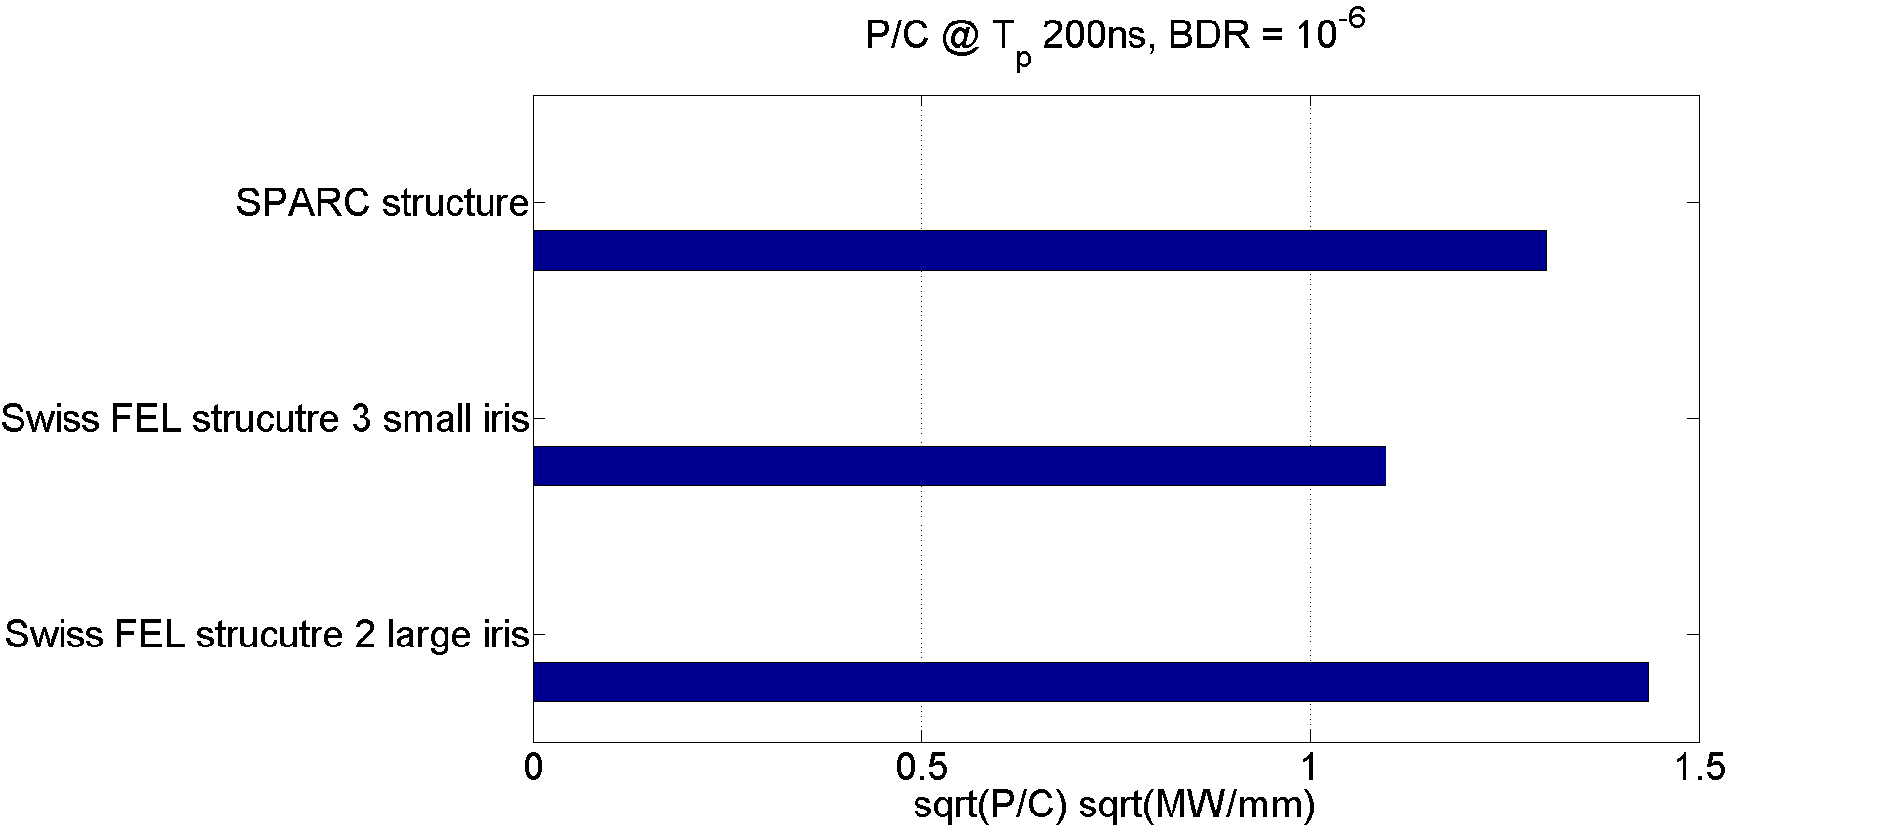
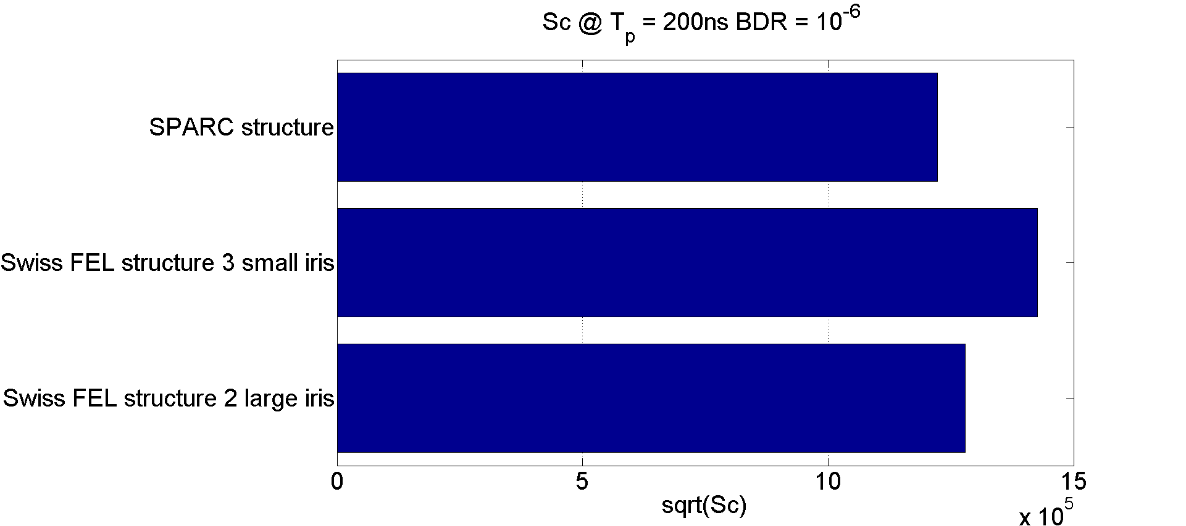
Comparison of C-Band design parameters

Slide 16
PSI Future Plans
Start testing structure 4 in 2 or 3 weeks
Structure 4 has a J-coupler which is the same as the coupler which will be on the output of the full 2m structure.
In November the pulse compressor will be tested.
In February the 2m structure will be tested.

