Slide 1

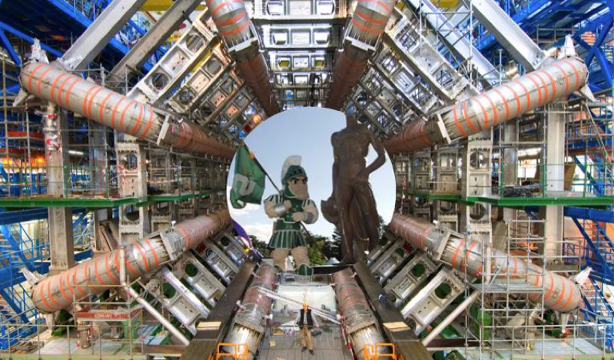


Breaking News
from the LHC!
Albert De Roeck
CERN, Geneva, Switzerland
Antwerp University Belgium
Davis University USA
IPPP, Durham UK
20 August 2012

Slide 2
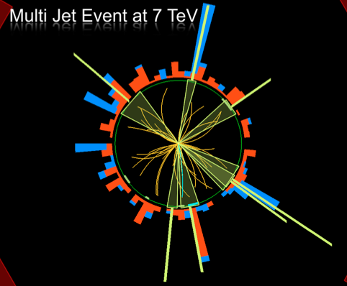
Outline
Introduction: News on the
LHC & experiments
Physics results
  The observation of a
  new particle at 125 GeV
  Searches for New
  Physics
  QCD/EW measurements
  for searches
Summary

Slide 3
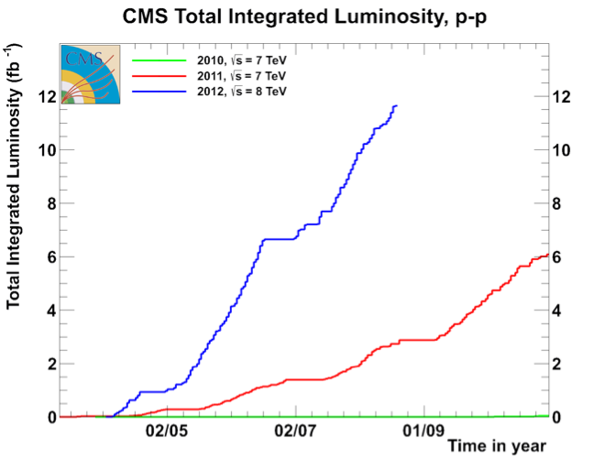
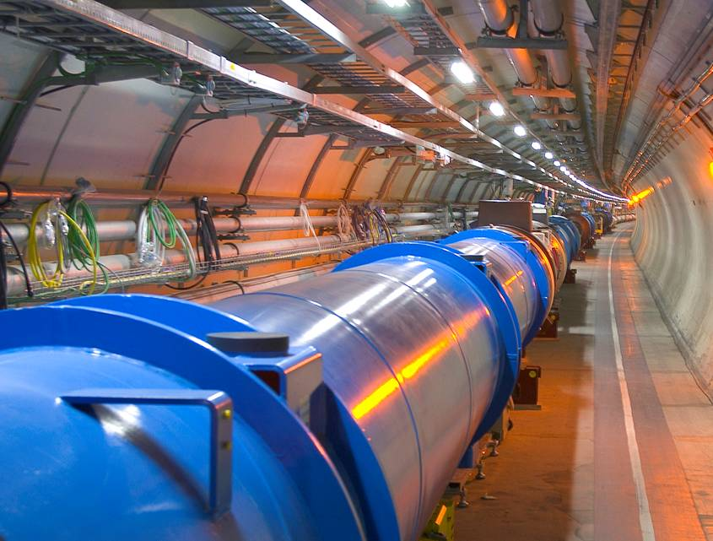
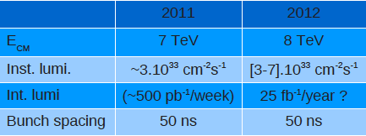
LHC is doing very well
Last year: luminosity 3 . 10³³ cm⁻² s⁻¹ ⇒ 5 fb⁻¹ collected in total
This year: luminosity 7 . 10³³ cm⁻² s⁻¹ ⇒ 11 fb⁻¹ collected so far
25-30 fb⁻¹ total expected by end 2012

Slide 4
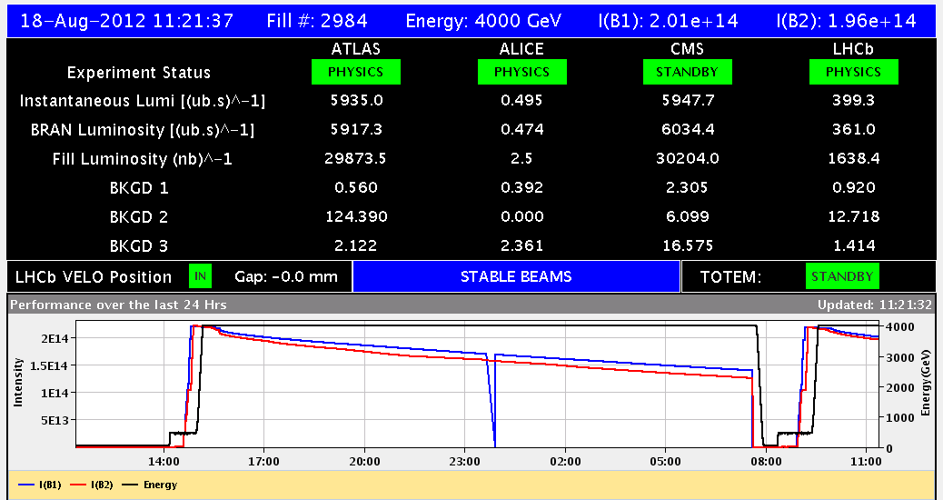
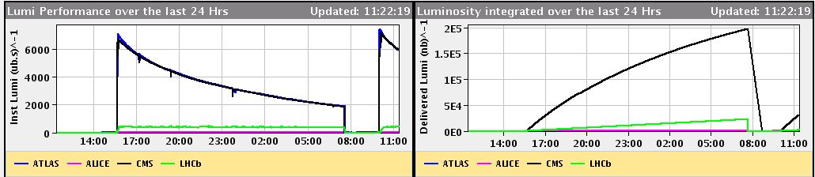
The LHC Schedule & Performance
250 pb⁻¹/day
The 2012 pp run is extended till December 17: another 14 weeks
Now: 1.5E11 particles /bunch -> increase to 1.7E11 ?
Now: 7E33cm⁻²s⁻¹ -> increase to 9E33cm⁻²s⁻¹?
=> >300 pb⁻¹/day in the last weeks? 30 fb⁻¹ total is possible!
Breaking news: yesterday 1.56E11/ bunch and 7.4E33cm⁻²s⁻¹

Slide 5
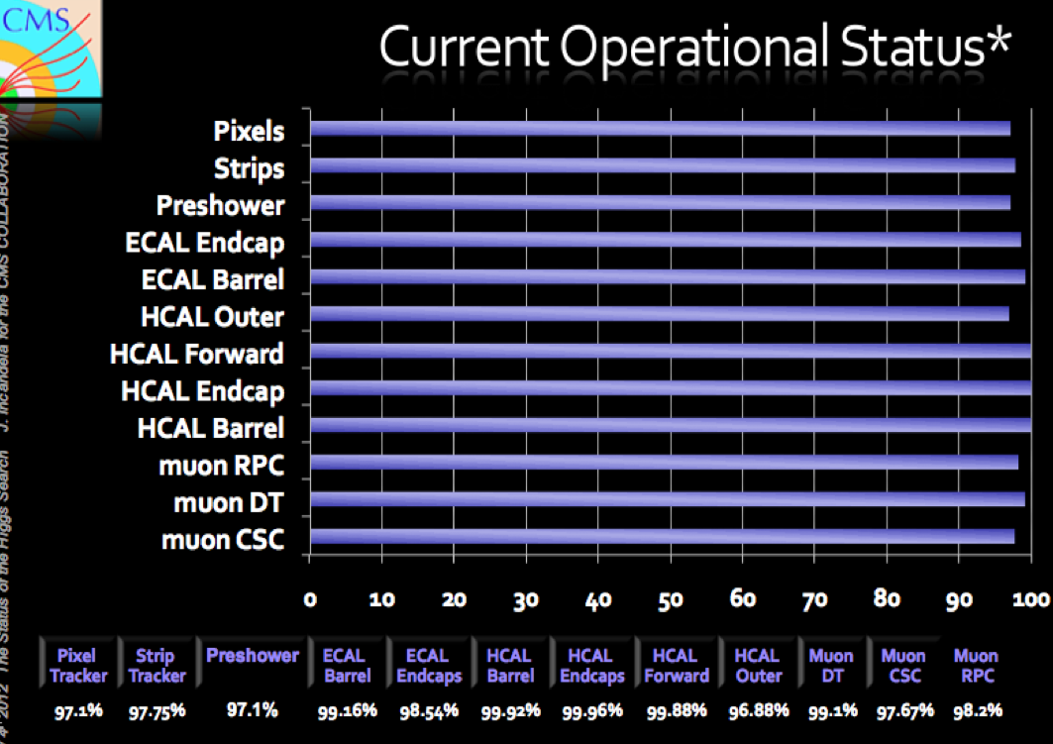
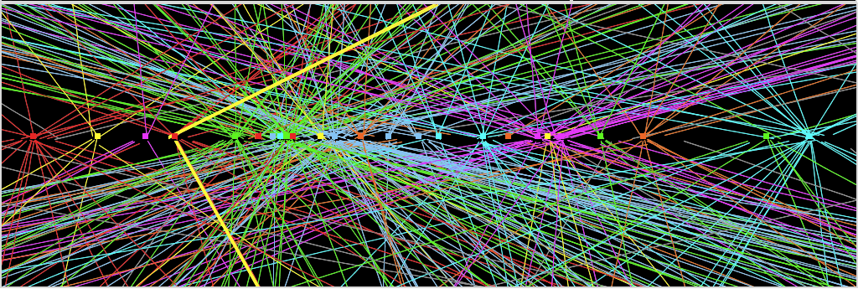
The experiments are in good shape!
ATLAS
CMS
Fraction of non-operational detector channels: (depends on the sub-detector)
Few permil (most cases) to 4%
Data-taking efficiency = (recorded lumi)/(delivered lumi):~ 94.6%
Good-quality data fraction, used for analysis : ~ 93.6%
(will increase further with data reprocessing)
Pile-Up 2012!!
Z→ μμ event from 2012 data with 25 reconstructed vertices
Z→ μμ
An issue for jet measurements

Slide 6
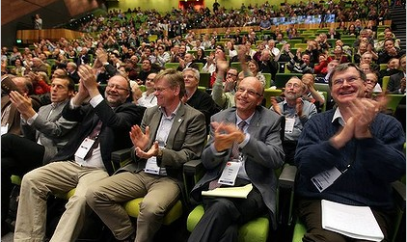
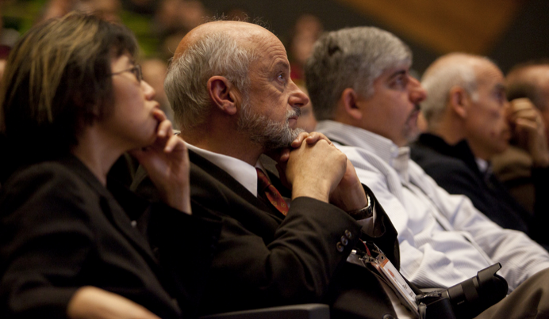
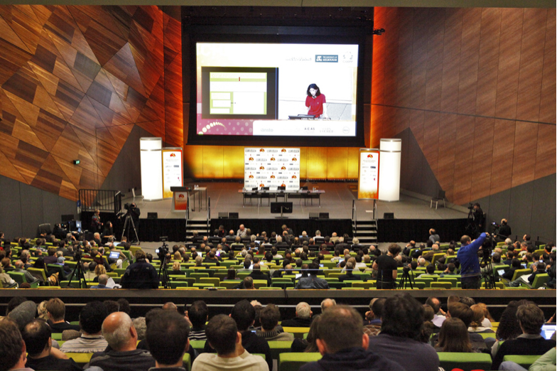

July 4th 2012 17:00 Melbourne
Official announcement of the observation of a Higgs-like particle with mass of 125-126 GeV by CMS and ATLAS.
Historic seminar at CERN with simultaneous transmission and live link at the large particle physics conference of 2012 in Melbourne, Australia
Melbourne

Slide 7
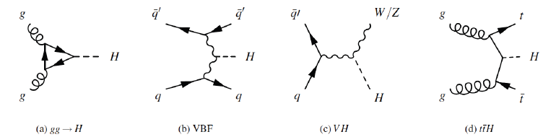
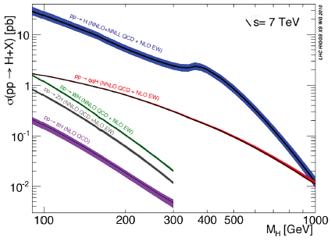
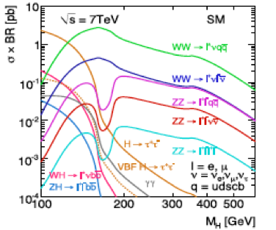
Higgs Searches
Production: gg fusion, VBF and VH, (ttH)
Decay:γγ, ZZ, WW, tautau, bb,…

Slide 8
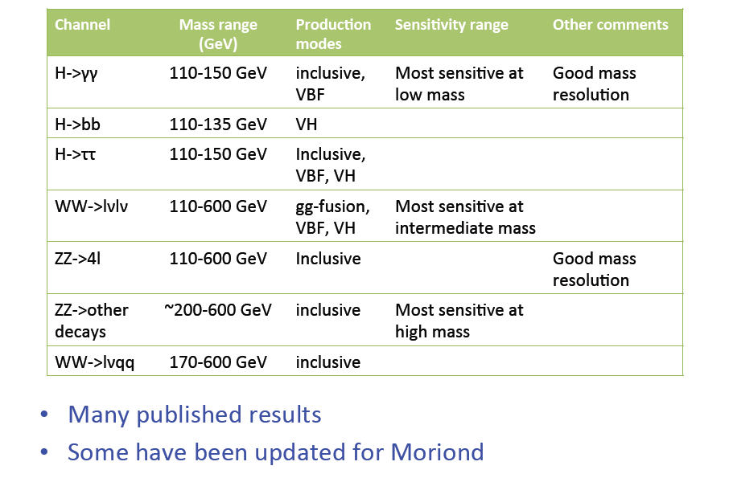
Higgs Studies

Slide 9
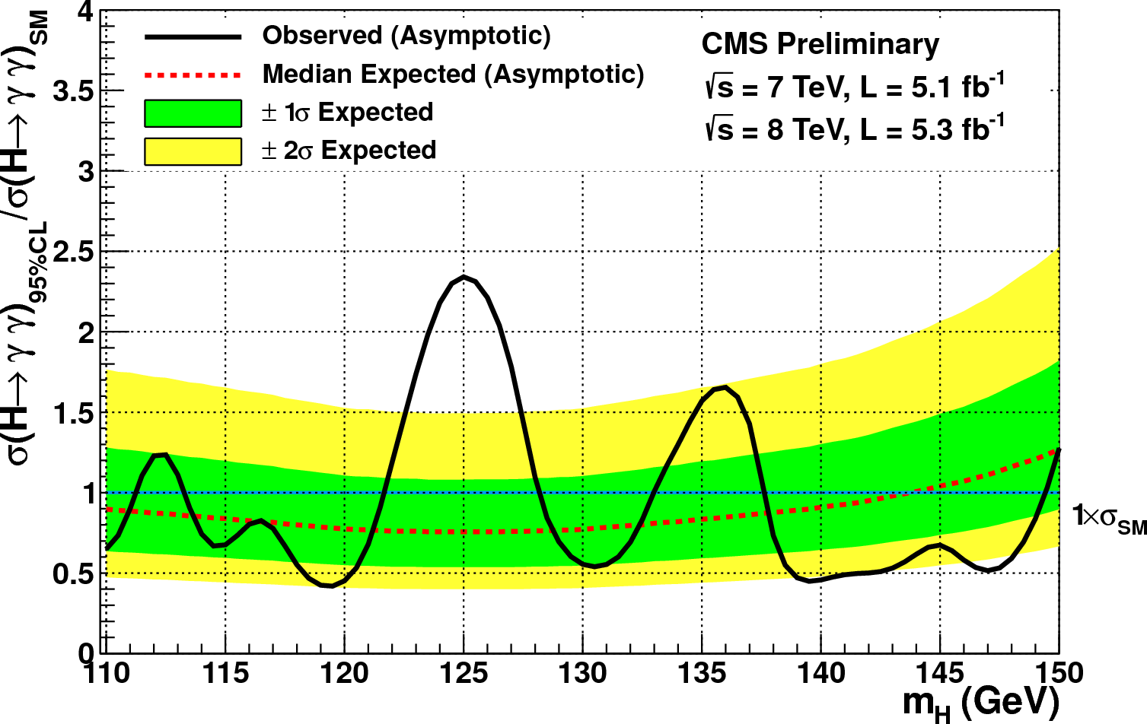
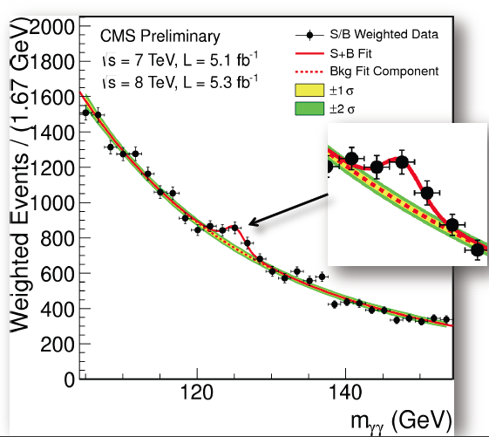
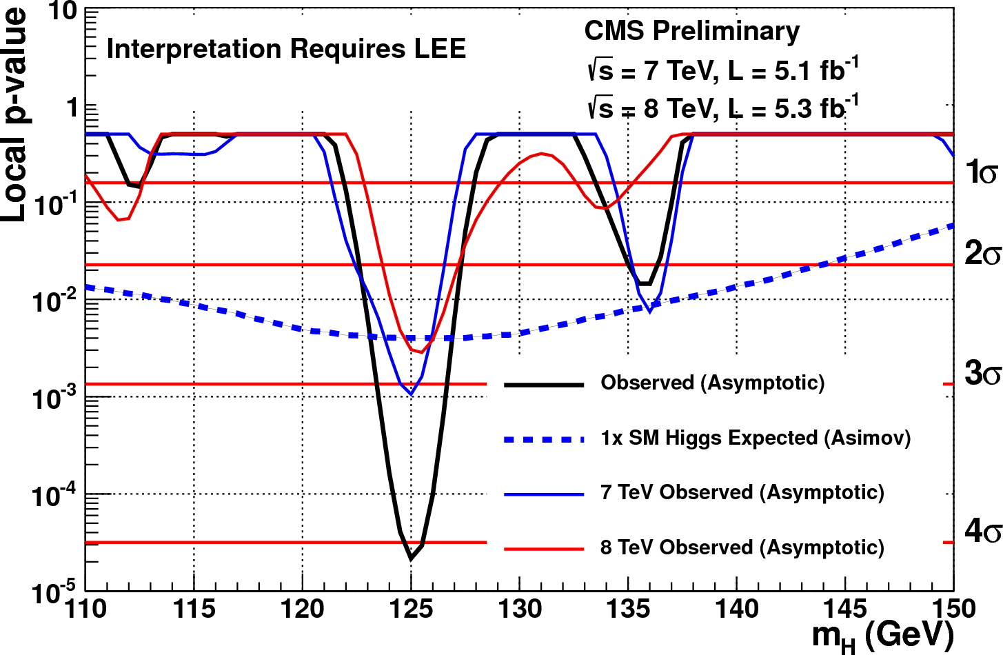
CMS: Higgs
Search for the Higgs boson: use ALL Luminosity delivered for 2011 and 2012
CMS analysed five low mass channels + combination (plus a few high mass channels)
Higgs to γγ
Diphoton mass spectrum
Analysis classes weighted with S/B
Observed significance at 12 GeV:
4.1 σ

Slide 10
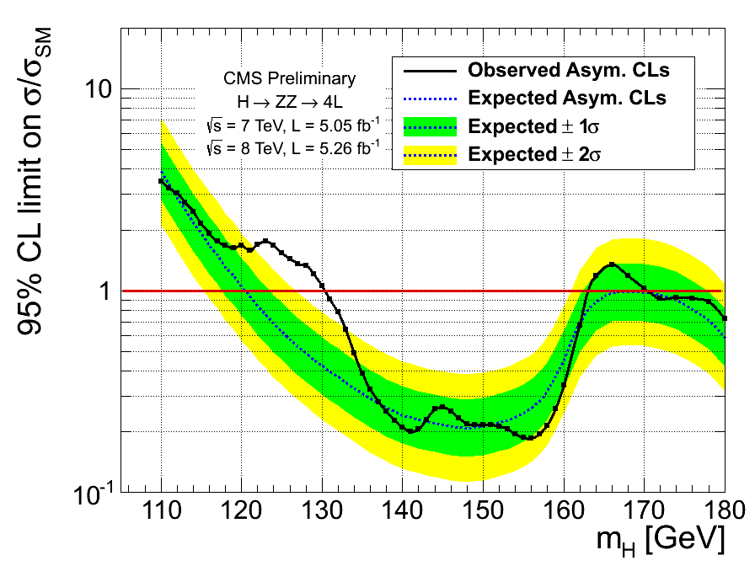
CMS: Higgs
Higgs to ZZ to 4 charged leptons
Observed significance at 125.6 GeV:
3.2 σ

Slide 11
CMS: Higgs
Higgs to bb
Higgs to WW
Higgs to tau tau

Slide 12
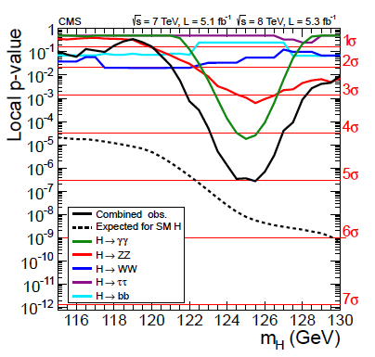
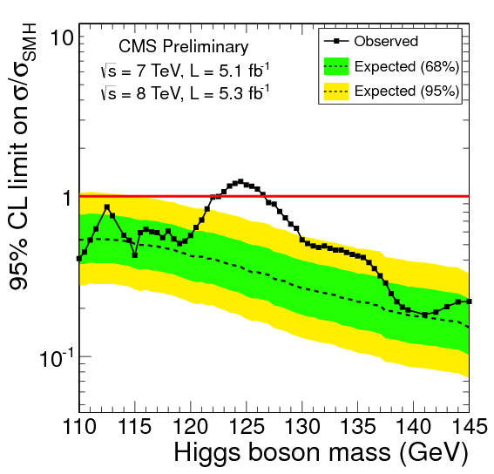
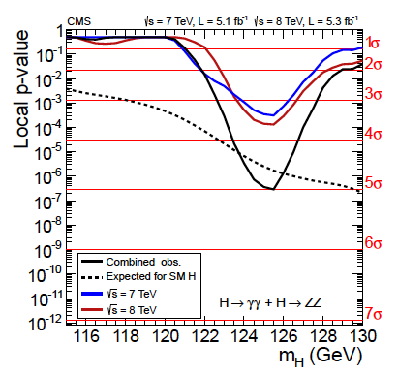
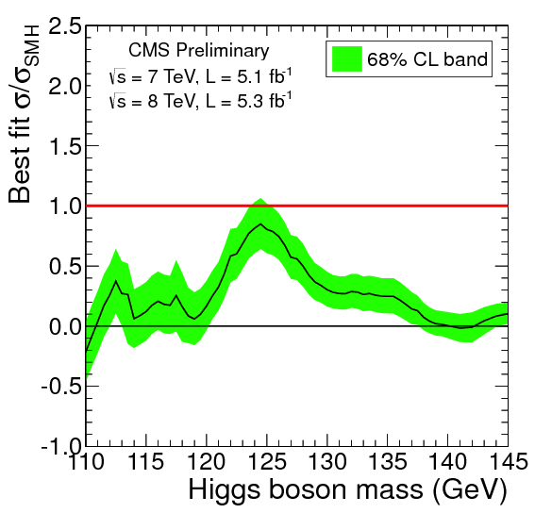
CMS: Higgs
All channels
CMS observes a
new boson with
a significance of
5 sigma
The particle is
consistent with a
Higgs-like boson
ZZ and γγ channels

Slide 13
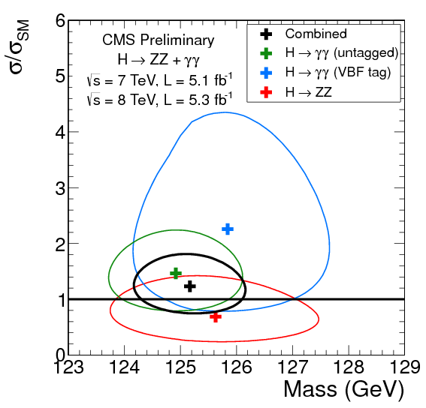
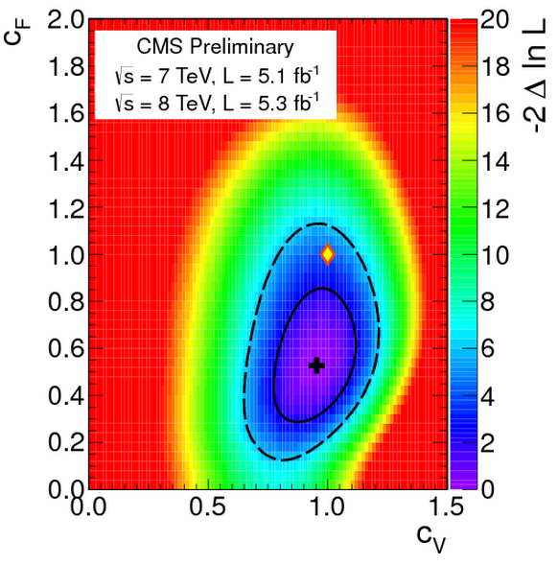
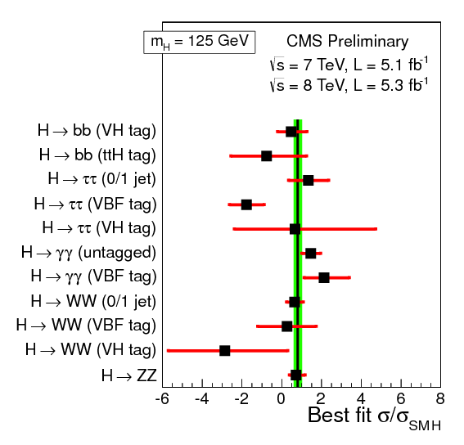
CMS: Higgs
Particle Mass = 125.3 +/- 0.4 +/- 0.5 GeV
Couplings to vector bosons and fermions
Different channels
Total strenght
0.87 +/- 23
SM Higgs-like within 2σ but
certainly not definite yet…

Slide 14
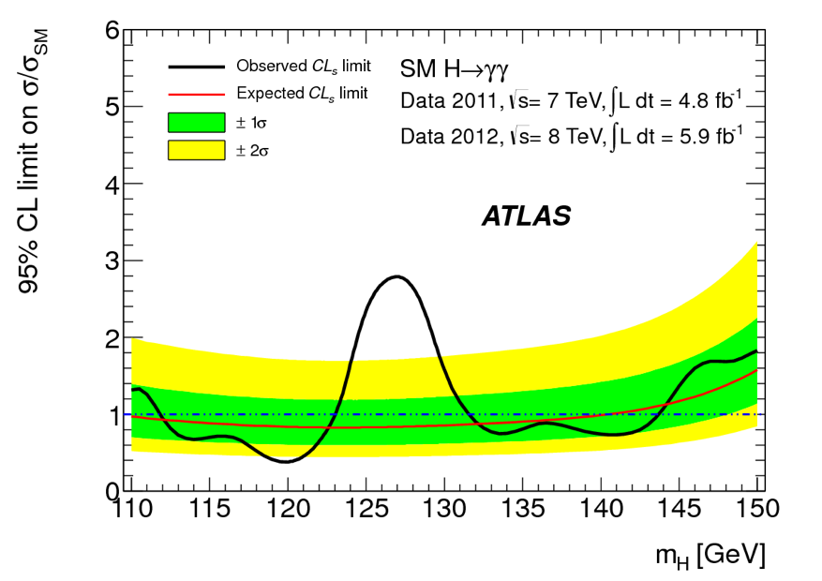
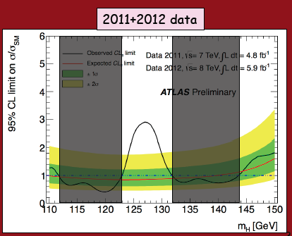
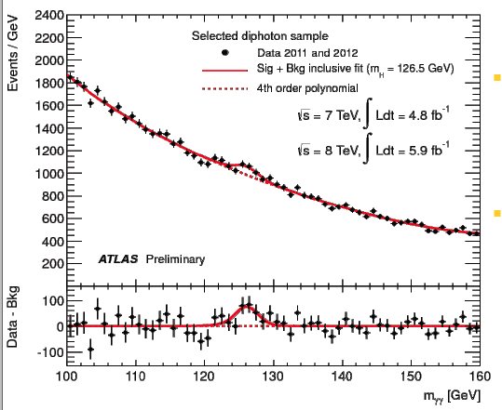
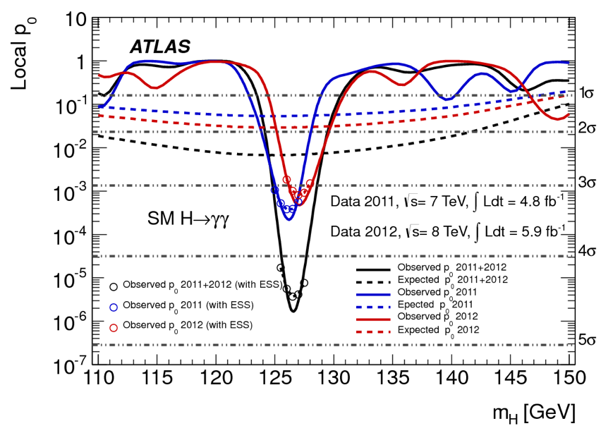
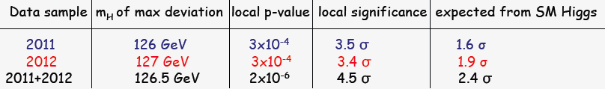
ATLAS : Higgs
Higgs to γγ

Slide 15
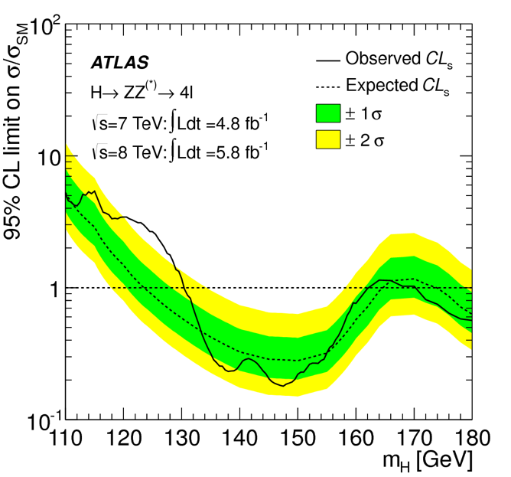
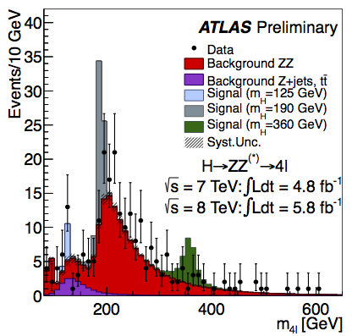
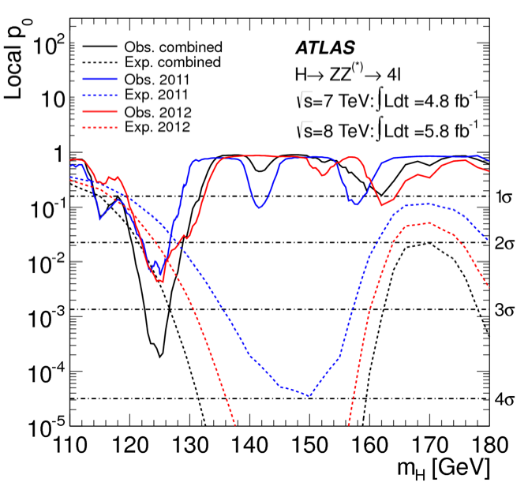
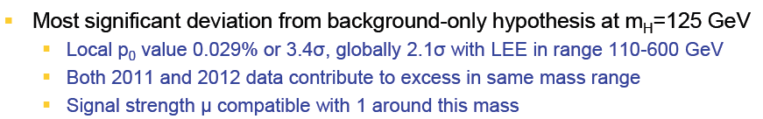
ATLAS: Higgs
Higgs to ZZ to 4 charged leptons

Slide 16
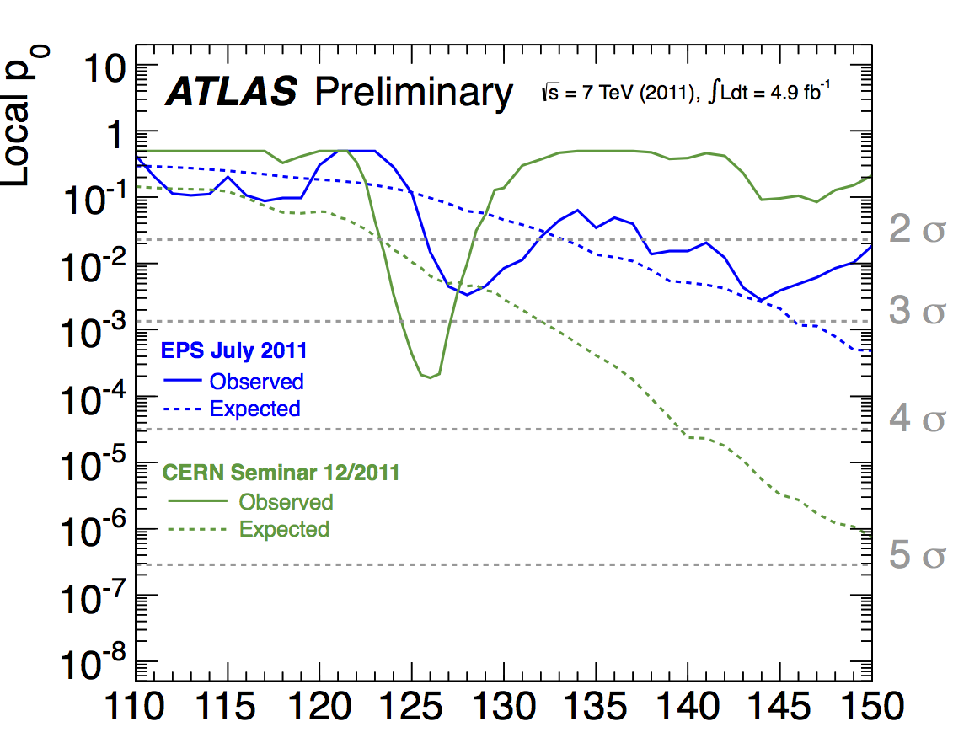
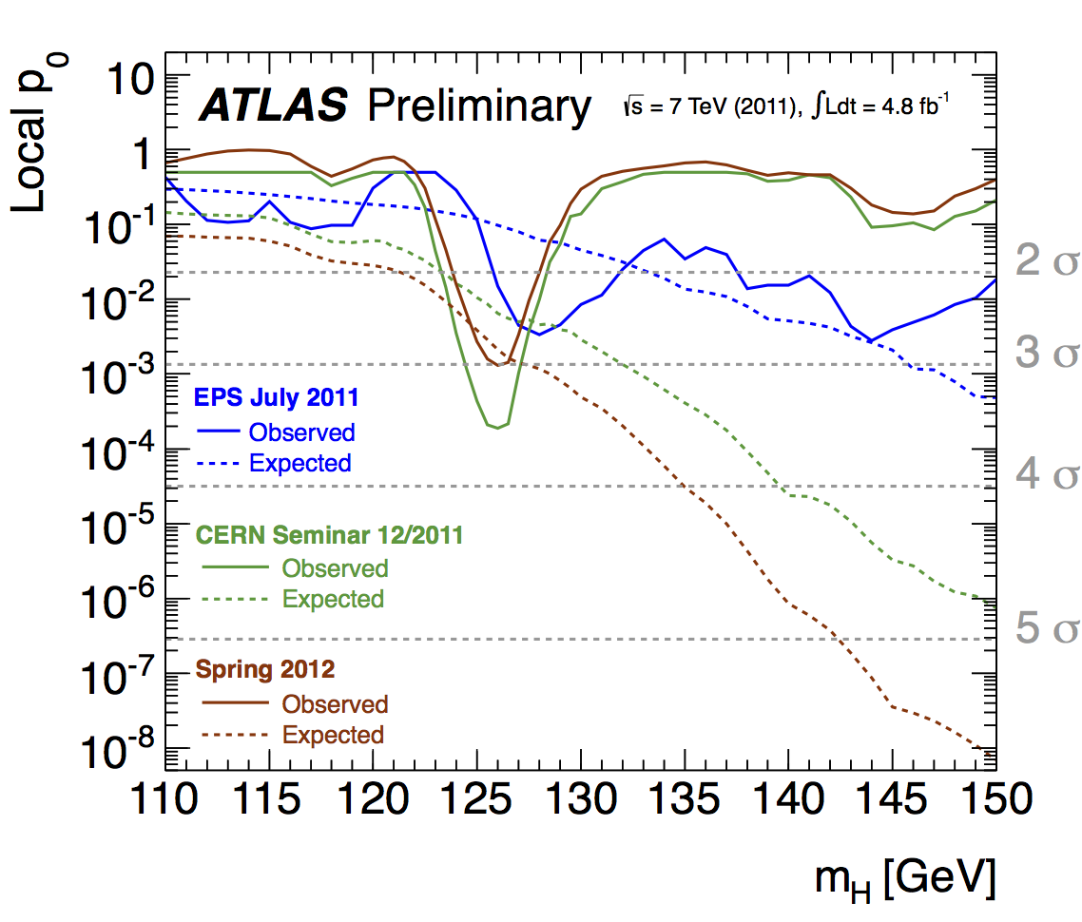
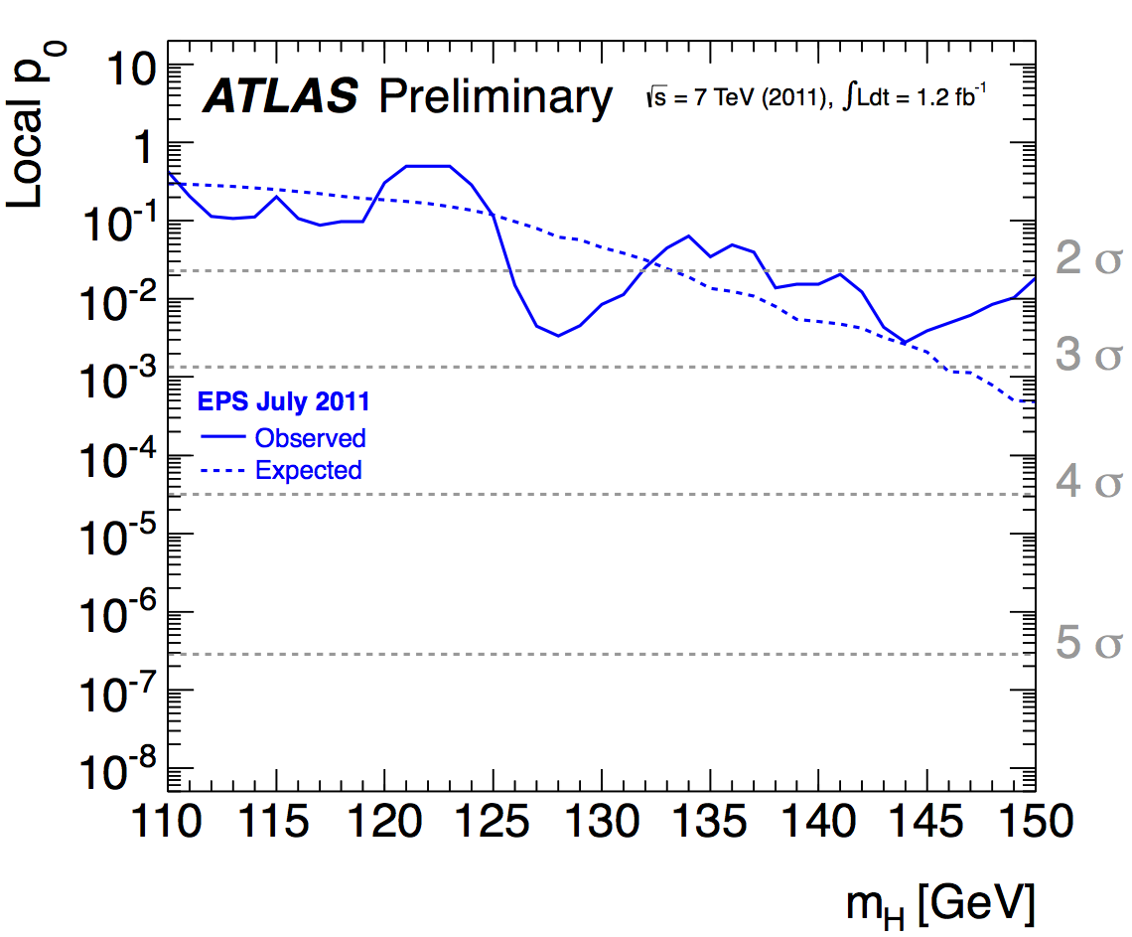
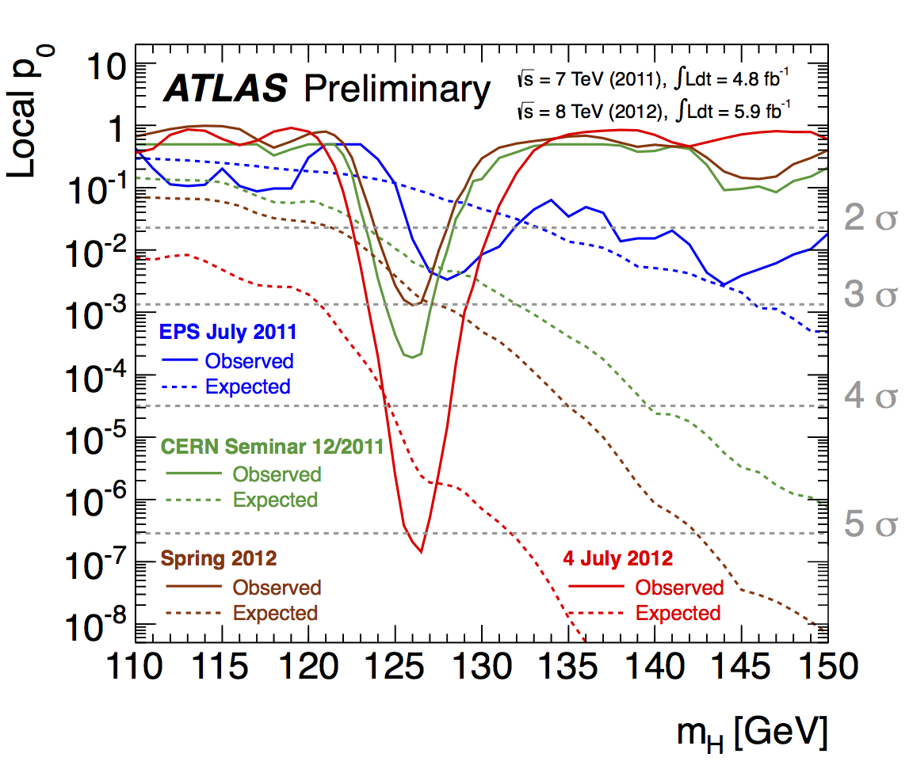
Evolution of the excess with time
Energy-scale
systematics
not included

Slide 17
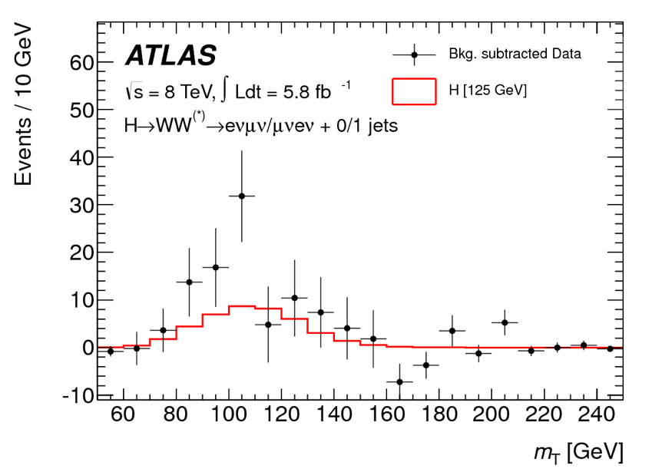
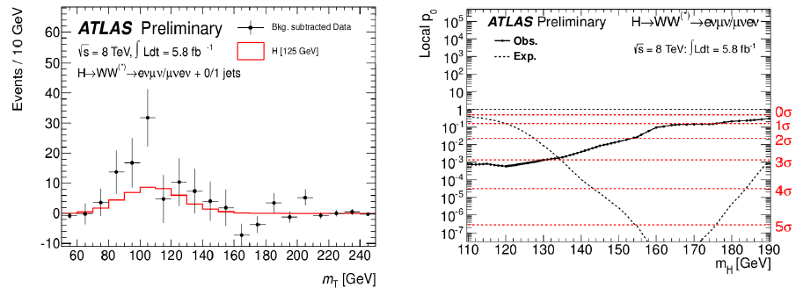
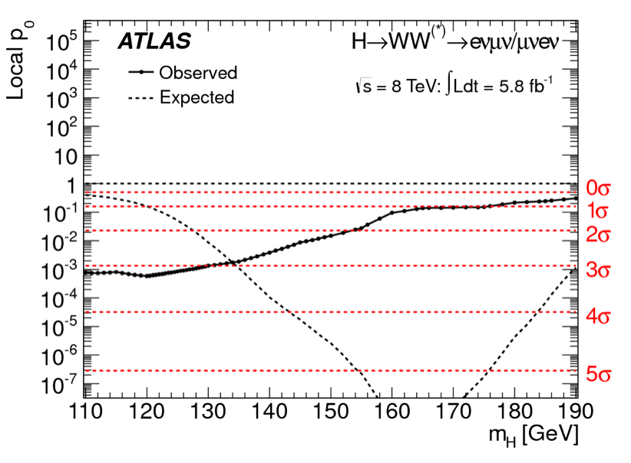
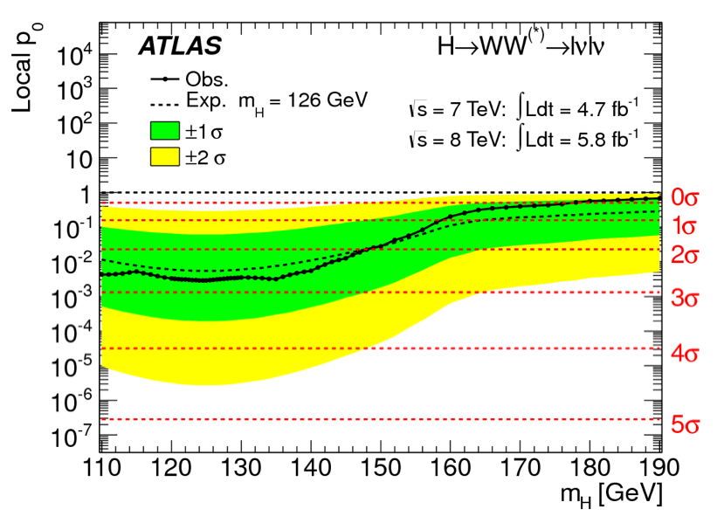
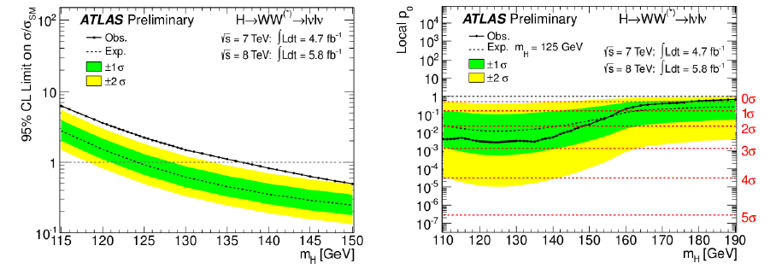
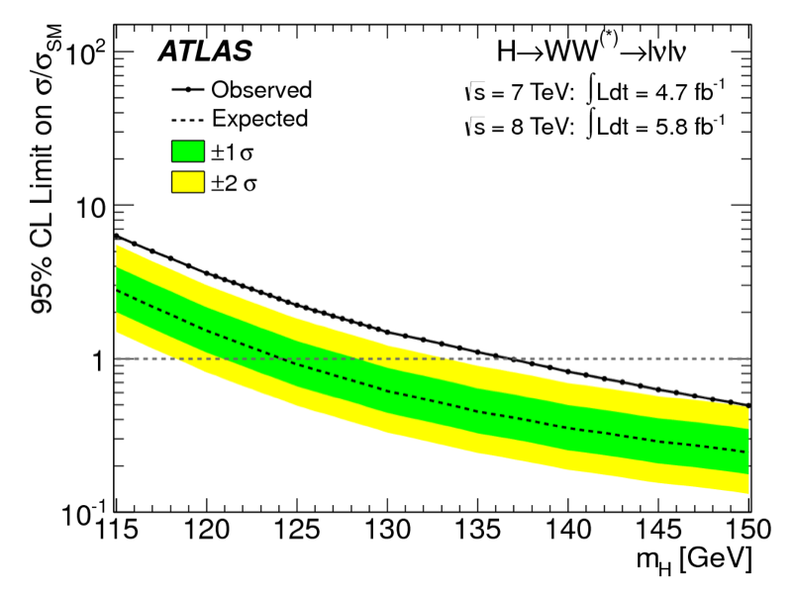
ATLAS: Higgs
New since ICHEP: H-> WW -> lνlν
e-μcombinations only
An excess
of 2.8σ!

Slide 18
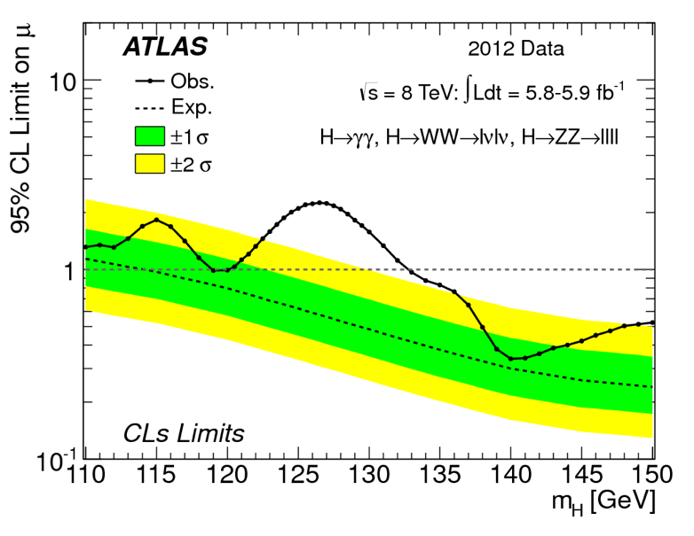
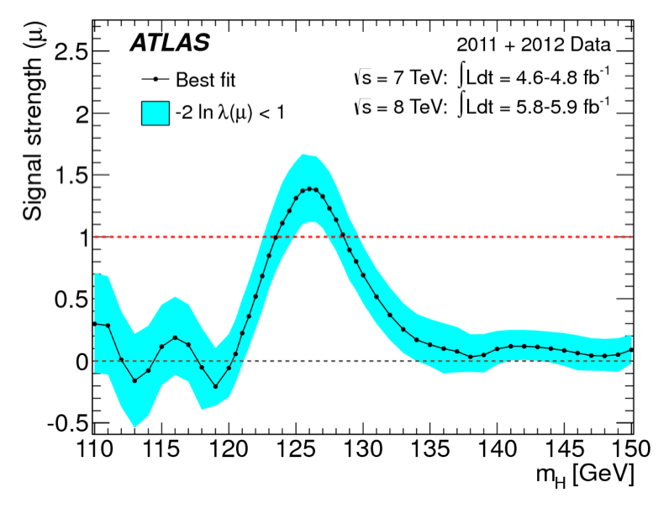
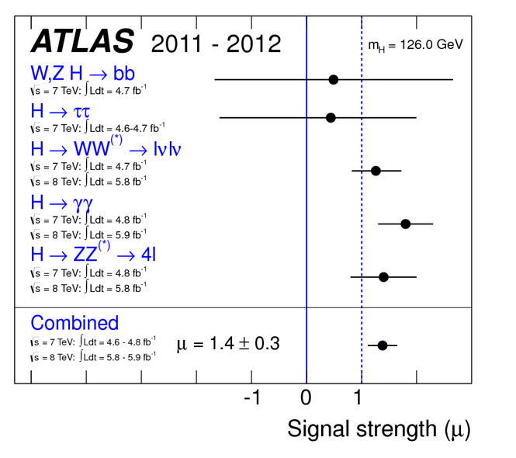
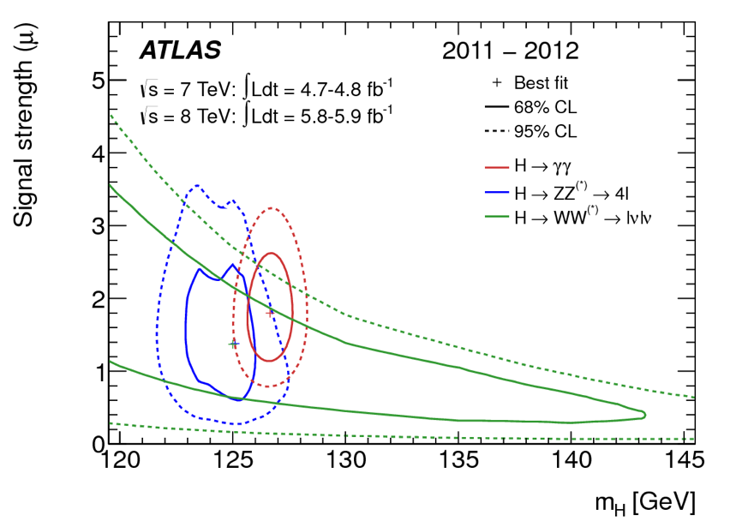
ATLAS: Higgs
ATLAS observes a
new boson with
a significance of
5.9 sigma
The particle is
consistent with a
Higgs-like boson
Particle Mass = 126.0 +/- 0.4 +/- 0.4 GeV

Slide 19


Event Candidates
4e candidate with m_{4e}= 124.6 GeV
p_{T} (electrons)= 24.9, 53.9, 61.9, 17.8 GeV
m₁₂= 70.6 GeV, m₃₄= 44.7 GeV
12 reconstructed vertices
4μ candidate with m_{4μ}= 125.1 GeV
p_{T} (muons)= 36.1, 47.5, 26.4, 71 .7GeV
m₁₂= 86.3 GeV, m₃₄= 31.6 GeV
15 reconstructed vertices

Slide 20


Event Candidates
ZZ-> μμee event
2 photon event

Slide 21
Higgs Publication
Two papers are published side by side in the same issue of PLB
Special booklet edition with the two papers and an art cover

Slide 22











The Press…
The discovery of the Higgs made the headlines worldwide

Slide 23

The Theorists…
A. Pomarol ICHEP2012

Slide 24



The Community (The day after…)

Slide 25

The Theories

Slide 26

The Theories ??

Slide 27




Technicolor still Alive?
Ken Lane, seminar
CERN, last week
Should be easy to test
-> No ZZ,WW decays:
That does not look good!

Slide 28

The Theories
“125 GeV is a mass of maximum agony” N. Arkani Hamed May 2012
But excellent for the experiments & property measurements

Slide 29
Next Steps for the Higgs
Now we need more data to study this new particle
Spin and CP studies?
Couplings: measure as many production/decay channels?
Deviations from Standard Model? Composite?
Look also for “non-standard” decays?
Is it alone or accompanied?
Exotic decays?
Another 10-20 fb⁻¹ at 8 TeV will help!!
Note: the “2012 run” got extended by 7 weeks which should give an extra 5-10 fb⁻¹ before the ~ 2 year shut-down

Slide 30

Tevatron: Summary of the Results
Especially strong in the H-> bb channel…

Slide 31




Tevatron : H-> bb
arXiv:1207.6436
Evidence for coupling to fermions??
Interesting to see where the LHC
results will land with the 2012 data

Slide 32







What About New Physics @ LHC?
New Gauge Bosons?
Supersymmetry
ZZ/WW resonances?
Technicolor?
Little Higgs?
Extra Dimensions?
Hidden Valleys?
Black Holes???
What stabelizes the Higgs Mass? Many ideas, no all viable any more
A large variety of possible signals. We have to be ready for that
Notes:
31

Slide 33

SUSY Searches: No signal yet to date…
Breaking News from SUSY2012
arXiv:1207.1898
•So far NO clear signal of
supersymmetric particles
has been found
•We can exclude regions
where the new particles
could exist.
•Searches will continue for
the next years
m₀ and m_{1/2} are SUSY
parameters at the GUT scale
We are crossing the border of excluding gluinos and squarks (light quark partners) well over 1 TeV, depending on assumptions/constraints
CMS-SUS-11-015

Slide 34

SUSY Searches: No signal yet to date…
Breaking News from SUSY2012
ATLAS-CONF-2012-109
•So far NO clear signal of
supersymmetric particles
has been found
•We can exclude regions
where the new particles
could exist.
•Searches will continue for
the next years
m₀ and m_{1/2} are SUSY
parameters at the GUT scale
We are crossing the border of excluding gluinos up to 1.6 TeV, at low m₀, depending on assumptions/constraints
CMS-SUS-11-015

Slide 35

Searching for Gauginos
Using multi-lepton
Channels
No signal so far
arXiv:1208.3144
Limits ~ 500 GeV
for chargino,
depending on
neutralino & model

Slide 36


Supersymmetry: Third Generation
N. Arkani-Hamed
CERN Nov 2011
Low mass stops and sbottom? Dedicated searches ongoing
Importance of the partners of the third generation: stops and bottoms
…Other scenarios, such as compressed spectra, multi-top production…

Slide 37


Stop/Sottom Searches
CMS SUS-11-020, 024
ATLAS-conf-12-070, 071, 073, 074
Grand summary of the stop searches
Third generation studies reach 500 GeV stop/sbottom exclusions
in some regions of phase space

Slide 38




SUSY: Simplified Models
Constraints and limits on cross sections for
event topologies arXiv:1105.2838
Reduce the process to final states
without “intermediate” particles
Natural SUSY survives the LHC so far, but we are
getting close push the limits

Slide 39


Higgs @ 125 GeV has Consequences
•A 125 GeV Higgs is challenging to
accommodate in constrained versions
of SUSY particularly for natural
superpartner masses
•Starts to constrain some of the
simpler models
•If SUSY exists, is it really natural?

Slide 40

Higgs Branching Ratios & New Physics
•Use the Higgs to ZZ and gamma-gamma results and other data to
constrain model space
•Expectation for end of the run this year: space left for the stop quark and
the neutralino
C. Grojean et al.
arXiv:1207.7355

Slide 41







Other Searches at 8 TeV @ ICHEP
W’ ~ 3 TeV
Z’ ~ 2.5 TeV
q* ~ 3.5 TeV
Heavy Neutrinos ~ 1.8 TeV
Black Holes ~ 4 TeV

Slide 42

Collider Searches for New Physics
50 new analyses from ATLAS and CMS contributed to ICHEP
But no sign of new physics yet…
No low hanging fruits!
Similar figure exists for ATLAS

Slide 43

Many QCD/EWK Results @ LHC
This workshop…
EG: Inclusive jet and Dijet production
Many measurements of single particles, diffraction, pQCD

Slide 44

Top Measurements at 8 TeV
Production of top quark pairs.
Standard Model predictions are still OK at 8 TeV

Slide 45

QCD & Searches
M. Mangano, Perimeter workshop August 2012

Slide 46

Higgs Cross Sections Uncertainty today
J. Campbell
ICHEP2012
Room for improvement…

Slide 47

QCD & Higgs
Measurements needed for the Higgs (PDFs, α_{s}, precision pQCD, control of VBF channels (qqZ)…
Making measurements with the Higgs, ie compare the γγ peak with the side bins
M. Managano

Slide 48



New Physics with Boosted Objects
Boost 2012, Valencia, July
W,Z and top decays from heavy, typically multi-TeV objects are of special interest at the LHC
•ΔR ~ 2m/p_{T}: decay product merge at large p_{T}
•New techniques developed – and discussed in this
series of topical Workshops- for leptonic and
hadronic decays of W,Z, top…
Eg.: Jet substructure, grooming: mass drop filtering,
trimming, pruning…
ATLAS-CONF-2012-065
A lot of new experimental results at this workshop…

Slide 49



Top resonance study
arXiv:1207.2409
Boosted objects are reconstructed as one fat jet R=1.0, p_{T}> 250 GeV. Analyse the jet substructure
Modified isolation for the leptonic decay side
Also new data from CMS at this meeting

Slide 50



Detailed QCD jet Studies
Detailed QCD jet studies such as substructure studies grooming are important to get:
  Deeper insight into pQCD
  To perform searches for New Physics in a new way
  Boosted Higgs… Butterworth et al. PRL 100 (2008) 242001
CMS-QCD-10-41
arXiv:1203:4606
K_{T} splitting scale
Subjet multiplicity
Jet width

Slide 51



Hidden Valley Physics: New Signatures
M. Strassler, K. Zurek
Possible new
Higgs decay
modes
Will produce“Weird Jets”
and a lot of secondary
vertices
⇒ Difference with QCD jets??
⇒ Study SM jet structure!!
50
Notes:
50

Slide 52
Conclusion
LHC and the experiments are in good shape and eager on the rest of the 2012 data. Last data before 2014-15’
A new Higgs-like particle is with us!
  This opens a lot of prospects for new studies
No convincing sign of New Physics yet. The phase space is getting systematically scanned. Low energy SUSY?
QCD is reaching high precision, and testing at the LHC is very important. The Higgs may be a new tool. We should also get predictions as precise as possible for Higgs
Deeper understanding on pQCD is important but could also be key to searches for new physics. Examples: Boosted objects (hadronic and leptonic decays), jet substructure, quark/gluon jet separation…
I hope this workshop will add new ideas & directions

Slide 53
Backup

Slide 54

Example BSM Physics

