Slide 1

Study of higher harmonics based on
(3+1)-d relativistic viscous hydrodynamics
Department of Physics, Nagoya University
Chiho NONAKA
In Collaboration with Yukinao AKAMATSU, Makoto TAKAMOTO
November 15, 2012@ATHIC2012, Pusan, Korea
Notes:
30 min

Slide 2

Time Evolution of Heavy Ion Collisions
collisions
thermalization
hydro
hadronization
freezeout
observables
higher harmonics
strong elliptic flow @RHIC
particle yields:
P_{T} distribution
model
fluctuating
initial conditions
hydrodynamic model
final state interactions:
hadron base
event generators
Viscosity, Shock wave

Slide 3
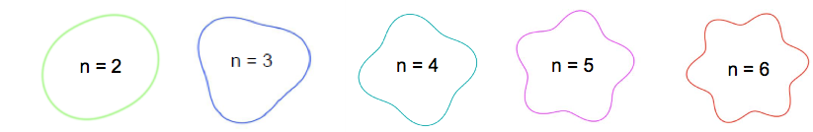
Higher Harmonics
Higher harmonics and Ridge structure
Mach-Cone-Like structure, Ridge structure
Challenge to relativistic hydrodynamic model
Viscosity effect from initial ε_{n} to final v_{n}
Longitudinal structure (3+1) dimensional
Higher harmonics high accuracy calculations
State-of-the-art numerical algorithm
Shock-wave treatment
Less numerical viscosity

Slide 4
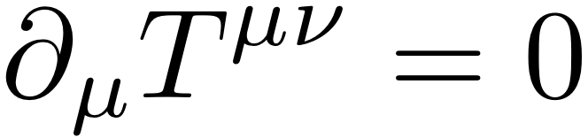
Viscous Hydrodynamic Model
Relativistic viscous hydrodynamic equation
  First order in gradient: acausality
  Second order in gradient: systematic treatment is not established
    Israel-Stewart
    Ottinger and Grmela
    AdS/CFT
    Grad’s 14-momentum expansion
    Renomarization group
Numerical scheme
  Shock-wave capturing schemes

Slide 5
Numerical Scheme
Lessons from wave equation
  First order accuracy: large dissipation
  Second order accuracy : numerical oscillation
  -> artificial viscosity, flux limiter
Hydrodynamic equation
  Shock-wave capturing schemes: Riemann problem
    Godunov scheme: analytical solution of Riemann problem, Our scheme
    SHASTA: the first version of Flux Corrected Transport algorithm, Song, Heinz, Chaudhuri
    Kurganov-Tadmor (KT) scheme, McGill
Notes:
Wave equation: simple, analytical solution
KT

Slide 6
Current Status of Hydro
Ideal

Slide 7
Our Approach
Takamoto and Inutsuka, arXiv:1106.1732
Israel-Stewart Theory
  (ideal hydro)
  1. dissipative fluid dynamics = advection + dissipation
exact solution
  Riemann solver: Godunov method
Contact discontinuity
Rarefaction wave
Shock wave
Two shock approximation
Mignone, Plewa and Bodo, Astrophys. J. S160, 199 (2005)
Rarefaction wave shock wave
Akamatsu, Nonaka, Takamoto, Inutsuka, in preparation
  2. relaxation equation = advection + stiff equation

Slide 8
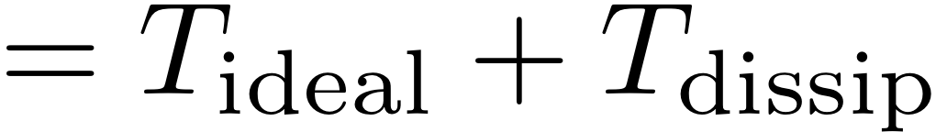
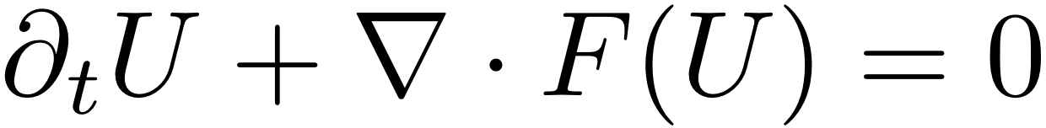
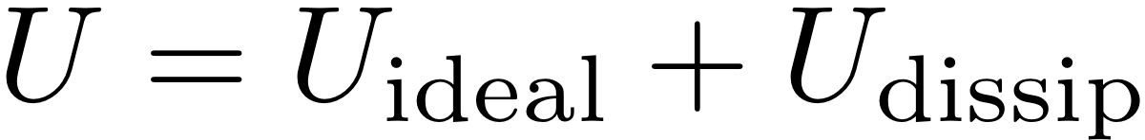
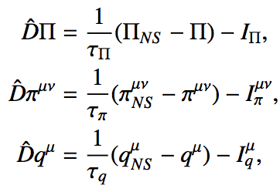
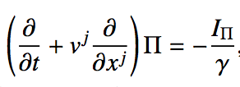

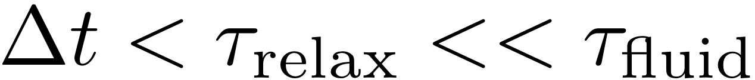
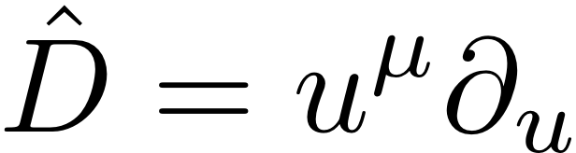
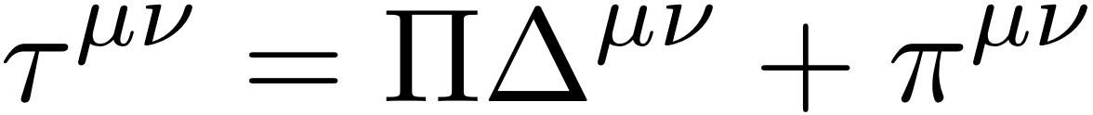
Numerical Scheme
Israel-Stewart Theory
Takamoto and Inutsuka, arXiv:1106.1732
1. Dissipative fluid equation
2. Relaxation equation
+
advection
stiff equation
I: second order terms

Slide 9
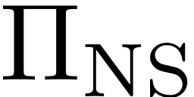

Relaxation Equation
Takamoto and Inutsuka, arXiv:1106.1732
Numerical scheme
+
advection
stiff equation
up wind method
during Δt
~constant
Piecewise exact solution
fast numerical scheme

Slide 10
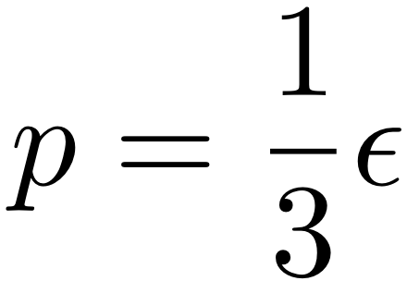
Comparison
Shock Tube Test : Molnar, Niemi, Rischke, Eur.Phys.J.C65,615(2010)
Analytical solution
Numerical schemes
SHASTA, KT, NT
Our scheme
T=0.4 GeV
v=0
EoS: ideal gas
T=0.2 GeV
v=0
0
10
Nx=100, dx=0.1

Slide 11
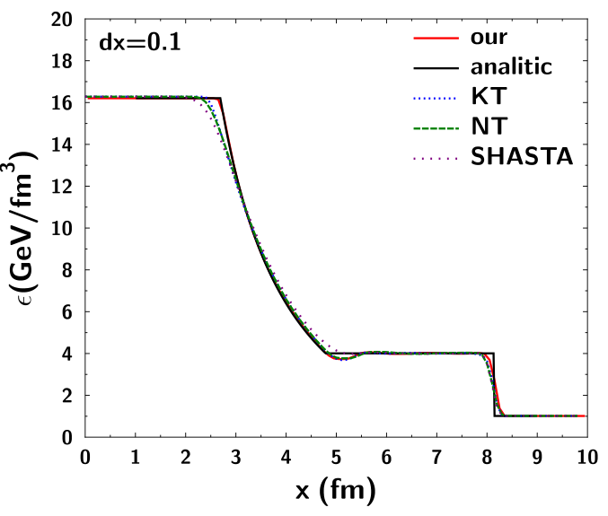
Energy Density
t=4.0 fm dt=0.04, 100 steps
analytic

Slide 12
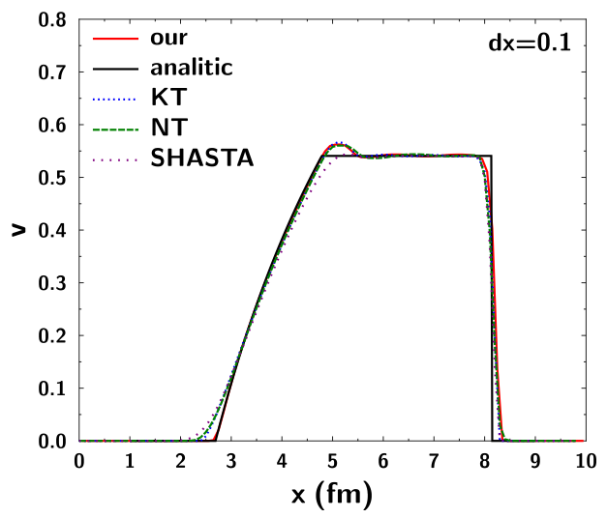
Velocity
t=4.0 fm dt=0.04, 100 steps
analytic

Slide 13
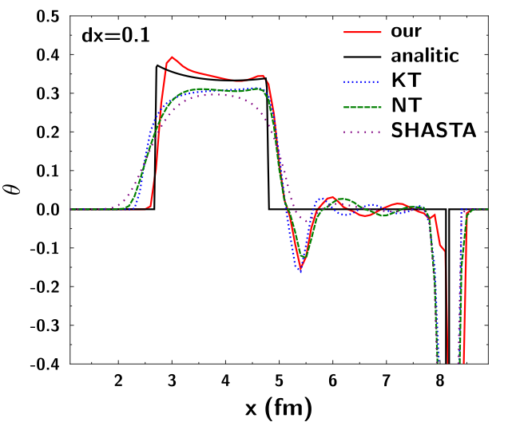
θ
t=4.0 fm dt=0.04, 100 steps
analytic

Slide 14
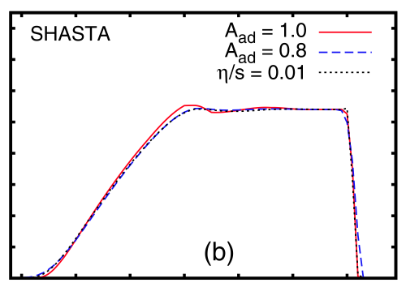
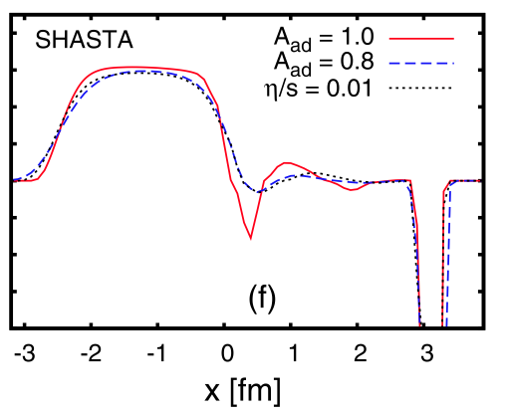
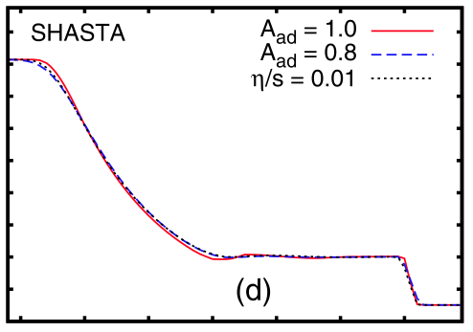
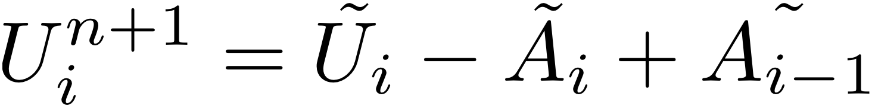
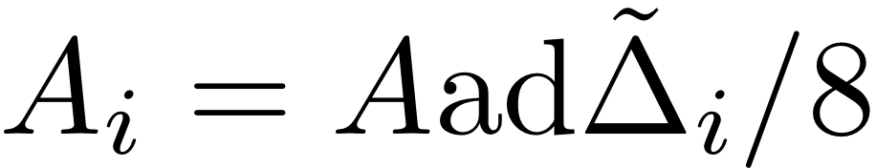
Artificial and Physical Viscosities
Molnar, Niemi, Rischke, Eur.Phys.J.C65,615(2010)
Antidiffusion terms : artificial viscosity
stability

Slide 15
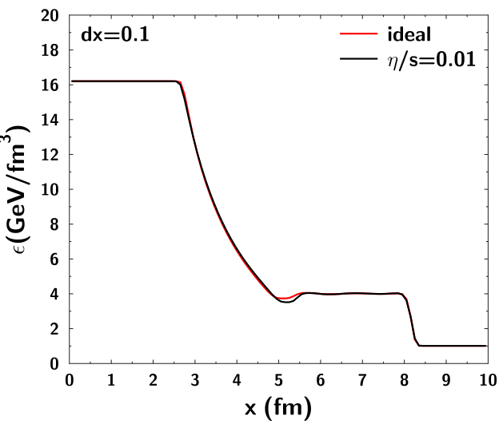
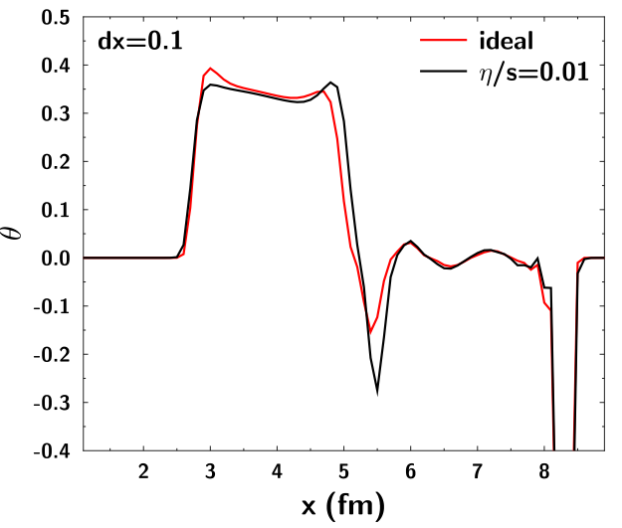
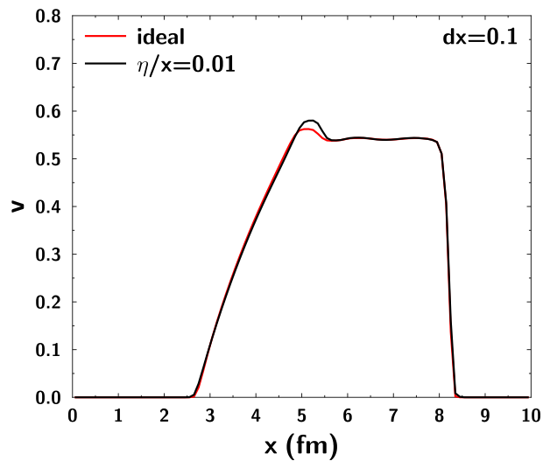
Viscosity Effect

Slide 16
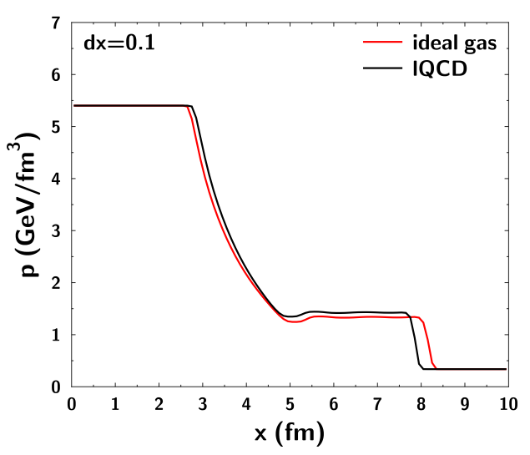
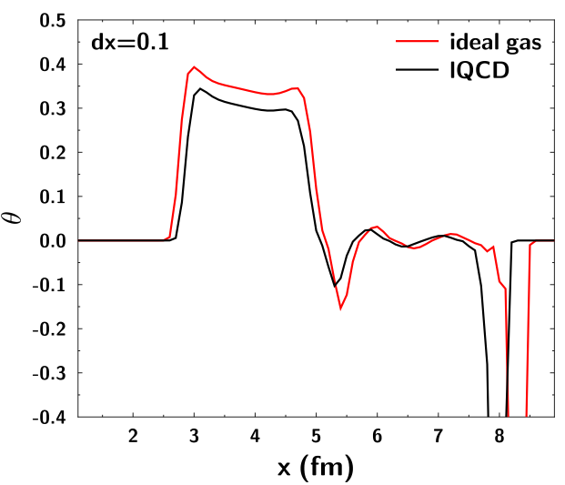
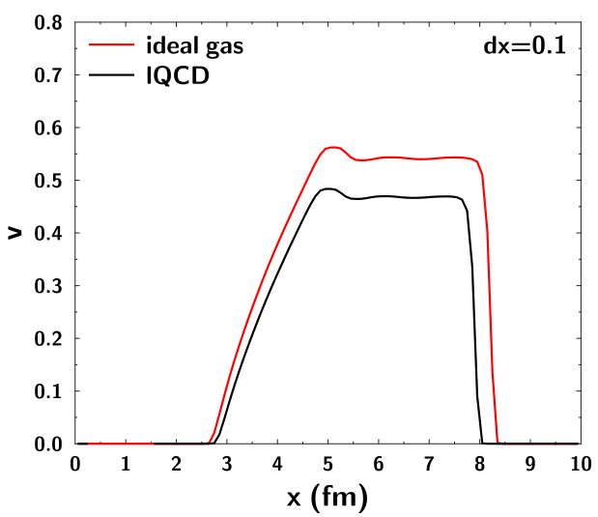
EoS Dependence

Slide 17
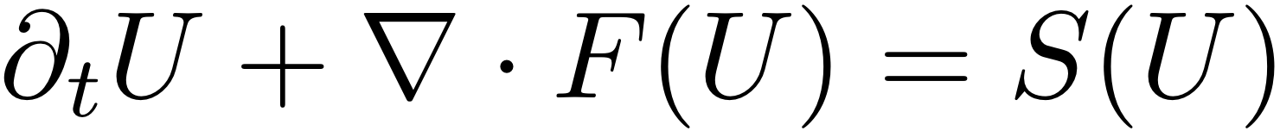
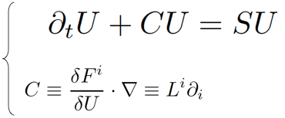
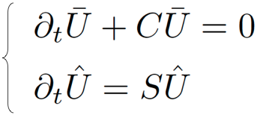
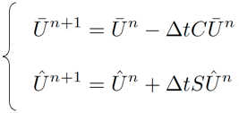
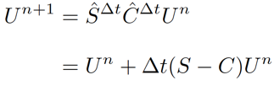
To Multi Dimension
Operational split and directional split
Operational split (C, S)

Slide 18

To Multi Dimension
Operational split and directional split
Operational split (C, S)
2d
3d
L_{i} : operation in i direction

Slide 19
Higher Harmonics
Initial conditions
  Gluaber model
smoothed
fluctuating

Slide 20
Higher Harmonics
Initial conditions at mid rapidity
  Gluaber model
smoothed
fluctuated
t=10 fm
t=10 fm

Slide 21
Time Evolution of v_{n}
Smoothed IC
Fluctuating IC
v₂ is dominant.
v_{n} becomes finite.

Slide 22
Time Evolution of Higher Harmonics
Petersen et al, Phys.Rev. C82 (2010) 041901
Ideal hydrodynamic calculation
at mid rapidity
ε_{n}, v_{n}: Sum up with entropy density weight
EoS: ideal gas

Slide 23


Viscosity Effect
14
fm⁻⁴
initial
Pressure distribution
Ideal
t~5 fm
t~10 fm
1
t~15 fm
1
7
Viscosity
7
0.9
0.25

Slide 24

Viscous Effect
fm⁻⁴
20
initial
Pressure distribution
Ideal
t~5 fm
fm⁻⁴
t~10 fm
t~15 fm
1.2
0.25
9
Viscosity
0.3
9
1.2

Slide 25
Summary
We develop a state-of-the-art numerical scheme
  Viscosity effect
  Shock wave capturing scheme: Godunov method
  Less artificial diffusion: crucial for viscosity analyses
  Fast numerical scheme
Higher harmonics
  Time evolution of ε_{n} and v_{n}
Work in progress
  Comparison with experimental data
Our algorithm
Akamatsu

Slide 26
Backup

Slide 27
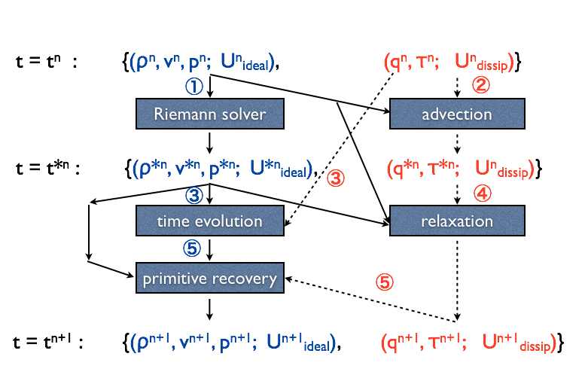
Numerical Method
Takamoto and Inutsuka, arXiv:1106.1732
SHASTA,
rHLLE, KT

Slide 28
2D Blast Wave Check
t=0
Pressure const.
Velocity |v|=0.9
Velocity vectors（t=0)
Shock wave
50 steps
1000 steps
100 steps
500 steps
Numerical scheme, in preparation
Akamatsu, Nonaka and Takamoto
Application to Heavy Ion collisions
At QM2012!!

Slide 29
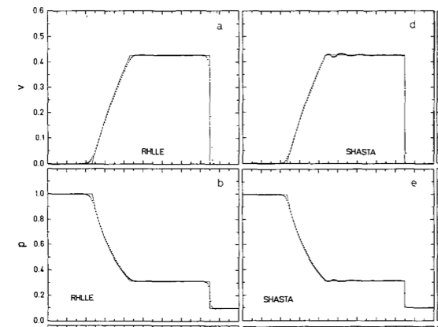
rHLLE vs SHASTA
Schneider et al. J. Comp.105(1993)92

