Slide 1

Future Perspectives of the ALICE Experiment and
ALICE detector upgrades
Taku Gunji
Center for Nuclear Study
The University of Tokyo
For the ALICE Collaboration
The 4Th Asian Triangle Heavy Ion Conference in Pusan, Nov. 14-17, 2012

Slide 2
Outline
Heavy ion physics at LHC energy
Current status of ALICE
Long-term upgrade
Core detector upgrades
Physics perspectives
Summary and Outlook

Slide 3
Heavy Ion Physics at LHC Energy
To fully exploit scientific potential of the LHC – unique in:
  Large cross sections for hard probes
  High initial temperature/long space-time evolution
  Gluon saturation/initial conditions (?)
  Strongest (Color) EM field shortly after the collisions
Precision measurement of the QGP parameters at μ_{b}=0
  conditions similar to those in early Universe
  calculable with the Lattice QCD
  Quantitative study of QGP in conjunction with RHIC
Experiments need to have the capability to measure:
  Soft probes(PID flow & spectra, correlation)/EM probes (ALICE)
  Hard probes through jets (ATLAS/CMS and ALICE)

Slide 4
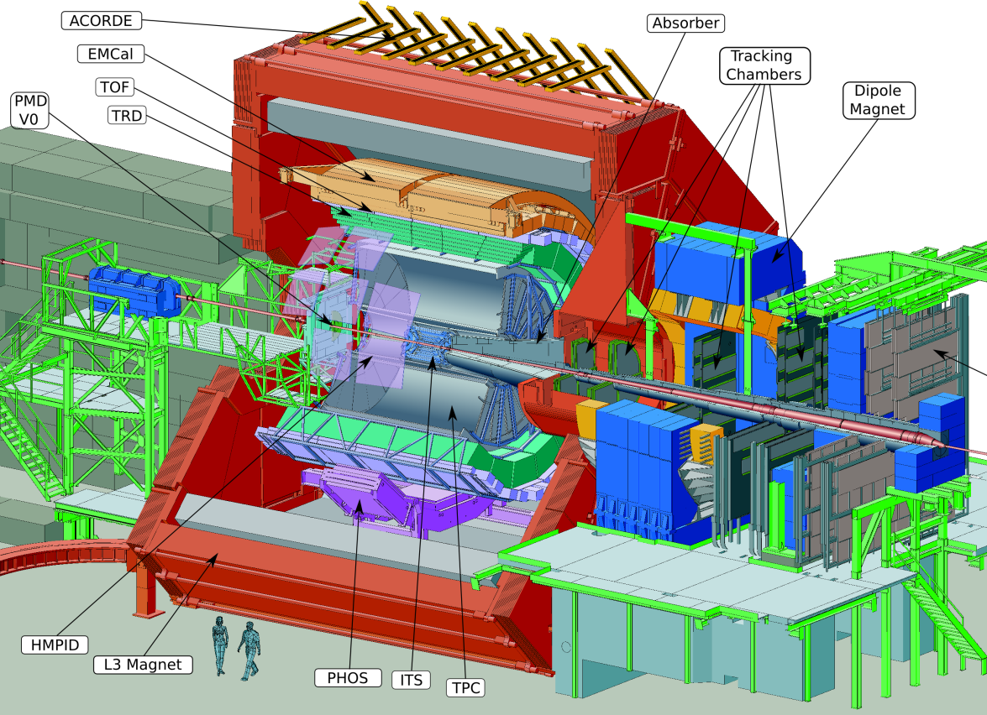
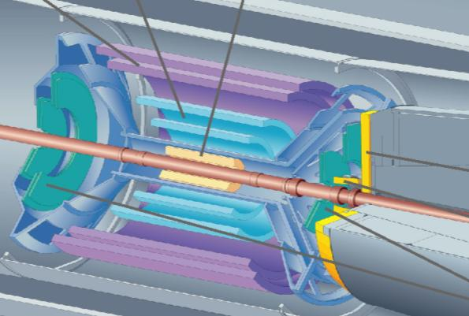
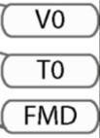
Current Status of ALICE

Slide 5
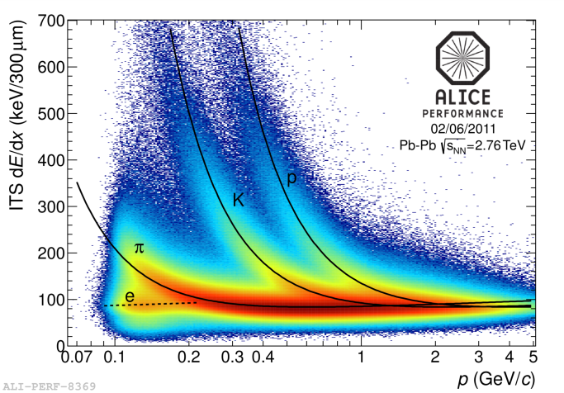
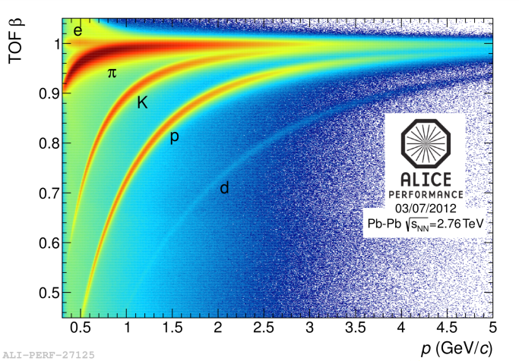
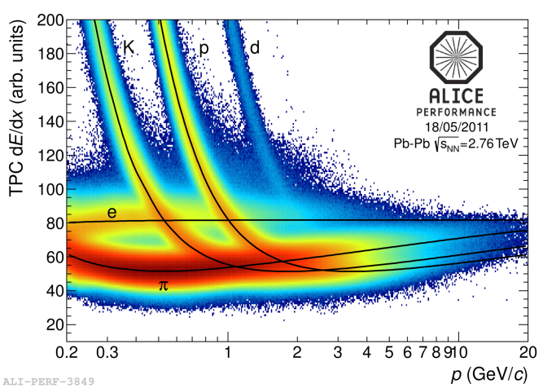
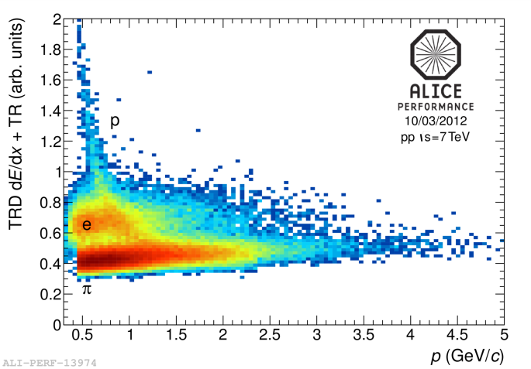
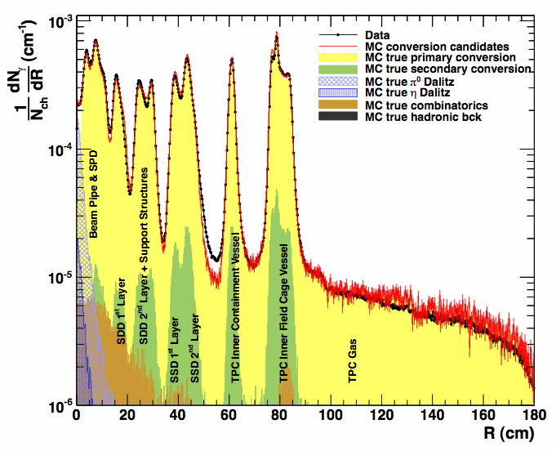
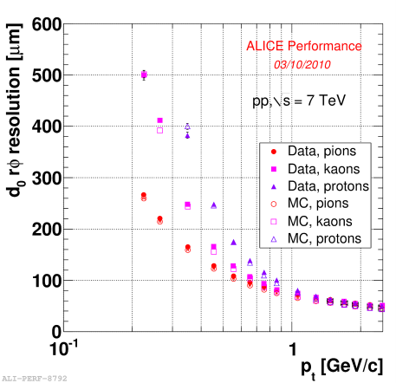
Detector Performance
ITS
TPC
TOF
TRD
vertexing
Particle Identification (pi/K/P/e/mu) for wide p_{T} region
Efficient low-momentum tracking – down to ~ 100MeV/c
Excellent vertexing capability
Low material budget (10% of X₀)
good reconstruction capability of photon conversions

Slide 6
Future ALICE Program
ALICE heavy-ion program approved for 1~10nb⁻¹:
Possible scenario
  2013–14 Long Shutdown 1 (LS1)
    completion of TRD and installation of Di-jet CAL
  2015 Pb–Pb at √s_{NN} = 5.1 TeV
  2016–17 Pb–Pb at √s_{NN} = 5.5 TeV
  2018 Long Shutdown 2 (LS2)
  2019 Pb-Pb 2.85nb⁻¹
  2020 Pb-Pb 2.85nb⁻¹ (low magnetic field)
  2021 p-p reference run
  2022-2023 Long Shutdown 3 (LS3)
  2024-2026: Pb-Pb/p-Pb run with ALICE upgrade
  (3.5 month/year for HI, 1 month with low B)

Slide 7
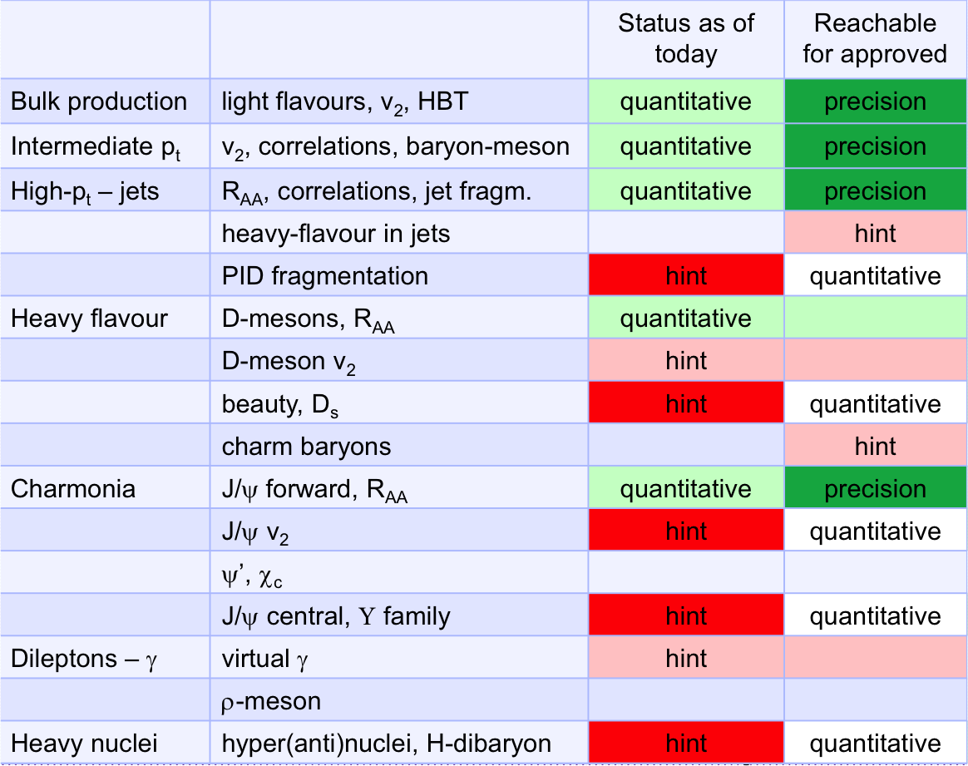
ALICE Status as of Today

Slide 8
Long-term upgrade (Physics)
At the LHC, uniquely accessible with the ALICE detector:
  Measurement of heavy-flavor meson and baryon with wide p_{T} & y
    transport properties of the medium, HQ thermalization
  J/ψ , ψ’, and χ_{c} states down to zero p_{T} in wide rapidity range
    Recombination vs. dissociation/sequential melting
    Screening and color correlation length of the medium
  Measurement of low-mass and low-p_{T} dileptons
    Chiral symmetry restoration – LVM spectral function
    Thermal radiation/space time evolution – low mass dilepton continuum
    Photon/DI-electrons from strong (Color) EM field
  Jet quenching and fragmentation (PID)
    Jet energy recuperation at very low p_{T}
    Heavy flavor tagged jets, quark vs. gluon induced jets
  Heavy-nucleus states, exotic hadrons (hypernuclei, H-dibaryon)
  Prompt photons/jets at forward rapidity, rapidity gap
    Low-x gluon saturation, early stage dynamics

Slide 9
Long-term upgrade (Strategy)
Most of the physics signals are rare and some of them are untriggerable (ex. Di-electrons, HQ baryons)
  Require a large event samples on tape
  Target:
    Pb-Pb recorded luminosity > 10nb⁻¹ (8x10¹⁰ evts)
    p-p recorded luminosity > 6 pb⁻¹ (1.4x10¹¹ evts)
  Increase rate capabilities for MB heavy-ion collision
    read out all Pb-Pb interactions at a maximum rate of 50kHz (i.e. L = 6x10²⁷ cm⁻²s⁻¹), with a minimum bias trigger
    Upgrade of TPC (less deadtime) and ITS (better vertexting)
    All readout electronics (pipelined readout)
    DAQ (data compression, HLT, event building)
Upgrade in LS2 and have HI runs until 2026
  ALICE upgrade proposal endorsed by LHCC

Slide 10
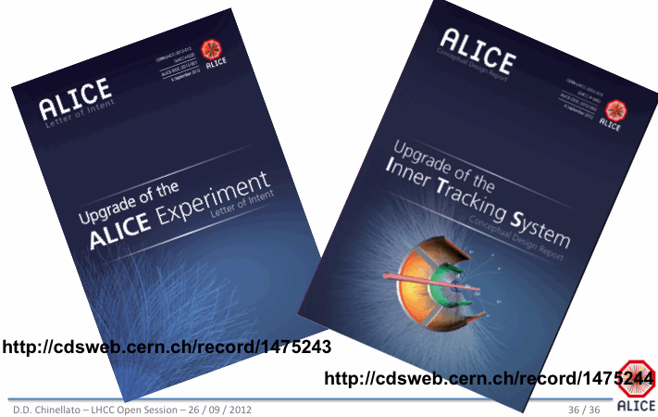
ALICE upgrade LoI

Slide 11
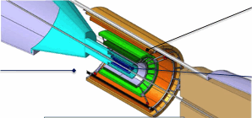
Core Detector Upgrades - ITS
6->7 Si layers
  7 pixels or 3(pixel)+4(strip)
  Inner most at R=2.2cm
  Low material 0.3%X₀/lay (←1.14%X₀)
  Hybrid-pixel or MAPS(MIMOSA, LePIX, INMAPS). Extensive R&D.
  Improve vertex resolution by factor of 3
  Improve low pT tracking efficiency

Slide 12
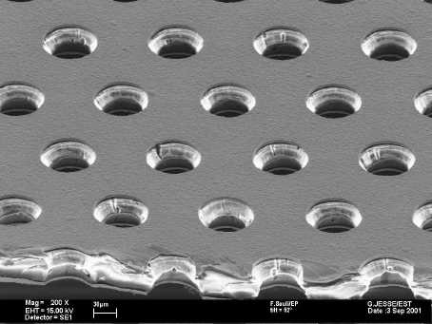
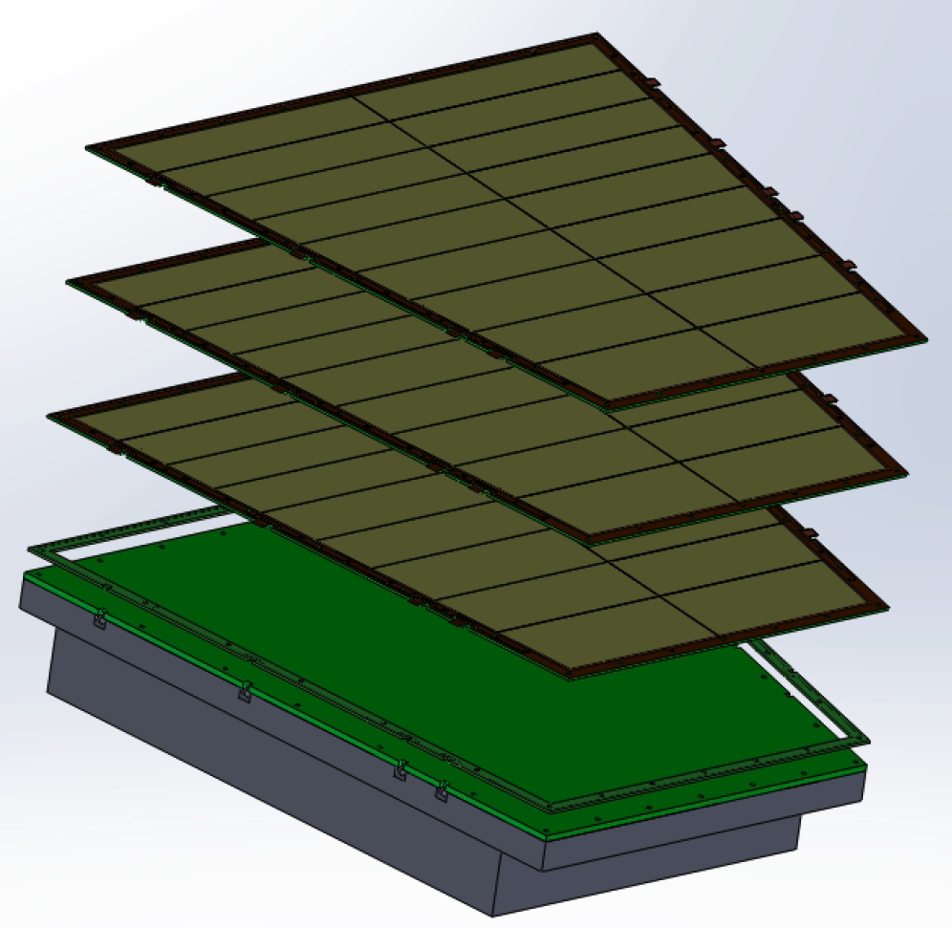
Core Detector Upgrade - TPC
TPC Continuous readout without gating grid
  3.5kHz as current maximum operation
  limited by gating grid and pileup protection
Replace MWPC readout by GEM readout
  Efficient to block back-drifting ions
  High rate capability
  Preserve PID and tracking capability
Extensive R&D started
  Gain stability of GEM under Ne/CO₂
  Systematic study of Ion back flow
    0.25% is requirement
    Test bench at CERN, TUM, Tokyo
    Garfield simulation
  Beamtest and test in p+Pb at ALICE
  Electronics R&D

Slide 13
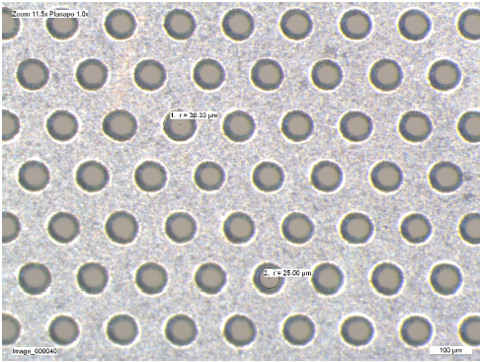
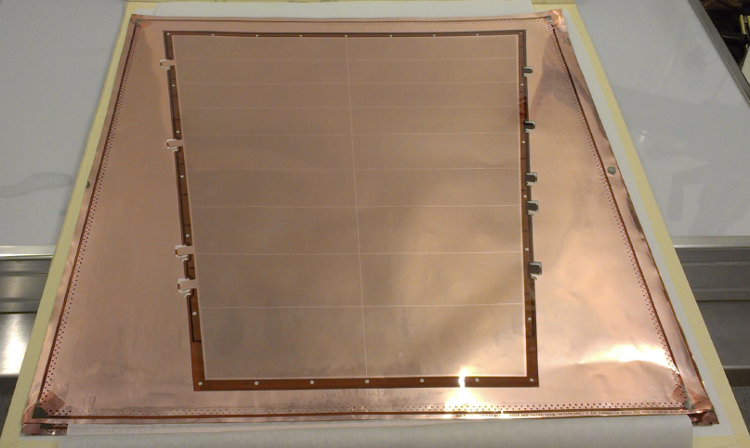
Core Detector Upgrade - TPC
Inner Readout Chamber (IROC) Prototype Preparation
  Beamtest at CERN-PS T10 beamline
  in Nov.-Dec.
    Use electronics composed
    of PCA16 + sALTRO
  Test under p+Pb collisions
    Install in ALICE cavern in Dec.
First GEM foils in Munich
  single mask, ~50 cm
Being inspected, framed,
installed in pad plane

Slide 14
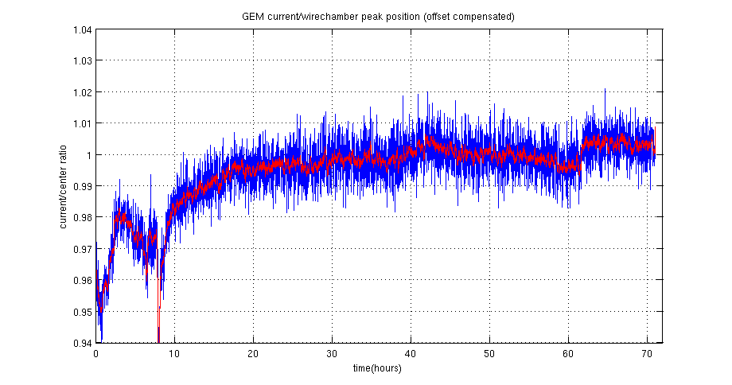
Core Detector Upgrade - TPC
Some results of the GEM R&D studies in the lab.
  Gain stability : stable 1-2%
  Ion back flow
    Target of 0.25% can be
    achievable (Ar/CO₂).
    More study is on-going.
    (Ne/CO₂, geometry
    optimization)
Corrected, normalised GEM current
Ar(90)/CO₂(10)
Amptek
Mini X-ray tube
Ag target: Kα=22KeV
Rate (Ar(70)/CO₂(30))
= 5x10⁷ Hz
(much larger rate
than 50kHz Pb-Pb)
(Some space-charge
effects might be in
the measurements)

Slide 15
Core Upgrade - DAQ
DAQ upgrade
  Requirements: ~1TByte/s detector readout, 20GB/s in storage
  Strategy:
    Data reduction by (partial) online reconstruction and compression.
    Store only reconstructed data (tight coupling between online and offline)
FTP (Fast Trigger Processor)
CLK/L0/L1, data tagging (ITS/TPC)
DDL/RORC
DDL3(10GB/s)
10-12 DDL3, PCIe GEN3 in RORC3
Network
10/100GBit Ethernet
QDR/FDR Infiniband (42/50GBit)
FLP (First Level Processor)
ZS, data compression/localized
reconstruction
EPN (Event building and Processing Node)
Event building/final data compression
(CPU/GPU)

Slide 16
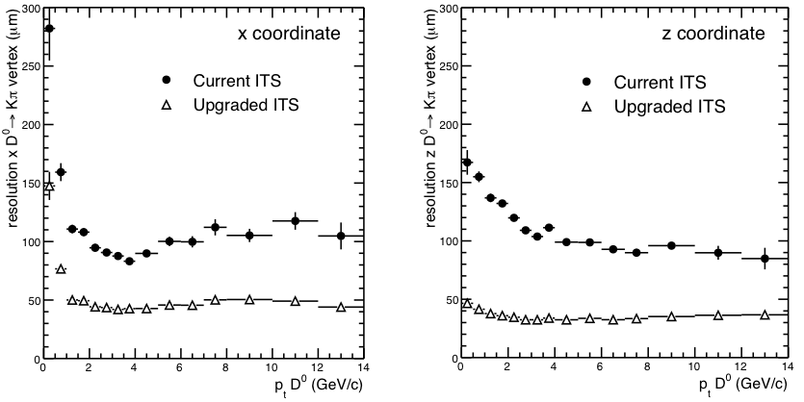
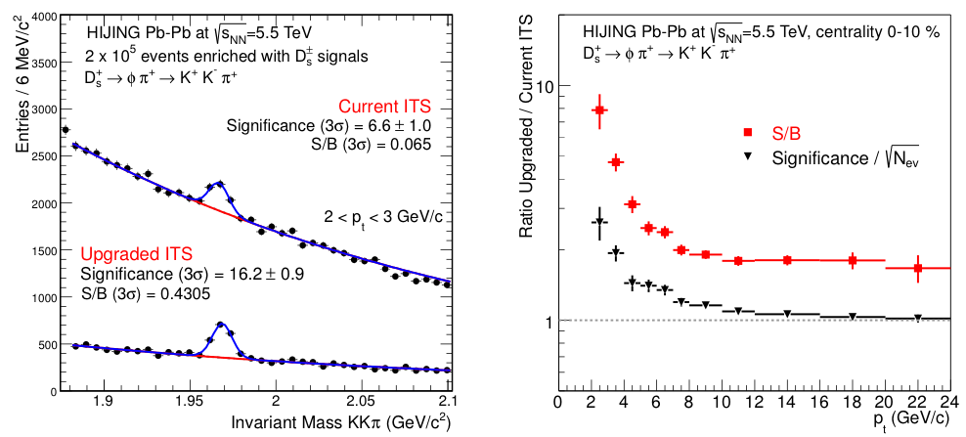
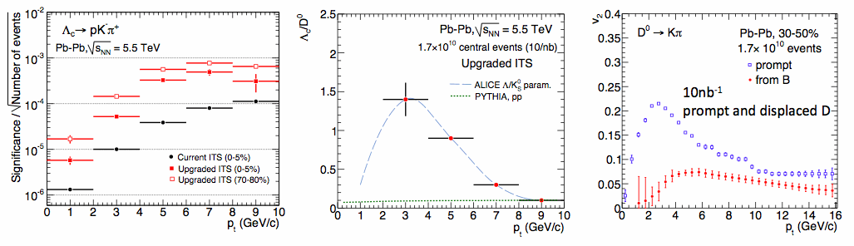
Heavy Flavor Measurements
Improvement of secondary vertex resolution by x2
  Measurement of Λ_{c}, D_{s}, Λ_{b}
  v2 and R_{AA} for wide pT range (down to low pT)

Slide 17
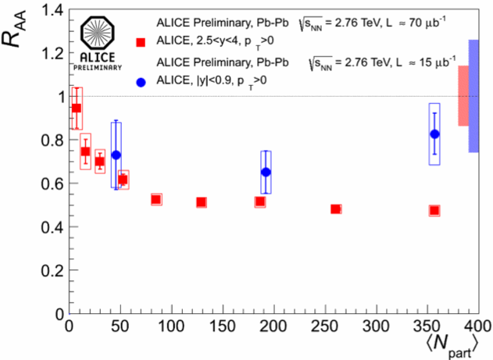
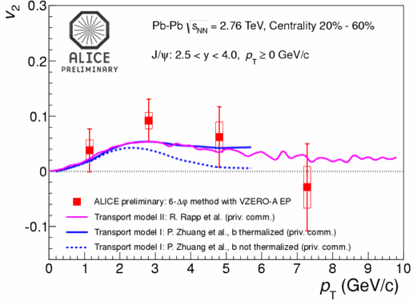
Quarkonia Measurements
Precision measurement of quarkonia
  pT dependence of R_{AA} and v2 for J/ψ, ψ’, (χ_{c}), Y
  J/ψ Polarization, Quarkonia by γ+A (→ gluon PDF)

Slide 18
Di-electron Measurements
Unique Physics and Measurement at the LHC
  Chiral symmetry restoration
  Thermal radiation, Radiation from Glasma
Need to fight with:
  Conversion/Dalitz
  S/N (combinatorial)
  Charm contributions
    Charm yield
    Correlation of pairs

Slide 19
Di-electron Measurements
Electron ID by TPC/TOF
  High rate TPC required
BG rejection (conversion,
Dalitz, charm pairs)
  New ITS upgrade
  required (especially,
  to suppress conversions and
  systematic uncertainties of
  charm)

Slide 20
Di-electron Measurements
Electron ID by TPC/TOF
  High rate TPC required
BG rejection (conversion,
Dalitz, charm pairs)
  New ITS upgrade
  required (especially,
  to suppress conversions and
  systematic uncertainties of
  charm)
current ITS/low rate
new ITS/high rate
0.3<M<0.7
0.3<M<0.7
current ITS/low rate
new ITS/high rate
1.1<M<1.5
1.1<M<1.5

Slide 21
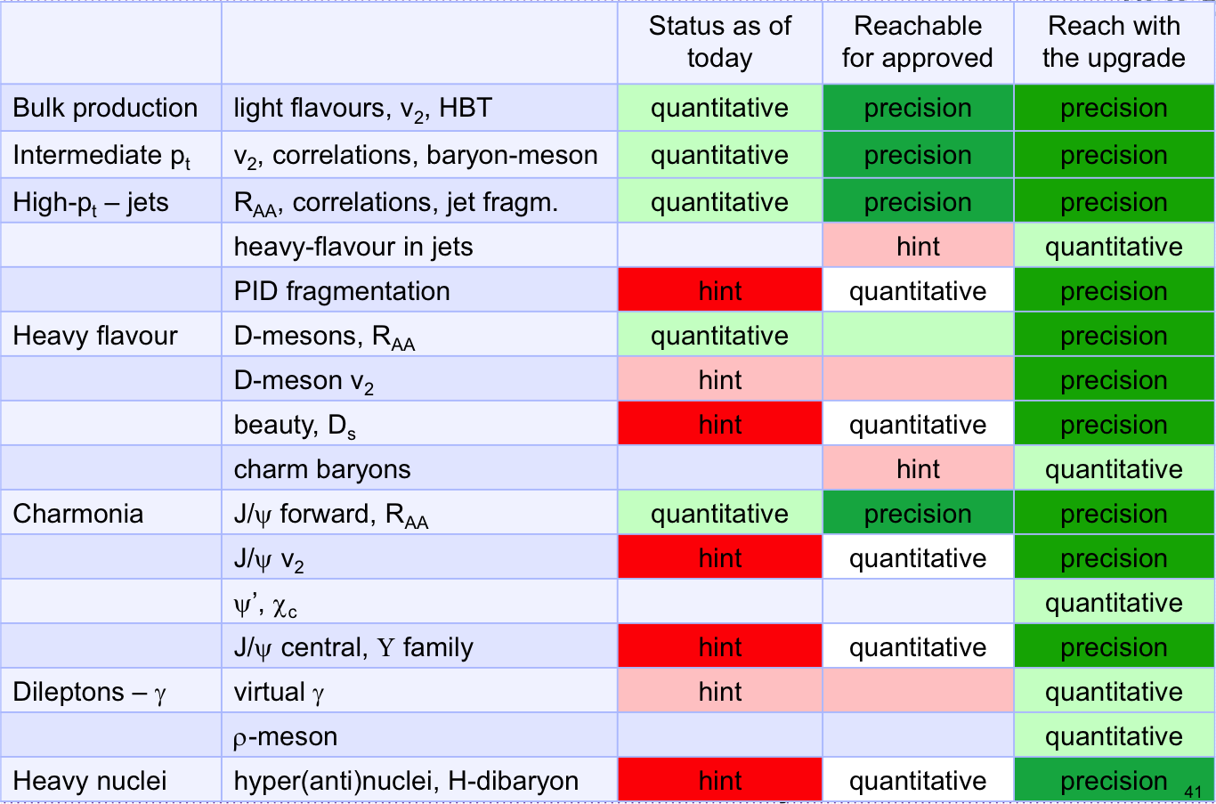
ALICE Status with the upgrades

Slide 22
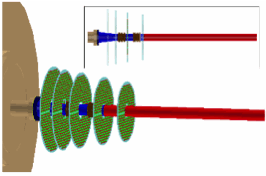
Other upgrades – MFT/VHMPID
MFT(Muon Forward Tracker)
  5 station of Si-pixel planes covering
  Muon arm acceptance
  Improve secondary vertex measurement
  Better BG rejection, b-tagging for J/ψ
  Improve mass resolution for low mass di-muons
VHMPID (Very High Momentum PID)
  Focusing RICH for high momentum PID in central barrel
  C₄F₄O₈ Cherenkov radiator, CsI photocathode with MWPC or GEM readout
  Track-by-track hadron PID in jets
  Detailed understanding of jet structure,
  fragmentations, parton energy loss
Y. Jungyu P6C
in this conf.
arXiv:1103.601

Slide 23
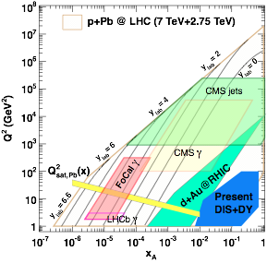
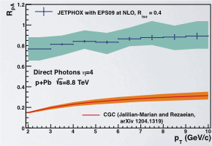
Other upgrades - FOCAL
C.A. Salgado, JPG 38 (2011) 124036
FOCAL(Forward Calorimeter)
  Gluon saturation at small-x
  Early stage dynamics of HI collisions
Unique opportunity for ALICE
  highest eta(>3) with wide p_{T} coverage
  Prompt photon, π⁰, jets, (quarkonia)
  and correlation with rapidity gap
W+Si EM Sampling Calorimeter
  + H-CAL behind under consideration
  Two possibilities on location
    3m (2.5<eta<4.2) from IP
    8m (3.3<eta<5.0) from IP

Slide 24
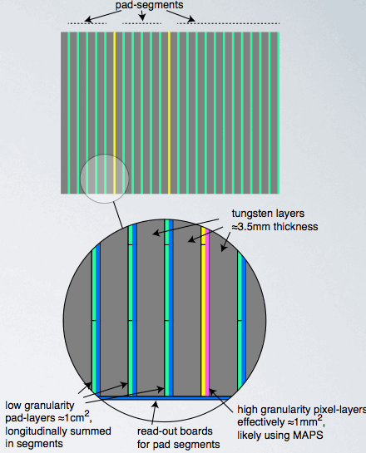
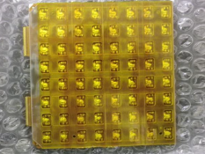
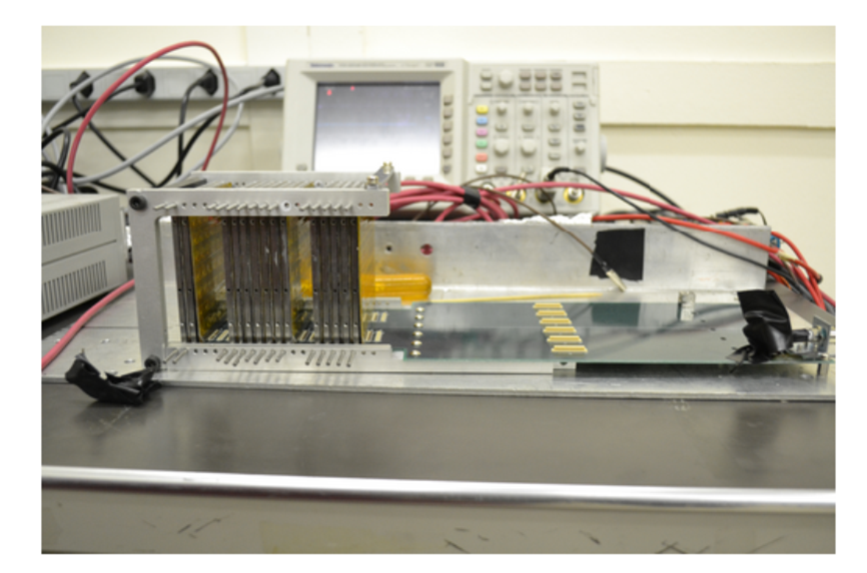
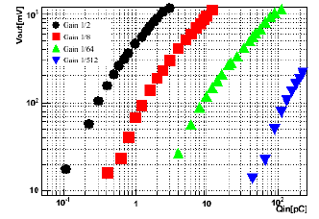
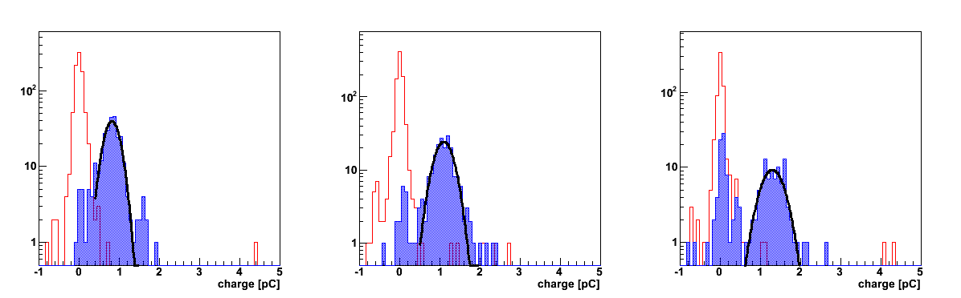
Other upgrades - FOCAL
FOCAL detector design
  Two combination of the detector
    Low granularity Si-Pad layers
    High granularity Si pixel layers
      Separation of π⁰→2γ and prompt γ
Prototype R&D
  Si-Pad and electronics
  ASIC development (CNS et al.)
  Si-Pixel (MAPS) development
Beamtest of CNS FoCAL (Si-Pad) in 2011
pedestal
Electron
3 GeV
pedestal
Electron
4 GeV
pedestal
Electron
5 GeV

Slide 25
Summary and Outlook
ALICE upgrades have been proposed to strengthen physics programs for precision QGP studies.
  Unique in low pT physics, HQ measurements, dielectron measurement
  Inspecting 50kHz of minimum bias Pb-Pb collisions
  Require core upgrades (ITS, TPC, electronics, and DAQ), enhanced rate capabilities , and running beyond LS2/LS3.
    Significant R&D efforts are on-going
  Further enhancement of the ALICE setup under investigation
    Muon measurement, high momentum PID in central barrel, and forward physics

Slide 26
Backup slides

Slide 27
Run at 50 kHz Pb-Pb after LS2
With present MWPC readout, space-charge leads to unbearable distortions (order 1 m) and deterioration of dE/dx (10-20% gain drop)
GEMs offer the possibility to sustain continuous readout under high rates at a lower gain, while efficiently blocking ions to the % level
100 m² of large size foils, long drifts, high rates

Slide 28
Performance simulations – position and momentum resolution
20% worse position resolution due to lack of PRF – with present pad planes
Momentum resolution practically recovered with combined tracking
The present pad plane pattern would do the job
New, optimised pad plane restores resolution

Slide 29
Ongoing R&D: Ion Back Flow (IBF)
High rates and long drifts: ‘standard’ GEM operation results in too large distortions (IBF 5-10%).
IBF can be minimised by optimising electric fields, GEM geometry, gain sharing*: for IBF ~ 0.25% distortions stay well below 10 cm, as shown in simulations below
Target value is IBF ~ 0.25% at gain 1000-2000
* M. Killenberg et al. NIM A530, 251 (2004) , B. Ketzer et al. arXiv:1207.0013

