Slide 1
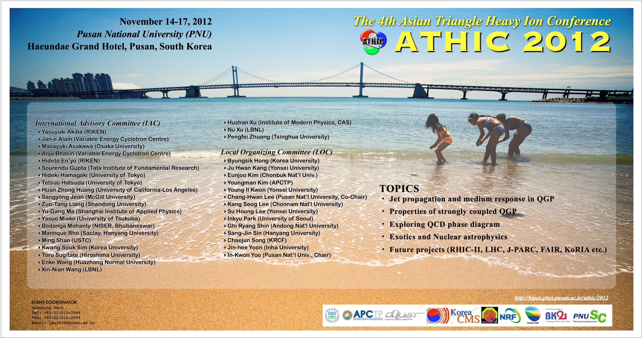

Slide 2

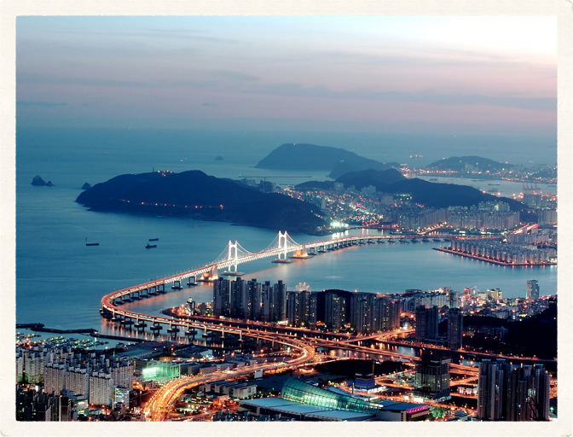
Welcome to Busan

Slide 3
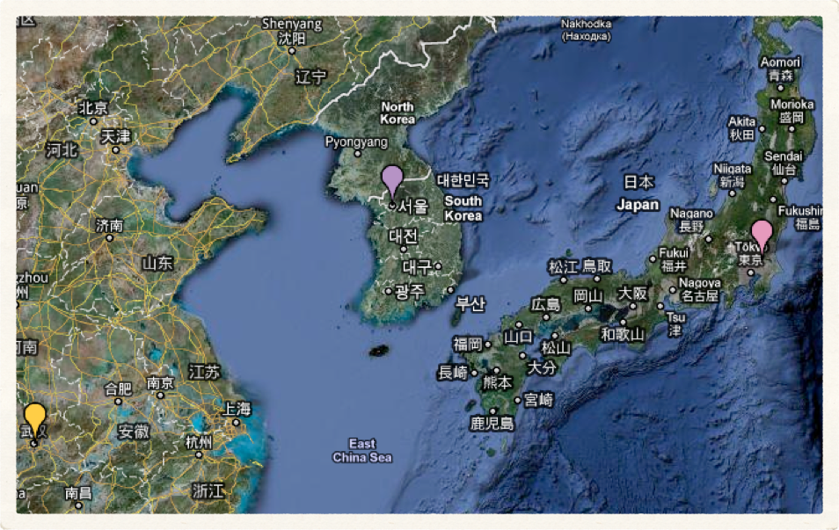

Busan (Pusan, 부산, 釜山) Korea
ATHIC2006
Yonsei Univ.
74 participants
28 talks
ATHIC2010
Wuhan Univ.
111 participants
61 talks
ATHIC2008
Tsukuba Univ.
87 participants
52 talks
ATHIC2012
Pusan Nat’l Univ.
140 participants
82 talks

Slide 4
Busan (Pusan, 부산, 釜山) Korea
ATHIC2006
Yonsei Univ.
74 participants
28 talks
ATHIC2010
Wuhan Univ.
111 participants
61 talks
ATHIC2008
Tsukuba Univ.
87 participants
52 talks
ATHIC2012
Pusan Nat’l Univ.
140 participants
82 talks

Slide 5
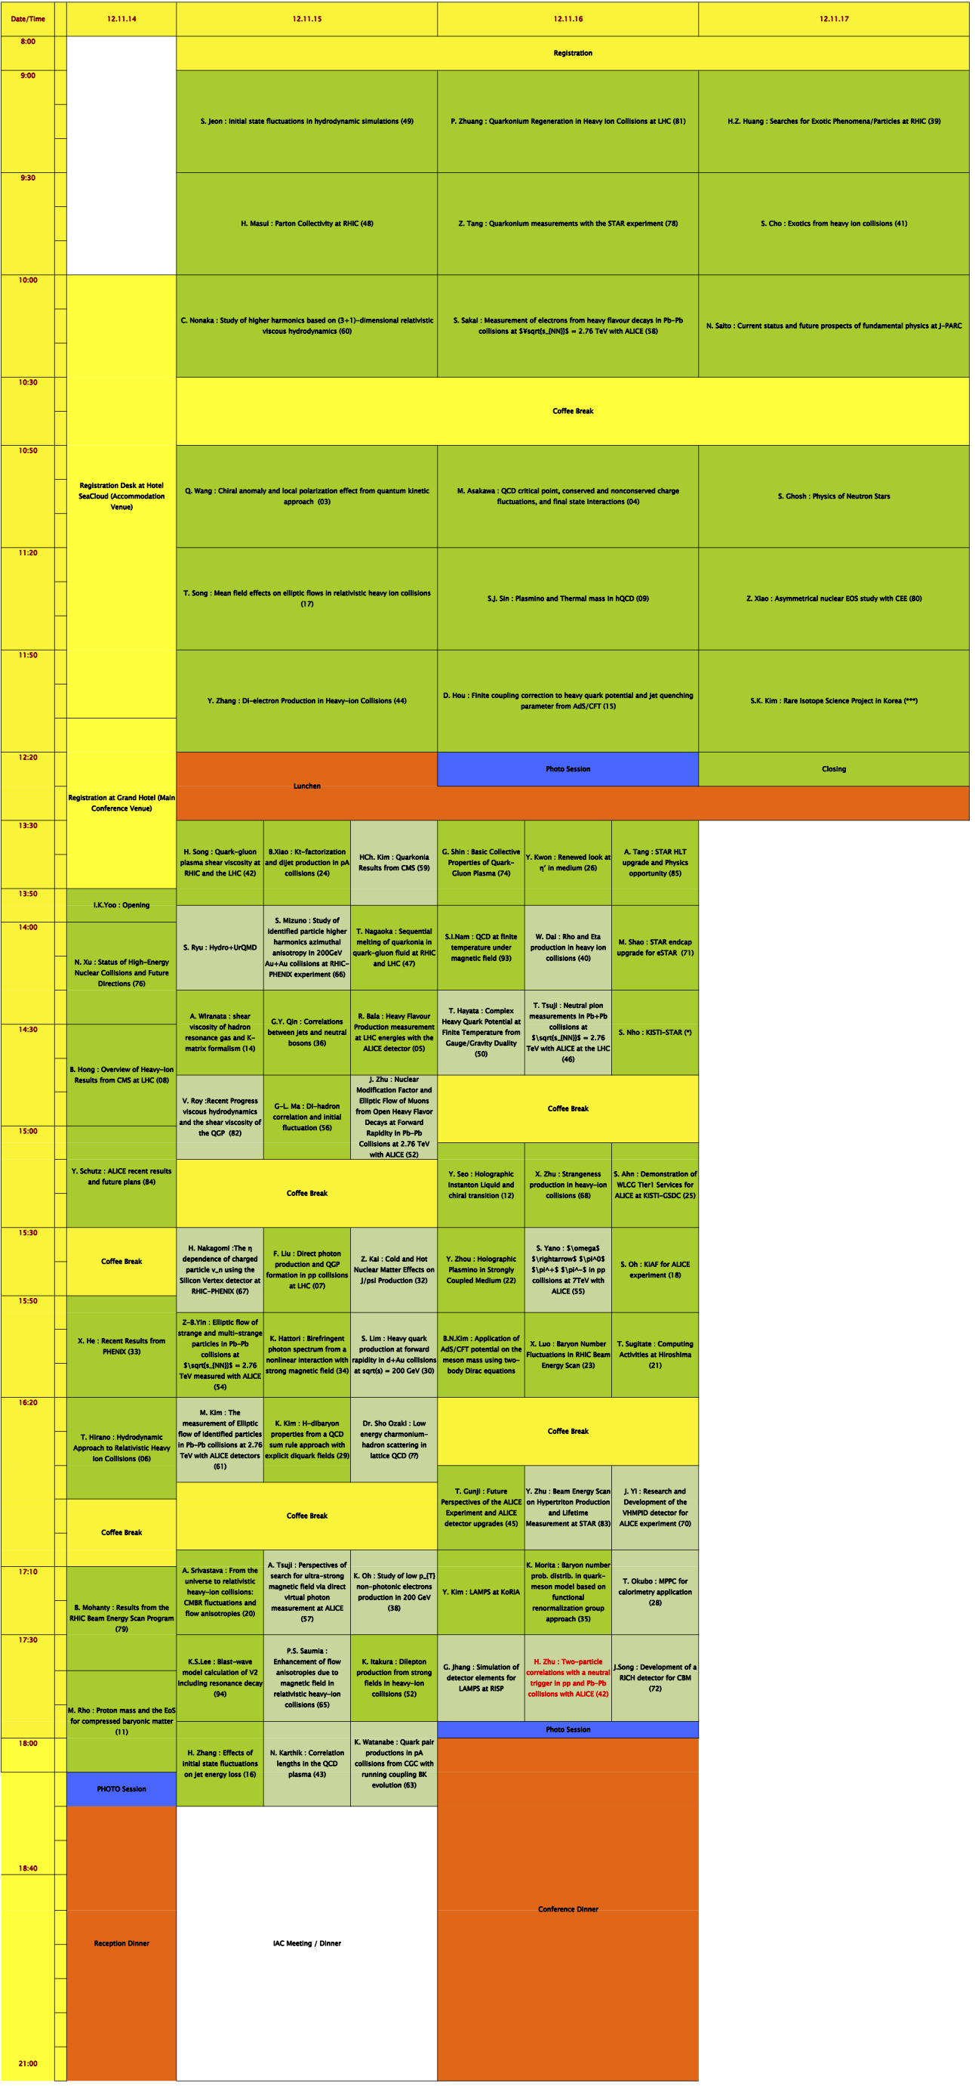
Scientific Program

Slide 6
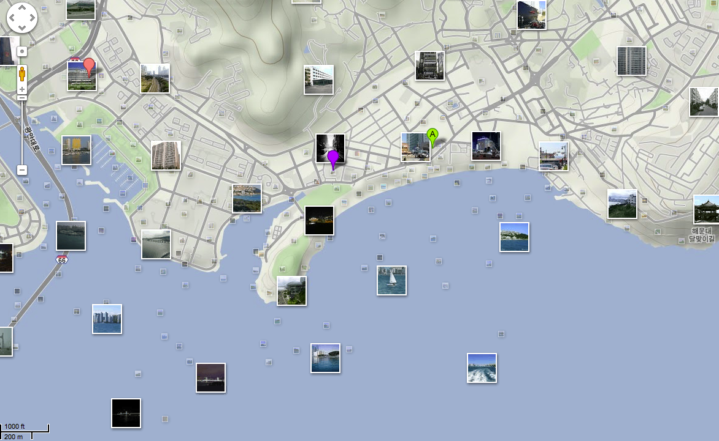
Conference Venue
Grand Hotel
Sky Hall (22F) : Plenary / Parallel A
Emerald Hall (6F) : Reception / Lunch
Joongwon Hall (2F) : Parallel B
Namwon Hall (2F) : Parallel C
Hostel Arpina
Banquet (Nov. 16)
Sea Cloud Hotel
Hotel Rooms
Rest. Konakomo : Dinner (Nov.15)

Slide 7

Enjoy ATHIC2012 !

