Slide 1



RAON
Heavy ion accelerator for
rare isotope science
The 4th Asian Triangle Heavy Ion Conference(ATHIC2012)
2012.11.14~17
Sun Kee Kim
Rare Isotope Science Project (RISP)
Institute for Basic Science (IBS)

Slide 2


RAON
“라온”
a pure Korean word
meaning Delightful, Joyful, Happy,…
“with a wish that this accelerator
would be a delightful gift for scientists
all over the world and for the bright
future of mankind.”

Slide 3

Brief History
International Science Business Belt(ISBB) plan (2009.1)
Preliminary Design Study (2009.3-2010.2)
Conceptual Design study (2010.3-2011.2)
International Advisory Committee(2011.7)
Institute for Basic Science(IBS) established(2011.11)
Rare Isotope Science Project(RISP) launched(2011.12)
      Rare isotope accelerator complex is the representative facility of IBS
Technical Advisory Committee(2012.5)
Baseline Design Summary (2012.6)
International Advisory Committee(2012.7)
Technical Design (present – 2013.6)

Slide 4
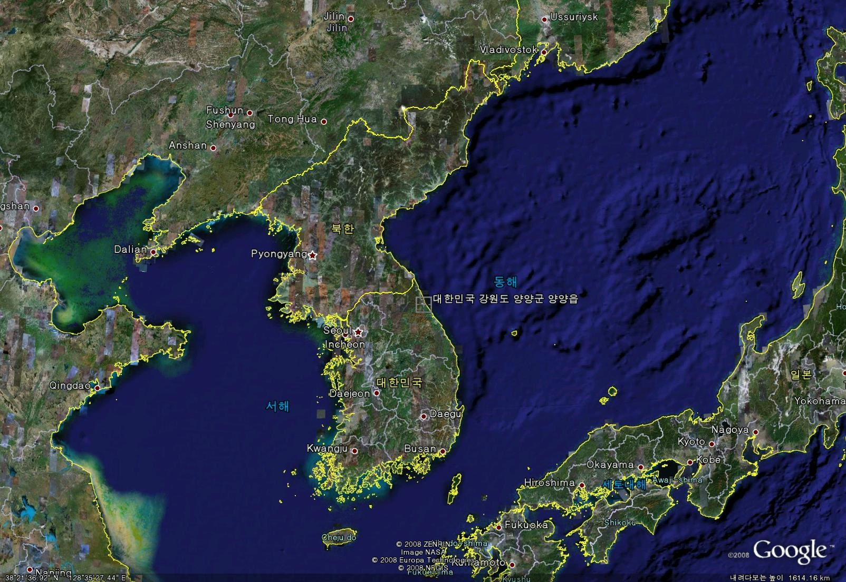
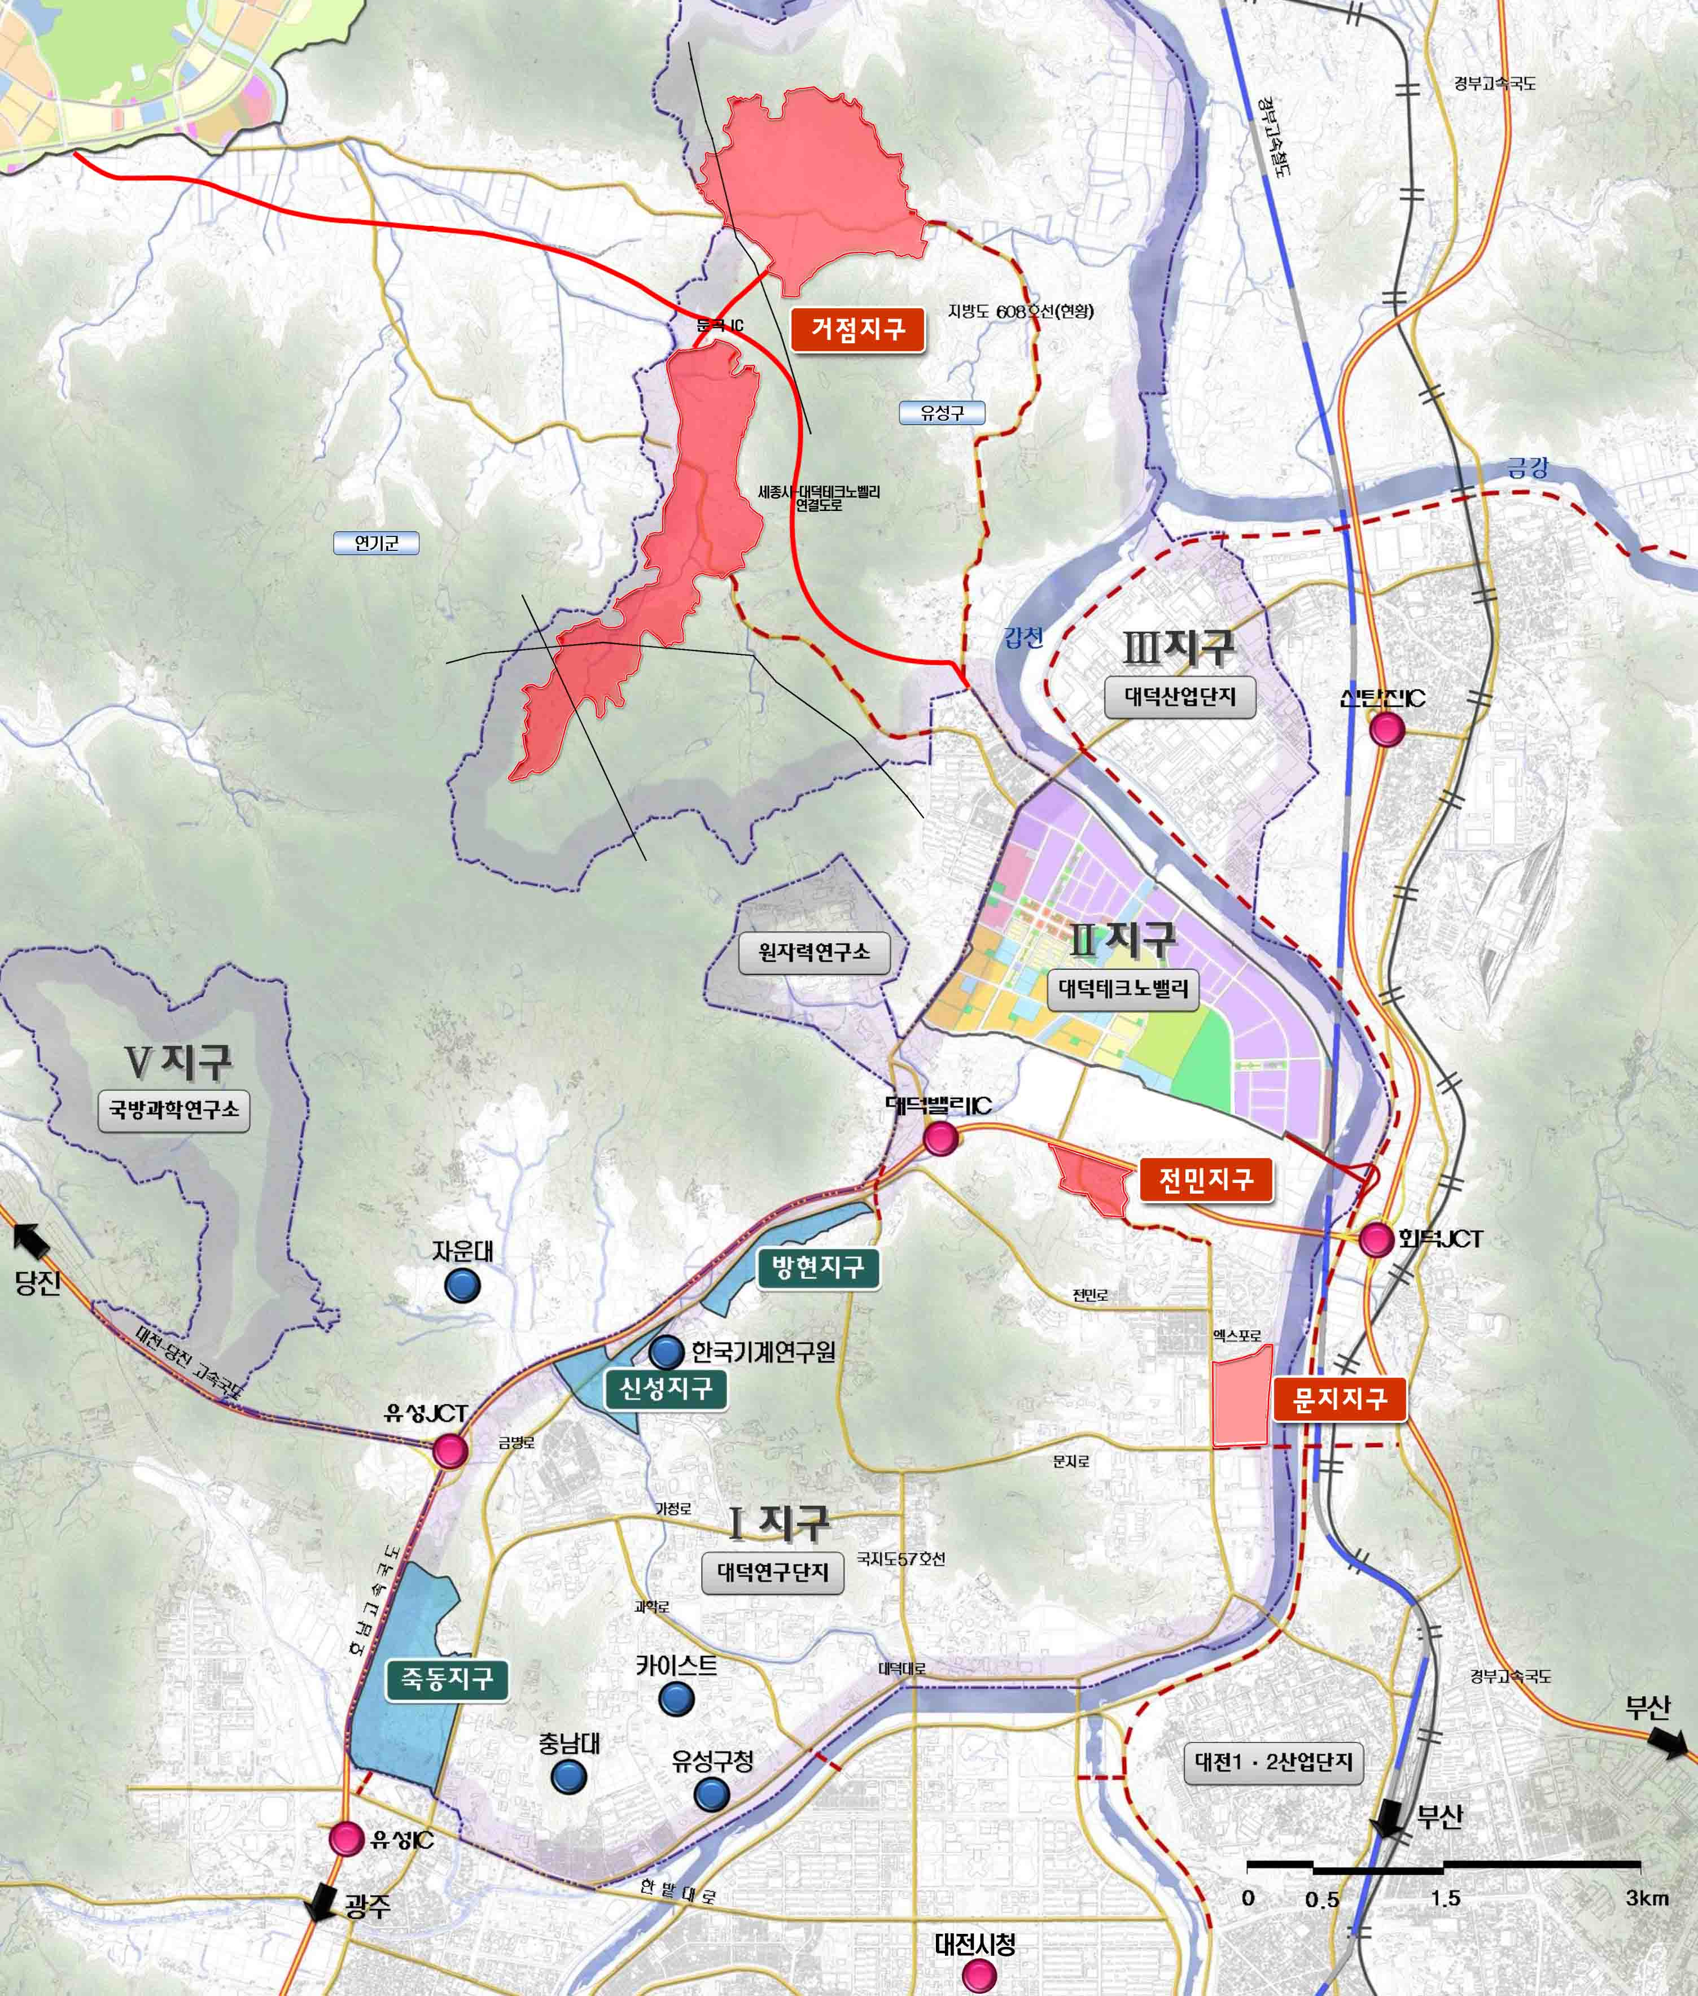
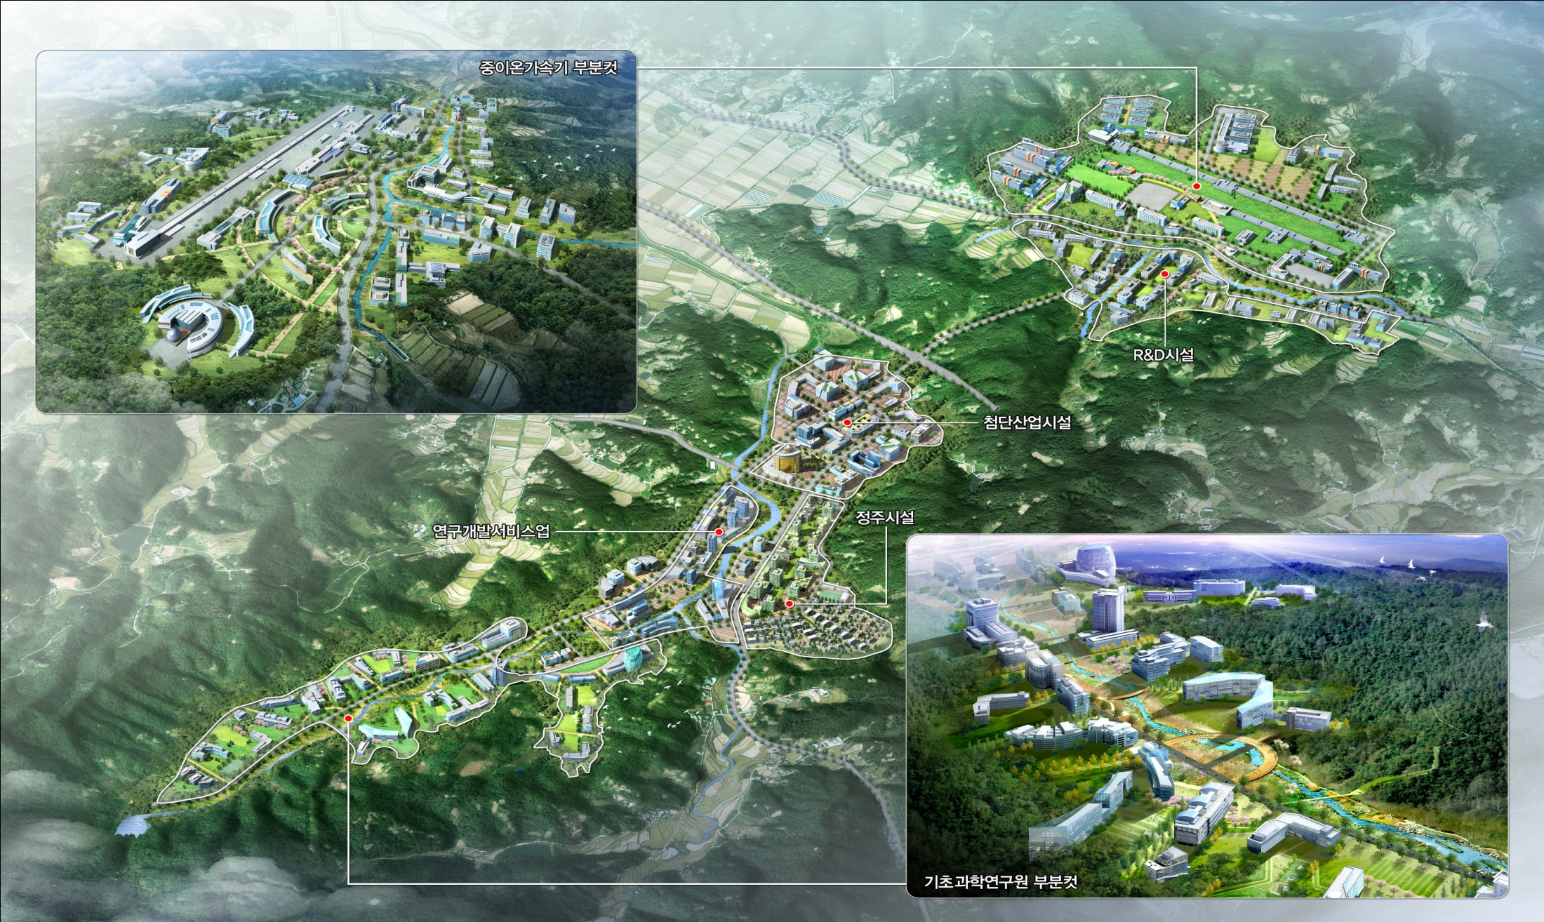
Location

Slide 5

Institute for Basic Science
Bird Eye View of IBS

Slide 6









Organization of IBS (Institute for Basic Science)
4. Organizational Structure
Board of Directors
Auditor
President
Scientific Advisory Board
Rare Isotope Science Project
Office of
Policy Planning
Accelerator Institute
(Affiliated Institution)
Secretariats
Office of
Research Services
Research Center
(Headquarters)
Research Center
(Campus)
Research Center
(Extramural)
Office of Administrative Services
16 centers were selected so far !
IBS consists of 50 research centers, supporting organizations, and affiliated research institutes
Each Research Center : ~50 staff, average annual budget ~ 9 M USD
The number of staff: 3,000 (2017, including visiting scientists and students)
Annual Budget: USD 610 million (2017, including operational cost for the Accelerator Institute)
4

Slide 7
Organization of RISP
RISP
Director
Advisory Committee
(IAC, TAC, PAC)
Project Management Group
Experimental Systems Division
Accelerator Systems Division
Theory
Division
Conventional Facilities
Division
Administration
Division
· ISOL Team
· Detector Systems Team
· Application Facility Team
· Beam Physics & Injector Team
· SCL Team
· IF & RF Team
· Cryogenic & Control Team
· Nuclear Physics Team
· Particle & Astrophysics Team
· Civil Engineering Team
· Conventional Facilities Team
· Management & Planning Team
· Research Management Team
· Information & Cooperation Team

Slide 8
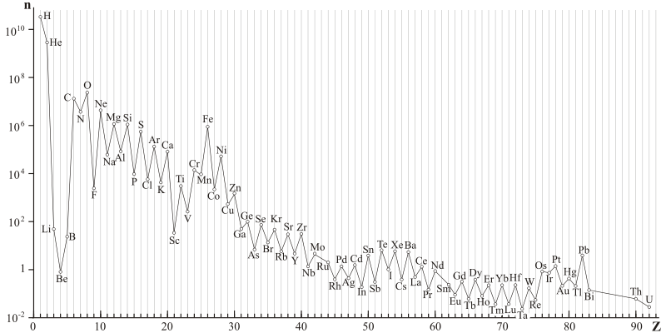
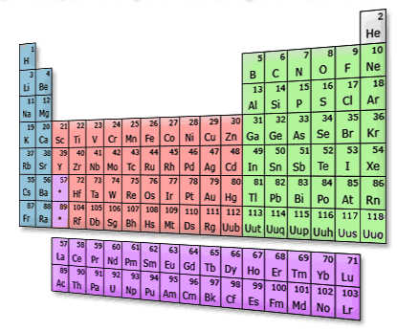

Origin of elements
Where am I from ?

Slide 9
Origin of elements
Light elements were produced by Big-bang
Heavy elements up to Fe were produced by nuclear fusion in Stars
Elements heavier than Fe were produced by consecutive capture of
neutrons followed by beta decays (in violent astronomical processes
Such as Supernova explosion)
→ s-process, r-process → still to be understood!
Elemental Abundance in Solar system

Slide 10
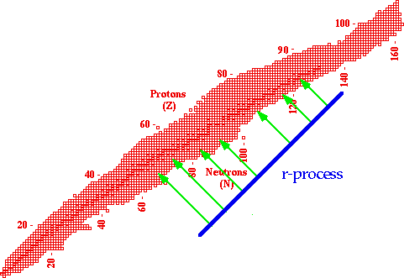
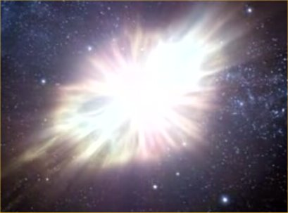
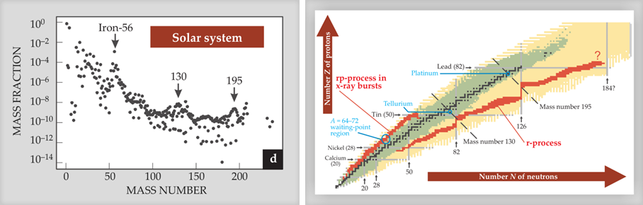
Origin of elements
ㅊ
Isotope ratio in the solar system
Evidence of r-process
“Our bodies are debris of Supernovae”
Hendrik Schatz, Physics Today, Nov. 2008, p. 40
To understand the neutron rich isotopes is crucial to explain r-process

Slide 11
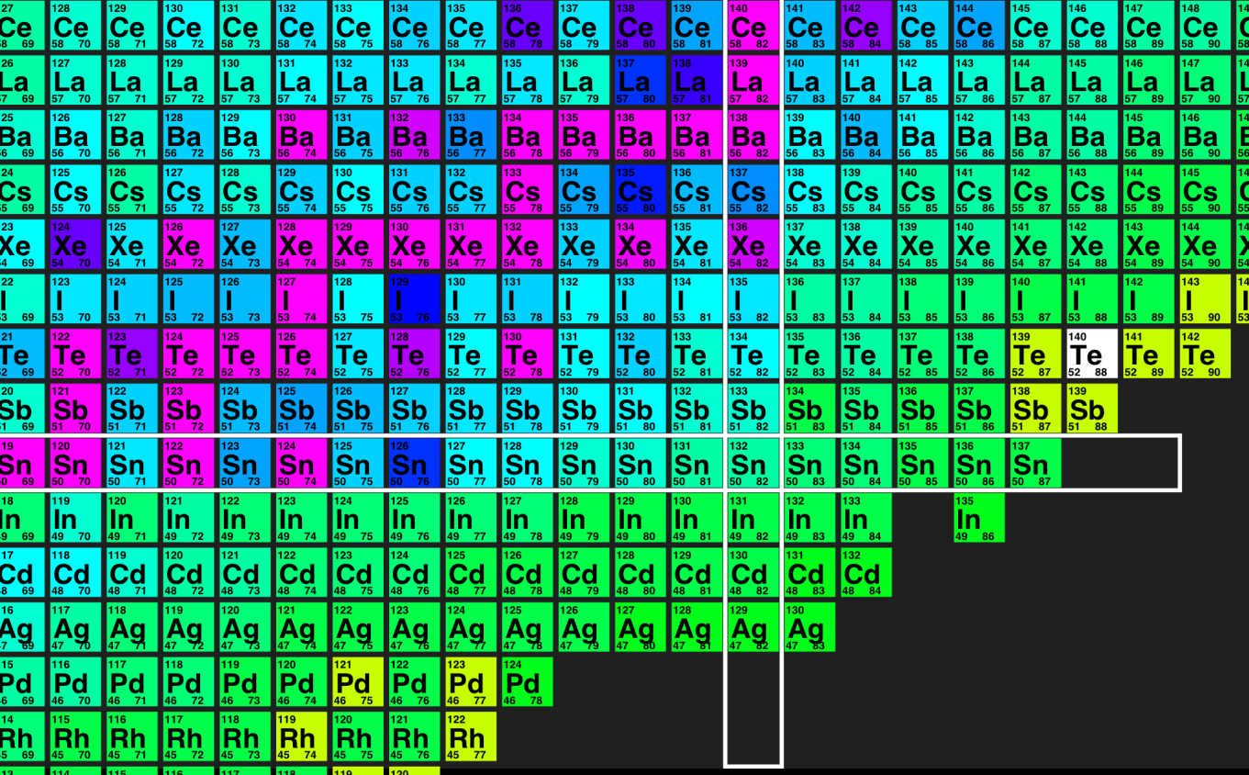
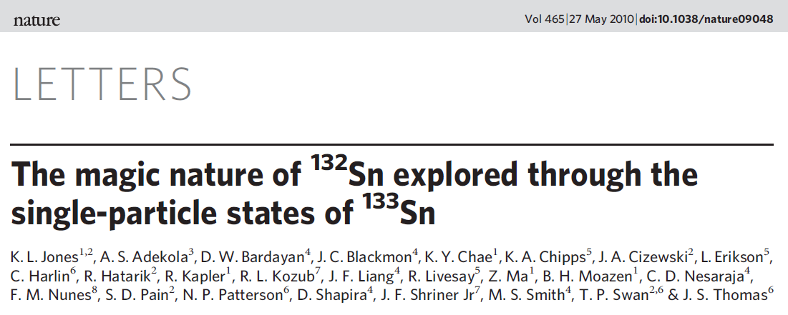
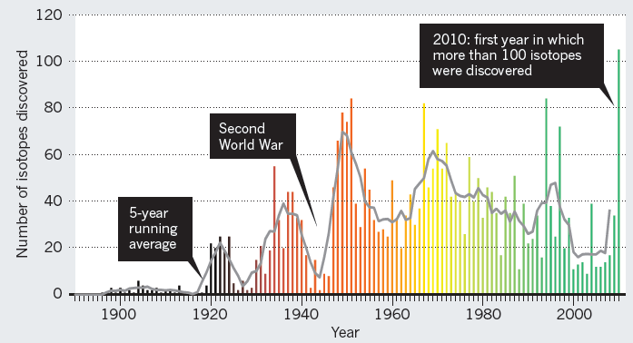

Origin of elements

Slide 12
Research area with rare isotopes
Pure Science
Application for the society
Nuclear Physics
Nuclear Data - Energy
Nuclei with excessive neutrons
New elements
Equation of state of nucleus
Basic data for next generation nuclear reactor
Transmutation of nuclear waste
Material Science
Nuclear astrophysic
New material development
New method of characterization
β-NMR / μSR
Origin of elements
Nucleosythesis
Evolution of stars, neutron stars, supernovae
Bio & medical application
Atomic/Particle Physics
New medical theraphy
Genetic modification
New isotopes for medical imaging
Atomic trap
Fundamental Symmetries

Slide 13

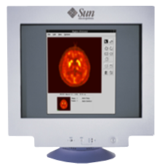
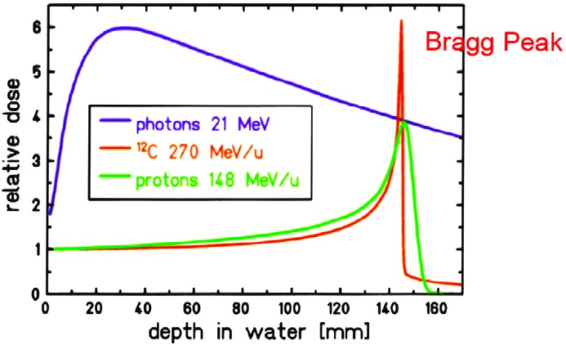
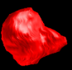


γ
3
PET Image by Annihilation
Rare Isotope Beam
β
⁸B
⁸B
γ
⁸Be*
⁴He + ⁴He
1
Bragg Peak of Heavy
Ion Beam
2
Secondary Effect by Alpha Particle
due to Heavy Ion Beam

Slide 14
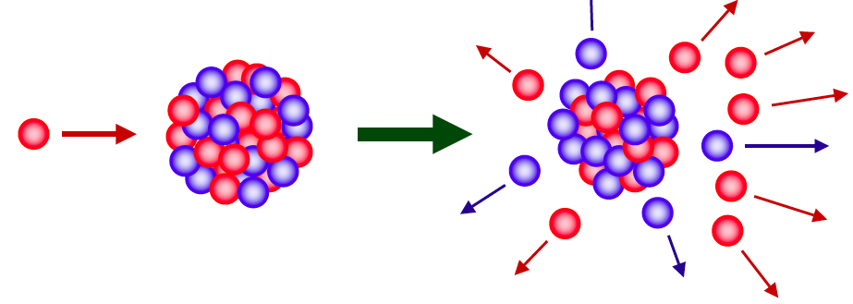
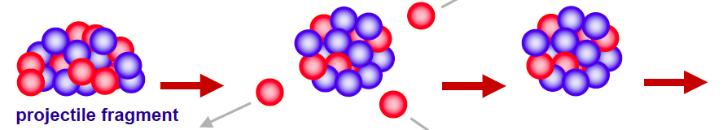
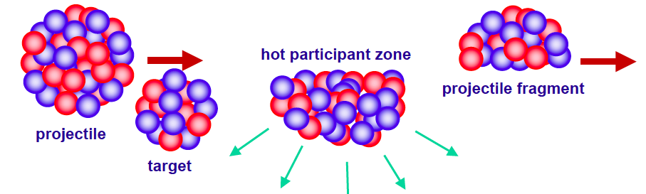
RI Beam production
ISOL(Isotope Separator On-Line)
proton → thick target (eg. Uranium Carbide) → spallation or fission of target nuclei(low energy)
RI Ions
Reacceleration
RI Beam
Cyclotron
Proton 70 MeV, 70 kW
Driver LINAC
Heavy ion
e.g. U : 200MeV/u, 400 kW
Stopping
Stopped Beam
Experiment
(Traps)
RI ion beam
Fast Beam
Experiment
IF(In-Flight Fragmentation)
Heavy stable isotope beam → thin target → fragmentation of projectile (high energy)

Slide 15
Accelerator : RAON
High intensity rare isotope beam with ISOL and IF methods
70MeV, 1mA proton beam, ²³⁸U target - 70kW ISOL system
200MeV/u, 8.3pμA, ²³⁸U beam and other stable isotope beam - 400kW IF system
High current high purity neutron-rich RI beam
For example, ¹³²Sn : ~250MeV/u, ~ 10⁸ pps
- ISOL + acceleration
Production of exotic beams combining ISOL and IF methods
Simultaneous operation of IF and ISOL systems
Design Consideration for the future
Wide variety of isotope beams
Upgradable to higher energy and higher intensity
World leading RI beam facility for longer term

Slide 16
Science topics
Research Field | Theme | Topics | Example reactions Apparatus | Beam | Production
Nuclear Science | Origin of elements/ Stellar Evolution | r-process waiting point | ∙ ¹²³Nb, ¹²⁴Mo, ¹²⁵Tc, ¹²⁶Ru ∙ Decay Station | ∙ primary beam(PB) : ²³⁸U - E: 200 AMeV - Intensity: > 1 pμA | ∙ IF
 |  | Contribution of isomer interaction to nucleosynthesis | ∙ ^{26m}Al+p→ ²⁷Si+γ ∙ Recoil Spectrometer | ∙ PB : ²⁸Si ∙ SB : ^{26m}Al - E: < 5 AMeV - Intensy: > 10⁷ pps | ∙ IF
 |  | Escape process to rp-proces | ∙ ¹⁵O+α→ ¹⁹Ne+γ ∙ Recoil Spectrometer | ∙ PB : p(ISOL), ¹⁶O(IF) ∙ SB : ¹⁵O - E: < 10 AMeV - Intensity: > 10¹⁰ pps | ∙ ISOL ∙ IF
 |  | Superheavy elements | ∙ ⁶⁴Ni + ²³⁸U → ²⁹⁹120 + 3n ∙ SHE spectrometer | ∙ PB: ⁶⁴Ni - E: < few AMeV - Intensity: > few pμA | ∙ Stable Ion Beam
 | Nuclear structure and Nuclear force | Nuclear structure of rare isotopes with neutron magic number near 126 | ∙ ¹⁴⁴Xe + ²⁰⁸Pb →¹⁹⁶Yb + X ∙ Decay Station | ∙ SB: ¹⁴⁴Xe - E: > 100 AMeV - Intensity: > 10⁶ pps | ∙ ISOL
 |  | Symmetry energy | ∙ ¹³²Sn+¹¹⁹Sn→X+Y ∙ Large Acceptance Spectrometer | ∙ PB:p(ISOL), ²³⁸U(IF) ∙ SB: ¹³²Sn - E: 10~250 AMeV - Intensity: > 10⁷ pps | ∙ ISOL (Low E) ∙ IF (High E)
 | Nuclear data | Neutron capture cross section | ∙ p + Be, Li, C ∙ neutron irradiation facility | ∙ PB: p - 70 MeV (p) - 1 kHz ~10 MHz pulse beam | ∙ Cyclotron

Slide 17
Science topics
Research Field | Theme | Topics | Example reactions Apparatus | Beam | Production
Atomic and Molecular Physic | Mass and spectroscopy of rare isotopes | Study of rare isotopes near neutron Dripline | ∙ medium mass n-rich beam ∙ Atomic trap facility | ∙ PB: p(ISOL), ²³⁸U(IF) ∙ SB : ¹³²Sn toward neutron drip line - E: < 60 keV - Intensity: > 1 pps | ∙ ISOL ∙ IF
Material Science | Characterization of new material | Local Electromagneic structure of material | ∙ Low Mass RI beam ∙ β-NMR, β-NQR ∙ μSR spectroscopy | ∙ PB : ⁸Li, ¹¹Be, ¹⁵O, ¹⁷Ne, muon - E: < ~10 keV - Intensit: > 10⁸ pps | ∙ ISOL ∙ IF
Bio and Medical Science | Understanding | Biological optimization of heavy ion therapy and on-line imaging of dose of nuclear therapy | ∙ Low Mass RI beam ∙ RI irradiation facility | ∙ SB : ⁸B, ⁹C, ¹¹C - E: 200~400 AMeV - Intensity: > 10⁷ pps | ∙ ISOL ∙ IF

Slide 18
Concept of RAON
20m
ECR-IS (10keV/u, 12 pμA)
 | Driver Linac |  |  |  | Post Acc. | Cyclotron
Particle | H⁺ | O⁺⁸ | Xe⁺⁵⁴ | U⁺⁷⁹ | RI beam | proton
Beam energy(MeV/u) | 600 | 320 | 251 | 200 | 18.5 | 70
Beam current(pμA) | 660 | 78 | 11 | 8.3 | - | 1000
Power on target(kW) | 400 | 400 | 400 | 400 | - | 70
128.5m
LEBT
RFQ (300keV/u, 9.5 pμA)
MEBT
100m
SCL1 (18.5 MeV/u, 9.5 pμA)
Driver Linac
Chg. Stripper
SCL2 (200 MeV/u, 8.3 pμA for U⁺⁷⁹)
(600MeV, 660 μA for p)
375m
100m
80m
70m
20m
ISOL
Target
MEBT
RFQ
CB
HRMS
μSR, Medical
250m
SCL3
RF Cooler
Cyclotron
(p, 70 MeV, 1mA)
IF Target
ECR-IS
Atom/Ion Trap
Gas Catcher
IF Separator
Post Accelerator
110m
ISOL system
IF system
100m
CB : Charge Breeder
HRMS : High Resolution Mass Separator
Low Energy Experiments
Nuclear Astrophysics
Material Science
β-NMR
High Energy Experiments
Nuclear Structure/
Symmetry Energy

Slide 19
Concept of RAON
20m
RI Ions
Reacceleration
RI Beam
ECR-IS (10keV/u, 12 pμA)
Cyclotron
Proton 70 MeV, 70 kW
128.5m
LEBT
RFQ (300keV/u, 9.5 pμA)
MEBT
Driver LINAC
Heavy ion
e.g. U : 200MeV/u, 400 kW
Stopping
Stopped Beam
Experiment
(Traps)
RI ion beam
Fast Beam
Experiment
100m
SCL1 (18.5 MeV/u, 9.5 pμA)
Driver Linac
Chg. Stripper
SCL2 (200 MeV/u, 8.3 pμA for U⁺⁷⁹)
(600MeV, 660 μA for p)
375m
100m
80m
70m
20m
ISOL
Target
MEBT
RFQ
CB
HRMS
μSR, Medical
250m
SCL3
RF Cooler
Cyclotron
(p, 70 MeV, 1mA)
IF Target
ECR-IS
Atom/Ion Trap
Gas Catcher
IF Separator
Post Accelerator
110m
ISOL system
IF system
100m
CB : Charge Breeder
HRMS : High Resolution Mass Separator
Low Energy Experiments
Nuclear Astrophysics
Material Science
β-NMR
High Energy Experiments
Nuclear Structure/
Symmetry Energy

Slide 20
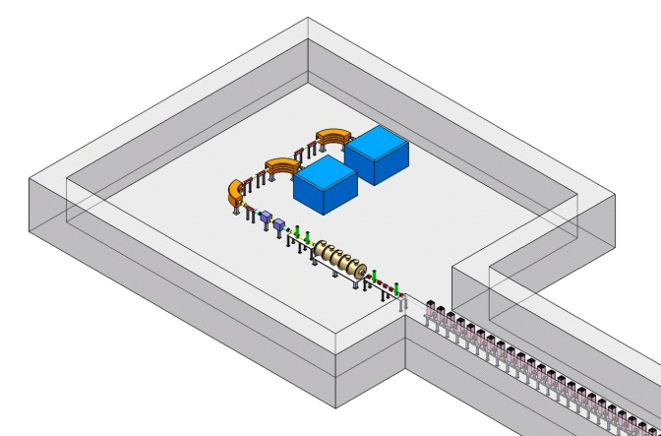
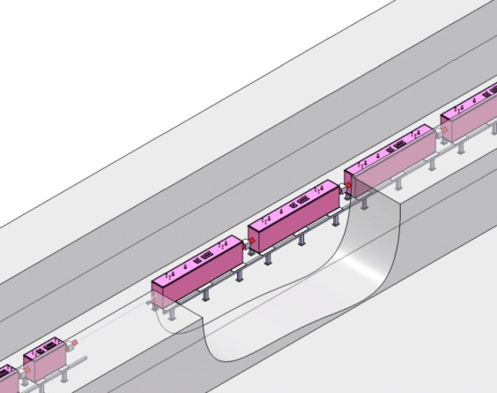
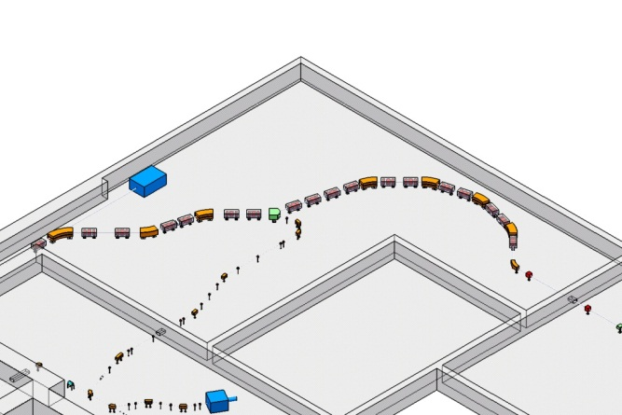
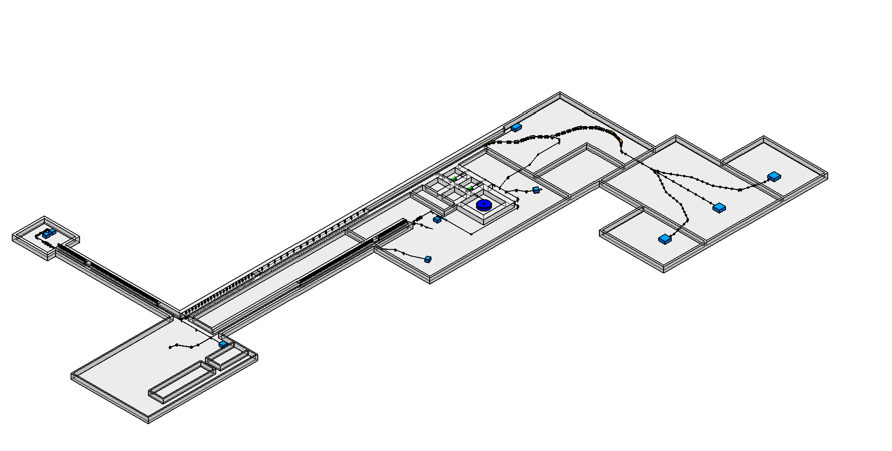
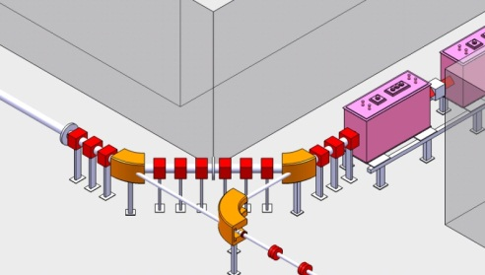
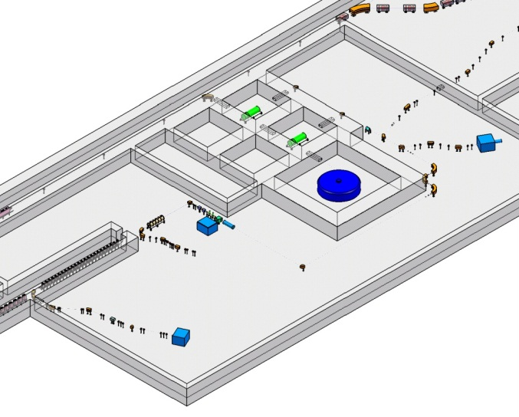
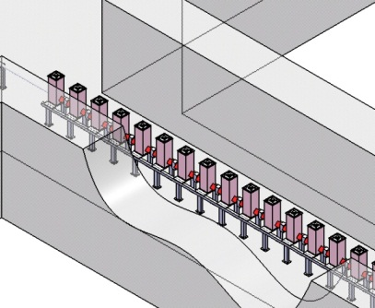
Injector
SCL2
IF system
Charge Stripper
High Energy
Lab
ISOL system
Low Energy
LAB
Cyclotron
SCL1

Slide 21
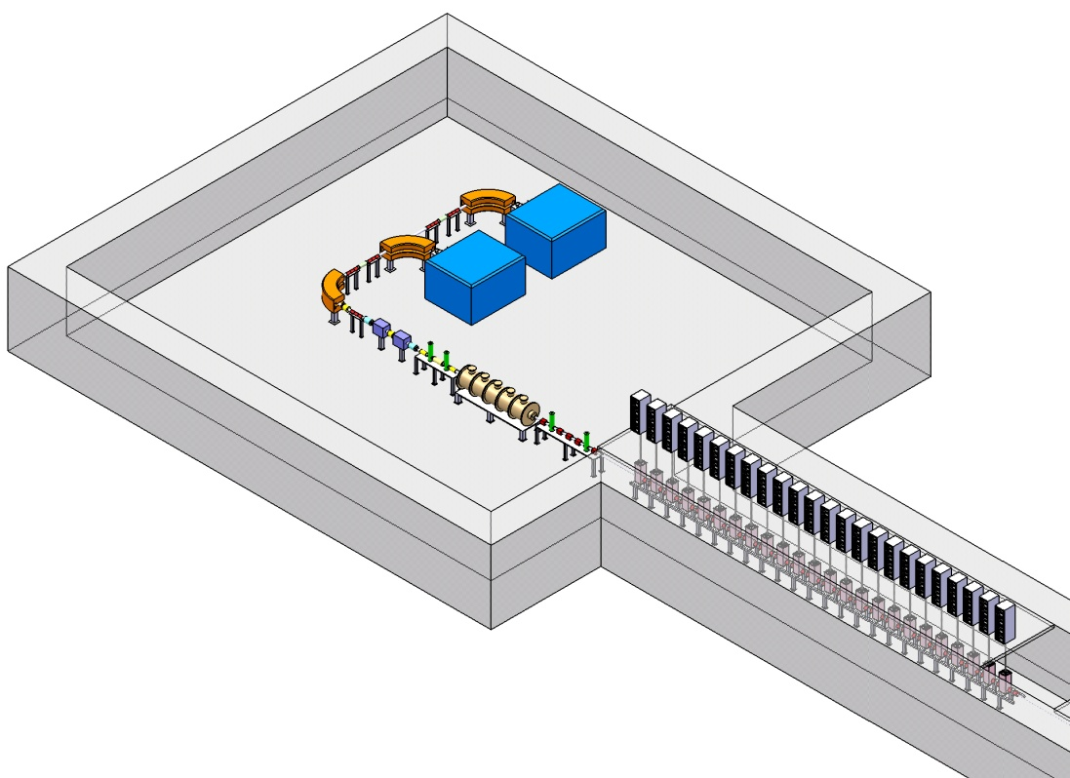
Driver Linac - Injector
ECR-IS
Ion Source | Proton to Uranium
Energy | 10 keV/u
RF power | 10 kW
Emittance | 0.1π mm-mrad
Current | 400 euA (²³⁸U³³⁺, ²³⁸U³⁴⁺)
RF Frequence | 28 GHz
ECR-IS
LEBT
LEBT
Beam Energy | 10 keV/u
Particles | ²³⁸U³³⁺, ²³⁸U³⁴⁺
Emittance growth | < 10 %
Beam Current | 12 pμA
RF Frequency | 40.625 MHz
RFQ
MEBT
RFQ
Input energy | 10 keV/u
Output energy | 300 keV/u
Emittance (rms) | 0.12πmm-rad
Frequence | 81.25 MHz
Input charge | 33, 34 (Uranium-238)
Input current | 12 pμA
Output current | 9.5 pμA
MEBT
Beam Energy | 300 keV/u
Emittance growth | <10 %

Slide 22
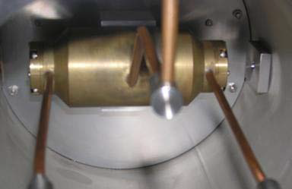
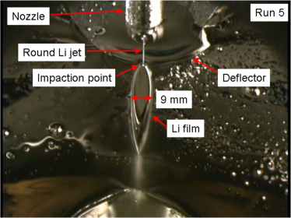
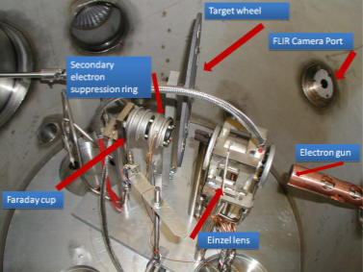
Driver Linac SC Linac(SCL)
400 kW
@200 MeV/u
(for ²³⁸U)
Candidate for charge stripper
He Gas Liquid Lithium Solid Carbon
(BNL) (ANL) (MSU)
Q = 77⁺, 78⁺, 79⁺ 80⁺, 81⁺
Linac-2
SRR1 : 325 MHz , β= 0.30
SRR2 : 325 MHz , β= 0.53
MEBT
Rebuncher + Quad. Mag.
81.25 MHz
Linac-1
QWR : 81.25 MHz, β= 0.047
HWR : 162.5 MHz , β= 0.12
Charge stripper section
Q = 33⁺, 34⁺
Charge state : 33.5⁺ → 79⁺
500 keV/u
18.5 MeV/u

Slide 23
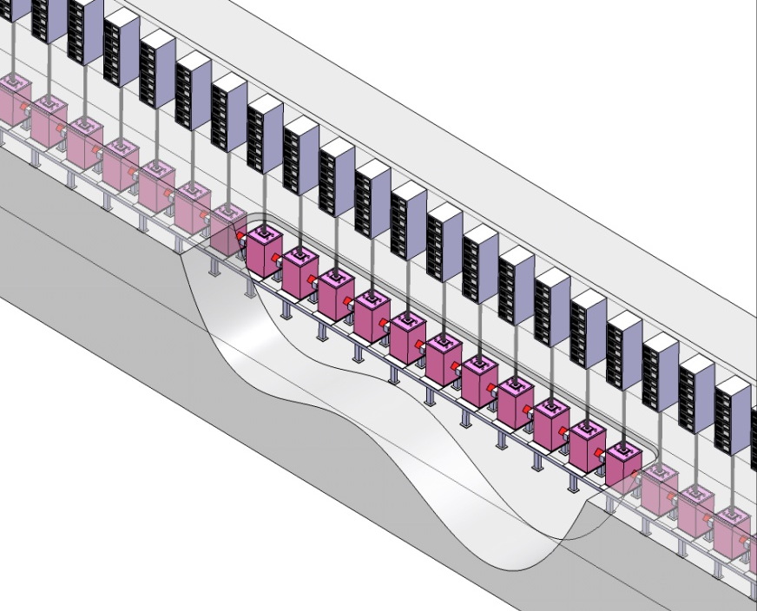
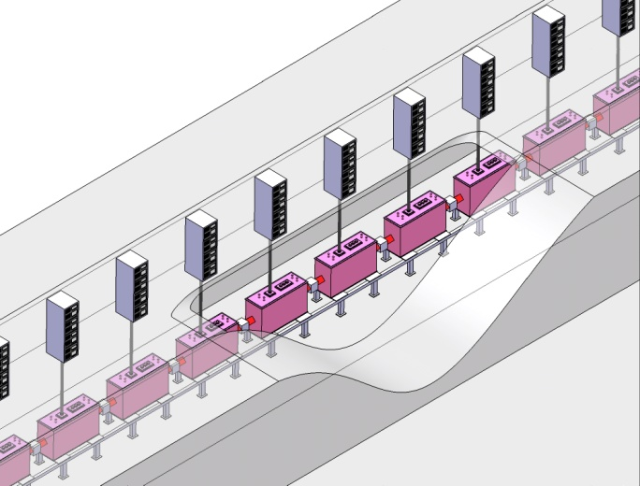
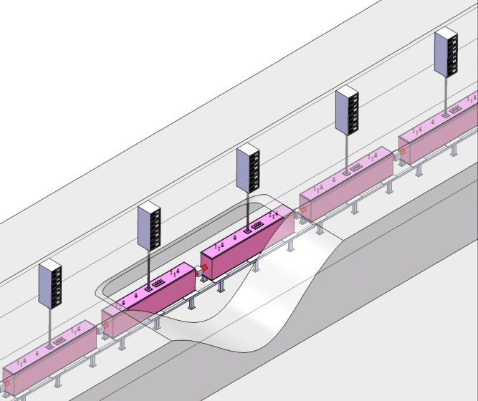
Driver Linac SC Linac(SCL)
 | SCL1 |  |  | SCL2
 | Segment 1 | Segment 2 |  | Segment 3 | Segment 4
Injection Energy | 0.3 MeV/u | 2.5 MeV/u |  | 18.5 MeV/u | 70.9 MeV/u
Output Energy | 2.5 MeV/u | 18.5 MeV/u |  | 70.9 MeV/u | 200 MeV/u
Cavity type | beta=0.047 QWR | beta=0.12 HWR |  | Beta = 0.30 SSR | beta = 0.53 SSR
Frequency | 81.25 MHz | 162.5 MHz |  | 325 MHz | 325 MHz
No. of Cavities | 24 | 138 |  | 88 | 136
No. of Cyromodule | 24 | 14 | 16 | 22 | 17
Cavity/Cryomodule | 1 | 3 | 6 | 4 | 8
# QD | 48 | 60 |  | 44 | 34
length | 25.5 | 71.0 |  | 66.0 | 101.8

Slide 24
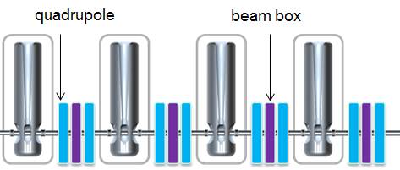
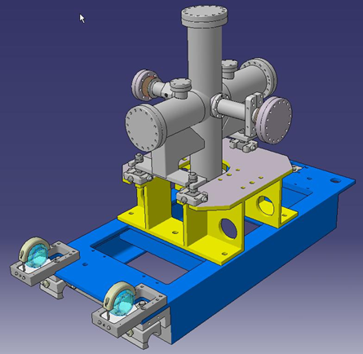
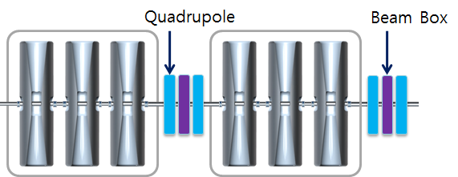
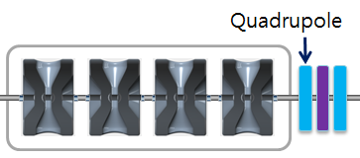
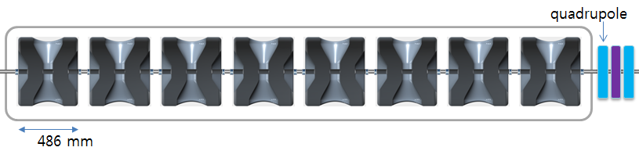
Driver Linac SC Linac(SCL)
[1 QWR + 1 QD] x 24
SCL1
[3 HWR + 1 QD] x 14
[6 HWR + 1 QD] x 16
beam box example
(courtesy of SPIRAL2)
[4 SSR + 1 QD] x 22
SCL2
[8 SSR + 1 QD] x 17

Slide 25
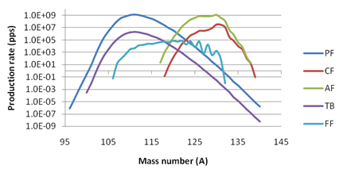
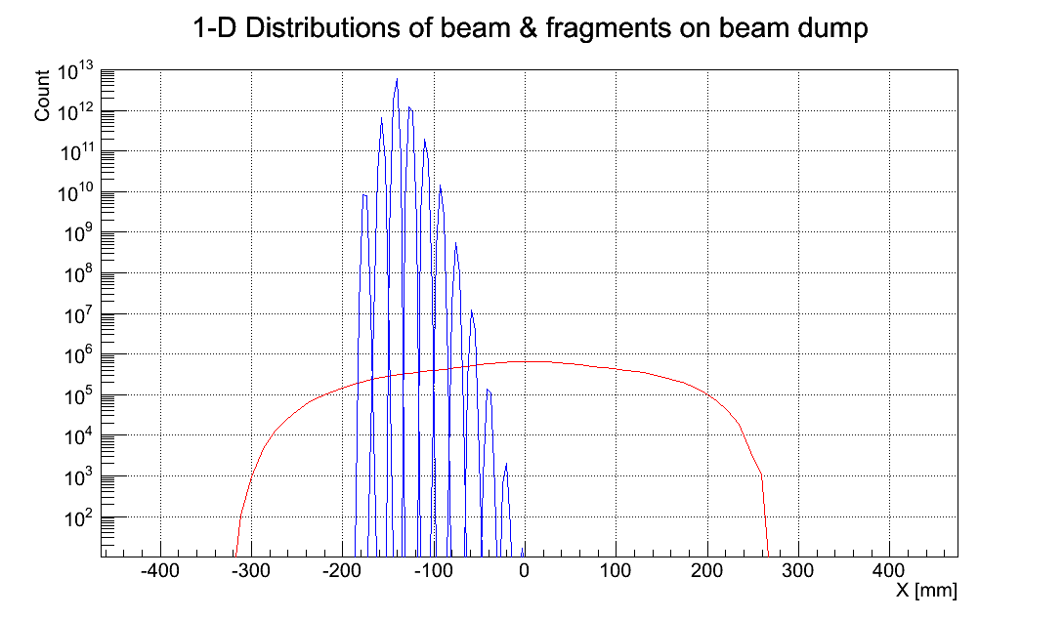
In-flight Fragment Separator
²³⁸U, 200 MeV/u, 400 kW
Pre-separator: S-shape
Main separator: C-shape
Yields at Be target
Distribution at final focal point
U⁹²⁺
Distribution at beam dump
¹³²Sn
Max. magnetic rigidity= 9 T⋅m
Separator
Momentum acceptance | ± 5% (± 3% )*
Angular acceptance | ± 50 mrad (± 40 mrad)*

Slide 26
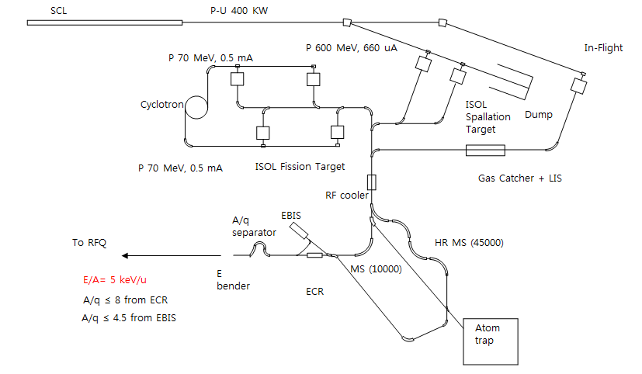
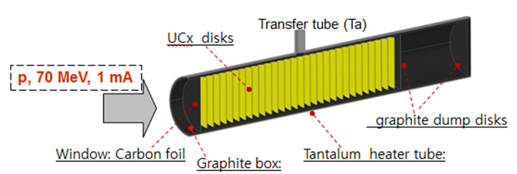
ISOL system
Target
Type | 70 kW multi-layered fission target
Material/density | UC_{x} / 2.5 g/cm³
fission rate(expected) | 1.3 × 10¹⁴ fission/s
¹³²Sn expectation | 2 × 10¹⁰ /s
HRMS(High Resolution Mass Separator)
Mass Resolution | 45,000
Bρ | 0.33 Tm

Slide 27
Facilities for the scientific researches
27
- Design of the experimental facilities in conceptual level
- User training program with the international collaboration
Nuclear Structure
Nuclear Matter
Nuclear Astrophysics
Atomic physics
Nuclear data by fast neutrons
Material science
Medical and Bio sciences
HIgh resolution Detector for Nuclear Structure measurement
Large Acceptance Multi-Purpose Spectrometer (LAMPS)
Korea Recoil Spectrometer (KRS)
Atom & Ion Trap System
neutron Time-of-Flight (n-ToF)
β-NMR
Reseach Facilty for Heavy Ion Therapy

Slide 28
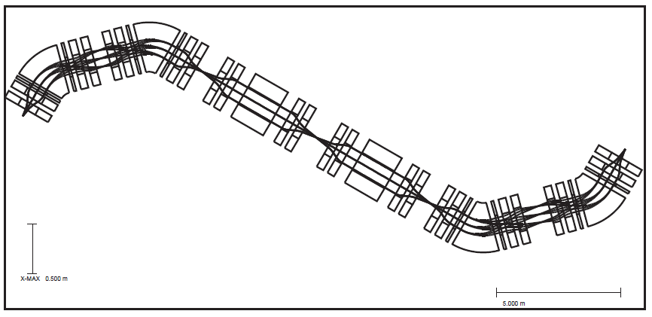
Experimental Systems – Recoil Spectrometer
n-rich RI beams (A= 80~140) from ISOL
- (d,p) reactions for r-process
Recoil tagging by recoil spectrometer
ΔE-E telescope array @ F0
Recoil Spectrometer
Maximum magnetic rigidity | ~ 1.5 Tm
Mass resolution (DM/M) | < 0.5 %
Momentum resolution (Dp/p) | ~ 0.05 %
Angular acceptance | ± 100 mrad
Background reduction | < 10⁻¹⁵
SHE search with SI beams (⁶⁴Ni, ⁵⁸Fe)
²³²Th + ⁵⁸Fe → ^{290-x}116 + xn, ²³²Th + ⁶⁴Ni → ^{296-x}118 + xn
²⁴⁴Pu + ⁵⁸Fe → ²⁹⁹120 + 3n, ²³⁸U + ⁶⁴Ni → ²⁹⁹120 + 3n
Recoil separation with p-rich RI beams from ISOL system
- radiative capture reactions : (p,γ), (α,γ) reactions
- gamma-array @ F0, recoil detection @ F6
Recoil tagging
protons
Detectors
Wien Filter
RI beams
Recoils
F1
F2
F0
F6
γ-rays
Gamma-array
F5
RI beams
F3
RI beams
Recoils
Reaction
F4

Slide 29
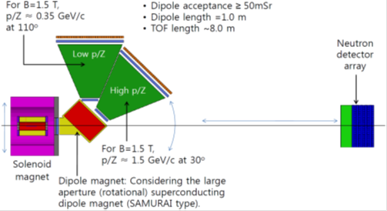
Experimental Systems
Experimental Observables for E_{sym}
Particle ratios
  n/p, ³H/³He, ⁷Li/⁷Be, etc.
  π⁻/π⁺
Collective flow
  v₁ & v₂ of n, p, and heavier clusters
  Azimuthal angle dependence of n/p ratio w.r.t. the R.P.
Pygmy dipole resonance
  Energy spectra of gammas
  Sizes of n-skins for unstable nuclei
Various isospin-dependent phenomena
  Isospin fractionation and isoscaling in nuclear multifragmentation
  Isospin diffusion (transport)
LAMPS at low-energy exp. hall
(LAMPS-L)
Large Acceptance Spectrometer
Beam | < 250 MeV/u (> 10⁸ pps)
Magnet | SC solenoid (homogeneous 1T magnetic field within ± 70 cm from the center) dipole magnet (Max. B = 6T, rotatable)
TPC | 1x1.2 m², 3π Sr coverage, GEM Based pad readout
Neutron Detector | 10x10x200 cm³ forward array, 30 cm thick surrounding TPC, energy resolution < 0.1
Si layer | 10 - 30 mm Si strip detectors, 350 mSr coverage
CsI | high energy resolution, 350 mSr coverage
Gamma Detector | energy resolution ~ 10 MeV

Slide 30
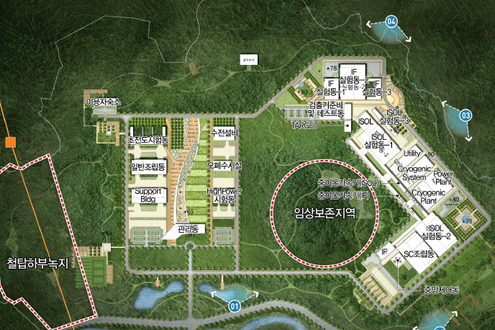
Conventional Facilities

Slide 31
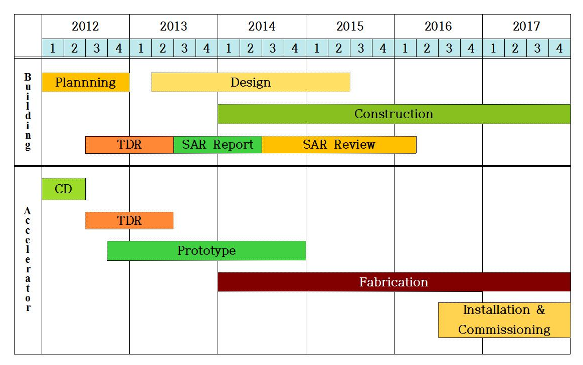
Schedule and Major Milestone
Baseline Design Summary (June 2012)
Ground breaking : 2014
SAR clear : early 2016
Technical Design Report (by June 2013)
First SCL Module
Start Installation

Slide 32
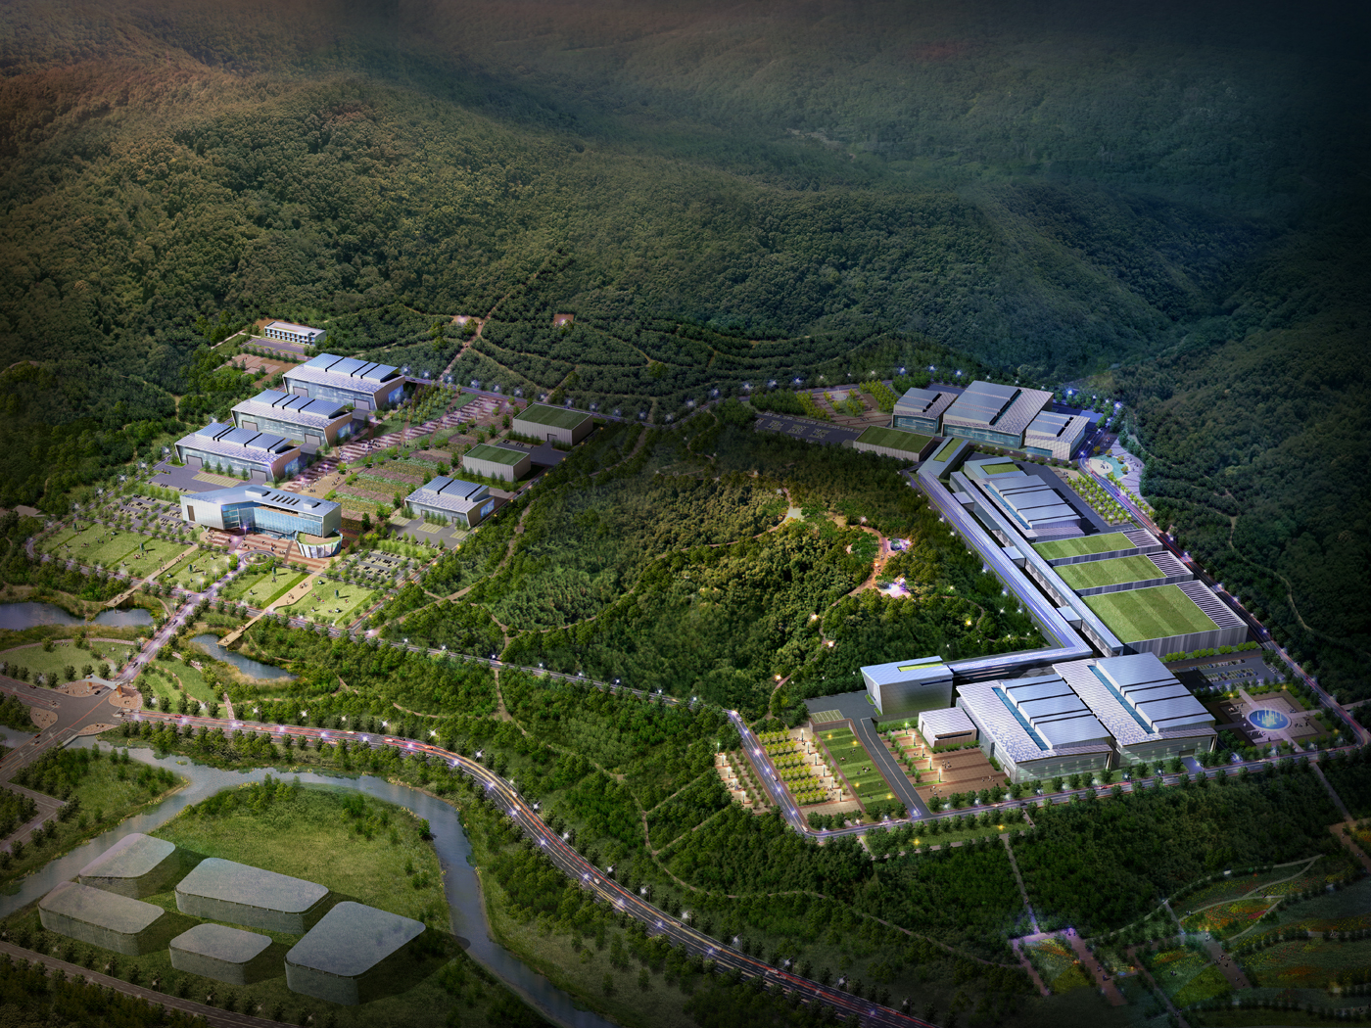
감사합니다
Thank you

Slide 33
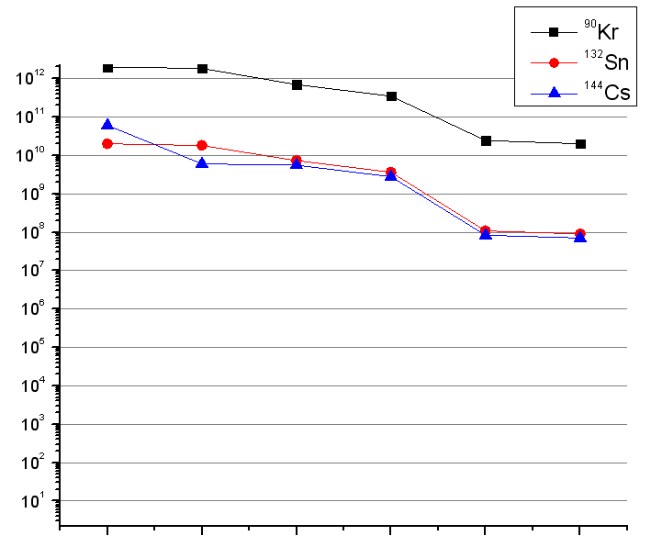
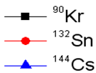
ISOL Yield Estimation
release
ionization
transport
charge breeding
post acc.
Isotope | Half-life | Yield@target (pps) | Overall eff.(%) | Expected Intensity(pps)
⁷⁸Zn | 1.5 s | 2.19 x 10¹⁰ | 0.04 | 1 x 10⁷
⁹⁰Kr | 32 s | 1.99 x 10¹² | 1.00 | 2 x 10¹⁰
⁹⁴Kr | 0.2 s | 1.29 x 10¹¹ | 0.51 | 7 x 10⁸
⁹⁷Rb | 0.17 s | 1.02 x 10¹¹ | 0.88 | 9 x 10⁸
¹²⁴Cd | 1.24 s | 4.98 x 10¹¹ | 0.02 | 1 x 10⁸
¹³²Sn | 40 s | 1.95 x 10¹⁰ | 0.45 | 8 x 10⁷
¹³³In | 0.18 s | 3.75 x 10⁷ | 0.18 | 7 x 10⁴
¹⁴²Xe | 1.22 s | 2.84 x 10¹⁰ | 2.08 | 6 x 10⁸
¹⁴⁴Cs | 1.01 s | 6.01 x 10¹⁰ | 0.12 | 7 x 10⁷
Beam Intensity (pps)
target
ε_{r}
ε_{i}
ε_{trans}
ε_{cb}
ε_{acc}
Efficiency of each component
* Overall efficiency was estimated using the information from existing ISOL systems.
(HRIBF, CERN-ISOLDE, KEK-ISOL, etc.)

Slide 34
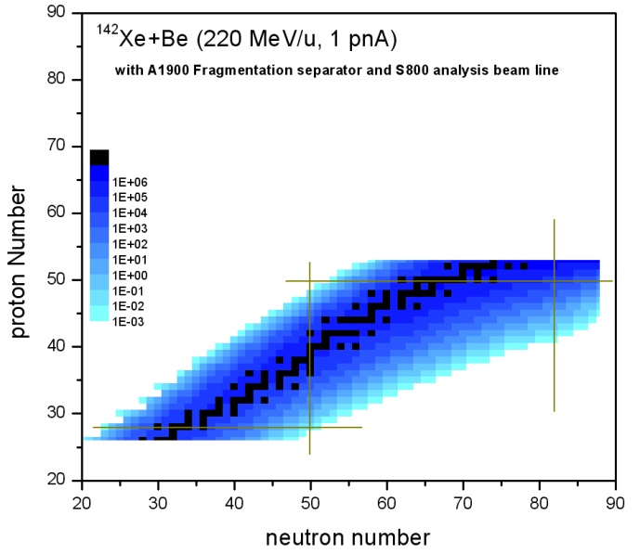
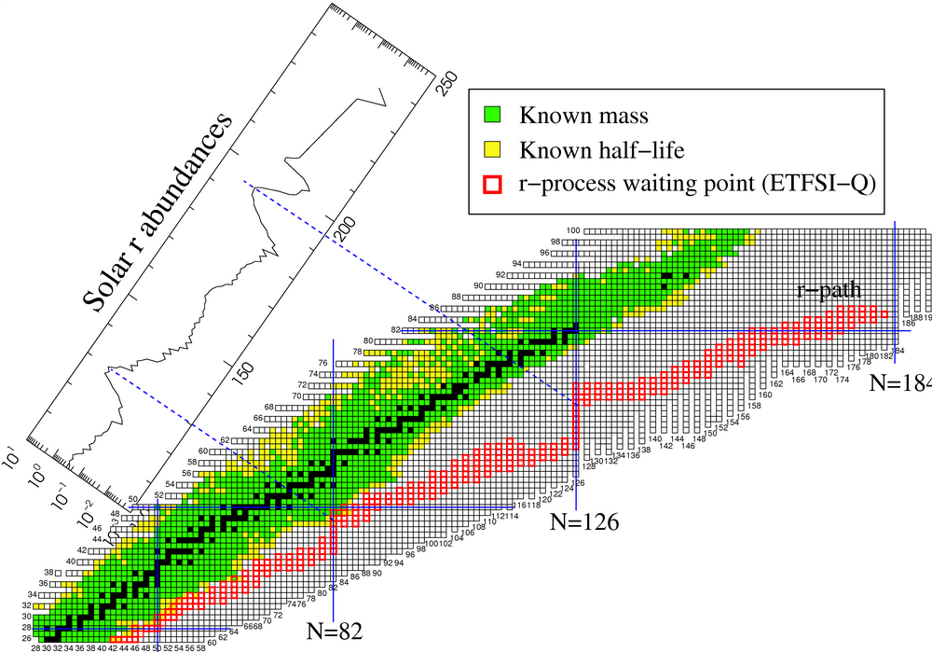
More Exotic RI Beams
LISE++ calculation
EPAX2 model
dp/p = 2.23%
Target thickness and beam line parameters are optimized for each nuclide
Z =50
r-process
Reach new n-rich isotope with rates of 10⁻³ ~ 10 pps
Z = 28
N =82
N =50
Nuclide | Estimated Intensity (pps)
¹¹⁰Y | 1.8
¹¹⁰Zr | 1.8
¹¹⁴Nb | 1.1
¹¹⁶Mo | 3.8
¹¹⁸Tc | 1.4
Operational mode: ¹⁴²Xe(ISOL) → Post-Accelerator → Driver Linac → IF target → Fragment Separator → Experiments
Note that ~10³ times larger than ¹³⁶Xe (350 MeV/u, 10 pnA)+Be

