Slide 1


Status Updates on
STAR Computing at KISTI
November 16, 2012
Seo-Young Noh
Haengjin Jang
{rsyoung, hjjang}@kisti.re.kr

Slide 2
Contents
Introduction to GSDC
Computing Resources
STAR Computing
MoU Summary & Conclusions

Slide 3
Introduction to GSDC

Slide 4
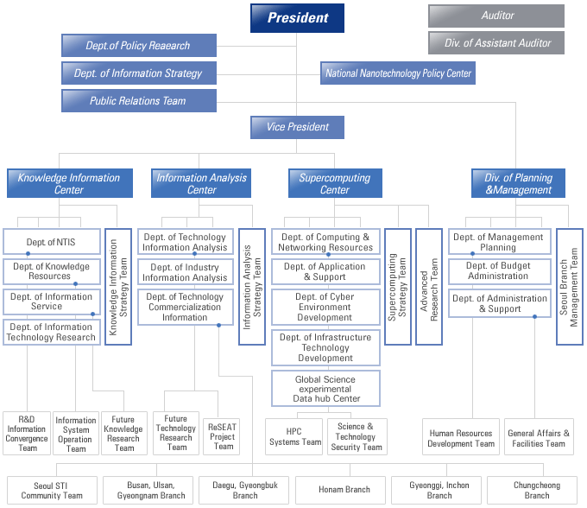

Organization
GSDC is under Supercomputing Center,
focusing on Data Intensive Computing
+30 Staffs
Global Science experimental
Data hub Center

Slide 5
Mission
Supporting Data Intensive Researches through Advanced Data Computing Environment sharing Global Experimental Data
Extended to Various
Research Areas
Brain Science
Environments
Nano Science
…
2009~
Increasing
Computing Capabilities
ALICE
CDF
Belle
LIGO
…

Slide 6

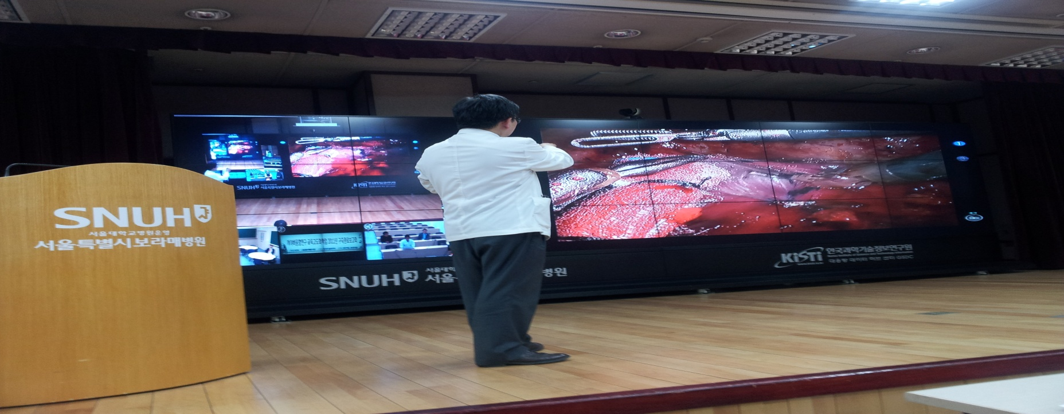
Major Projects
3 major projects seamlessly connected each other.
Data is everything! Data is being stored, shared, and utilized.
Ministry of Education, Science and Technology
GSDC
◆
❖
⬥
Global Data Hub Projects
Scientific Data Center Project
Cyber Infrastructure
Global Data Pipelining and Sharing Environment
Advanced Infrastructure for Storing and Computing Data
Data Utilization

Slide 7












Major Experiments
Supporting data intensive computing research areas with tight collaboration with research communities
Funding
KNU-WCU
RAW Data
ALICE Tier-1 prototype
ALICE Tier-2
KiAF (KISTI Analysis Farm)
RAW Data

Slide 8
Computing Resources

Slide 9
Resources – by 2011
+2,000 Computing Cores, +2 PB Storage
Doubling computing resources every year!
Server
Year | Spec | Mem. | Node | Core
2008~ 2009 | Dell, Intel Xeon E5405x2(2.0GHz 4Core) | 16GB | 6 | 48
 | HP, Intel Xeon E5420x2(2.5GHz 4Core) | 16GB | 16 | 128
 | IBM, Intel Xeon E5450x2(3.0GHz 4Core) | 16GB | 38 | 304
2010 | IBM, Intel Xeon X5650x2(2.66GHz 6Core), | 24GB | 36 | 432
2011 | Intel Xeon X5650 x2(2.66GHz 6Core) | 24GB | 75 | 900
 | Intel Xeon X5640 x2(2.4GHz 6Core) | 24GB | 35 | 420
Total |  |  | 206 | 2,232
Storage
Year | Model | Type | Usable Size | Physical Size
2008 ~ 2009 | NetApp FAS2050(SAN only, RAID6) | SAN | 30 TB | 48 TB
 | NetApp FAS6080(SAN & NAS, RAID6) | SAN & NAS | 200 TB | 334 TB
2010 | Hitachi USP-V (SAN & NAS, RAID6) | SAN & NAS | 600 TB | 960 TB
2011 | EMC CX4-960 | SAN | 1,240 TB | 1,800 TB
Total |  |  | 2,070 TB | 3,142 TB

Slide 10
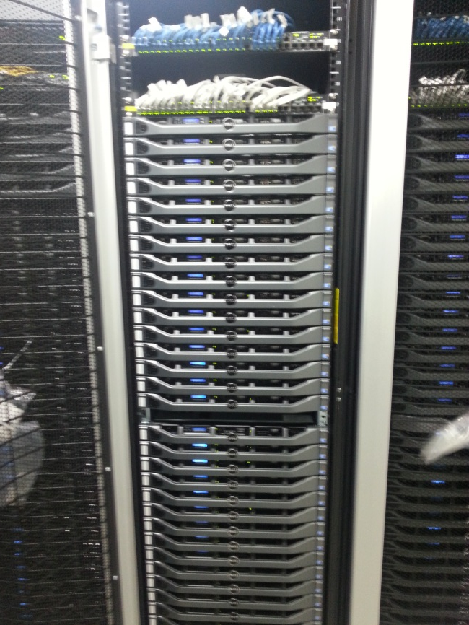
Resources - New Server & Storage in 2012
New +1,500 cores, +1.2 PB storage, 700 TB tape systems with high specification were introduced.
Server
Year | Spec | Mem. | Node | Core
2012 | Intel Sandy Bridge x2 (2.6GHz 8Core) | 96GB | 94 | 1500
Storage
Year | Model | Type | Usable Size | Physical Size
2012 | EMC NL108 | NAS | 1,200 TB | 1,920 TB
Tape
Year | Model | Type | Usable Size
2012 | IBM | Tape | 700TB

Slide 11
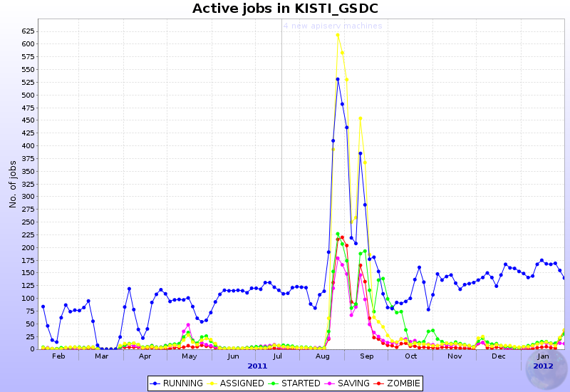
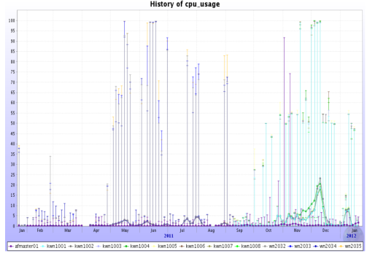
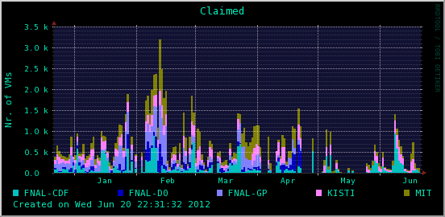
Resource Allocation
Resource allocations and support ranges are defined through consultation with user communities.
Experiments |  | Computing Cores | Storage (TB)
ALICE | Tier 1 | 900 | 1000
 | KiAF | 96
CDF | CDF Farm | 432 | 180
STAR | STAR Farm | 1024 | 50
KNU | HCP Farm | (200) | (50)
Belle | Belle Farm | 126 | 170
LIGO | LIGO Farm | 120 | 100
Neuro | Gbrain Farm | 120 | 52
Earth Sci. | Storage Only | - | 50
Etc. | DMRC, Nano, | - | 310 TB
<ALICE Tier 1>
<KiAF>
<CDF Farm>

Slide 12
STAR Computing

Slide 13
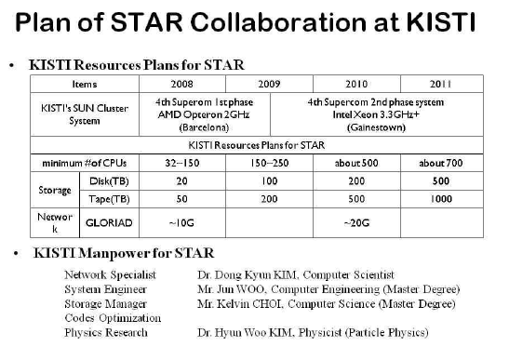
Background
History
  Many discussions on KISTI’s contribution to STAR collaboration since 2007
  Vision to Asia regional center for STAR computing, but not fruitful results
Early
2012
Big gap
Not much progressed!
*Courtesy from Prof. Yoo’s final report in 2009
In January 2012, set up a master plan for STAR computing farm at KISTI which keeps compromised resources at our best.

Slide 14
Transitions from Old to New
Thanks to Xianglei Zhu
Jan. 2012
Thanks to BNL team
Intel Sandy Bridge (2.6GHz 16 Core)
March
July
November
192
Cores
192
Cores
192
Cores
August
1024
Cores
Not functionally working
= STAR S/W, Batch System
= Grid Middleware
Not satisfying requirements
= 2GB RAM/job
= 60GB Scratch Disk/job
Function: O.K
Requirement: Not O.K.
Function: O.K
Requirement: O.K.
Function: O.K
Requirement: O.K.
Minor tunings need
Meeting with STAR Community in DC and agreed
(Thanks to Prof. Yoo at PNU)
Opening KISTI STAR computing farm in Nov.
Mutual agreement exchange at ATHIC 12

Slide 15
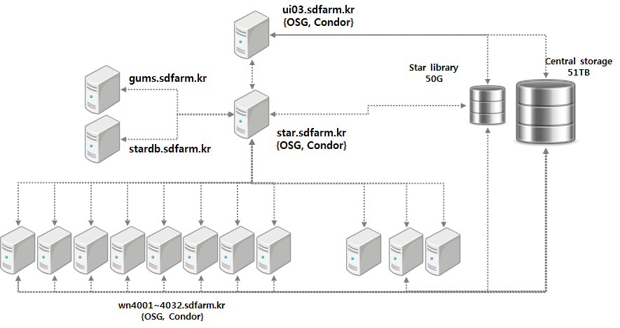
STAR Computing Farm @ KISTI
System Configuration
Grid Jobs
Local Job Submission
Authentication
Gatekeeper
Simulation Parameter
Synchronization
Total 1024 Cores
Scientific Linux 6.2
Intel Sandy Bridge (2.6GHz 16 Core)

Slide 16

STAR Computing Farm @ KISTI
Open Science Grid
On-Site System
DB
stardb.sdfarm.kr
UI
ui03.sdfarm.kr
CE
star.sdfarm.kr
Grid Job
Jobs/
Credential
Local Job
Jobs
❶
❸
❺
❹
Check
Credential
worker node
(wn4001~
wn4032)
❷
Get Proxy
Credential
VOMS
⓿
GUMS
(gums.sdfarm.kr)
Synch
(e.g. 60 mins)
Off-Site

Slide 17
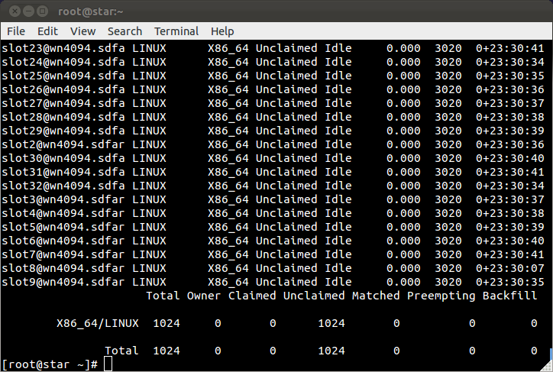
Local Computing Test
Computing Pool
Current: 1024 Cores

Slide 18
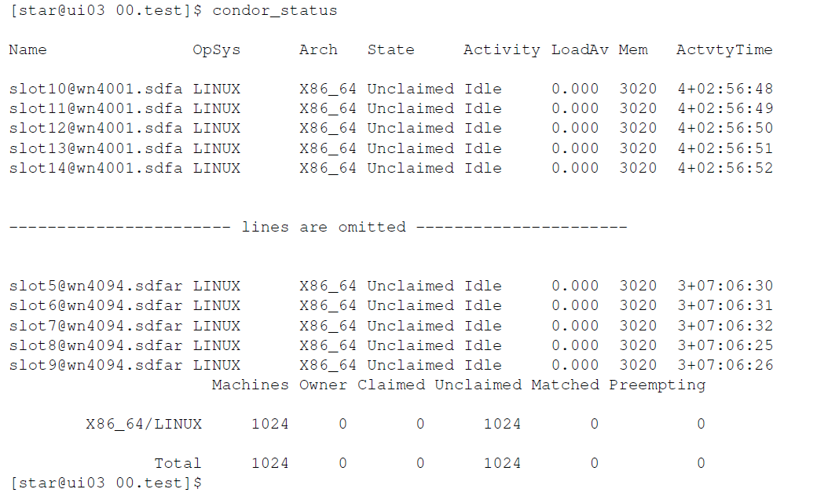
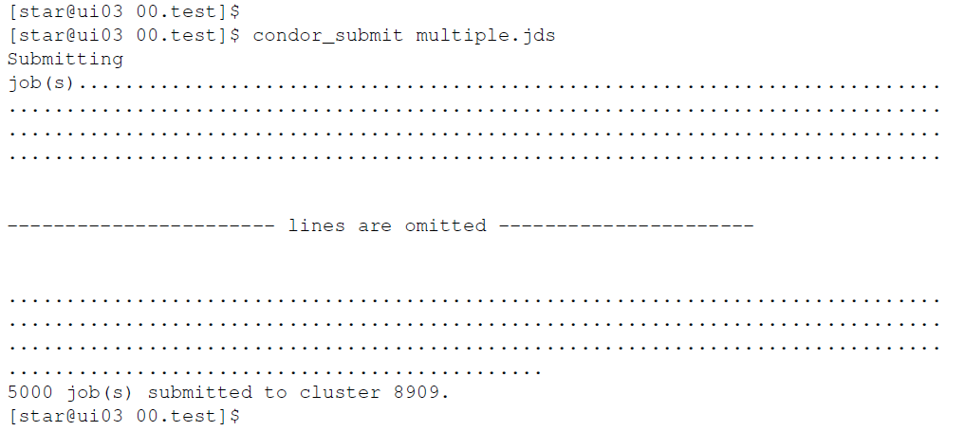
Local Computing Test
Job Submission Test
◆ ui03 machine
Local users, not grid users, can log on to ui03.sdfarm.kr to submit jobs!
⬥ job submission
❖ 1024 cores
 5000 jobs submitted

Slide 19
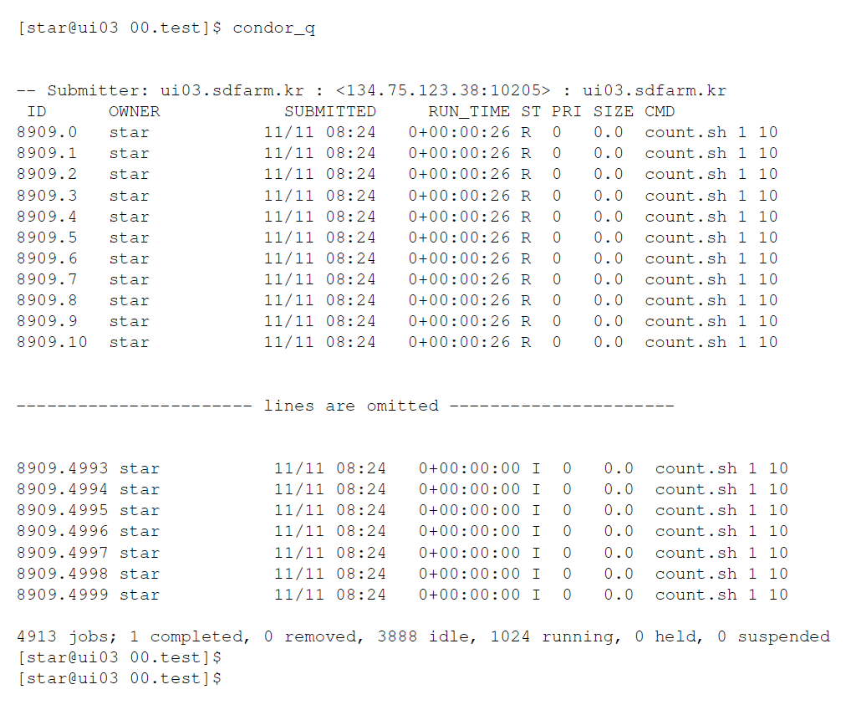
Local Computing Test
Queue Filling Test
◆ Queue status checking
1024 slots are filled by 5000 jobs and working properly returning correct results.
❖ All slots are filled!

Slide 20
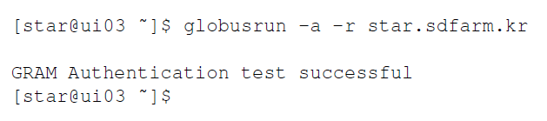
Grid Middleware Test
Authentication Test
➲ Working with GUMS
➲ Asking hostname through fork
Managed Fork Test
➲ Correctly return the hostname
➲ Asking hostname through Condor
Condor Job Manager Test
A job assigned to wn3089
returns its hostname

Slide 21
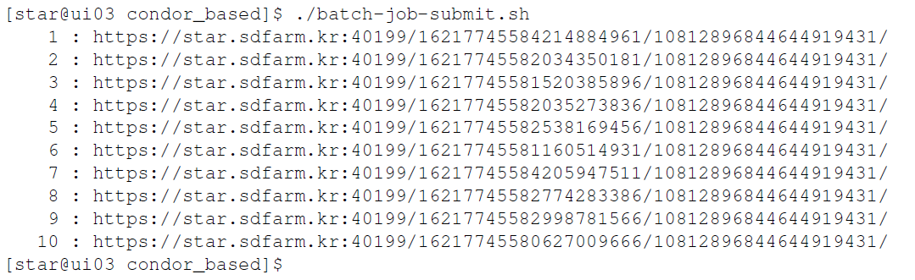
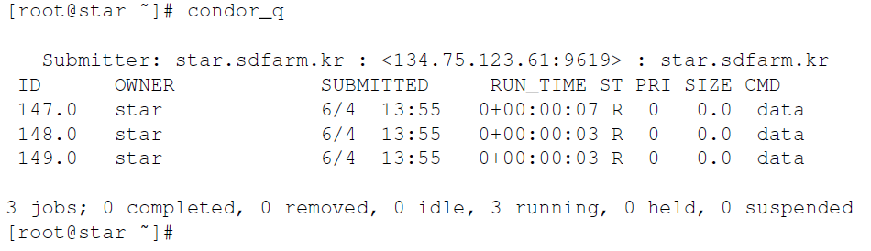
Grid Middleware Test
Submitting multiple grid jobs
➲ ui03.sdfarm.kr
➲ 10 grid jobs submitted to star.sdfarm.kr
➲ root@star.sdfarm.kr
Filling the queue gradually

Slide 22
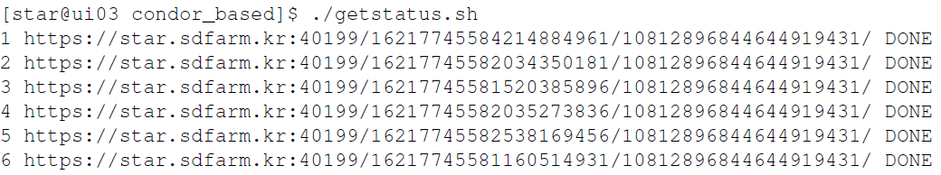
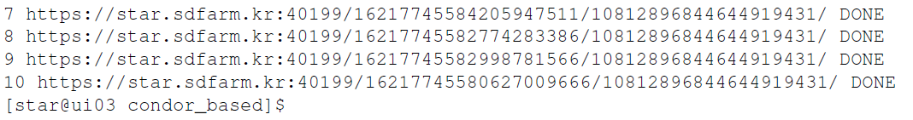
Grid Middleware Test
Results of multiple grid jobs
Asking the status of 10 grid jobs
submitted to star.sdfarm.kr
➲ ui03.sdfarm.kr
➲ Successfully done

Slide 23
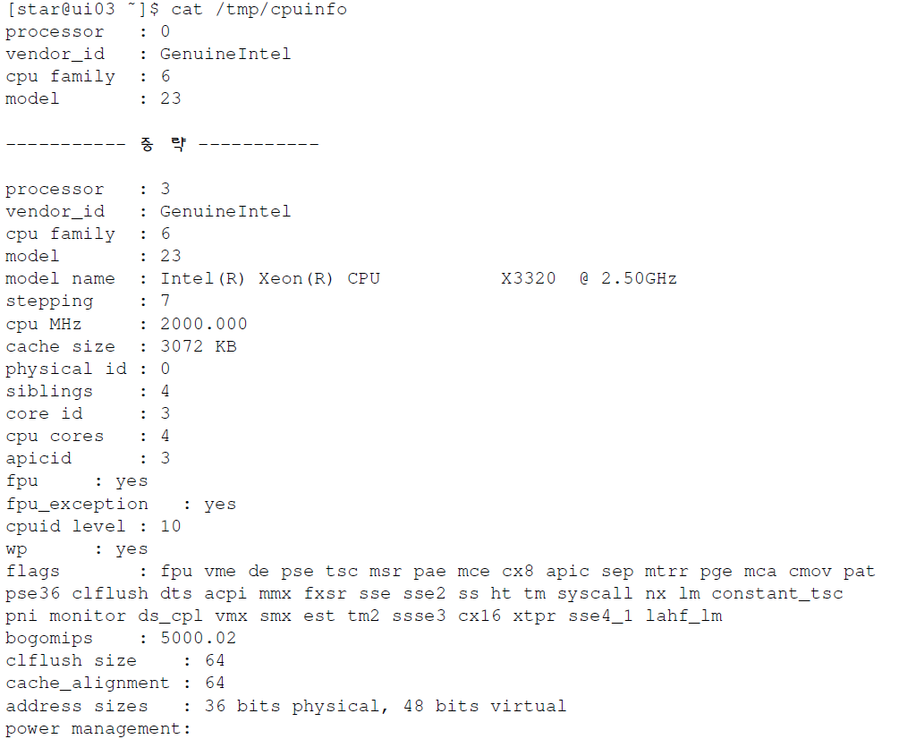
Grid Middleware Test
Copying a file from CE using GridFTP
➲ Copy star.sdfarm.kr/proc/cpuinfo to ui03.sdfarm.kr/tmp/cpuinfo
➲ ui03.sdfarm.kr
➲ cat /tmp/cpuinfo
proc/cpuinfo file at star.sdfarm.kr has been successfully copied to ui03.sdfarm.kr/tmp/cpuinfo

Slide 24

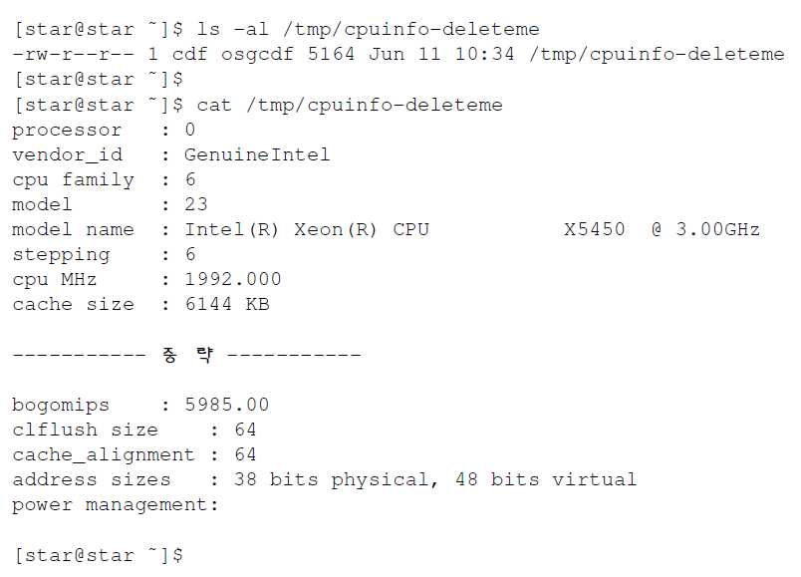
Grid Middleware Test
Copying a file to CE using GridFTP
➲ ui03.sdfarm.kr
➲ Copy ui03.sdfarm.kr/proc/cpuinfo to star.sdfarm.kr/tmp/cpuinfo-deleteme
➲ star.sdfarm.kr
proc/cpuinfo file at ui03.sdfarm.kr has been successfully copied to the computing element

Slide 25

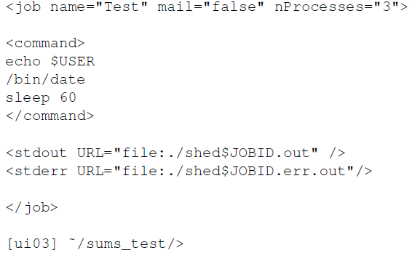
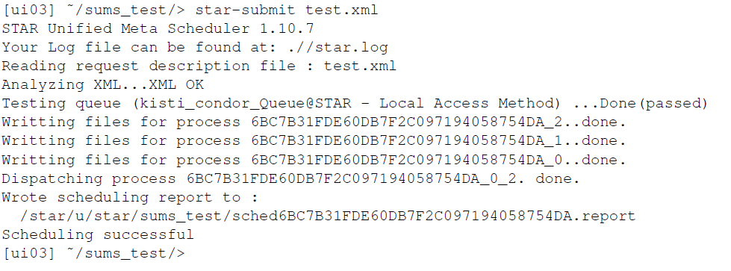
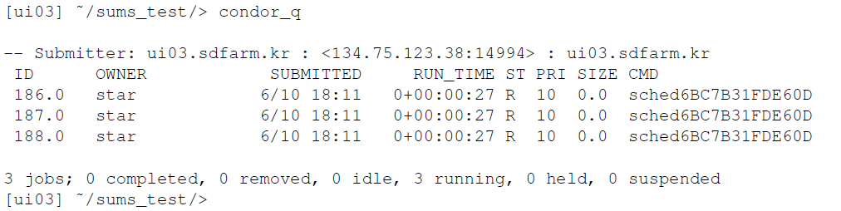
SUMS Test
SUMS: STAR Unified Meta Scheduler
◆ Test file
➲ Getting $USER and Date
❖ Submitting test jobs
➲ 3 jobs to kisti_condor_Queue
⬥ Checking submitted jobs
➲ 3 jobs running

Slide 26
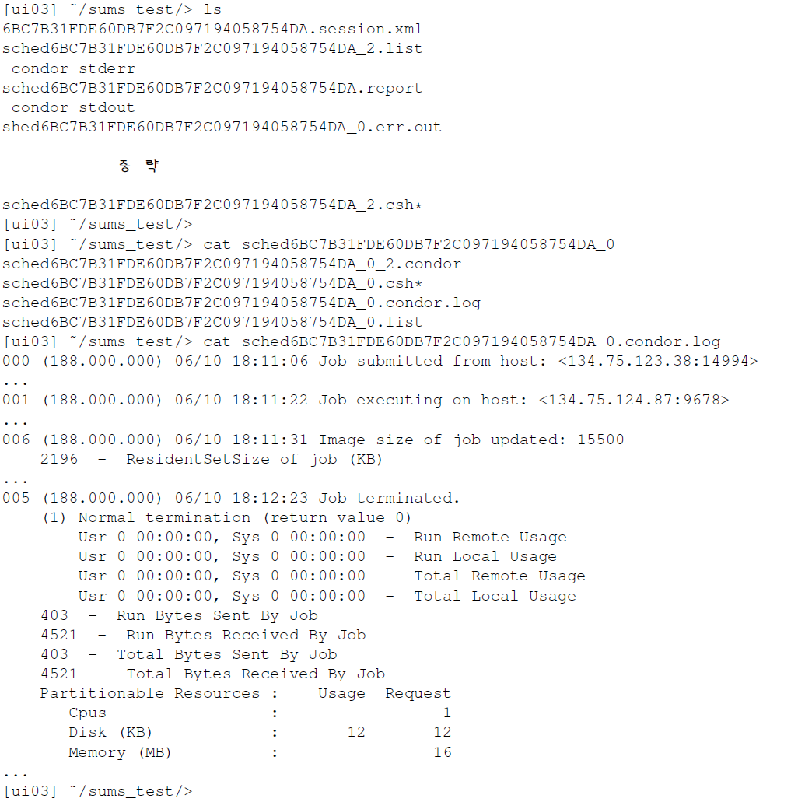
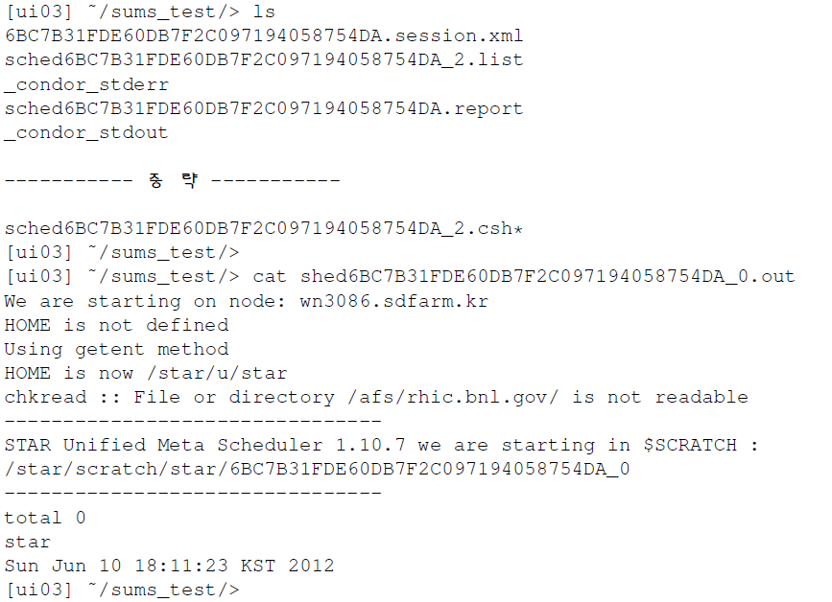
SUMS Test
◆
Log file
❖
Result file
➲ A job has been
successfully done
Successfully print
$USER & Date

Slide 27
MoU Summary & Conclusions

Slide 28
MoU Summary
Computing Resources
Resource | Y. 2012 | Y. 2013 | Y. 2014*
CPU | 1024 | 1024 | 1024
Disk Storage (TB) | 50 | 50 | 50
* Resource allocation will be discussed with STAR community
Primary Contact Points in Communication
Service | Name | Organization
GSDC STAR System Management | Seo-Young Noh | GSDC
STAR Software | Xianglei Zhu | STAR Community
STAR Computing General | Jerome Lauret | BNL
STAR Collaboration General | In-Kwon Yoo | Pusan National University

Slide 29
Conclusions
Big achievement this year, been tried since 2007!
Many thanks to Xiaglei Zhu, BNL team, and Prof. Yoo for STAR S/W installation, testing, and communication
Playing an important role in STAR computing as a Asia STAR computing center.
Official MoU will lay the groundwork for two parties’ tight collaborations

Slide 30
Thank You!

