Slide 1
Searches for Exotic Particles and Phenomena at RHIC
Huan Zhong Huang
黄焕中
Department of Physics and Astronomy
University of California
Los Angeles, CA 90095-1547
ATHIC Conference
Nov 14-17, 2012 @ Pusan, Korea

Slide 2
Outline
RHIC as an Exotic Particle Factory
Exotic Di-Hyperons
ΩΩ
ΞΞ
  ΛΛ
Hyperon-Hyperon Interactions
-- precise determination of Lambda-Lambda
Lambda-Cascade interactions
-- is there an H particle? Definitive answer?!
3) QCD topological excitations/Local Parity Violation ?

Slide 3
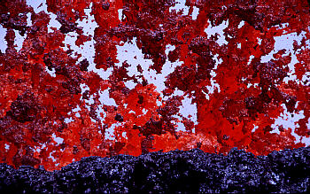
An Equilibrated Partonic System
Λ
Ξ
Ω
Volcanic mediate p_{T} – Spatter (clumps)
Cluster formation is a common phenomenon for matters
at high temperature and density !

Slide 4
Searches for Exotics Beyond 2q and 3q Structure
RHIC – a unique hyperon factory
-- possibly an exotic particle generator
Resonance Particles are difficult in HIC @RHIIC
-- huge combinatorial background !
Pentaquark candidates to search for
-- pK_{S}
-- pK⁺
-- Ξ⁻ π⁻
-- Ωπ or ΩK
Di-baryons
Λ−Λ correlation and/or H particle
[Ξ⁰-p]→Λp
[Ω-Ω]

Slide 5
Hyperon Production Rate
Central Au+Au Collision (0-5%)
dn/dy @ mid-rapidity

Slide 6
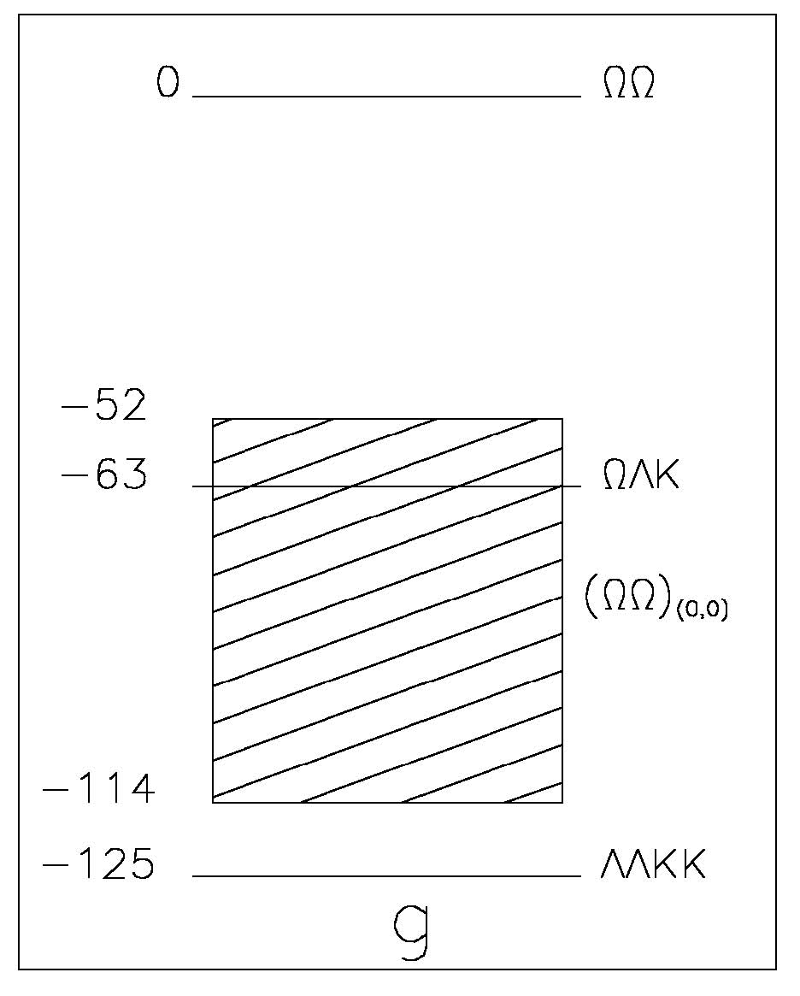
An ΩΩ State ?
Z.Y. Zhang, Y.W. Yu et al
ΩΩ state is the most bound
state !
The production venue:
heavy ion collisions
Production rate ?

Slide 7
ΞΞ Bound State
Nucleon-Nucleon
Hyperon-Hyperon
p-p – resonance
coulomb repulsive
p-n -- bound state deuteron
n-n – unbound state
ΞΞ state
-- Gerald Miller 2004

Slide 8
Physics Information in Correlation Function
Λ−Λ Correlation Function:
both Λs from the primary vertex –
if there is a ΛΛ resonance state
-- enhanced peak at resonance
and attractive Λ−Λ interactions
if there is a bound state H, then two
Λs near threshold can form H
-- depletion of Λ−Λ correlations
(WRT a reference?!)
(if we can measure p-n correlation,
the effect of deuteron formation)
both Λs from secondary vertices –
weak decay product – [Ξ-Λ] state?

Slide 9
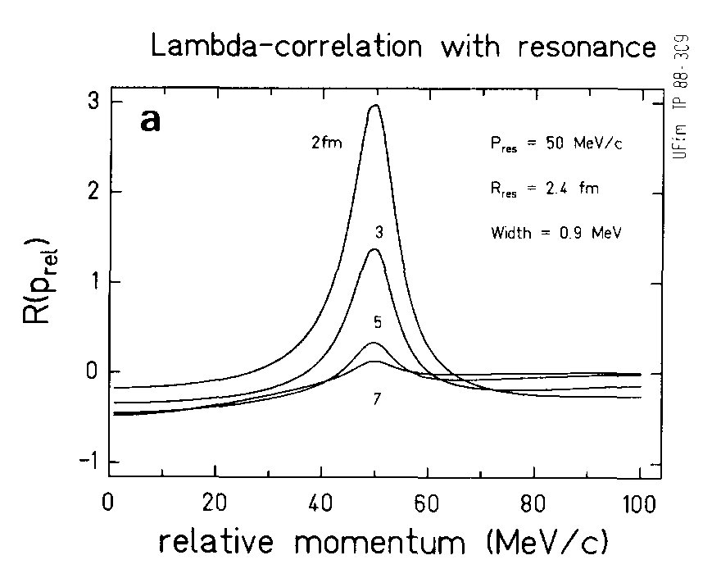
H⁰ in Λ-Λ Correlations
Influence of possible low energy resonance on Λ-Λ correlations.
Greiner and Muller, Phys Lett B 219 (1989) 199
A wide resonance will be difficult to observe!

Slide 10
Correlation Function and Direct Decay Searches Complementary
Correlation Function – Depletion of phase space due
to bound state formation
-- inclusive, sensitive to total yield
Direct Searches
-- depend on branching ratio
If H(uuddss) is a weakly bound state with a binding
energy ~ 10s MeV as predicted by recent
Lattice QCD calculations,
H→Λ+p+π
branching ratio?

Slide 11
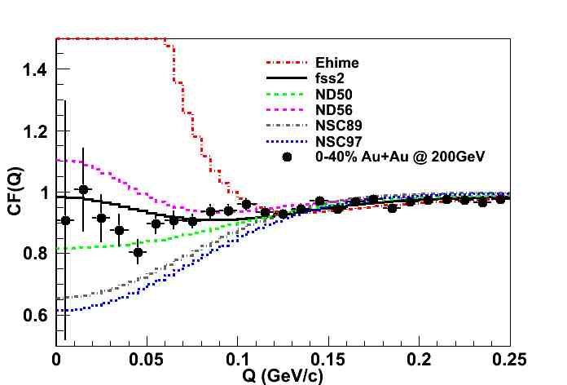
ΛΛ Correlation Function
Not very Strong Correlation
Type of ΛΛ interaction:
  Meson exchange models: Nijmegen model D, F, Soft Core (89, 97)
  Quark cluster model interaction: fss2
  Phenomenological model: Ehime
ΛΛ interaction → Attractive
Inclusive ΛΛ correlations: Feed down contributions included in theoretical models.

Slide 12
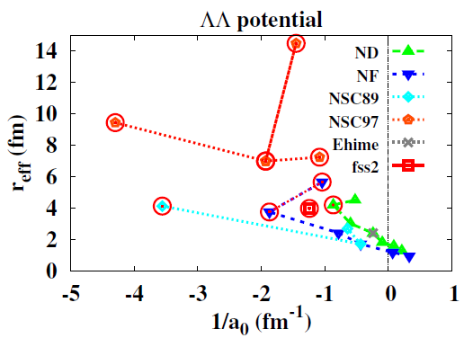
Theoretical Model Fit to Data
A. Ohnishi, HHI workshop proceedings 2012
Scattering length (a₀) is negative
Current fit from different potential models to data gives indication towards non-existence of bound H-dibaryon
Large uncertainty in Σ and other hyperon feeddown contributions

Slide 13
Heavy Ion Collisions versus Kaon Beam Facility
Hyperon-hyperon interaction:
kaon beam facility –
difficult to go beyond
Λ-Λ
Ξ-N systems
@RHIC
Ξ-Λ
Ξ-Ξ
Ξ-Ω
Ω-Ω systems possible candidates
J. Schaffner-Bielich et al (H-H); G. Miller (Ξ-Ξ); Z.Y. Zhang et al (Ω-Ω)
[Σ⁺ p] ◊ p + p ,
[Ξ⁰ p] ◊ p + Λ ,
[Ξ⁰ Λ] ◊ p + Ξ⁻, Λ + Λ
[Ξ⁰ Ξ⁻] ◊ Ξ⁻ + Λ ,
13

Slide 14
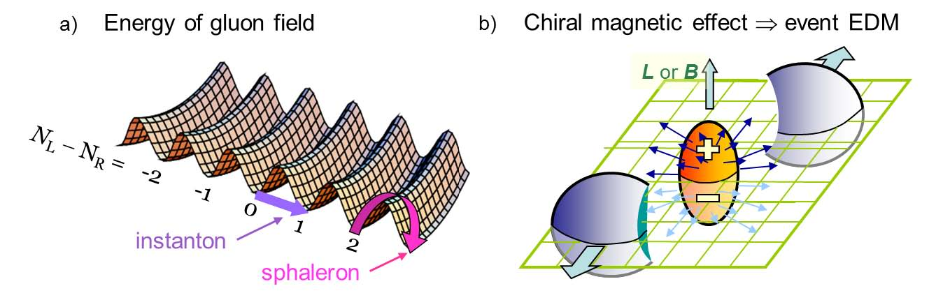
QCD – Fundamental Corner Stone
of the Standard Model
QCD and QCD Vacuum
– very rich underlying dynamical structure !!
many intriguing features – (not really exotic)
chiral symmetries
topological vacuum excitations

Slide 15
QCD Exotic Dynamic Phenomenon
QCD Vacuum Sphaleron excitation
coupled to strong magnetic field from
spectator protons
-- charge separation across the
reaction plane
parity violating in strong interaction
Local Parity Violation
Kharzeev et al NP A803, 227 (2008)
Voloshin, PRC70, 057901 (2004)
charge dependent – same sign (++,--) and opposite sign(+-, -+)
sensitive to charge separation

Slide 16
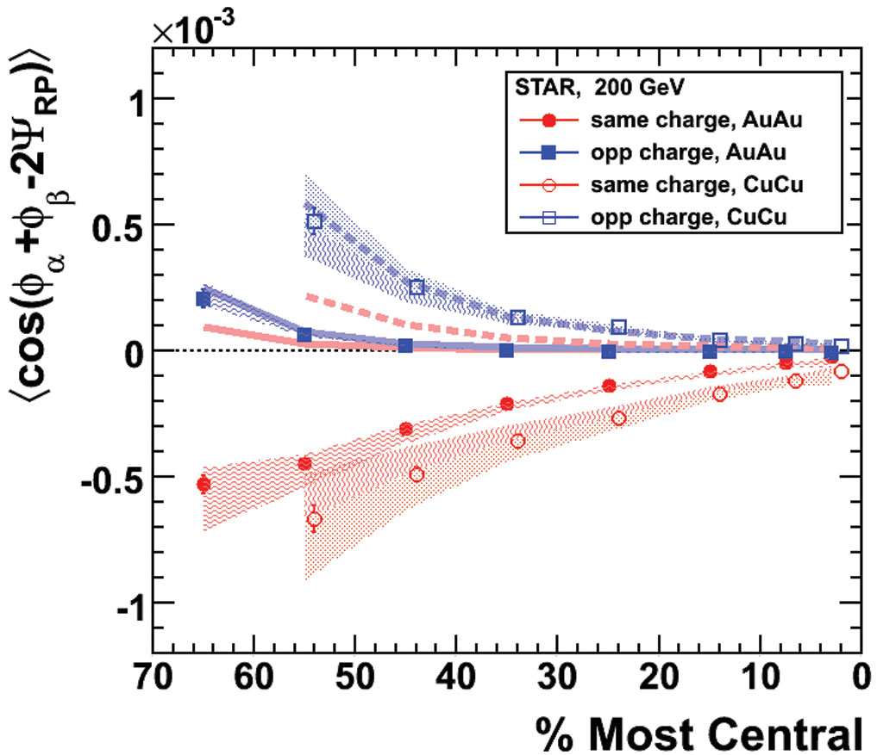
The Interpretation is not Unique
Empirically, indeed there is
RP-dependnt Charge Separation !
Can it be due to a special coupling
Between charge balance function
and v2 ?
STAR Phys. Rev. Lett.103: 251601 (2009)
Phys.Rev.C83:014913,2011
(γ_{OS}-γ_{SS}) Scaled by Npart

Slide 17
Beam Energy Scan Data
The disappearance of (γ_{OS}-γ_{SS}) at 7.7 GeV
Why? -- no QGP formation at 7.7 GeV?
Ingredients in Scott Pratt’s model –
charge balance function and
v2 induced RP dependence on balance function

Slide 18
U+U Collisions at RHIC 2012
Uranium – large deformation
Variation on v2 induced background level

Slide 19
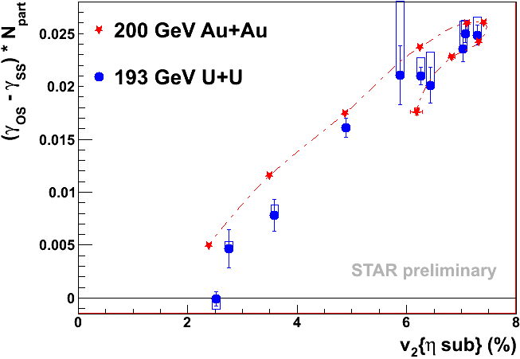
(γ_{OS}-γ_{SS}) Disappears Faster Than v₂
Elliptic flow v₂ induced background (cluster model or blastwave or
balance function or momentum/charge conservation) ALONE
does not constitute the entire observed (γ_{OS}-γ_{SS}) signal !!

Slide 20
Chiral Magnetic Wave induced Quadrupole Moment ?
v₂ was measured with the Q-cumulant method.
Clear A± dependency
v₂(A±) slopes for π±:
  opposite sign
  similar magnitude
v₂ difference vs A± may have a non-zero intercept: other physics?

Slide 21
Electric Quadrupole Moment?
STAR QM12 Preliminary
Empirically there is a v₂(π⁻)-v₂(π⁺) difference
depending on the charge asymmetry !
alternative explanations ?
what does it mean to have an electric quadrupole
moment for an exploding system ?
Y. Burnier, D. E. Kharzeev, J. Liao and H-U Yee (2012).

Slide 22
Towards a Definitive Answer?
All theoretical models for LPV are wrong
or only partially correct !
Experimental Knobs –
-- turn off QGP and/or change magnetic field
-- vary the magnitude of the elliptic flow v2
The measured (γ_{OS}-γ_{SS}) likely has contributions from
possibly LPV signal and background correlations !
How to decompose the signal and background ?
Need new ideas and experimental approaches !

Slide 23
QCD Beyond and Exotics
QCD -- the fundamental corner stone of the Standard Model
RHIC provides a futile ground for exploration of QCD
A New Dimension to RHIC Physics –
Dedicated QCD Machine & Beyond
Exotic
AA
(Deconfinement
Phase Transition)
AA
pp
pp
pA
pA
(spin)
(CGC,EMC)

