Slide 1
QGP viscosity at RHIC and LHC energies
-- a 2012 status report
Huichao Song
Peking University
ATHIC 2012
Pusan , South Korea, Nov. 14-Nov. 17, 2012
Thanks for discussions from S. Bass, U. Heinz, M. Luzum, H. Petersen, S. Moreland, L. Pang, Z. Qiu, B. Schenke, C. Shen, R. Soltz, X.-N. Wang …
11/16/2012

Slide 2
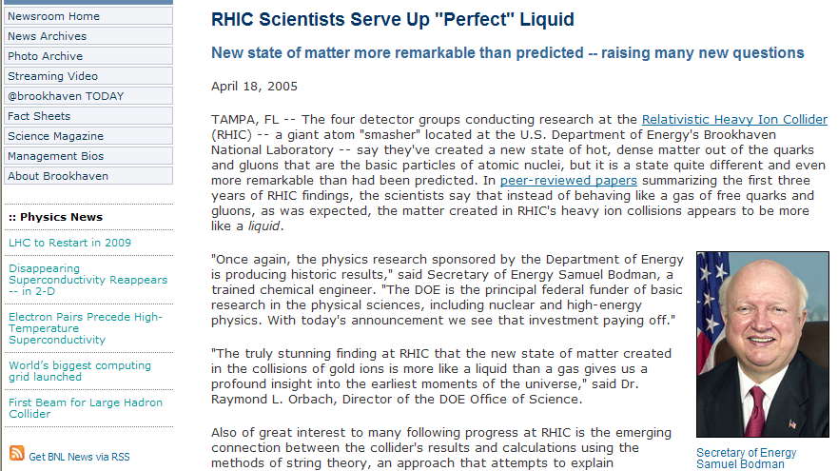
QGP-the most perfect fluid in the world?
BNL News, 2005
How perfect is the QGP fluid?

Slide 3
Shear viscosity:
Bulk viscosity:
viscous hydrodynamics
Input: “EOS”
Assume zero net baryon density & heat conductivity at RHIC and LHC
2+1-d: OSU, INT, Stony Brook, Pudue, Calcutta (2008), Crakow, Frankfurt(2010)
3+1-d: Mcgill(2011), MSU, Crakow(2012),
Nagoya (2012).
Notes:
Introduction
3

Slide 4
Generic features of shear & bulk viscosities

Slide 5
Shear viscosity:
Bulk viscosity:
acts against the buildup of flow anisotropy
acts against the buildup of radial flow
Notes:
Introduction
5

Slide 6
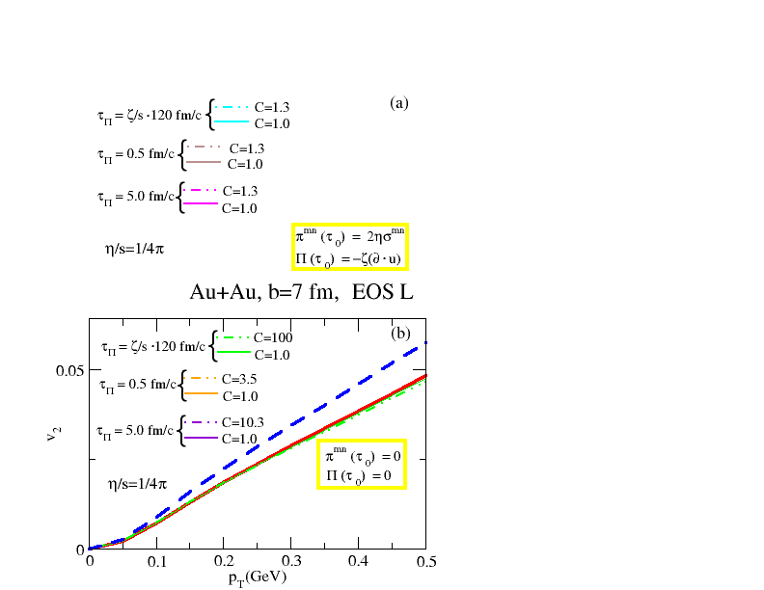
Shear viscosity:
Bulk viscosity:
acts against the buildup of flow anisotropy
acts against the buildup of radial flow
The shear viscosity leads to a significant suppression of V2 (Romatsche & Romatsche PRL07; song & Heinz PLB08, PRC08; Dusling & Teaney PRC 08; Molnar & Huovinen JPG 08 … …)
ideal
shear visc.
shear+ bulk visc.
Bulk viscous effects are much smaller than shear ones due to the critical slowing down near phase transition (Song & Heinz PRC09)
Visc. suppression
of elliptic flow
Song & Heinz PRC09
One can extract the QGP shear viscosity from exp data without large contamination from bulk viscosity
Notes:
Introduction
6

Slide 7
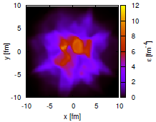
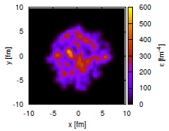
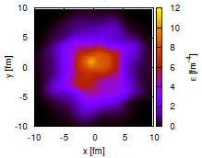
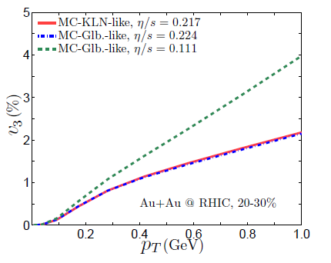
initial profile
ideal hydro evolution
(B.Schenke)
viscous hydro evolution
Qiu & Heinz 2011
Viscous suppression
of triangular flow
The shear viscosity tends to smear out the inhomogeneous structures, leading to a suppression of V3 (Schenke, Jeon & Gale PRL2011, PRC2012; Qiu & Heinz PRC2011
… … )
Notes:
Introduction
7

Slide 8
QGP viscosity at RHIC energies (2008)
-early attempts from viscous hydrodynamics

Slide 9


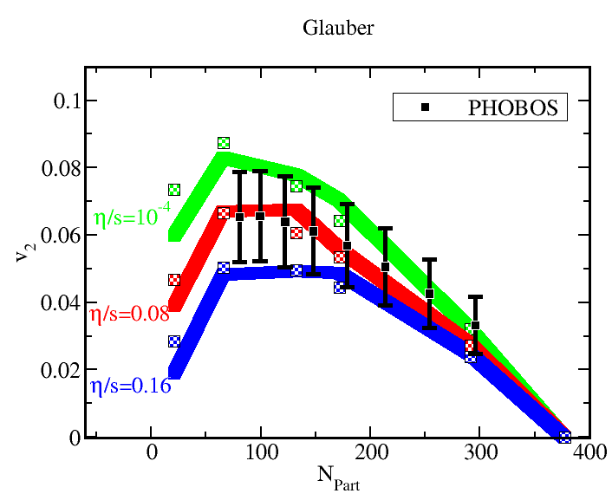
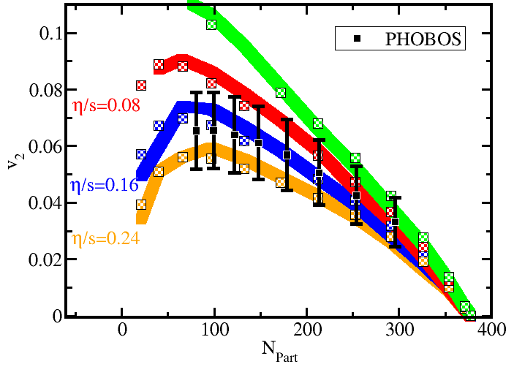
Viscous hydro & QGP viscosity (2008)
Glauber
Luzum & Romatschke, PRC 2008
KLN
Glauber & KLN initializations lead to 100% uncertainties for the QGP shear viscosity
Effects that are not included in this viscous hydro calculations
-non-equilibrium chemical composition of HRG : (PCE vs. CE) ~100%
-transport properties of HRG (or equil. HRG vs. non-equil. HRG) : ~100-150%
-bulk viscosity: ?%

Slide 10
QGP viscosity at RHIC energies (2011)
-results from the VISHNU hybrid model

Slide 11
VISHNU hybrid approach
H. Song, S. Bass, U. Heinz, PRC2011
Tsw=165MeV
Initial conditions viscous hydro hadron cascade
VISHNU:
Other related developments
-chemical composition of HRG
Hadron
Cascade
-3+1 d viscous hydro+ hadron cascade: Ryu et al., arXiv1210.4588 .
-transport properties of HRG
-EoS: (s95p-PCE) (Huovinen & Petreczky10)
-2+1 d vs 3+1 viscous hydro: Shen, Schenke & Heinz on going work;
-switching temperature:
Tsw=165MeV
-initial conditions
Vredevoogd &Pratt, PRC85,044908(2012)

Slide 12
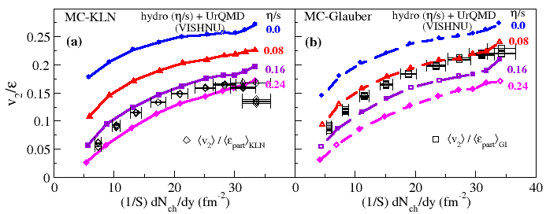
VISHNU hybrid model & QGP viscosity (2011)
H. Song, S. Bass, U. Heinz, T. Hirano, and C. Shen, PRL2011
MC-KLN
MC-Glauber
The analysis uses:
-integrated V2 for all charged hadrons: In contrast to V2(PT), it is less sensitive to
bulk viscosity, corrections, radial flow & chemical composition of HRG
-corrected exp. V2 data that remove non-flow & fluc. effects

Slide 13
VISHNU hybrid model & QGP viscosity (2011)
H. Song, S. Bass, U. Heinz, T. Hirano, and C. Shen, PRL2011
MC-KLN
MC-Glauber
-Main uncertainties come from initial conditions
-Other uncertainties (much smaller)
-Initial flow, bulk viscosity, single shot vs. e-b-e calculations
(each of them shift V2 by a few percent, partial cancellation among them)

Slide 14
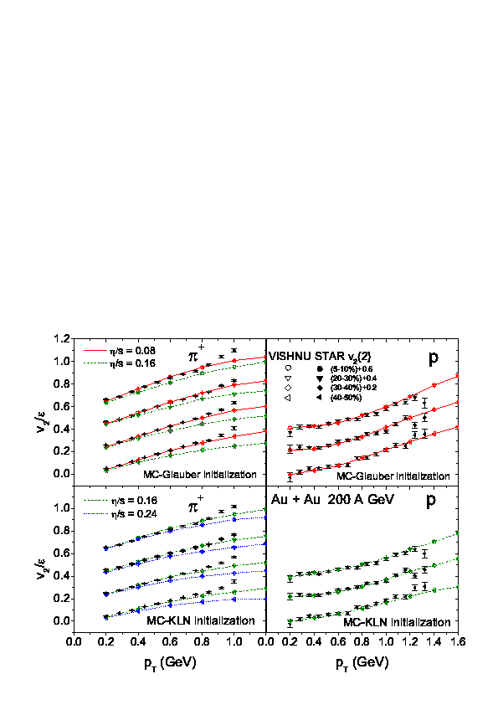
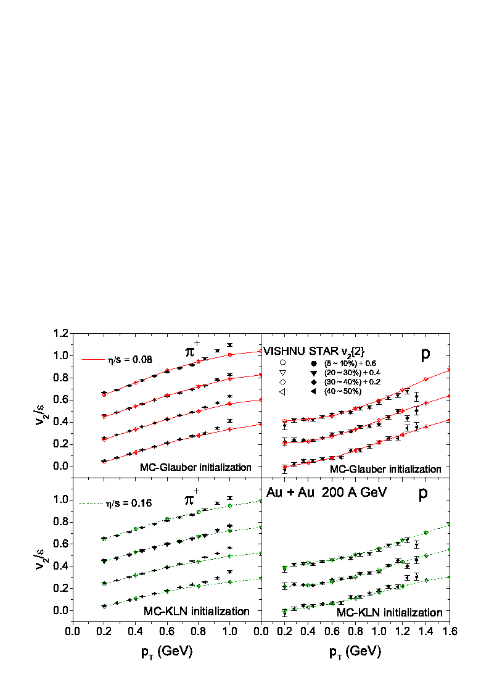
further tests: for identified hadrons
H.Song, S. Bass, U. Heinz, T. Hirano, and C. Shen, PRC2011
5-10%
20-30%
20-30%
30-40%
30-40%
40-50%
40-50%
Glauber
Glauber
5-10%
20-30%
20-30%
30-40%
30-40%
40-50%
40-50%
KLN
KLN

Slide 15
Initialization models, pre-equilibrium dynamics & QGP viscosity

Slide 16
VISHNU hybrid model & QGP viscosity (2011)
H. Song, S. Bass, U. Heinz, T. Hirano, and C. Shen, PRL2011
MC-KLN
MC-Glauber
Main uncertainties come from initial conditions
MC-KLN, larger HIGHER value of QGP viscosity
MC-Glauber, smaller LOWER value of QGP viscosity

Slide 17
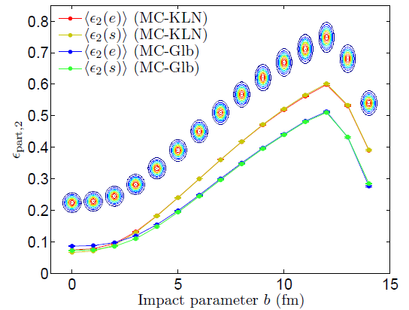
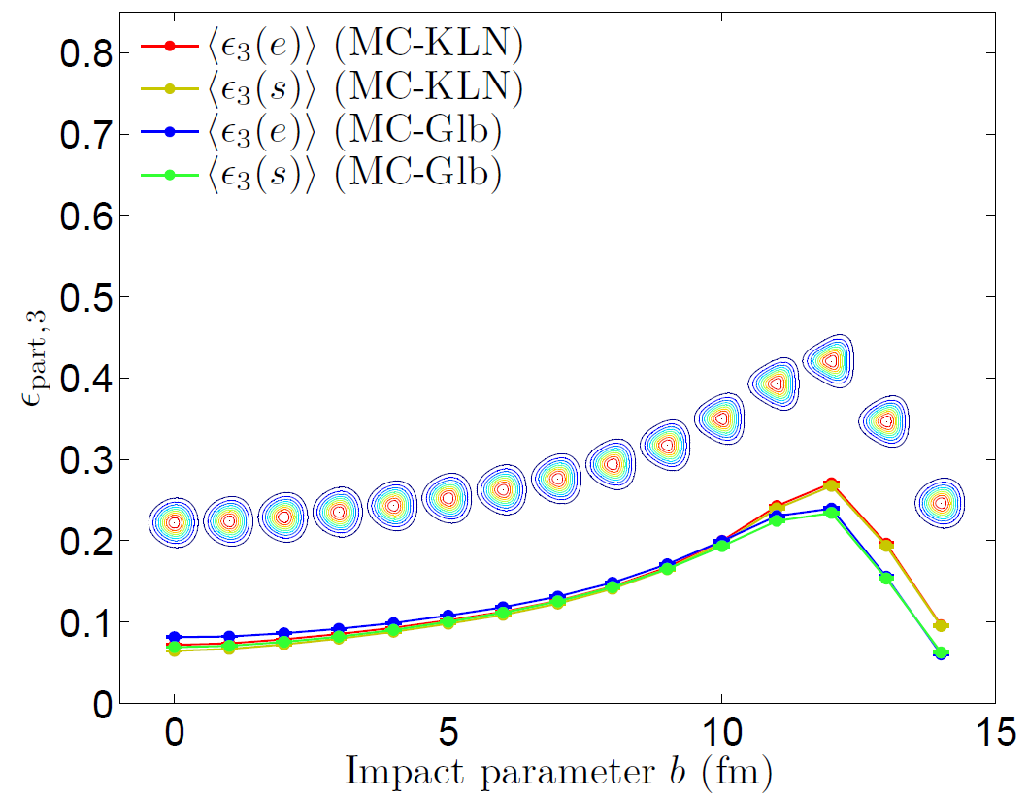
MC-KLN & MC-Glauber initializations & V3
Viscous Hydro
MC-KLN
MC-Glauber
Zhi & Heinz 2011
-triangular flow is sensitive to QGP shear viscosity, but not sensitive to MC-KLN or MC-Glauber initializations
Qiu & Heinz,2011

Slide 18
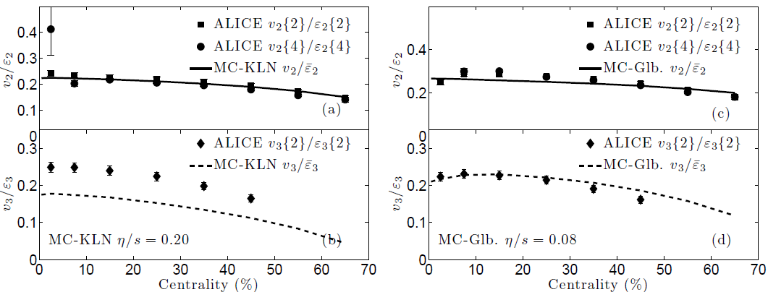
MC-KLN & MC-Glauber initializations & V3
Pure viscous hydro simulations :
Qiu, Shen & Heinz 2011
V3 prefer lower value of QGP viscosity

Slide 19
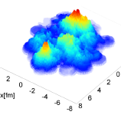
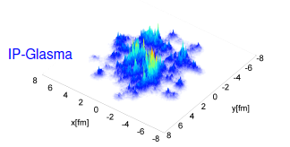
Initialization Models
-fluctuations of nucleon positions:
MC-Glauber:
T. Hirano & Y. Nara, Phys. Rev. C 79 064904 (2009)
(used in the VISHNU hybrid model)
MC-KLN:
-fluctuations of color charges (in the framework of CGC):
IP-Glasma: B. Schenke et al., arXiv:1202.6646; 1206.6805 [nucl-th]
C. Gale, et al., arXiv: 1210.5144, 1209.5330 [nucl-th].
Correlated Fluctuation: B. Muller & A. Schafer, arXiv:1111.3347 [hep-ph]
S. Moreland, Z. Qiu and U. Heinz, arXiv:1210.5508
-fluctuations of local gluon numbers (in the famework of MC-KLN):
Multiplicity fluctuations: A. Dumitru and Y. Nara, Phys. Rev. C 85, (2012) 034907
A. Dumitru, arXiv:1210.7864 [hep-ph].

Slide 20
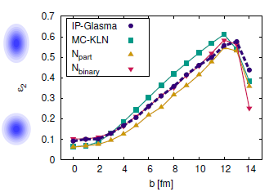
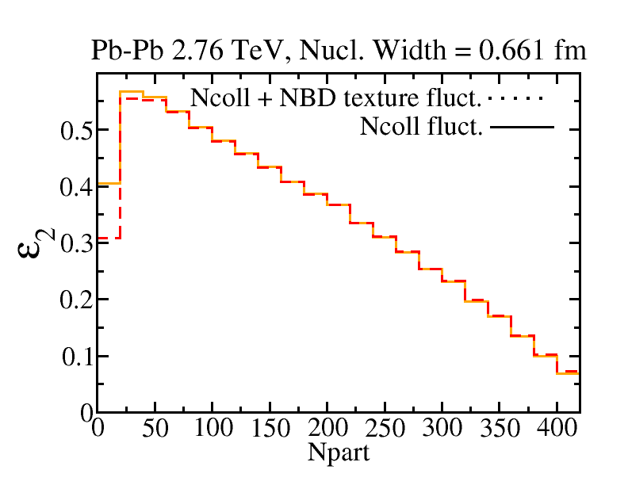
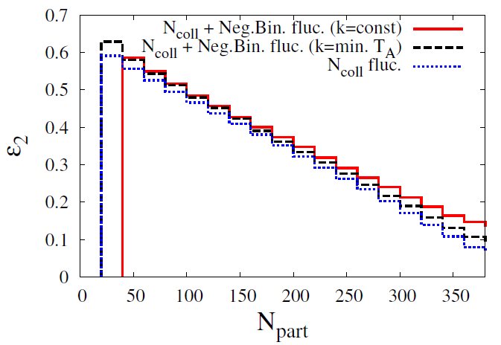
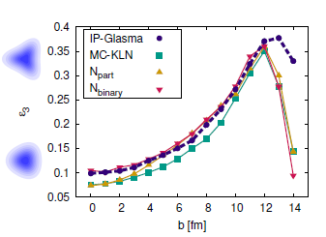
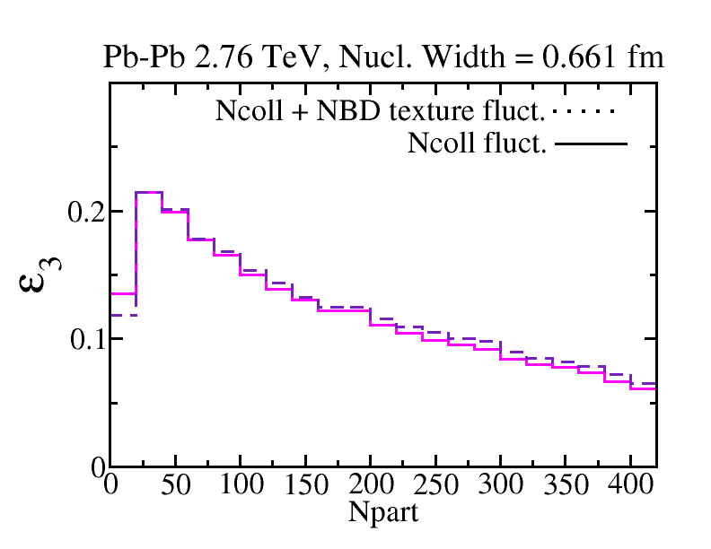
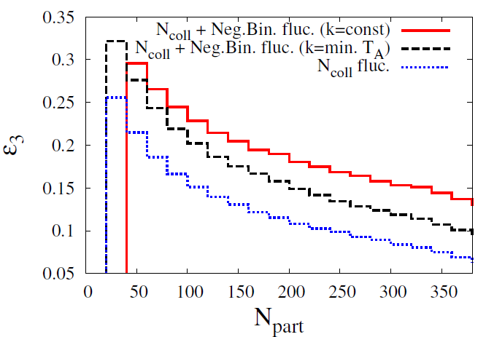
Schenke, et al. Moreland+ Heinz Dumitru +Nara
Correlated fluctuations
Multiplicity fluctuations
IP-Glasma
Correlated fluctuations
Multiplicity fluctuations
IP-Glasma

Slide 21
Pre-equilibrium dynamics
Free Streaming limit: G. Qin, et. al., Phys. Rev. C82 064903 (2010); OSU, on-going work
Hydro limit: OSU group, on-going work
Pre-equilibrium dynamics smoothes out fluctuations, reducing , but building radial flow
-early flow & fluctuations from dynamical models:
URQMD initialization: H.Petersen & M. Bleicher, Phys. Rev. C81, 044906,2010
AMPT initialization: L. Pang, Q.Wang & X.N.Wang, arXiv:1205.5019 [nucl-th]
L. Pang, Q.Wang & X.N.Wang, arXiv: 1211.1579[ nucl-th]
EPOS/NEXUS initialization: K. Werner et al., Phys. Rev. C83:044915,2011;
H. J. Drescher et, al., Phys.Rev. C65 , 054902 (2002).
IP-Glasma: B. Schenke, et.al, arXiv:1202.6646; 1206.6805 [nucl-th]
C. Gale, et al., arXiv:1210.5144, 1209.5330 [nucl-th].

Slide 22
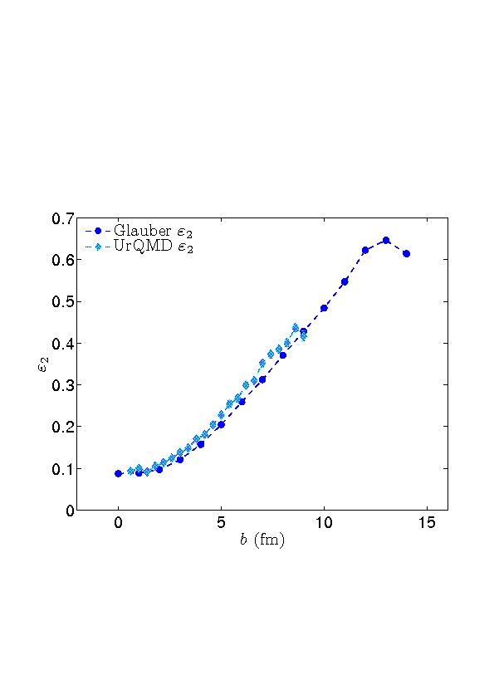
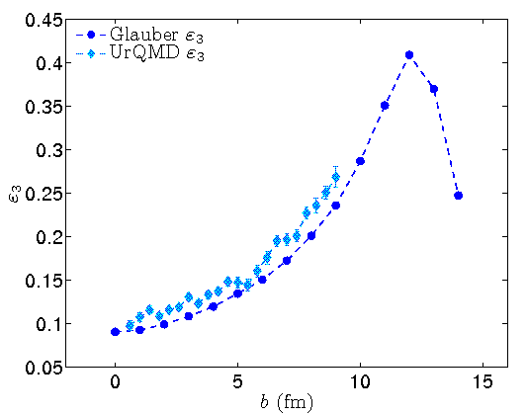
Pre-equilibrium dynamics
Fluctuations in energy deposition slightly increase
Petersen & Qiu, unpublished notes;
please also refer to Phys.Rev. C82 041901 (2010)
-early flow & fluctuations from dynamical models:
URQMD initialization: H.Petersen & M. Bleicher, Phys. Rev. C81, 044906,2010
also refer to talk of H.Petersen on 17 Aug., Plenary VA
AMPT initialization: L. Pang, Q.Wang & X.Wang, arXiv:1205.5019[nucl-th]
also refer to talk of L. Pang on 15 Aug., Parallel 4D
EPOS/NEXUS initialization: K. Werner et al., Phys. Rev. C83:044915,2011;
H. J. Drescher ,et al., Phys.Rev. C65 , 054902 (2002)
also refer to r of M. Nahrgang on 16 Aug
IP-Glasma: B. Schenke, et.al, arXiv:1202.6646; 1206.6805 [nucl-th]

Slide 23
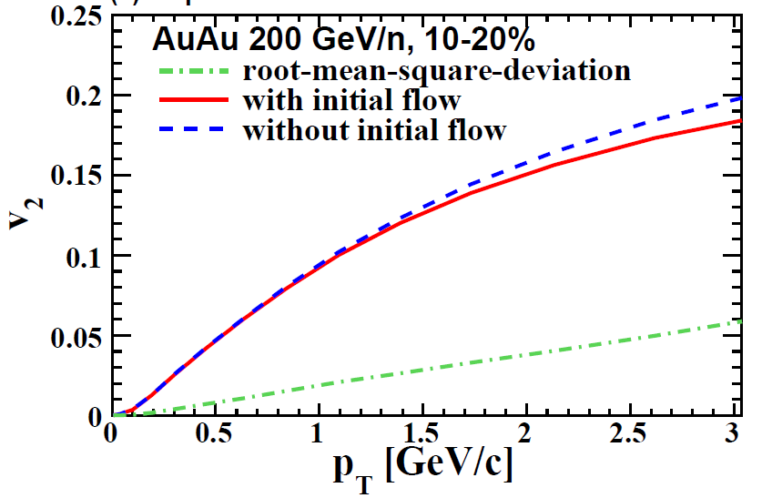
Pre-equilibrium dynamics
Early longitudinal flow fluctuations reduce V2
L. Pang, Q.Wang & X.Wang, arXiv:1205.5019[nucl-th]
-early flow & fluctuations from dynamical models:
URQMD initialization: H.Petersen & M. Bleicher, Phys. Rev. C81, 044906,2010
also refer to talk of H.Petersen on 17 Aug., Plenary VA
AMPT initialization: L. Pang, Q.Wang & X.Wang, arXiv:1205.5019[nucl-th]
also refer to talk of L. Pang on 15 Aug., Parallel 4D
EPOS/NEXUS initialization: K. Werner et al., Phys. Rev. C83:044915,2011;
H. J. Drescher ,et al., Phys.Rev. C65 , 054902 (2002)
also refer to poster of M. Nahrgang on 16 Aug
IP-Plasma: B. Schenke, et.al, arXiv:1202.6646; 1206.6805 [nucl-th]
B. Schenke on 15 Aug., Parallel 3A

Slide 24
Pre-equilibrium dynamics
Free Streaming limit: G. Qin, et. al., Phys. Rev. C82 064903 (2010); OSU, on-going work
Hydro limit: OSU group, on-going work
Pre-equilibrium dynamics smoothes out fluctuations, reducing , but building radial flow
-early flow & fluctuations from dynamical models:
URQMD initialization: H.Petersen & M. Bleicher, Phys. Rev. C81, 044906,2010
AMPT initialization: L. Pang, Q.Wang & X.N.Wang, arXiv:1205.5019 [nucl-th]
L. Pang, Q.Wang & X.N.Wang, arXiv: 1211.1579[ nucl-th]
EPOS/NEXUS initialization: K. Werner et al., Phys. Rev. C83:044915,2011;
H. J. Drescher et, al., Phys.Rev. C65 , 054902 (2002).
IP-Glasma: B. Schenke, et.al, arXiv:1202.6646; 1206.6805 [nucl-th]
C. Gale, et al., arXiv:1210.5144, 1209.5330 [nucl-th].
Except IP-Glamsa, most pre-equilibrium dynamics was studied within the ideal hydro framework. Their quantitative influences on are still unknown.

Slide 25
QGP viscosity at LHC energies

Slide 26
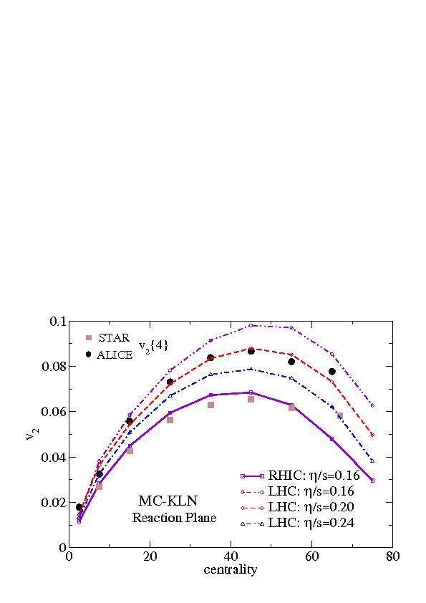
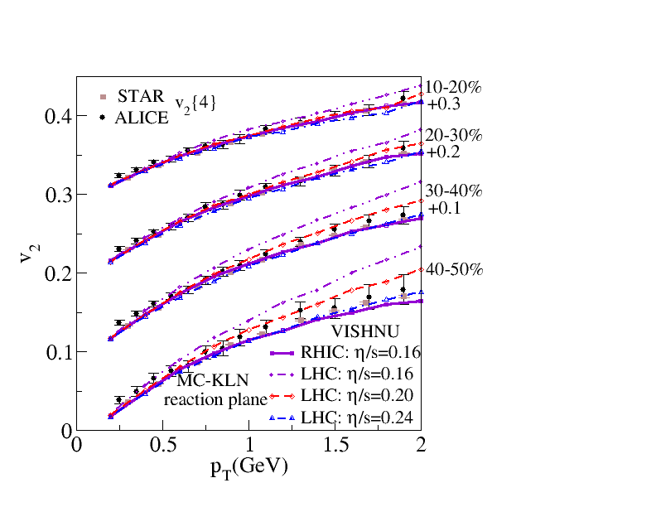
V2 at RHIC and LHC
Song, Bass & Heinz, PRC 2011
The average QGP viscosity is roughly the same at RHIC and LHC
Please also refer to C. Gale, et al., ArXiv: 1209.5330 [nucl-th]

Slide 27
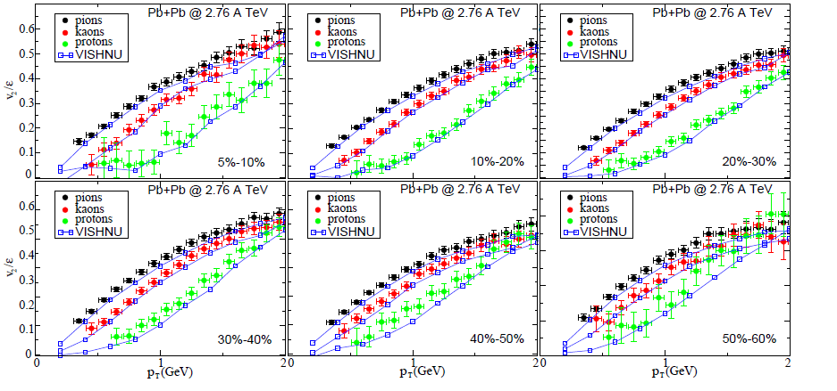
for pions, kaons & protons at LHC
VISHNU
Heinz, Shen & Song, 2011
A very nice fit of V2(PT) for all centrality bins at LHC from VISHNU hybrid model

Slide 28
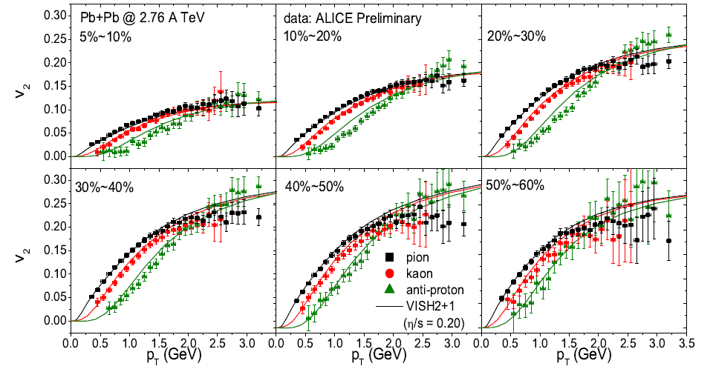
for pions, kaons & protons at LHC
Viscous Hydro
Heinz, Shen & Song, 2011
Results from pure viscous hydrodynamics (WITHOUT hadron cascade),
results shown at QM2011

Slide 29
for pions, kaons & protons at LHC
Heinz, Shen & Song, 2011
Viscous Hydro
VISHNU
A comparison between viscous hydrodynamics and VISHNU

Slide 30
Temperature dependent

Slide 31
V2(PT) at RHIC and LHC
Song, Bass & Heinz, PRC2011
Assuming const.
RHIC:
LHC:
also confirmed by C. Gale,
et al., ArXiv: 1209.5330 [nucl-th]
Is QGP fluid more viscous for the temperature region covered by LHC?
One needs to investigate the temperature dependence of

Slide 32
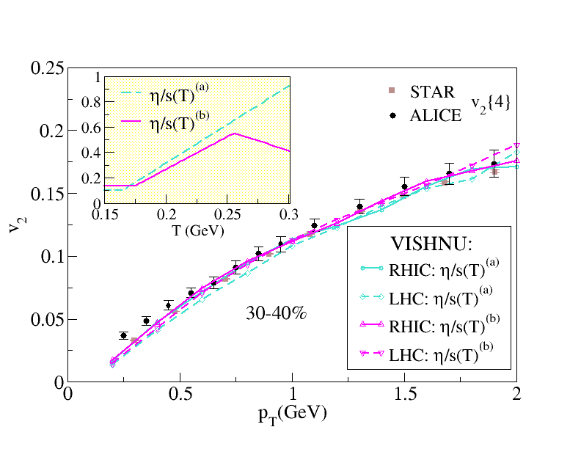
Is QGP fluid more viscous at LHC ?
Song, Bass & Heinz, PRC2011
We can not constrain
from v2 and spectra

Slide 33
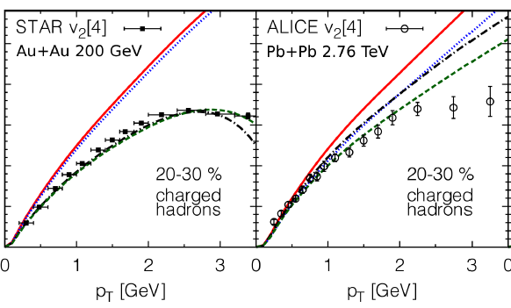
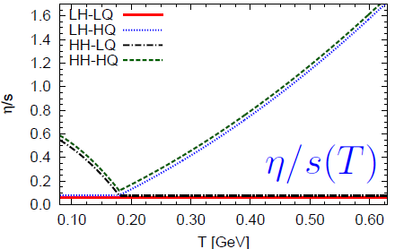
Results from Frankfurt group:
H. Niemi, G.S. Denicol, P. Huovinen, E. Molnar, and D.H. Rischke, Phys. Rev.
Lett.84, 011901(2011);
arXiv:1203.2452[nucl-th]
Elliptic flow is dominated by the hadronic viscosity at RHIC energies

Slide 34
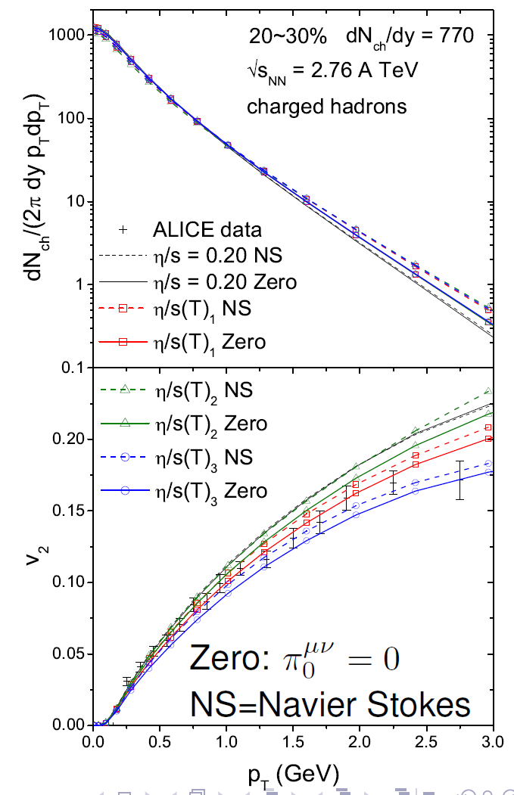
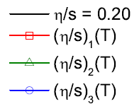

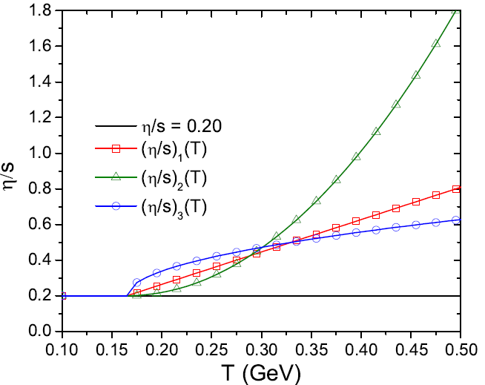
Investigations from viscous hydro: C. Shen, U. Heinz, P. Huovinen, H.Song PRC2011
LHC
Extra complications:
V2 is not only sensitive to
but also sensitive to initialization of
It is not an easy task to extract
from experimental data

Slide 35
Current Developments

Slide 36
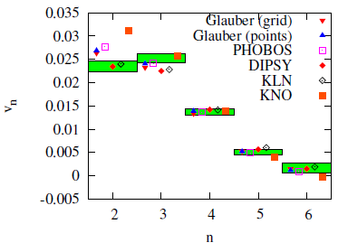
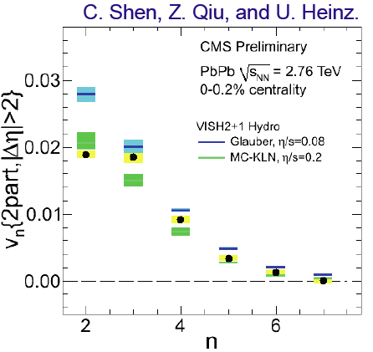
Extracting from Vn in ultra-central collisions
Luzum & Ollitrault, arXiv: 1210.8422
Viscous Hydro
-In most central collisions, fluctuation effects are dominant (Geometry effects are suppressed)
-can not simultaneously fit V2 and V3 with single (MC-Glauber & MC-KLN)

Slide 37
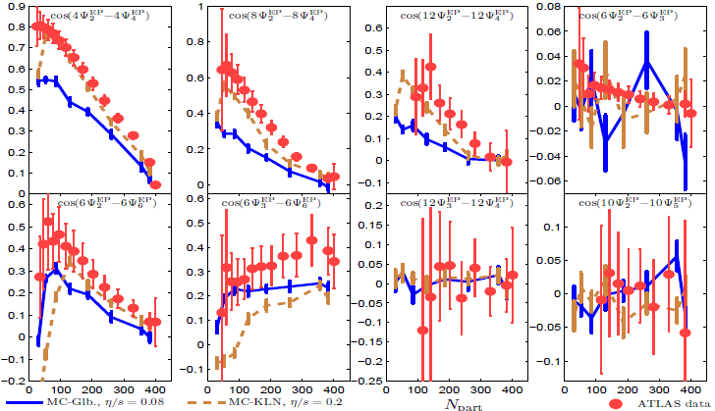
Higher Order Event Plane Correlations
Qiu & Heinz, arXiv:1208.1200[nucl-th]
EXP. data:[ATLAS Collaboration], CERN preprint ATLAS-CONF-2012-049
Pure e-b-e viscous hydro simulations :
qualitatively reproduce the measured event plane correlations

Slide 38
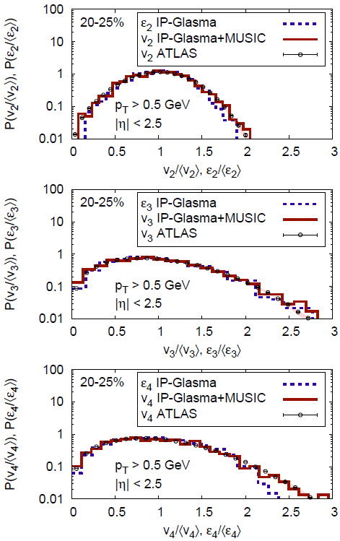
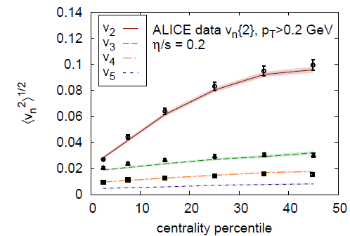
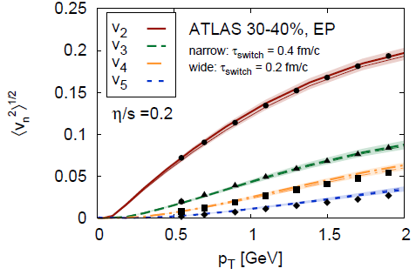
Vn & E-b-E Vn distributions
C. Gale et al., arXiv:1209.4330[nucl-th]

Slide 39
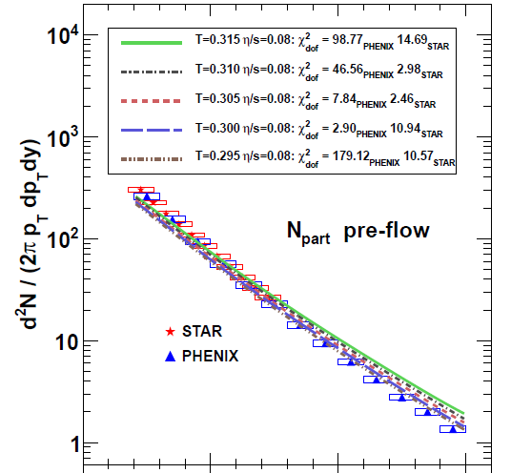
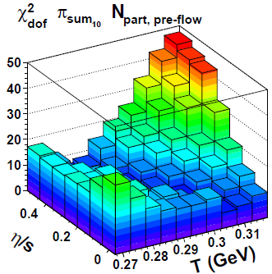
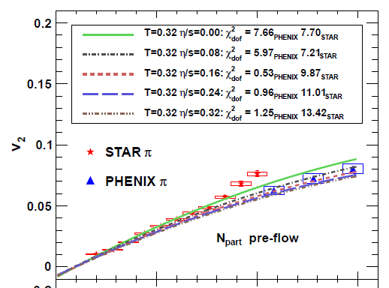
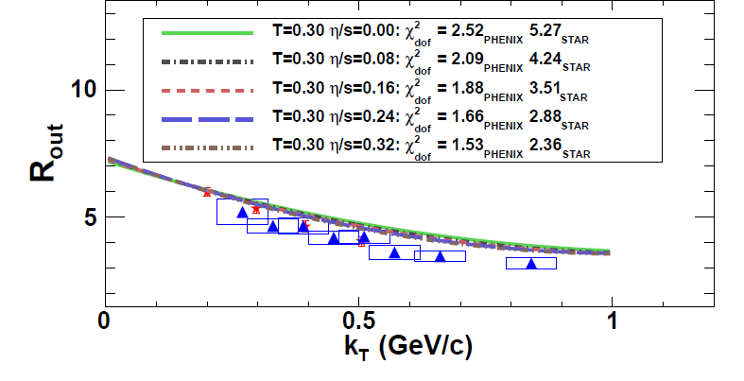
Early CHIMERA Results
(Comprehesive Heavy Ion Model Evaluation and Reporting Algorithm)
Spectra
spectra
elliptic flow
Constraining initial temperature & shear viscosity from pion spectra, elliptic flow & HBT radii at 0-20% centrality with evolution.
HBT
R. Soltz, et al., arXiv:1208.0897[nucl-th]

Slide 40
Summary

Slide 41
Uncertainties from initial quantum fluc.
(visc. hydro)
V2
Mc-Gl.
Mc-KLN
(VISHNU)
V2
IP-Glasma
Corr. Fluc.
Mc-Gl.
(visc. hydro)
V2,V3
Mul. Fluc.
Mc-Gl.
Initial
Flow Fluc.
… …
Mc-KLN
Mc-KLN
Mc-Gl.
2008 early 2011 late 2011 2012 2012 year
(Pre-QM)
(Post-QM)
Recent developments on initialization models:
color charge fluctuations; multiplicity fluctuations; initial flow fluctuations … …

Slide 42
Uncertainties from initial quantum fluc.
(visc. hydro)
V2
Mc-Gl.
Mc-KLN
IP-Glasma
(visc. hydro)
Vn &Vn distri.
(VISHNU)
V2
?
Corr. Fluc.
Mc-Gl.
(visc. hydro)
V2,V3
Mul. Fluc.
Mc-Gl.
Initial
Flow Fluc.
… …
IP-Glasma
Mc-KLN
Mc-KLN
Mc-Gl.
2008 early 2011 late 2011 2012 2012 year
(Pre-QM)
(Post-QM)
Recent developments on initialization models:
color charge fluctuations; multiplicity fluctuations; initial flow fluctuations … …
A further study of flow data at different aspects : elliptic, triangular flow
& higher order flow harmonics, higher-order event plane correlations … ...
This will help us to constrain initialization models, tightening the limit on
This is a rapidly evolving area, much more in the near future

Slide 43
Thank you

Slide 44
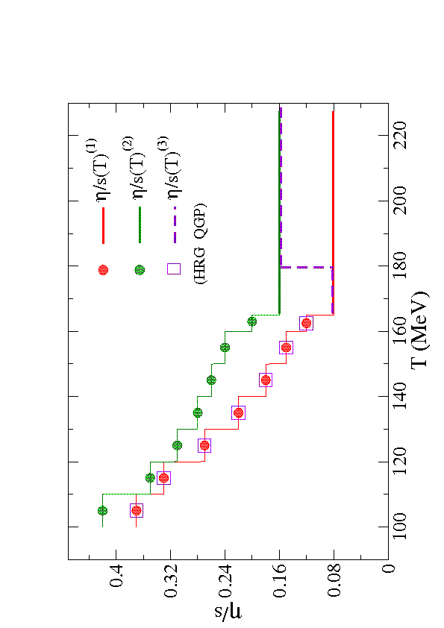
Effective Hadronic viscosity from VISHNU
Results from Frankfurt group:
H. Niemi, G.S. Denicol, P. Huovinen, E. Molnar, and D.H. Rischke, Phys. Rev.
Lett.84, 011901(2011);
arXiv:1203.2452[nucl-th]
Song, Bass & Heinz PRC2011

Slide 45
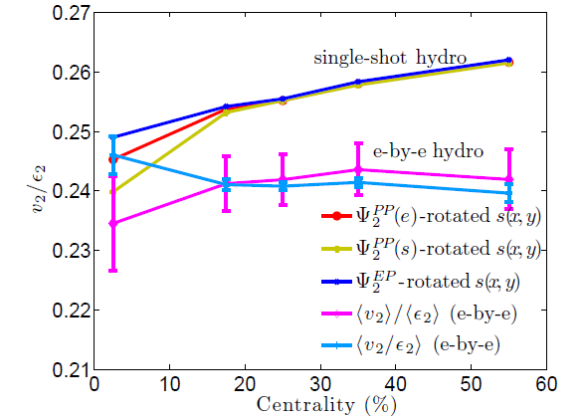
e-b-e hydro vs. single shot hydro

Slide 46
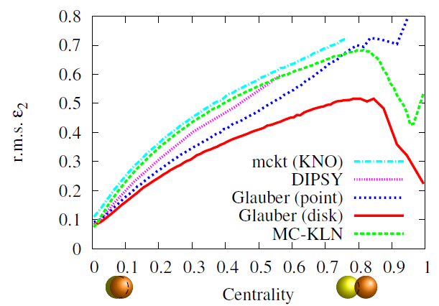
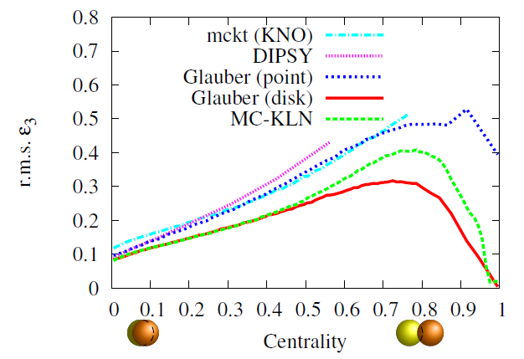
see talk of M. Luzum

