Slide 1
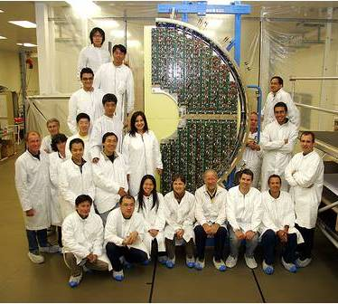
Measurement of the leakage current of Si sensors of the CMS Preshower after an integrated luminosity of 5.86 fb⁻¹
D. Barney, M. Guthoff, A. Honma, S-W. Li, A. Peisert,
Y-M. (Jacky) Tzeng, G. Qin
Description of the Preshower
Current measurement
Calculation of annealing effects
Summary and plans

Slide 2
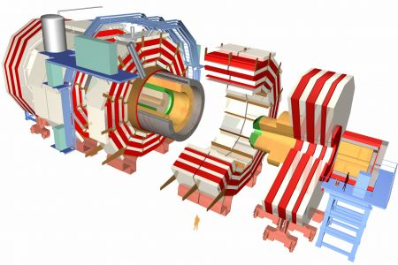
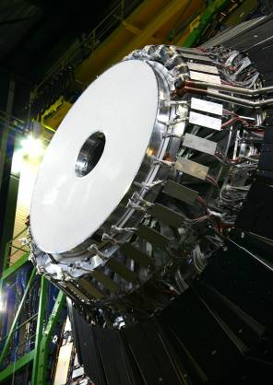
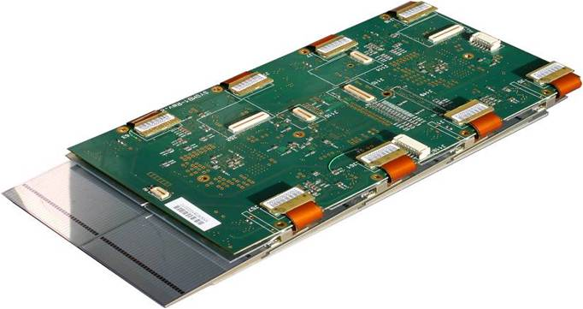
The CMS Preshower: part of the end cap el. calorimeter
Preshower + ECAL
2 layers of lead absorbers
each followed by Si sensors
and digital electronics
Z = ± 304, ± 309 cm
45 cm < R <121 cm
Si sensors, p-on-n , DC coupled, 63×63×0.32 mm³
32 strips 1.9 mm wide
4288 total, 1072/absorber
Produced by 6 vendors from Russia, India, Taiwan and Hamamatsu
Sensors mounted on Al tiles and
assembled into “ladders” of 6 to 10 tiles
Very efficient cooling of the absorbers
Good heat evacuation from the electronic
Si temperature 2ºC above the T_{coolant}
stable and uniform over the whole surface to 0.5ºC
ladder
digital electronics

Slide 3
The CMS Preshower: powering and I measurement
Sensors are biased by pairs, with some exceptions at the innermost
and outermost perimeters (to make a disk with square pieces).
There are 2216 bias lines between the detector and the patch panel in
the service cavern which groups them into 192 CAEN channels.
Each channel powers between 6 and 35 sensors.
The voltage and current of each CAEN channel is monitored continuously.
Manual measurements of the current of each pair/singlet were performed
several times in different conditions:
cooling on, power on
cooling on, power off
cooling off, power off, temperature of the sensors = T_{cavern}
From the analysis of these measurements we concluded that the temperature of the sensors is 2ºC higher than the T of the coolant
Important for estimating the annealing effects.

Slide 4
Current: measurement and simulation
Sensors suffering from an anomalous
excess current, talk of A. Honma
Current measured on December 14, 2012 at the initial full depletion voltage and at 18.9ºC (power and cooling switched off)
scaled to 0ºC
Fluka simulation:
event generated with DPMJET3
1000 collisions at 3.5 TeV
the geometry Φ symmetric
the flux of particles is scaled to the flux of 1 MeV equivalent neutrons
statistical error ~ 4%
Scaling: Fluka gives NIEL φ/p-p collision
→ Hamburg model → I(φ, time, T)
13% difference between the measurement and calculation
center of the sensor or of the pair

Slide 5
Annealing effects
Calculated using the Hamburg model for a single sensor placed in a spot with the highest particle fluence.
Temperature and delivered luminosity retrieved daily.
Scaled for comparison with the measured current on CAEN supplies.
Channels supplying only
Hamamatsu sensors chosen
for this comparison – no excess current
channel 1 – 20 sensors
channel 2 – 7 sensors
Good agreement shows that
the annealing effects are well
described by the model.

Slide 6
Summary and plans
The leakage current of CMS Preshower silicon sensors was measured after an integrated luminosity of 5.86 fb⁻¹, at 18.9ºC
The dependence of the current on the distance from the beam is in good agreement with the Fluka simulation
  The measured current is 13% lower than simulated in absolute scale
The Hamburg model describes well the annealing of the current
Planning to measure E_{g} by varying the temperature (pretty simple)
The measurement of the full depletion voltage is in progress and will be reported later

