Slide 1
Progress on investigation of dynamic vacuum
(RF structures only)
Sergio Calatroni
With Cedric Garion, Irene Martini, Chiara Pasquino, Pedro Costa Pinto, Mauro Taborelli

Slide 2
Requirements from beam dynamics
The vacuum threshold for preventing fast ion beam instability (essentially due to direct field ionization and not the usual impact ionization) :
  Main beam linac requirements :
  total p ≤ few 10⁻⁹ Torr each for CO, N₂ and/or H₂O.
  H₂ is not harmful (p ≤ few10⁻⁸)
True for practically all the main LINAC length, also inside the RF accelerating structures
For details see:
  G. Rumolo, A Oeftiger http://cdsweb.cern.ch/record/1406050?ln=en
  C. Garion https://edms.cern.ch/document/1095288/1

Slide 3
The problem
Static vacuum: not discussed here
Dynamic vacuum
  Breakdowns
  Dark current

Slide 4
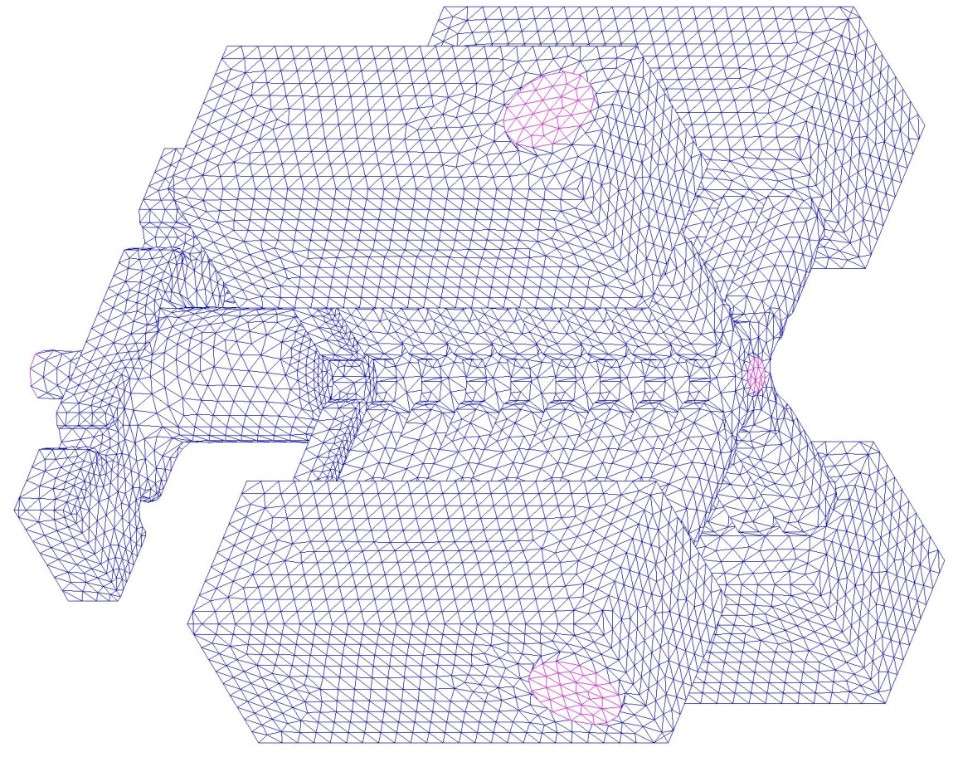
Dynamic vacuum – Breakdown I
Pumping surfaces
2.10¹² H₂ or CO molecules released during breakdown (in a baked system)
Data measured in DC “spark test” reported in PRST-AB12, 092001 (2009)
FE code model

Slide 5
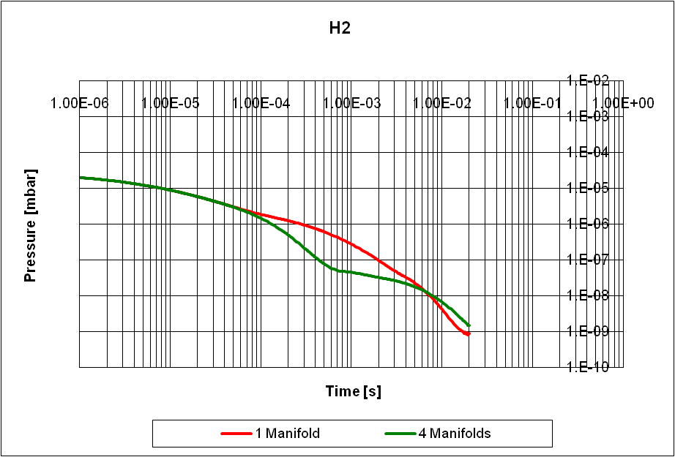
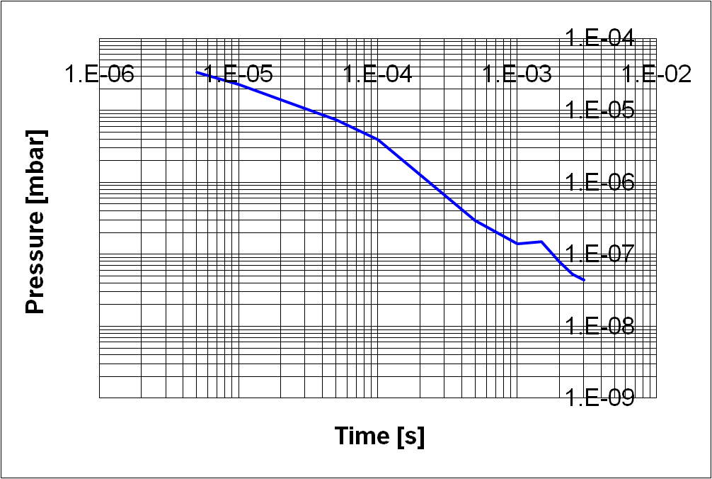
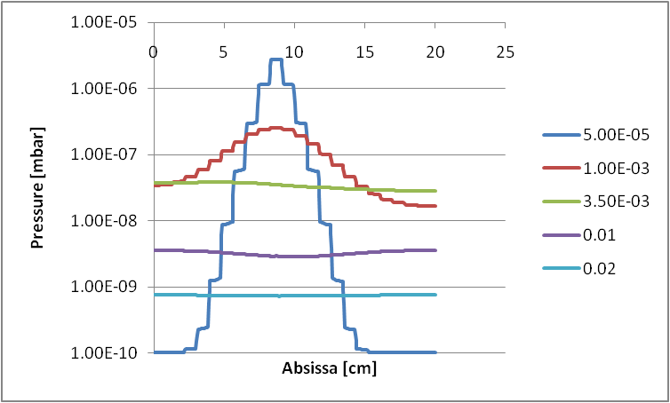
Dynamic vacuum – Breakdown II
Calculated with Monte-Carlo and thermal analogy model
Maximum pressure vs time:
20 ms to reach 10⁻⁹ mbar for H₂
20 ms to reach 5x10⁻⁸ mbar for CO
(Note: CLIC repetition rate = 50 Hz
Duty cycle = 20 msec)
Monte-Carlo
Calculated with thermal analogy model (and Monte-Carlo model)
Four manifolds
Longitudinal pressure distribution in the cells:
Uniform after ~3 ms

Slide 6
Dynamic vacuum - Dark currents
Dark-current electrons are field-emitted, impact on surfaces and desorb gas
Dynamic vacuum by ESD: desorbed molecules fill the whole cell volume
No pumping
e⁻ current ~ 10^{-4÷-3} A during pulse
Need e⁻ distribution and energy + ESD coefficients at high energy
How are e⁻ distributed inside the cell? Structure?
e⁻ on faraday cup
e⁻ on faraday cup

Slide 7
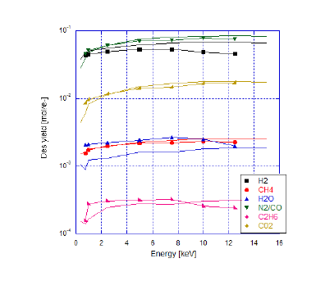
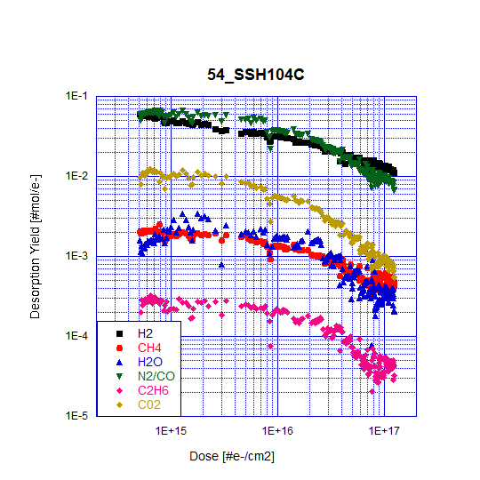
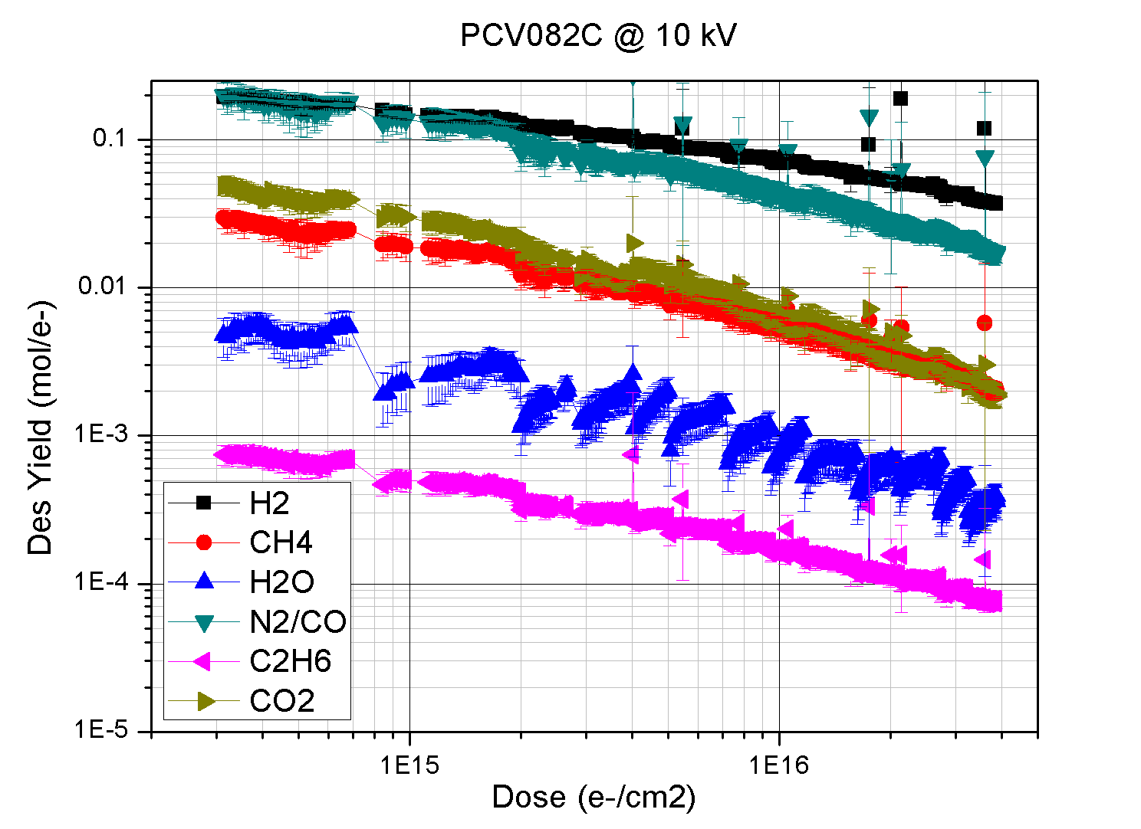
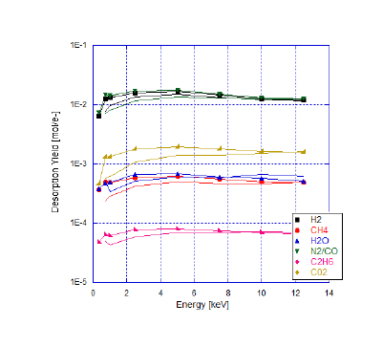
ESD data
Work of C. Pasquino & I. Martini for master thesis:
New ESD measurement system at high-voltage.
Several surface treatments being studied
Notes:
Dose per pulse few 10E8. Ten days for 1E16, 100 Days for 1E17

Slide 8
Dynamic vacuum I – Results
Molecules released per pulse ~ few 10⁷ both for H₂ and CO, resulting in pressure bursts of few 10⁻⁸ mbar locally
Pressure goes to < 10⁻⁹ mbar in less than 1 msec !
This is faster than the sampling time of common vacuum gauges...
Same plot as for dynamic vacuum due to breakdowns (2x10¹² molecules released)
Extrapolating to 1000 less molecules released due to ESD

Slide 9
Outlook 1
Static vacuum achieved but only marginally with present design
  Need more precise data on water re-adsorption (sticking probability depends on coverage)
Dynamic vacuum due to breakdowns seem to be under control (recovery time ≤ pulse repetition)
  However, data from RF tests are needed for further cross-checking

Slide 10
Outlook 2
Dynamic vacuum due to dark currents: still open question
Experimental programme:
  ESD data on unbaked copper at high e⁻ energy from CERN √
  Dark current simulations from SLAC – ACE3P
  Introduce these into MC+FEM models and get gas distribution
  Direct measurements should be attempted in 12 GHz test bench
    Feasibility should be demonstrated
    Collaborations ?

Slide 12
Molecule speed
 | Atomic mass | Molecule speed @ 300 K [m/s] | Molecule displacement in RF pulse [mm]
H2 | 2 | 1579 | 3.16E-01
H2O | 18 | 526 | 1.05E-01
CO | 28 | 422 | 8.44E-02
CO2 | 44 | 336 | 6.73E-02
Assuming a molecular speed of 300 K = 0.026 eV

Slide 13
Data
Total e- current [A] | Pulse duration [ns] | Total charge [C] | Number of electrons | Solid angle (one cell, one side) | Total electrons on copper | Dose per pulse (e- /cm2)
1.00E-04 | 200 | 2.00E-11 | 1.25E+08 | 0.027439024 | 4.56E+09 | 4.42E+08
ESD coefficient for H2 (unbaked copper) | Total H2 molecules per RF pulse | Equivalent pressure at RT (total volume)
2.00E-01 | 9.11E+08 | 1.12E-08
ESD coefficient for CO2 (unbaked copper) | Total CO2 molecules per RF pulse
6.00E-02 | 2.73E+08 | 3.37E-09
ESD coefficient for H2 (copper baked 250 C) | Total H2 molecules per RF pulse
1.30E-02 | 5.92E+07 | 7.29E-10
ESD coefficient for CO2 (copper baked 250 C) | Total CO2 molecules per RF pulse
6.00E-03 | 2.73E+07 | 3.37E-10
ESD coefficient for H2 (copper baked 300 C) | Total H2 molecules per RF pulse
3.00E-03 | 1.37E+07 | 1.68E-10
ESD coefficient for CO2 (copper baked 300 C) | Total CO2 molecules per RF pulse
1.60E-03 | 7.29E+06 | 8.98E-11
10⁷ pulses to start conditioning
(~2 days at 50 Hz)
10⁹ pulses for ÷10 ESD reduction
(200 days at 50 Hz)
G. Vorlaufer CERN-Thesis (2002)
10 times maximum allowed
3 times maximum allowed
Benvenuti et al LEP2 94-21
For the dynamic vacuum of breakdowns we were considering 2x10¹² molecules.
MathewsonJVSTA 15 (1997) 3093

